Slide 1
hegel and elements of the philosophy of right
Dr Imogen Peck
University of Warwick

Slide 2
structure
The Purpose of Philosophy: The Preface
The History of Philosophy and the Philosophy of History
Freedom and Subjective Freedom
The Dialectic

Slide 3
I. THE PURPOSE OF PHILOSOPHY
‘To comprehend what is is the task of philosophy, for what is is reason. As far as the individual is concerned, each individual is in any case a child of his time; thus philosophy, too, is its own time comprehended in thoughts. It is just as foolish to imagine that any philosophy can transcend its contemporary world as that an individual can overleap his own time or leap over Rhodes’.
Preface, Elements of the Philosophy of Right

Slide 4
Reason and reconciliation
‘To recognise reason as the rose in the cross of the present, and thereby to delight in the present – this rational insight is the reconciliation with actuality which philosophy grants to those who have received the inner call to comprehend’.
Preface, Elements of the Philosophy of Right
Reconciliation with the world in the form of comprehension.
Comprehension of the present as part of a wider set of purposes.

Slide 5
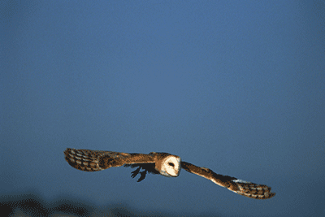
Philosophy as is not ought; philosophy comes too late to perform the latter function
As the thought of the world it appears only when actuality has gone through its formative process and attained its completed state
(only) when actuality has reached maturity does the ideal appear opposite the real and reconstruct this real world, which it has grasped in its substance, in the shape of the intellectual realm.
‘When philosophy paints its grey in grey, one form of life has become old, and by means of grey it cannot be rejuvenated, but only known. The owl of Minerva flies at dusk’.
Preface, Elements of the Philosophy of Right

Slide 6
II. THE HISTORY OF PHILOSOPHY AND THE PHILOSOPHY OF HISTORY
History of Philosophy
History of reflection, the nature of reflection, and the development of the way in which people reflect over time.
Philosophy of History
The meaning or direction of history.
‘The only thought which Philosophy brings with it to the contemplation of History, is the simple conception of Reason; that Reason is the Sovereign of the World; that the history of the world therefore, presents us with a rational process.’
The Philosophy of History

Slide 7
The spirit of history
‘History in general is the development of the Spirit in time, as nature is the development of the Idea in space […] the final cause of the World at large is the Spirit's consciousness of its own freedom, and ipso facto, the reality of that freedom [… ] This is the only aim that sees itself realized; the only pole of repose amid the ceaseless change of events and conditions, and the sole efficient principle that pervades them’.
The Philosophy of History

Slide 8
Historical epochs
Oriental - understands that only one person is free, the ruler or the despot
Greek - holds that some persons are free
Germanic - knows that all persons, or humanity as such, are free.

Slide 9
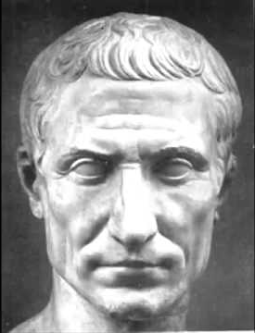
The cunning of reason
‘it is not the universal Idea which enters into opposition, conflict, and danger; it keeps itself in the background, untouched and unharmed, and sends forth the particular interests of passion to fight and wear themselves out in its stead. It is what we may call the cunning of reason that it sets the passions to work in its service, so that the agents by which it gives itself existence must pay the penalty and suffer the loss….Caesar had to do what was necessary to overthrow the decaying freedom of Rome; he himself met his end in the struggle…’.
The Philosophy of History

Slide 10
Hegel and historicism
All human beliefs and practices derive of their necessity from their specific historical context
Historical development is inevitable and progressive
There are no universal moral laws or legal codes, because the only rationale for morals and laws derives from their specific historical and cultural context

Slide 11
iII. freedom
Isaiah Berlin, Four Essays on Liberty (1969)
Negative liberty – absence of constraint on one’s actions
Positive liberty – self-determination
Associates Hegel with positive liberty

Slide 12
The end of history is freedom, as rational, self-conscious, self-determination.
Negative liberty as the absence of constraint, but not freedom from determination.
Determination by the will is only freedom when the will is itself self-determined; it is self-determined only when I can step aside and reflectively endorse its objectives; and when that reflective endorsement is itself rational; and it is rational, only when it is self-conscious and when that self-consciousness understands itself in relation to the movement of human consciousness in history.
‘Only in this freedom is the will completely with itself, because it has reference to nothing but itself, so that every relationship of dependence on something other than itself is thereby eliminated’.
Elements of the Philosophy of Right (23)

Slide 13
Subjective freedom
‘The right of the subject's particularity to find satisfaction, or - to put it differently - the right of subjective freedom, is the pivotal and focal point in the difference between antiquity and the modem-age. This right, in its infinity, is expressed in Christianity and it has become the universal and actual principle of a new form of the world’.
Elements of the Philosophy of Right (185)

Slide 14

Iv. The DIALECTIC

Slide 15
HEGEL’S DIALECTIC
Thesis – antithesis – synthesis
A form of consciousness encounters an object or event or idea, which stands against that form, not being assimilatable within the existing form. It stands as a negative, creating contradictions and tensions within the thesis. The synthesis, bridges and resolves those tensions, while at the same time preserving the ‘moments’ of the original thought and its negation.
The overcoming, or aufhebung is not an abolition, but a recognition that is preserved in the more developed form of consciousness.

Slide 16
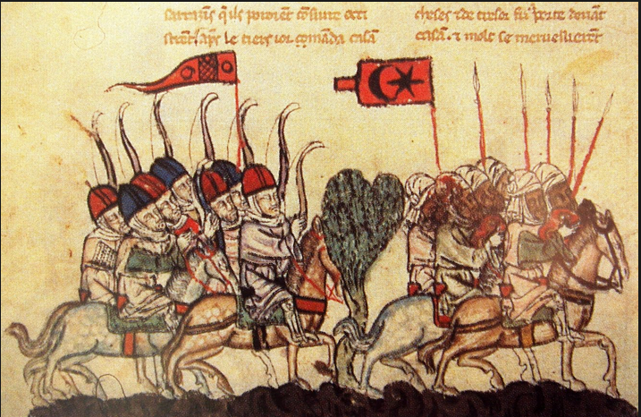
History and consciousness: the crusades
'At the Holy Sepulchre the vanity of opinions passes away; there is all seriousness. In the negation of that define and present embodiment it is that the turning point in question is found, and those words have an application “Thou wouldst not suffer thy Holy one to see corruption”. Christendom was not to find its ultimatum of truth in the grave. At this sepulcher the Christian world received a second time the response given to the disciples when they sought the body of the lord there: “Why seek ye the living among the dead? He is not here, but is risen”. You must not look for the principle of your religion in the Sensuous, in the grave among the dead, but in the living spirit in [the host].’
The Philosophy of History, pp. 390-1

Slide 17
bibliography
David James, ‘Subjective Freedom and Necessity in Hegel’s Philosophy of Right’, Theoria: A Journal of Social and Political Theory (2012)
Michael Inwood, A Hegel Dictionary (1992)
Dudley Knowles, The Routledge Philosophy guidebook to Hegel and the Philosophy of Right (2002)
Fredrick Beiser, Hegel (2010)
Alan Patten, Hegel’s Idea of Freedom (1999)

