Slide 1
Language, history, nation
Dr Imogen Peck
University of Warwick
https://www.youtube.com/watch?v=XFX8S9aAgvw

Slide 2
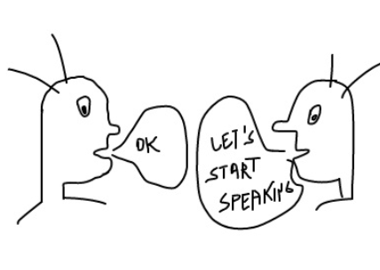
THREE LINES OF INQUIRY
Language, culture, and identity
German romanticism
Nationalism

Slide 3
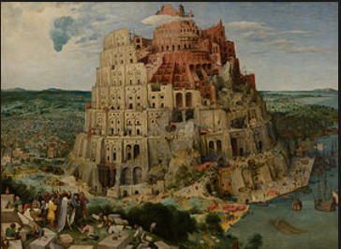
Talk about talk
Language as a gift from God
As originating in universal language of pain and pleasure
Conventional signs
Distinctions from other animals

Slide 4
Reflection on language: 18thc views
‘[I]n the beginnings of language, men seem to have attempted to express every particular event, which they had occasion to take notice of, by a particular word, which expressed at once the whole of that event. But as the number of words must, in this case, have become really infinite, in consequence of the really infinite variety of events, men found themselves partly compelled by necessity, and partly conducted by nature, to divide every event into what may be called its metaphysical elements, and to institute words, which should denote not so much the events, as the elements of which they were composed’.
Adam Smith, Considerations on the first formation of languages (1767 – appendix to Theory of Moral Sentiments)
‘[I]f men needed speech in order to learn to think, they needed still more to know how to think in order to discover the art of speech.’
Jean-Jacques Rousseau, Discourse on Inequality (1755)
Etienne Bonnot de Condillac:
Human language originates as expressive gesture and vocalization in the face of fear, and then desire.
Language evolution runs from expressive origins to the philosophical present, in which it becomes analytically precise, but loses vivacity and immediacy.

Slide 5
Aristotle and logos (speech-reason)
Distinguishing human end is the capacity for speech and reason (logos).
Progressive account of development of union of two, household, village, to polis
Need to see this as an increasingly articulate world – which reaches its summit in the vita contemplative.

Slide 6
German romanticism
Romanticism:
Rejects classical instrumentalism of language and discourse.
Starts from a voice of nature within the individual.
Endorses expressivism (i.e. a way of expressing individual feeling).
‘See the whole of nature, behold the great analogy of creation. Everything feels itself and its like, life reverberates to life.’
Man’s calling is ‘that he become the organ of sense of his God in all the living things of creation, according to the measure of their relation to him.’
Herder

Slide 7
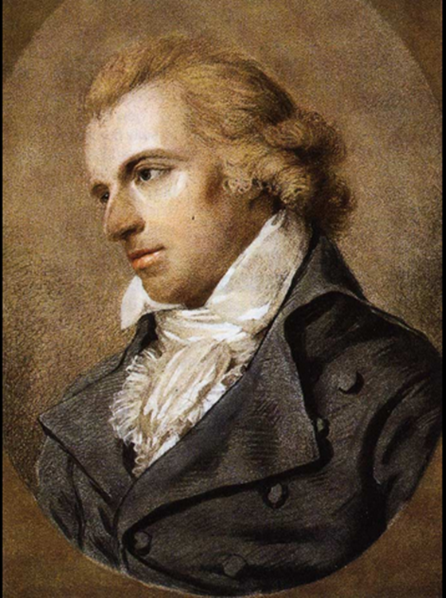
Friedrich Schiller, On the Aesthetic Education of Man (1795)
Focus on aesthetics and culture
‘Physical man actually exists, while moral man is merely a problem yet to be solved. Once reason abolishes the natural state, as it must do if it is to assume its place, it risks physical, actual man for the sake of moral man as yet unformed, risks the existence of society for a mere potential ideal society’. (l.3)
‘The character of the age must therefore first lift itself from its deep degradation, free itself from the blind force of nature to which it was subject, and return to its simplicity, truth and substance’. (l.7)

Slide 8
He who in the great ring dwelleth,
Homage pays to sympathy!
To the stars above leads she,
Where on high the Unknown reigneth.
Joy is drunk by every being
From kind nature’s flowing breasts,
Every evil, every good thing
For her rosy footprint quests.
Gave she us both vines and kisses,
In the face of death a friend,
To the worm were given blisses
And the Cherubs God attend.
Chorus.
Fall before him, all ye millions?
Know’st thou the Creator, world?
Seek above the stars unfurl’d,
Yonder dwells He in the heavens.
Joy commands the hardy mainspring
Of the universe eterne.
Joy, oh joy the wheel is driving
Which the worlds’ great clock doth turn.
Flowers from the buds she coaxes,
Suns from out the hyaline,
Spheres she rotates through expanses,
Which the seer can’t divine.
Joy, thou beauteous godly lightning,
Daughter of Elysium,
Fire drunken we are ent’ring
Heavenly, thy holy home!
Thy enchantments bind together,
What did custom stern divide,
Every man becomes a brother,
Where thy gentle wings abide.
Chorus.
Be embrac’d, ye millions yonder!
Take this kiss throughout the world!
Brothers—o’er the stars unfurl’d
Must reside a loving Father.
Who the noble prize achieveth,
Good friend of a friend to be;
Who a lovely wife attaineth,
Join us in his jubilee!
Yes—he too who but one being
On this earth can call his own!
He who ne’er was able, weeping
Stealeth from this league alone!
Chorus.

Slide 9
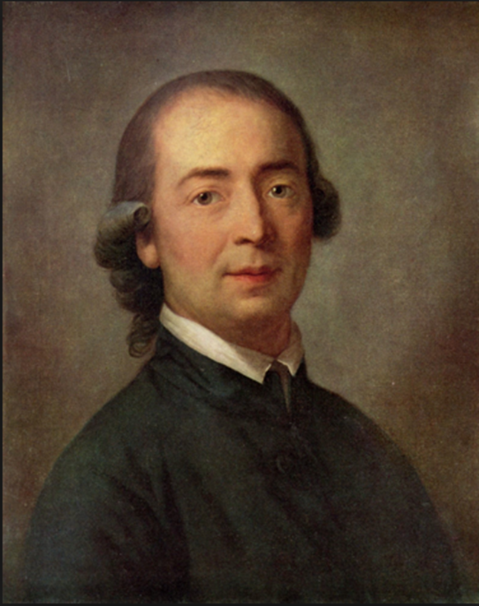
Johann Gottfried Herder (1744-1803)
Born Prussia
Taught by Immanuel Kant and Johann Georg Hamman
Became a clergyman
Met Goethe in Paris, influential in the sturm und drang literary movement.
Published Origin of Language (1772).

Slide 10
Herder on language
‘In all original languages the remnants of these natural sounds can still be heard. (but […] they are not the main thread of human speech, not its roots, merely the sap which vitalizes these.’
‘Even the first elementary operation of the reasoning power of the mind is inconceivable without the use of language […] man himself had to find a language by operating his own powers’.
‘Man is by nature a gregarious creature, born to live in society; hence the development of language is both natural and essential to him. […] No man lives for himself alone; he is knit into the texture of the whole’.

Slide 11
Herder’s historicism
Three central theses of historicism:
1. social, political and cultural institutions and activities are subject to change and are adapted to their circumstances, so there is no single ideal constitution, language, religion or culture.
2. a culture is a non-recurring unique whole, an organic unity or individual, whose values, beliefs, institutions, traditions, and language are all inseparable from one another.
3. the development of every culture is organic, showing the stages of growth of any living being – birth, youth, maturity, decay and death.
F Beiser, Enlightenment, Revolution and Romanticism (1992)

Slide 12
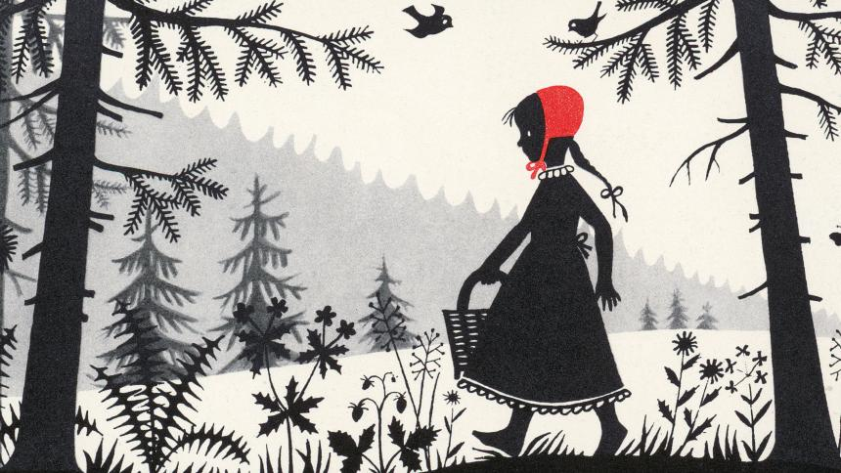
THE BROTHERS GRIMM

Slide 13
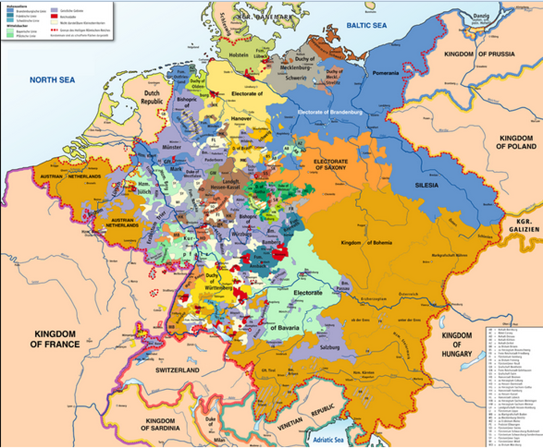
Holy Roman Empire 1789

Slide 14
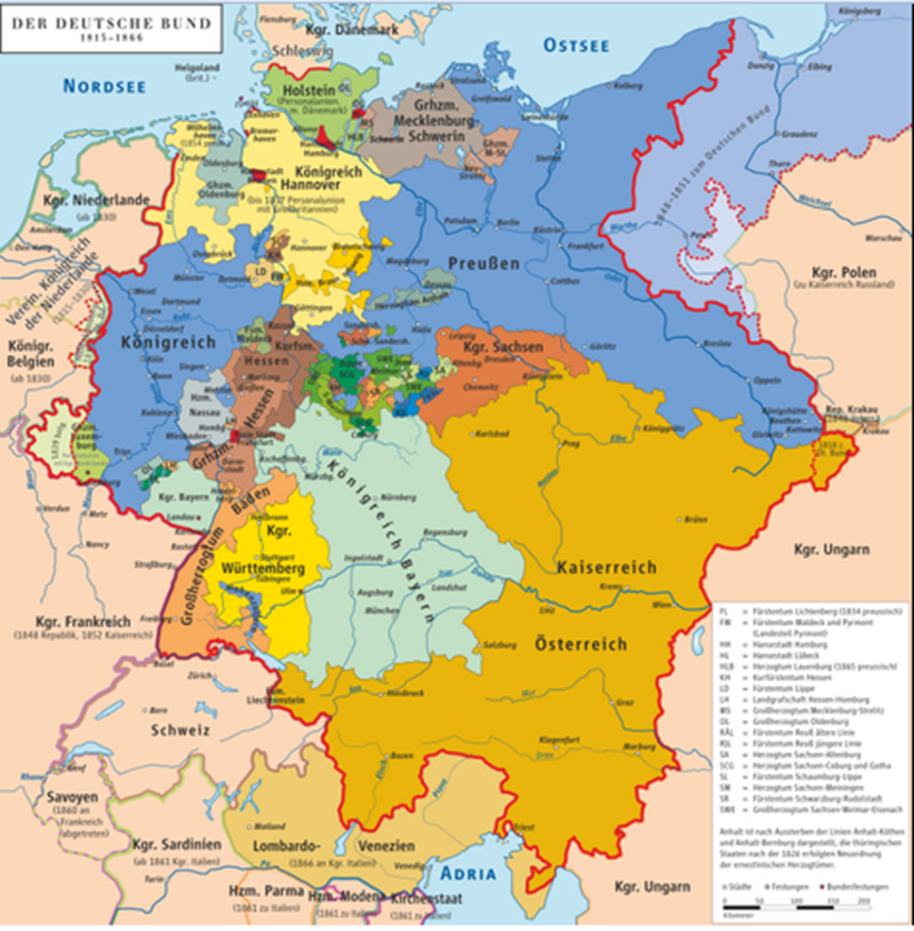
Confederation of German states 1816-1866

Slide 15
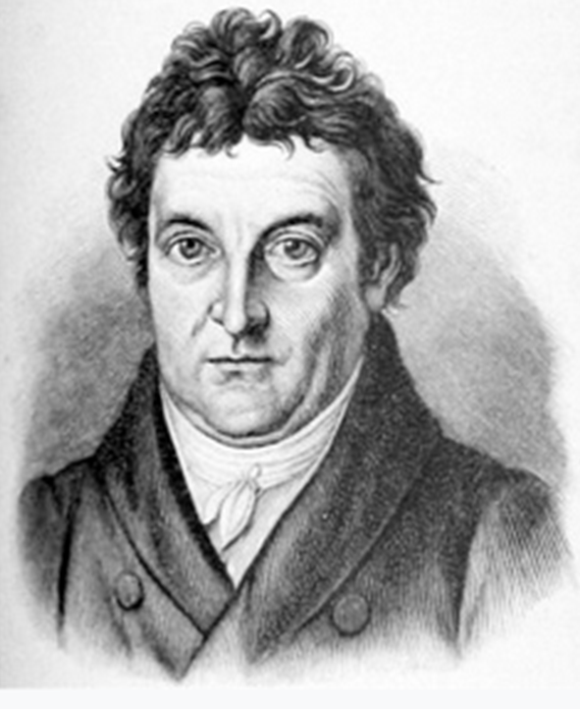
Johann Gottlieb Fichte, ADDRESSES TO THE GERMAN NATION (1807)
Addresses … delivered in French occupied city of Berlin Dec 1807
To a German Nation …when there is none (41 separate territories).
Drawing on Herder’s sense that ‘the nation is coextensive with the people or Volk, the totality of a given cultural and ethnic community…’ (eg Grimm project)
VS
Christin Martin Wieland: ‘I see Saxon, Bavarian, Württemberg, and Hamburg patriots … but German patriots who love the entire Reich as their fatherland…Where are they?’

Slide 16
FICHTE’S ANSWER…
‘All who either live creatively, bringing forth the new in themselves, or, should this not have fallen to their lot, at least decisively abandon things of vanity and keep watch to see whether somewhere they will be caught by the stream of original life, or….at least have an inkling of freedom and do not hate or fear it, but love it: all these are original men; they are, when viewed as a people, an original people, the people as such: Germans.
[…] Those who believe in spirituality and in the freedom of this spirituality, who desire the eternal progress of this spirituality through freedom – wherever they were born and whichever language they speak – are of our race, they belong to us and they will join us’.

Slide 17

https://www.youtube.com/watch?v=lRE1QPRQnH4

