Slide 1
Virtue, vice, and institutions: Mandeville and montesquieu
Dr Imogen Peck
Department of History

Slide 2
SHARED CONCERNS
The relationship between the institutions of the state and the virtues and vices of its members.
Commerce and luxury and their role in society.
The extent to which the political world should be an effort to constrain the passions of men, and how far those passions might actually be useful – or indeed the product of the society in which they live.

Slide 3
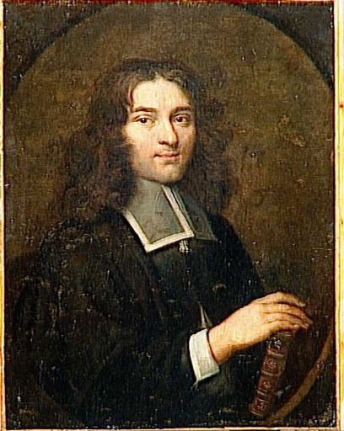
Bernard MANDEVILLE: Life and Writings
1670 - Born in Rotterdam
1682-3 - Visited England.
1695 - Emigrated to England permanently
1703 - Published The Pamphleteers: A Satyr and Some Fables after the Easie and Familiar Method of Monsieur de la Fontaine
1705 - Wrote The Grumbling Hive
1709-10 - Produced The Female Tatler
1714 - First edition of The Fable of the Bees

Slide 4
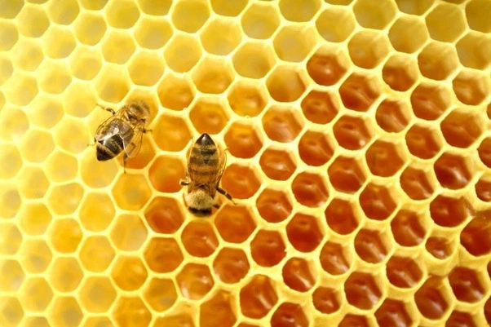
The grumbling hive
‘Thus every part was full of vice
Yet the whole Mass a Paradise
Flatter’d in Peace, and fear’d in Wars
They were th’ Esteem of Foreigners
And lavish of their wealth and lives
The Balance of all other hives
Such were the blessings of that state
Their crimes conspir’d to make them great […]
The worst of all the multitude
Did something for the common good’
So few in the vast Hive remain
The hundredth part they can’t maintain
Against th’ Insults of numerous foes […]
They triumph’d not without their cost For many thousand bees were lost Hard’ned with toils and exercise
They counted ease itself a vice
Which so improv’d their temperance That to avoid extravagance
They flew into a hollow tree
Blest with content and honesty’

Slide 5
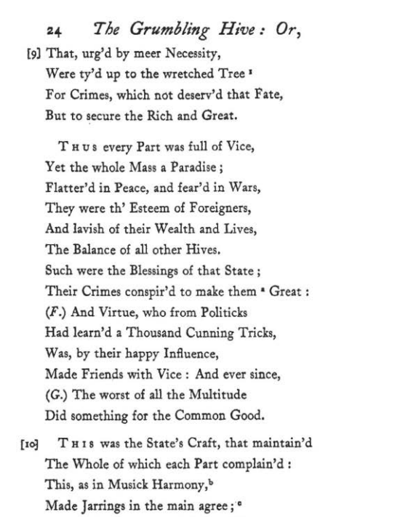
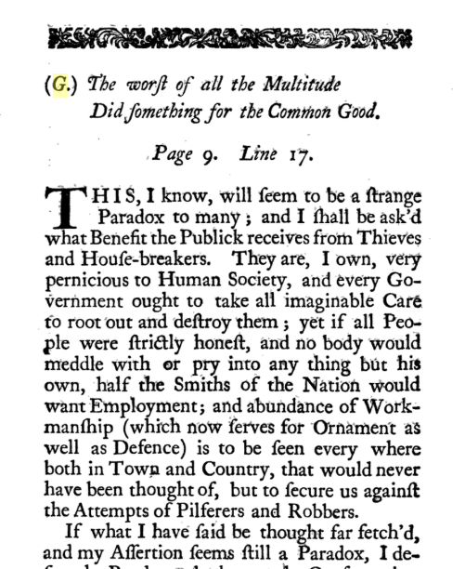
THE GRUMBLING HIVE AND THE FABLE OF THE BEES

Slide 6
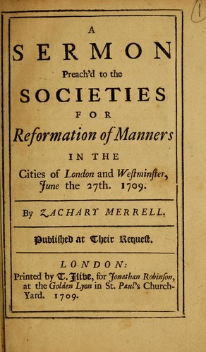
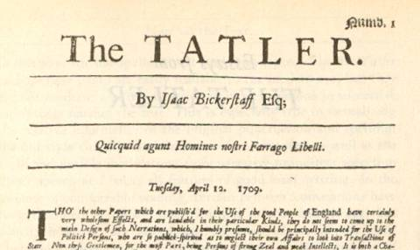
Private vice and public corruption in the 18thc
Copies of A Sermon Preach’d to the Societies of the Reformation of Manners (1709) and an edition of The Tatler, from the same year.

Slide 7
VIRTUE AND SELF INTEREST IN MANDEVILLE
Man is innately self-interested:
‘all untaught animals are only solicitous of themselves and naturally follow the best of their own inclinations without considering the good or harm that their being pleased will accrue to others’.
You inculcate a sense of virtue and morality by appealing to this self-interest:
‘contrary to the impulse of Nature, [each] should endeavour the benefit of others, or the Conquest of his own Passions out of a Rational Ambition of being good’.
(‘An Inquiry into the Origin of Moral Virtue’, The Fable of the Bees)

Slide 8
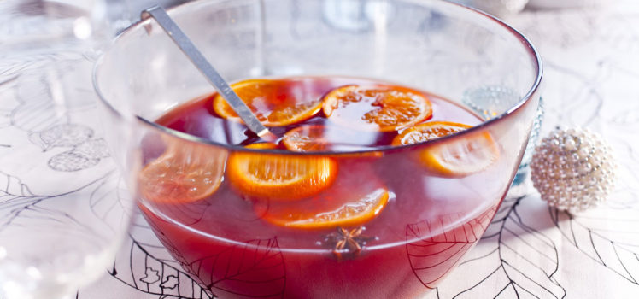
Private vices, public benefits
The body politic is like a ‘bowl of punch', made up of virtues and vices.
‘Experience teaches us that the ingredients I named, judiciously mixt, will make an excellent Liquor, lik’d of and admir’d by men of exquisite palates’.
(Remark K, The Fable of the Bees)

Slide 9
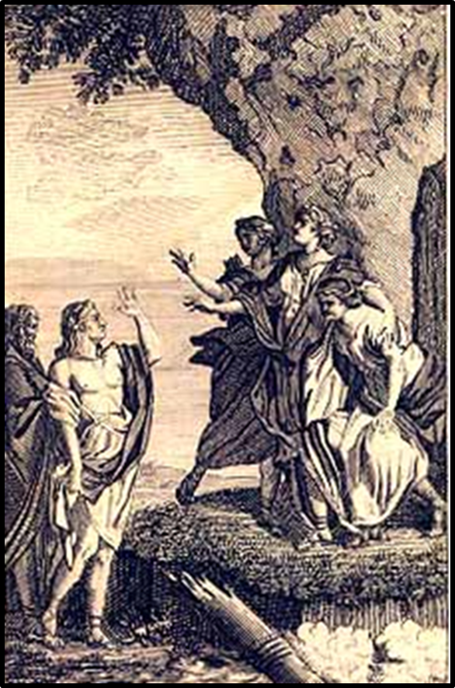
The debate on luxury: François de Salignac de la Mothe-Fénelon
Under the yoke of luxury ‘the whole nation goes weak; all ranks are confounded […] all live above their rank and income, some from vanity and ostentation, and to display their wealth; others from false shame, and to hide their poverty’.
Les Aventures de Télémaque (1699)
Minerva guiding Telemachus

Slide 10
IN DEFENCE OF LUXURY
‘so many things which were once looked upon as the invention of luxury are now allowed even to those that are so miserably poor as to become objects of charity, nay counted so necessary, that we think no human creature ought to want them. In the first ages man, without doubt, fed on the fruits of the earth, without any previous preparation, and reposed himself naked like other animals on the lap of their common parent: whatever has contributed since to make life more comfortable, as it must have been the result of thought, experience, and some labour, so it more or less deserves the name luxury’.
(Remark P, The Fable of the Bees)

Slide 11
Charles-louis de secondat, baron de la brede et de montesquie
(i.e. Montesquieu)
Born in France in 1689
1721 – Published Persian Letters
1734 – Published Considerations on the Causes of the Greatness of the Romans and their Decline
1748 – Published The Spirit of the Laws
1750 – English translation of The Spirit of the Laws published

Slide 12
nATURAL LAW AND THE STATE OF NATURE
State of nature
‘instead of being sensible to his equality, [man] would fancy himself inferior. There would, therefore, be no danger of attacking each other; peace would be the first law of nature’ (Book I)
Law of Nature
‘Law in general is human reason, inasmuch as it governs all the inhabitants of the earth: the political and civil laws of each nation ought to be only the particular cases in which human reason is applied. They should be adapted in such a manner to the people for whom they are framed that it should be a great chance if those of one nation suit another.’
(Book I)

Slide 13
Forms of government
Republic (democracy and aristocracy)
Monarchy
Despotic
‘a republican government is that in which the body or only a part of the people is possessed of the supreme power: monarchy, that in which a single person governs by fixed and established laws: a despotic government, that in which a single person directs everything by his own will and caprice’.
(Book II)

Slide 14
Principles of government
Republic – virtue
Monarchy – honour
Despotic – fear
‘the difference between the nature and principle of government is that the former is that by which it is constituted, the latter that by which it is made to act. One is its particular structure, and the other the human passions that set it in motion’.
(Book III)

Slide 15
HONOUR AND AMBITION IN MONARCHIES
Honour
‘Honour sets all the parts of the body politic in motion, and by its very action connects them; thus each individual advances the public good, while he only thinks of promoting his own interest.’
Book III
Ambition
‘in a monarchy it has some good effects; it gives life to the government, and is attended with this advantage, that it is in no way dangerous, because it may be continually checked.’
Book III

Slide 16
ON LUXURY
Luxury is ‘extremely proper for monarchies, and that under thus government there must be no sumptuary laws – meaning laws that would regulate consummation – as riches, by the very constitutions of monarchies, are unequally divided, there is an absolute necessity for luxury. Were the rich not to be lavish, the poor would starve’.
(Book VII)
Pellatt and Green’s glassware shop in St Paul’s Churchyard, London (1809), an example of the rise in luxury goods in the late 18th/ early 19th cs.

Slide 17
bibliography
Goldsmith, Private Vices, Public Benefits (1985)
Hont, ‘The early Enlightenment Debate on Luxury’ in The Cambridge History of 18thc Political Thought
Welchman, ‘Who Rebutted Mandeville?’, History of Philosophy Quarterly (2007)
Cook, ‘Bernard Mandeville and the Therapy of the Clever Politician’, Journal of the History of Ideas (1999)

