Slide 1
‘All that is solid’: marx and revolution
Dr Imogen Peck
University of Warwick

Slide 2
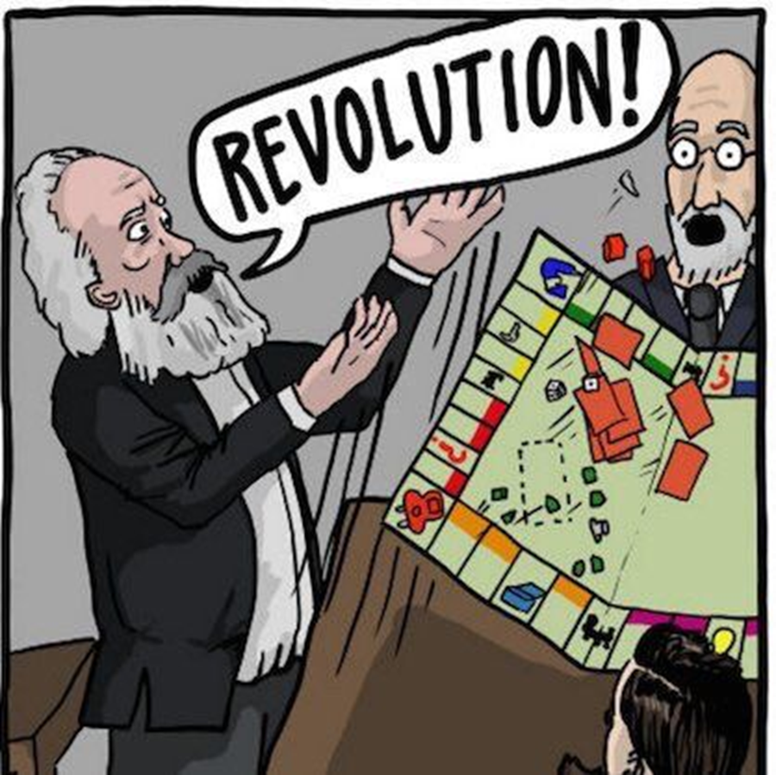
Revolution in marx: 3 contenders
The ‘Universal Class’ (Marx and Hegel)
Alienation (Marx in the Manuscripts)
Historical Materialism (The Preface)

Slide 3
THE YOUNG HEGELIANS
Group of German intellectuals in 1830s and 1840s (e.g. Feuerbach, Schmidt, Bauer, Strauss).
Drew on Hegel’s ides that the purpose and promise of history was the total negation of everything conducive to restricting freedom and reason.
But unlike Hegel mounted radical critiques on religion and the Prussian political system.

Slide 4
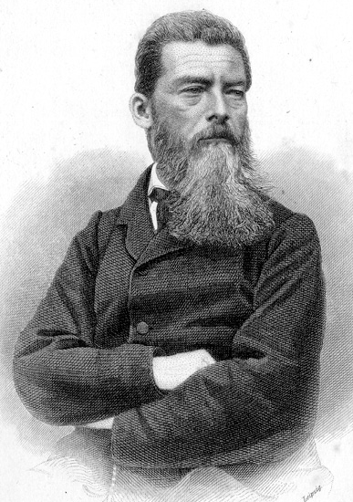
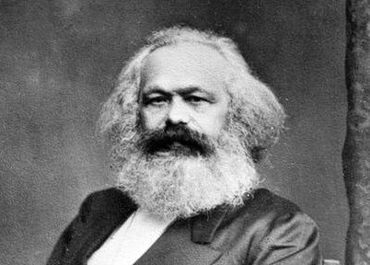
MARX AND the BREAK FROM THE YOUNG HEGELIANS
God was merely a projection of human attributes, desires, and potentialities. If men realised this, they would be in a position to realise that they had created God, and that this realisation would allow men to appropriate these attributes for themselves.
Agrees that man created God, and not the other way around. But increasingly starts to think that religion isn’t the most relevant factor – it’s not the sole basis of the establishment’s power…

Slide 5
Marx’s critique of bureaucracy
Hegel - the bureaucracy performed a mediating function between different social groups, acting as a kind of ‘universal class’ that acts in everyone’s interests.
VS.
Marx - thinks that the bureaucracy encouraged the political divisions that were essential to its own existence and thus pursued its own ends to the detriment of the community at large.

Slide 6
Marx on ‘rights’
‘The right of man to freedom is not based on the union of man with man, but on the separation of man from man […] The right of man to property is the right to enjoy his possessions and dispose of the same arbitrarily, without regard for others men […] It leads man to see in other men not the realisation but the limitation of his own freedom’.
On the Jewish Question (1844)

Slide 7
Marx’s ‘universal class’
‘the formation of a class with radical chains, a class in civil society that is not a class of civil society, of a social group that is the dissolution of all social groups, of a sphere that has a universal character because if its universal sufferings and lays claim to no particular right, because it is the object of no particular injustice but of injustice in general […]
It is, finally, a sphere that cannot emancipate itself without emancipating these other spheres themselves. In a word, it is the complete loss of humanity and thus can only recover itself by complete redemption of humanity. This dissolution of society, as a particular class, is the proletariat’.
A Contribution to the Critique of Hegel’s Philosophy of Right (1844)

Slide 8
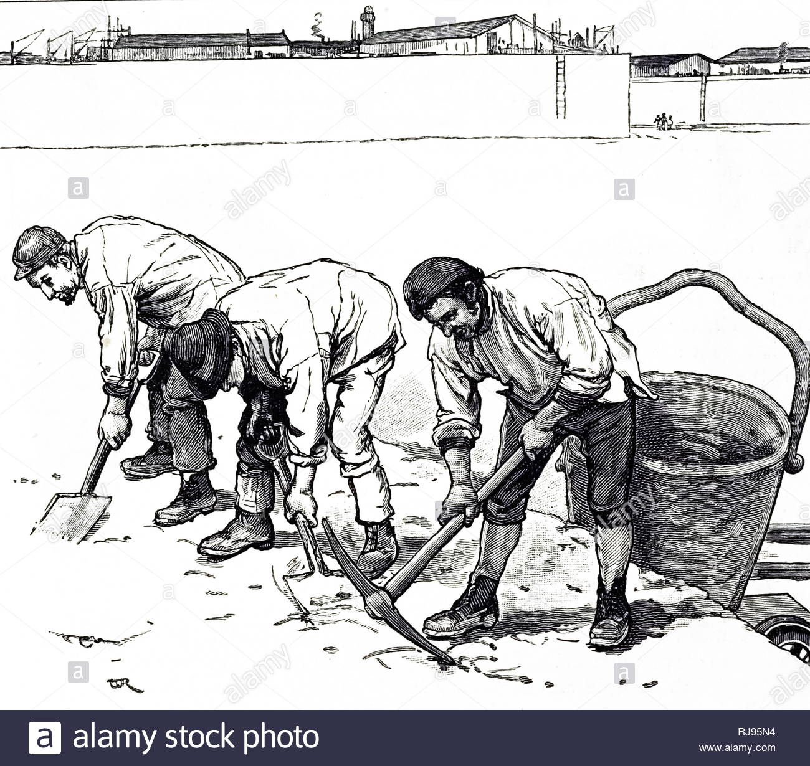
Self-realization in marx
Labour is the instrument of man’s self-realisation.
‘Labour is a process in which both man and nature participate, and in which man of his own accord starts, regulate, and controls the material reactions between himself and nature […] By thus acting on the external world and changing it, he at the same time changes his own nature. He develops his slumbering powers and compels them to act in obedience to his sway’. (Capital, Vol I).

Slide 9

alienated labour
‘Capitalism is the most extreme form of alienation’ (Grundrisse)
2 facets of capitalism that generate alienation:
Private property
Division of labour
Man becomes detached both from both his labour and from its products.

Slide 10
Self-actualization under communism: or, the escape from alienation
‘Communism, as a fully developed naturalism, equals humanism, and as a fully developed humanism equals naturalism; it is the genuine resolution of conflict between man and nature and man and man’.
Economic and Philosophical Manuscripts (1844)

Slide 11
YOUNG VS OLD MARX / OLD VS NEW MARX
Young Hegelian Marx
Economic and Philosophical manuscripts
Alienation
Commodity Fetishism
Hegelian overtones/Dialectics
Idealism
Older Political Economy Marx
Scientific analysis
Systematic explanatory theory of historical development
Reductionism
Historical materialism/determinism

Slide 12

Historical materialism
The development of human history is the product of material conditions.

Slide 13
Stages of history
Economic Structure Level of Productivity
1. Pre-class society No surplus
2 Pre-capitialist/feudal class society Small surplus
3. Capitalist Society Moderately high surplus, but less than
4. Post-class society Massive surplus/abundance

Slide 14
PRODUCTIVE FORCES AND PRODCUTIVE RELATIONS
Productive Forces = labour power + means of production (e.g. machines, premises).
Productive Relations = structures that control these productive forces (i.e. the economic structure of society).
Productive force determine relations (primacy thesis)

Slide 15
PRODUCTIVE FORCES IN HISTORY
As they develop productive forces will come into conflict with the existing relations of production.
For example…
A feudal society where the lord owns everything.
People begin to develop new technologies – for grinding corn, creating cloth etc.
But those technologies can’t be exploited within the feudal system of relations.
Therefore feudal relations start to fetter the productive forces, leading to tensions, and, ultimately, to revolutions.
Revolutions will change the economic structure so that those relations CAN be exploited.

Slide 16
PRODUCTIVE FORCES IN THE PREFACE
‘At a certain stage of development, the material productive forces of society come into conflict with the existing relations of production or – this merely expresses the same thing in legal terms – with the property relations within the framework of which they have operated hitherto. From forms of development of the productive forces these relations turn into their fetters. Then begins an era of social revolution. The changes in the economic foundation lead sooner or later to the transformation of the whole immense superstructure’.
Preface to a Contribution to Political Economy (1859)

Slide 17
3 TYPES OF EXPLANATION
Intentional (too voluntarist)
Causal (too reductionist)
Functional (G. A. Cohen’s answer)

Slide 18
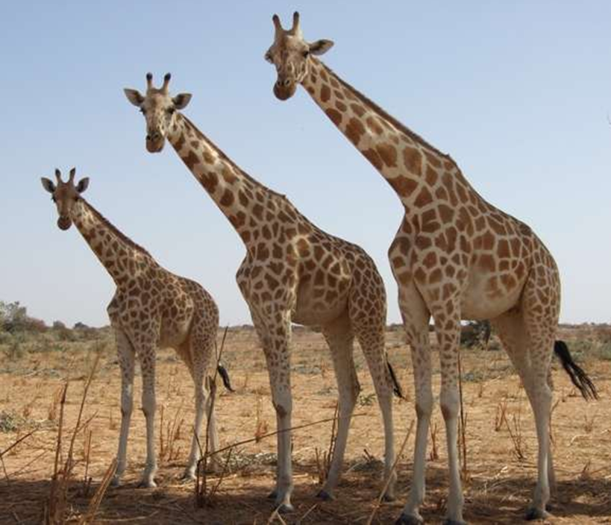
Karl marx’s theory of history: a defence (1978)
Functional explanation - explanation in which the existence of an entity or process is explained by its effect.
E.g. Why does the Giraffe have a long neck? Because having a long neck is optimal for survival (X occurs, because if X were to occur it would bring about Z).
You get the kinds of changes you need in the productive relations because of their value in supporting the productive forces.

Slide 19
bibliography
G. A. Cohen, Karl Marx’s Theory of History: A Defence (1978)
Istvan Meszaros, Marx’s Theory of Alienation (1980)
Jon Elster, Making Sense of Marx (1985)
David Leopold, The Young Karl Marx (2007)
David McLellan, Karl Marx: Selected Writings (1977)

