Slide 1
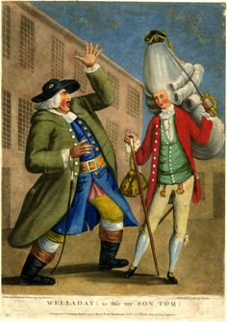
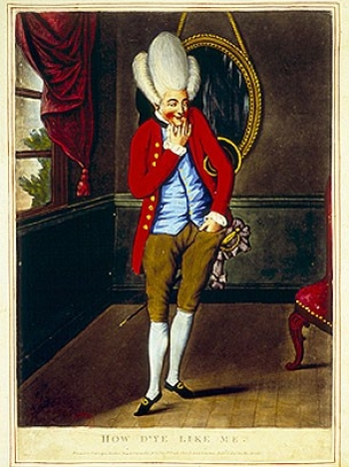
Macaroni Fashion

Slide 2
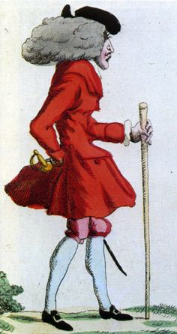
Some Main Features of the Macaroni
Embracing femininity
Consumption and Luxury
Against self fashioning in the sense that didn’t conform to social standards at the time- though a definite strong construction of ones self

Slide 3
Origin
Originated in the 1760s and 1770s
Macaroni’s- Ultra-fashionable English men who adopted a particularly flamboyant and fashionable mode of dressing and behaviour. It was an
Urban style, coined to describe the wealthy youth of the clubs of St James's in London, York and Bath
Macaroni dress entwined with a rising homosexually, forming its own subculture that emerged in urbanized Western Europe by the late seventeenth century
Formed out of a resurgence towards femininity

Slide 4
Features of Macaroni Dress
Small scratch-wig of the older generation with elaborate hairstyles similar in type to the contemporary female coiffure
Outfit- tight-sleeved coat with short skirts, waistcoat, and knee breeches, emphasizing pastel colours, patterns, and textile ornamentation
Typical brocaded and embroidered silks and velvets, encrusted with chenille threads and metallic sequins
The out use of a pigtail and wig-bag was viewed as a Francophile affectation; so much so that the visual shorthand for Frenchmen in caricature imagery was this device.

Slide 5
Accessories
Macaroni men deployed a number of accessories that characterized court society.
Hanger sword, which was traditionally the preserve of the nobility, and which in England was fading from general usage.
Other Macaroni features include red-heeled and slipper-like leather shoes with decorative buckles of diamond, paste, or polished steel
Nivernais or nivernois hat named after the French ambassador resident in London
Large floral corsages or nosegays
Chateleines or hanging watches, and seals suspended around the waist
Decorative neoclassical metal snuffboxes
Eyeglasses
Very much a show of wealth but a focus also on delicate accompanying pieces

Slide 6
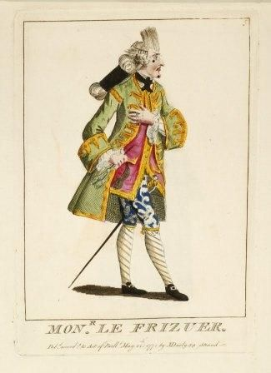
Colours and Cosmetics
Typical colours included pastel pea green, pink, and deep orange, while not vivid, bright and brash, feminine colours
Striped or spotted fabrics on stockings, waistcoats, and breeches were popular
Often worn in contrasting arrangements.
Emphasizing of courtly artifice in posture, gesture, and speech further underlined by the use of cosmetics such as face-whiteners and rouge – priori quite feminine attire
to the extent that people changed their accents and idiom

Slide 7
Why?
Show of wealth
Trait of being “travelled”, or at least adopting certain Continental affectations, was particularly important for the identity of the macaroni- links into wealth
French and Italian goods and manners had added appeal in that travel to the Continent had not been possible and the importation of French textiles had been banned during the Seven Years War (1756–1763)
By spending, behaving and looking a certain way they moulded an image of aristocracy that was impossible for those lower down the social scale to emulate, and so kept their power, status and exclusivity
Not purely this as ignorant to the changing sexuality that was associated with the Macaroni's

Slide 8
Sexuality
Contrasted earlier in the century
Previously, aggressive masculine demine who was associated with vices such as excessive drinking, gambling, and whoring
1750s saw a rise in a cautious gay subculture
Mostly in London, centred around a number of taverns known as molly houses
Homosexuality shifted from an action to an identity
The act of sodomy, on which homosexuality was predicated, changed from something one did, to something one was – could be a ‘sodomite’
Though macaroni's not necessarily seen as homosexual
“by the 1760s when the macaroni emerged, such attention to fashion was read as evidence of a lack of interest in women, or as potentially unattractive to women”

Slide 9
Not Completely Accepted
Protestant British associated Italy and as such macaroni's with perversity and an expenditure of its sexual energies on cuckoldry and sodomy.
In occasional prints, plays, and satires the macaroni was cast as an indeterminate figure who did not fit normative stereotypes of gender and sexuality.
Fictional descriptions of "Lord Dimple," "Sir William Whiffle," and "Marjorie Pattypan" deployed the notion of a neutral or unnatural gender in which "inappropriate" feminine attributes were grafted onto male appearance, dress, and behaviour

Slide 10
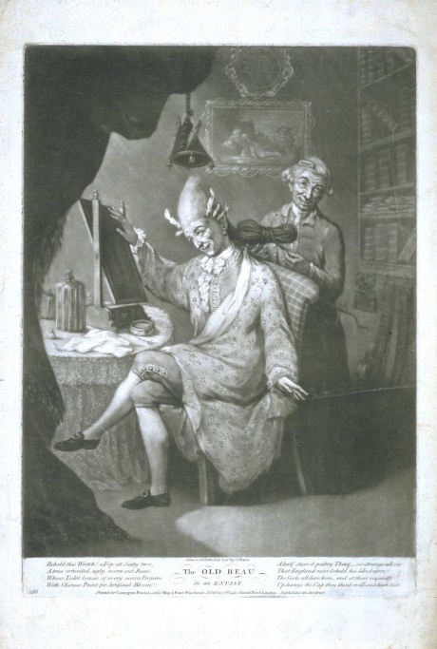
The Old Beau in an Extasy
Elderly Macaroni sits at a dressing table in a flowered robe and curling papers – a setting normally associated with female portraiture – seemingly admiring the handiwork of his male hairdresser.
Macaroni being aroused both by his own adorned appearance, and by the man who attends him in this intimate setting – particularly as the extreme shapes of his hair (or wig) are again producing phallic images

Slide 11
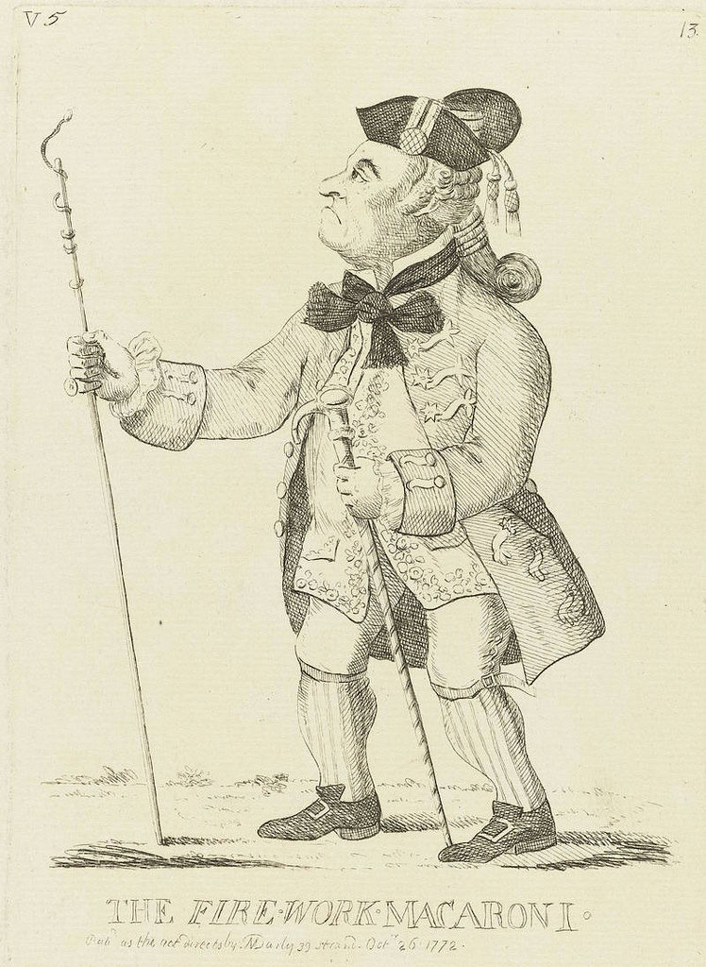
Case of Captain Robert Jones
Sodomized a 13 year old boy but attained royal pardon to escape hanging
Letter that was published in the Public Ledger on August 5
“this MILITARY MACCARONI” was “too much engaged in every scene of idle Dissipation and wanton Extravagance
Sodomy, it was insinuated, was not just the secret vice of an individual but a defining characteristic of a recent type of dandy
Portrayed as aggressively predatory towards male youths

Slide 12
How Were They Different From the Prior Style
Men’s dress had been extravagant earlier in the century
Macaroni style was so ostentatious to point of it becoming a caricature of previous male fashions
More exaggerated than Dandies
Dandy was restricted and simplistic in his look, a Macaroni was obvious, and in-your-face.
Lifestyles, comparable and both groups spent time around London’s elite hot-spots and playing fashionable card games.
Carefree behaviour and profligate gambling soon became the hallmark of the Macaroni

Slide 13
Reverted Back After Macaroni
The lesser aristocracy began to view the foppish ways of their superiors as effeminate, and instead chose to adopt a more ‘manly’ style of living based on the ways of the country gentleman and not the courtier.
Form of meritocracy- viewed any French or Italian style as ludicrous, and developed a new style based on the ‘virtues of work, enterprise, and earned wealth’ rather than inherited title

