Slide 1
The politics of education
Dr Imogen Peck
University of Bristol

Slide 2
structure
Education in the 18thc
Rousseau on education (the Third Discourse, Considerations on the Government of Poland, and Emile)
Responses to Rousseau

Slide 3
I. Education in the 18thc
‘I think I may say that of all the Men we meet with, Nine Parts of Ten are what they are, Good or Evil, useful or not, by their Education…
God has stampt certain Characters upon Mens Minds, which, like their Shapes may perhaps be a little mended; but can hardly be totally alter’d, and transform’d into the contrary’.
John Locke, Some Thoughts Concerning Education (1693)

Slide 4
LOCKE AND EDUCATION
A gentleman’s education should consist of 4 main things:
Virtue, which was necessary to make one ‘tolerable to oneself and others’
Wisdom, the unrelenting search for what is true
Breeding, the respect shown for self and others
Learning, the accumulation of substantive knowledge about things
(Some Thoughts Concerning Education)

Slide 5
Education in public discourse
‘the little Buds of their Minds will begin to open, and their watchful Mama will be imploy’d like a skilfull gardener, in assisting and encouraging the charming Flower thro’ its several hopeful Stages to Perfection, when it shall become one of the principal Ornaments of the delicate garden…’.
(Richardson, Pamela, 1741, IV)
Joseph Highmore's illustration of Pamela teaching her children (1743-45)

Slide 6
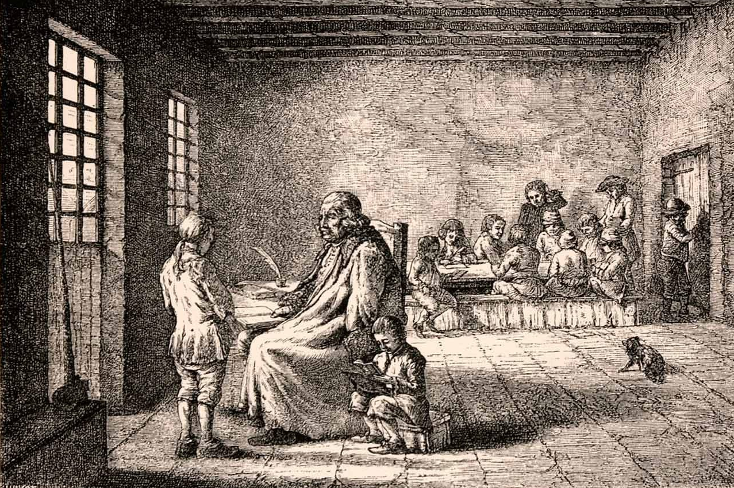
Public vs private education
In France, expulsion of the Jesuits prompted debates over the role of public education.
1762-1765 – 32 tracts on the subject published.
e.g. Charles Etienne Pesselier, Lettres sur l’education (1762)
Engraving of a school teacher and pupil 18th (1876)

Slide 7
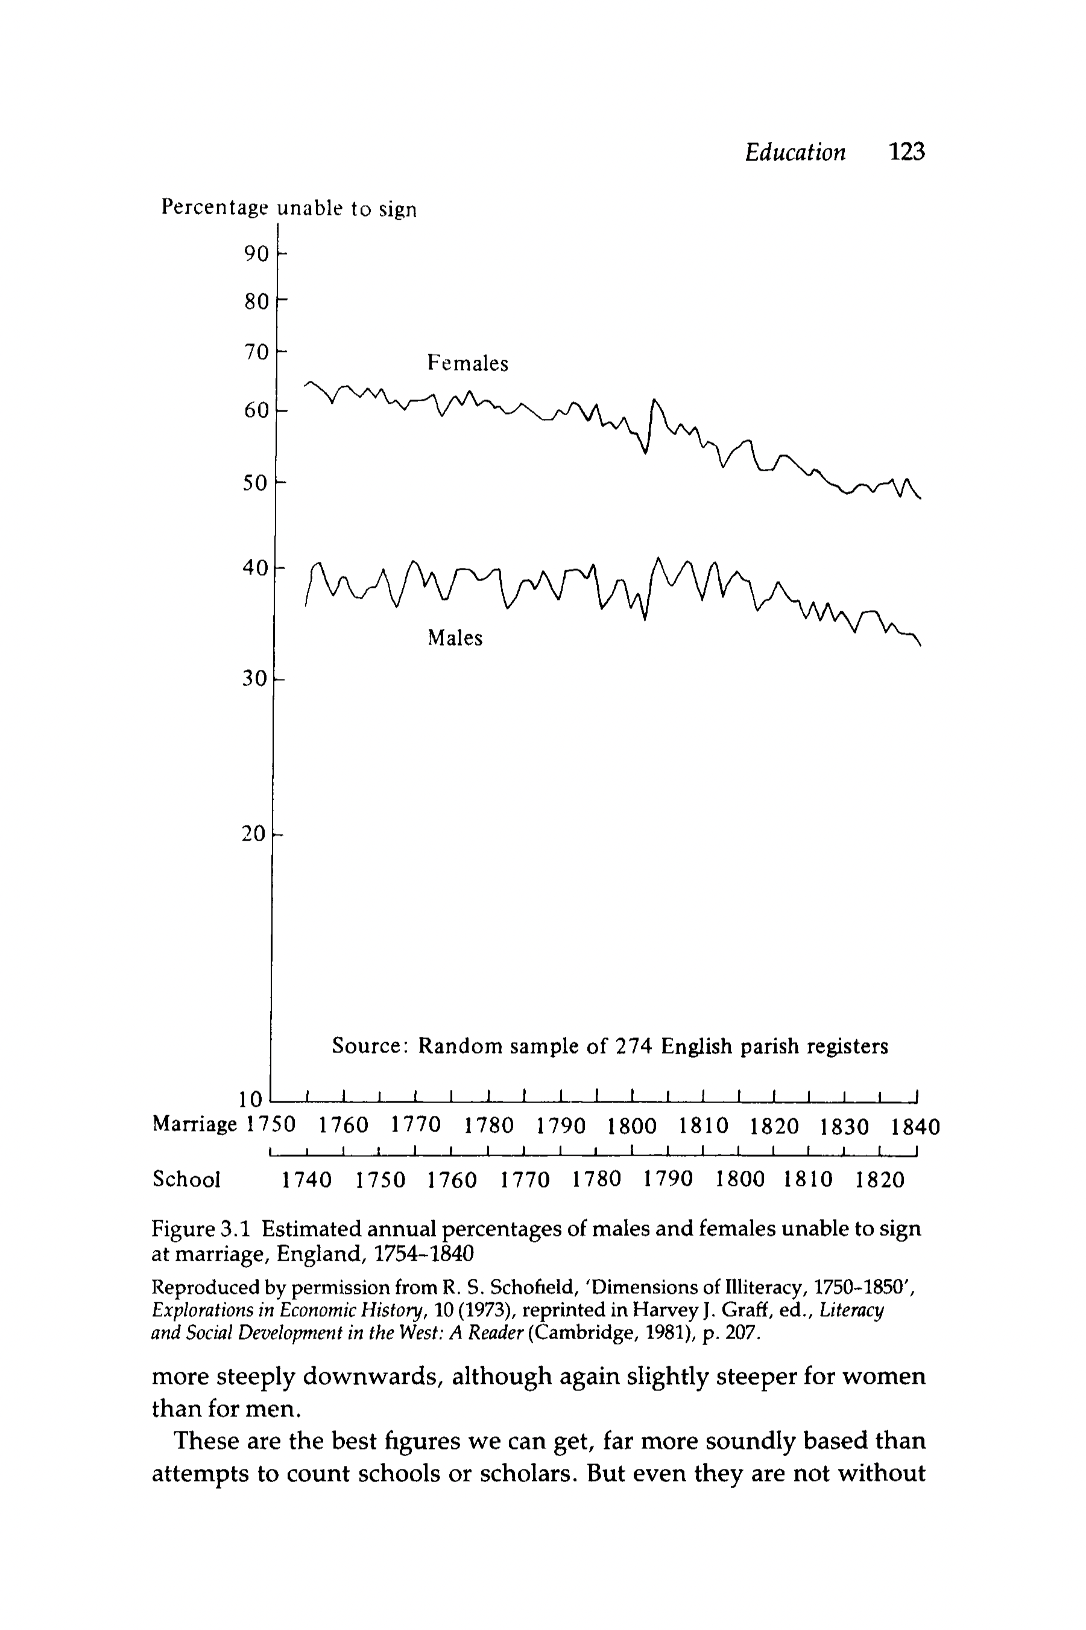
THE SHAPE OF SCHOOLING
Increase in number of charity and Sunday schools
Gradual rise in literacy
Education vs economic contribution
1844 – Factory Act

Slide 8
ii. Rousseau and the politics of education
‘In spite of so many writings having as their end, it is said, only what is useful for the public, the first of all useful things, the art of forming men, is still forgotten. After Locke’s book my subject was still entirely fresh’.
Emile, Book I
‘Of all the faculties of man, reason, which is, so to speak, only the composite of all the others, is the one that develops with the most difficulty and latest. And it is this one which they want to use in order to develop the first faculties!...This is to begin with the end, to want to make the product the instrument’.
Emile, Book II

Slide 9
EDUCATION OUTSIDE EMILE
Third Discourse:
The object of public schools should be to create citizens who will love their country and its laws, and who will perceive their own interests as synonymous with those of the collective.
To do this, public, state-organised education must start early – ‘early enough never to consider their own persons except in terms of being related to the body of the state, and not to perceive their own existence except as part of the state’s existence…It is too late to alter our natural inclinations when they have taken their course and habit has been joined with self-love…It is from the first moment of life that one must learn to deserve to live’.
Project for the Education of M de Sainte-Marie (1740)
Julie, or the New Heloise (1761)
A Discourse on Political Economy i.e. the Third Discourse (1776)
Considerations on the Government of Poland (1782)

Slide 10
A CURRICULUM FOR PUBLIC EDUCATION
'he should be familiar with everything Poland has produced; at 12, know all its provinces, all its roads, all its towns; at 15, to have mastered his country’s entire history, and at 16, all its laws; let his mind and heart be full of every noble need, every illustrious man, that ever was in Poland so that he can tell you about them at a moment’s notice’.
(Considerations on the Government of Poland)
Matejko, Constitution of 3 May 1791 (celebrating the new constitution of the Polish-Lithuanian commonwealth)

Slide 11
EMILE AND THE STATE OF NATURE
‘Self-love, which regards only ourselves, is contented when our true needs are satisfied. But amour propre which makes comparisons, is never content and could never be…Thus what makes man essentially good is to have few needs and to compare himself little to others; what makes him wicked is to have many needs and to depend very much on opinion’.
Emile, Book IV
In the state of nature, men are motivated by two main passions:
amour de soi – a constant impulse to preserve one’s life
pity – compassion for the suffering of other members of society.
As man enters society, he becomes afflicted by amour propre - self-love and vanity that is based on comparison with, and a desire to be viewed favourably when measured against, other men.

Slide 12
FREEDOM AND EDUCATION
‘The truly free man wants only what he can do and does what he pleases. That is my fundamental maxim. It need only be applied to childhood for all the rules of education to flow from it’.
Emile, Book IV

Slide 13
The structure of emile
Books I-III
are devoted to the rearing of a ‘civilised savage’, a man who cares only about himself, who is independent and self-sufficient and on whom no duties that run counter to his inclination and so divide him are imposed, whose knowledge of arts and sciences does not involve his incorporation into the system of public opinion and division of labour.
Books IV-V
attempt to bring this atomic individual into human society and into a condition of moral responsibility on the basis of his inclinations and generosity.
(From Allan Bloom, ‘Introduction’ (1979))

Slide 14
BOOKS I-III: A NEGATIVE EDUCTAION
4 maxims:
Let them have the use of all the strength that nature gives them.
Aid and supplement what is lacking to them, whether in intelligence or strength, in all connected to physical need
In the help you give them limit oneself solely to the really useful, without granting anything to whim or desire.
Study their language and care in order that, at an age when they do not know how to dissimulate, one can distinguish in their desires what comes immediately from nature and what comes from opinion.
Emile, Book I
The child receives almost nothing from the tutor, but nor does the tutor frustrate the child’s will by ordering him around or preventing him from doing things that he wants to do. Thus, the child will grow up knowing neither dominion, domination by another, or rebellion.

Slide 15
BOOKS iV-V: ENTERING SOCIETY
‘we are attached to our fellows less by the sentiment of their pleasures than by the sentiment of their pains, for we see far better in the latter the identity of our natures with theirs and the guarantees of their attachments to us. If our common needs unite us by interest, our common miseries unite us by affection. The sight of a happy man inspires in others less love than envy.
…Do you wish, then, to excite and nourish in the heart of a young man the first movements of nascent sensibility and turn his character towards beneficence and goodness? Do not puts seeds of pride, vanity, and envy in him by the deceptive image of the happiness of men’.
Emile, Book IV

Slide 16
READING HISTORY
‘All conquerors have not been killed; all usurpers have not failed in their enterprises; several will appear happy to minds biased by vulgar opinions. But he who does not stop at appearances but judges the happiness of men only by the condition of their hearts will see their miseries in their very successes; he will see their desires and their gnawing cares extend and increase with their fortune; he will see them getting out of breath in advancing without ever reaching their goals’.
Emile, Book IV

Slide 17
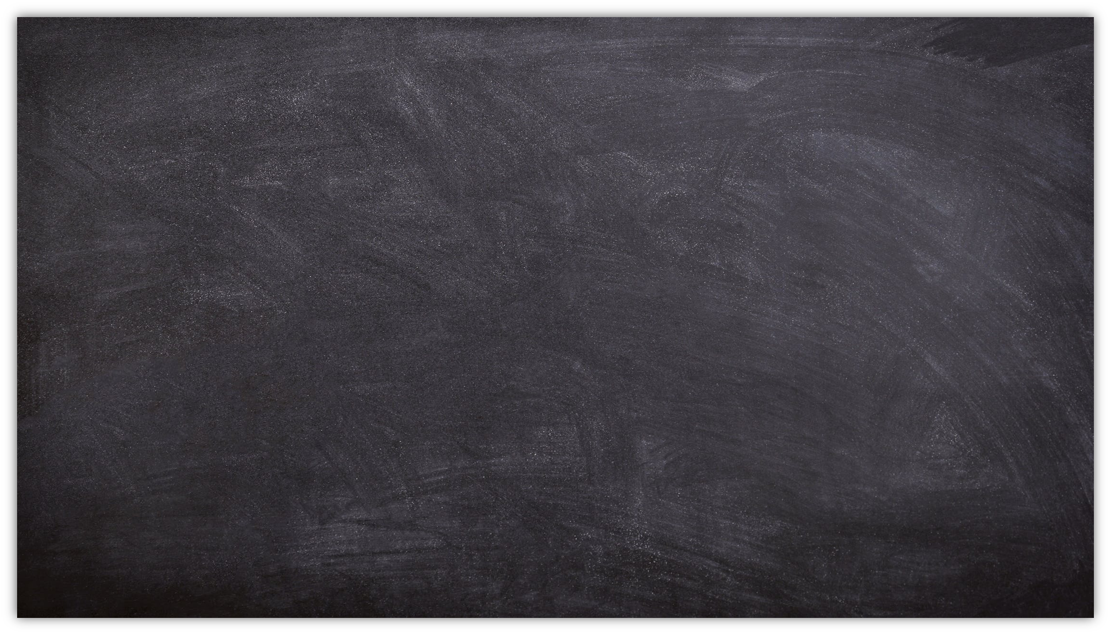
III. Responses to emile
Public vs private
Role of religion
Natural man and social man
Negative education – experience vs corruption
Messire Louis-René de Caradeuc de La Chalotais, Essai d'éducation nationale ou Plan d'études pour la jeunesse (1763)
Giacinto Sigismondo Gerdil, Réflexions sur la théorie et la pratique de l'éducation contre les principes de Mr Rousseau (1763)

Slide 18
bibliography
Jean Bloch, Rousseauism and Education in 18thc France (1995)
Kenneth Wain, On Rousseau: An Introduction to his Radical Thinking on Education and Politics (2011)
Allan Bloom, ‘Introduction’ to Emile, or education (1979)
Robin Douglass, Rousseau and Hobbes: Nature, Free Will, and the Passions (2015)
W. B. Stephens, Education in Britain, 1750-1914 (1999)

