Slide 1
The discovery of society?
Dr Imogen Peck
University of Warwick

Slide 2
structure
Society in the Early Modern period
Virtues, Vices, and Society
The Scottish Enlightenment

Slide 3
I. ‘SOCIETY’ in early modernity

Slide 4
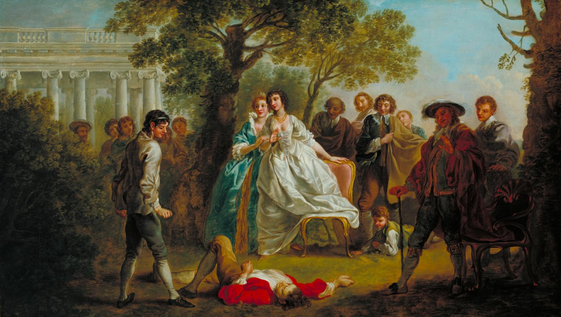
Society as company
Let every man be master of his time
Till seven at night: to make society
The sweeter welcome, we will keep ourself
Till supper-time alone: while then, God be with you!
Macbeth III(i)
JAQUES: I thank you for your company; but, good faith, I had as lief have been myself alone.
ORLANDO: And so had I; but yet, for fashion sake, I thank you too for your society.
JAQUES: God be wi' you: let's meet as little as we can.
ORLANDO: I do desire we may be better strangers.
As you like it III(ii)

Slide 5
Caravaggio, The Cardsharps (1594)

Slide 6
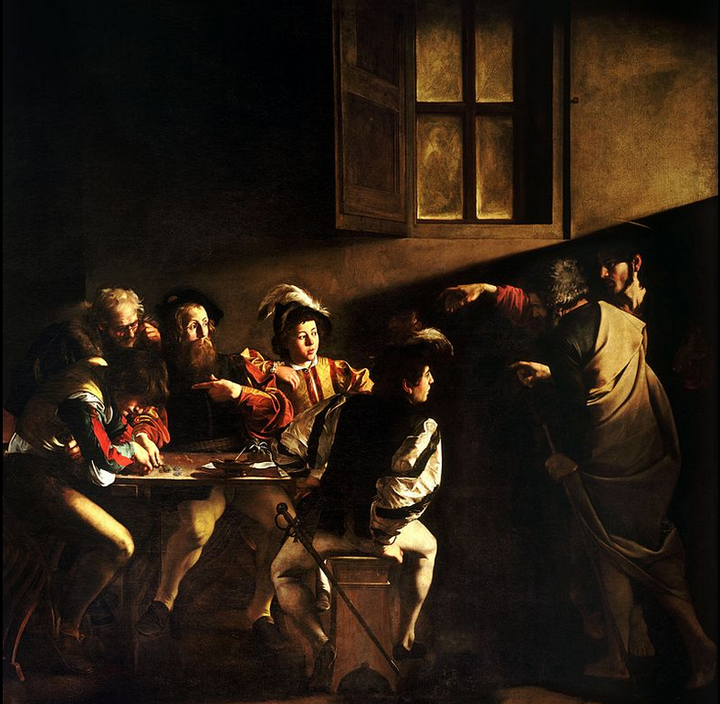
Caravaggio, The calling of St Matthew (c 1600)

Slide 7
Society as contract/association
1555 in J. D. Marwick Rec. Convent. Royal Burghs Scotl. (1870)
That na fremen..tak vpoun hand to keip sociatie in merchandice or ressaif ony geir to trauffique their with fra ony vnfremen.
1569 in J. H. Burton Reg. Privy Council Scotl. (1877)
The said Johnne enterit in societie with the said abbot.
1592 W. West Symbolæogr.: 1st Pt.
Societie is a contract by consent about a thing to be had and used in common on both sides.
John Barston, The Safegard of Societie (1576)
First (English) text to have society in the title.
Discusses 5 kinds of society
Emphasis on ‘society of one town’, a special kind of societie and fellowship of one people, gathered together in one town, which resembles the beginning of all civility’.

Slide 8
‘Whereas in 1576 ‘society’ was a species of social interaction through which and by which things were (or should be done) by 1976 it invoked national and local crucibles in which things happened. […] Society was increasingly applied to a widening spectrum of social interaction, all of which was rooted in the basic concept of voluntary and peaceful association’.
(Phil Withington, Society in Early Modern England, pp.104-105)

Slide 9
From ‘commonwealth’ to ‘society’
‘no political society can be, nor subsist, without having in itself the power to preserve the property, and in order thereunto, punish the offences of all those of that society; there, and there only is political society, where every one of the members hath quitted this natural power, resigned it up into the hands of the community in all cases that exclude him not from appealing for protection to the law established by it’.
Locke, Two Treatises, ch VII (Of Civil or Political Society)

Slide 10
Ii. Virtue, vices, and society

Slide 11
Virtue in the classical world
Plato
Courage, temperance, wisdom, and justice
Cicero
‘Virtue is a disposition [habitus] of spirit [animus] in harmony with the measure of nature and of reason. So when we know all its parts, we will have considered all the force of simple honor. It has four parts: prudence, justice, fortitude, temperance’.

Slide 12
‘fallen man’ in the reformation world
No account of natural goodness, virtues are remedies for vices, and passions need restraining by law and punishment. But why trust government to be any better?
At the end of 17th C get a transformation of passions into a source of order (potentially destructive, but also potentially beneficial…).
‘Out of ferocity, avarice and ambition, the three vices which lead all mankind astray, society makes national defence, commerce, and politics, and thereby causes the strength, the wealth , and the wisdom of republics: out of these three great vices which would certainly destroy man on earth, civil happiness emerges. This principle proves the existence of divine providence: through its intelligent laws the passions of men who are entirely occupied by the pursuit of their private utility are transformed into a civil order which permits men to live in human society’.
Giambattista Vico

Slide 13
Natural sociability?
‘kind instinct [s] to associate; of natural affections, of compassion, of love of company, a sense of gratitude, a determination to honour and love the authors of any good offices toward any part of mankind, as well as of those toward our selves’
Hutcheson, Reflections on the Common Systems of Morality (1724)
‘natural affections and appetites, ‘implanted by nature, which are not directed towards physical pleasure or advantage but towards certain higher things which in themselves depend on association with others’.
Hutcheson, Inaugural Lecture on the Social Nature of Man (1730)

Slide 15
iii. The Scottish enlightenment
How do you explain these changes in social forms?
How do you distinguish and differentiate 18thc society from the kinds of society that existed before?

Slide 16
Stadial theory
The age of hunters – where property only extended to what one could carry on one person.
The age of shepherds, or pastoralism – which witnessed the development of animal property.
The age agriculture – where society became settled and landed property became pivotal in the production of sustenance.
The age of commerce – which was synonymous with contemporary Europe, and the culture of trade and consumption.

Slide 17
Millar and the origin of the distinction of ranks
Considers four relations of power:
husband/wife
father/son
master/servant
sovereign/subject
‘The following inquiry is intended to illustrate the natural history of mankind in several important articles. This is attempted, by pointing out the more obvious and common improvements which gradually arise in the state of society, and by showing the influence of these upon the manners, the laws, and the government of the people’.
Origin of Ranks, Introduction

Slide 18
IMPROVEMENT AND PROGRESS
'There is, however, in man a disposition and capacity for improving his condition, by the exertion of which, he is carried on from one degree of advancement to another’.
Origin of Ranks, Introduction
Wherever men of inferior condition are enabled to live in affluence by their own industry, and, in procuring their livelihood, have little occasion to court the favour of their superiors, there we may expect that idea of liberty will be universally diffused. This happy arrangement of things is naturally produced by commerce and manufactures; but it would be as vain to look for it in uncultivated parts of the world, as to look for the independent spirit of an English wagoner among person of low rank in the highland of Scotland’.
Origin of Ranks, V.III

Slide 19
The limits of progress
‘It should seem, however, that there are certain limits beyond which it is impossible to push the real improvements arising from wealth and opulence. In a simple age, the free intercourse of the sexes is attended with no bad consequences; but in opulent and luxurious nations, it gives rise to licentious and dissolute manners, inconsistent with good order, and with the general interest of society’.
Origin of Ranks, I.VI

Slide 20
Montesquieu vs. the Scottish enlightenment
Montesquieu, The Spirit of the Laws (1748)
Sees the interconnections between the different elements of society – education, institutions, form of rule, types of punishment, culture, religion, etc.
But there’s no consistent causal account – its about the need for about internal harmony and equilibrium.
Scottish Enlightenment c 1740-1800s
Group of writers and philosopher who reflected on the nature of society: Adam Smith, John Millar, Henry, Lord Kames, Adam Ferguson etc.
In their accounts reproduction of conditions of life becomes central – and becomes a central causal mechanism. Moves economy to the heart of their theory of progress and civilisation.

Slide 21
bibliography
Phil Withington, Society in Early Modern England (2010)
Christian Mauer, ‘Self-interest and sociability’, in The Oxford Handbook of British Philosophy in the 18thc (2013)
Alexander Brodie, The Scottish Enlightenment (2001)
Nicholas Millar, John Millar and the Scottish Enlightenment (2017)

