Slide 1
The Romantic self
Dr Imogen Peck
University of Warwick

Slide 2
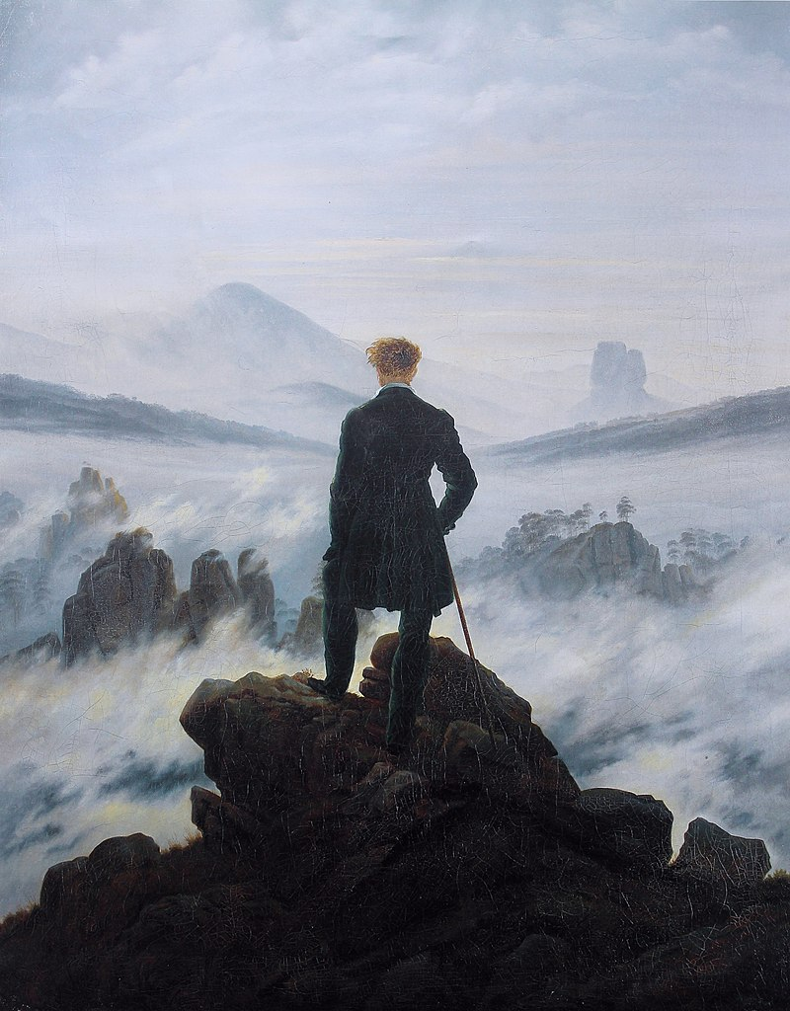
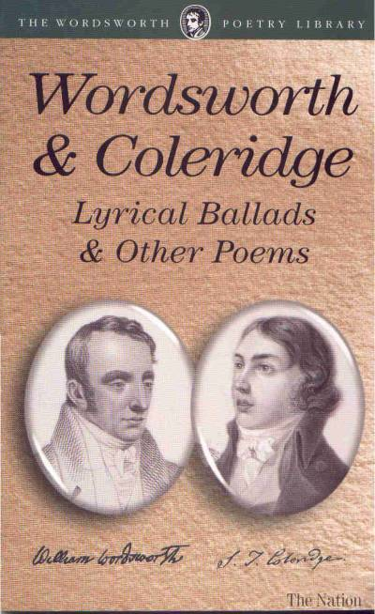
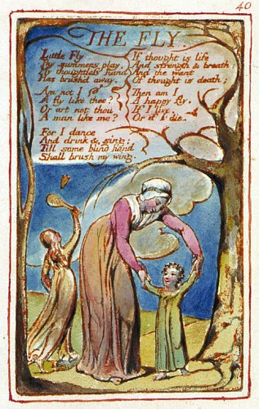
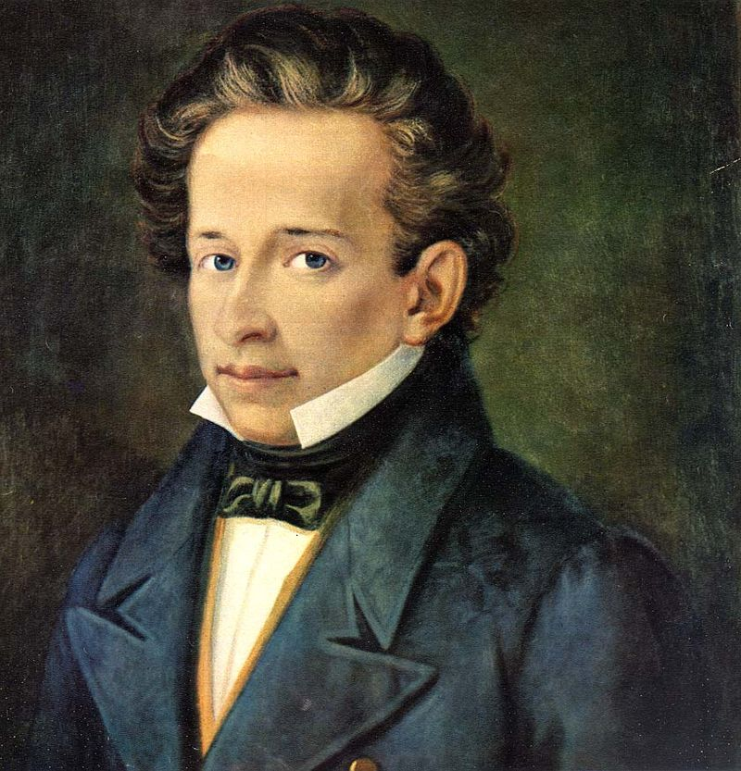
locating ROMANTICISM
Casper David Friedrich, ‘Wanderer Above the Sea Fog’ (1818)
Wordsworth and Coleridge, Lyrical Ballads (1798)
William Blake, Songs of Innocence and Experience (1789)
Giacomo Leopardi, Italian philosopher/poet/essayist (b. 1798, d. 1837)

Slide 3
‘Romanticism was a European cultural movement, or set of kindred movements, which found in a symbolic and internalised romance plot a vehicle for exploring one’s self and its relationship to others and to nature, which privileged the imagination as a faculty higher and more inclusive than reason, which sought solace in or reconciliation with the natural world, which ‘detranscendentalised’ religion by taking God or the divine as inherent in nature or in the soul and replaced theological doctrine with metaphor and feeling, which honoured poetry and all the arts as the highest human creations, and which rebelled against the established canons of neoclassical aesthetics and against both aristocratic and bourgeois social and political norms in favour of values more individual, inward, and emotional’.
Michael Ferber

Slide 4
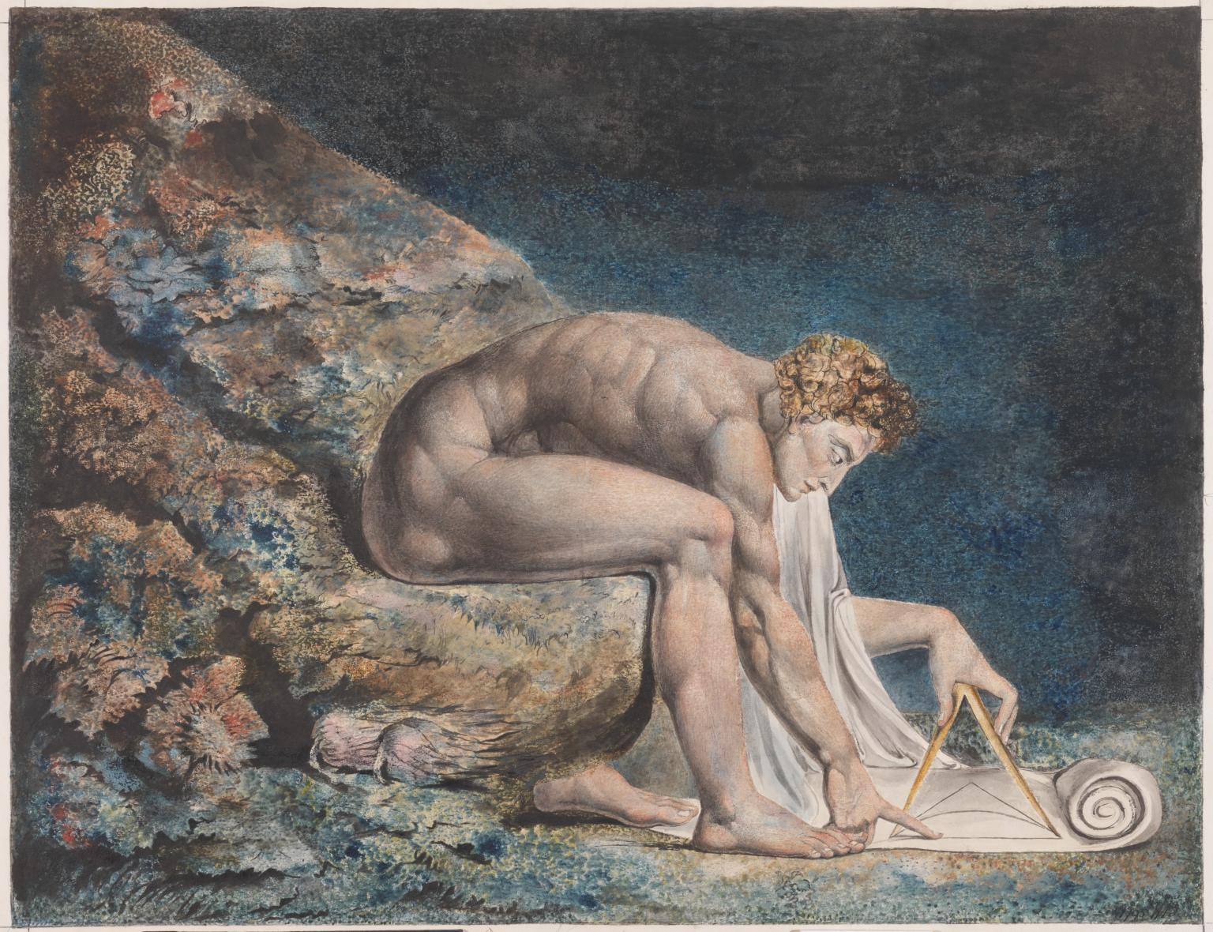
reason vs imagination
William Blake, ‘Newton’ (c. 1795-1805)

Slide 5
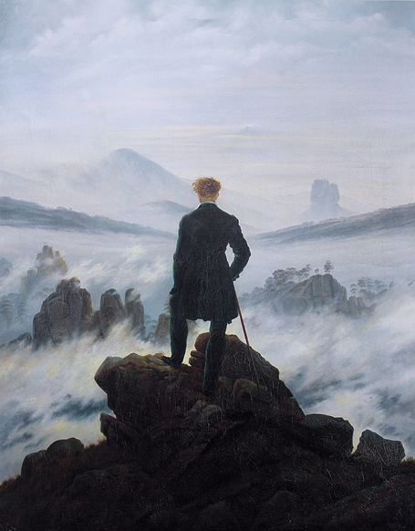
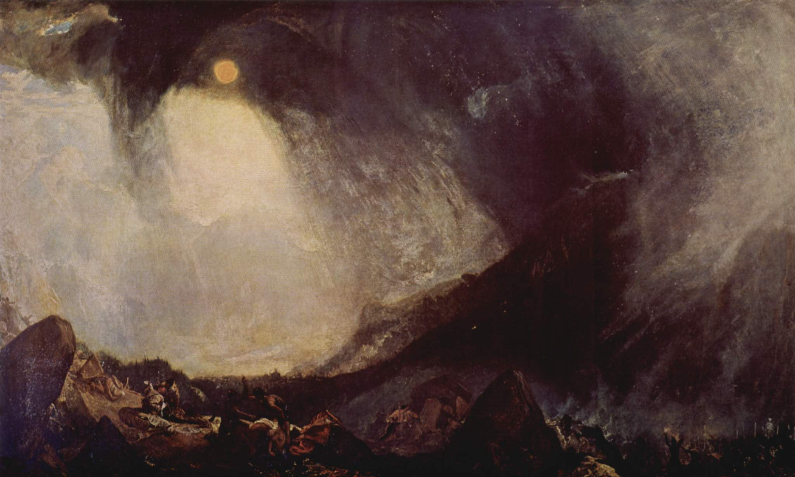
Nature and the natural world
Casper David Friedrich, ‘Wanderer Above the Sea Fog’ (1818)
J. M. W. Turner, ‘Snowstorm: Hannibal and his Army Crossing the Alps’ (1812)

Slide 6
A lecture in 3 parts
Karl Philip Moritz
William Wordsworth
William Blake

Slide 7
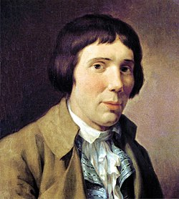
Karl Philip moritz
Anton Reiser (4 vols 1785-90)
Half Bildungroman; half autobiography
Analysis of the psychological development of a young man

Slide 8
The Vulnerability of self to others
‘it is likely that the nobleman imagined Reiser was preparing to leave and had been a little too hasty with his parting compliment. - but the very haste made such a dreadful impression on Reiser, and suddenly devalued his entire being so much, that, once he was outside the door, he remained a while stock still – ‘thank you for your visit’ became linked in his mind with the ‘stupid boy’ uttered by the inspector at the seminary, the merchant’s ‘I didn’t mean you’, the sixth formers ‘par nobile fratrum’, and the Rector’s ‘truly idiotic’.
Anton Reiser

Slide 9
Annihilation of the self
‘For a moment he felt as though he were annihilated; all the faculties of his soul were paralysed – the thought of having been a nuisance, even for a moment, fell upon him like a mountain – at that instance he felt he would have liked to shuffle off an existence that had been such a nuisance to another creature beside himself’.
‘Strong self-confidence irresistibly consumes its weaker rival – by mockery, by stigmatising its object as ridiculous. Becoming ridiculous is a kind of annihilation, and making someone else ridiculous is an unsurpassably murderous assault on that person’s self-confidence. – By comparison, being hated by everyone else is desirable’ (because it would animate us with a spirit of self defiance) But to have no friend, and not even an enemy - that is veritable hell, comprehending all the torments of conscious annihilation that a thinking being can suffer’.

Slide 10
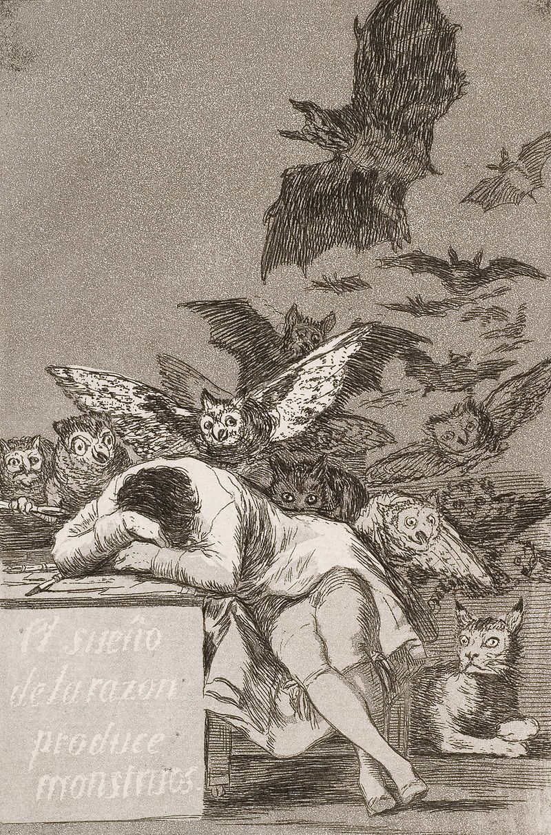
Francisco Goya, ‘The Sleep of Reason Produces Monsters’ (c. 1797-1799)

Slide 11
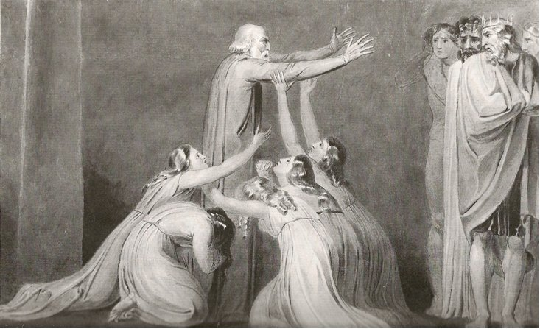
William blake and the intuition of selfhood
‘Why [are] men bound beneath the heavens in reptile form,
A worm of sixty winters creeping on the dusky ground’
Tiriel
William Blake, ‘Tiriel Denouncing his Sons and Daughters’

Slide 12
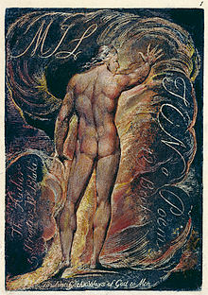
Milton and visions
Frontispiece, Milton (1810)
The text at the bottom is from Paradise Lost: ‘justify the ways of God to men’.

Slide 13
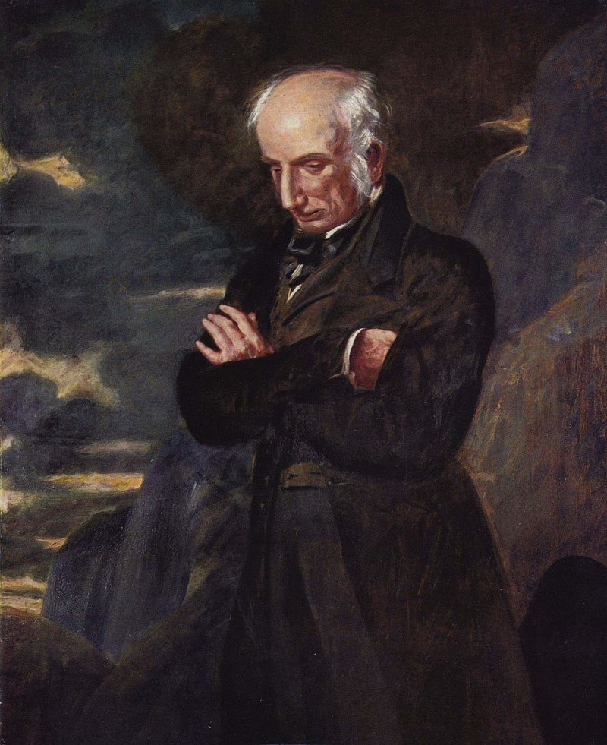
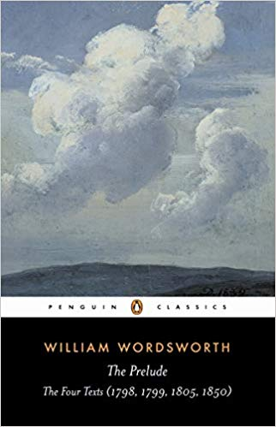
WORDSWORTH AND THE PRELUDE

Slide 14
Poetry and the romantic self
‘The poems are the living substance of this inquiry [into the self] […] The is indeed the starting point of such poetry, but it is also its goal, only to be known by being imaginatively grasped as it weaves the complex web of its own experience […] The poets are alert to the complexity of the experiencing self, they regard identity not as an evident fact but as an ultimate achievement, its realized possession both the motive and the reward for creative exertion’
Patricia Bell, The Central Self, p. 64

Slide 15
Was it for this
That one, the fairest of all rivers, loved
To blend his murmurs with my nurse’s song,
And from his alder shades and rocky falls,
And from his fords and shallows, sent a voice
That flowed along my dreams? For this didst thou
O Derwent, travelling over the green plains
Near my ‘sweet birthplace’, didst thou, beauteous stream,
Make ceaseless music through the night and day,
Which with its steady cadence tempering
Our human waywardness, composed my thoughts
To more than infant softness, giving me
Among the fretful dwellings of mankind,
A knowledge, a dim earnest, of the calm
Which Nature breathes among the hills and groves?
(The Prelude, Book 1, ll. 271-285)

Slide 16
Nature and self
‘[…] we had crossed the Alps.
Imagination!—lifting up itself
Before the eye and progress of my song
Like an unfathered vapour, here that power,
In all the might of its endowments, came
Athwart me.
(Prelude, Book 6, ll. 524-529)
A meditation rose in me that night
Upon the lonely mountain when the scene
Had passed away, and it appeared to me
The perfect image of a mighty mind’
(Prelude, Book 13, 66-69)

Slide 17
bibliography
Lillian Furst, Romanticism (1969)
Franklin Baumer, Modern European Thought: Continuity and Change (1977)
Lillian Furst, Romanticism in Perspective (1969)
Stephen Gill (ed), William Wordsworth: The Prelude. A Casebook (2006)
Laura Quinney, William Blake on Self and Soul (2009)

