Slide 1
Tocqueville: democracy in America
Dr Imogen Peck
University of Warwick

Slide 2
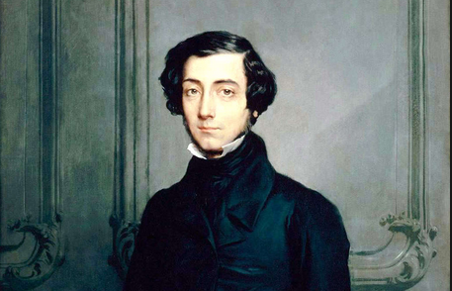
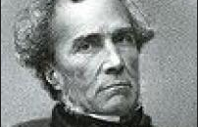
FRENCHMEN IN AMERICA
Gustave de Beaumont (1806-1866) Alexis de Tocqueville (1805-1859)
Travel together to America in April 1831, arrive in May, and then return to France at the end of February 1832.
Working on a book on penal reform, Systeme Penitentiare (1832).

Slide 3
DEMOCRACY IN AMERICA
Two volumes: 1835 and 1840.
Ostensibly about America – but actually about France?
America as the most pure case of democratic revolution – i.e. a transition from a land-based military nobility to a society of great diversity but without a dominant caste or class.
This change inevitable; but its outcome is not.

Slide 4
'democracy’ in democracy in America
Democracy as the ‘Spirit of the Age’
Used in 2 ways:
A society marked by equalisation of condition
A form of political rule in which the people are sovereign
How can you have a well-ordered society, if it is going to be one marked by this equalisation of condition? What political form are going to be suitable to democratic society, and are going to protect people’s individual liberty?

Slide 5
CLAIM i: General historical thesis of tendency to equalisation of condition
Structure dominated by a few families. The power of the clergy is founded and increases.
The clergy open their ranks to commoner and noble; so, equality moves into government.
Kings and nobles ruin themselves with war, while the lower orders enrich themselves with commerce.
'the value attached to high birth declined just as fast as new avenues to power were discovered'
Merchants and financiers take their place in government. Knowledge became an attribute of government

Slide 6
FEATURES OF EQUALISATION OF CONDITION
Fashion and consumption: inherently equalising.
Development of science and knowledge increases: ‘every addition to science, every fresh truth, and every new idea became a germ of power placed within the reach of the people...’.
Rise of literary culture: ‘Literature became an arsenal open to all, where the poor and the weak daily resorted to arms'.
Everything contributes to advance the people against their rulers.
This is an inescapable process a 'providential fact - all have been blind instruments in the hands of God.'

Slide 7
CLAIM ii: This process is not fully determined
Could end in despotism and tyranny a - ‘democracy abandoned to its wild instincts’, as it was in France during the terror.
Or it could end in a system in which liberty is preserved.

Slide 8
CLAIM III: REQUIRES A NEW SECIENCE OF POLITICS
One that…
…is going to study democracy in its fullest and most peaceful form (i.e. America)
…is not just about legal and constitutional solutions
Three major influences:
Geography and physical circumstances
Laws
Moeurs – ‘habits of the heart’, the moral and intellectual condition of the people

Slide 9
Tocqueville on freedom
Freedom is central:
i. For diversity
ii. For security and prosperity
iii. For virtue
'Freedom is in truth a sacred thing. There is only one thing else that better deserves the name: that is virtue. But then what else is virtue if not the free choice of what is good.’
Reciprocal character of freedom and virtue.

Slide 10
4 WAYS DEMOCRACY THREATENS FREEDOM
Tyranny of the Majority/of Opinion
The valuing of equality above liberty
The undermining of the conditions for sustaining a commitment to the public realm
The threat to freedom from centralized authority

Slide 11
Tyranny of the majority
‘The essence of democratic government in America is the absolute sovereignty of the majority. State constitutions have done little to further and much to enhance this (although not the Federal constitution). It is achieved by dominance of people over the legislature - through frequent elections. Government is subject to general convictions and the passions of the majority; representatives become delegates, their freedom of action restricted, so little room for virtue and judgment’.
‘The power of the majority is irresistible: numbers outweigh all other factors. The minority submit, acknowledging majority right’

Slide 12
Tyranny in America
'If an individual is wronged in the US, to whom can he apply for redress? If to public opinion, public opinion constitutes the majority; if to the legislative, it represents the majority and implicitly obeys it; if to the executive power, it is appointed by the majority and serves as a passive tool in its hands. The public force constitutes the majority under arms; the jury is the majority invested with the right of hearing criminal cases; and in certain states even the judges are elected by the majority. However iniquitous or absurd the measure of which you complain, you must submit to it as well you can’.
Vol 1, p. 271

Slide 13
CHECKS ON TYRANNY
'If a legislative power could be so constituted as to represent the majority without being a slave to its passions, an executive so as to retain a proper share of authority, and a judiciary so as to remain independent of the other two powers, a government would be formed which would still be democratic while incurring scarcely any risk of tyranny.’
(Vol I, p. 272)

Slide 14
IMPACT OF TRYANNY ON OPINION
'the majority possesses a power which is physical and moral at the same time, which acts upon the will as much as upon the actions and represses not only all contest, but all controversy. I know of no country in which there is so little independence of mind and real freedom of discussion as in America’.
Vol I, p. 273
‘In the American republics, where the majority is so absolute and irresistible, one must give up one's rights as a citizen and almost abjure one's qualities as a man if one intends to stray from the track it prescribes’.

Slide 15
Equality vs. freedom
Equality has a tendency to undermine freedom
'The passion for equality may elevate the humble to the rank of the great - but there exists also in the human heart a depraved taste for equality, which impels the weak to attempt to lower the powerful to their own level and reduces men to prefer equality in slavery to inequality with freedom’.
Need an elite to inspire respect and can act as a restraint – the judiciary and law.
His concern is with the way in which France unleashed a series of forces in the revolution that its institutions could not control – that the levelling spirit means that people will brook no authority – and in that process, it will degenerate into anarchy that produces and necessitates, despotism – cf Napoleon.
Example of Tocqueville’s political sociology

Slide 16
Democracy and individualism
Tendency for democracy to undermine the conditions for commitment to the public realm.
Democratic societies, by their obsession with equality, and associated obsession with material wealth, result in individualism, viz:
i. faith in individual reason as the sole basis of opinion and belief and (relatedly)
ii. self-centred, self-interested concentration on personal ends.
‘Individualism is a mature and calm feeling, which disposes each member of the community to sever himself from the mass of his fellows and to draw apart with his family and friends, so that after he has thus formed a little circle of his own, he willingly leaves society at large to itself. […] Selfishness blights the germ of all virtue; individualism at first only saps the virtues of public life; but in the long run it attacks and destroys all others and is at length absorbed into downright selfishness.’

Slide 17
The effects of individualism
‘The will of man is not shattered, but softened, bent and guided; men are seldom forced to act, but they are constantly retrained from acting. Such a power does not destroy, but it prevents existence; it does not tyrannize, but it compresses, enervates, extinguishes, and stupefies a people, till each nation is reduced to nothing better than a flock of timid and industrious animals, of which the government is the shepherd.’

Slide 18
Threat of centralisation
Individualism means centralised government will become more and more powerful, as we surrender more and more responsibility to government.
Which we think serves our interests – but in fact, it means that we collapse back into this private world.
'Private life in democratic times is so busy, so excited, so full of wishes and of work, that hardly any energy or leisure remains to each individual for public life’.

Slide 19
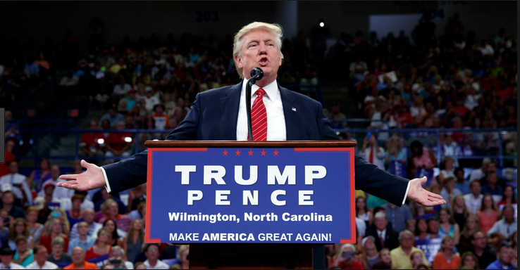

Slide 20
RESTRAINTS ONTYRANNY OF THE MAJORITY
‘Crucially religion, where a diversity of sects is combined with a universality of moral law; Christianity reigns without obstacle, by universal consent; the consequence is that every principle of the moral world is fixed and determinate, although the political world is abandoned to the debates and experiments of men...while the law permits the Americans to do what they please, religion prevents them from conceiving, and forbids them to commit, what is rash and unjust’.
Separation of government from administration; local involvement as a breakwater against central power.
Respect for legal profession
Role of judges in American society
Natural environment; laws, customs, manners and moeurs ('the whole moral and intellectual condition of a people').
Religion

Slide 21
America vs france
good manners and customs;
strong religion;
independent judiciary;
multiple secondary associations and intermediary associations;
separation of powers.
In such a state freedom, and thus virtue, can be resiliently secured.

