Slide 1
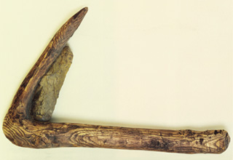
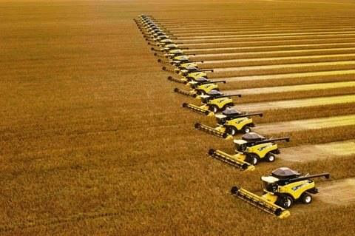
A Brief History of Agriculture
Neolithic wood and flint sickle
Combine harvesters

Slide 2
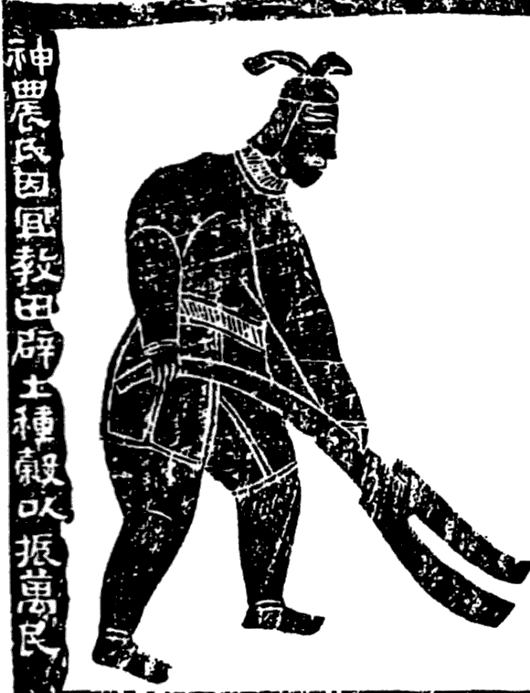
Shennong, Emperor of the Five Grains* *wheat, rice, millet, soybean, sorghum
Shennong Ploughing
Han Dynasty (202 BCE–220 AD)
Gan Bozong, Woodcut of Shennong
Tang dynasty (618-907)

Slide 3
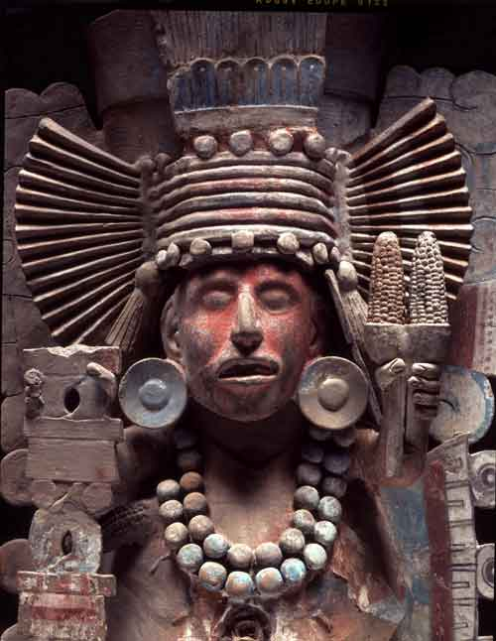
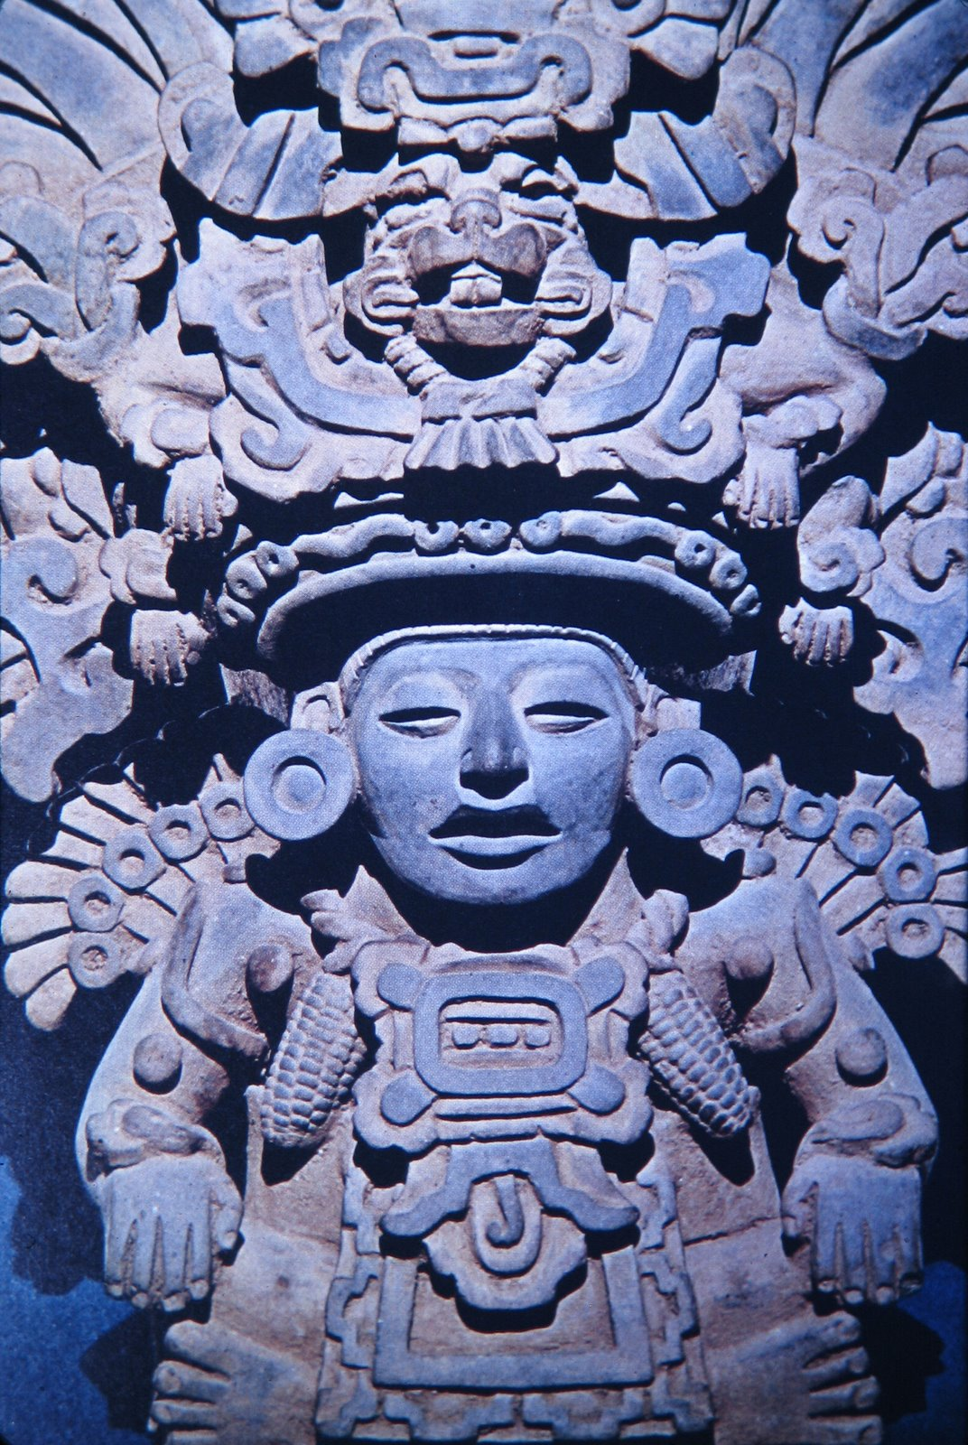
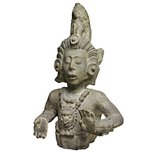
Meso-American Maize Deities
Xilonen
(Aztec maize goddess)
Maya Maize God, Copán, circa 700
Zapotec maize god

Slide 4
Main Points
The global nature of agriculture’s emergence in prehistoric times: agriculture emerged independently in a number of different parts of the world.
Some of the important developments in the history of agriculture, which occurred in ancient times, in the early modern era, and in the 19th and the 20th centuries.

Slide 5
The Emergence of Agriculture in Ancient Times

Slide 6
For agriculture you need to. . .
Select seeds
Manage the supply of water
renew the soil’s fertility
Protect the crop from pests
Apply some source of power

Slide 7
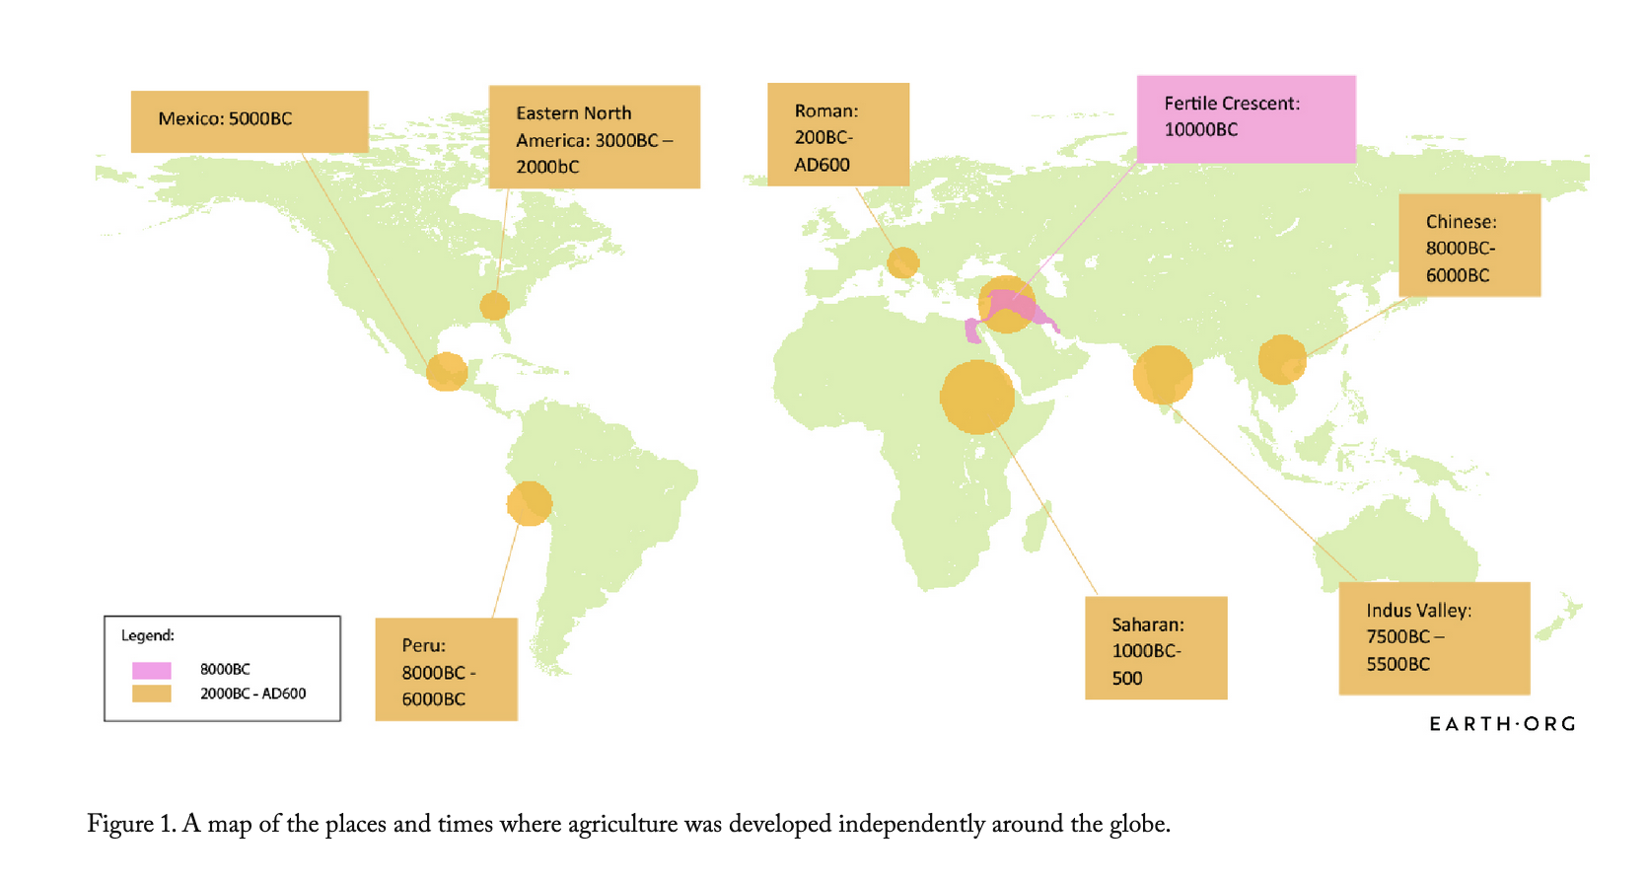
Early agriculture

Slide 8
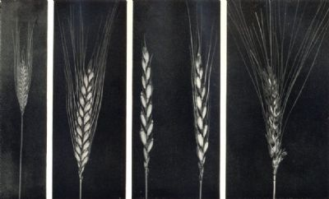
Various varieties of wheat: small spelt, einkorn, emmer, common spelt

Slide 9
Early agriculture

Slide 10
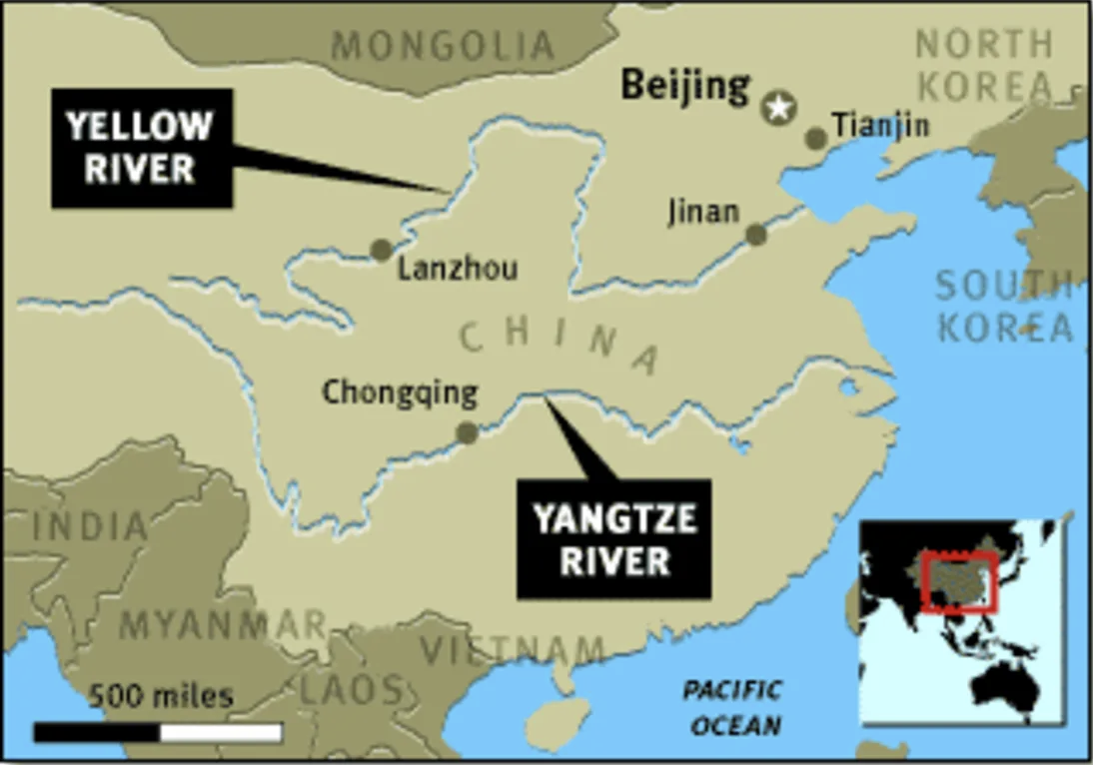
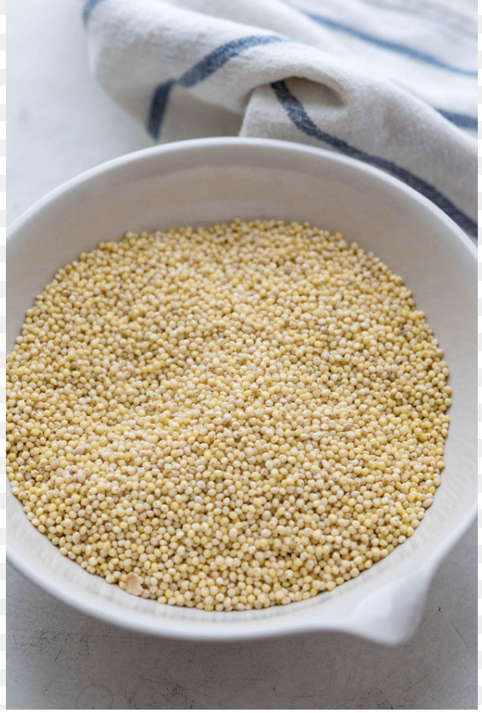
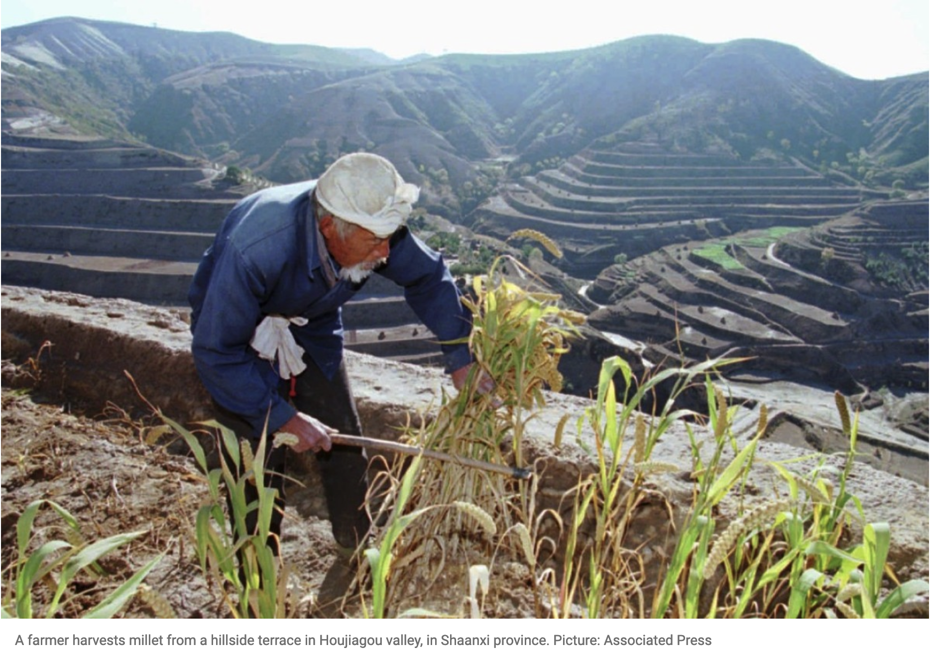
Yellow River (China)
millet

Slide 11
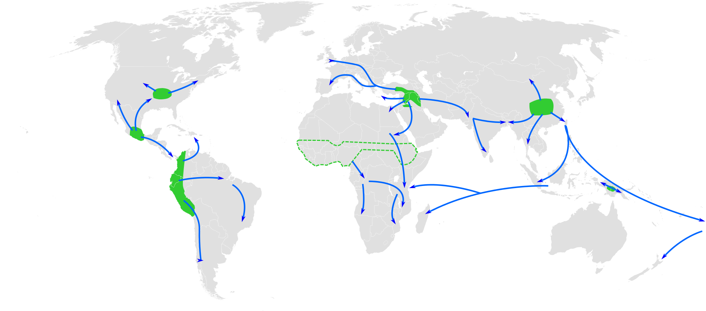
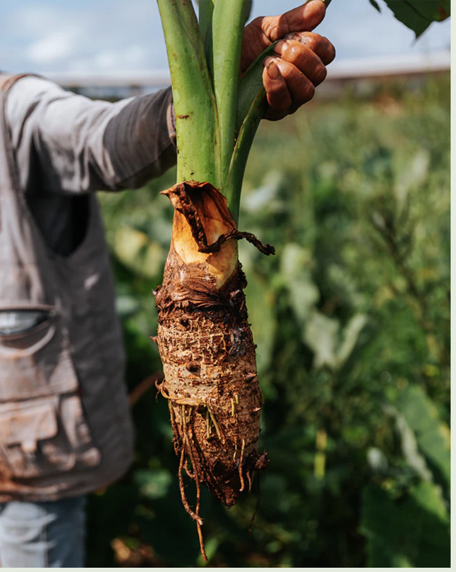
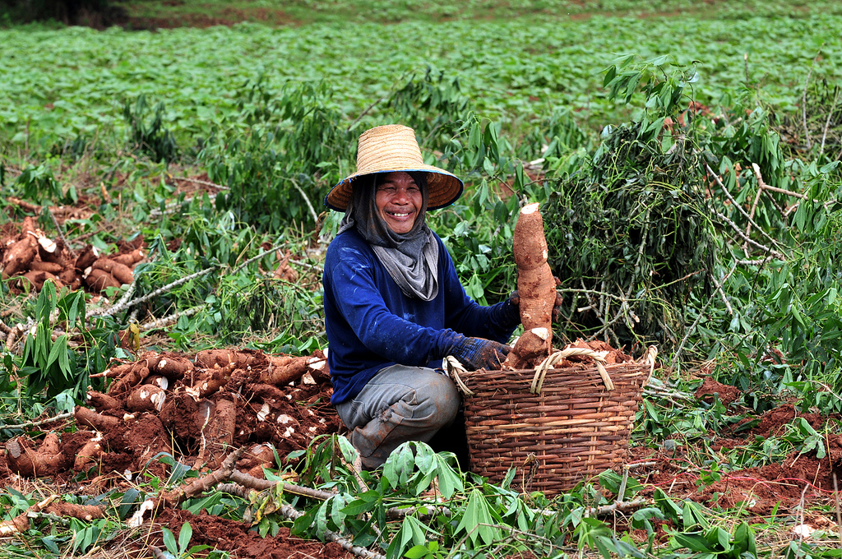
taro
Thai farmer with cassava (aka manioc)

Slide 12
Key crops
(domesticated by around 0 CE)
Wheat
Barley
Rice
Millet
Maize
Potato

Slide 13
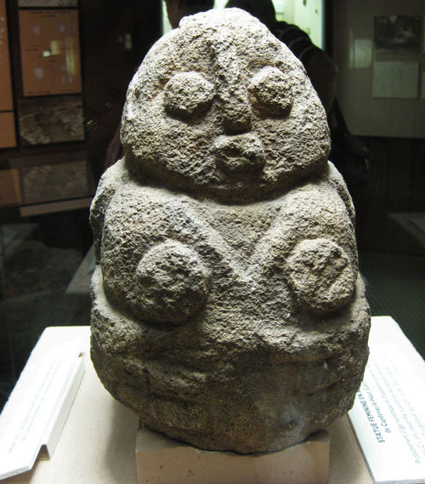
Important Themes in Early Agriculture
Labour and Social Structures
Role of women
Use of coerced/unfree labour
Emergence of states (and also greater inequality?)
Technologies
Consider the plough. . .
Irrigation
Fallowing/use of manure as fertiliser
Pech-Merle Cave (France) Neolithic Mother-Goddess

Slide 14
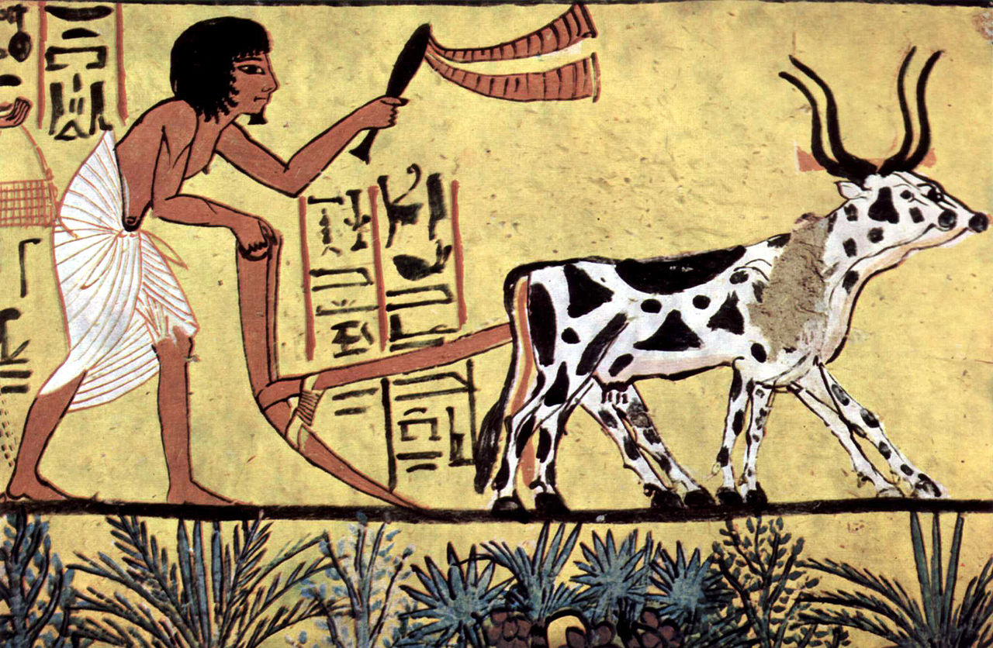
An Ard Plough

Slide 15
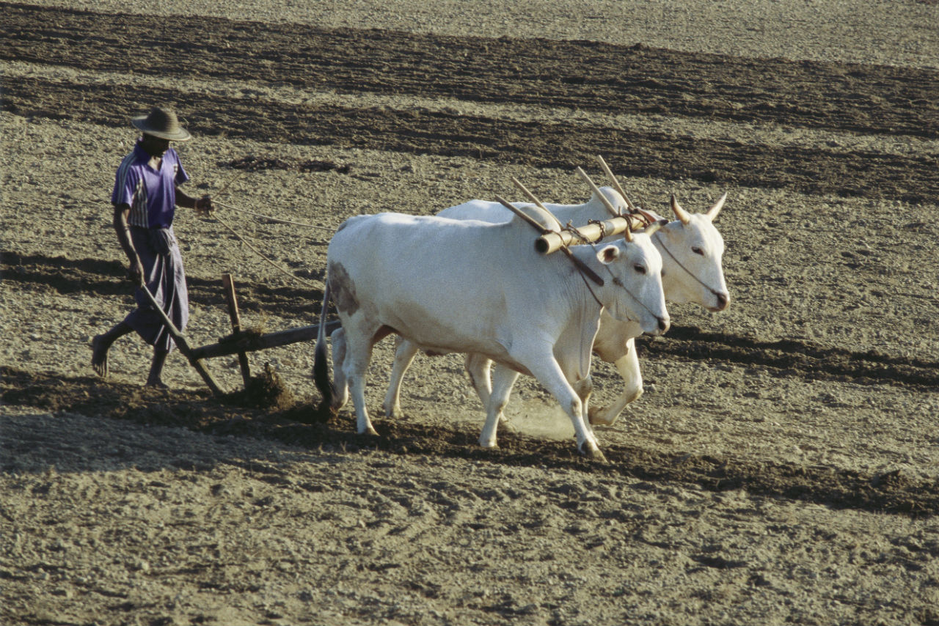
An Ard Plough in Action

Slide 16
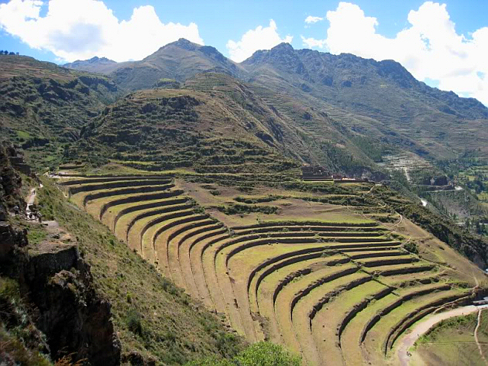
Inca terraces near Písac (Peru), 15th century

Slide 17
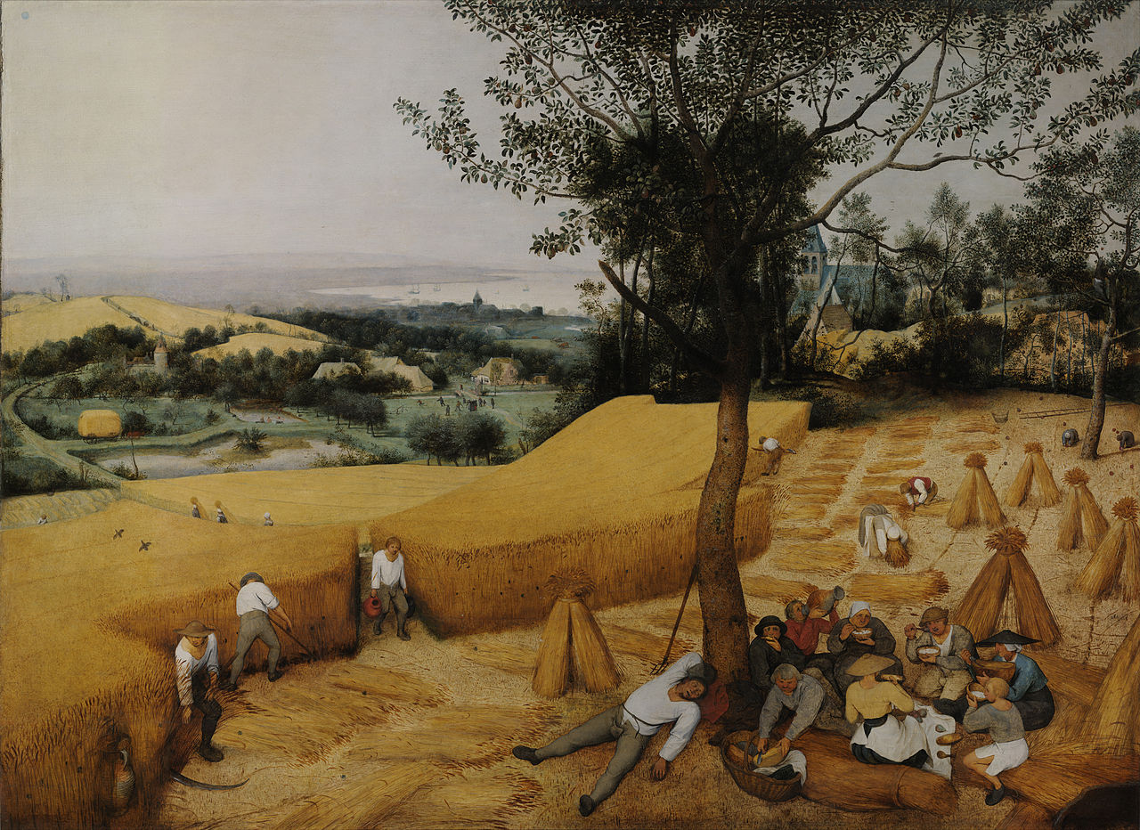
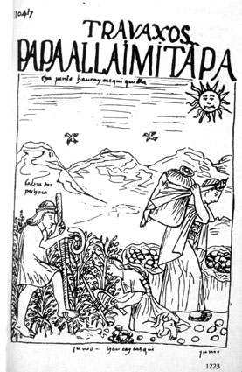
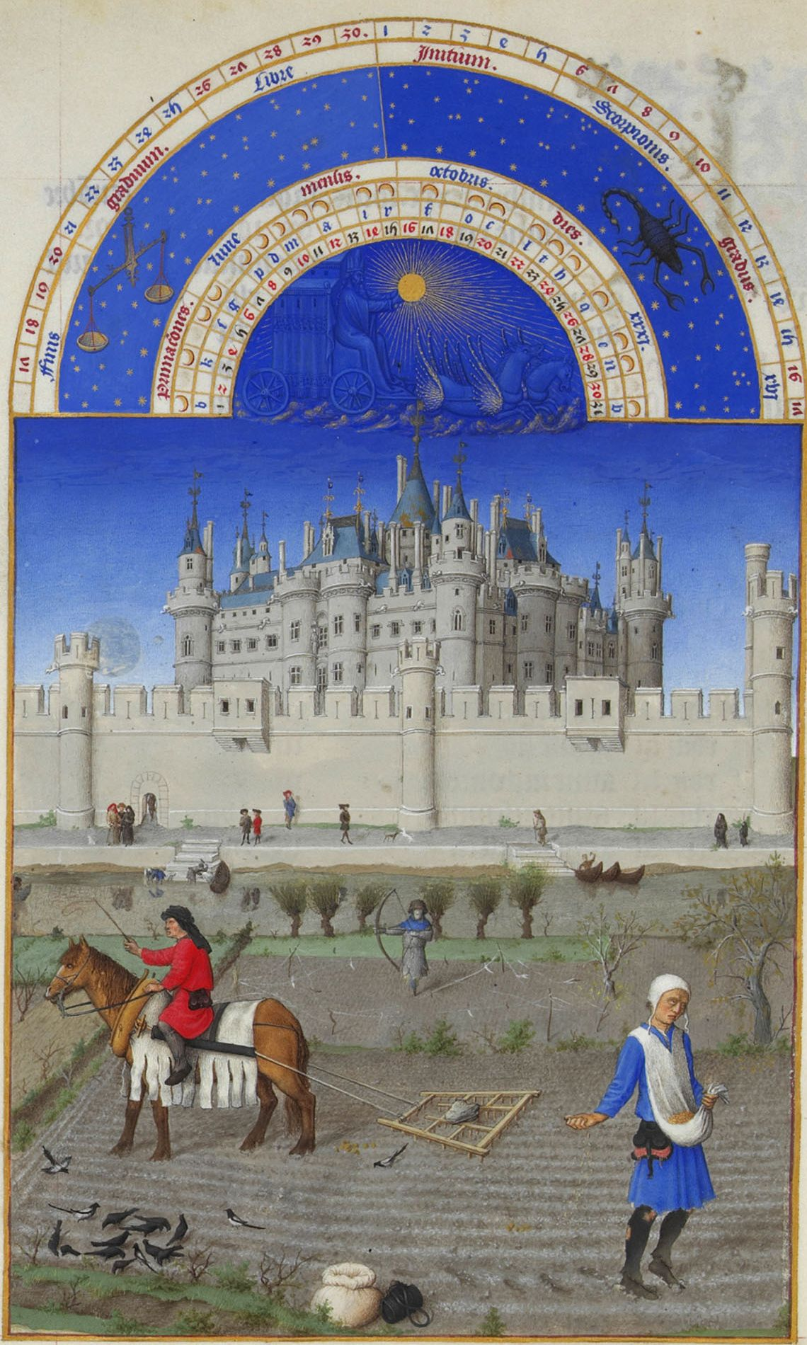
Continuities. . .
Pieter Breugel the Elder, The Harvesters, 1565--Europe
‘October’, Les très riches heures du Duc du Berry (c. 1416)—Europe
Felipe de Guamon Poma de Ayala, Nueva corónica y buen gobierno (c. 1615)--Peru

Slide 18
Early Modern Developments 16th-18th centuries

Slide 19
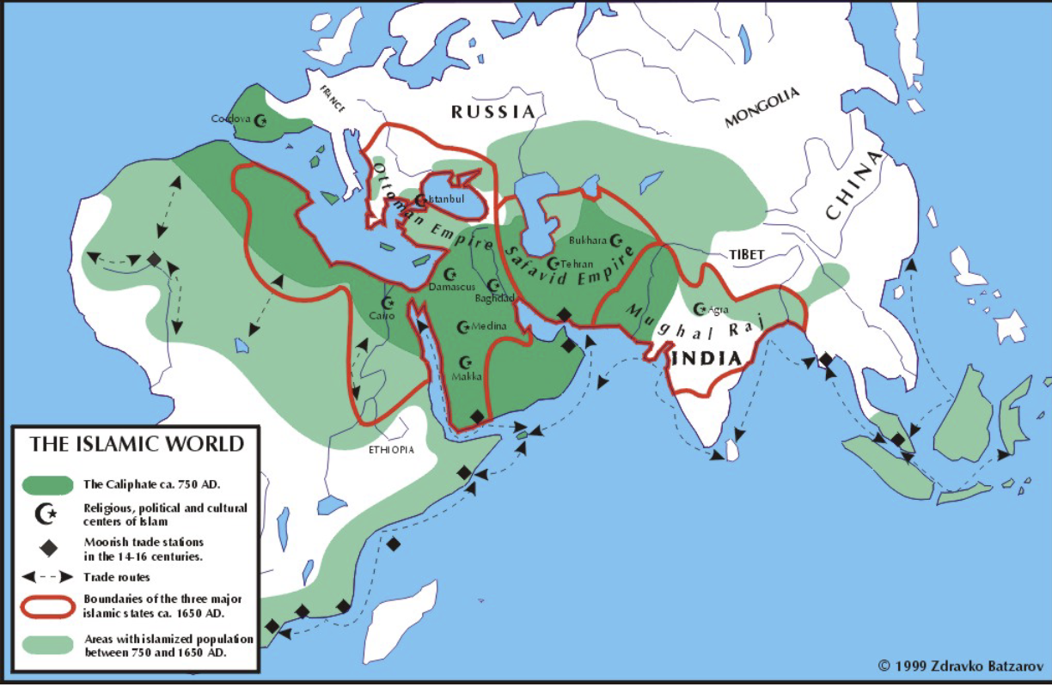
New Agricultural Developments Spread Through the Islamic World

Slide 20
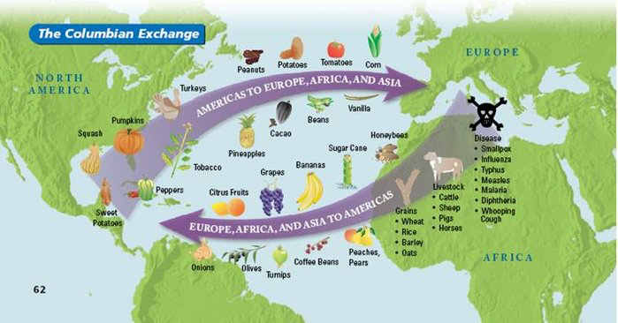
Columbian Exchange

Slide 21
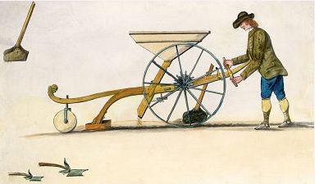
Jethro Tull’s Seed drill
Early-modern European ‘Agricultural Revolution’
new technologies
Mouldboard plough
Three-field system
Horse collar and horse shoes
Enclosures and drainage of wetlands
Soil-enriching crops (clover, turnips, etc.)
‘The humble turnip may have been as important as the steam engine in fuelling the industrial revolution’ (McMahon, Feeding Frenzy).

Slide 22
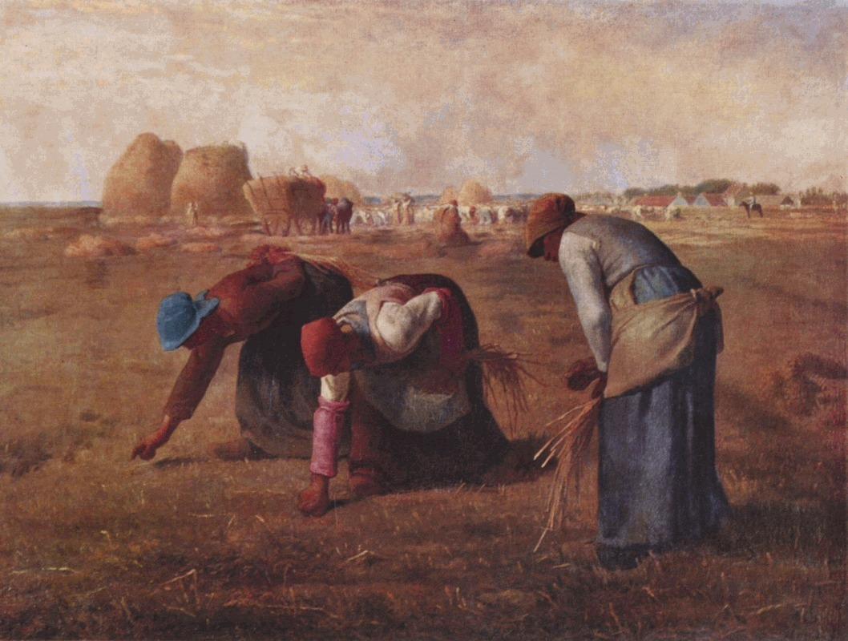
Jean-François Millet, The Gleaners, 1857
Continuities . . .

Slide 23
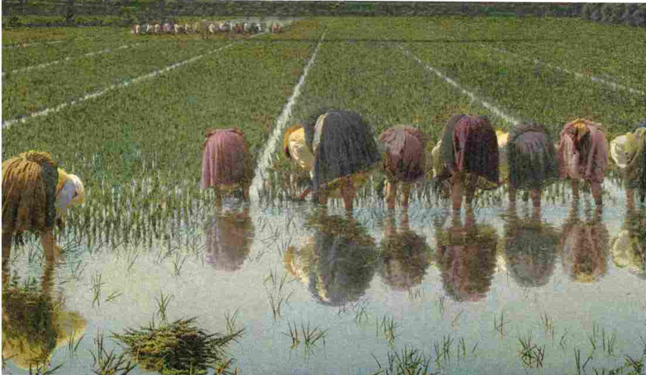
Angelo Morbelli, For Eighty Cents! (1893).

Slide 24
The Emergence of Industrial Agriculture 19th-20th centuries

Slide 25
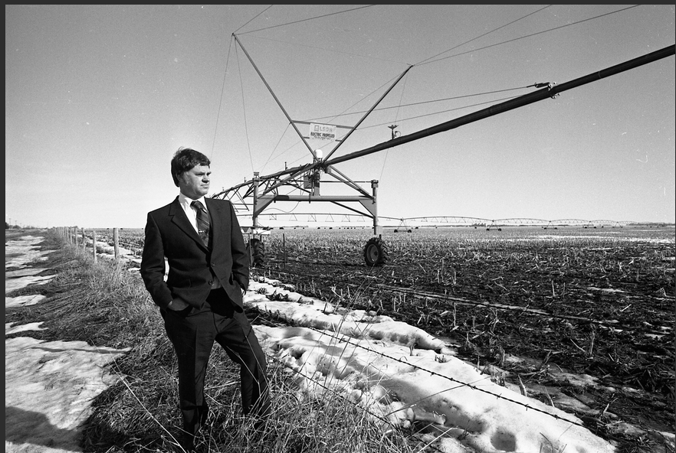
19^{th-} and 20th-century Technological Developments
Tractors
mechanized irrigation
Centre pivot sprinkler system, invented 1940

Slide 26
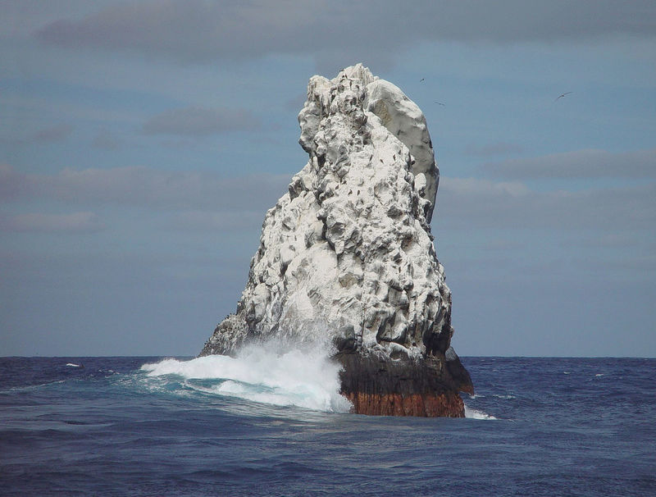
Increasing Production: Fertilisers
guano (19C)

Slide 27
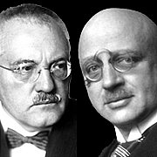
Increasing Production: fertilisers
Fritz Haber and Carl Bosch
Artificial nitrogen fertilisers (20C)

Slide 28
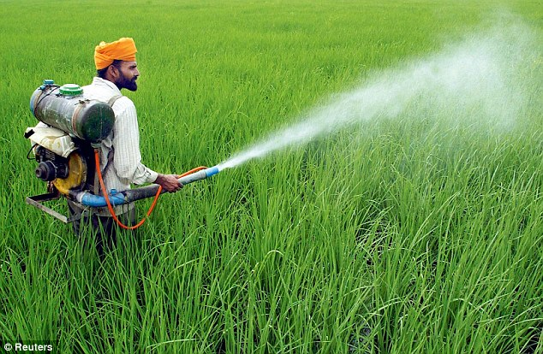
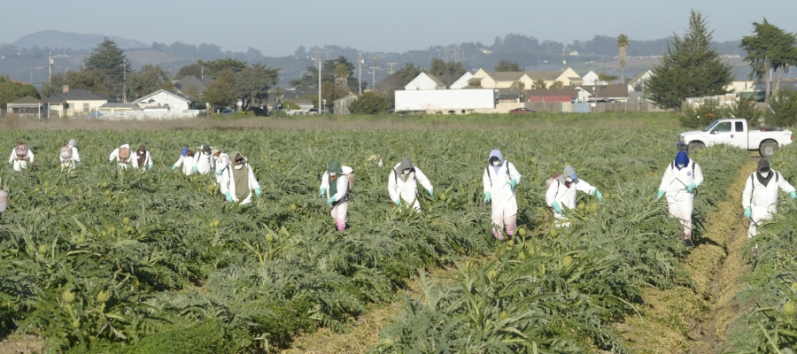
Increasing Production: pesticides
Artichoke growers in California spraying pesticides

Slide 29
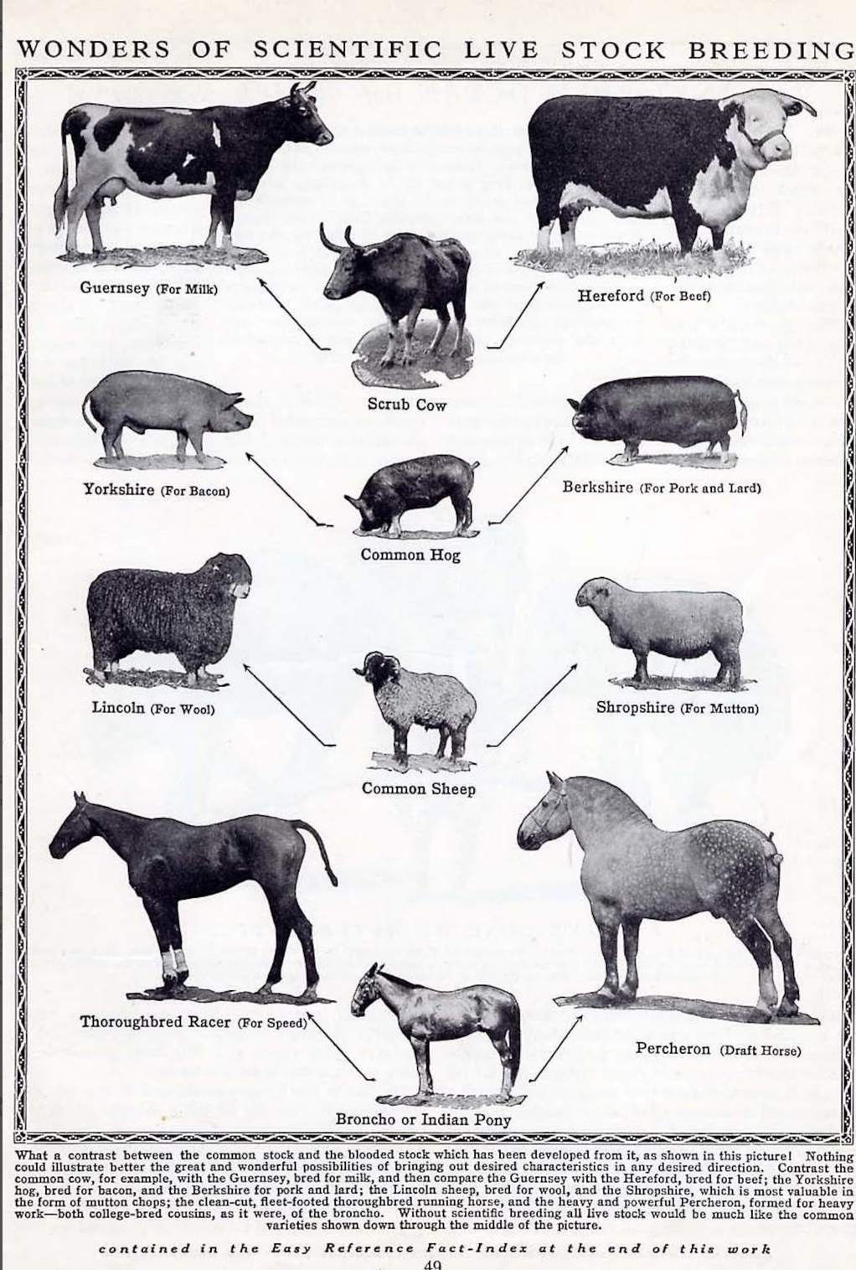
Daily Milk production (per cow)
Increasing Production: Selective Breeding
1900 2,000 litres
2010 10,000 litres

Slide 30
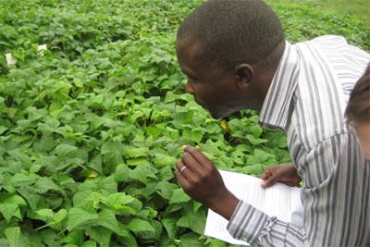
Dr. Charles Wasonga evaluates the performance of green beans grown at lower altitudes at the International Centre of Insect Physiology and Ecology in Mbita Point, Kenya.
Increasing Production: hybrid seeds

Slide 31
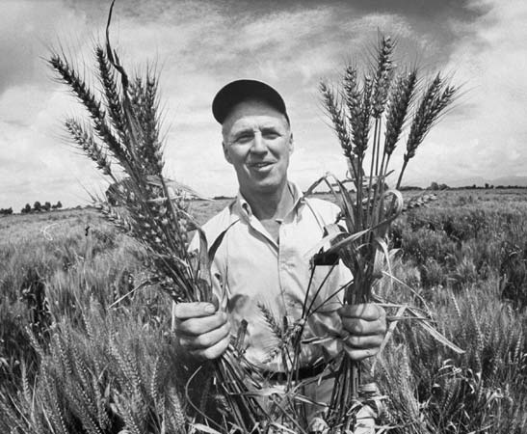
Norman Borlaug and the Green Revolution
Increasing Production: hybrid seeds

Slide 32
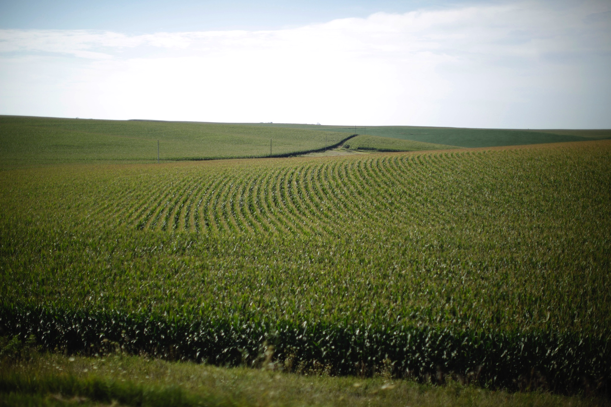
Modern Industrial Agriculture Requires. . .
Hybrid seeds
Chemical fertilisers
Pesticides
Fossil fuel
Ample water
Corn field in Iowa

Slide 33
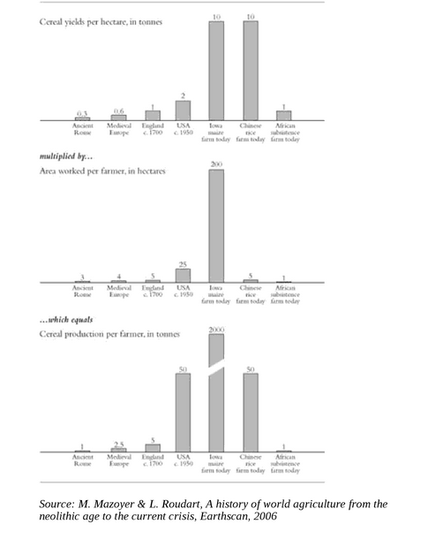
Modern industrial vs. traditional agricultural: yields per worker
2000 tonnes of grain per worker per year
vs.
1 tonne of grain per worker per year

Slide 34
Marcel Mazoyer and Laurence Roudart, A History of World Agriculture: from the Neolithic Age to the Present (2014).
In 2014 there were:
28 million tractors—2% of farmers own
250 million draught animals—19% of farmers own

Slide 35
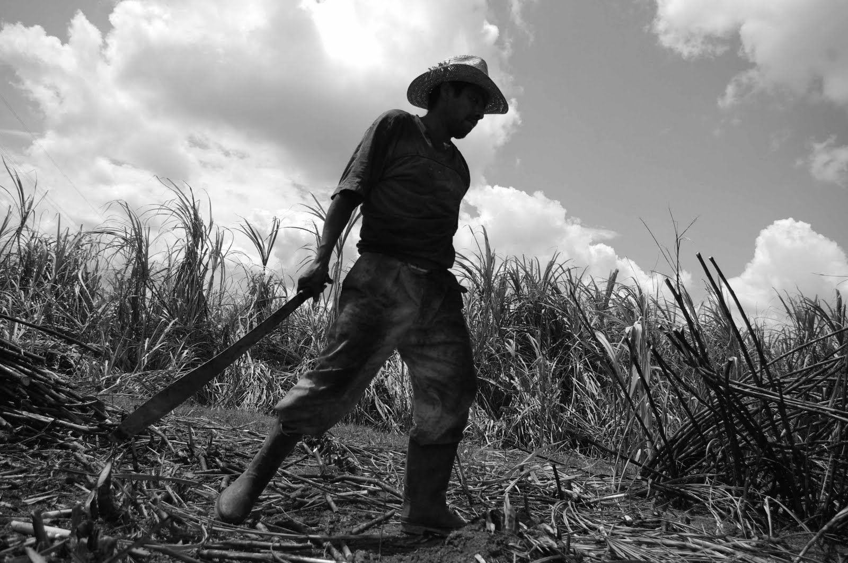

Slide 36
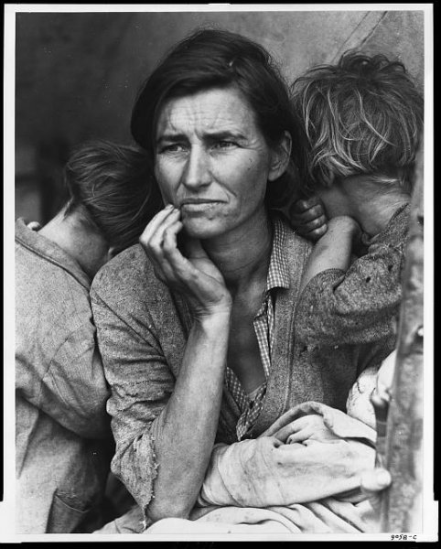
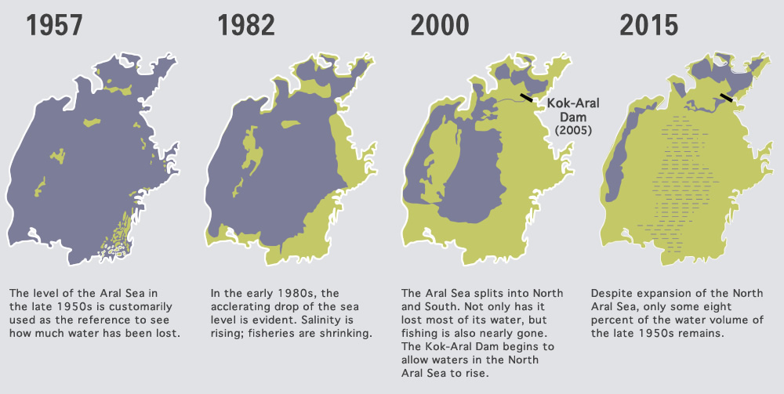
Dorothea Lange, Migrant Mother, Nipomo, California, 1936
Beinart and Lotte Hughes, Environment and Empire (2007).
‘Intensification of production . . . been fundamentally linked to global population growth, enhanced overall food security, and in some cases improved standards of living.’
The desertification of the Aral Sea

Slide 37
Main Points
The global nature of agriculture’s emergence in prehistoric times: agriculture emerged independently in a number of different parts of the world.
Important developments in the history of agriculture occurred in ancient times, in the early modern era, and in the 19th and the 20th centuries.

