Slide 1
Cooking at Home: Kitchen Technologies

Slide 2
Histories of Technology & Object Biographies
What can we learn from studying a specific object’s history?
What kinds of history does this approach enable?

Slide 3
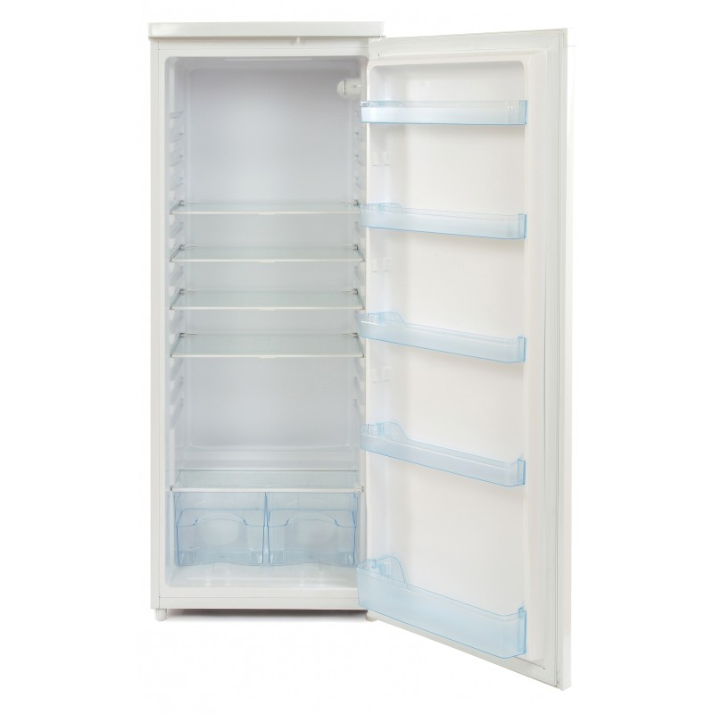
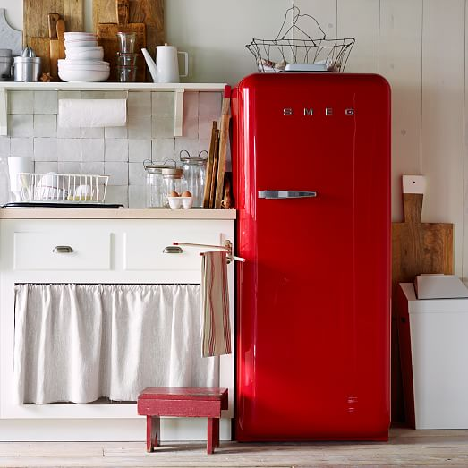
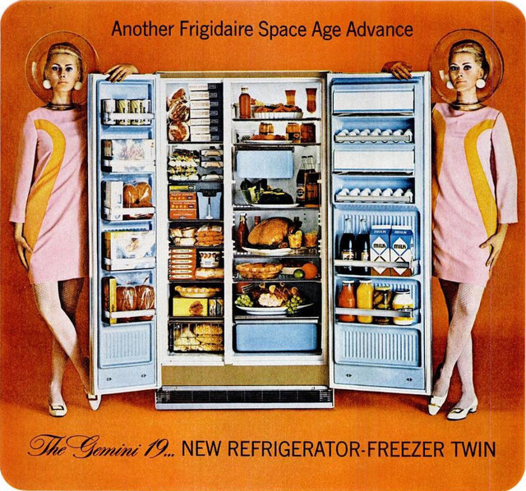
The refrigerator

Slide 4
Susanne Friedberg, Fresh. A Perishable History (2010).
‘In practice, refrigeration undermined not just farmers’ and merchants’ local markets but also traditional understandings of how food quality related to time, season, and place. It threw into question the known physics of freshness. Refrigeration’s conserving powers, in other words, threatened radical changes all across the food chain.’

Slide 5
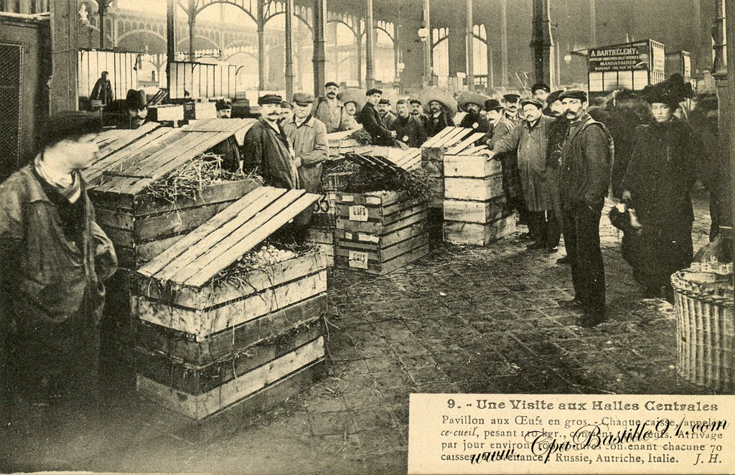
The ‘moral economy’ of the cold chain
Omer Décugis and his frigo at Les Halles (Paris)
Refrigeration was controversial ‘because of how fundamentally it challenged the everyday power relations and knowledge that governed commerce in perishable food’.
Susanne Freidberg, ‘Moral Economies and the Cold Chain’, Historical Research 88:239 (2015).
‘frigoriphobie’
Les Halles—the old Parisian food market

Slide 6
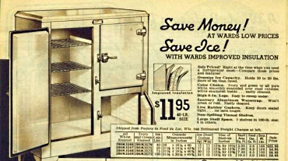
A modern device: the icebox

Slide 7
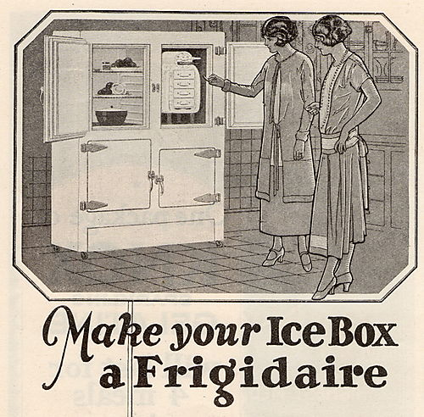

Slide 8
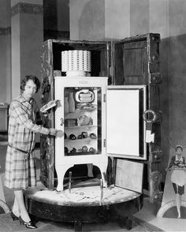
The domestic refrigerator
Developed 1890s-1910
Early models:
Kelvinator (1916)
Frigidaire (1916)
General Electric Monitor Top (1927)

Slide 9
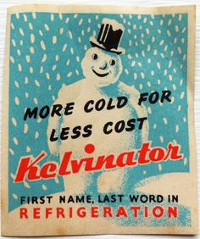
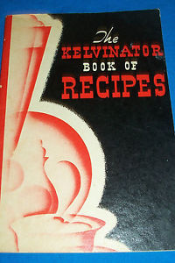
The Kelvinator

Slide 10
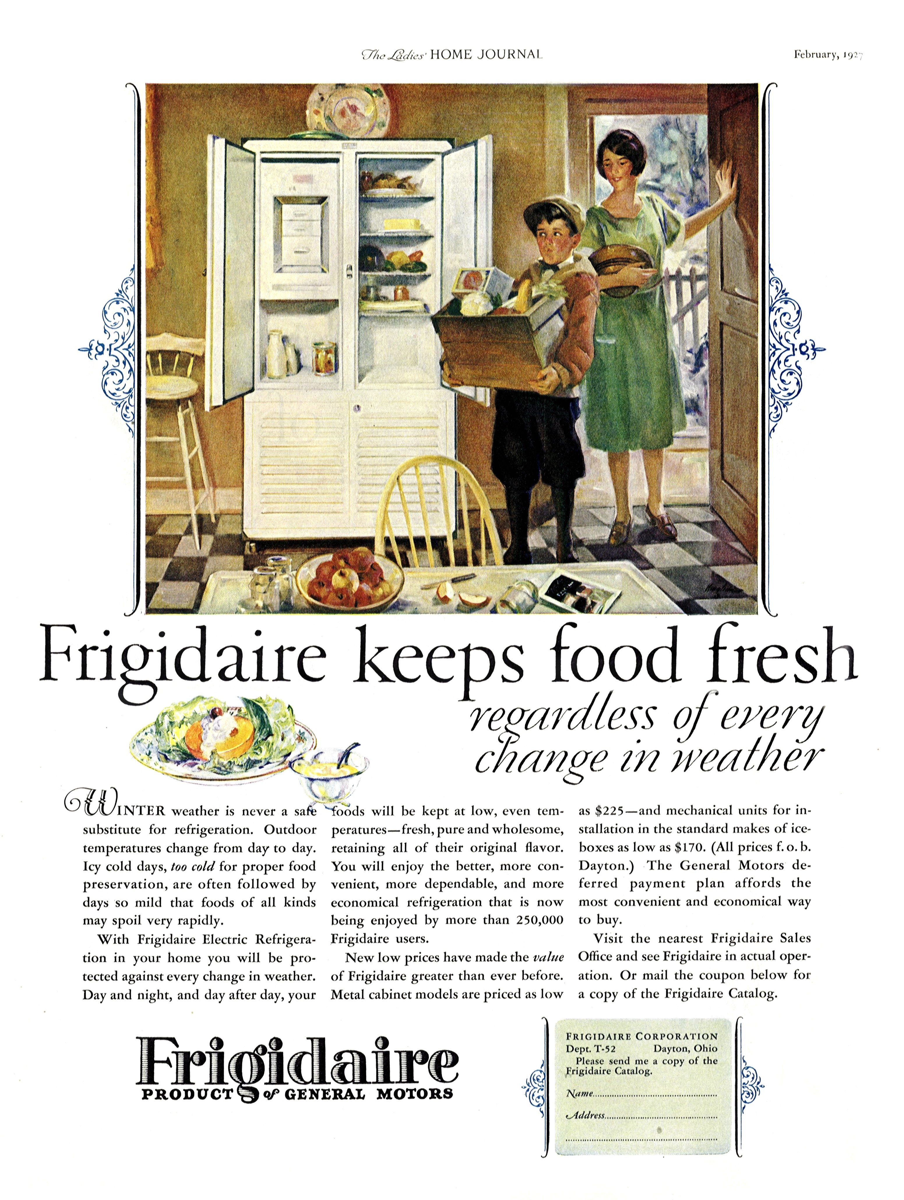
1927 Frigidaire advert

Slide 11
The refrigerator triumphs
By the 1950s, ‘rising affluence, suburbanization, the teaching of ‘scientific housekeeping,’ and the marketing of kitchen appliances as labor-saving status symbols all helped to ensure that the United States remained the world’s most thoroughly ‘refrigerated society’.
Friedberg, Fresh.

Slide 12
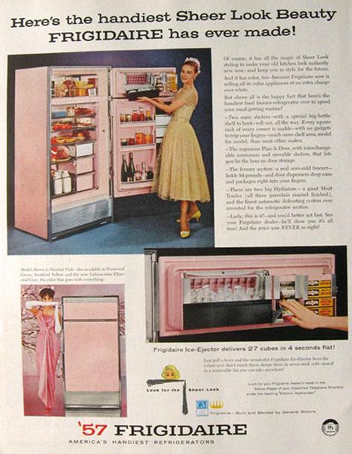
1957 frigidaire advert

Slide 13
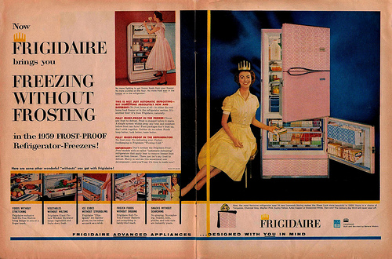
1959 frigidaire advert

Slide 14
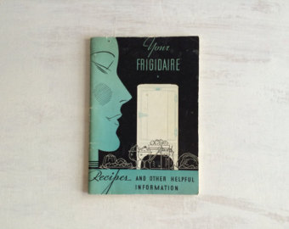
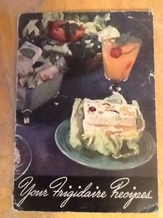
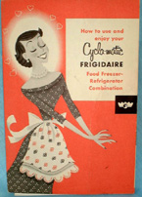

Slide 15
The loss of seasonality
‘Refrigeration wipes out seasons and distances. Duluth serves California or Florida orange juice for breakfast, Buffalo school children munch bananas from South America, Chicago dines on roast Long Island duckling. We grow perishable products in the regions best suited to them instead of being forced to stick close to the large markets.’
Ladies Home Journal (1929)
In 1941 American Cookery Magazine changed its column on ‘seasonable and tested recipes’ to ‘tested recipes of the month’.

Slide 16
Changing concepts of freshness
‘Consumers stopped expecting fresh food to be just-picked or just-caught or just-killed. Instead, they expected to find and keep it in the refrigerator.’
Friedberg, Fresh.

Slide 17
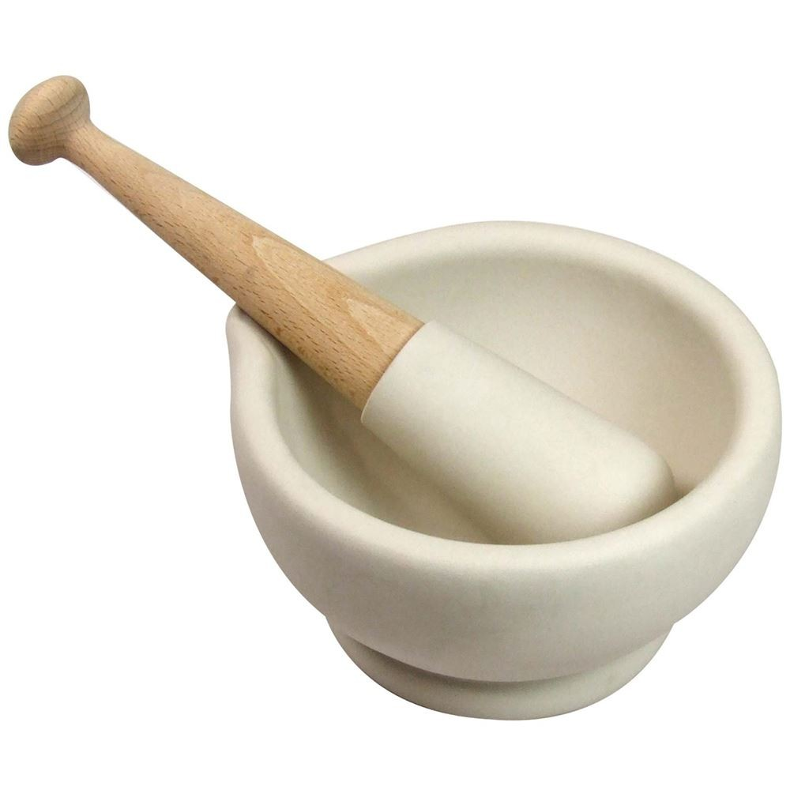
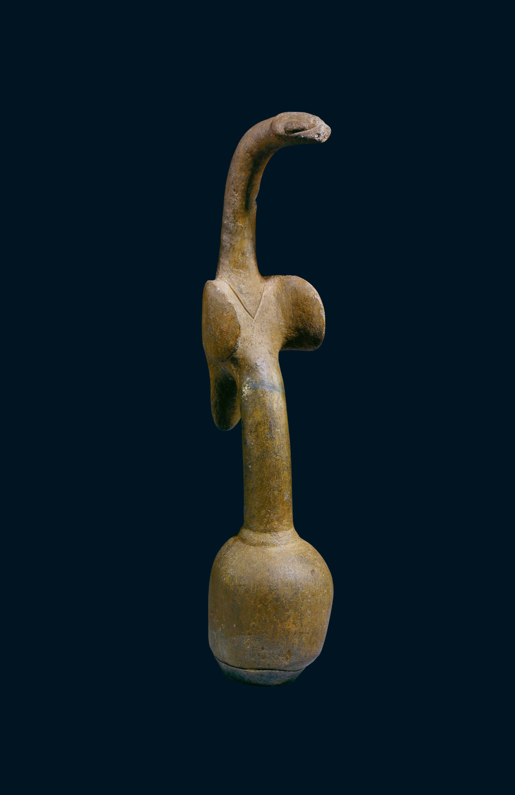
Mortar and pestle
Bird-shaped Pestle
6000–2000 BC
Papua New Guinea

Slide 18
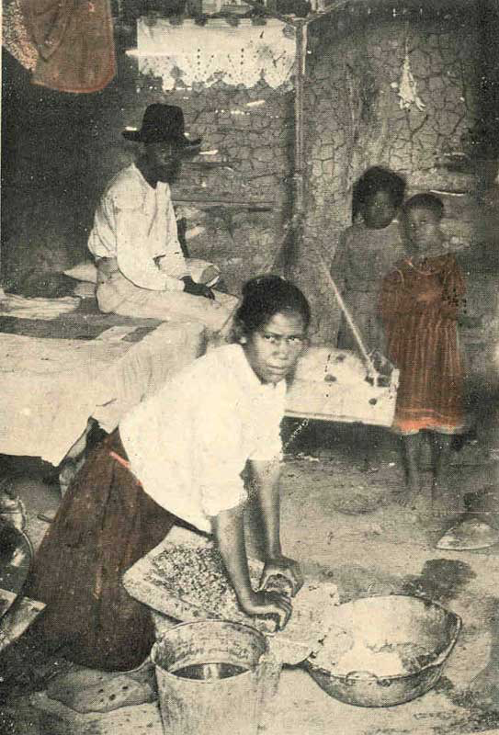
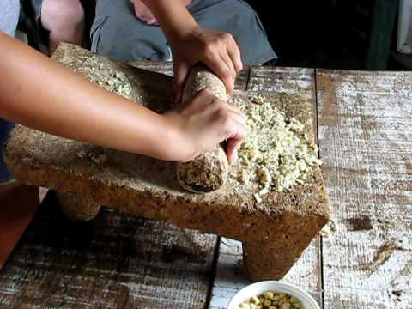
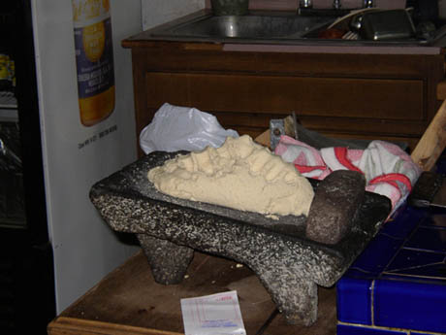
Metate and mano

Slide 19
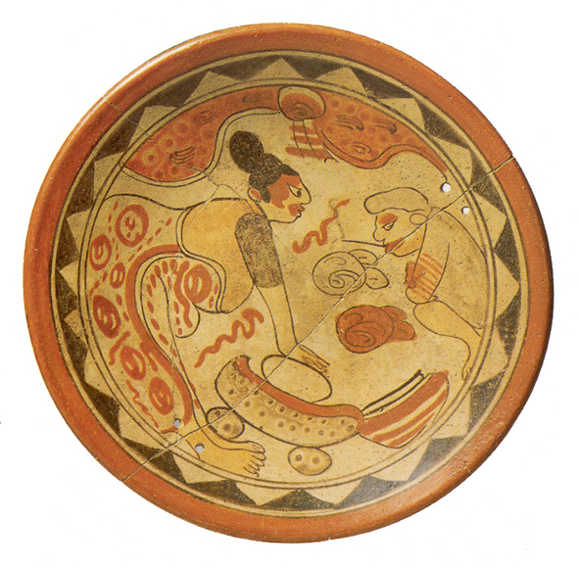
Maya bowl, circa 600-900 AD

Slide 20
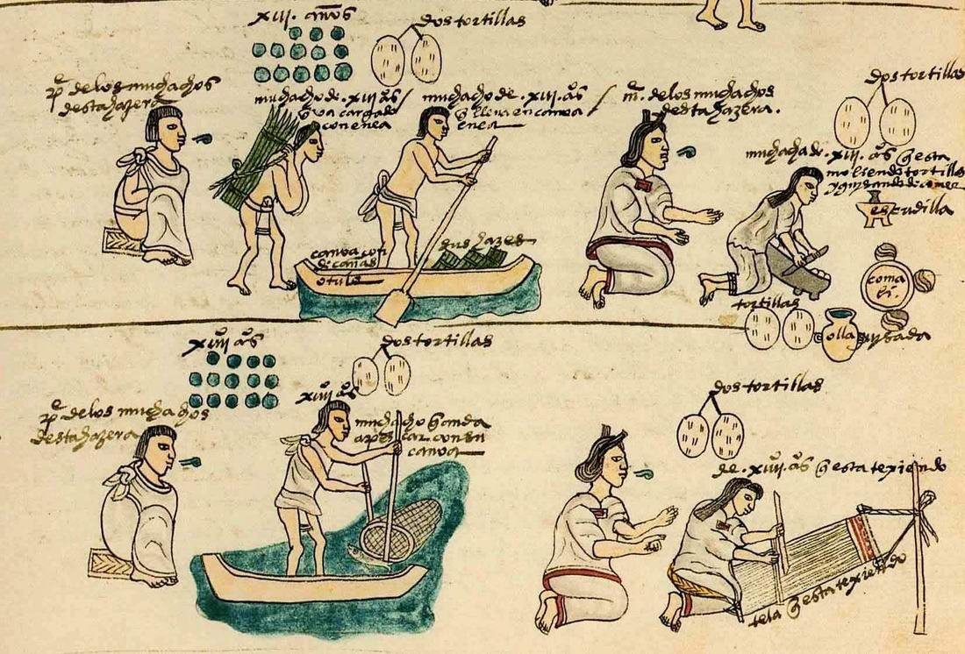
Codex Mendoza, circa 1540

Slide 21
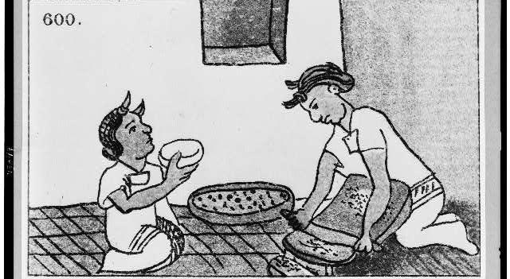
Florentine Codex, circa 1570

Slide 22
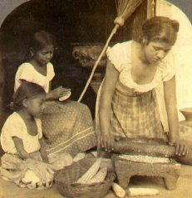
Meso-American women spent 35-40 hours per week making tortillas.
European women spent 3-4 hours per week preparing bread.
Women in China spent about 2 hours a day preparing rice.

Slide 23
Thomas Brocklehurst, Mexico Today: A Country with a Great Future (1883).
‘The labour of making tortillas is enormous, in a poor man’s house the wife is occupied most of the day. . . in the sole purpose of making the tortillas for the family. . . until the Mexican turn from tortillas to grinding their corn (i.e. wheat) and making bread, the drudgery of manufacturing tortillas will prevent their women from rising in the social scale and keep them in their present overworked and degraded condition.’

Slide 24
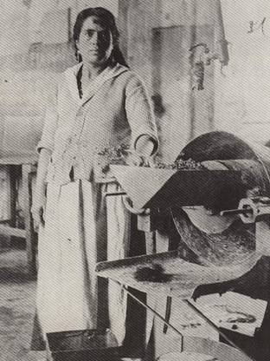
An early mechanised maize mill (molino de nixtamal)

Slide 25
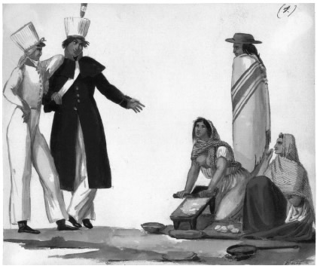
women making tortillas Claudio Linati, Trajes civiles, militares y religiosos de México (1828)

Slide 26
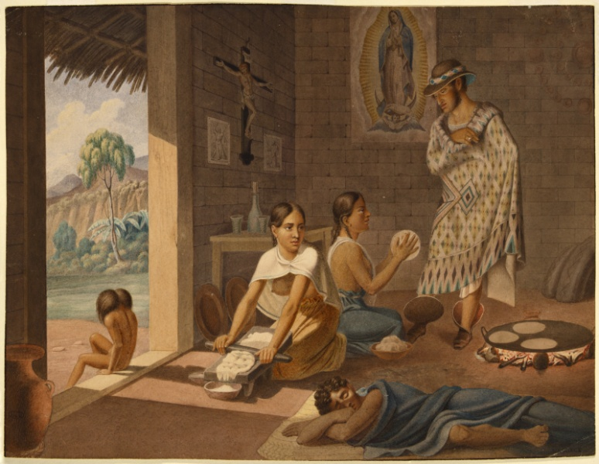
Jean-Frédéric Waldeck, Mexican Women Making Tortillas, c. 1834

Slide 27
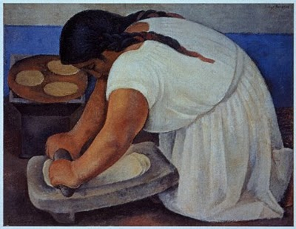
Diego Rivera

Slide 28
The reception of molinos de nixtamal
‘Husbands assert that the flavor of tortillas made of mill-ground nixtamal is very inferior; and . . . to bring her maize regularly to the mill to the neglect of her metate lowers a woman in her neighbor’s eyes.’
Women who do not grind their own maize suffer from ‘laziness of the knees’.
Robert Redfield, Tepoztlan: A Mexican Village. A Study of Folk Life (1930)

Slide 29
Kitchen technology and social class
‘Eating hand-made tortillas became a status marker for affluent sectors of the population while affording the mill meant an economic improvement for peasant families.’
Sandra Aguilar-Rodríguez, ‘Cooking Modernity: Food, Gender and Class in 1940s and 1950s Mexico City and Guanajuato’, D.Phil thesis, University of Manchester 2008.

Slide 30
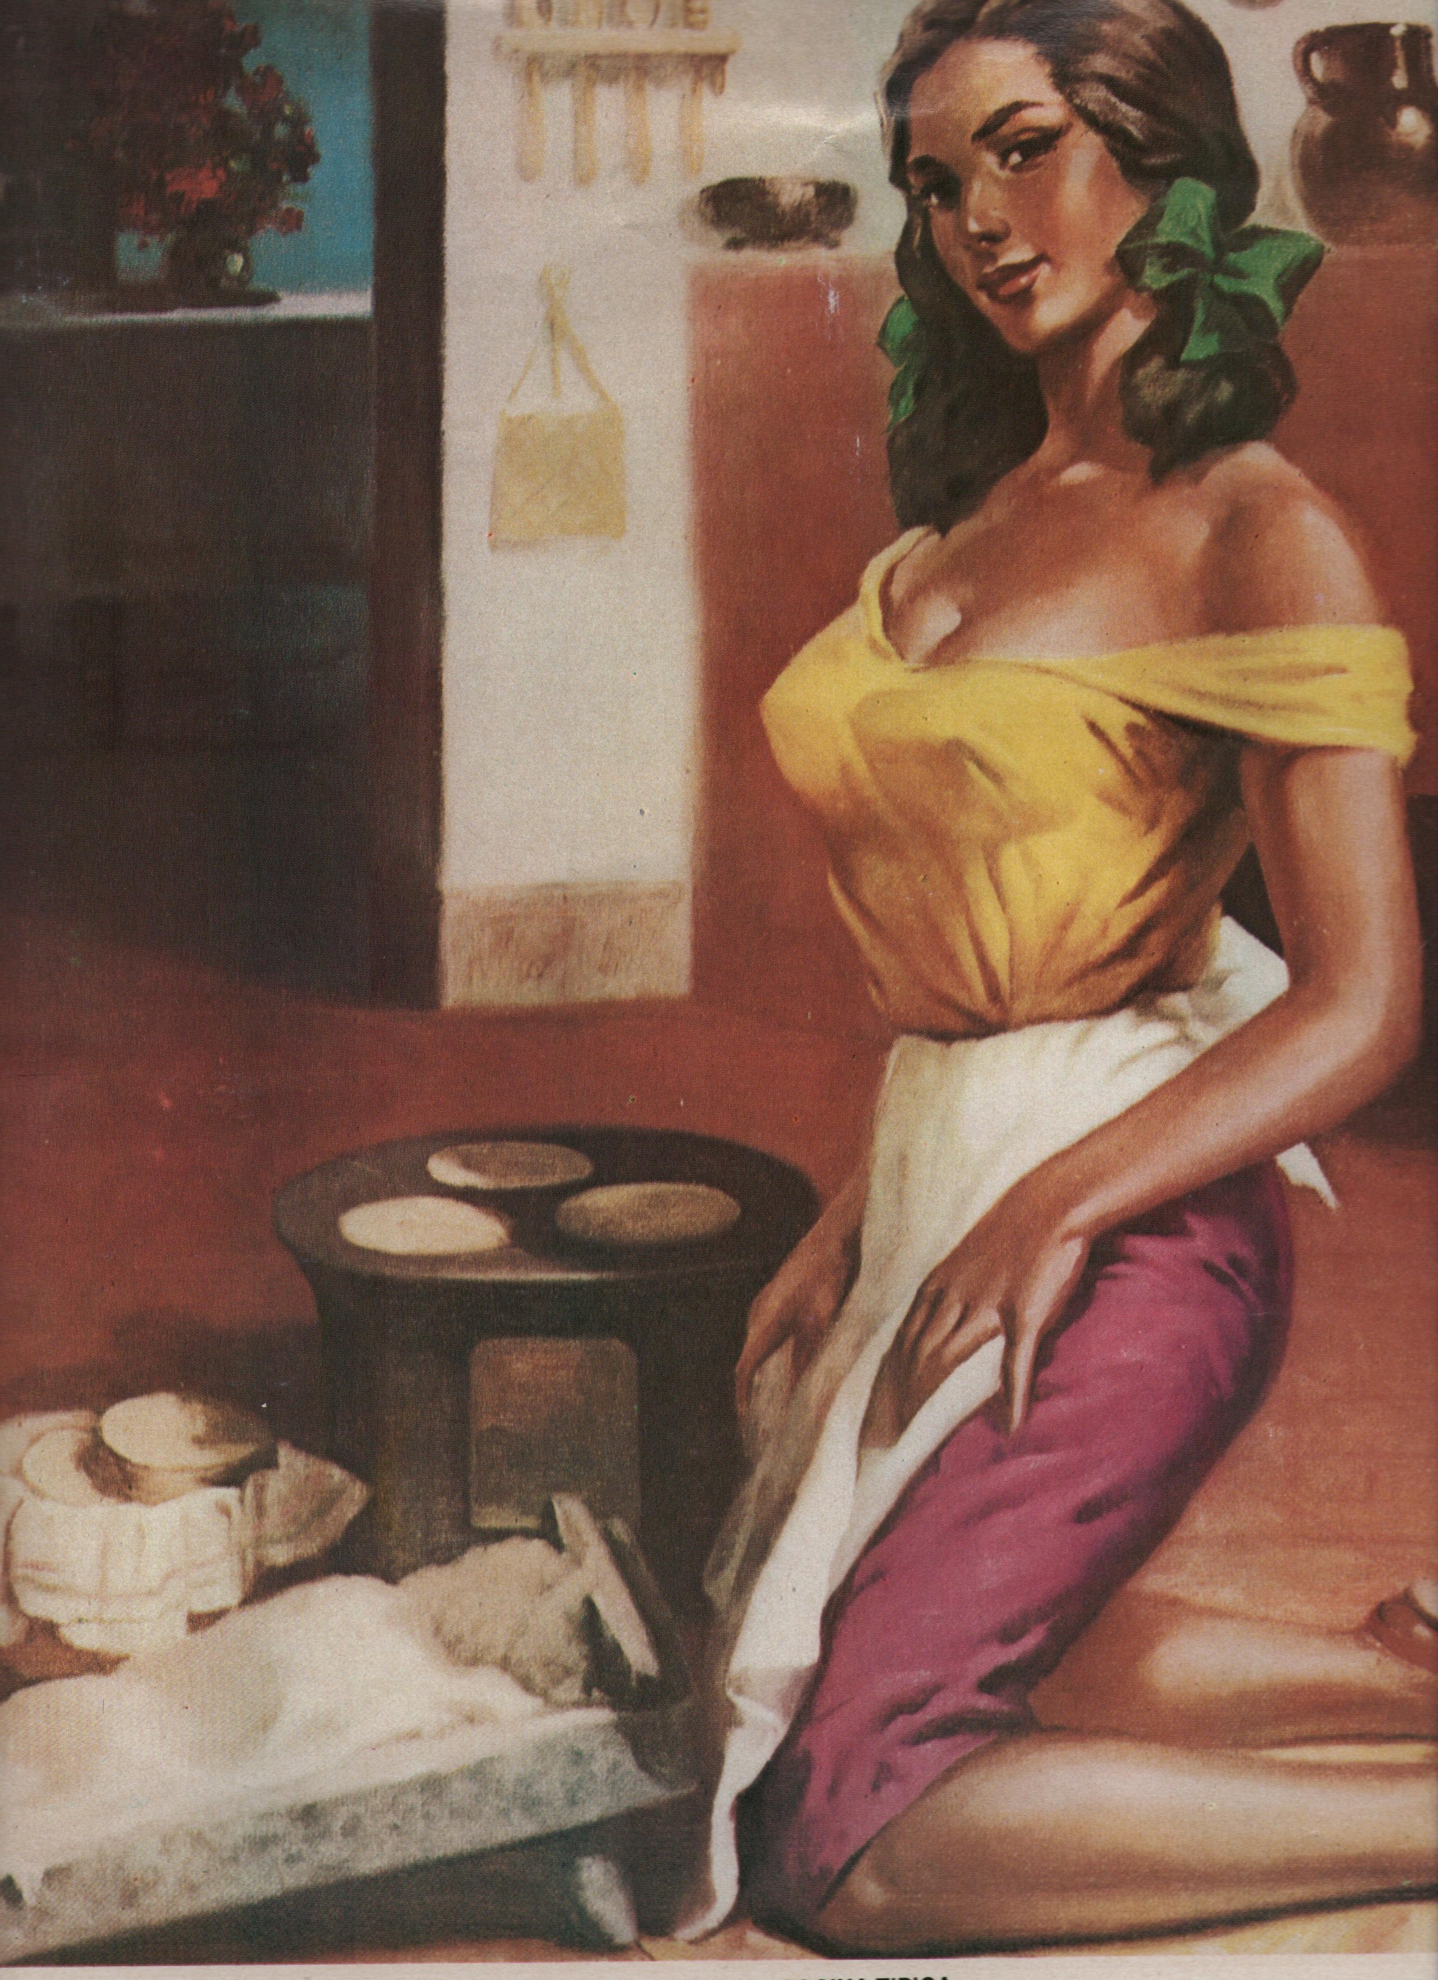
‘cocina típica’

Slide 31
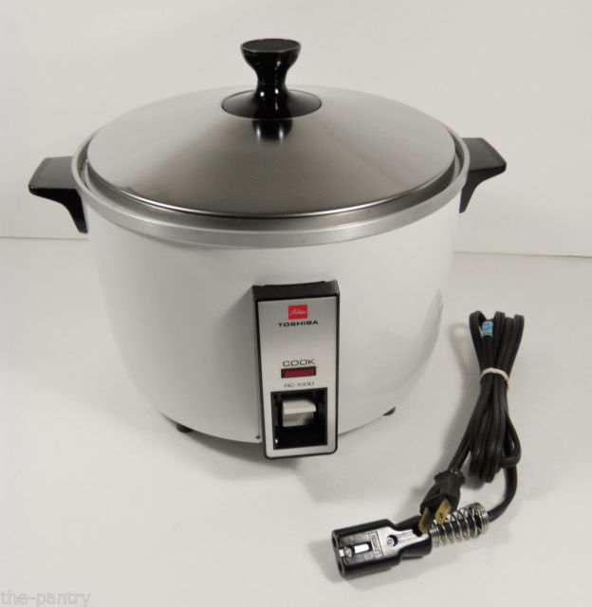
Rice cookers

Slide 32
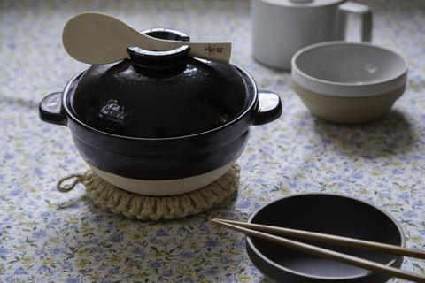
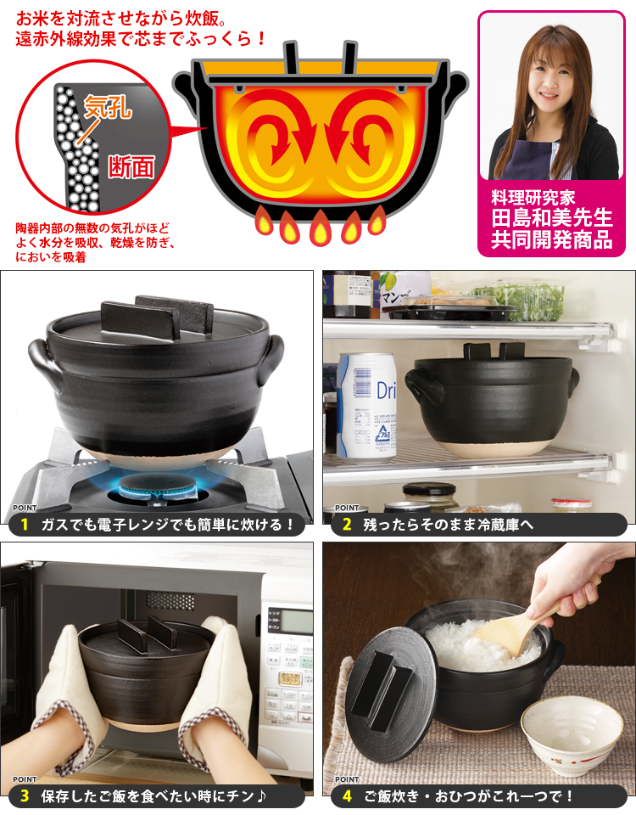
Before the rice cooker: the kamado

Slide 33
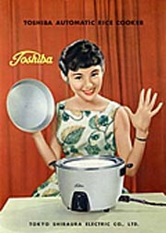
1955 advert for the first Toshiba rice cooker

Slide 34
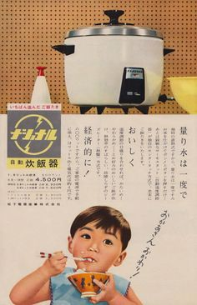
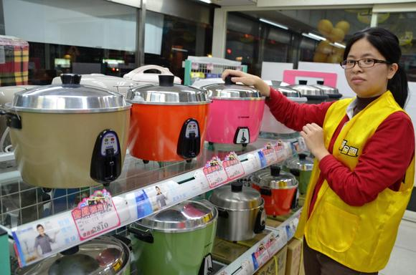
By 1960 over half of all Japanese households possessed a rice cooker.
Now fairly universal

Slide 35
The rice cooker’s success
reflects:
‘the importance of rice in Japanese daily meals, the centrality of rice-cooking to the (real or symbolic) role of the Japanese housewife, and . . . [the] technologically driven growth in Japanese manufacturing.’
Helen Macnaughtan, ‘Building up Steam as Consumers: Women, Rice Cookers and the Consumption of Everyday Household Goods in Japan’, The Historical Consumer. Consumption and Everyday Life in Japan, 1850-2000, eds. Penelope Franks and Janet Hunter (2012).

Slide 36
Do tools shape us or vice versa?
Technological determinism: objects shape events.
Social construction of technology (SCOT): technology is not the main driver of social change. Rather technologies are themselves socially and culturally embedded.

Slide 37
The freezer as an historical actor
‘From the moment of its purchase on, freezer owners are obliged to behave in certain ways: they have to learn the likes and dislikes of their new acquisition (it likes ice cream, it doesn’t like potatoes); they have to take special steps to prepare food for freezing; they have no option but to wait, sometimes for hours, before they can make proper use of deep-frozen foods; and so on. Although the freezer does allow its users to re-order shopping, cooking and eating practices, freezing, thawing and defrosting impose demands of their own.’
Elizabeth Shove and Dale Southerton, ‘Defrosting the Freezer: From Novelty to Convenience: A Narrative of Normalization’, Journal of Material Culture 5:3 (2000).

Slide 38

Actor-Network Theory
Society consists of the set of connections and associations between different things or ‘actants’.
These actants therefore have some agency: they shape and affect human society.
Actants are not necessarily living things. They can be refrigerators.
Bruno Latour (1947-)

Slide 39
The microwave-freezer alliance Is the microwave-freezer a ‘time machine’ that saves time? Or is it a solution to a problem (the social fragmentation of modern life) that it is partially responsible for creating?
The use of the freezer and microwave offers a particular form of convenience not about saving time but about ‘ordering, scheduling, co-ordination and timing’.
They allow us to re-sequence and re-order our eating practices to fit our ever more individualised schedules.
Do they therefore alleviate or do they instead exacerbate social fragmentation and the pressures of time that afflict modern society?
Elizabeth Shove and Dale Southerton, ‘Defrosting the Freezer: From Novelty to Convenience: A Narrative of Normalization’, Journal of Material Culture 5:3 (2000).

Slide 40
Save time; save money; be healthy.
Men in Finland say that microwaves ‘diminished their eating of cold sandwiches. . . The opinion of the ordinary men was that the microwave allowed them to eat more versatile and healthier food’.
Timo Myllyntaus, ‘The Entry of Males and Machines in the Kitchen: A Social History of the Microwave Oven in Finland’, Icon 16 (2010).

Slide 41
Nutrition, hygiene and the housewife
‘The “industrialization” of the domestic sphere was not only enacted by the increasing material presence of processed foods and domestic appliances but also by conventions of propriety on body care and hygiene, nutrition, and health circulated by new professionals . . . The functionalist-rationalist movement of the early twentieth century portrayed the ‘servantless housewife’ as an efficient and scientific manager of housework, duly performing her roles as mother and spouse but also, importantly, as a modern consumer of domestic technologies, industrialized and processed foods.’
Mónica Truninger, 'The Historical Development of Industrial and Domestic Food Technologies', The Handbook of Food Research, eds. Anne Murcott, Warren Belasco and Peter Johnson (2013).

Slide 42
Sue Bowden and Avner Offer, ‘Household Appliances and the Use of Time: The United States and Britain since the 1920s’, Economic History Review 47:4 (1994).
‘There is evidence that household appliances had little effect on the time spent in housework. In 1960 American women were spending about as much time in housework as they were in the 1920s. To some observers the explanation lies not in the technology itself but in cultural and social norms which identified women with housework and specified rising standards of house care. Washing machines did not save time since clothes were washed more often. Vacuum cleaners were used to clean the floors more frequently. In any instances, the introduction of technology acted to reallocate work back from the market to the housewives. Washing machines restored the washing of clothes and bed linen to the home: tasks previously performed by other household members, be they servants, husbands or children were gradually devolved back to the housewives. Technology has not saved women’s time because it has not been accompanied by any substantial rearrangement of the gender division of labour at home.’

Slide 43
Judy Wajcman:
‘The mechanization of the home has not substantially decreased the amount of time women spend on household tasks.’
Michael Bittman, James Mahmud Rice and Judy Wajcman:
‘The domestic division of labour by gender remains remarkably resistant to technological innovation.’

