Slide 1
Developmentalism and the Green Revolution

Slide 2

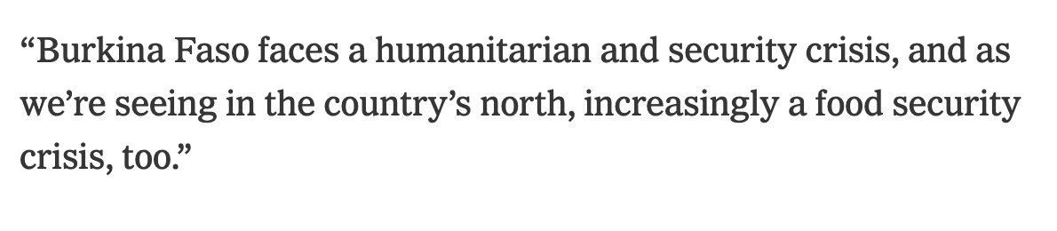
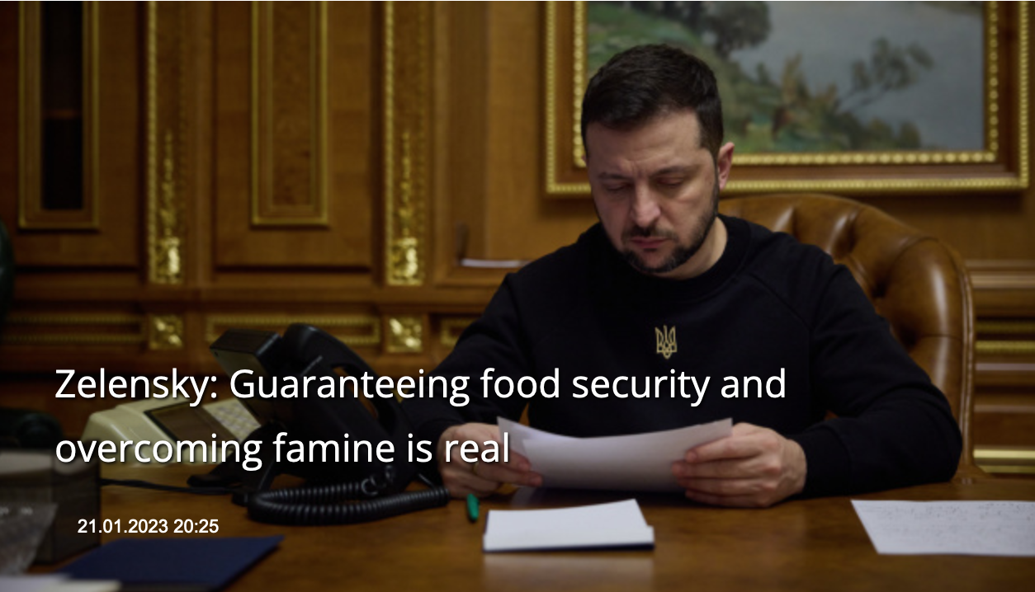

‘The risk of famine is increasing every day, according to the Integrated Food Security Phase Classification (IPC), which said this week that Gaza’s entire population is suffering “catastrophic levels of acute food insecurity”, the highest proportion of a population with acute food insecurity the monitor has ever recorded.’ Guardian 23 Dec 2023

Slide 3
Lecture Structure
Review the emergence, and critiques, of
food security
development
the Green Revolution
In short, this lecture explores food’s place in the post-war global order.

Slide 4
Food Security

Slide 5
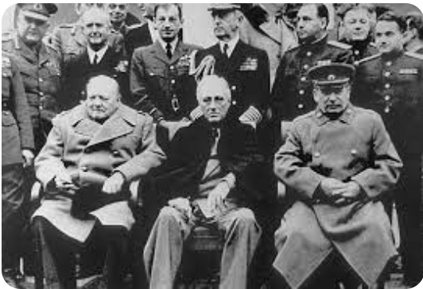
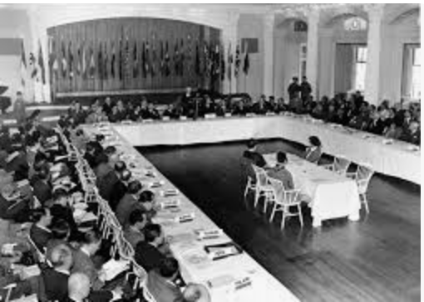
Creating the post-war order:
Bretton Woods (1944), Yalta (1945) etc.

Slide 6
‘Constitution of the United Nations Food and Agriculture Organization’, Québec, 16 Oct. 1945
Aims:
‘raising levels of nutrition and standards of living of the peoples under their respective jurisdictions; securing improvements in the efficiency of the production and distribution of all food and agricultural products; bettering the condition of rural populations; and thus contributing towards an expanding world economy and ensuring humanity’s freedom from hunger’.

Slide 7
Food and the Post-war International Order
Food and Agriculture Organization of the United Nations (FAO) (1945)
World Food Programme (1961)
World Food Council (1974)
Food Security Assistance Programme (1975)
International Fund for Agricultural Development (1976)
World Food Security Compact (1985)

Slide 8
Food Security as a Problem of Global Governance
‘The construction of a postwar order began with food.’
Nick Cullather, The Hungry World: America’s Cold War Battle Against Poverty in Asia (2010).

Slide 9
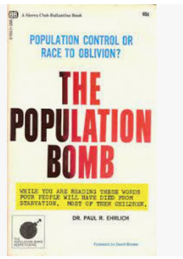
Food security as a problem of global governance
Concerns about ‘overpopulation’ and the fear of a ‘Malthusian crisis’ in which the global population outpaced food supply.
1968

Slide 10
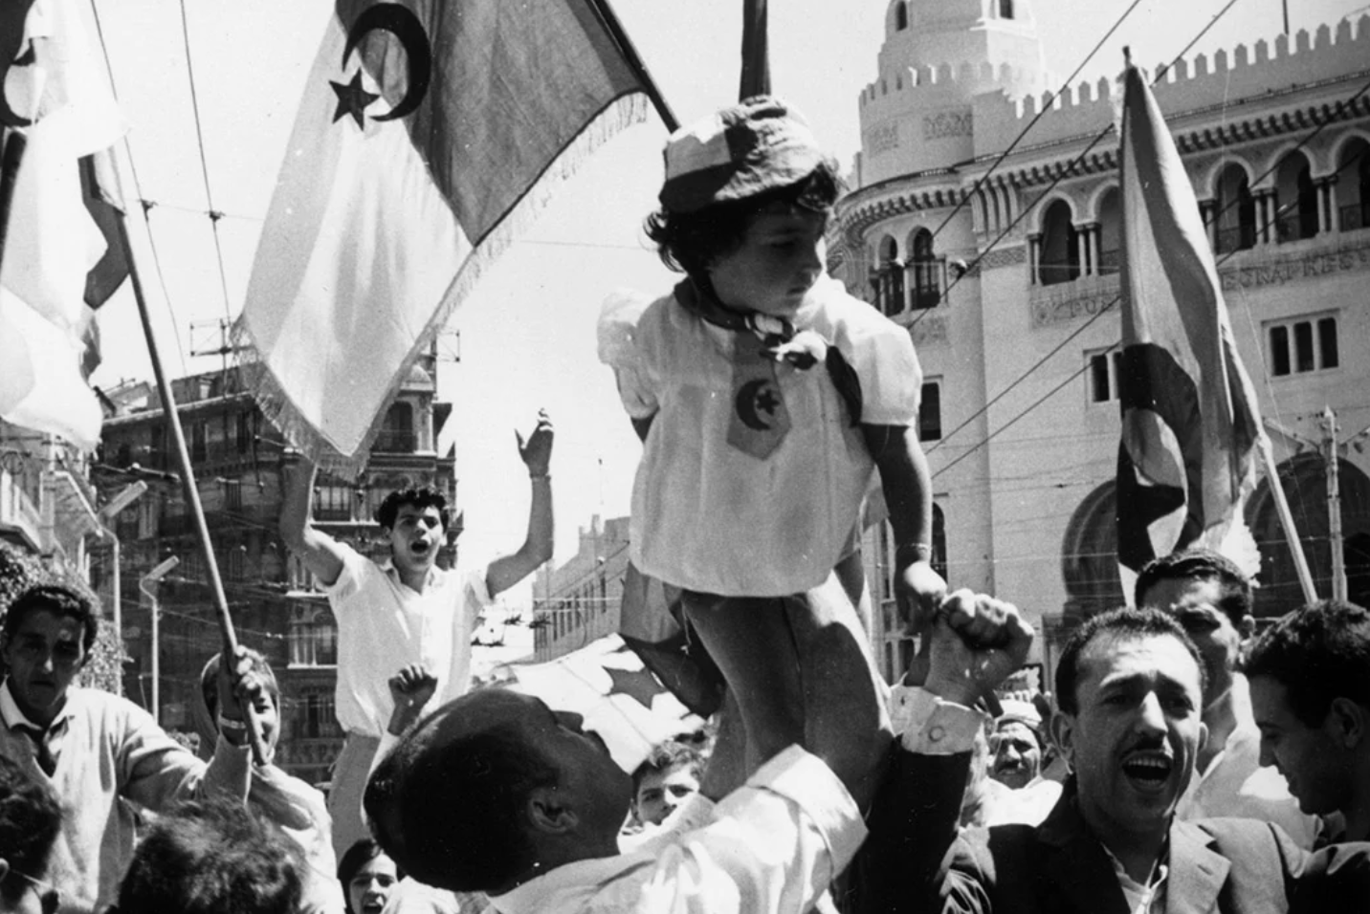
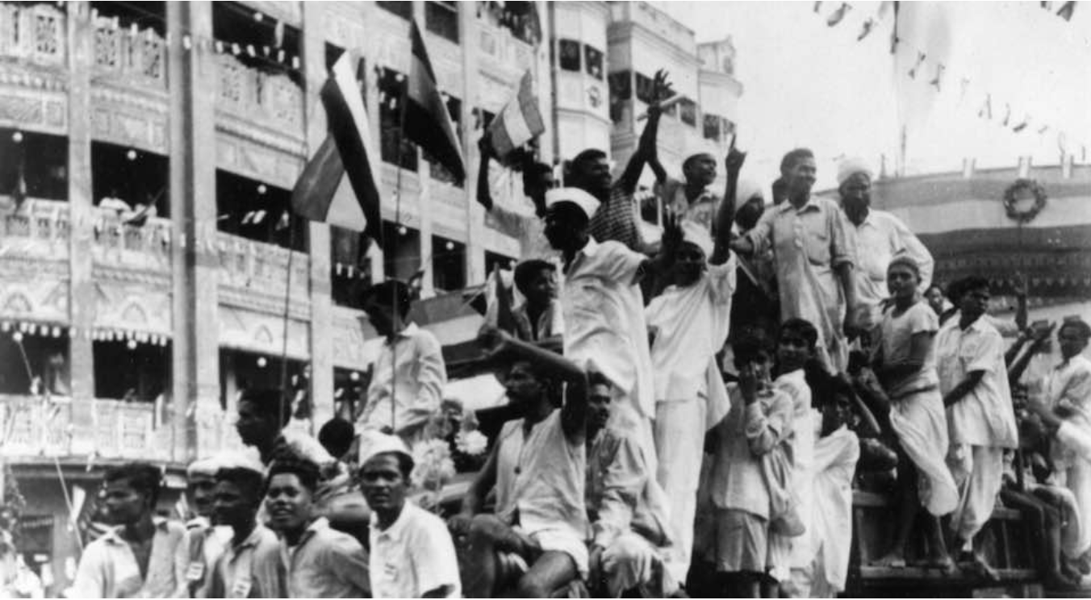
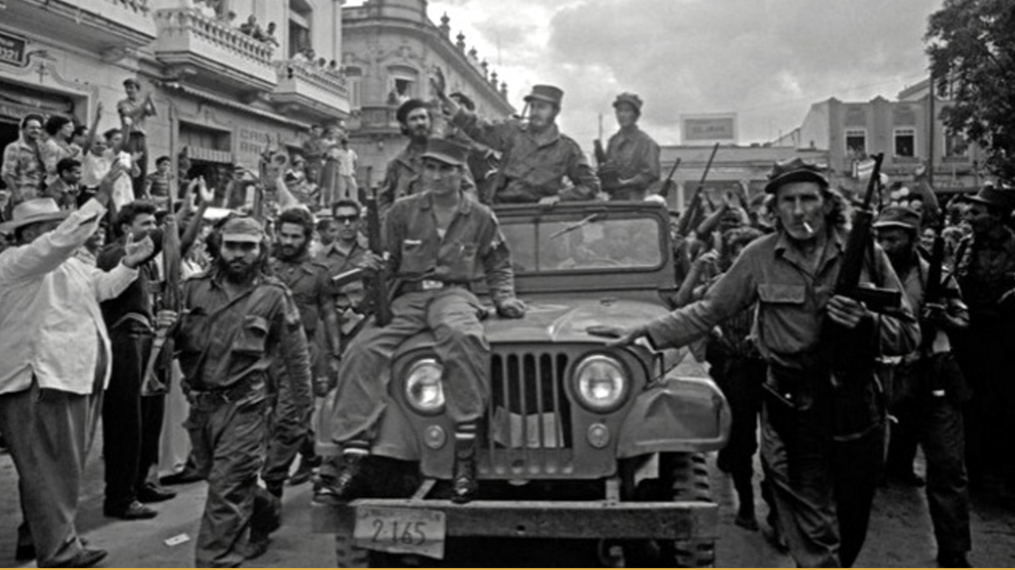
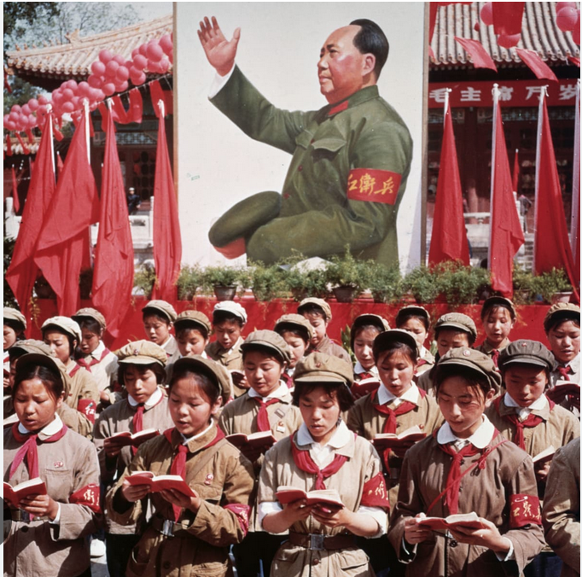
Nationalist Movements: a threat to the global order?

Slide 11
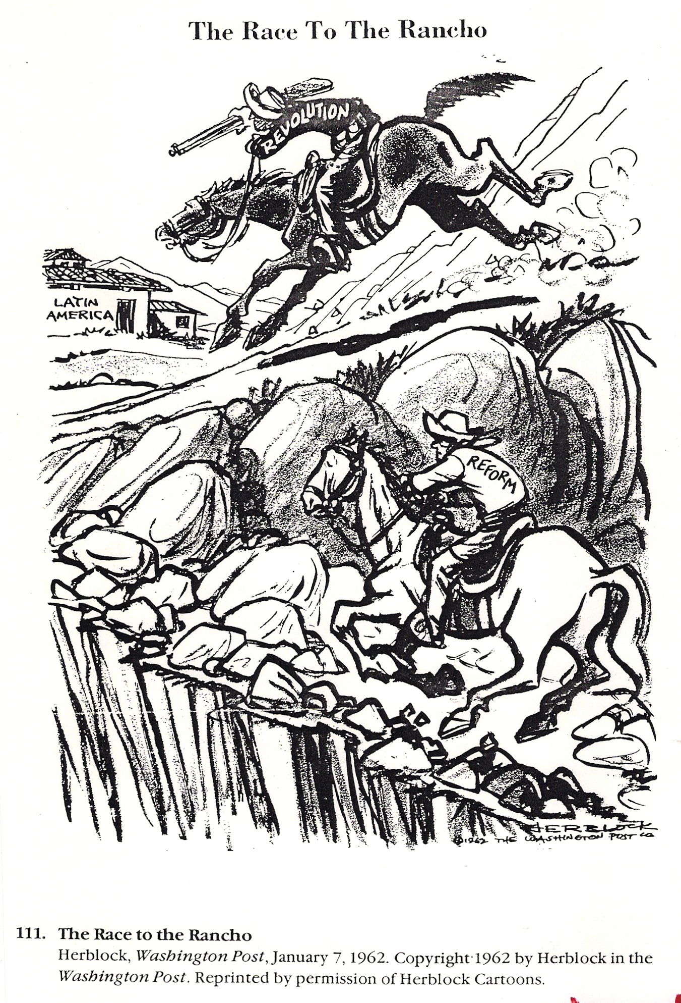
‘The Race to the Rancho’
(1962)

Slide 12
Food security as a problem of global governance
Concerns about ‘overpopulation’, which was thought to fuel nationalist and socialist movements in the developing world.
Hope was that a reduction in poverty combined with aggressive programmes of modernisation would dampen the allure of socialism.

Slide 13
Food security as a problem of global governance
Concerns about ‘overpopulation’, which was thought to fuel nationalist and socialist movements in the developing world.
Hope was that a reduction in poverty combined with aggressive programmes of modernisation would dampen the allure of socialism.
Better-fed populations, in turn, would provide more effective workers, further facilitating economic take-off.
Modernised agriculture was thus key to economic development and stability.

Slide 14
‘Food Security’
Term began to appear in United Nations documents in 1974, referring to the threat of food shortages caused by poor grain harvests.
Food security exists when there is ‘availability at all times of adequate world food supplies of basic foodstuffs to sustain a steady expansion of food consumption and to offset fluctuations in production and prices.’
United Nations, Report of the World Food Conference (1975).

Slide 15
‘We express our deep concern over the persistence of hunger, which, on such a scale, constitutes a threat both to national societies and, through a variety of ways, to the stability of the international community itself.’
United Nations, Rome Declaration on World Food Security, Rome, 13 Nov. 1996.

Slide 16
Harry S. Truman, Inaugural Address, 20 Jan. 1949
‘A bold new program for making the benefits of our scientific advances and industrial progress available for the improvement and growth of underdeveloped areas. More than half the people of the world are living in conditions approaching misery. Their food is inadequate. They are victims of disease. Their economic life is primitive and stagnant. Their poverty is a handicap and a threat both to them and to more prosperous areas. For the first time in history, humanity possessed the knowledge and skill to relieve the suffering of these people’.
‘Slowly but surely we are weaving a world fabric of international security and growing prosperity.’

Slide 17
'Development’
A postwar international strategy aimed at fostering industrialisation and economic growth in poorer countries.
Aim was to convert supposedly backward and overly-large agrarian populations into an industrial workforce through directed programmes of investment and intervention.
Ambitious development schemes supported by western governments, international bodies (e.g. World Bank), and private organisations (e.g. Rockefeller Foundation) were introduced from the 1950s.
Idea was that technical and scientific intervention by appropriately trained advisors would stimulate the necessary changes.

Slide 18
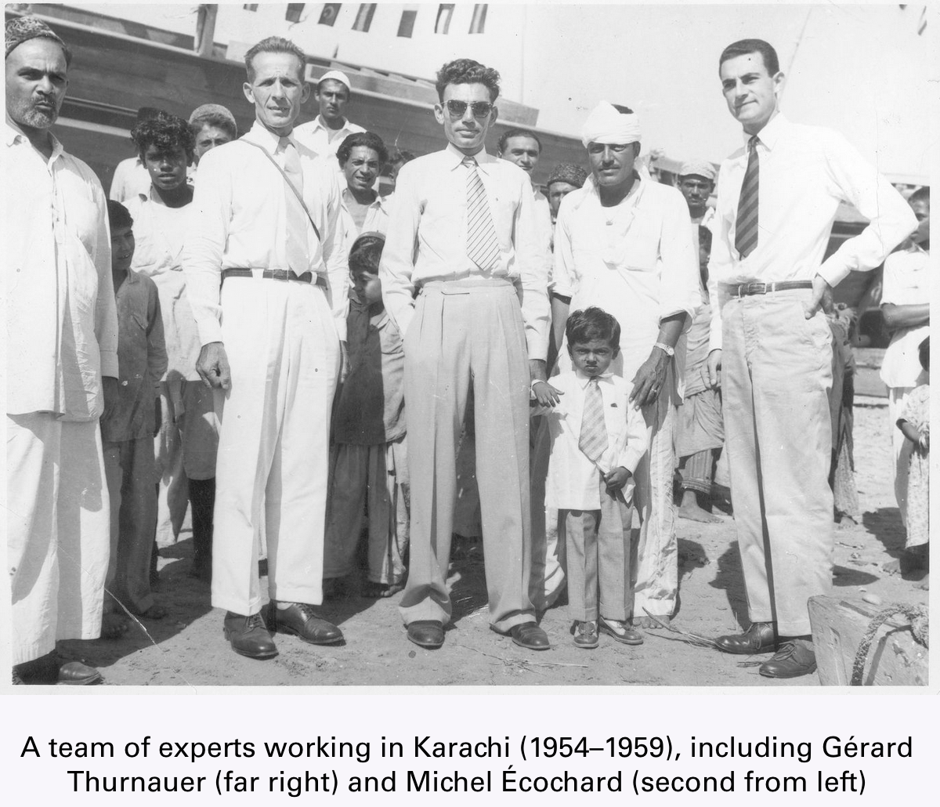
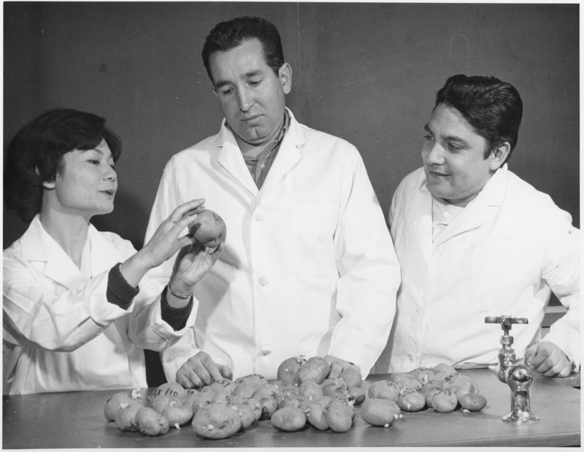
Rockefeller Foundation-funded scientists at work

Slide 19
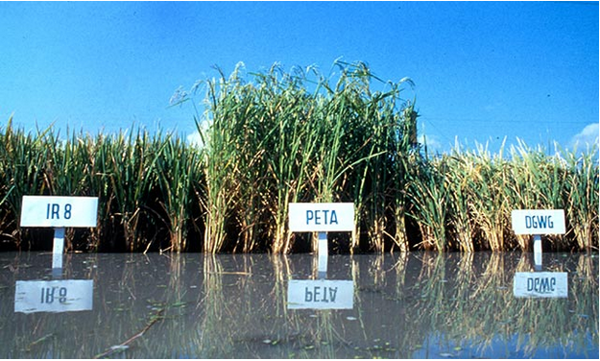
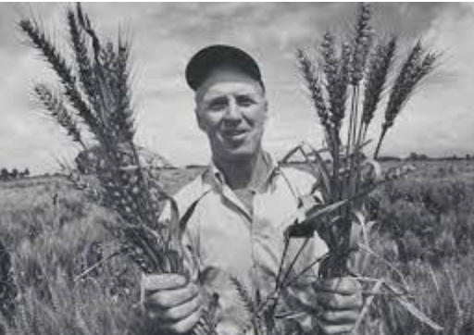
New seed varieties
Norman Borlaug (1914-2009)
‘Father of the Green Revolution’
IR8 variety of dwarf hybrid rice

Slide 20
We need to study ‘which nations get credit for transferring knowledge, and how we tell histories of science’.
Gabriela Soto Laveaga, 'Beyond Borlaug's Shadow: Octavio Paz, Indian Farmers, and the Challenge of Narrating the Green Revolution', Agricultural History 95:4 (2021).

Slide 21
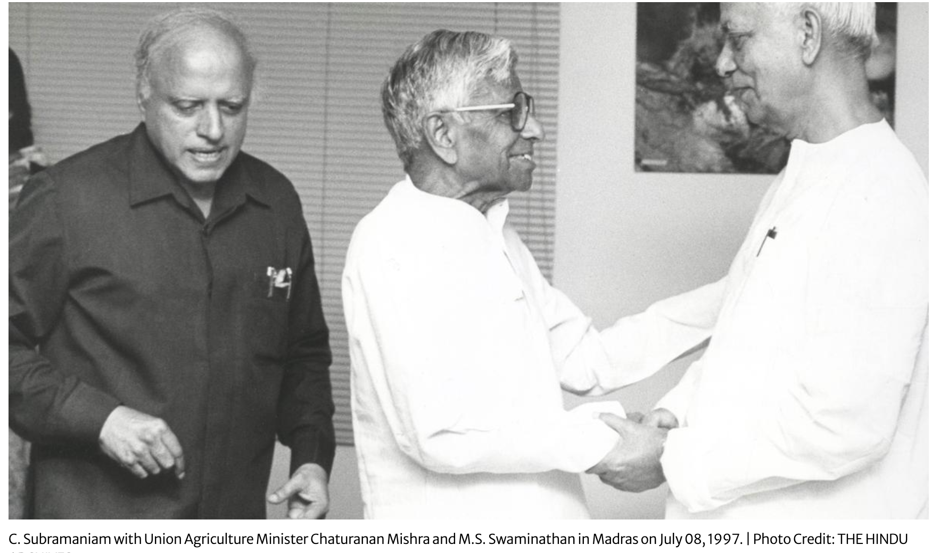
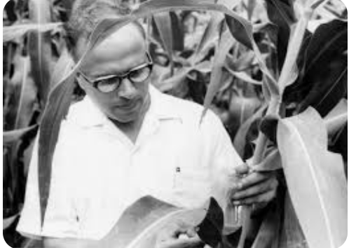
Dr MS Scaminathan (1925-2023)

Slide 22
Green Revolution (1950s-70s)
Aimed to increase agricultural productivity through the breeding of new hybrids, particularly of maize, wheat and rice.
Focus on technical expertise and the dissemination of ‘best practice’ from experts to farmers in the developing world.

Slide 23
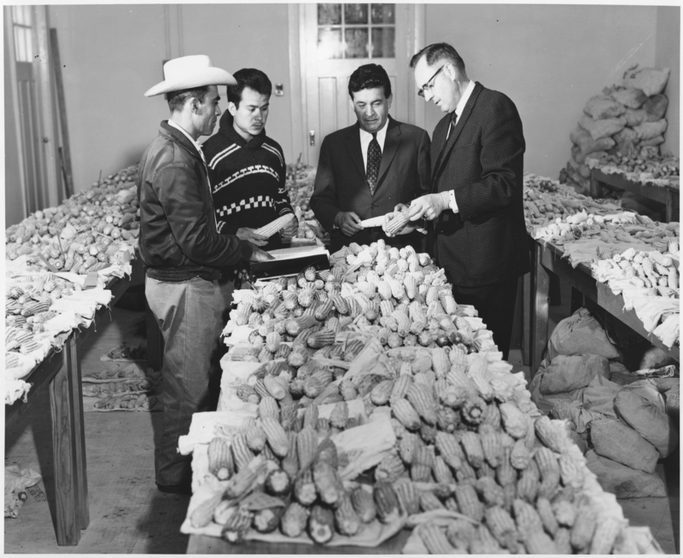
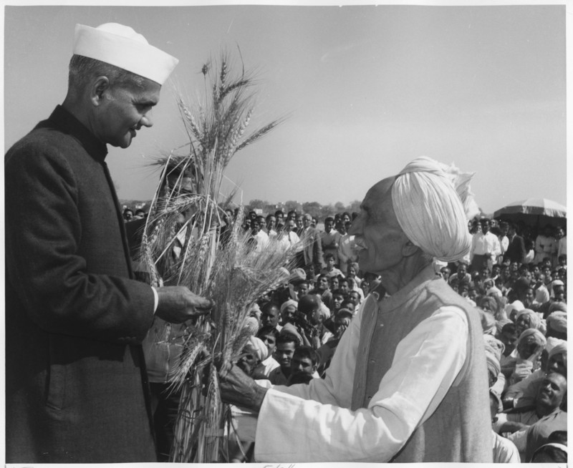
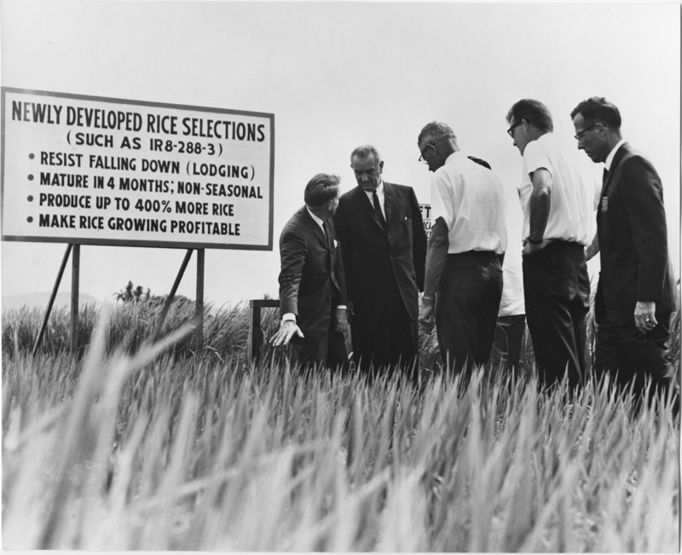
Green Revolution
Indian agricultural programme (1966)
Rockefeller Foundation scientists and Mexican farmers study maize collections from the Caribbean, and visit a test field of hybrid rice in the Philippines

Slide 24
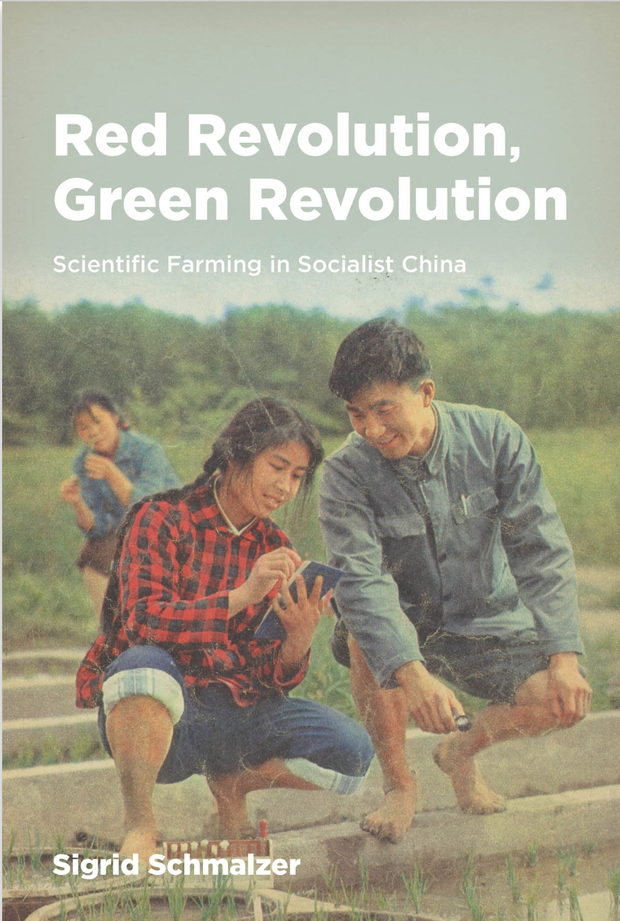
2016

Slide 25
Green Revolution (1950s-70s)
Aimed to increase agricultural productivity through the breeding of new hybrids, particularly of maize, wheat and rice.
Focus on technical expertise and the dissemination of ‘best practice’ from experts to farmers in the developing world.
Increased production but led to many criticisms about its environmental and social impact.

Slide 26
Focus on internationally-traded crops and commercial agriculture—not local staples
In 1971 the FAO acknowledged that its programmes tended to ignore crops that were ‘grown and consumed almost entirely in developing countries, and hardly enter into world trade’.
In India, the ‘chapati quality’ of wheat was dismissed by green revolution scientists as unimportant.
Yams were not a ‘priority crop’ for research in 1960s Kenya, despite being a major source of food for the population.

Slide 27
Critiques and Analyses of ‘Development’ as a Concept and as a Political Tool

Slide 28
Benefits of the Green Revolution
‘Between 1960 and 1990, food supply in developing countries increased 12-13%. Estimates suggest that, without [the Green Revolution], food production in developing countries would have been almost 20% lower (requiring another 20-25 million hectares of land under cultivation worldwide). World food and feed prices would have been 35-65% higher, and average caloric availability would have declined by 11-13%. Overall, these efforts benefitted virtually all consumers in the world and the poor relatively more so, because they spend a greater share of their income on food.’
P.L. Pingali, ‘Green Revolution: Impacts, Limits, and the Path Ahead’, Proceedings of the National Academy of Sciences of the United States of America 109:31 (2012).
In India wheat production increased from 7 million tons in 1947 to 17 million in 1968.

Slide 29

Development as a Form of Western Control
Development radically altered ‘the character and scope of the relations between rich and poor countries, and, in general, the very perception of what governments and societies were to do’.
‘“Development,” as a mode of thinking and as a course of practices, soon became an omnipresent reality. The poor countries became the target of an endless number of programs and interventions that seemed to be inescapable and that ensured their control.’
Arturo Escobar, ‘Power and Visibility: Development and the Invention and Management of the Third World’, Cultural Anthropology 3 (1988).
Arturo Escobar (1952-)

Slide 30
Some Development Binaries
Undeveloped Countries
Traditional
Child-like
Dependant
Agricultural
Rural
Not yet rational
Developed Countries
Modern
Adult
Independent
Industrial
Urban
Rational
Development ‘is basically a story about a transition from timeless traditions to timeless modernity’.
Nick Cullather, ‘Development? It's History’, Diplomatic History 24:4 (2000).

Slide 31
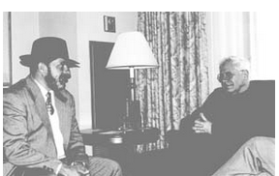
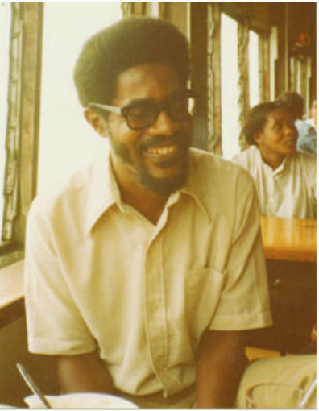
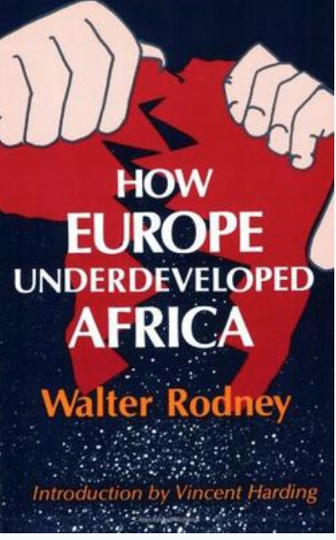
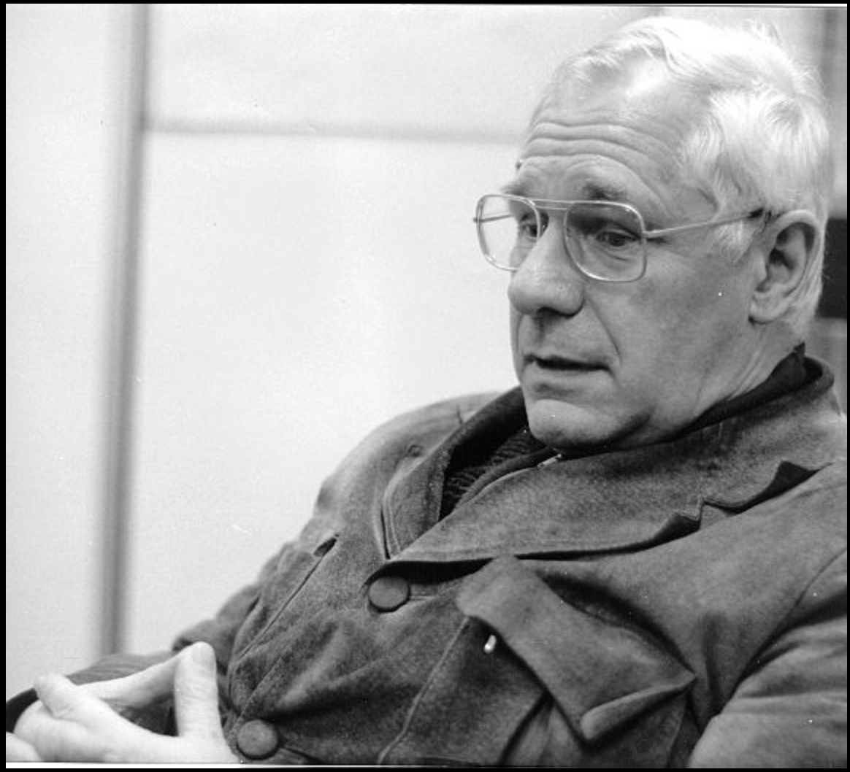
Dependency Theory
‘underdevelopment’
André Gunder-Frank and Lula, 1996
Walter Rodney (1942-1980): Guyanese historian and politician
André Gunder Frank (1929-2005): US-German sociologist
1972

Slide 32
The problem of the ‘backward peasant’
‘How to overcome the destructive conservatism of the people and generate the drastic agrarian reforms which must be effected if the country is to survive is one of the most difficult problems the political leaders of Tanzania have to face.’
Government report on Tanzania (1970).
Peasant farmers were ‘the problem to which the agricultural experts were the solution’.
James C. Scott, Seeing Like a State (1998).

Slide 33


‘This is exactly what food has become: a source of profits, a tool of economic and political control; a means of insuring effective domination over the world at large and especially over the ‘wretched of the earth’.’
Susan George, How the Other Half Dies: The Real Reasons for World Hunger (1976).
Susan George (1934-)

Slide 34
‘The West has tried to apply its own conceptions of ‘development’ to the Third World, working through local élites and pretending that the benefits showered on these élites would trickle down to the less fortunate, especially through the wholesale application of Western-inspired and Western-supplied technology. . . ‘Development’ has been the password for imposing a new kind of dependency, for enriching the already rich world and for shaping other societies to meet its commercial and political needs. Where food production is concerned, the ‘Green Revolution’ has been a flagrant example of a ‘development solution’ that has brought nothing but misery to the poor.’
George, How the Other Half Dies.

Slide 35
Conclusions
Food was central to the construction of the post-war world.
Post-war development programmes were fundamentally about food supply.
The Green Revolution grew out of these programmes and was, again, about the food supply.
Both development and the Green Revolution have been criticised as political and ideological programmes of westernisation, or of neo-imperialism, or of capitalism.
They have also been praised for reducing poverty and hunger.

Slide 36
Economic development is a ‘way of organizing power in a society, and of simultaneously concealing this power arrangement—more accurately, of concealing that it is a power arrangement’.
C. Douglas Lummis, Radical Democracy (1996).
‘Political technologies advance by taking what is essentially a political problem, removing it from the realm of political discourse, and recasting it in the neutral language of science.’
H. Dreyfus and P. Rabinov, Michel Foucault: Beyond Structuralism and Hermaneutics (1983).

