Slide 1
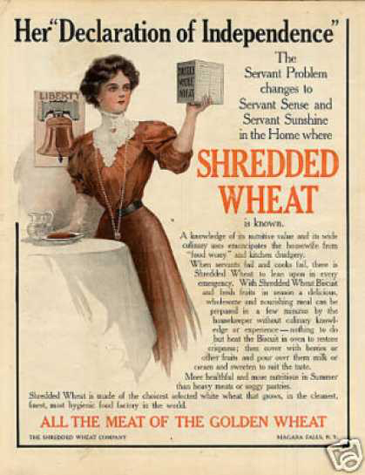
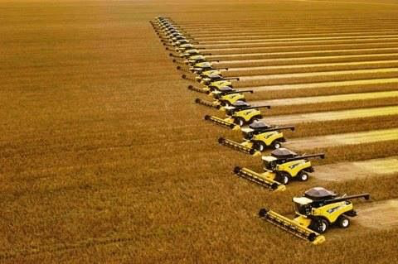
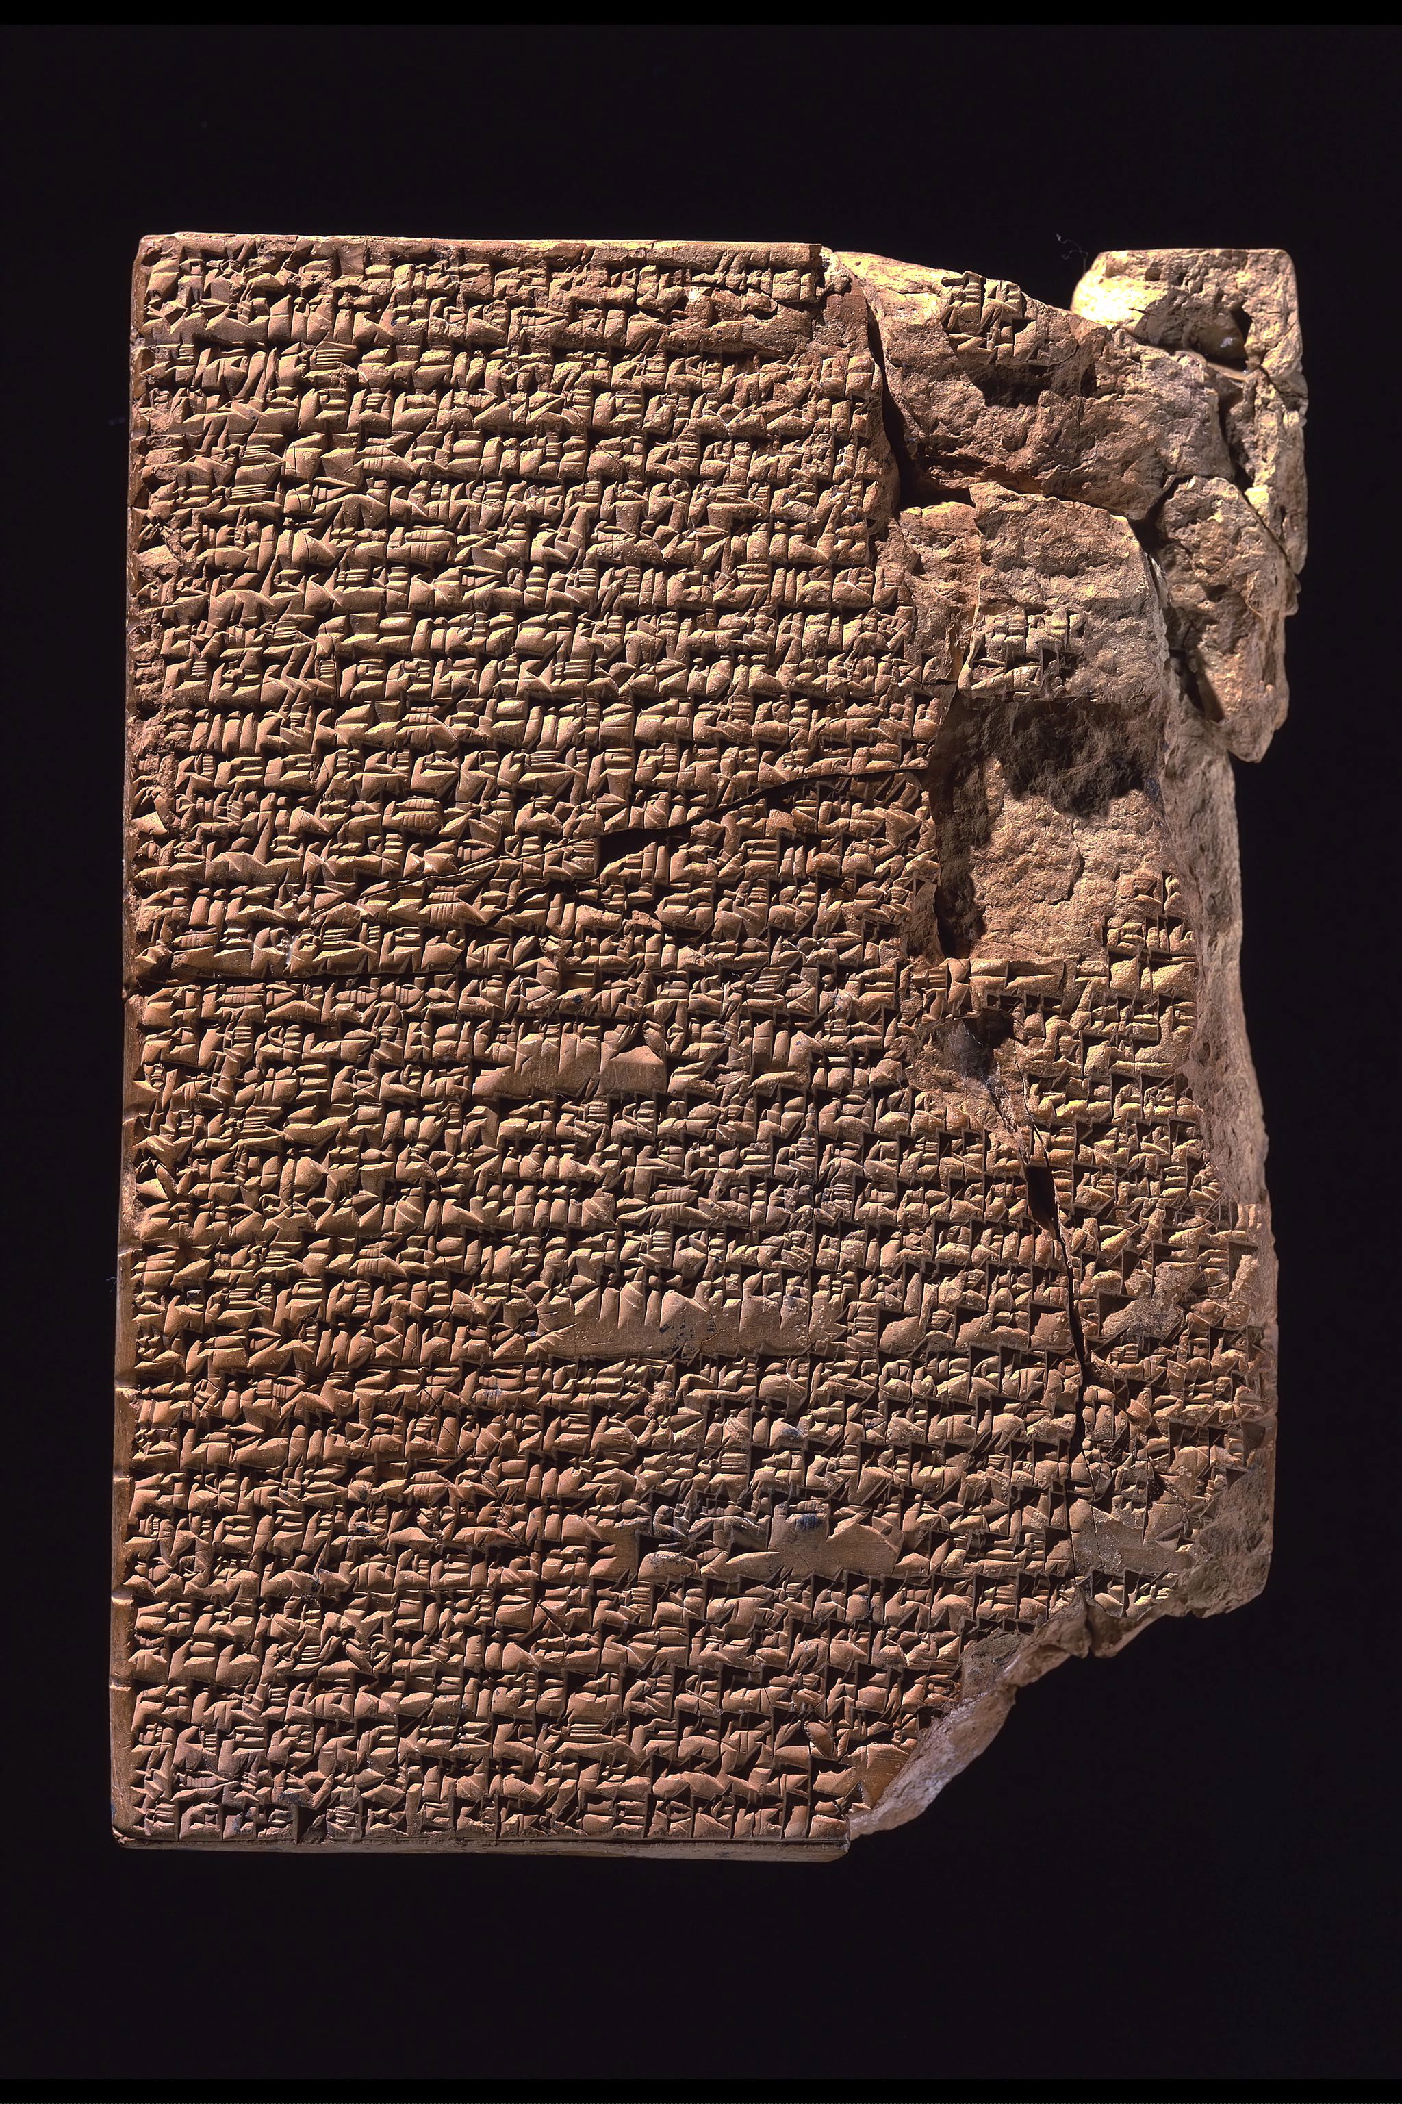
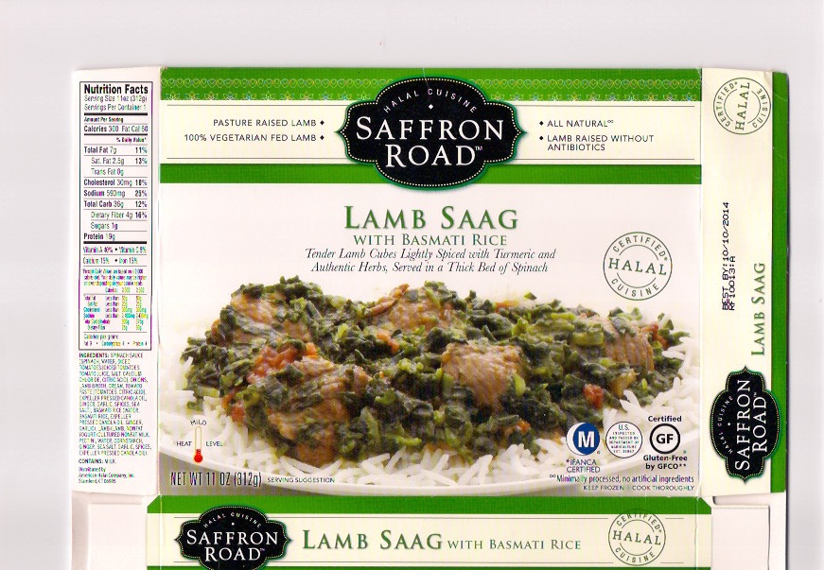
The Global History of Food (HI2A7)
Combine harvesters
‘Industrial halal’
The world’s oldest known cookbook, c. 1750 BC
1909 US advertisement for Shredded Wheat.

Slide 2
About the Module
Introduces you to the history of food, and helps show how food lies at the heart of virtually everything we do as people.
Covers a wide range of topics—from the emergence of ‘industrial halal’ to the history of dieting—using an equally wide range of sources and approaches.
Global in approach
Includes visits to local art galleries and museums (covid permitting)
Hannah Collins, ‘The Fragile Feast: Lemons’, 2011.

Slide 3
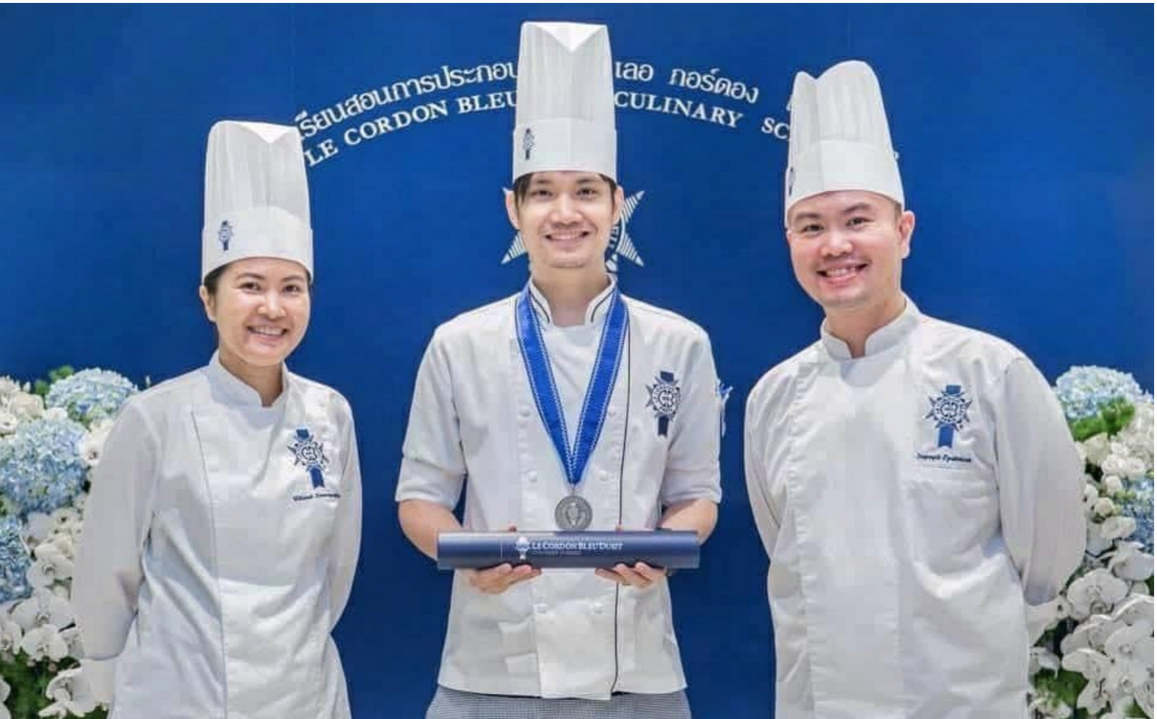
Assessment
seminar contribution (10%)
commonplace book (10%)
3,000-word essay (40%)
two-hour exam (40%)

Slide 4
Seminar contribution
The seminar contribution is based on a self-assessment.
At the end of the year you will evaluate your own engagement with the seminars, using a structured self-assessment form.
Interim feedback at the start of term two.

Slide 5
Commonplace Book
10% of your assessment consists of a commonplace book.
A commonplace book is a scrap-book of words and images.
Use whatever format you prefer, as long as you can upload it to tabula.
Use your commonplace book to record food-related ideas that you find stimulating. . .
. . . questions inspired by the module, connections between the topics we’ve covered and other aspects of your life, quotations, diagrams, drawings, items in the news, photographs. . .
The commonplace book can also be used to document the progress of the practical experiments assigned in class.

Slide 6
The 3000-word essay and the exam
ESSAY
You can write on any food-related topic that seizes your imagination.
Discuss your ideas with me and we will develop them into a topic and a title that work for you.
EXAM
7-day take home exam (like last year)

Slide 7
A Short Introductory Lecture: Eating as a Total Social Fact

Slide 8
Richard Wrangham’s ‘Cooking Hypothesis’
‘We should indeed pin our humanity on cooks.’

Slide 9
Richard Wrangham, Catching Fire: How Cooking Made Us Human (2009)
‘I believe that the transformative moment that gave rise to the genus Homo, one of the great transitions in the history of life, stemmed from the control of fire and the advent of cooked meals. Cooking increased the value of our food. It changed our bodies, our brains, our use of time, and our social lives. It made us into consumers of external energy and thereby created an organism with a new relationship to nature, dependent on fuel.’

Slide 10
The BBC’s 2006 ‘Evolution Diet’ experiment
‘The group's average blood pressure fell from a level of 140/83 - almost hypertensive - to 122/76. Though it was not intended to be a weight loss diet, they dropped 4.4kg (9.7lbs), on average.’
‘Going Ape’, 11 Jan. 2007, BBC News
https://www.bbc.co.uk/sn/humanbody/truthaboutfood/healthy/evodiet.shtml

Slide 11
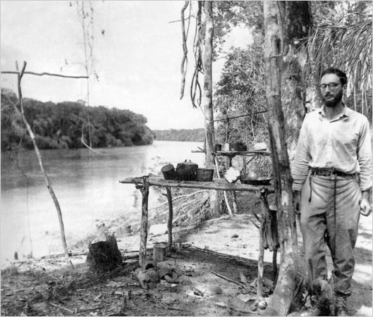
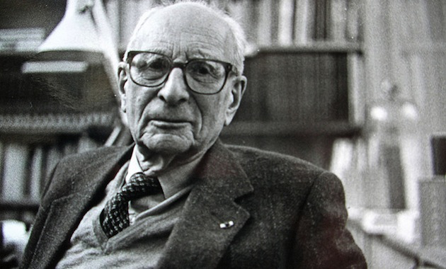
Claude Lévi-Strauss
(1908-2009)
Food is both ‘good to eat’ and ‘good to think [with]’
In Brazil in the 1930s

Slide 12
Lévi-Strauss’s culinary triangle
Notice how he links cooked food to culture.
From Claude Lévi-Strauss, The Raw and the Cooked (1964).

Slide 13
Edmund Leach
(1910-1989)
People ‘do not have to cook their food; they do so for symbolic reasons to show that they are men and not beasts’.

Slide 14
Dean Falk, Finding Our Tongues: Mothers, Infants and the Origins of Language (2009).
‘motherese’ (baby-talk)
Dean Falk

Slide 15
‘Why is eating nowadays so troublesome?’
‘Food, and what we should or should not eat, is one of the contemporary world’s most troublesome topics. The list of controversies is long: food additives, agro-chemicals, waste, subsidies, distance from nature, animal well-being, ready meals, dietary recommendations, meat production, food miles and animal antibiotics, to name only some of them.’
Alan Warde and Luke Yates, ‘Focus: Food and Eating’, Discover Society 36 (6 Sept. 2016).

Slide 16
Is food today both too cheap and too expensive?
In 2019 UK households spent on average 8% of their income on food.
The EU average is 12%.
(‘How much are households spending on food?’, 9 Dec. 2019, Eurostat, https://ec.europa.eu/eurostat/web/products-eurostat-news/-/ddn-20191209-1. )
20% - 30% of income is spent on food in most of the rest of the world.

Slide 17
Is food today both too cheap and too expensive?
The poorest 20% of British households spend 50% more of their household income on food than the national average.
Even before the pandemic over 1,500,000 people in the UK used food banks. The current figure is over 2,500,000.
Food Statistics Pocketbook, 2020,DEFRA, https://www.gov.uk/government/statistics/food-statistics-pocketbook/food-statistics-in-your-pocket-prices-and-expenditure#trend-in-share-of-spend-going-on-food-and-non-alcoholic-beverages-in-low-income-and-all-uk-households-2005-06-to-2017-18
Number of people receiving three days' worth of emergency food by Trussell Trust foodbanks in the United Kingdom from 2008/09 to 2020/21, https://www.statista.com/statistics/382695/uk-foodbank-users/

Slide 18
Food is about. . . ?
money profits
trade commodities
technology
pleasure anxiety
culture history
community identity
justice
ethics
agriculture
environment
health
nutrition

Slide 19
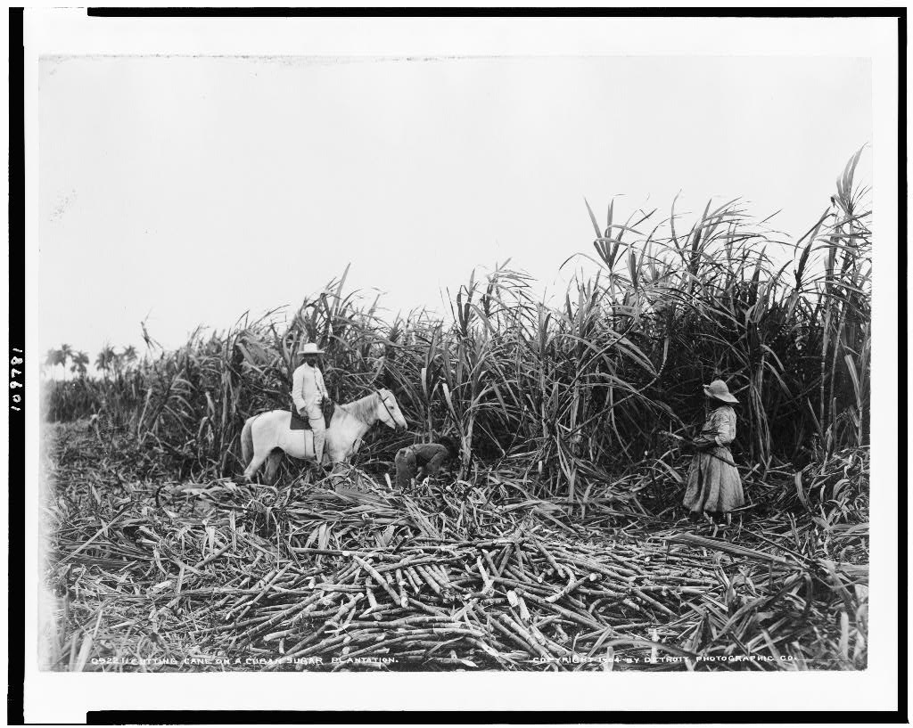
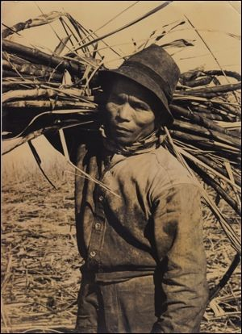
Sugar cultivation has long relied on unfree labour.
Cuban sugar plantation, 19th century
Melicio Labrador carrying sugar cane in Hawai’i

Slide 20
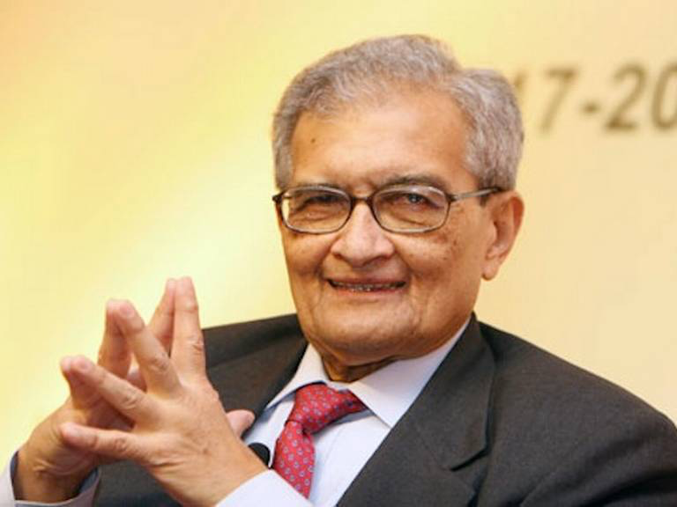
Amartya Sen
Nobel Prize-winning Indian economist famous (among other things) for his analysis of the causes of famine.

Slide 21
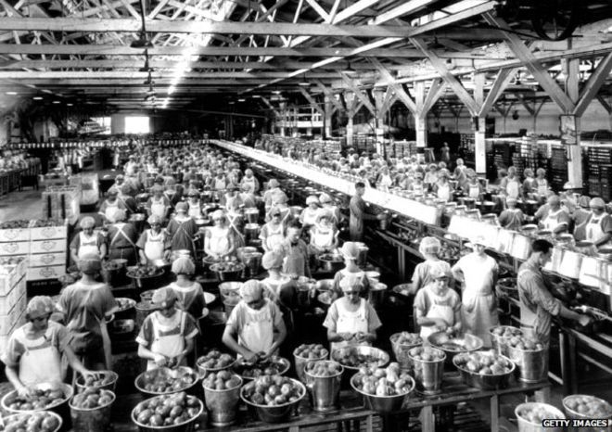
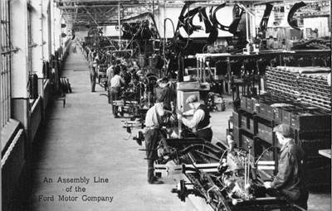
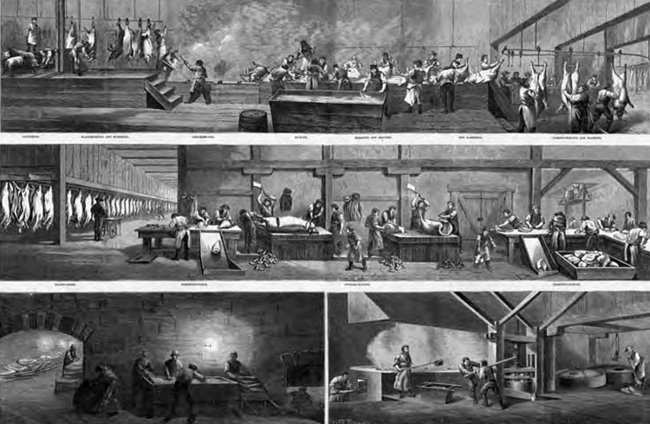
Mechanisation and Industrialisation
US Tomato factory (1930)
Ford Assembly Line (1913)
A Cincinnati Pork ‘Disassembly Line’, (1873)

Slide 22
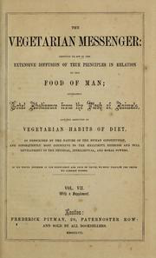
Early British Vegetarianism

Slide 23

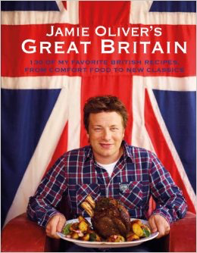

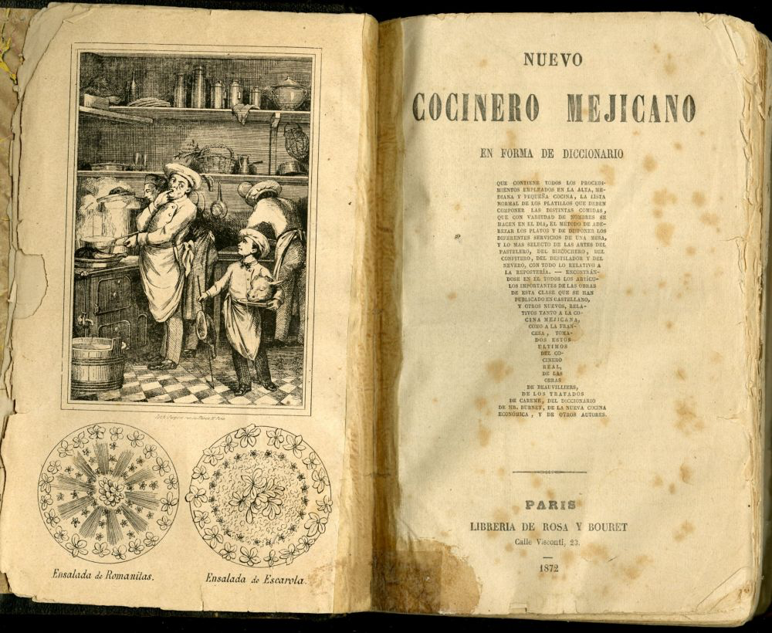

Slide 24
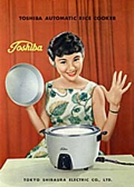
1955 advert for the first Toshiba rice cooker

Slide 25
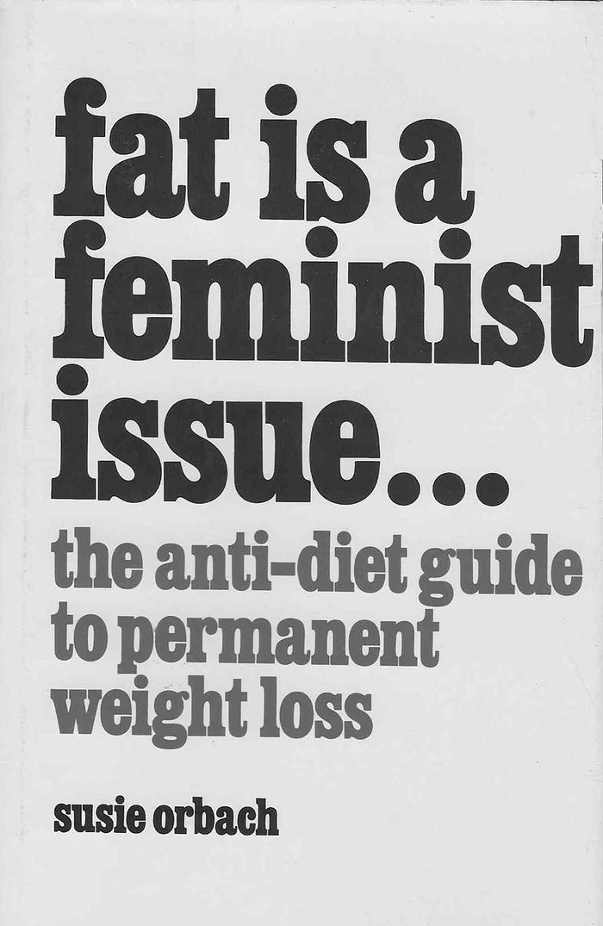
Susie Orbach

Slide 26
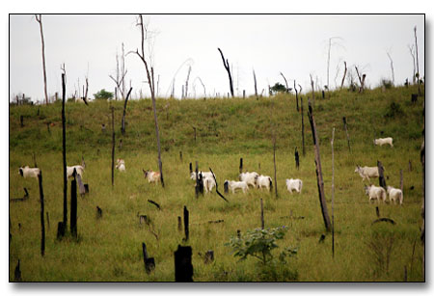

Deforestation in Amazonia
Cattle grazing in Amazonia
Without cattle

Slide 27
A Total Social Fact
‘an activity that has implications throughout society, in the economic, legal, political, and religious spheres’
(Marcel Mauss: ‘fait social total’)

