Slide 1
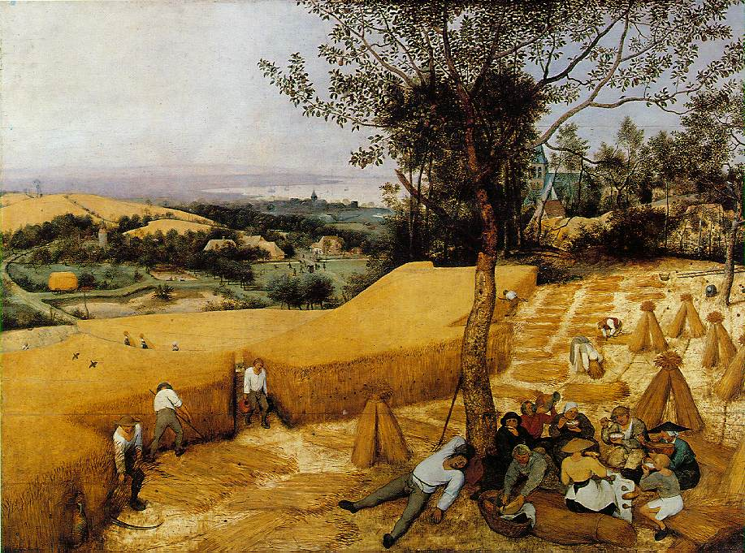
Food and the Environment
Pieter Bruegel the elder, The Harvesters, 1565, Metropolitan Museum of Art

Slide 2
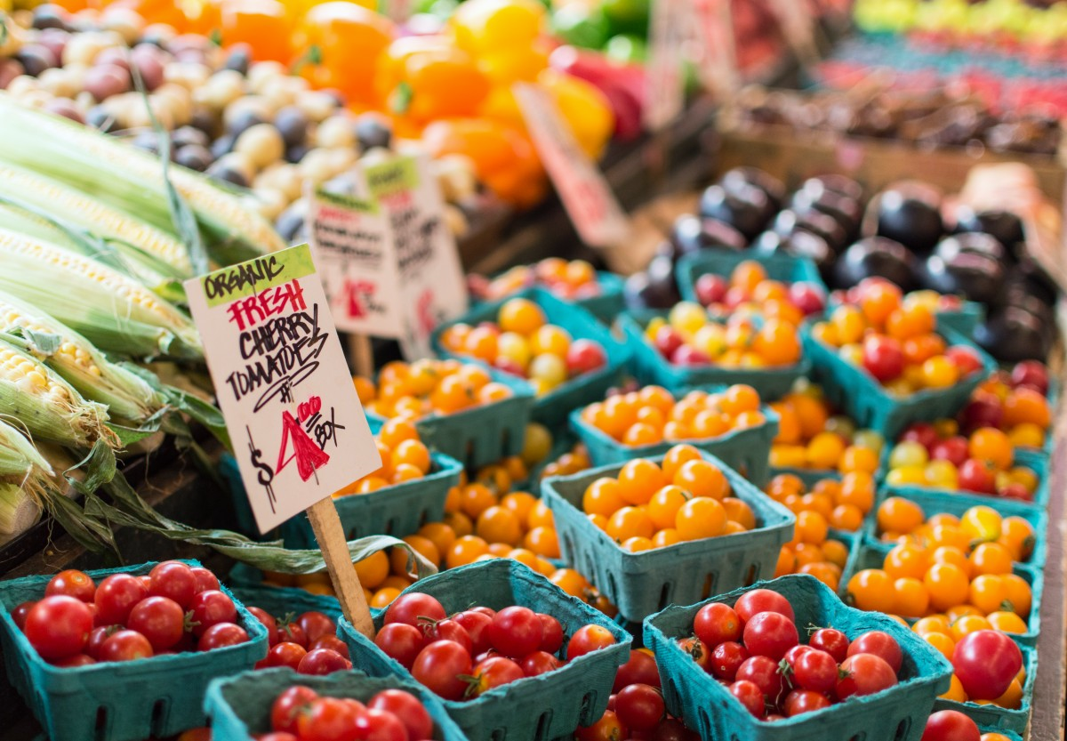

Food and Sustainable Development: A Cross-Cutting Issue
80% of the world’s poor live in rural areas and work mainly in agriculture.
10 food companies collectively generate more than $1.2bn daily.
More than 10% of the world’s population went hungry in 2020, while more than 2 billion people are overweight and obese.
25% of GHGs emissions are attributed to agriculture, forestry and land use change.
75-80% of Africa’s arable land is now degraded. Overgrazing is the main cause of this.
Nearly 90% of the world’s marine fish stocks are now fully exploited, overexploited or depleted.
Risks associated with poor diets are the leading cause of death worldwide.

Slide 3
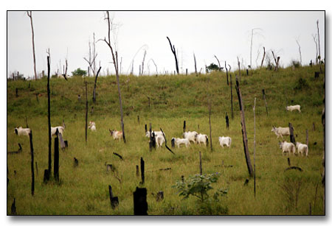
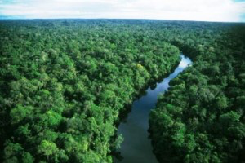
Amazonia
Cattle grazing in Amazonia
Without cattle

Slide 4
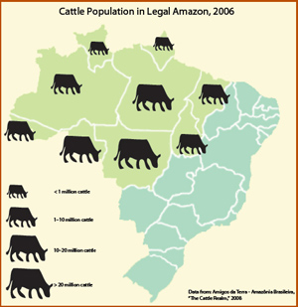
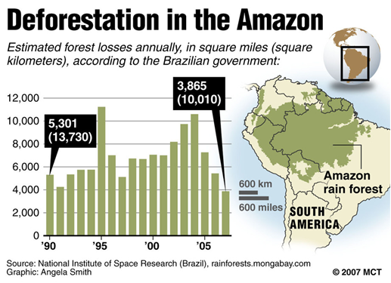
Cattle and Deforestation in the Amazon

Slide 5
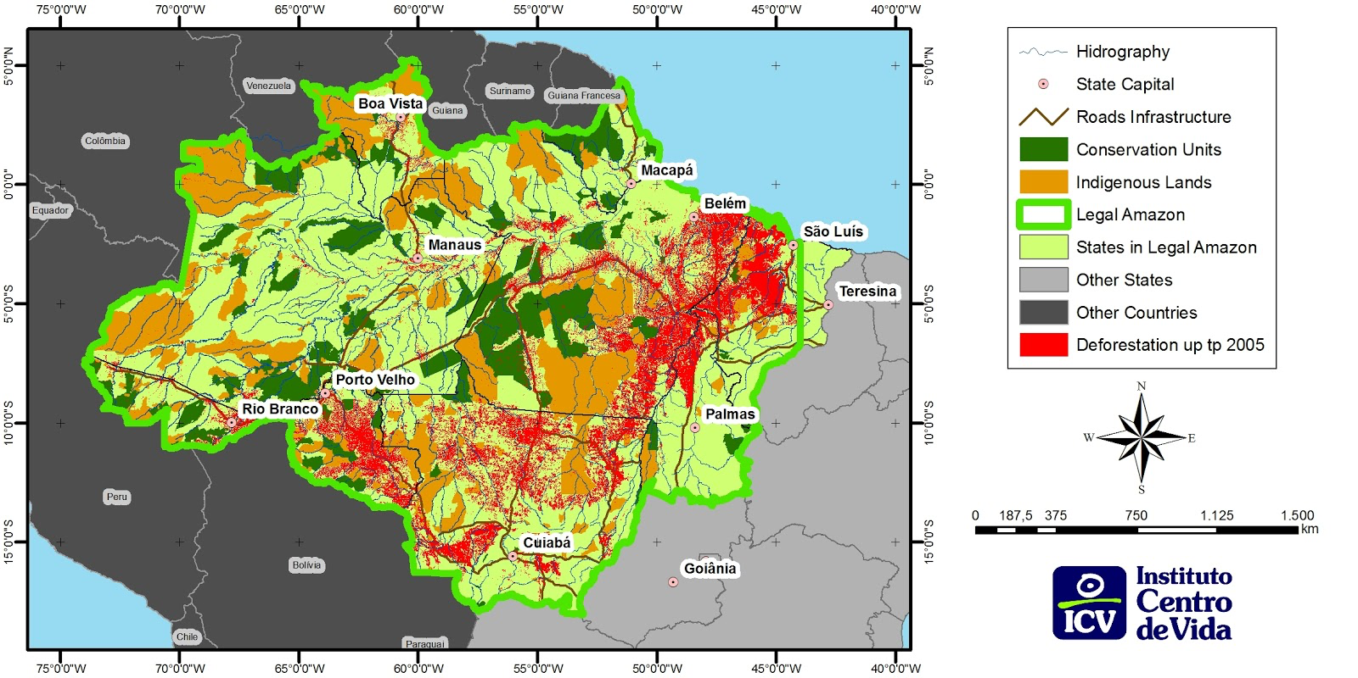
Deforestation in the Brazilian Amazon

Slide 6
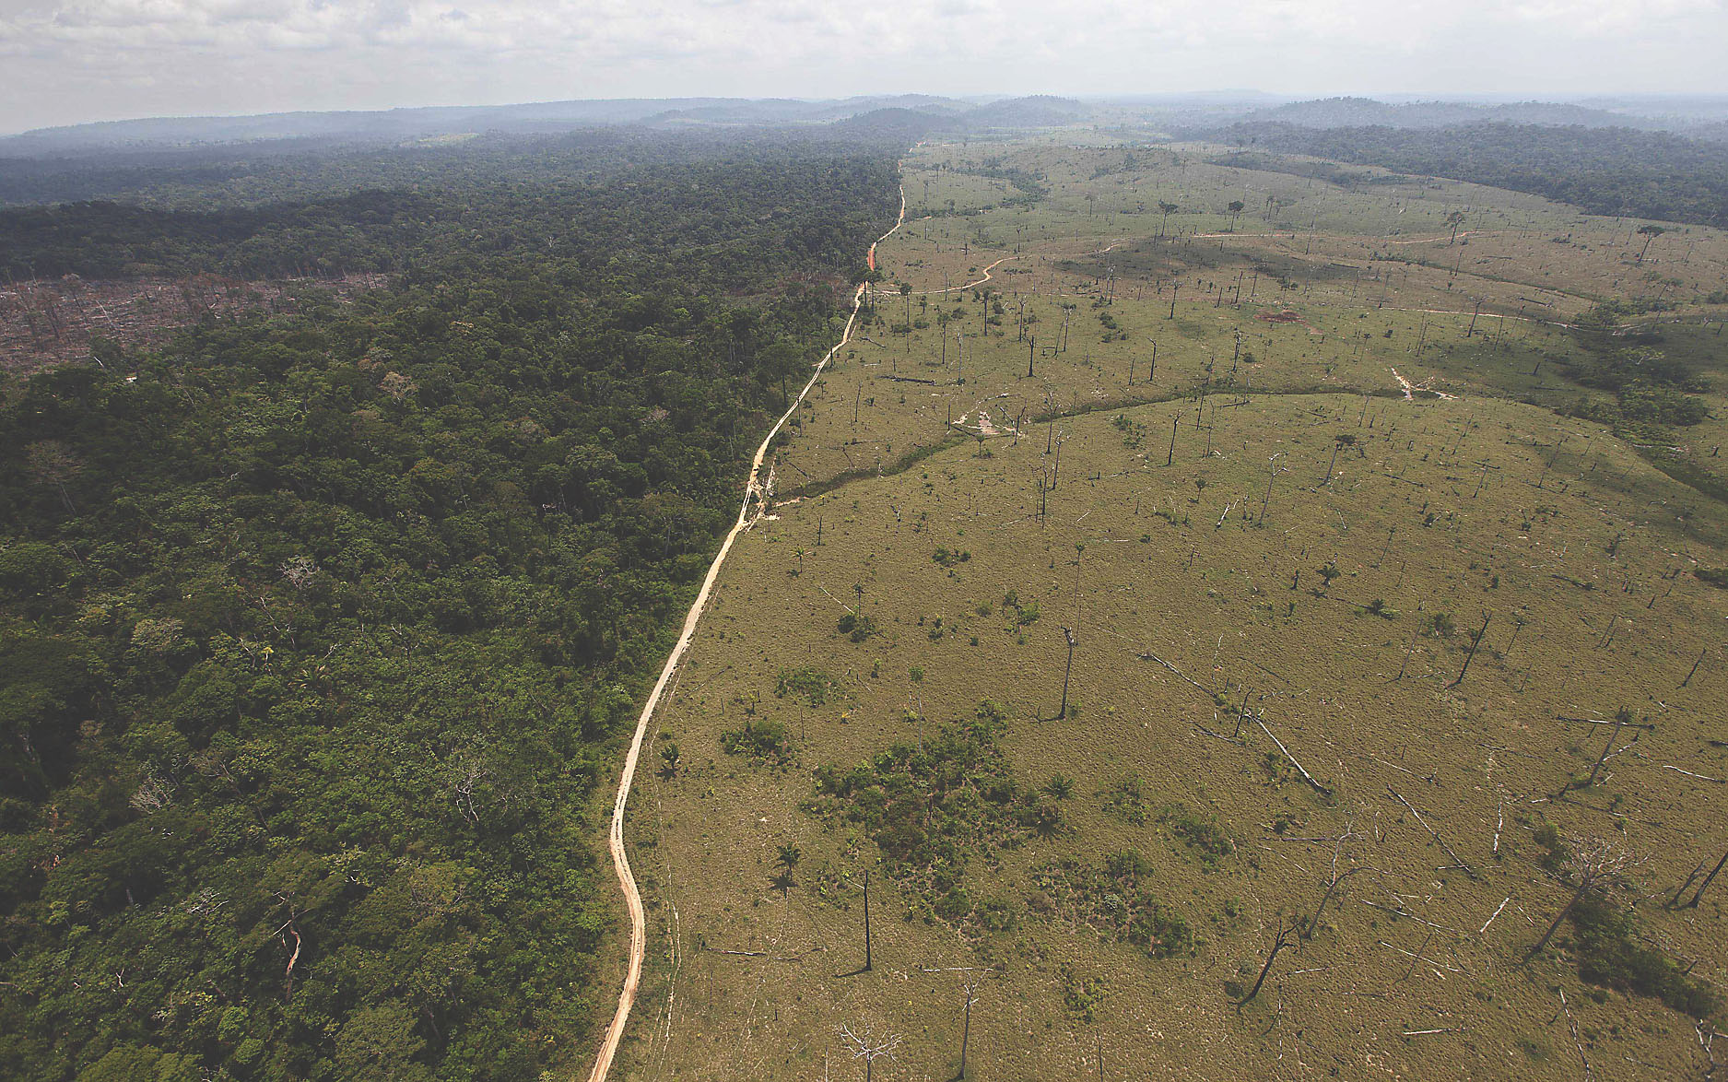
deforested area near Novo Progresso in the northern Brazilian state of Para (2013)

Slide 7
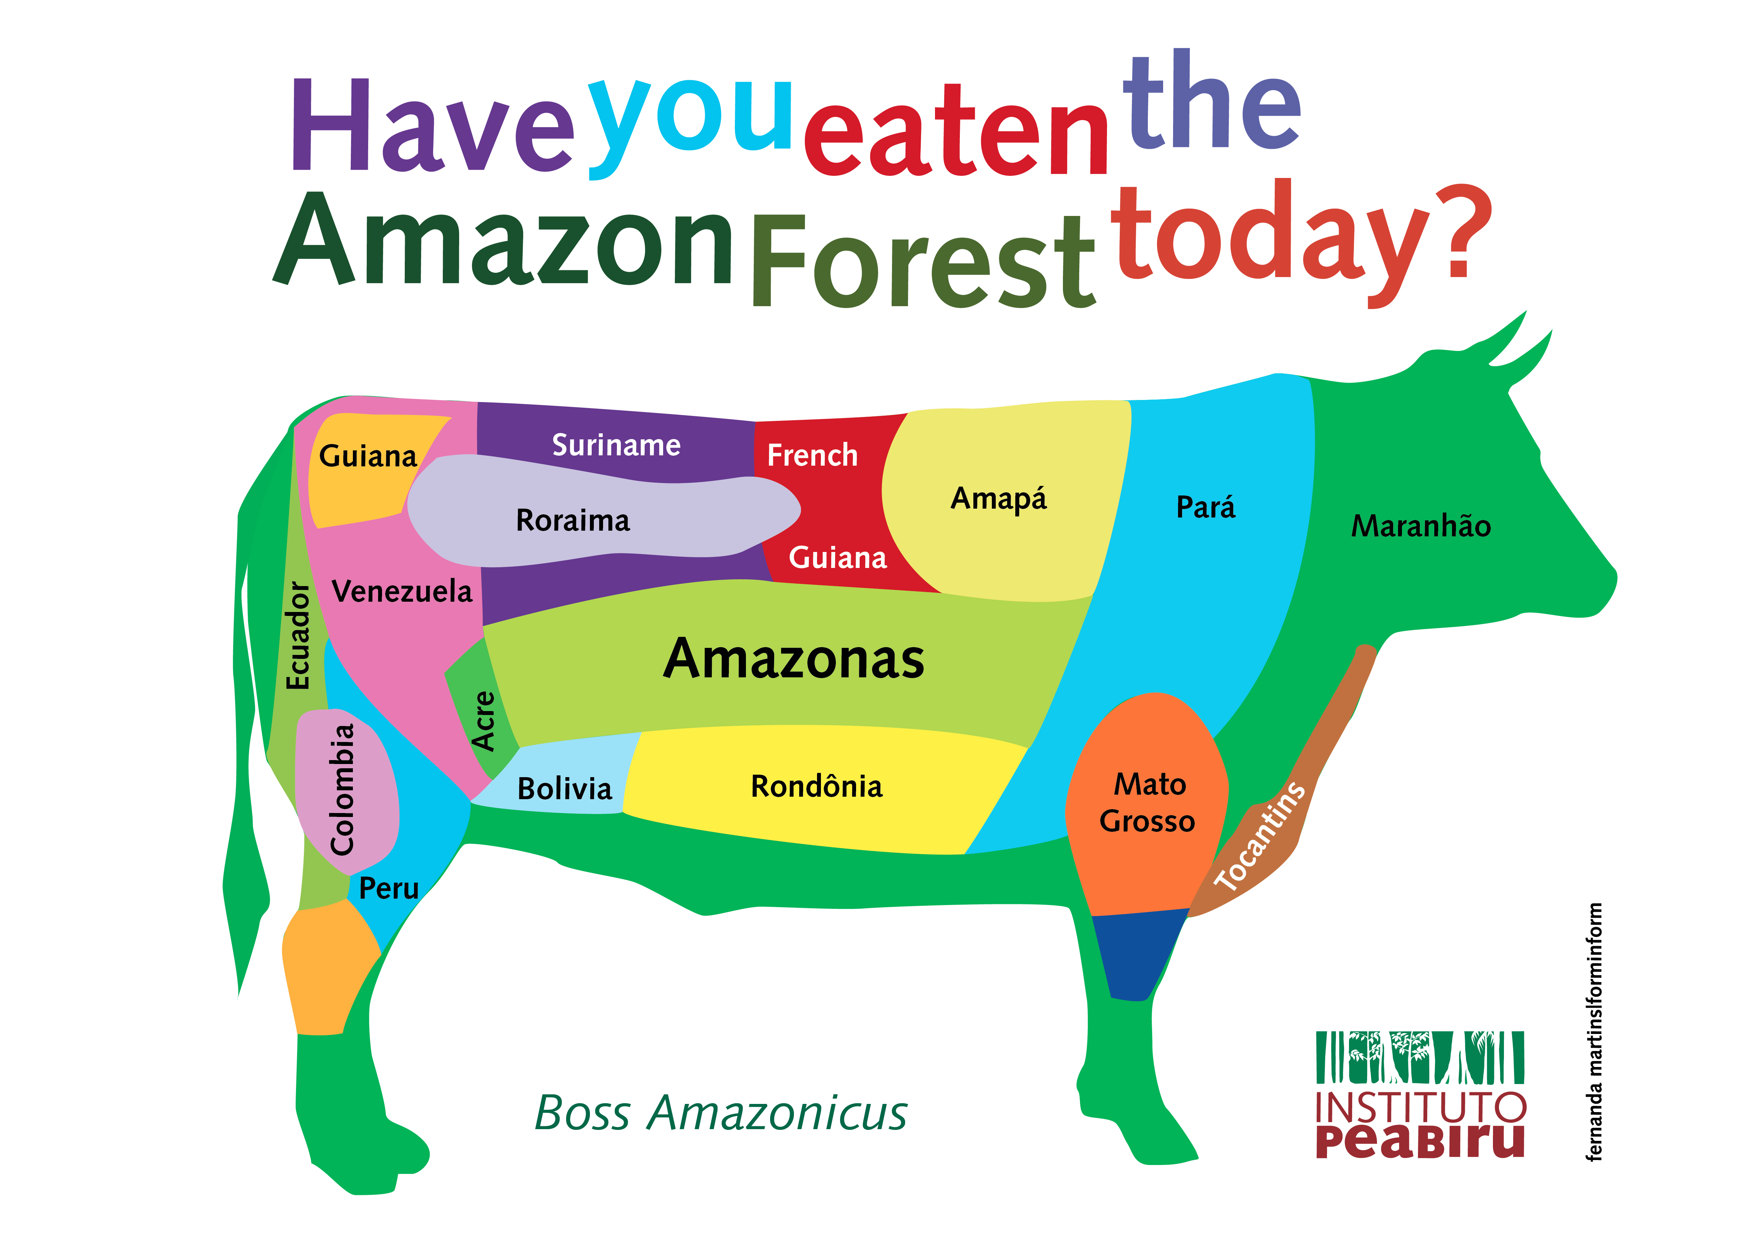

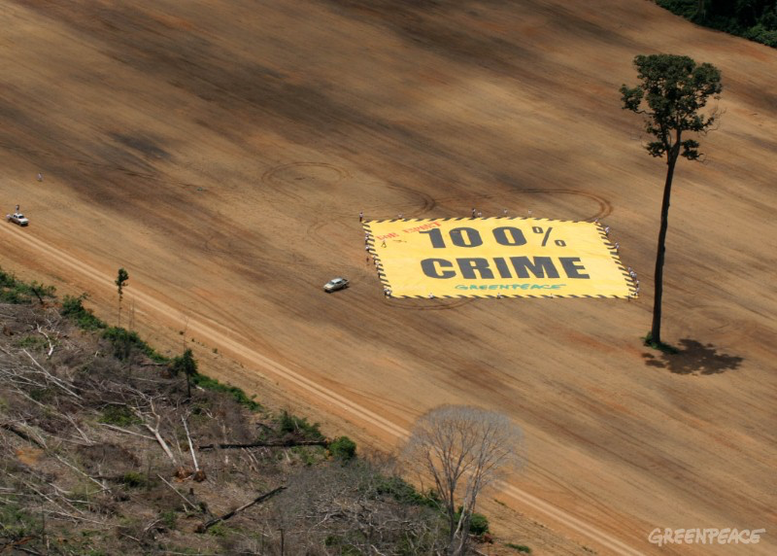
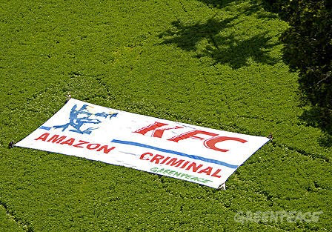

Slide 8
Jeremy Rifkin, Beyond Beef: the Rise and Fall of the Cattle Culture (1993).
Rifkin denounced the
‘devastating environmental, economic and human toll of maintaining a worldwide cattle complex’.

Slide 9
Last term we looked at the . . .
close links between colonialism, unfree labour and the production of commercial food crops such as sugar, coffee, tea, cacao, bananas . . .

Slide 10
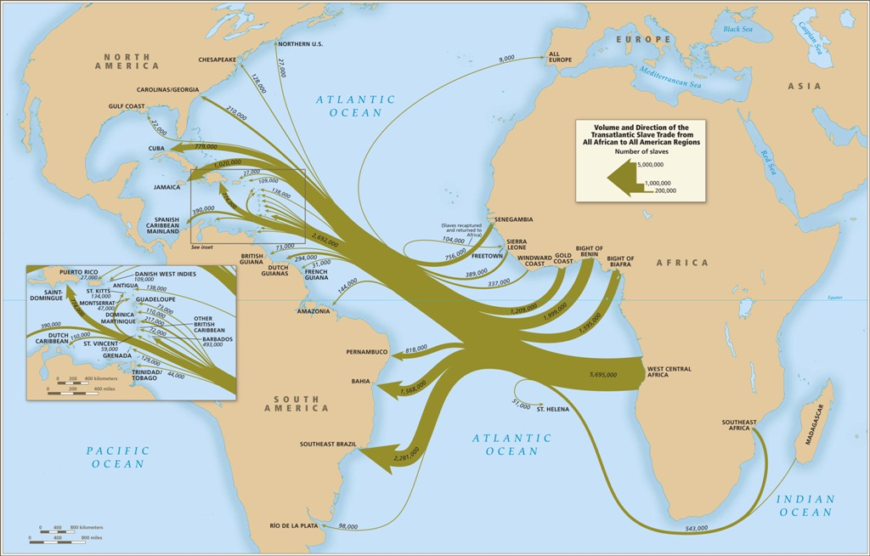
Atlantic slave trade

Slide 11
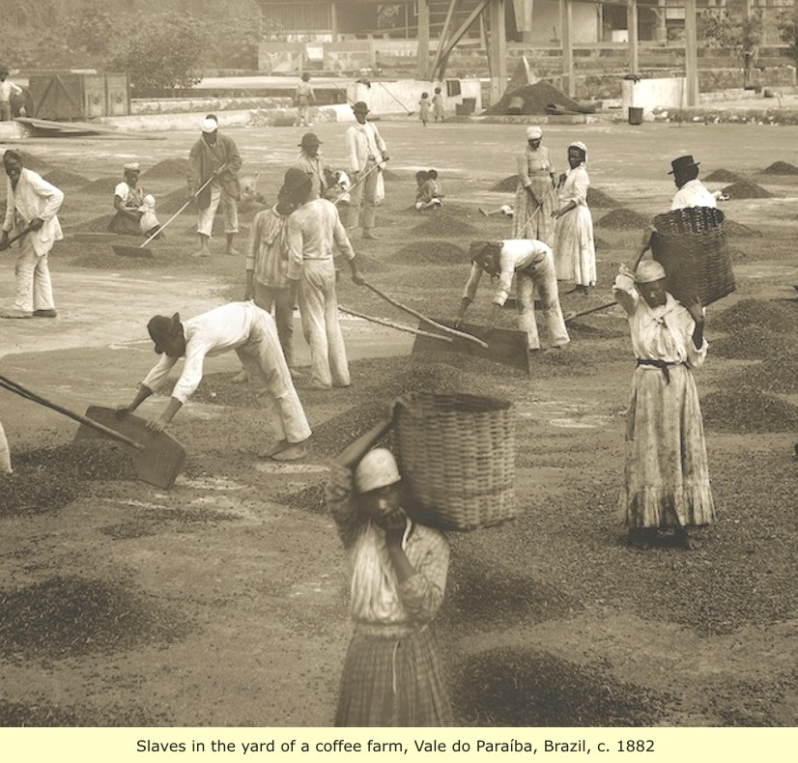
Enslaved workers on a Brazilian coffee plantation (1880s)

Slide 12
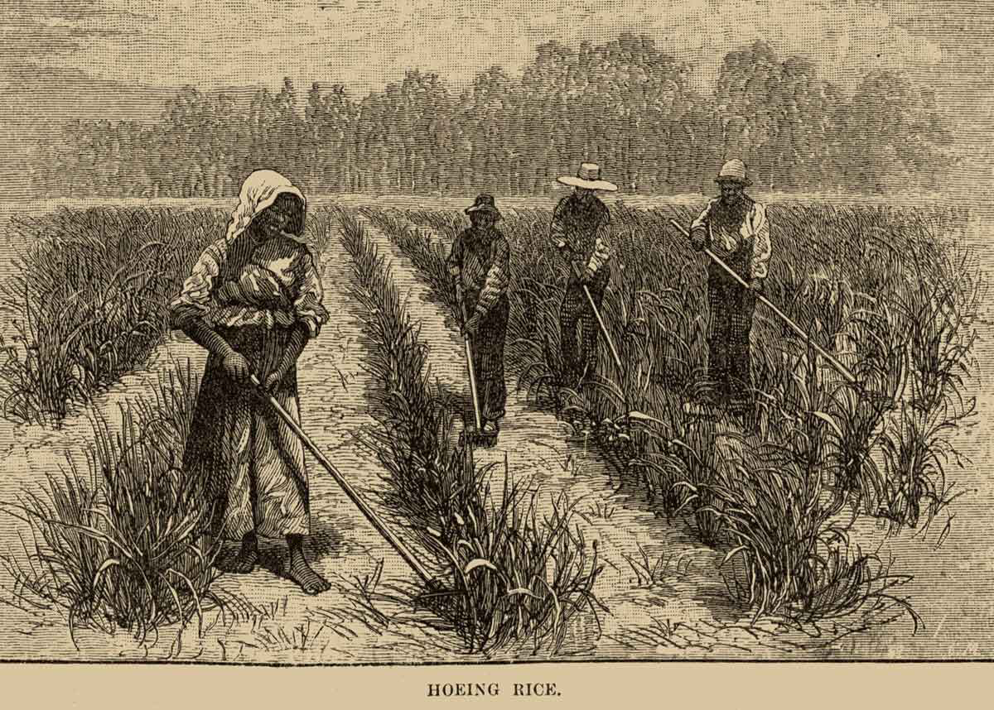
Enslaved workers tending rice on a North American plantation

Slide 13
Today let’s consider the
close links between colonialism, unfree labour, the production of commercial food crops
AND environmental change

Slide 14
Sterling Evans, ‘Agricultural Production and Environmental History’, The Oxford Handbook of Food History, ed. Jeffrey Pilcher (2012).
‘However profound the [environmental] changes wrought by [ancient] agrarian empires, they paled in comparison to the transformations of the industrial era.’

Slide 15
Lecture Structure
History of the history of the environment
Colonialism and environmental change
examples of sugar and ranching
‘Green imperialism’
The ‘ecologically noble savages’ debate
conclusions

Slide 16
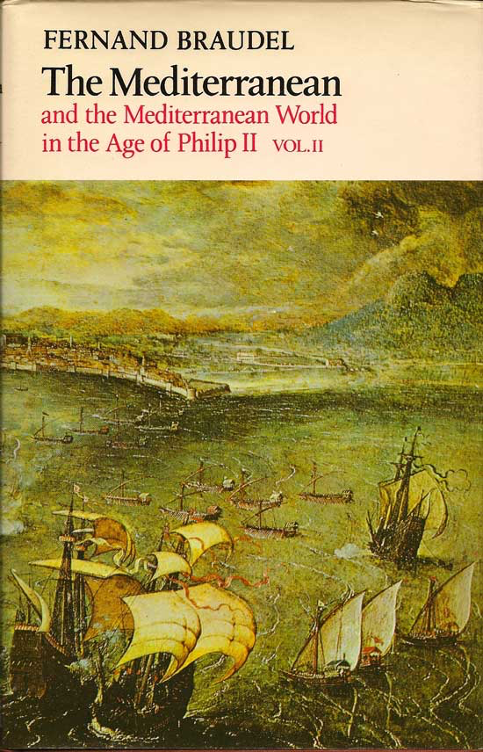
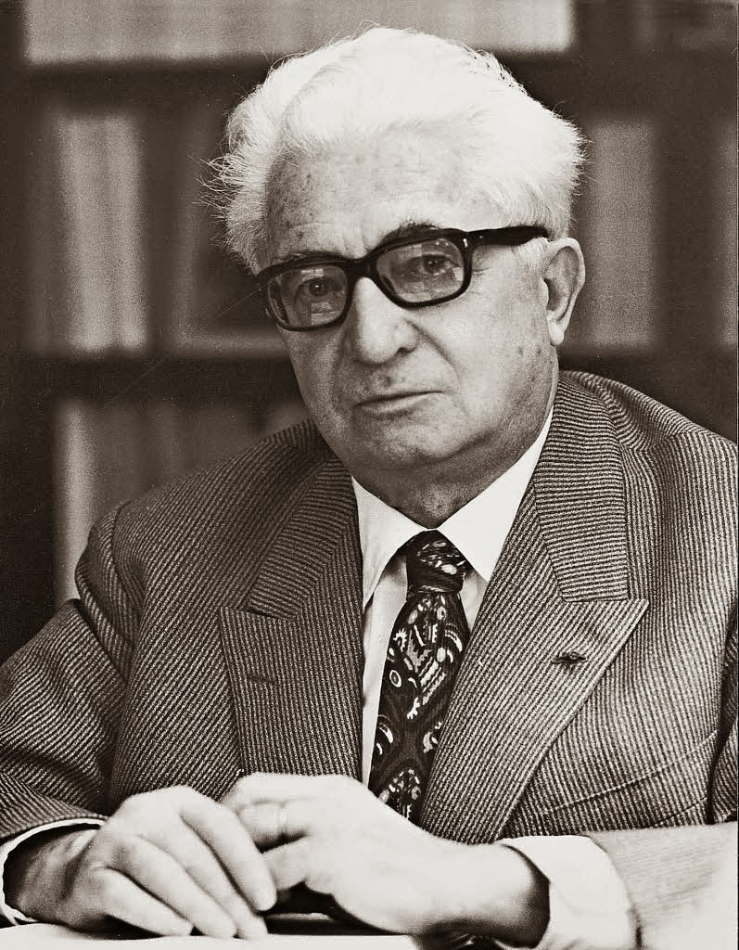
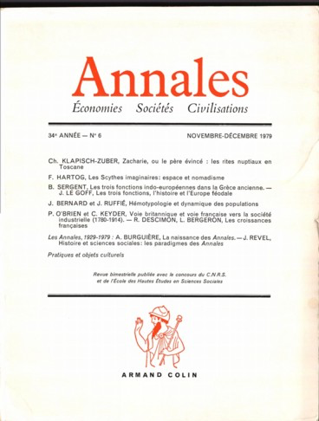
The history of the history of the environment
Annales school (very influential 1930s-1960s)
Fernand Braudel (1902-85):
longue durée vs. histoire évènementielle

Slide 17
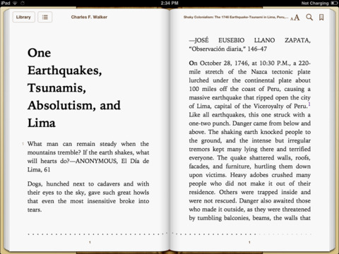
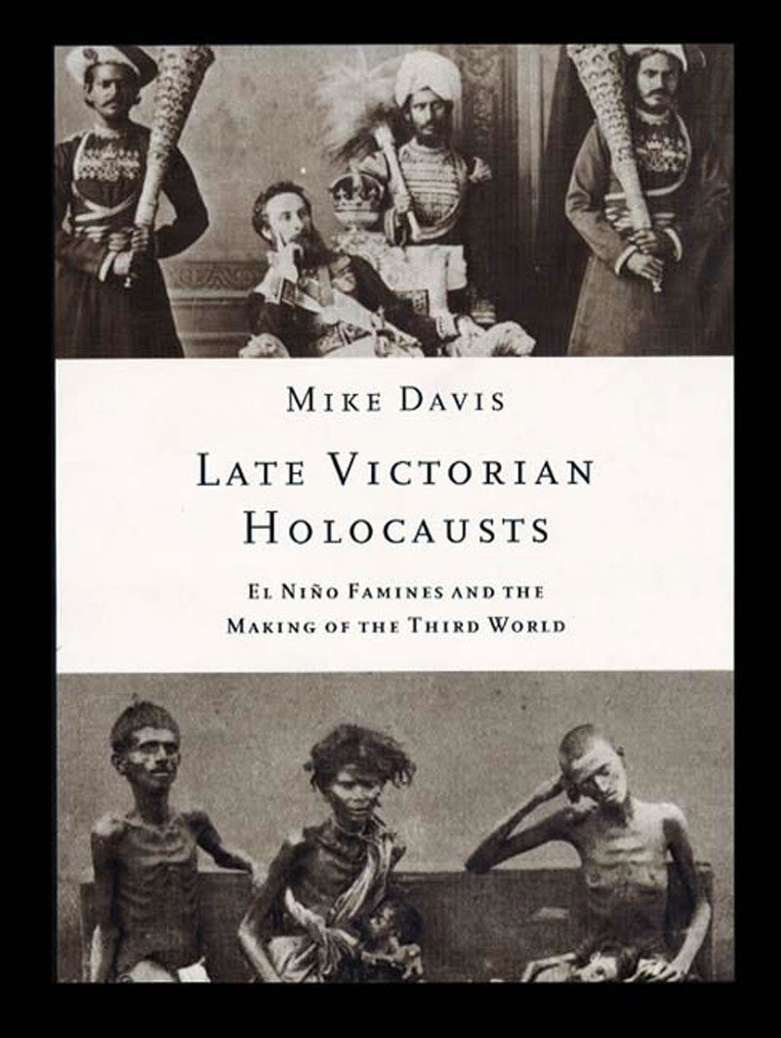
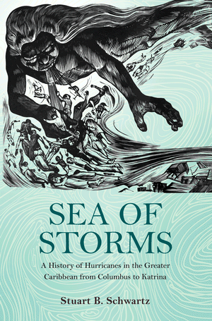
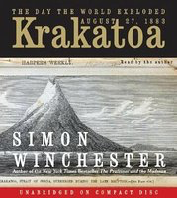
Histories of hurricanes, tsunamis, El Niño, volcanoes . . .

Slide 18
Colonialism and Environmental Change

Slide 19
William Beinart and Lotte Hughes, Environment and Empire (2007).
‘European imperialism was . . . inseparable from the history of global environmental change.’

Slide 20
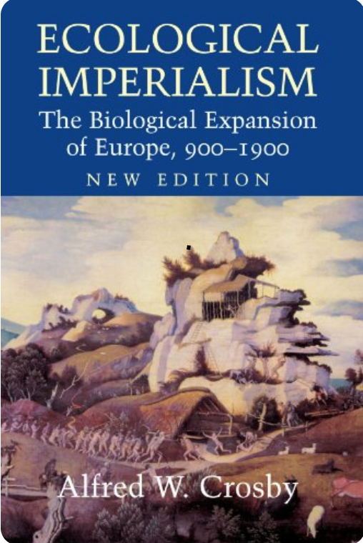
‘Ecological Imperialism’ Alfred Crosby’s term 1986

Slide 21
Sugar

Slide 22
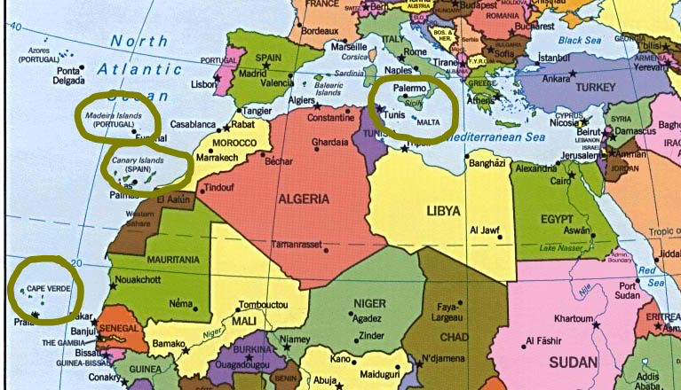
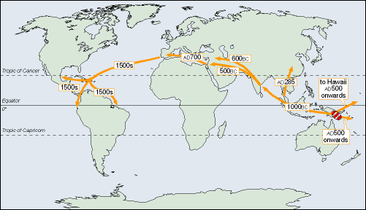
The spread of sugar
Early sites of cultivation

Slide 23
Jason W. Moore, ‘Sugar and the Expansion of the Early Modern World-Economy: Commodity Frontiers, Ecological Transformation, and Industrialization’, Review 23:3 (2000).
‘The sugar commodity frontier illustrates the fundamentally restless nature of world capitalism.’

Slide 24
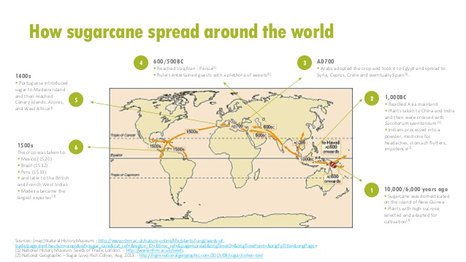

Slide 25
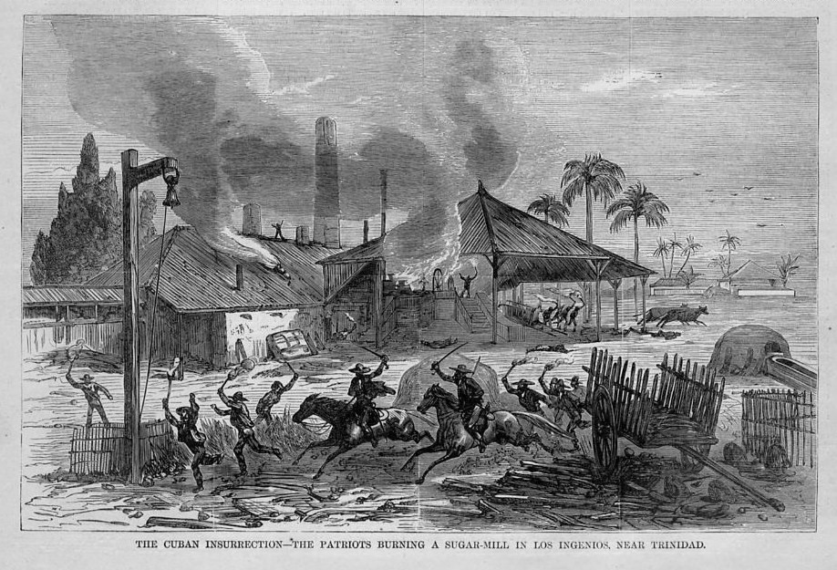
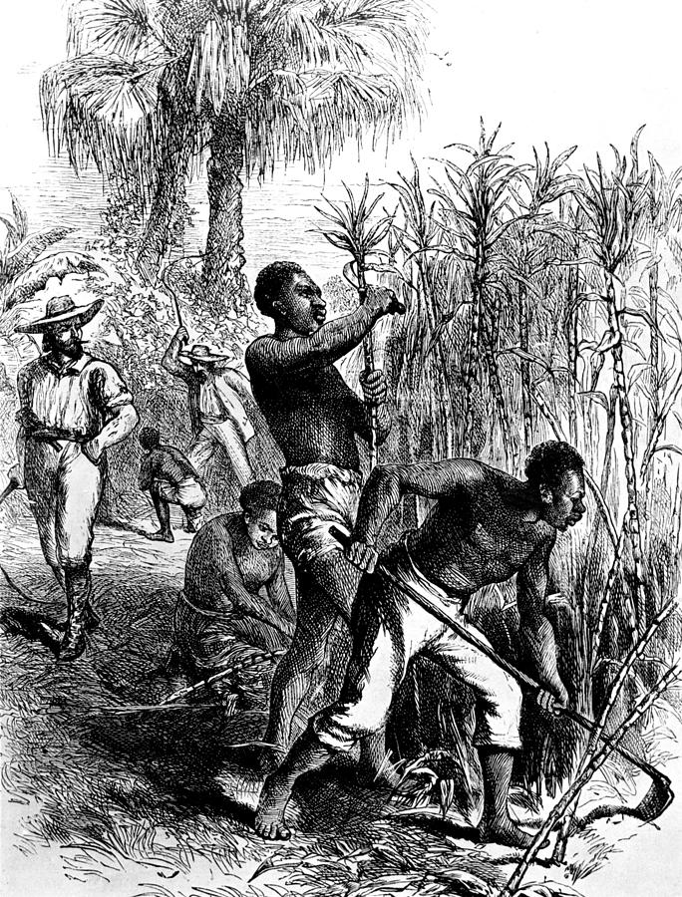
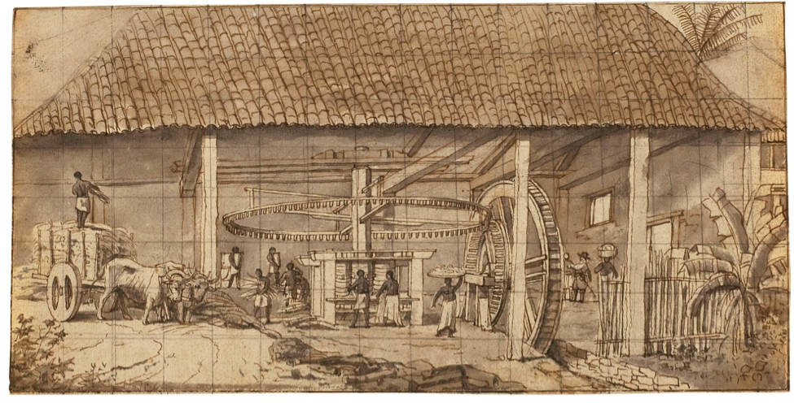
Sugar cultivation in the Americas: a modern industrial process reliant on enslaved labour

Slide 26
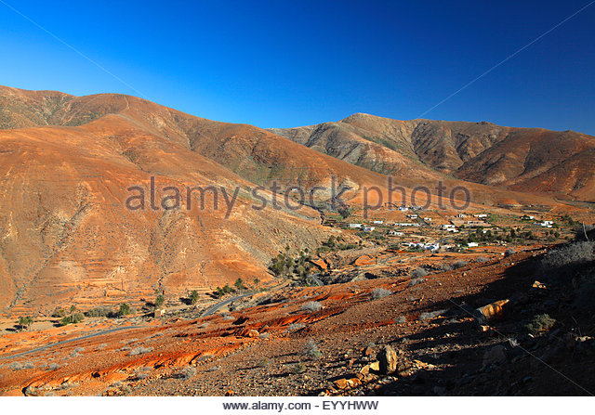
village in deforested mountains Vegas de Rio Palmas, Canary Islands

Slide 27
Moore, ‘Sugar and the Expansion of the Early Modern World-Economy’.
‘The link between sugar and deforestation was evident from the very beginning of sugar cultivation in the New World.’

Slide 28
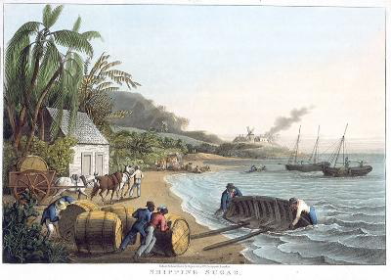
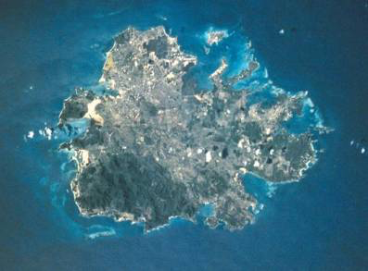
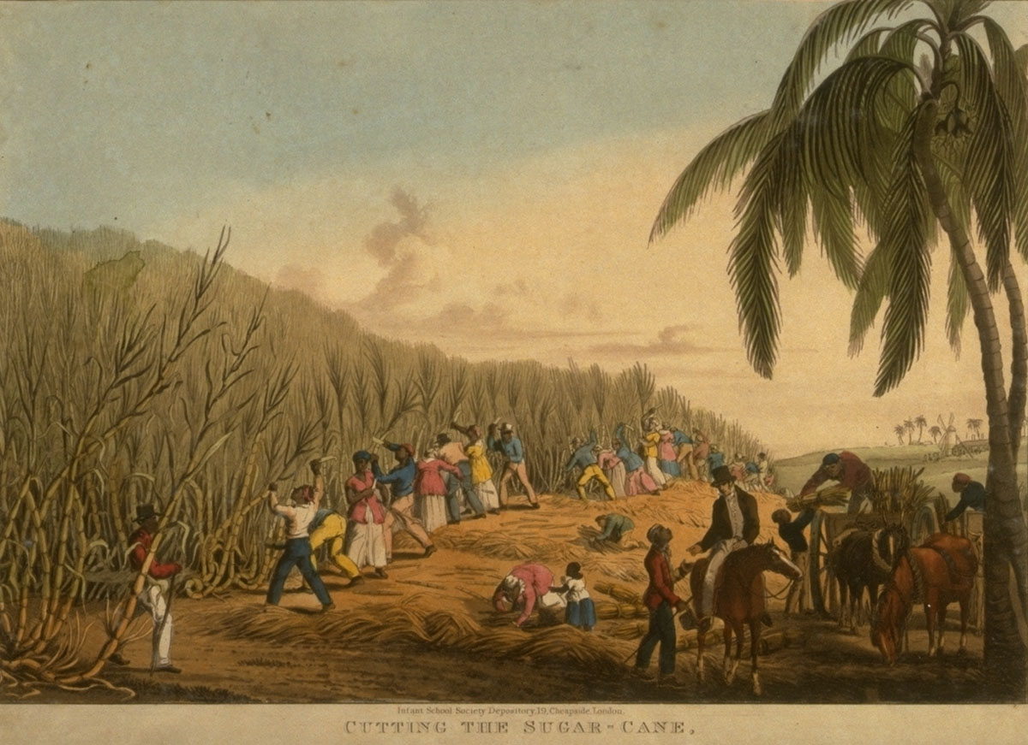
Deforestation in Antigua
Antigua 1820s
Antigua today

Slide 29
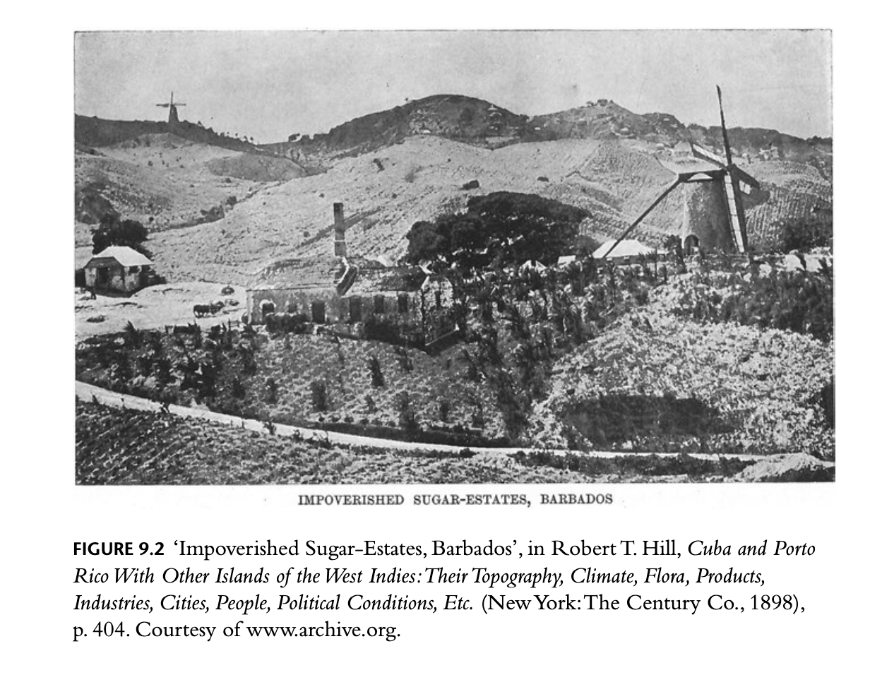
Environmental consequences of colonial sugar cultivation
deforestation
loss of soil fertility
silting of rivers
soil erosion
increased rainfall

Slide 30
William Beinart and Lotte Hughes, Environment and Empire (2007).
‘Sugar crushed an earlier landscape as well as hundreds of thousands of lives.’
(I would say: millions of lives.)

Slide 31
Moore, ‘Sugar and the Expansion of the Early Modern World-Economy’.
‘Early modern capitalist expansion [is] a socio-ecological process’.

Slide 32
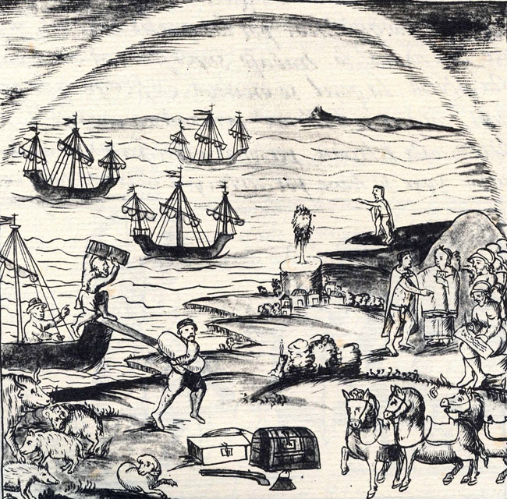
The Columbian Exchange: livestock Florentine Codex (16th century)

Slide 33
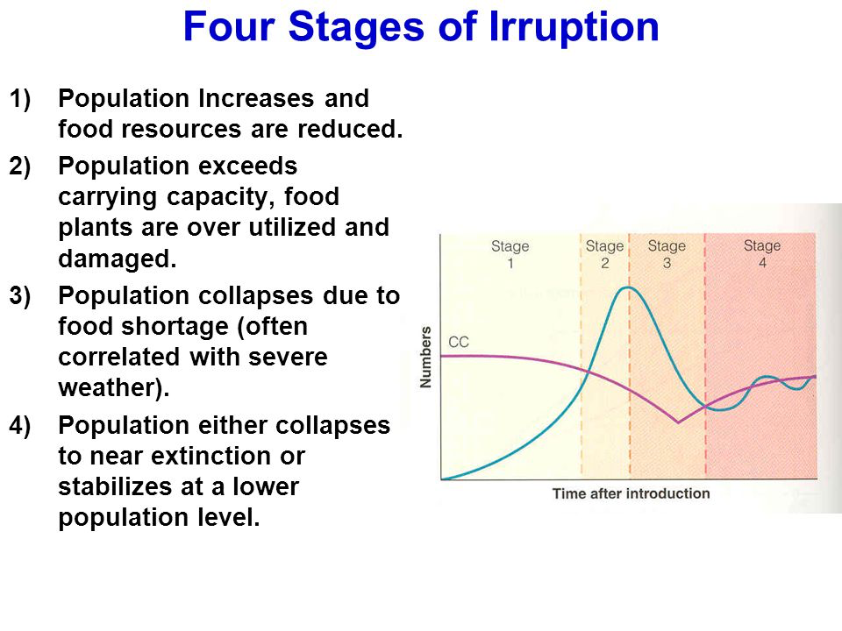
‘ungulate irruption’

Slide 34
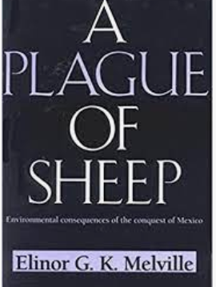
Elinor Melville, A Plague of Sheep: Environmental Consequences of the Conquest of Mexico (1994).
In colonial Mexico, after the introduction of sheep, ‘land became fit only for sheep. It was not inherently poor’.

Slide 35
‘Green imperialism’
(Richard Grove’s term)

Slide 36
John Locke, Second Treatise of Government (1689)
God made the world for everyone, but . . .
‘it cannot be supposed that He meant it should always remain common and uncultivated. He gave it for the use of the Industrious and Rational.’
‘Improvement’—a ‘legitimating metaphor’ for colonialism.
Fiona Mackenzie, ‘Contested Ground: Colonial Narratives and the Kenyan Environment, 1920–1945’, Journal of Southern African Studies 26:4 (2000).

Slide 37
Richard Grove, ‘Climatic Fears: Colonialism and the History of Environmentalism’, Harvard International Review 23.4 (2002).
‘It was in the tropics that the destructive environmental impact of globalization made its most obvious impact to the observer.’

Slide 38
Grove, ‘Climatic Fears’.
‘History shows that only serious state intervention to control capital or corporate interests can hope to deal with the deadly risks of climate change, forest loss, and species extinction.’

Slide 39
‘Ecologically Noble Savages’
vs. ‘Ecological Imperialism’??

Slide 40
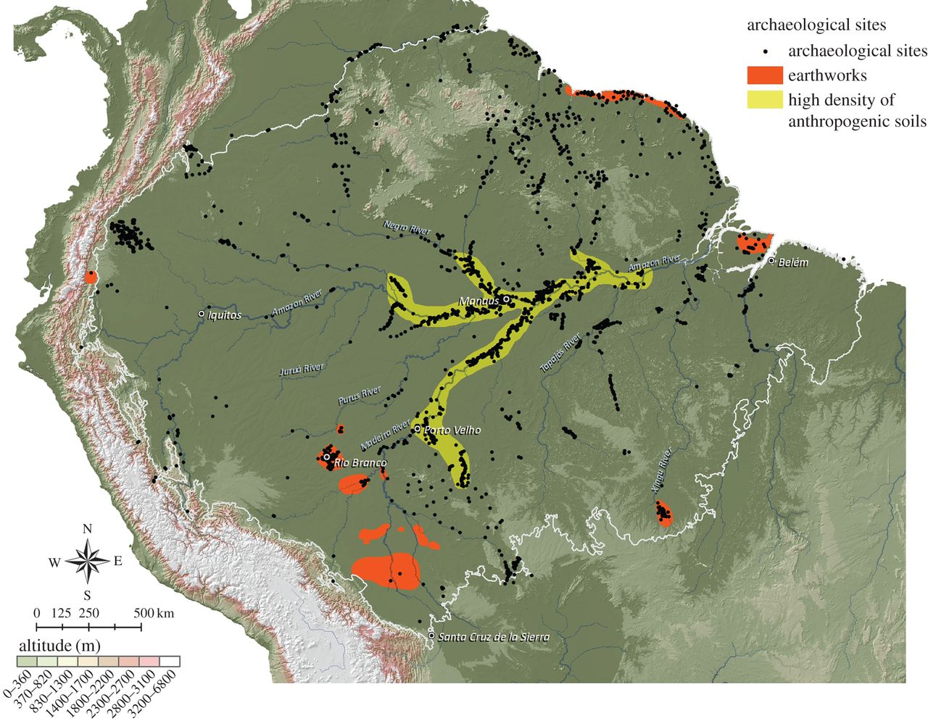
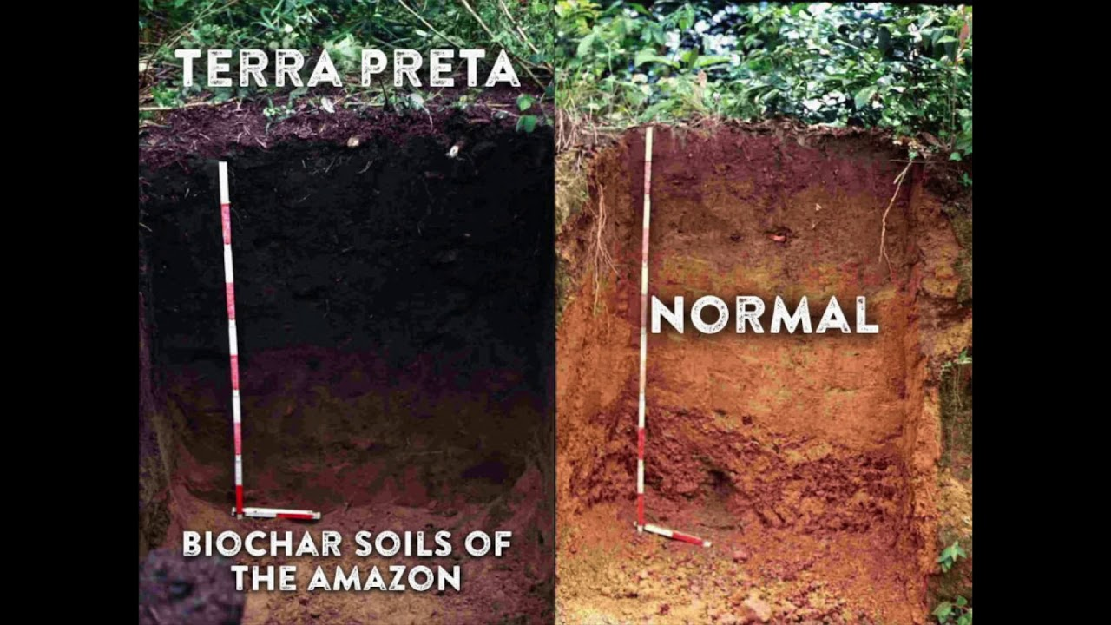
Terra preta (‘black earth’) in Amazonia

Slide 41
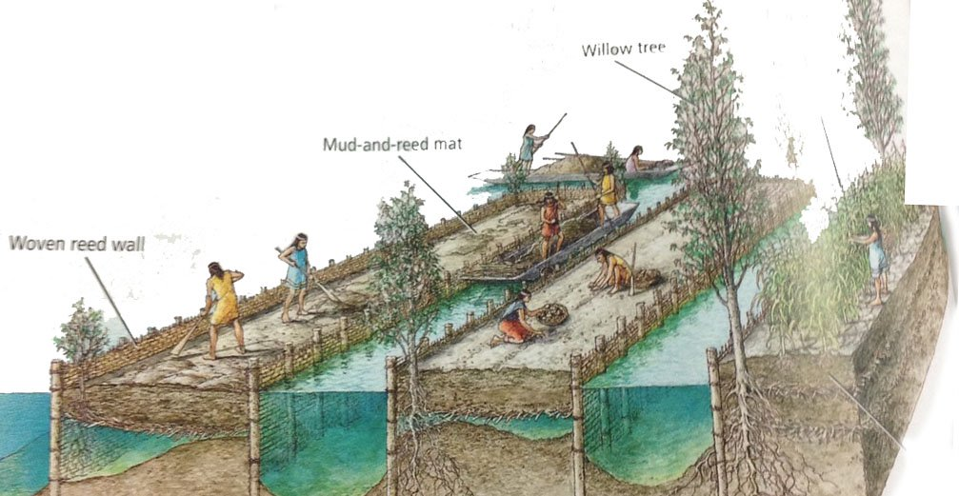
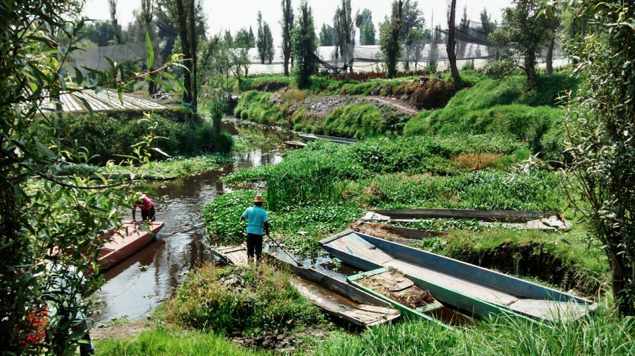
Chinampas: ‘floating gardens’ used in central Mexico

Slide 42
The Trees Bear Witness
‘The position of Brazil nut trees (Bertholletia excelsa) in Amazonia reflects human agency: “Genetic and demographic evidence suggests that they’ve been spread by humans for millennia, as part of a culture of agroforestry”. Most however are from the 16th and 17th centuries—there are few that are more recent. This is because “the missing stands of trees represent missing cohorts of people”—i.e. the Amazonia people who died after colonisation, and therefore did not spread any trees. These trees “are still bearing witness, after four or five hundred years, to the destruction of the people—the families and societies—who planted them one by one”.’
Sentences in double quotation marks are from Jared Farmer, Elderflora: A Modern History of Ancient Trees (2023).
The rest is from Verlyn Klinkenborg, ‘Trees in Themselves’, New York Review of Books 70:6 (23 March 2023), 37.

