Slide 1
Food & Art

Slide 2
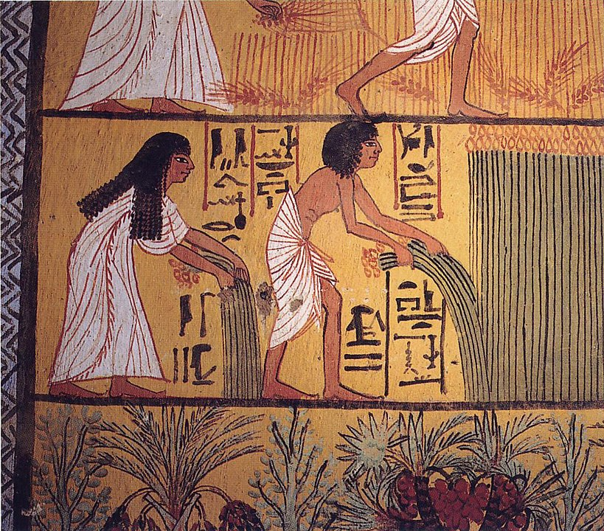
Mural of a couple harvesting grain, Deir el-Medina tomb (Egypt), c. 1000 BCE

Slide 3
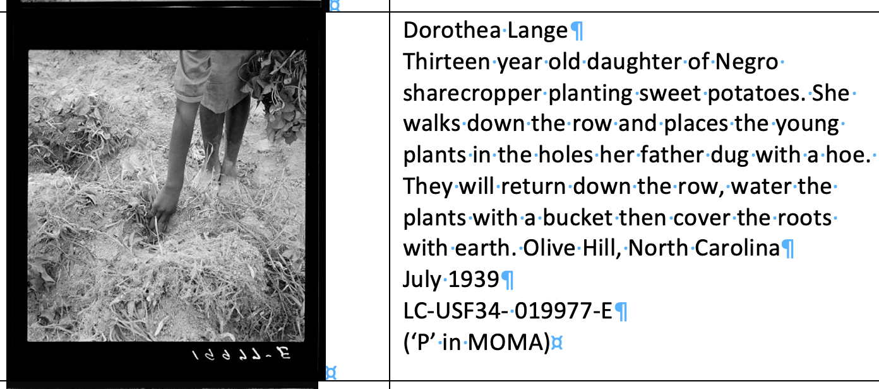

Slide 4
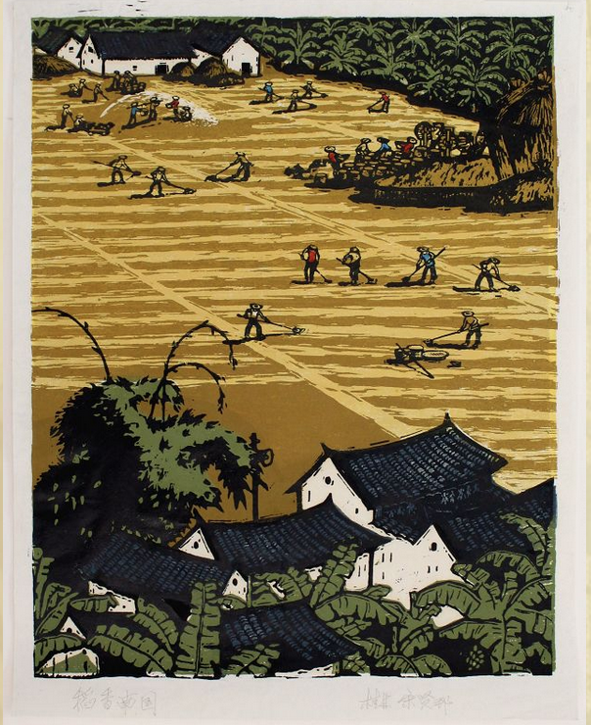
Song Xianbang, ‘Savoury Rice in South China’, 1960s.

Slide 5
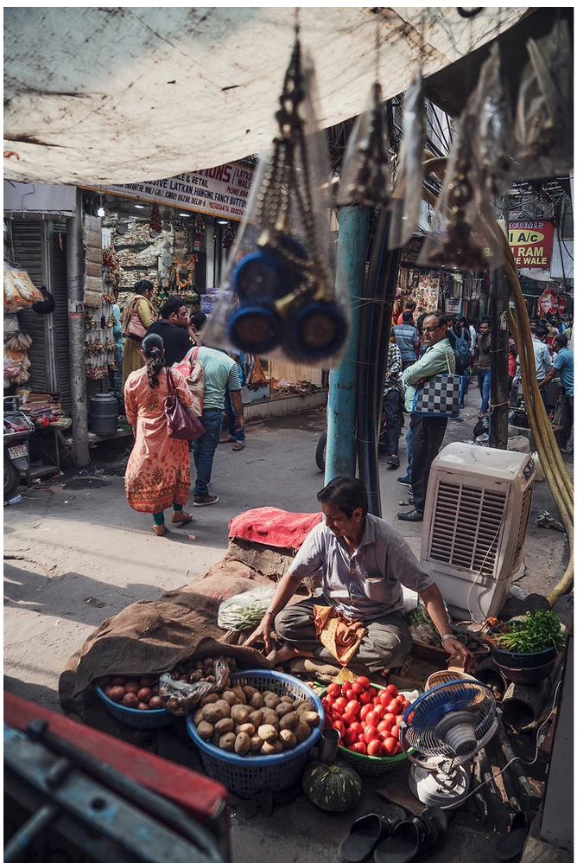
Sunil Gupta, ‘Vegetable vendor in Chandni Chowk, Old Delhi’, 2019.

Slide 6
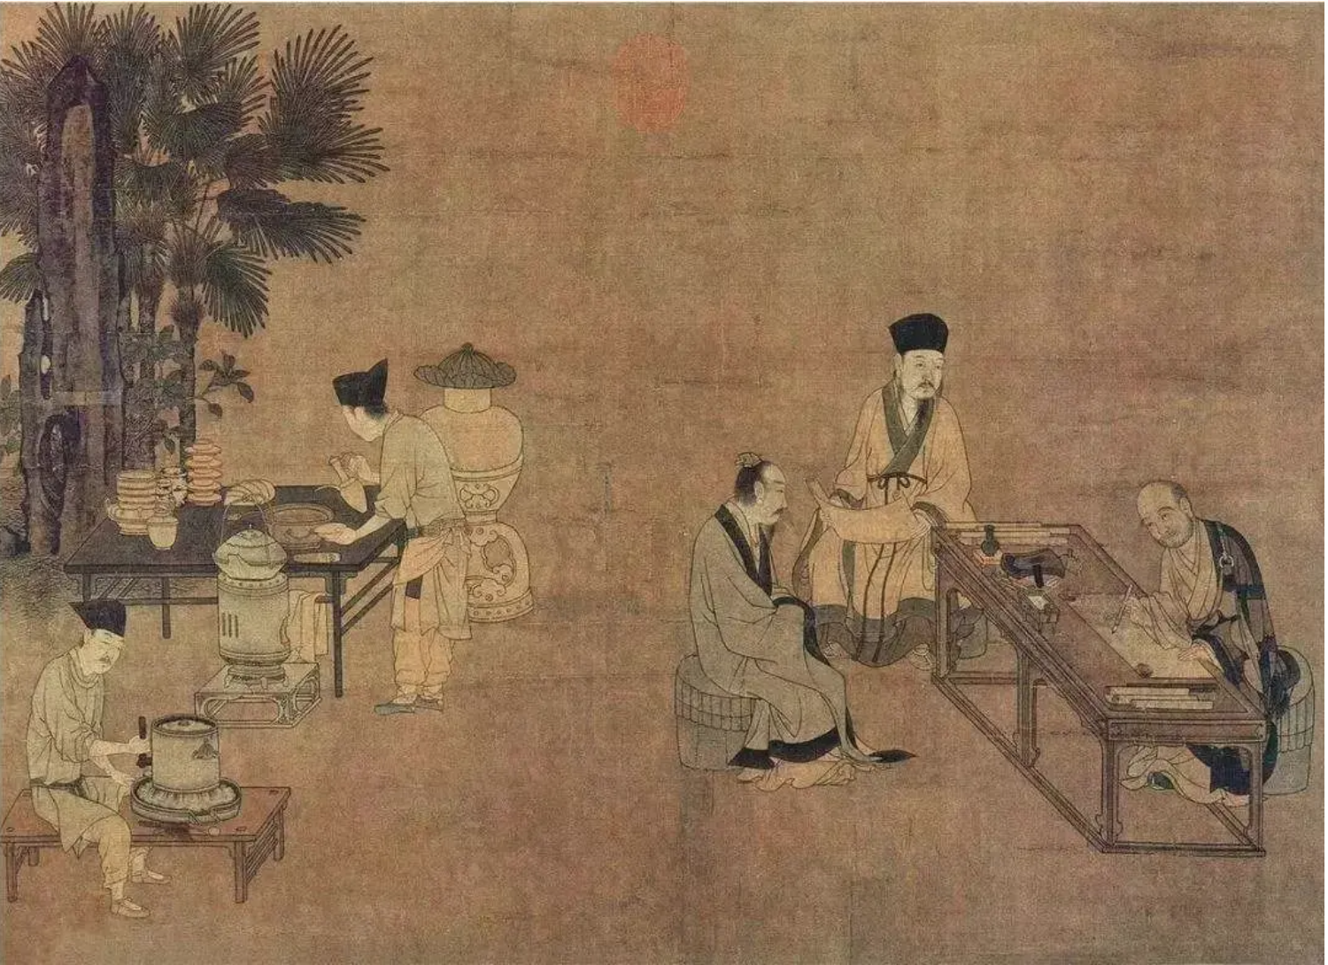
Liu Songnian, Song dynasty Grinding Tea , 1174-1224 , Southern Branch of the National Palace Museum, Taiwan

Slide 7
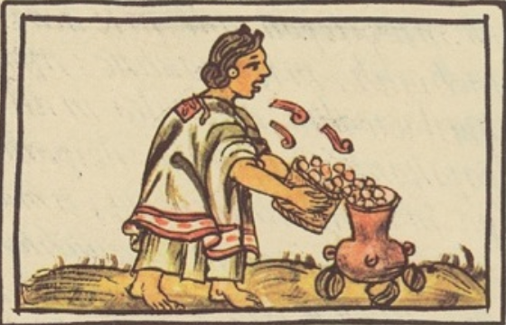
Aztec woman preparing corn, Florentine Codex, 16th century.

Slide 8
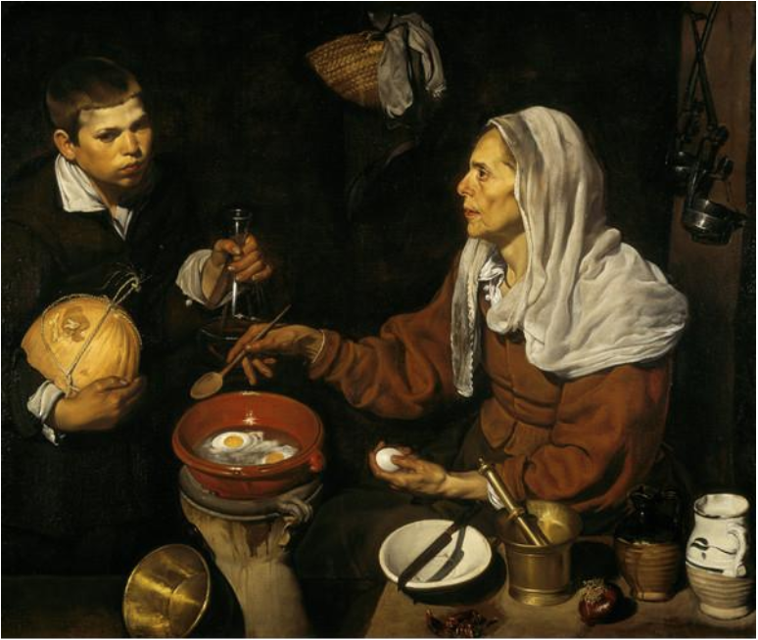
Diego Velázquez , An Old Woman Cooking Eggs, 1618, National Galleries of Scotland

Slide 9
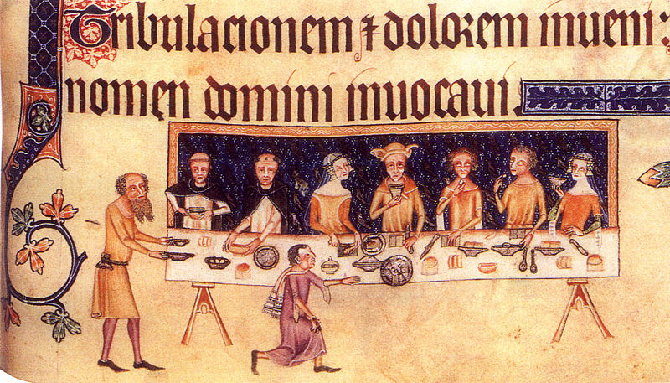
Luttrell Psalter, c. 1330

Slide 10
Pieter Breugel the elder, Peasant Wedding (1566-69), Kunsthistorisches Museum, Vienna

Slide 11
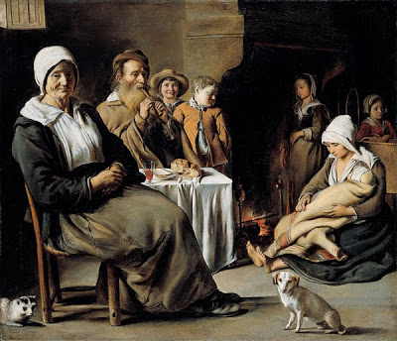
Louis Le Nain, Peasant Family in an Interior (1640s?), Louvre.

Slide 12
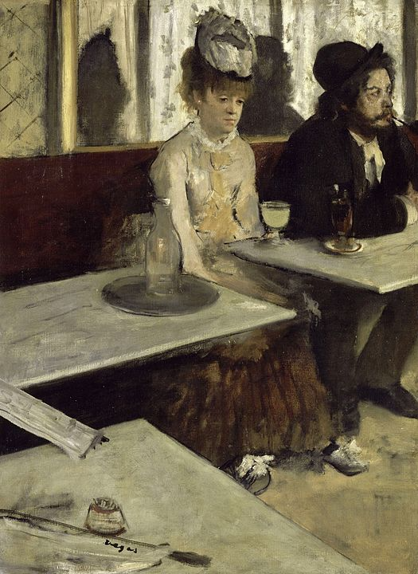
Edgar Degas, L’Absinthe, 1875-76, Musée d’Orsay

Slide 13
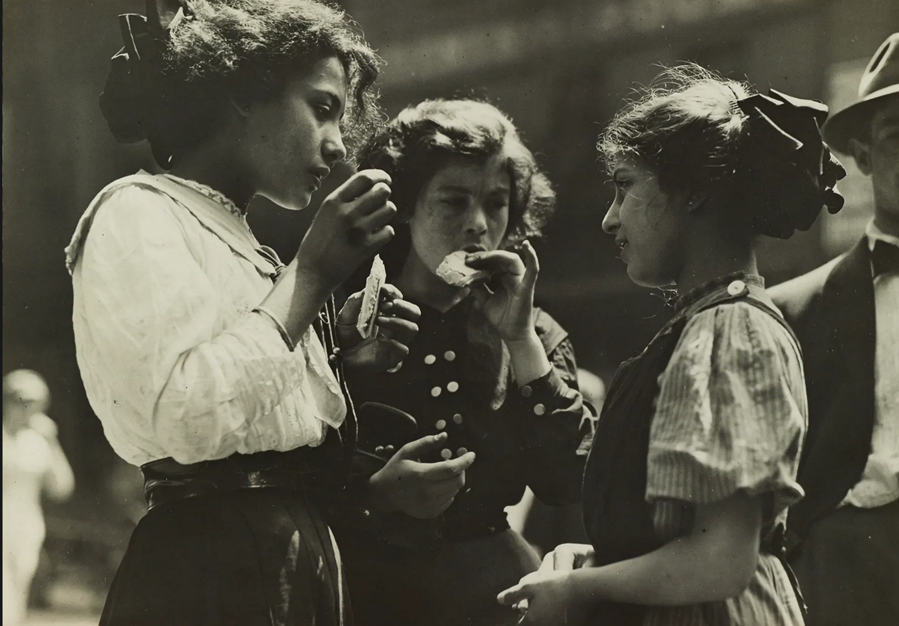
Louis Hine, Noon hour in East Side factory district, New York, 1912.

Slide 14
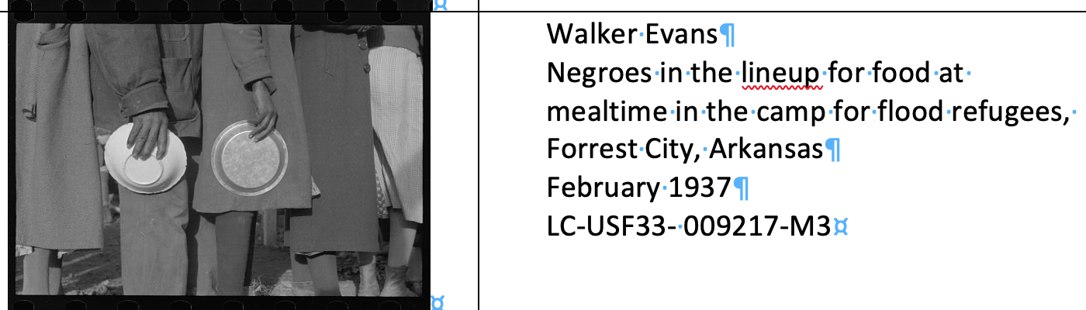

Slide 15
Art as Illustration

Slide 16
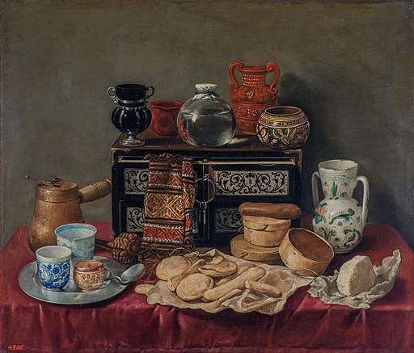
Antonio de Pereda, Still-Life with Ebony Chest, 1652, State Hermitage Museum
Dutch School, Two Ladies and an Officer Seated at Tea, c.1715, Victoria and Albert Museum.

Slide 17
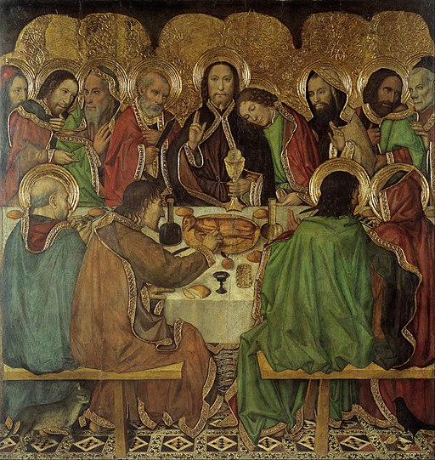
Jaime Huguet Last Supper, c.1470, Museu Nacional d’Arte de Catalunya, Barcelona.

Slide 18
Art as Evidence

Slide 19
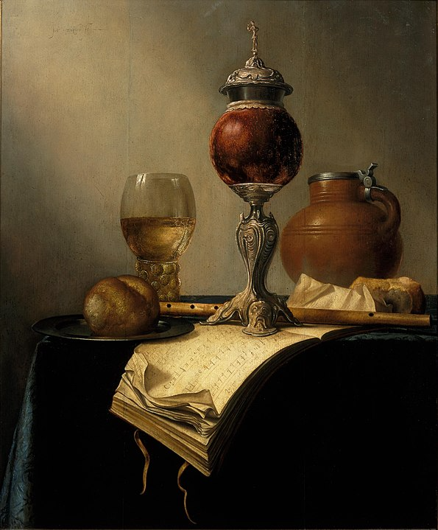
Jan Hendricksz van Zuylen, Still Life with Coconut Bowl, c.1650, Centraal Museum, Utrecht
’pronkstilleven’

Slide 20
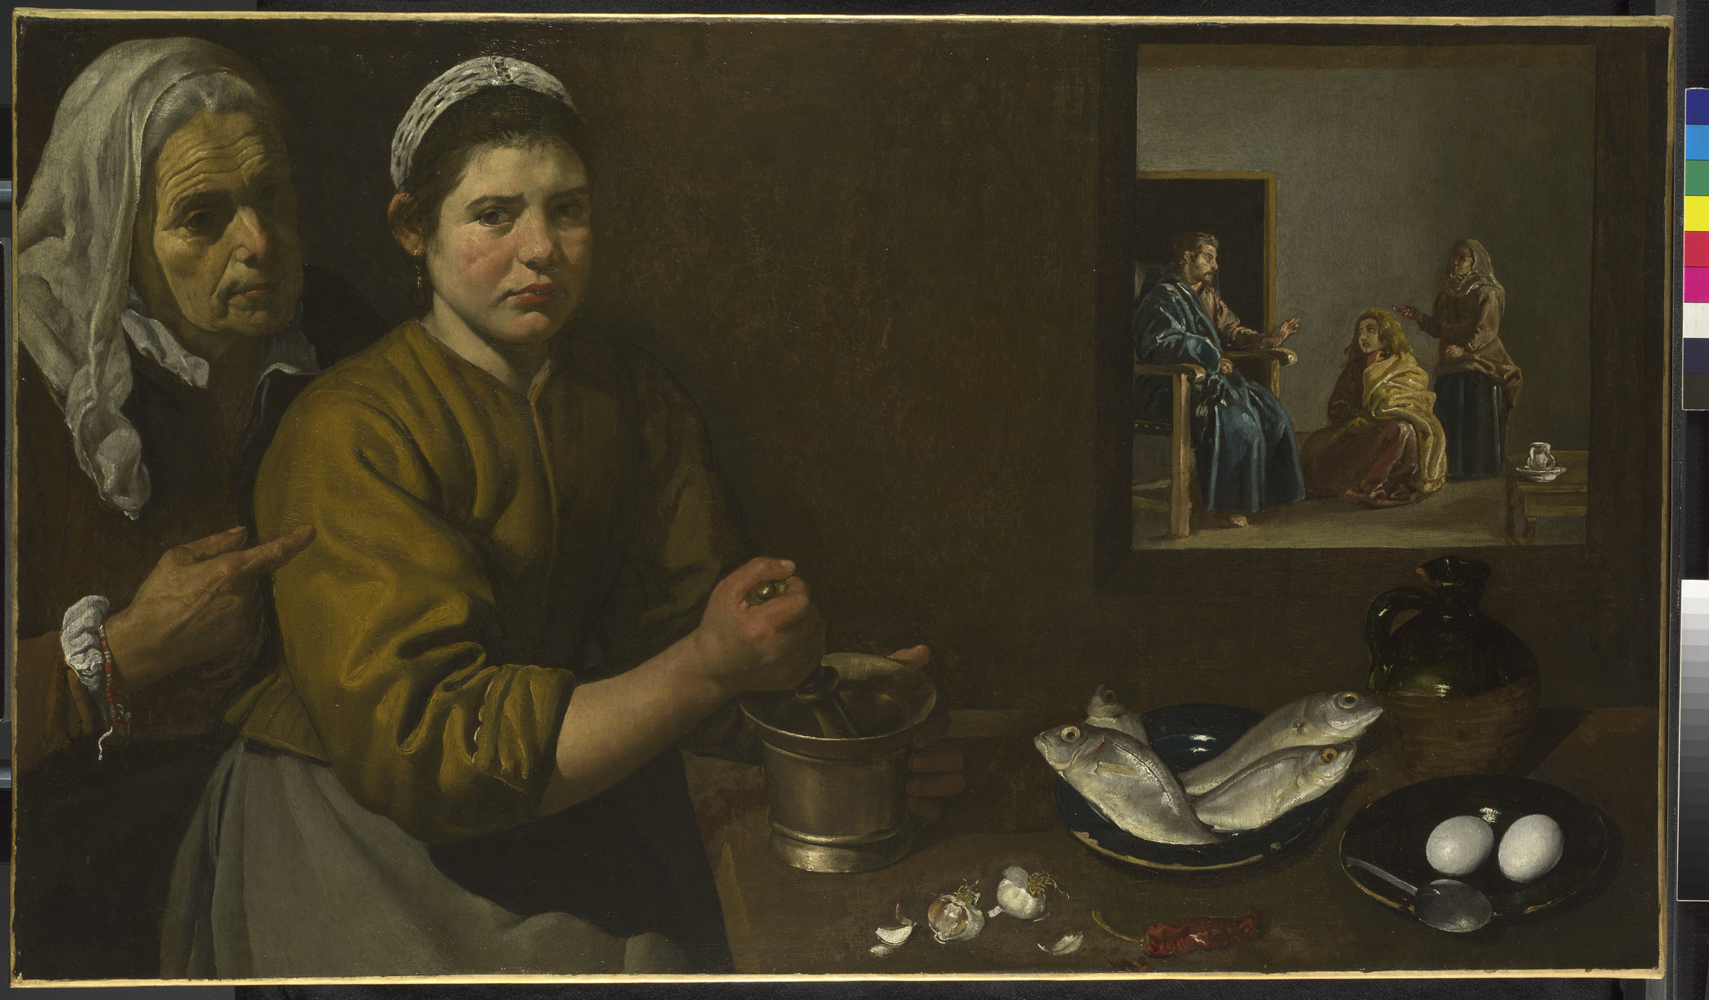
Diego Velázquez, Kitchen Scene with Christ in the House of Martha and Mary (1618), National Gallery, London
Chile pepper

Slide 21
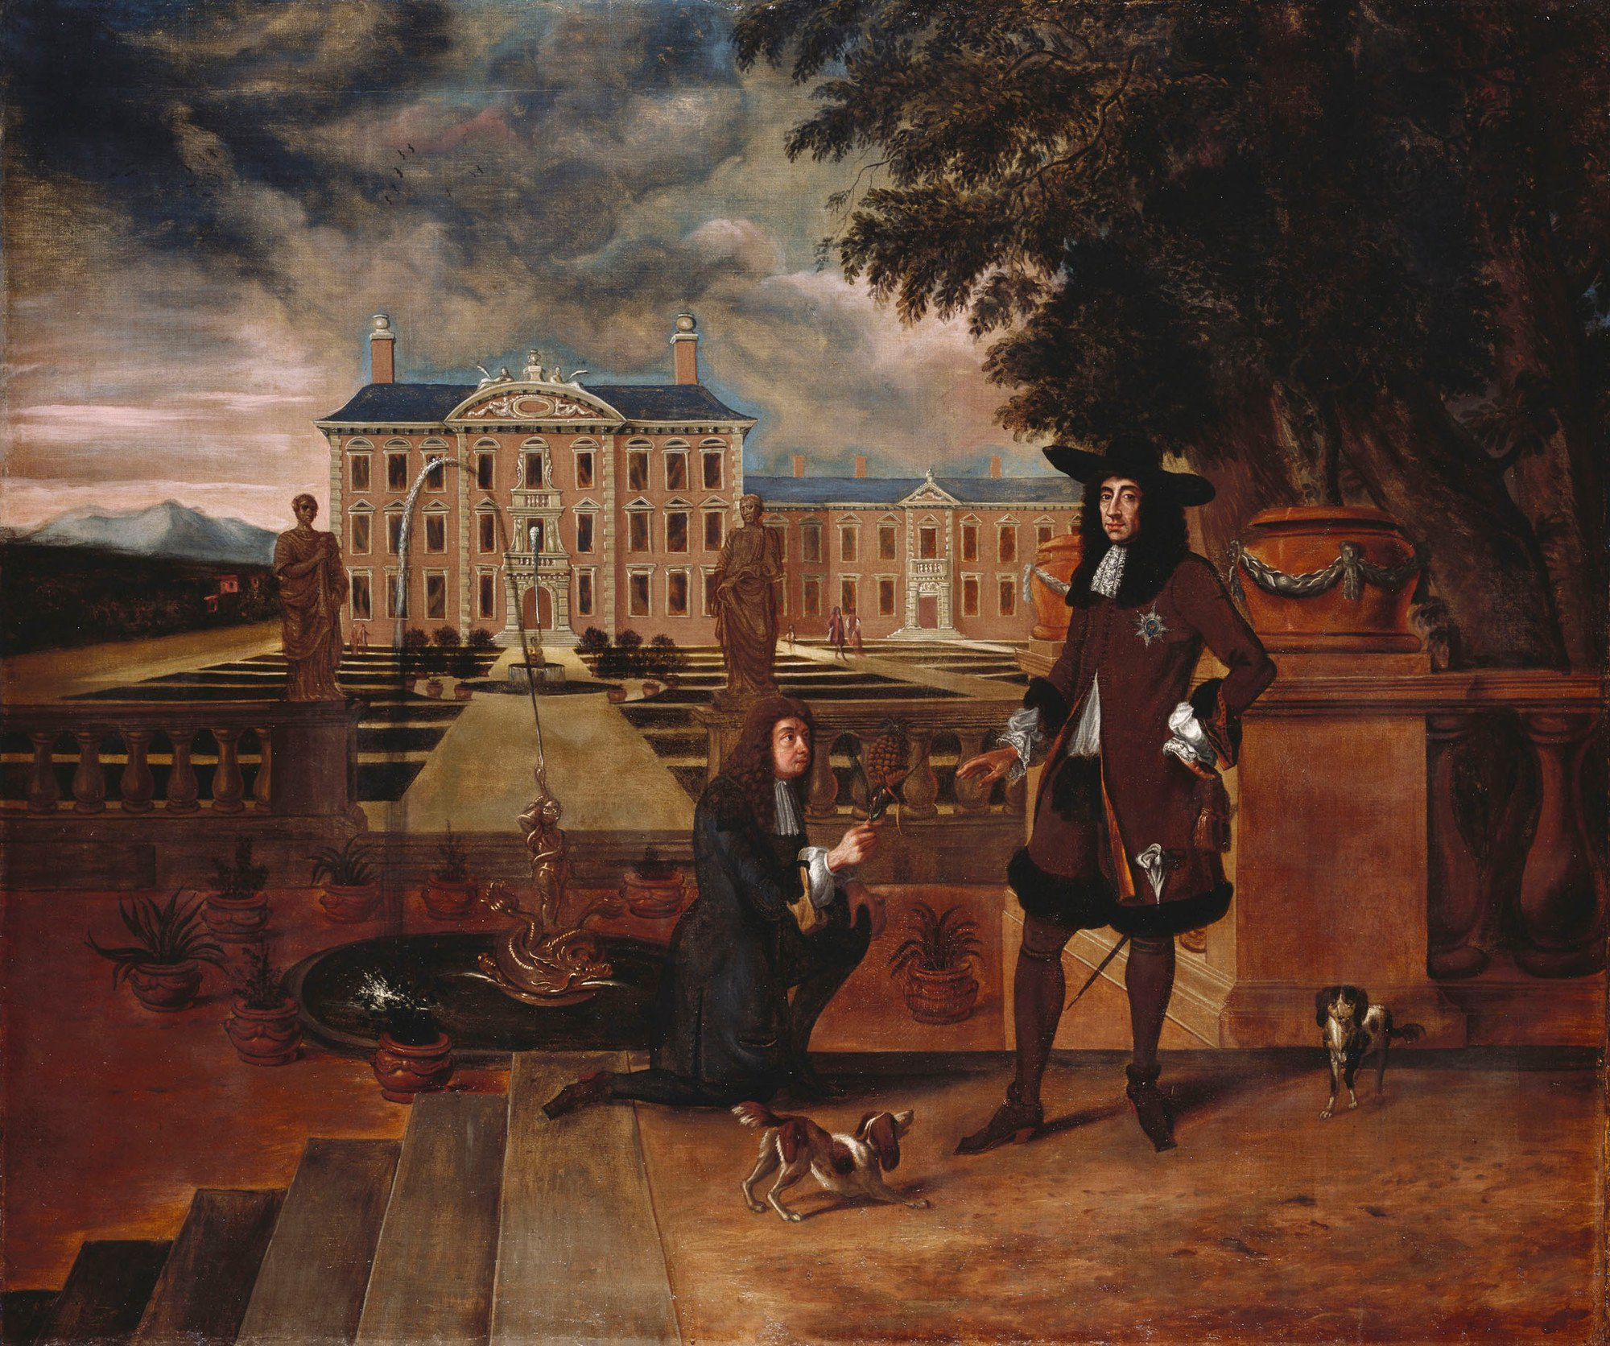
British School, Charles II Presented with a Pineapple, c.1675-80, Royal Collections Trust

Slide 22
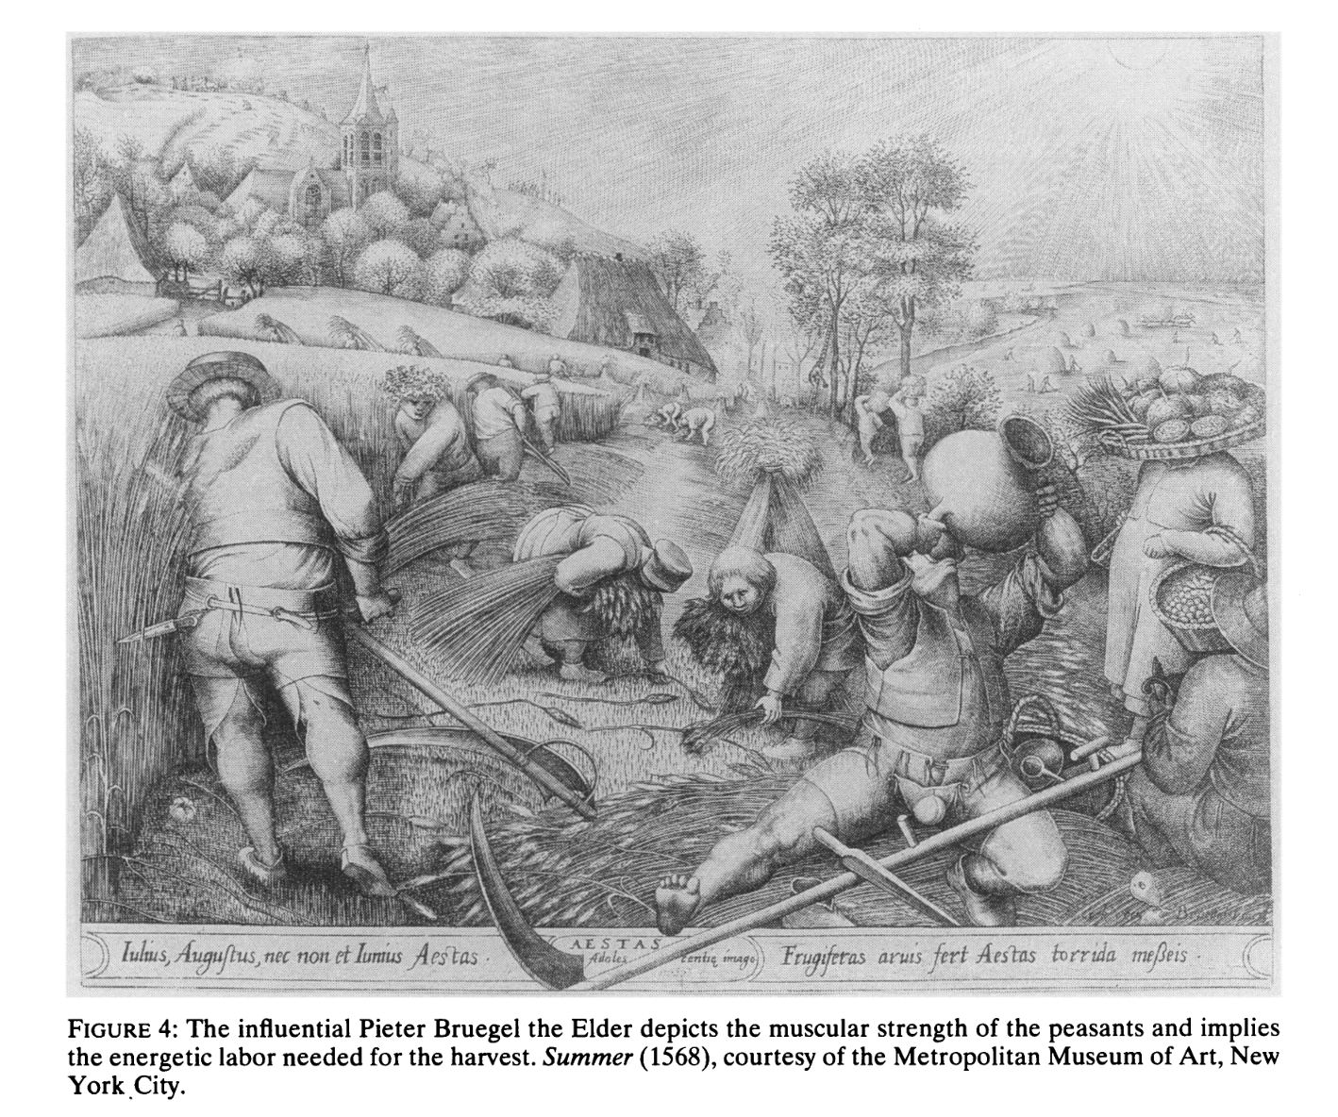
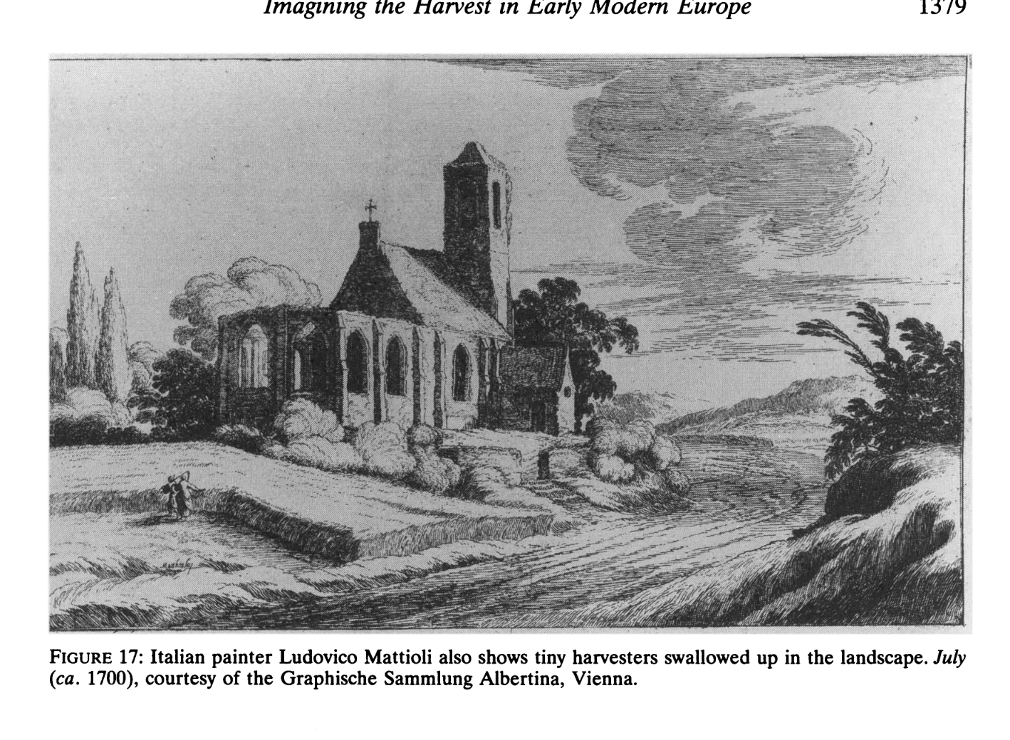
Liana Vardi, ‘Imagining the Harvest in Early Modern Europe’, American Historical Review 101:5 (1996).

Slide 23
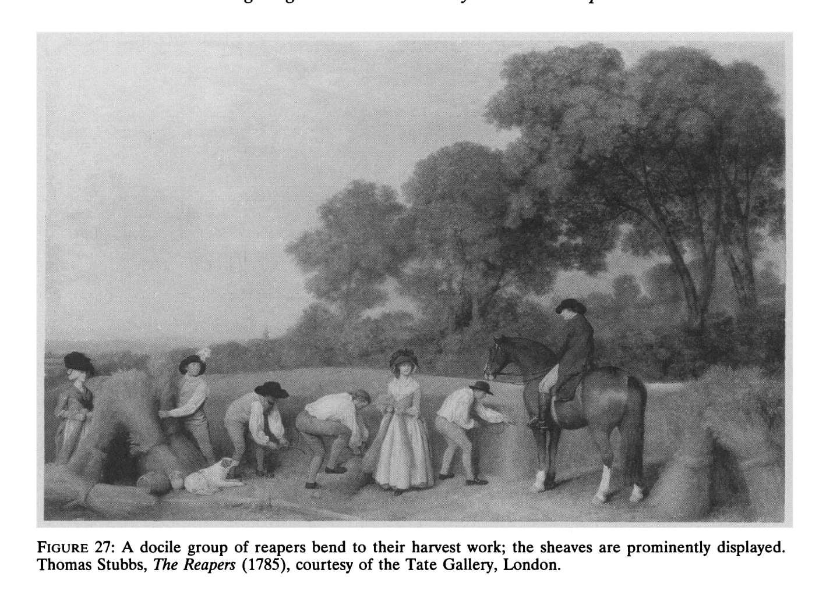
Liana Vardi, ‘Imagining the Harvest in Early Modern Europe’, American Historical Review 101:5 (1996).
‘The eighteenth century . . . adopted a new vision of the peasant. As a laborer, he was harmless and piteous and therefore a natural object of charity and paternalistic concern. As an independent farmer, he was virtuous, hard-working and devoted to his family. Anxious to learn and to be guided, the peasant emerged as a fitting citizen of the state.’

Slide 24
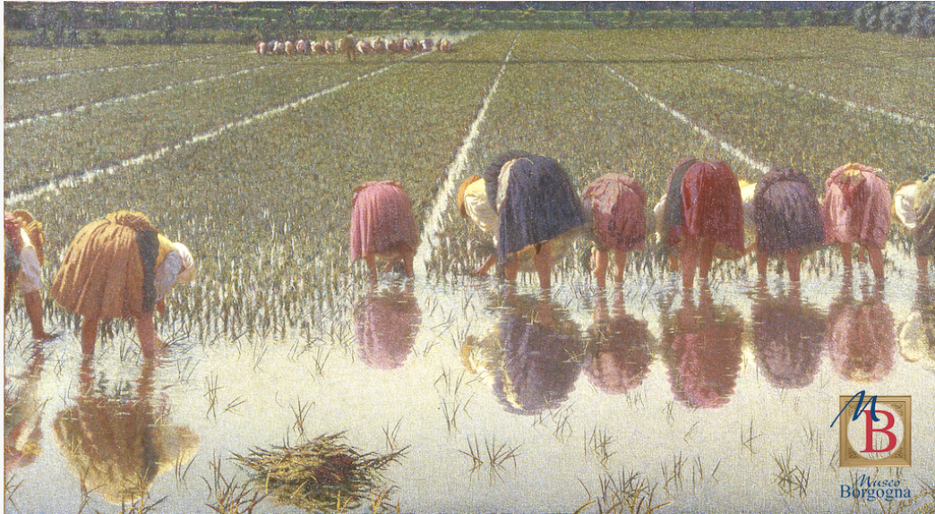
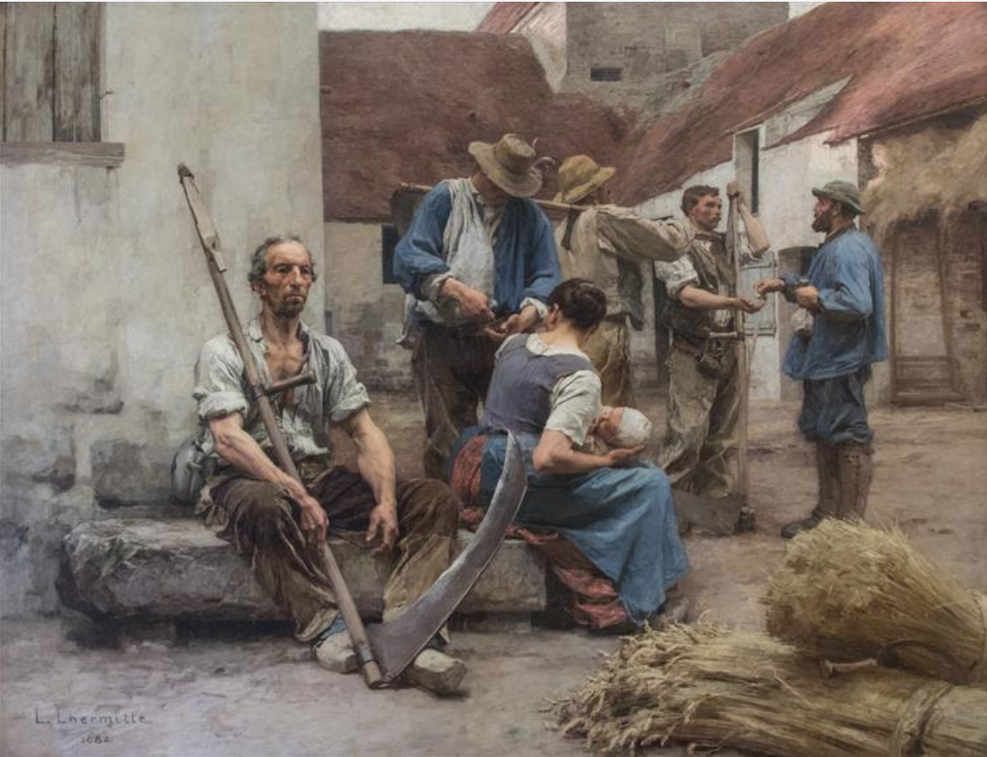
Richard Brettell and Caroline Brettell, Painters and Peasants in the Nineteenth Century (1983).
Léon Augustin Lhermitte, La paye des moissonneurs [The pay of the harvesters], 1882 Musée d’Orsay
Angelo Morbelli, Per ottanta centesimi! [For 80 Cents!], 1895-1897, Fondazione Museo Francesco Borgogna

Slide 25
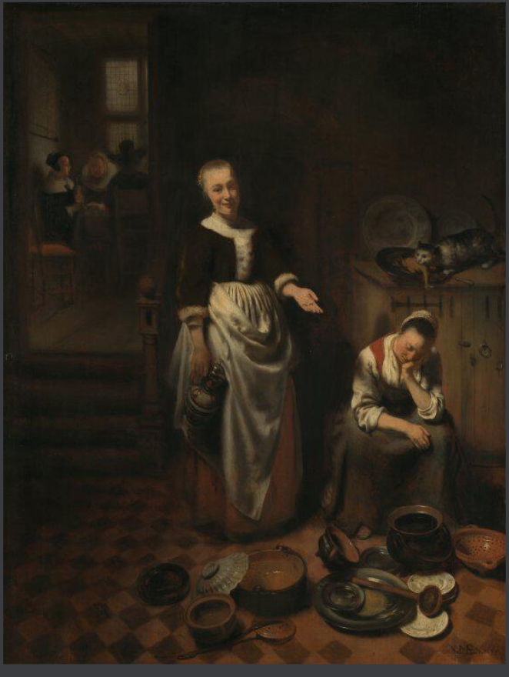
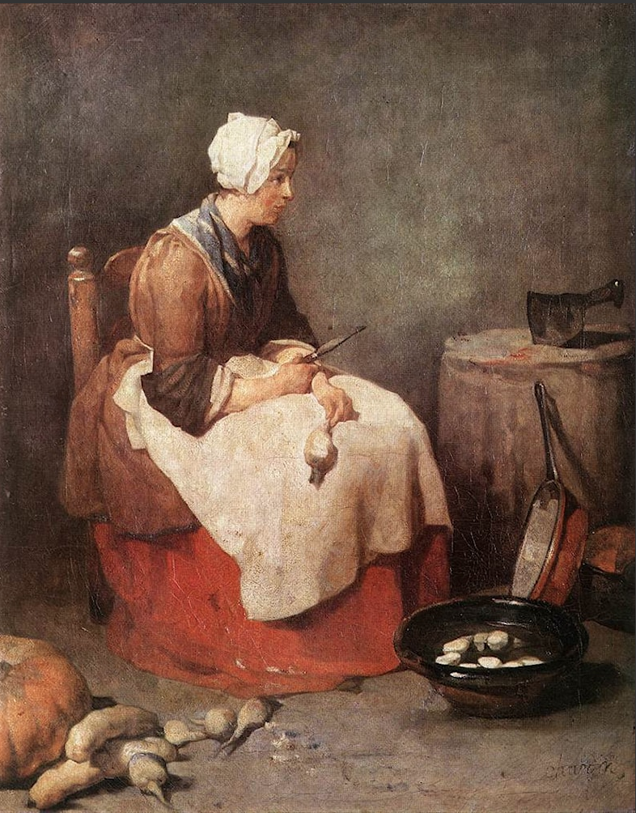
Jean-Baptiste Chardin, Woman Peeling Vegetables, c.1738, Alte Pinakothek, Munich
Nicholas Maes, The Idle Servant, 1655, National Gallery, London

Slide 26
Art as Argument

Slide 27
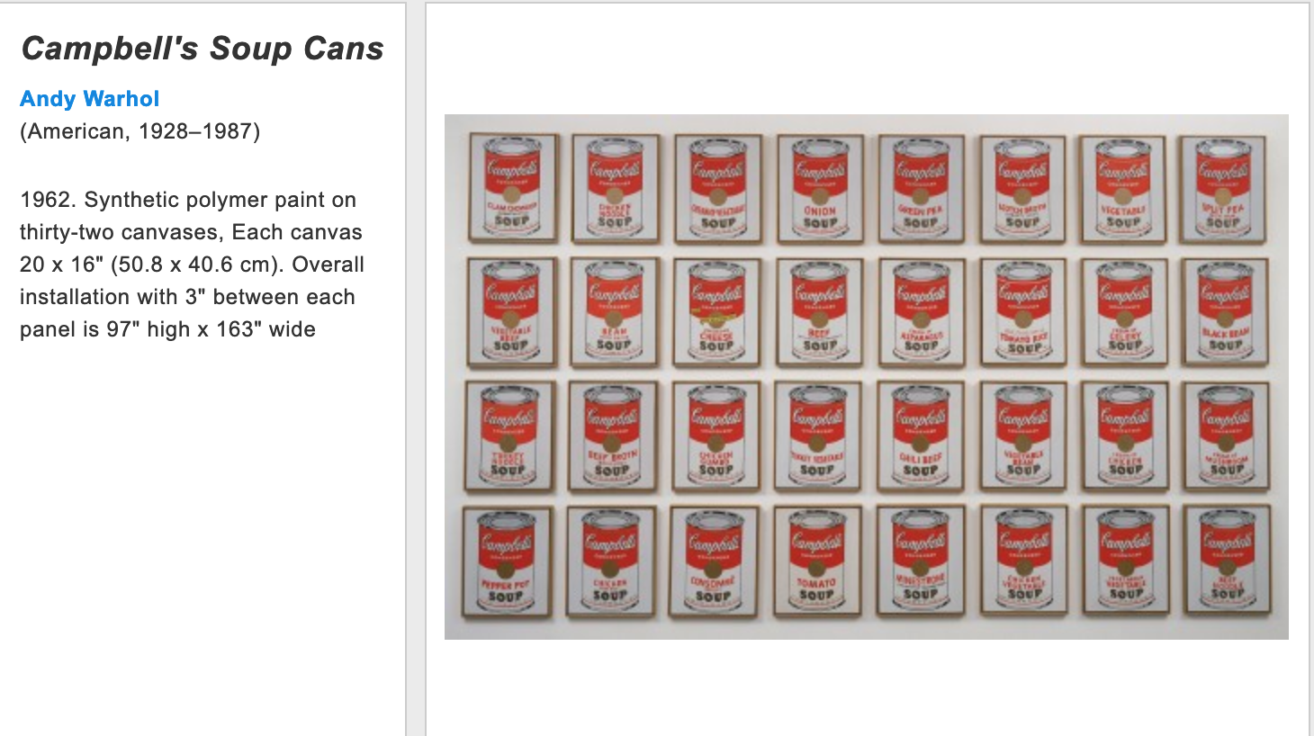

Slide 28
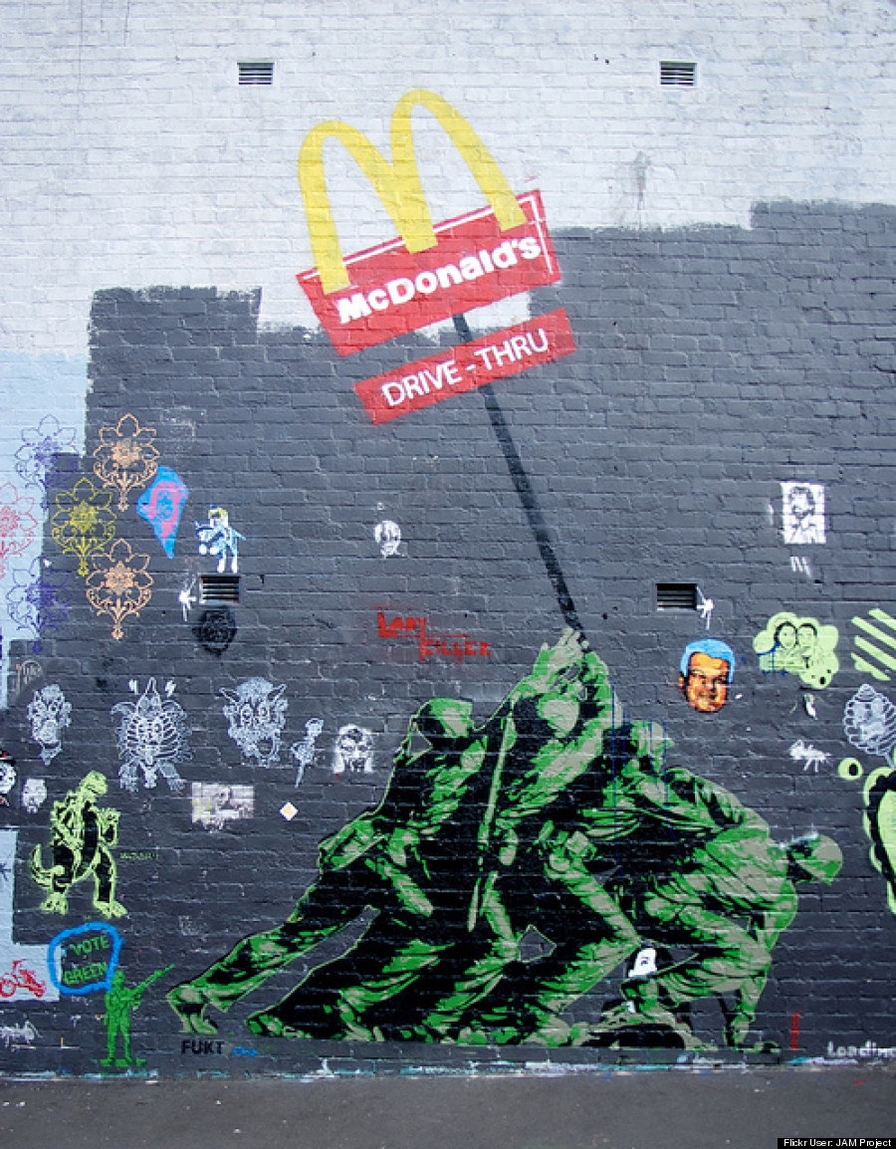
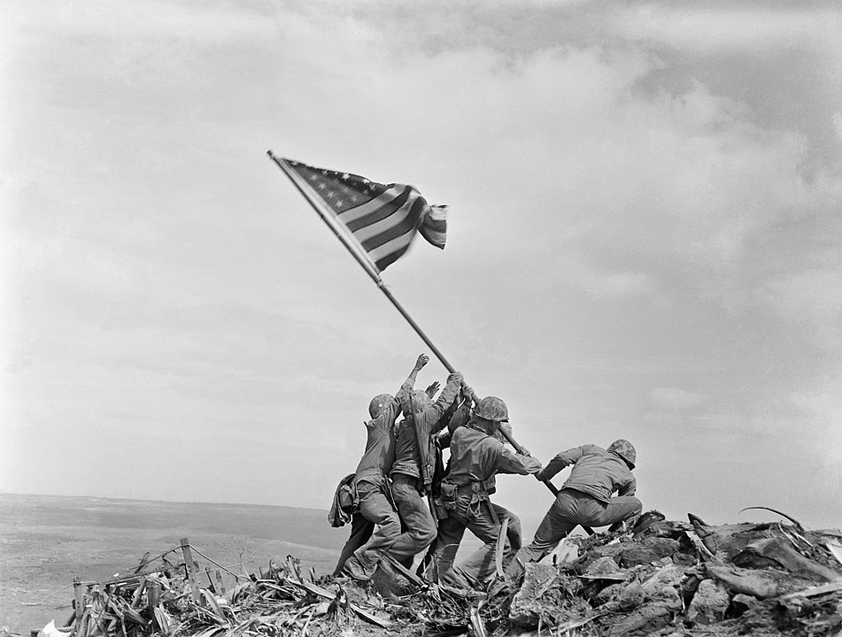
Mural by Fukt (2011), Sydney, Australia
Joe Rosenthal, Raising the Flag on Iwo Jima, 1945.

Slide 29
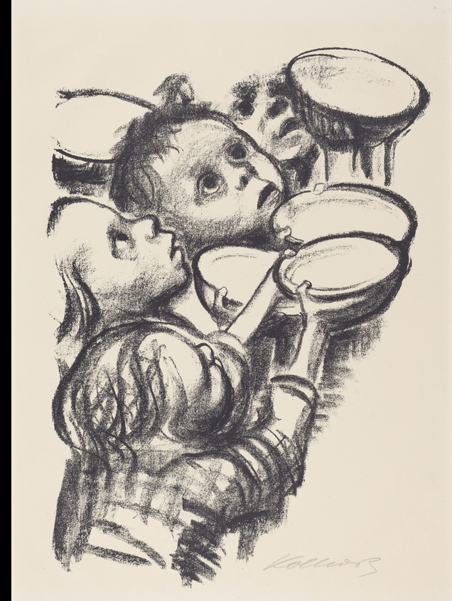
Käthe Kollwitz, ‘Germany’s Children Are Starving!’, 1924, National Gallery of Art, Washington
Kollwitz ‘simplified her graphic style to concentrate the moral force of this devastating image. As soon we move from eating food to feeding others, we enter the social realm, with obligations and responsibilities that transcend our own needs and pleasures. The emptiness of the bowls the children hold is seen as white space, while she uses the hauntingly dark orbs of their eyes to suggest the emptiness they feel, their hunger. This suggests not just pathos, but also anger. They raise both eyes and bowls not to the viewer, but to an unseen figure above and to their right. On one level, social failure is a shared responsibility: We are all to blame. But this image is more specific, more political and, hence, more powerful. It says these children are hungry and this is on you. The difference is vital, between feeling bad about the human condition and feeling angry about a failure of governance.
Philip Kennicott and Tom Sietsema, ‘Why do great artists paint food? Two critics hash it out’, Washington Post, 18 May 2023.

Slide 30
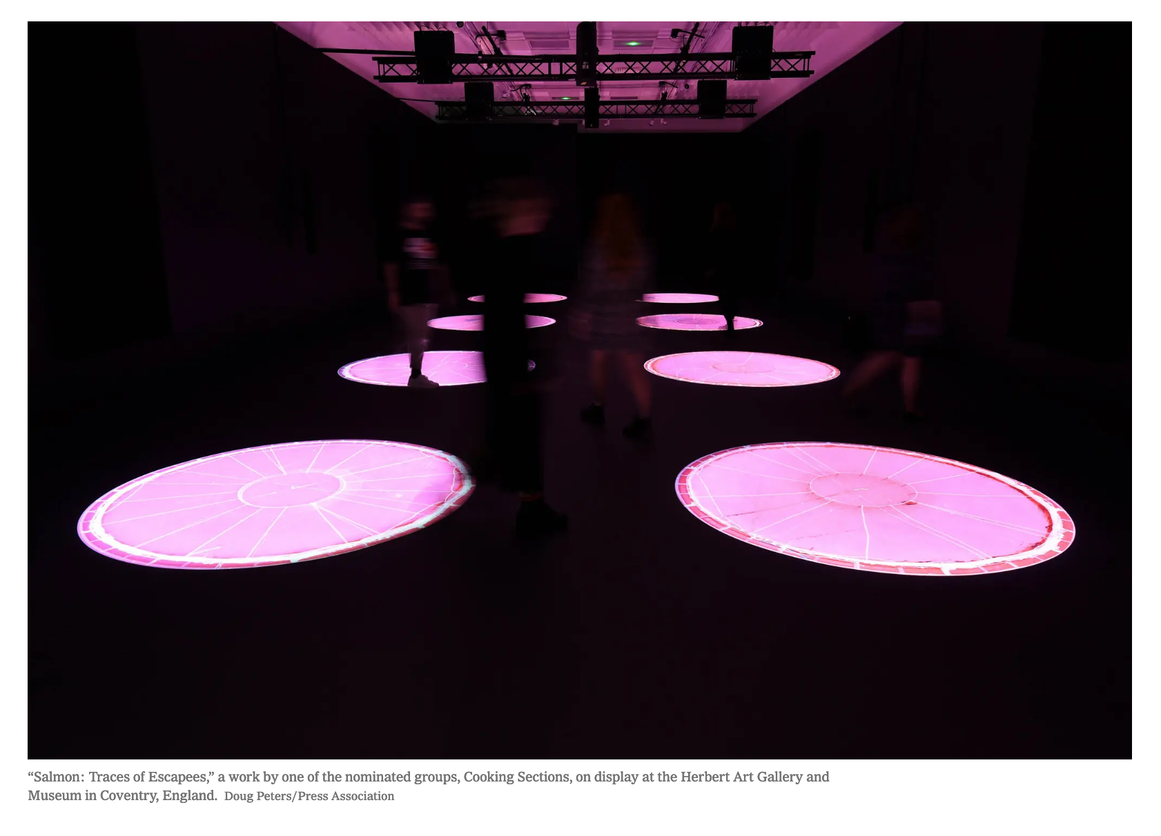
Art collective Cooking Sections’ installation Salmon: Traces of Escapees was one of the artworks that won the 2021 Turner Prize.
‘Cooking Sections address the environmental impact of intensive food production. Established in London in 2013 by Daniel Fernández Pascual and Alon Schwabe, their work uses food as a lens to observe landscapes in transformation, and as a tool for intervention in those very systems of food production and supply. . . ‘Salmon: Traces of Escapees’ is an audio and film installation that explores the environmental impact of salmon farms in Scotland. It reveals the gap between common perceptions of farmed salmon as an affordable luxury, and the reality of its mounting environmental costs – with excrement, drugs, synthetic colour and parasites polluting the surrounding waters.’ (Herbert Gallery website.)

Slide 31
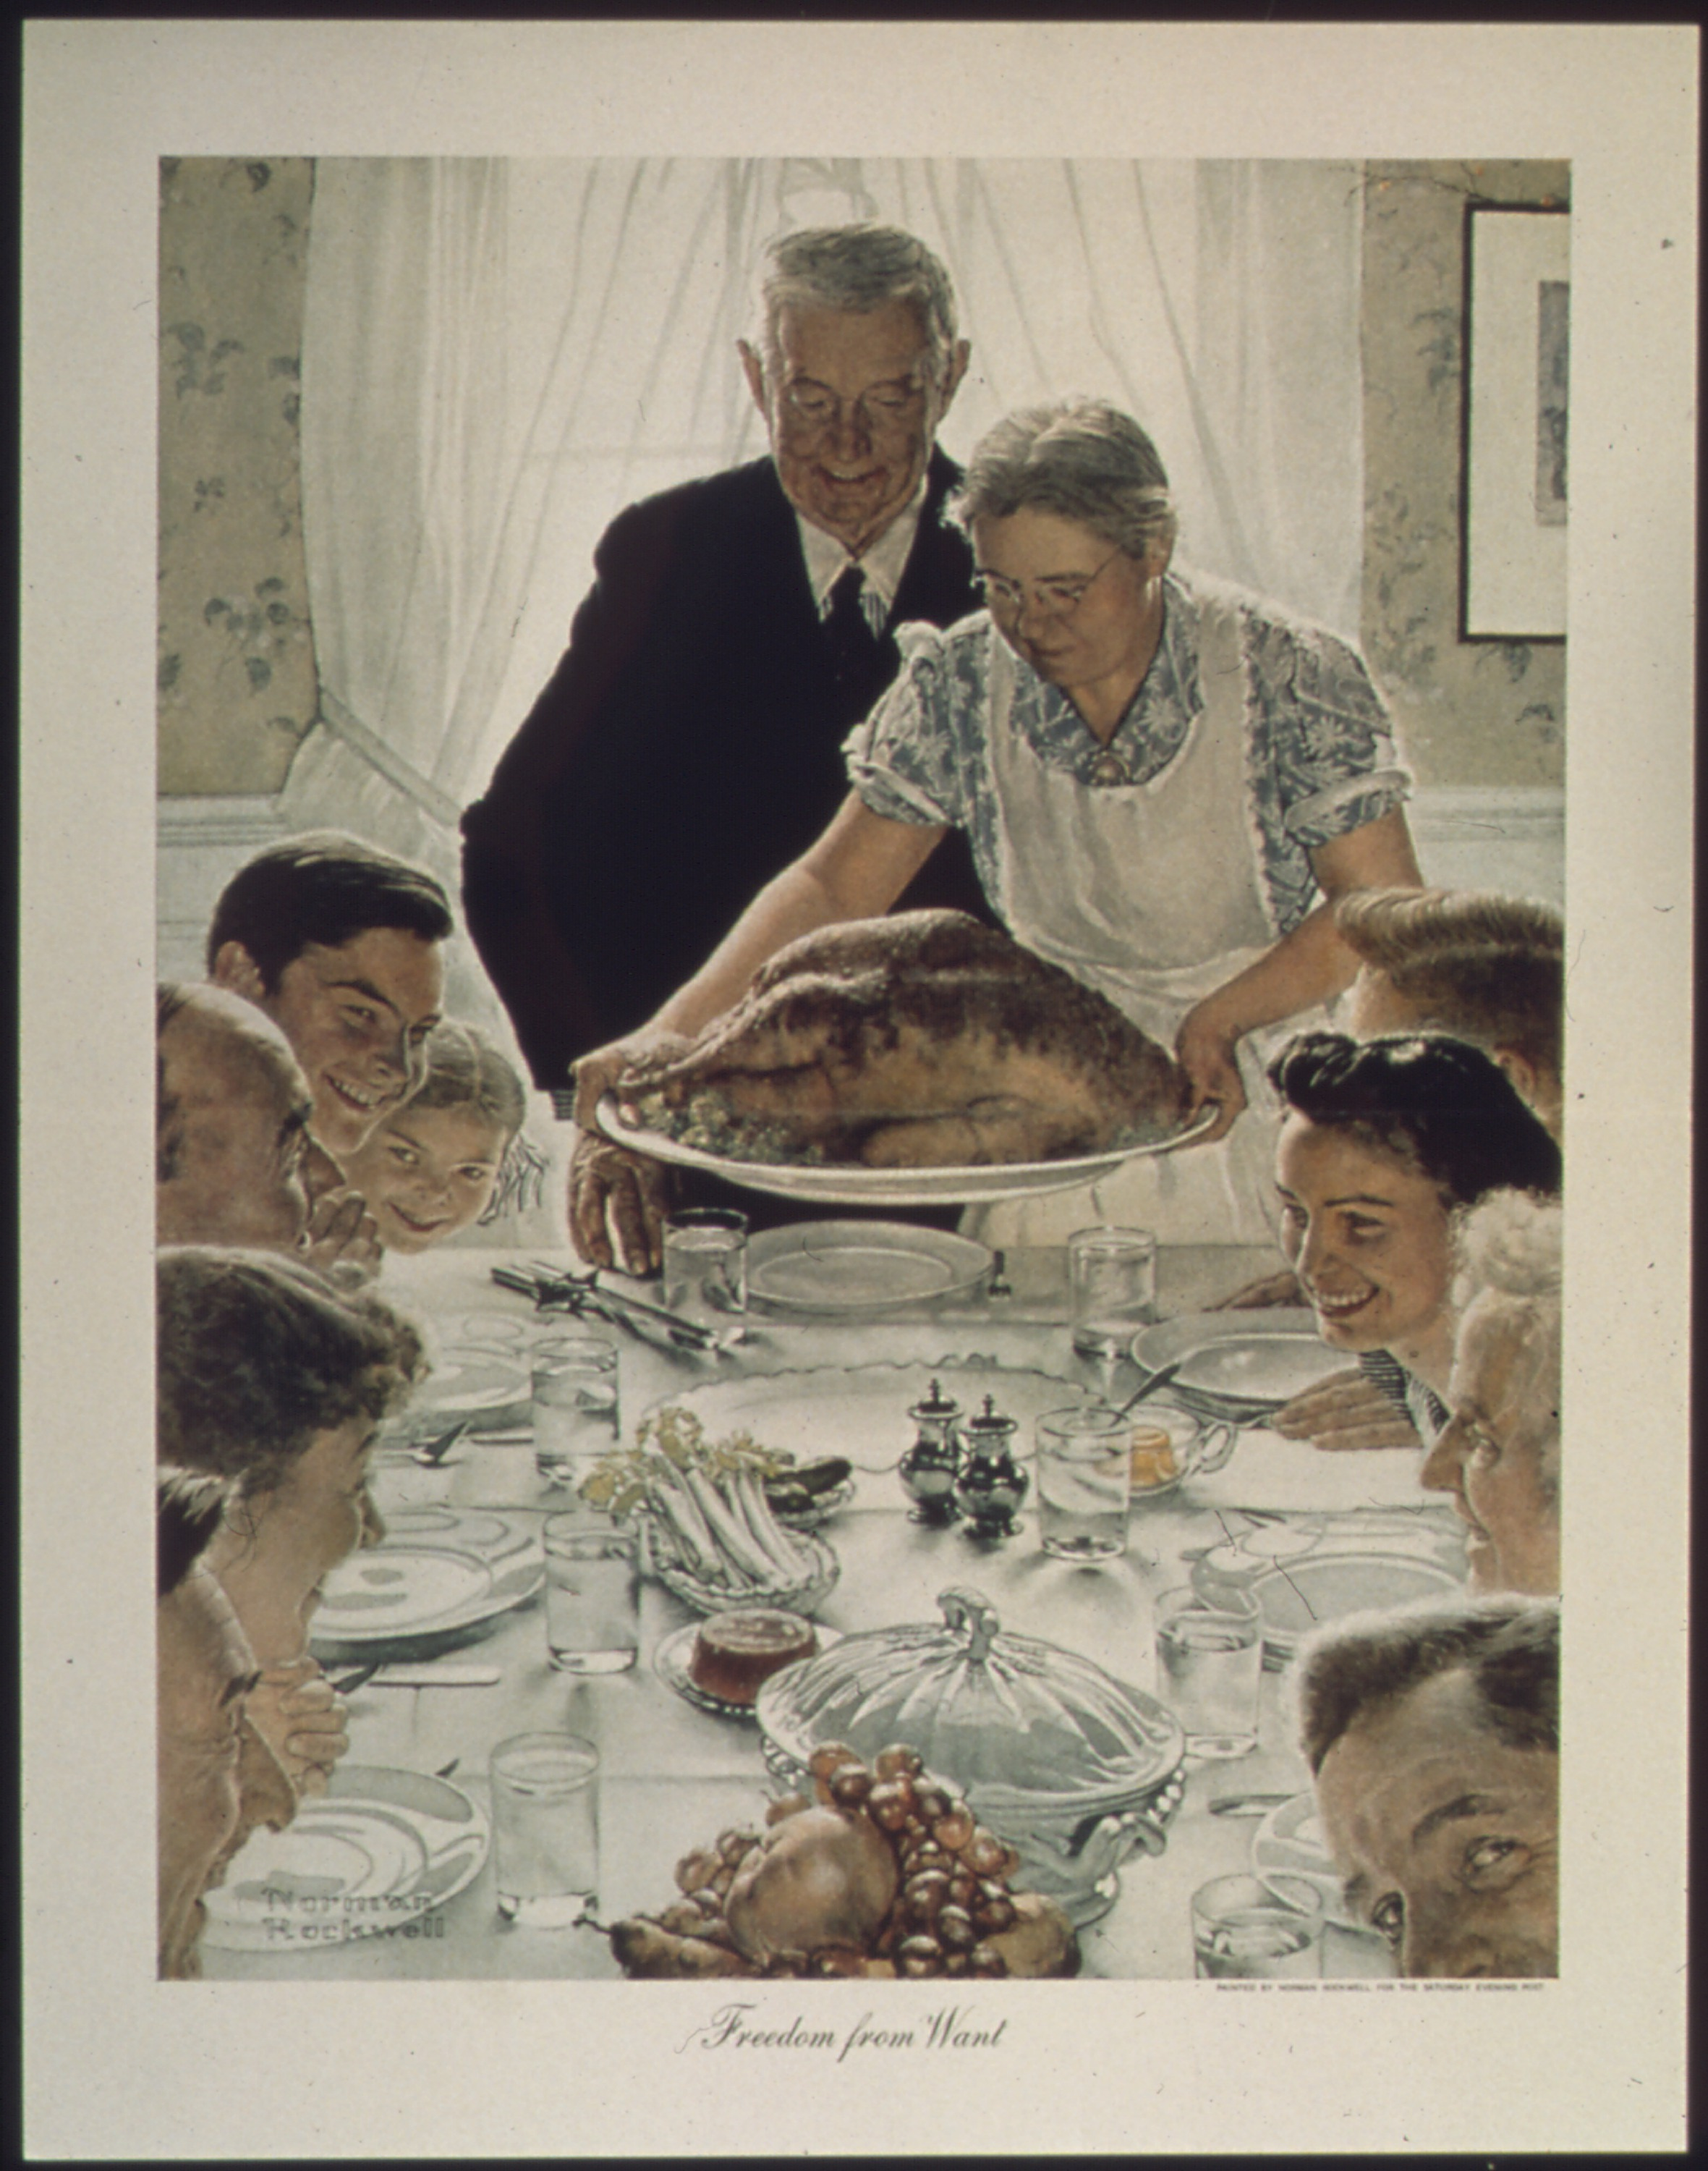
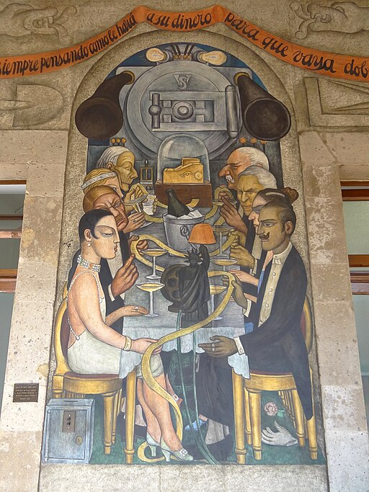
Diego Rivera, ‘Wall Street Banquet’, 1923-28, Secretaría de Educación Pública, Mexico City.
Norman Rockwell, Freedom from Want, 1943.

Slide 32
And Finally. . . .
Philip Kennicott and Tom Sietsema, ‘Why do great artists paint food? Two critics hash it out’, Washington Post, 18 May 2023:
https://www.washingtonpost.com/arts-entertainment/interactive/2023/great-artists-food-symbolism/

