Slide 1
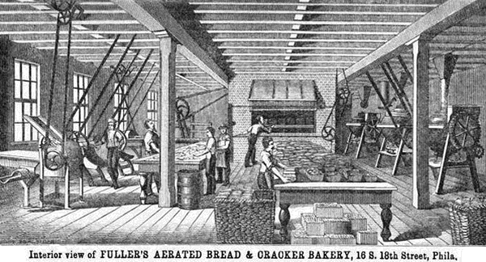
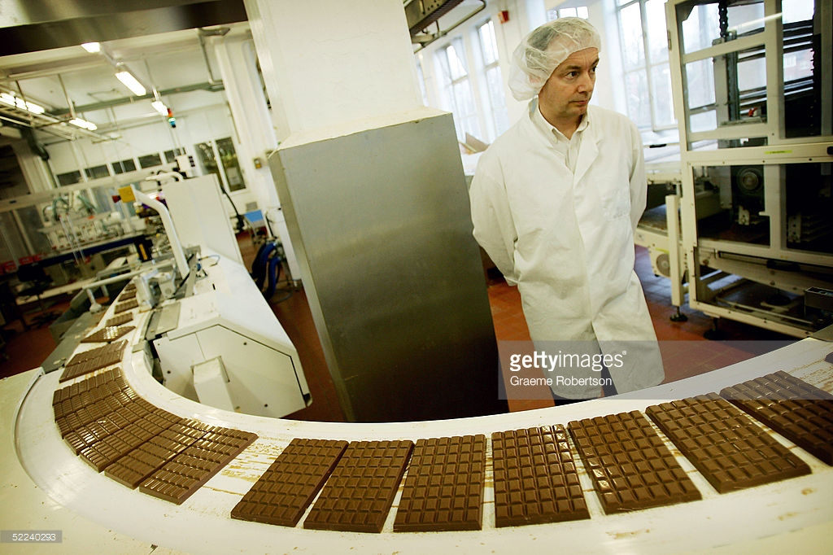
Industrial Food

Slide 2
HANDS-ON SESSION ON USING MATERIAL CULTURE TO STUDY THE HISTORY OF SUGAR
Leamington Museum and Art Gallery (Pump Rooms, Leamington Spa)
Friday 24 November 10.00-12.00
Email me by the end of the day if you’d like to attend—spaces are limited!

Slide 3
Today’s 3-4 seminar is RESCHEDULED!!
The replacement seminar will take place TOMORROW (14 November) 3-4pm in FAB 1.10.
If you can’t make this time, email me to let me know and I will record an authorized absence. You can come to talk to me in my office to discuss the session, too, if you like—let me know.
Many apologies!!

Slide 4
AND FINALLY . . .
Come to listen to several leading experts in the history of food (inc. chocolate) chat about their work. TODAY!!
Writing the History of Consumption
Writing the History of Food
New Work in the History of Food and Consumption
(Especially in Latin America)
Monday 13 November 2023
3.00-4.00, FAB 2.25, University of Warwick
ALL WELCOME (drop in at any point)
Tea and Coffee* (and cake)

Slide 5
When do you think this was written?
‘It is not unknown to some of our readers that Dr Dauglish, of Malvern, has recently patented a process for making bread ‘light’ without the use of leaven. . . The new process impregnates the bread, by the application of machinery, with carbonic acid gas, or fixed air. Different opinions are expressed about the bread; but it is curious to note, that, as corn is now reaped by machinery, and dough is baked by machinery, the whole process of bread-making is probably in course of undergoing changes which will emancipate both the housewife and the professional baker from a large amount of labour.’

Slide 6
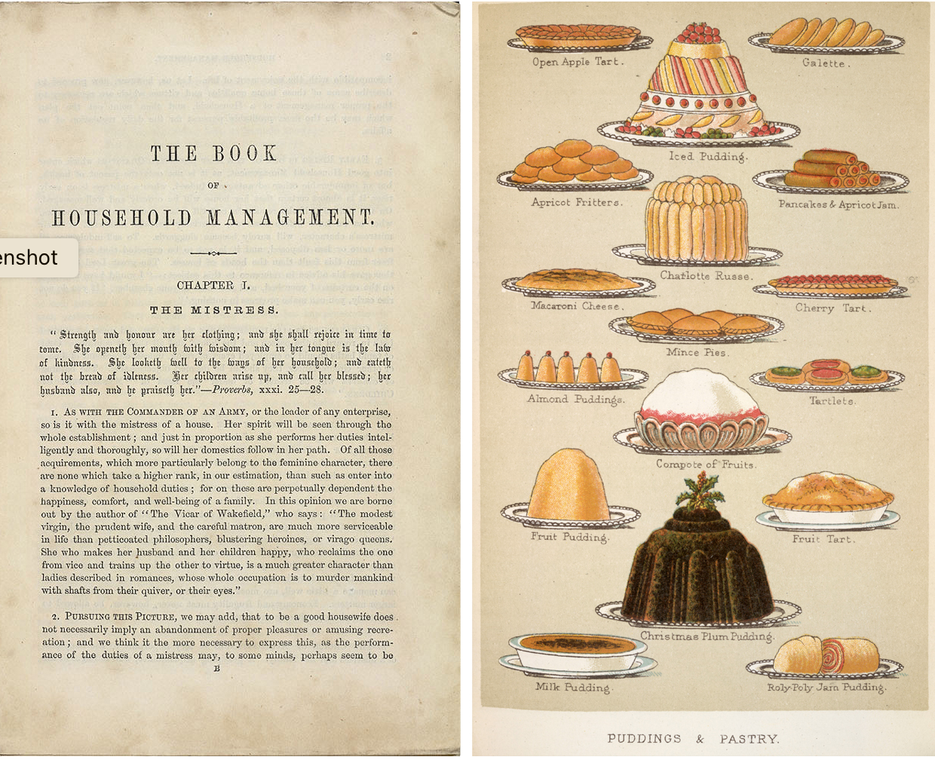
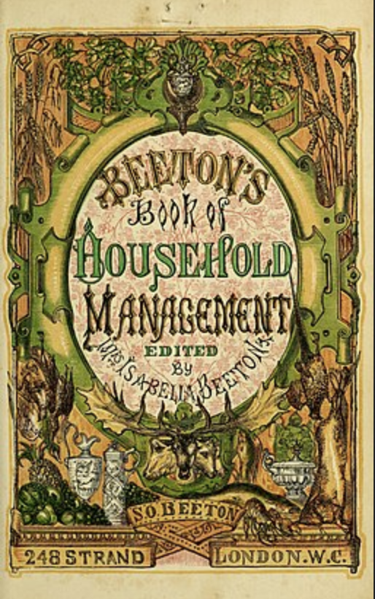
Isabella Beeton (1836-1865)
Isabella Beeton, Beeton’s Book of Household Management (1861).
Isabella Beeton, 1860

Slide 7
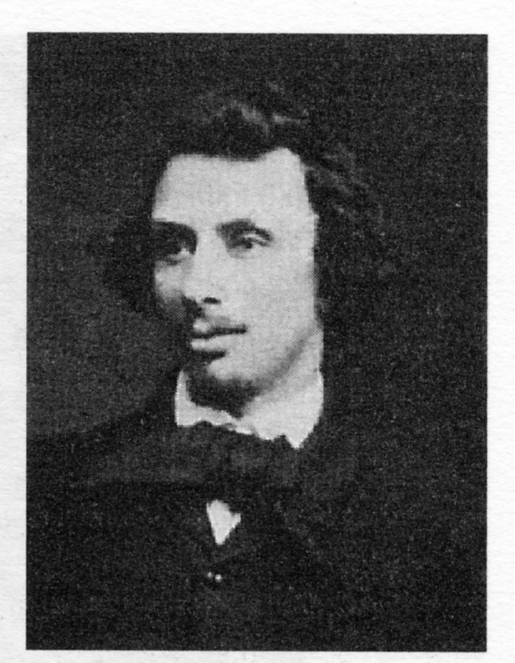
Isabella Beeton’s husband Samuel Beeton (1831-1877)

Slide 8
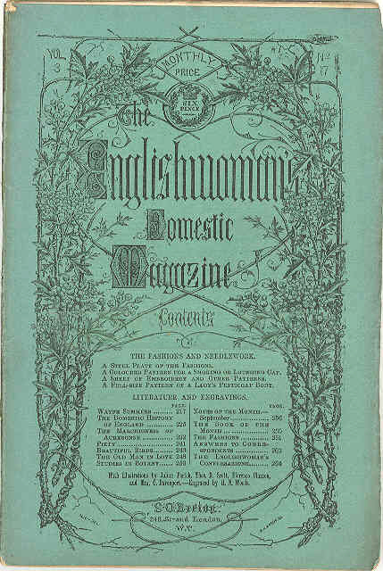
Magazine edited by Isabella Beeton and her husband Samuel Beeton
Once Isabella Beeton started editing the recipes, they increasingly reflected the nineteenth-century ‘industrialisation’ of food.

Slide 9
What is ‘industrial food’?

Slide 10
‘industrial food’
‘foods that are mass produced in a factory setting and require no or very little cooking to make them edible. These foods are also packaged which make them highly portable. Examples of industrial foods are commercially canned goods; frozen foods; ice cream; . . cake mixes; hot and cold cereals; instant mashed potatoes; pastry/pie shell mixes; and jams and jellies.’
Gabriella Petrick, ‘Industrial Food’, Oxford Handbook of Food History (2012).

Slide 11
‘industrial food’
Foods that reflect a complex of new, 19th-century technological developments in:
preserving
mechanisation
Transport
retailing
Jack Goody, ‘Industrial Food: Towards the Development of a World Cuisine’, Cooking, Cuisine and Class (1982).

Slide 12
New Technologies in Preservation
canning, dehydration, chilling

Slide 13
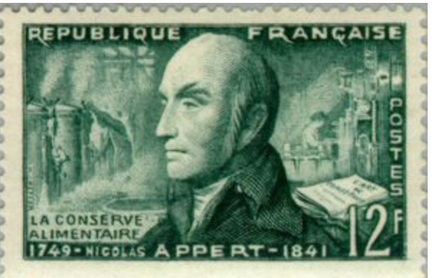
Preservation: Canning
A modern process (usually said to have been invented by Nicolas Appert in 1795)
Tinned fish, milk, milk, vegetables, meats . . .
By 1924 two million hundredweight of tinned condensed milk was imported annually into the UK.
1955 French stamp commemorating Appert’s contribution to food preservation techniques.

Slide 14
Preservation: Canning
‘By 1880 50 million tins of sardines were being packed annually on the west coast of France, three million of which were exported to Britain.’
Goody, ‘Industrial Food’.

Slide 15
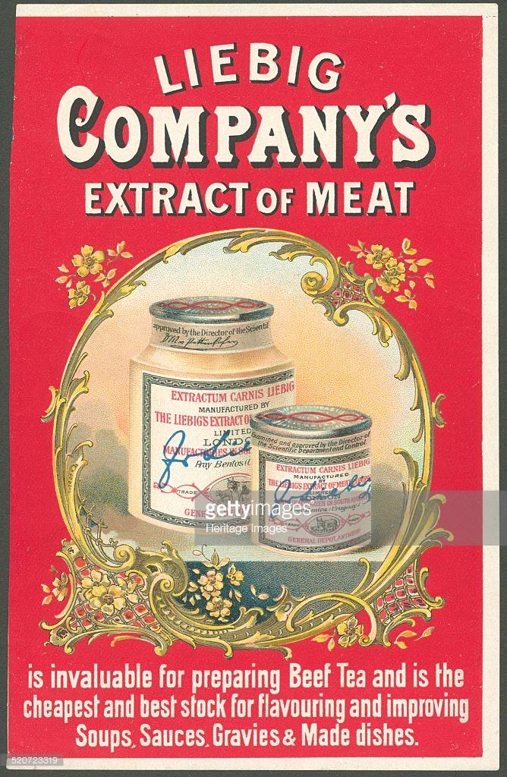
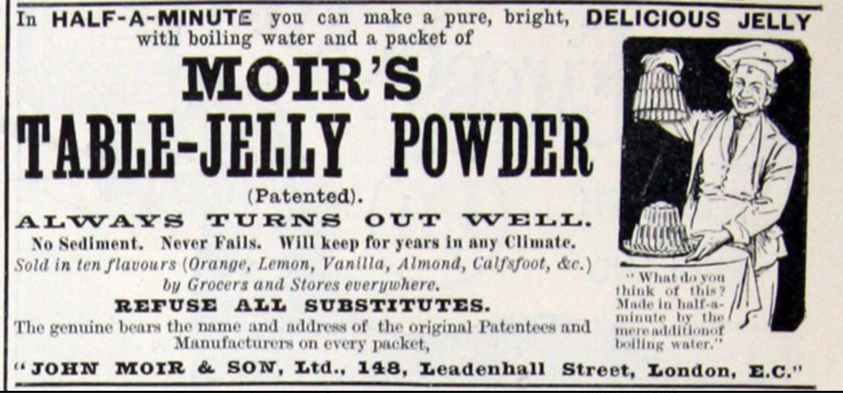
Preservation: Dehydration and Concentration
powdered milk, condensed milk, meat extract, bouillon cubes, meat powder. . .
1894 advert for Moir’s table-jelly powder

Slide 16
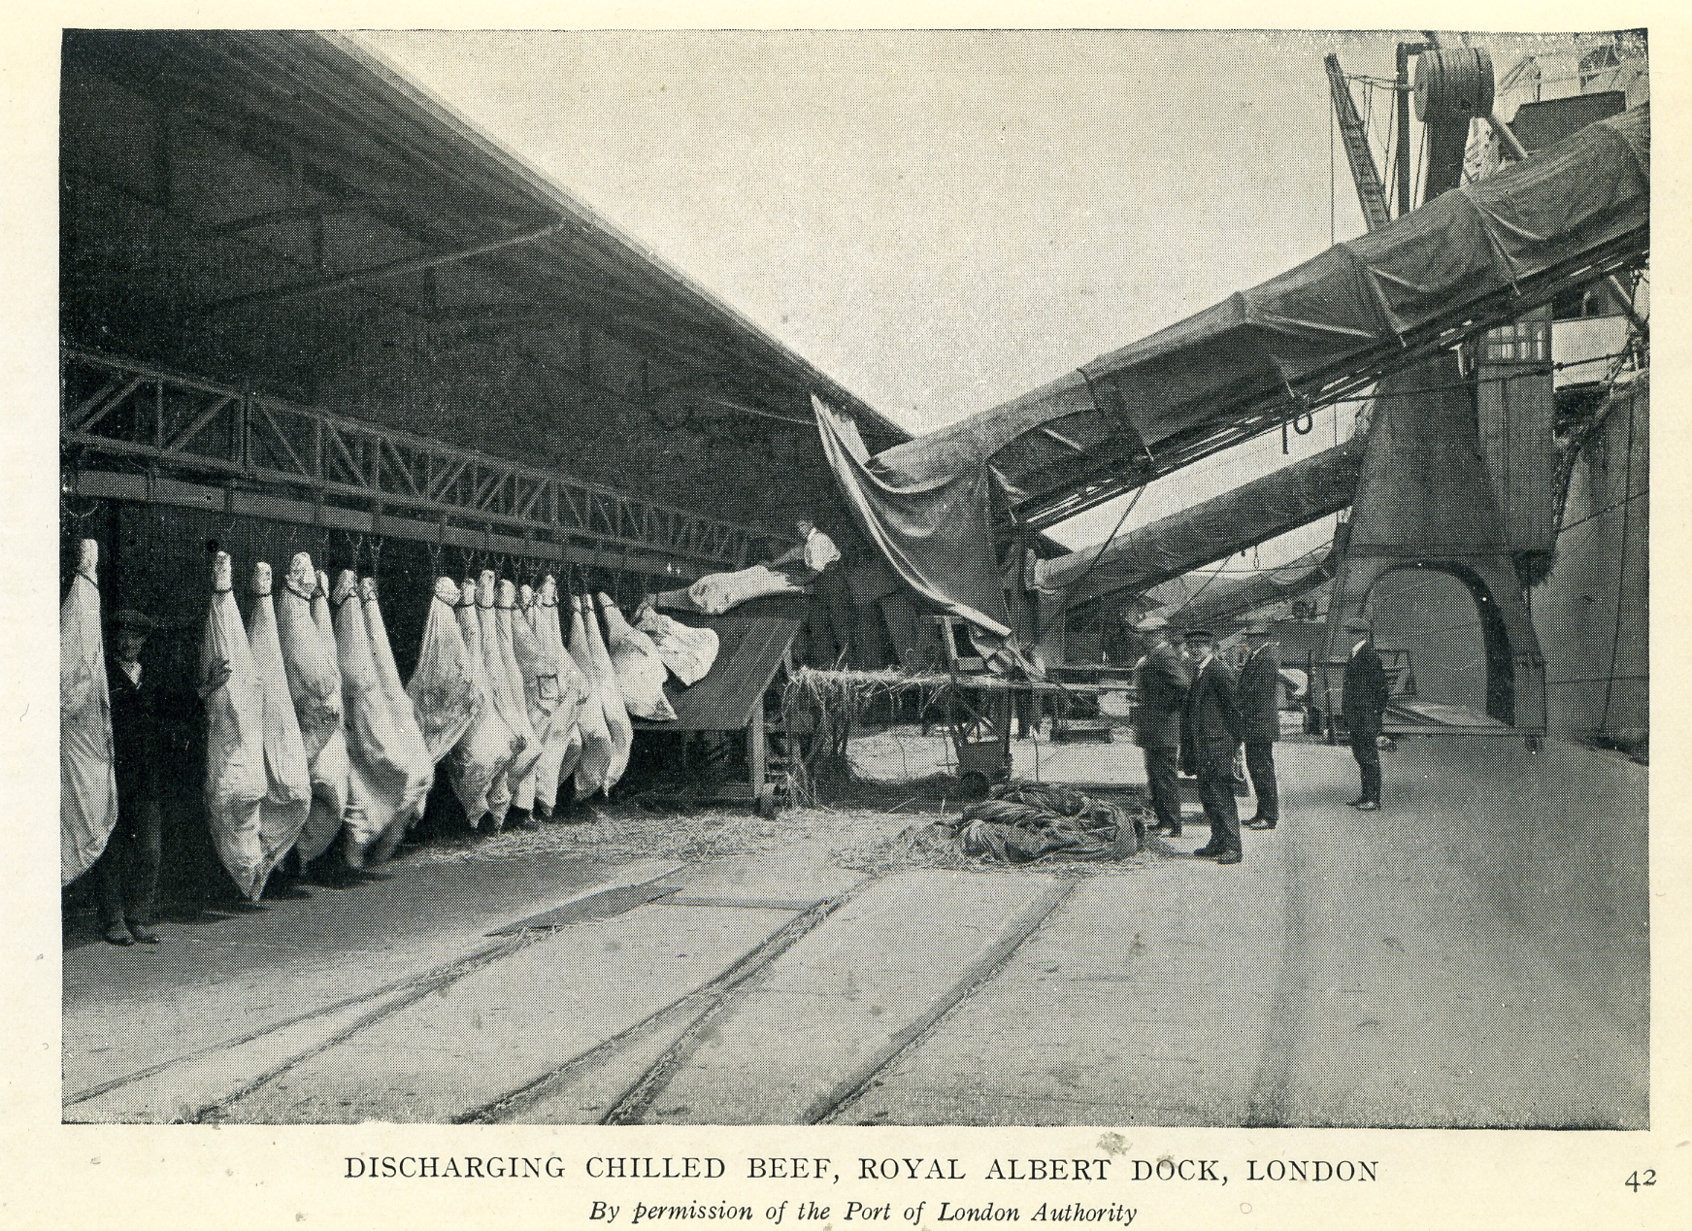
New Technologies in Preservation: Freezing and Chilling
meat, fish, vegetables
Chilled beef
Arriving in
London
1923

Slide 17
Mechanisation

Slide 18
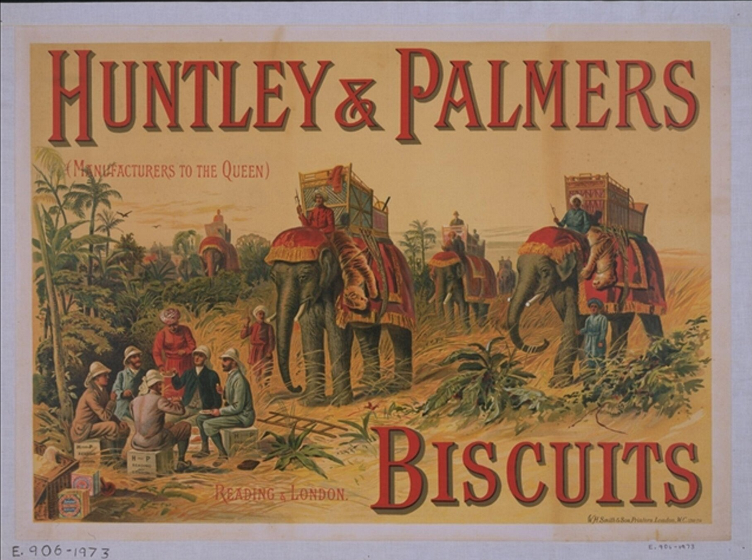
Mechanisation
Important in both agriculture (harvesters, etc.) and manufacturing.
Biscuit production was one of the first foods to be mechanised—mixing, rolling, cutting.
e.g. Huntley and Palmers biscuits (1841)
Mass-produced breakfast cereals.
e.g. Shredded Wheat (1892)
1891 advert for Huntley & Palmers Biscuits.
(Note the imperial motif.)

Slide 19
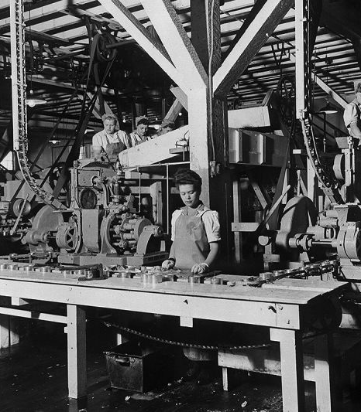
Mechanisation: Implications for labour
Workers in the labelling and packing section of a tinned salmon production line in a Vancouver factory (1940)

Slide 20
Mechanisation: Canning
Working by hand, a master canner could make 60 cans a day.
With a Merriam’s ‘Little Joker’ lidding device (invented in the 1880s) . . .
‘one workman and a boy could put tops and bottoms on 1,500 can bodies a day’.
Some of Merriam’s lidding devices
Quote from Edward Keughel, ‘Master of the Art of Canning: Baltimore, 1860-1900’, Maryland Historical Magazine 67:4 (1972).

Slide 21
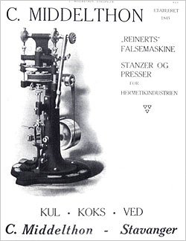
Mechanisation: Canning
But a Reinerts non round can seamer (1905) . . .
could seam 8,000 cans a day.
. . . . From 60 cans a day to
8,000 cans a day.

Slide 22
Mechanisation: Canning
‘The introduction of the Reinerts was to lead to the disappearance of the ancient trade of can soldering.’*
(but it wasn’t really that ancient. . .)
* ‘A family business that started up in Bilbao more than one hundred YEARS AGO’, http://www.somme.com/en/company/history.

Slide 23
Mechanisation: Canning
Unionisation
e.g. formation in 1884 of US Can Makers Mutual Protective Association
Strikes
e.g. 10 strikes by cannery workers in Baltimore between 1881 and 1895.

Slide 24
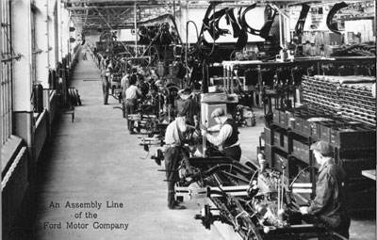
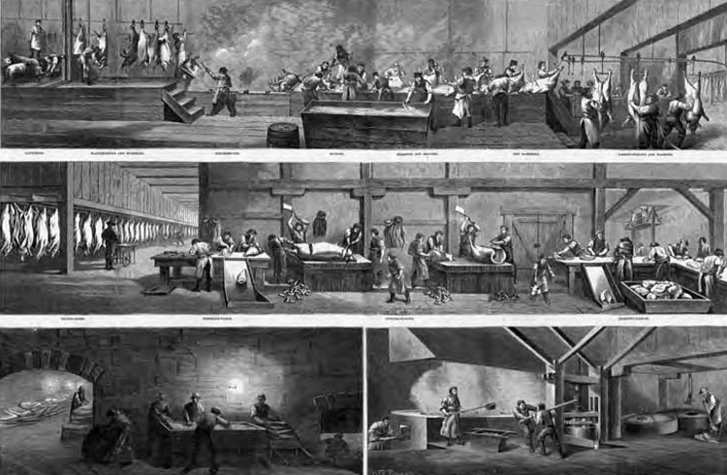
Mechanisation Assembly Lines and Disassembly Lines
Ford Assembly Line (1913)
‘Disassembly Line’, Cincinnati Hogs (1873)
‘The Fordist assembly line (where parts came to workers) was pioneered in large can-making factories such as American Can and large canneries such as Campbell’s and Heinz.’
Gabriella Petrick, ‘Industrial Food’, Oxford Handbook of Food History, ed. Pilcher (2012).

Slide 25
New Technologies in Transport
Railways and refrigerator ships

Slide 26
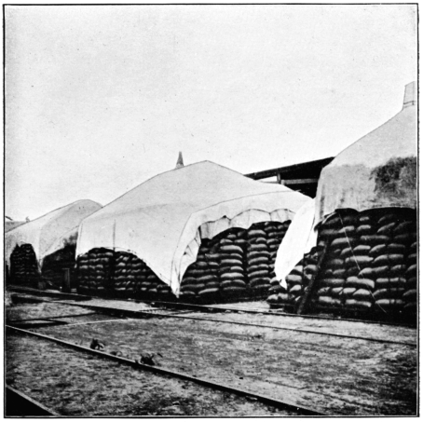
New Technologies in Transport: Railways
Wheat ready for loading at a station on the Central Argentine Railway
(circa 1910)

Slide 27
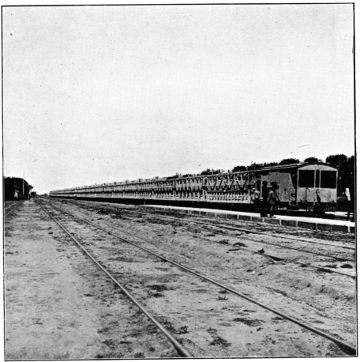
New Technologies in Transport: Railways
Central Argentine Railway
bringing cattle to Barrancosa (Argentina).

Slide 28
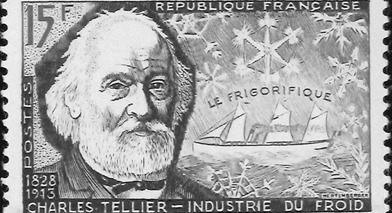
New Technologies in Transport: Refrigerator Ships
Le Frigorifique (1876)
Dunedin
Sailed from New Zealand to Britain carrying 5,000 frozen mutton carcasses (1882).

Slide 29
New Technologies in Retailing
Branding and advertising

Slide 30
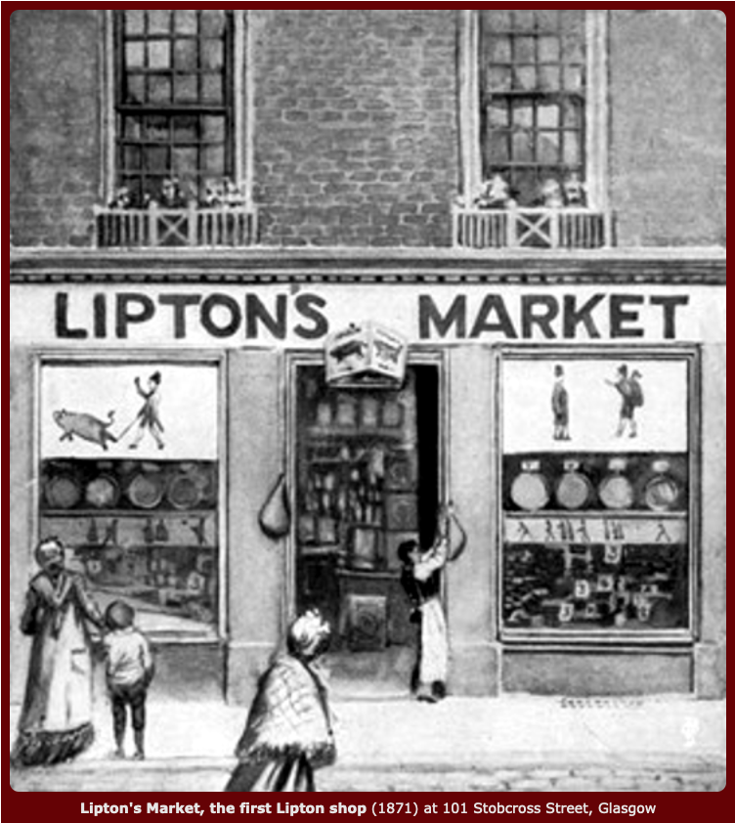
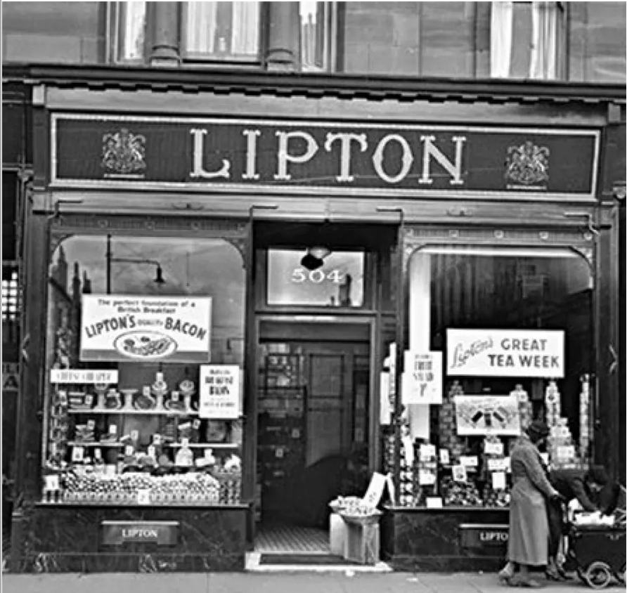
Retail: Branding The Chain Store
Lipton’s Grocery Stores in 1870s Glasgow

Slide 31
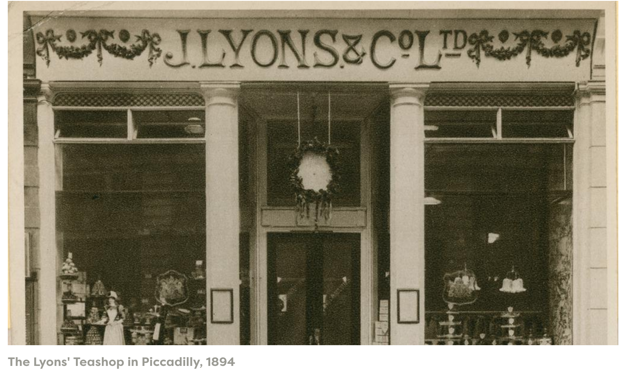
Retail: Branding The Chain Store

Slide 32
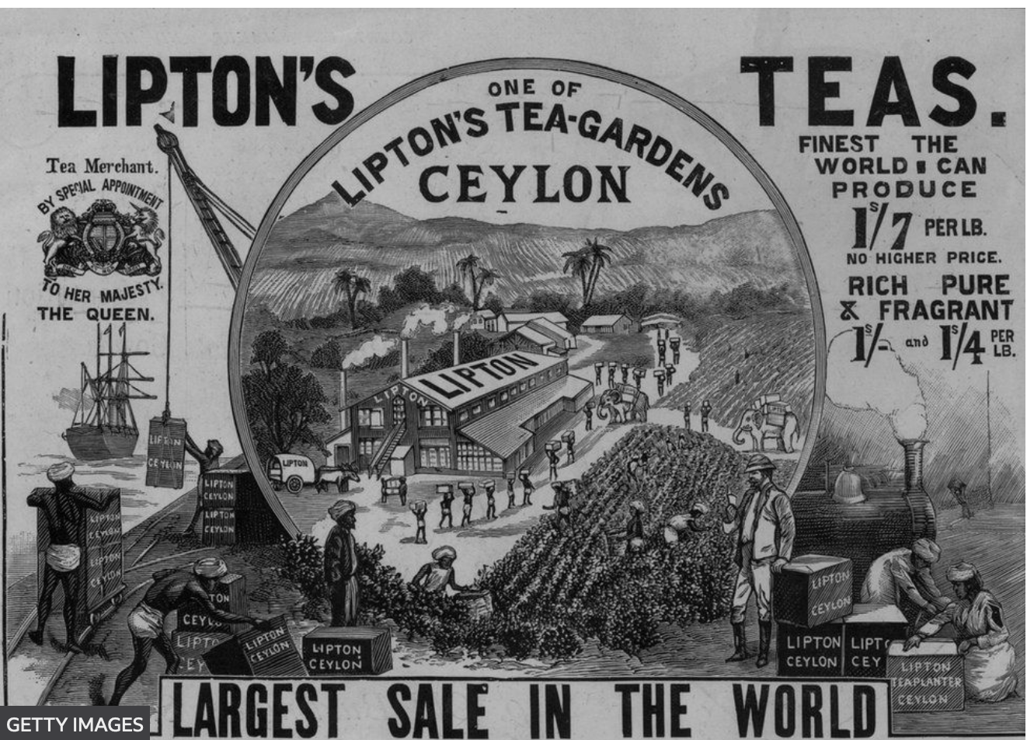
Retail: Branding

Slide 33
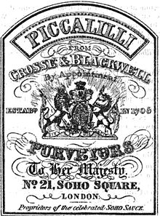
Retail: Branding
Branding erases the actual origin of a food, replacing it with a brand.
Richard Wilk, Home Cooking in the Global Village (2006)

Slide 34
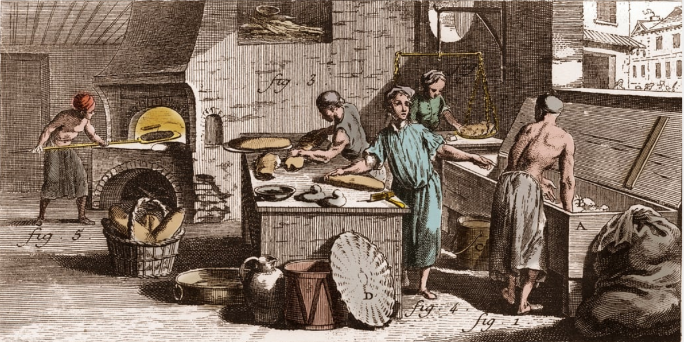
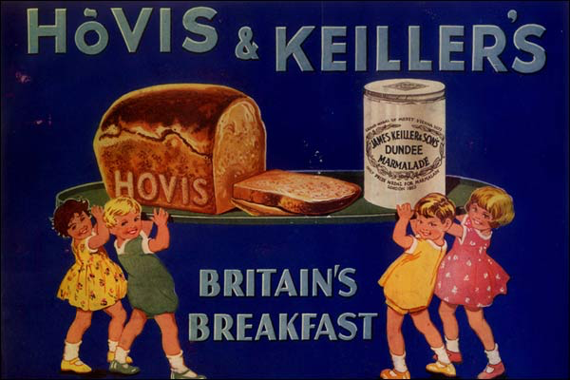
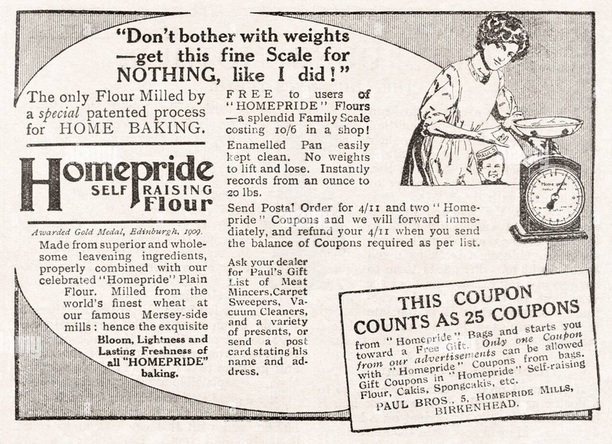
Retail: Advertising
An 18th-century bakery
(Encyclopedia or Dictionary of the Sciences, Arts and Professions)
Hovis Advertisement (1932)
Homepride Self Raising Flour advertisement (1912)

Slide 35

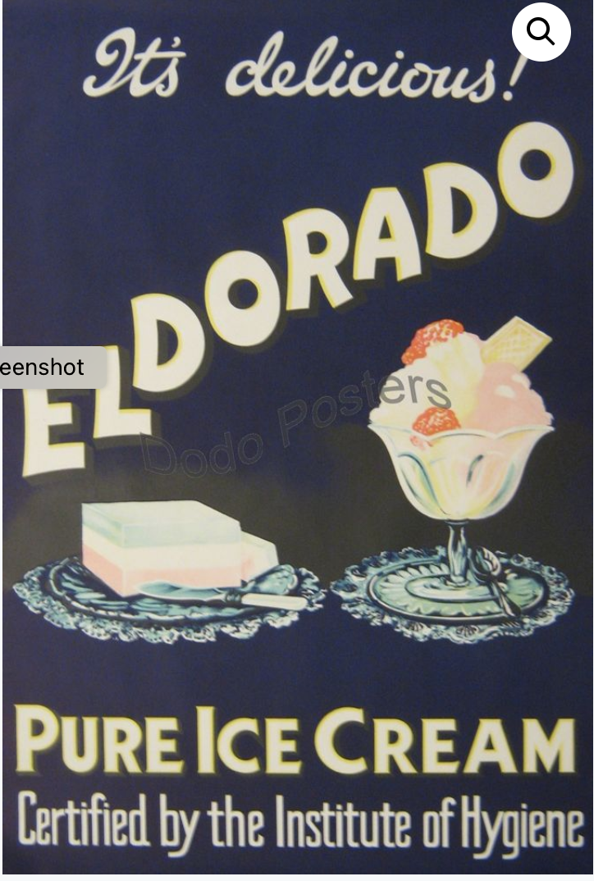
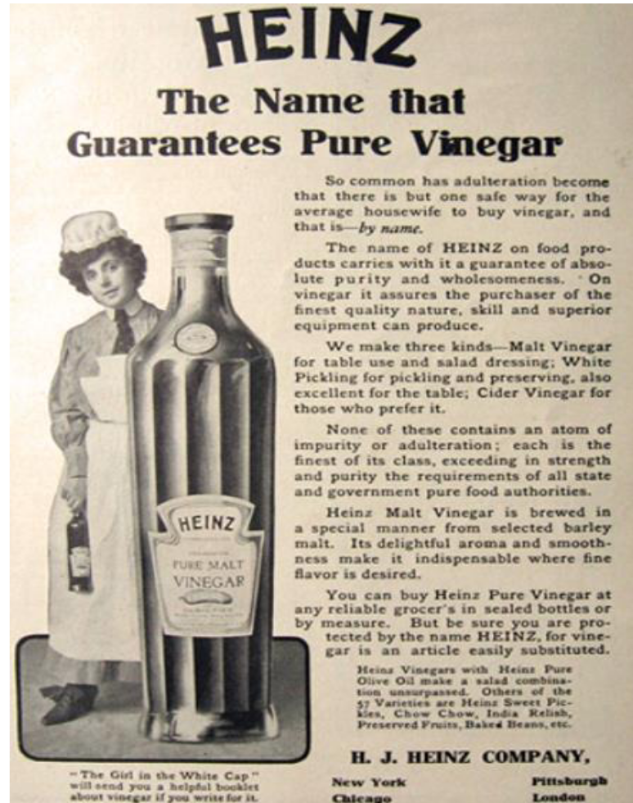
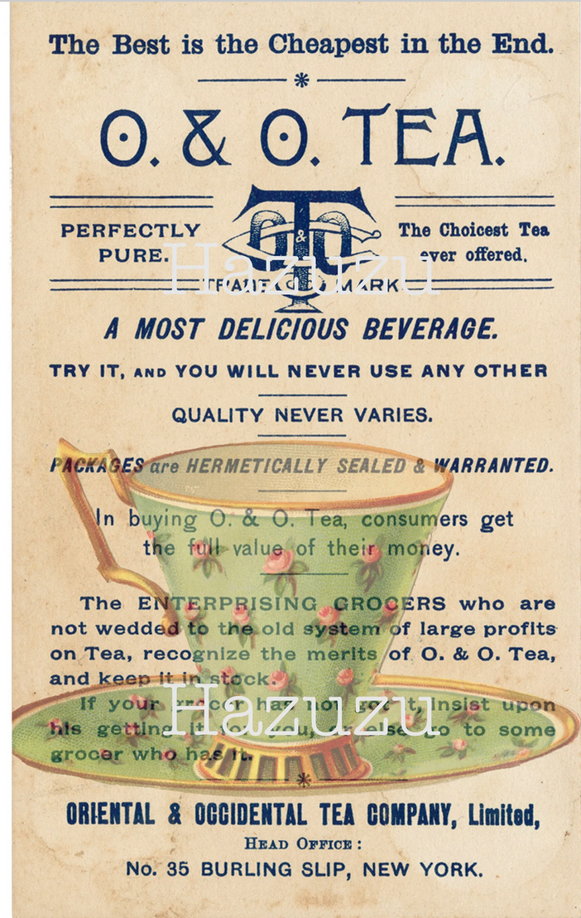
Retail: Anxieties about Pure Food
Branding plays on concerns about adulteration.
Upton Sinclair, The Jungle (1906)
US Pure Food, Drink, and Drugs Act (1906)
1906
1885

Slide 36
Industrial Food and Empire

Slide 37
Industrial Food and the British Empire
Early tinned foods travelled around the British empire—to India, Batavia, Hong Kong, Gibraltar, Manila, West Indies . . .

Slide 38
Industrial Food and Empire
‘Whether for European troops deployed up Egypt’s Nile River, explorers seeking the Pole, or emissaries of the British Raj in India, canned foods ranging from green peas to steak and kidney pudding and potted beef became essential accoutrements of imperial ventures.’
Jayeeta Sharma, ‘Food and Empire’, Oxford Handbooks of Food History, ed. Jeffrey Pilcher (2012)

Slide 39
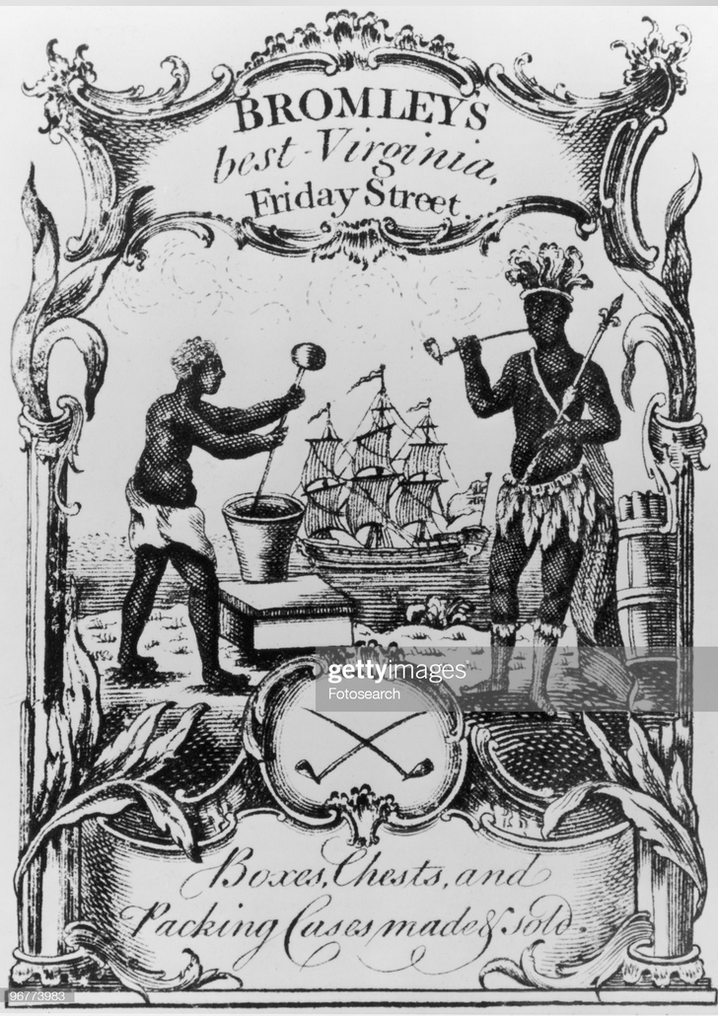
Industrial Food and the British Empire
1891 advert for Huntley & Palmers Biscuits.
Bromley’s best Virginia tobacco (1760)

Slide 40
Industrial Food and the British Empire
‘Eating connected the British to their empire as foods became not only the most abundant products of imperial trade, but also the empire’s most prevalent symbols.’
Troy Bickham, ‘Eating the Empire: Intersections of Food, Cookery and Imperialism in Eighteenth-Century Britain’, Past and Present (2008).

Slide 41
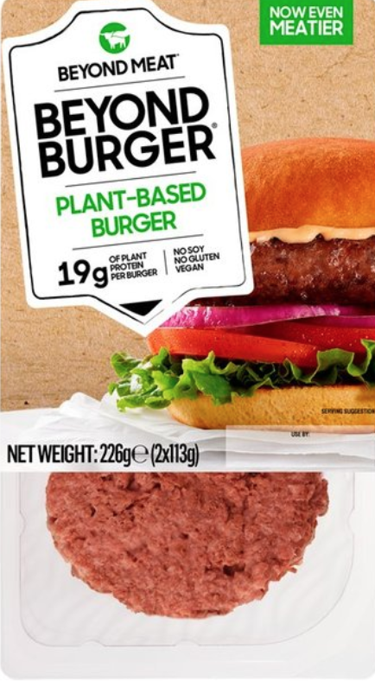
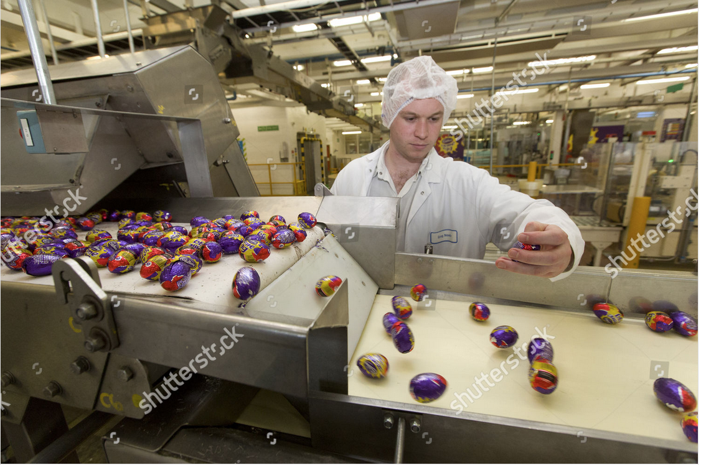
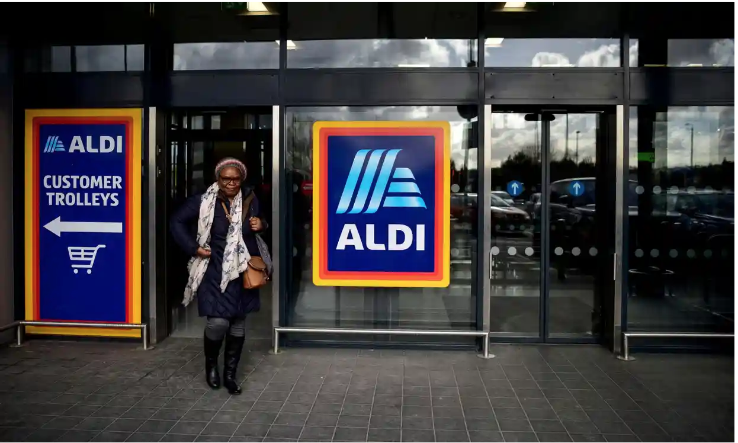
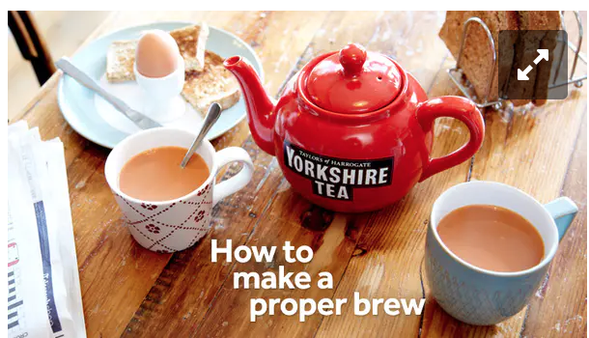
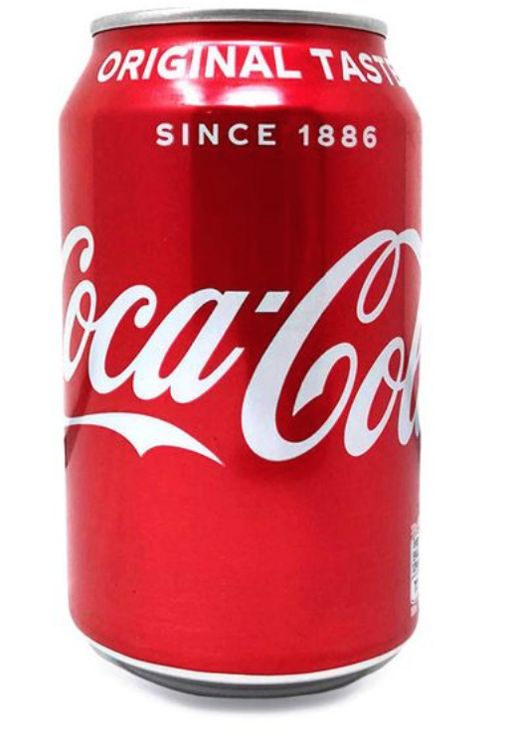

Our world of industrial foods
preservation, mechanisation, transport, retail

