Slide 1
For Next Week
practical exercise: object biographies
Every object has a life and often a series of afterlives, shaped by human use. This assignment asks you to perform an ‘object biography’ on a piece of kitchen technology, from a George Foreman grill to a Meso-American metate. Please select a specific, concrete object, from your kitchen, or a museum, or a store, or elsewhere. What materials and circumstances influenced its creation and survival? What can we learn by spending extended time with a single object and by trying to tell its story?
Conduct a brief ‘object biography’ of your choice of kitchen technology. Please send me a one-page biography before the seminar.

Slide 2
Calories, Vitamins and Nutritional Science

Slide 3
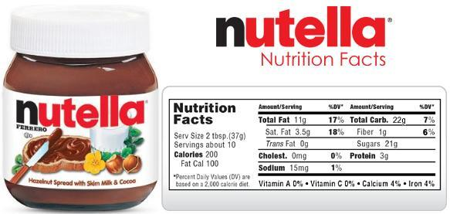
A nutritional label

Slide 4
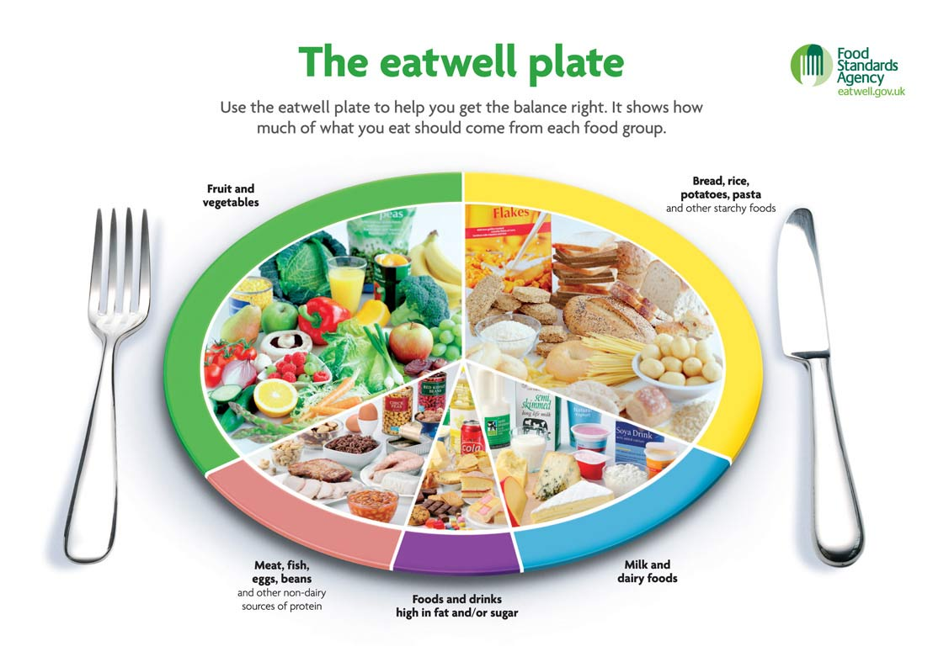
UK nutritional guidelines: the eatwell plate

Slide 5
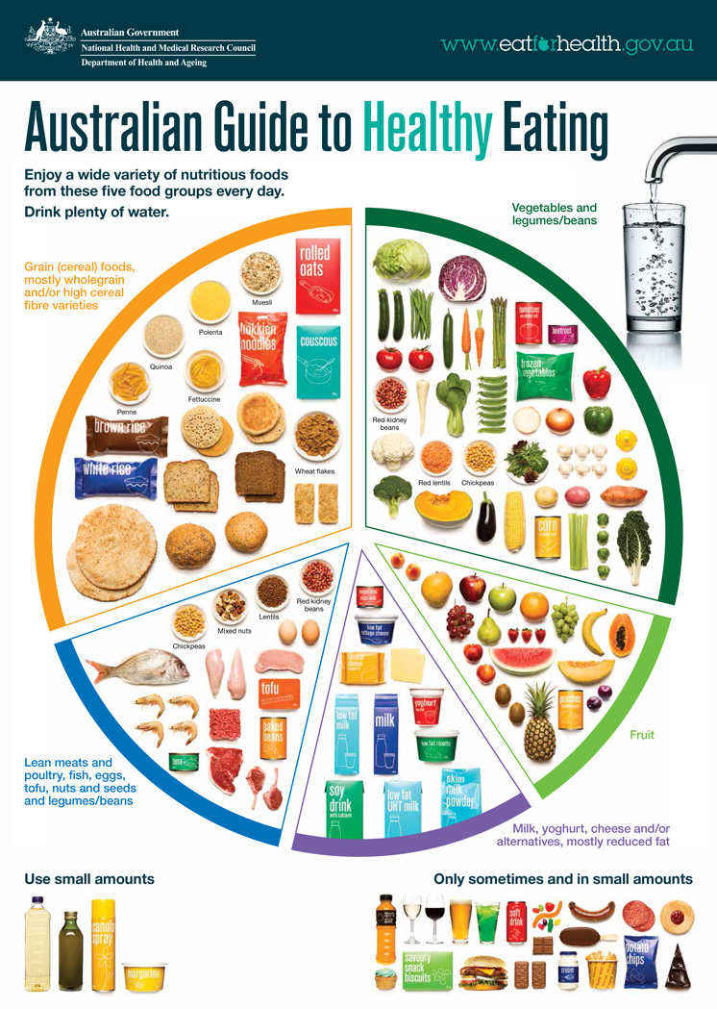
Australian healthy eating guidelines

Slide 6
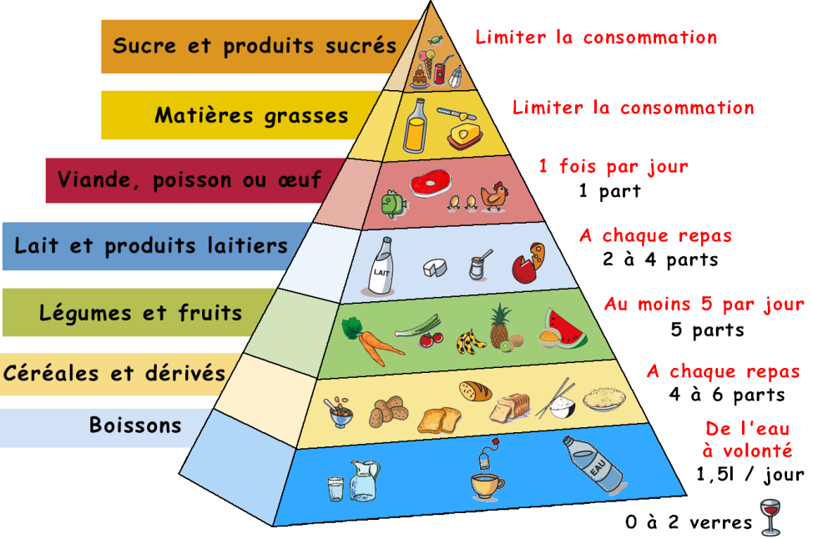
French nutritional pyramid

Slide 7
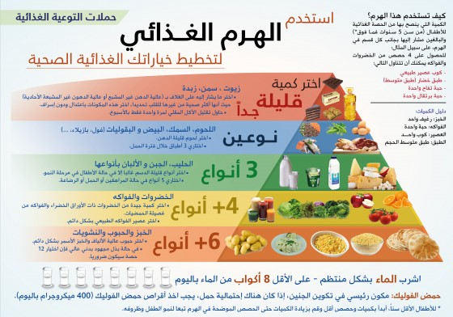

Slide 8
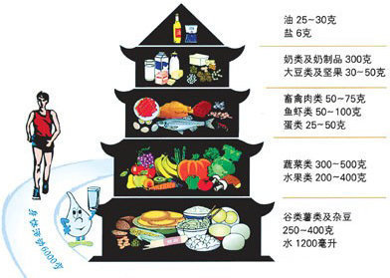
Chinese food pagoda

Slide 9
Qatar Supreme Council of Health dietary guidelines

Slide 10
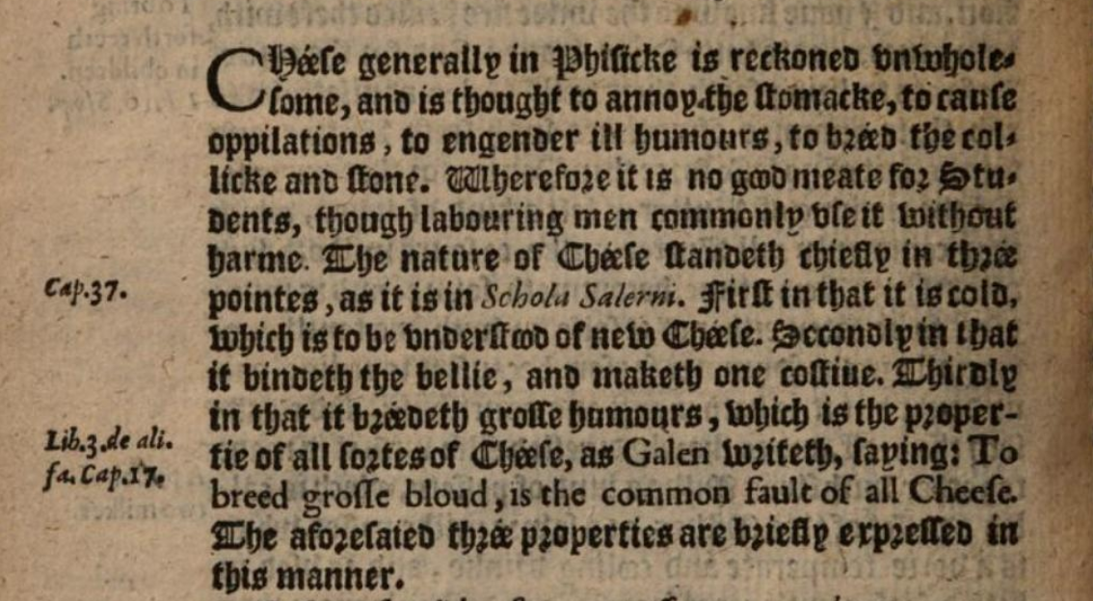
An early modern health manual
‘Cheese generally in physicke is reckoned unwholesome, and is thought to annoy the stomacke, to cause oppilations, to engender ill humours, to breed the colicke and stone. Wherefore it is no good meate for students, though labouring men commonly use it without harm.’
Thomas Cogan, The Haven of Health. Chiefely gathered for the comfort of students, and consequently of all those that have a care of their health (London, 1596).

Slide 11
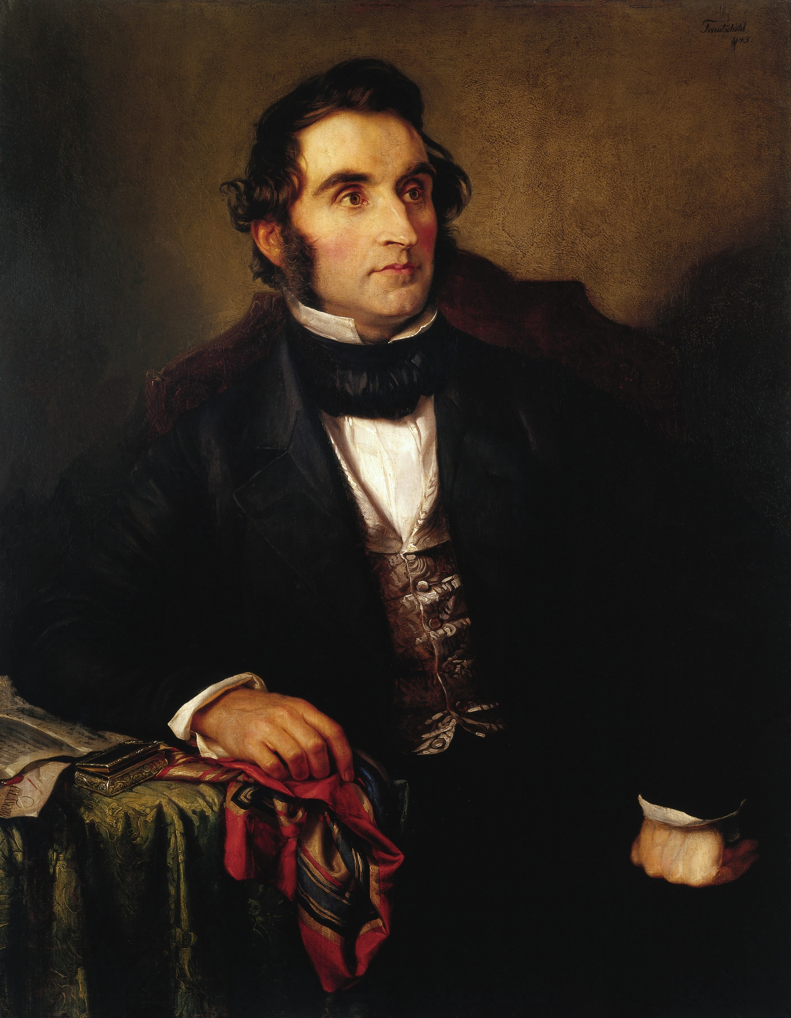
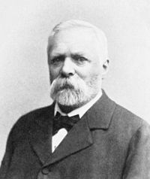
Central role of chemistry in 19th-century investigations of healthy eating
Concept of protein
Carl von Voit (1831-1908)
Justus von Liebig (1803-1873)
Wilhelm Trautschold, Justus von Liebig (c. 1846)

Slide 12
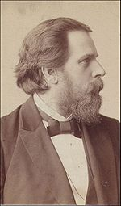
Max Rubner (1854-1932)
‘a calorie is a calorie’: calories as a means to compare the energy value of different foods
Between 1878 and 1883, Rubner developed his ‘isodynamic law’: calories derived from proteins, fats and carbohydrates are mutually interchangeable in the body. He later established ‘standard values’ for comparing the caloric equivalents of different foods.

Slide 13
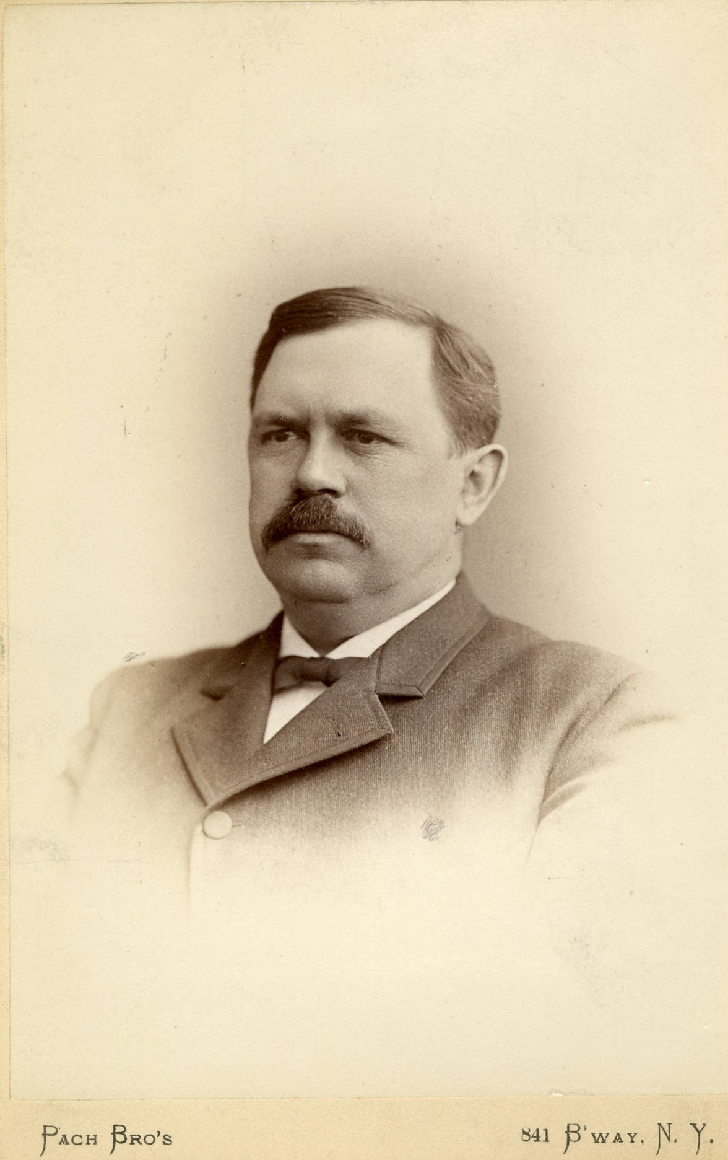
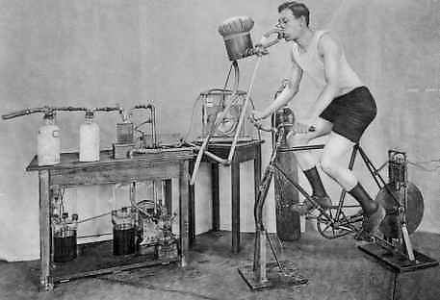
Wilbur Atwater (1844-1907)
Studies of the energy value of foods
Atwater’s cycle ergometer

Slide 14
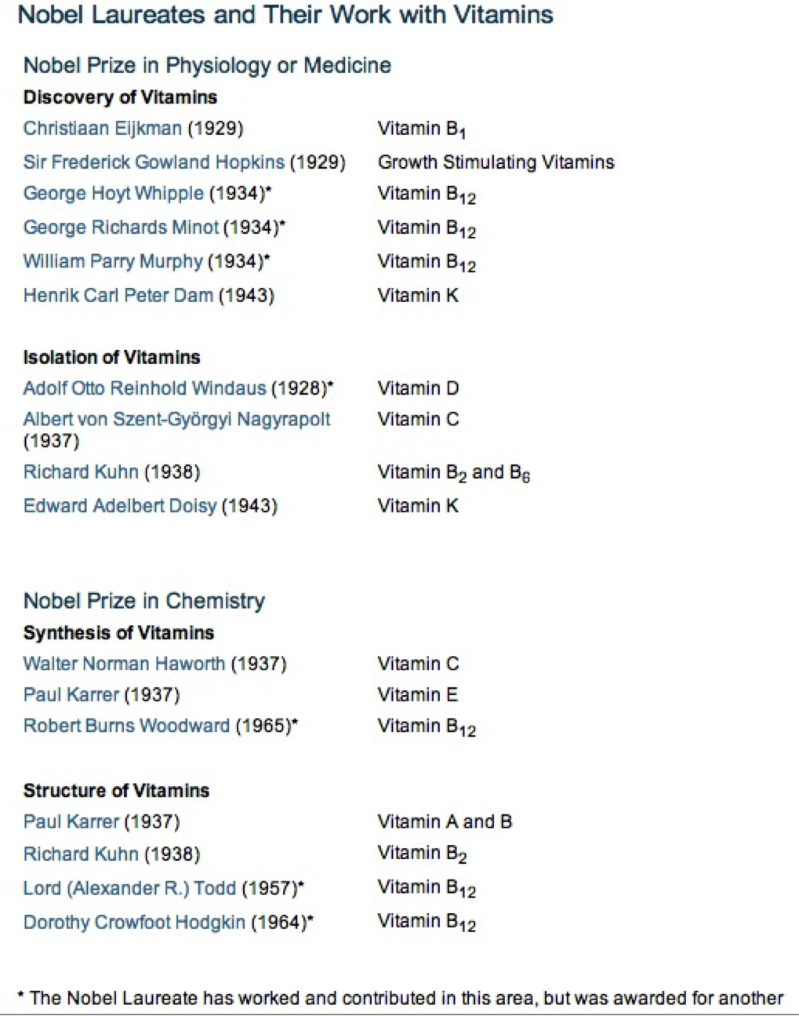
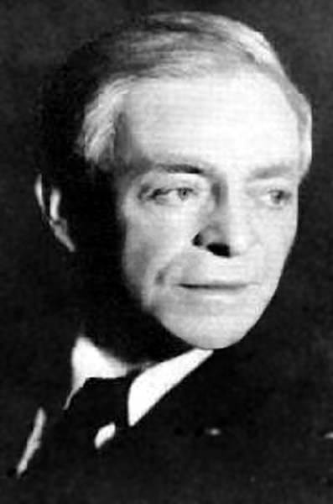
vitamins
Casimir Funk (1884-1967)
‘vitamins’ (vital amines)

Slide 15
‘Food science and food politics were in constant dialogue by the fin de siècle.’
Corinna Treitel, ‘Max Rubner and the Biopolitics of Rational Nutrition’, Central European History 41 (2008).
‘Nutrition is the foundation of the individual’s physical and mental performance, and thus the foundation of national productivity and public health.’
(Max Rubner)

Slide 16
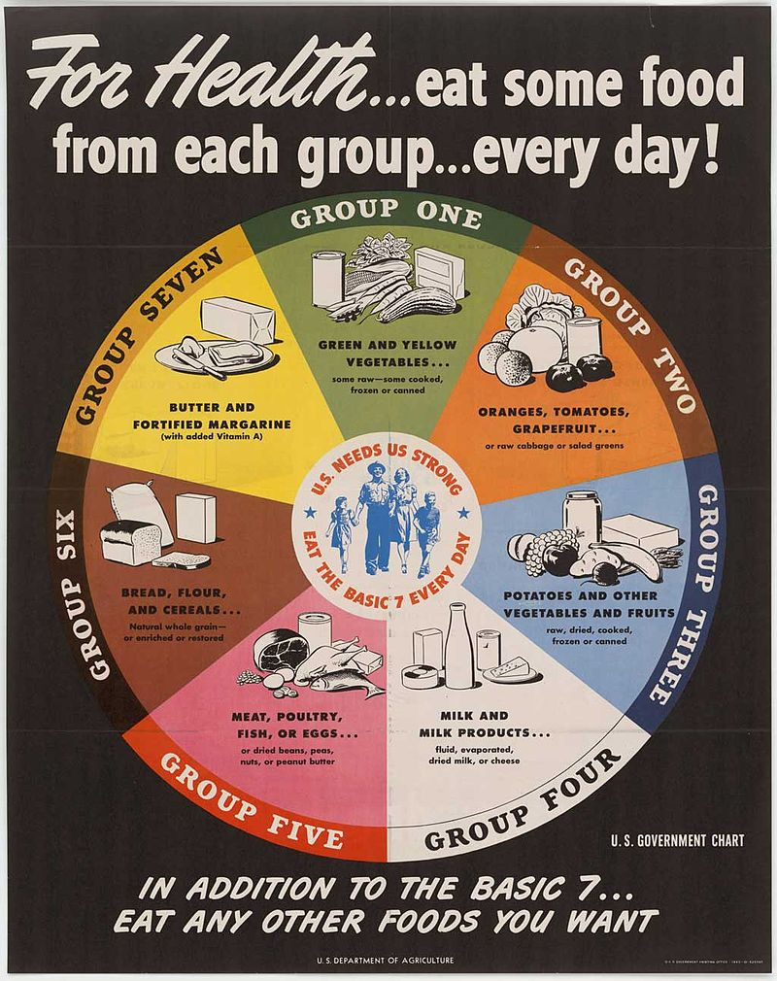
Some official dietary recommendations
Code Alimentaire (1910-12) France
League of Nations Standard (1935)
Recommended daily allowances (1941) USA
US ‘Basic 7’ (1943)

Slide 17
School meals:
The ‘Oslo breakfast’
Developed in the 1920s by Carl Schiøtz to improve the health of Norwegian school-children.
Free school meal consisting, typically, of:
Two slices of wholemeal bread spread with margarine
A slice of cheese
Half a pint of milk
Half an apple and half an orange
Cod-liver oil (seasonal)

Slide 18
School meals: UK and USA
1906 Liberal government in UK allows local educational authorities to provide free school meals.
(see sample documents on the National Archives website.)
1941 National School Meals Policy in UK requires schools to serve nutritionally-balanced meals.
1946 National School Lunch Act in USA establishes free or subsidised meals for poor students.

Slide 19
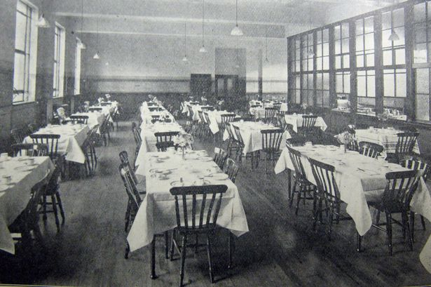
Workers’ canteens: UK
Templeton Dining Room at Dalmarnock Electricity Power Station
Workers’ canteen numbers double from 5695 (1941) to 11,630 (1944)

Slide 20
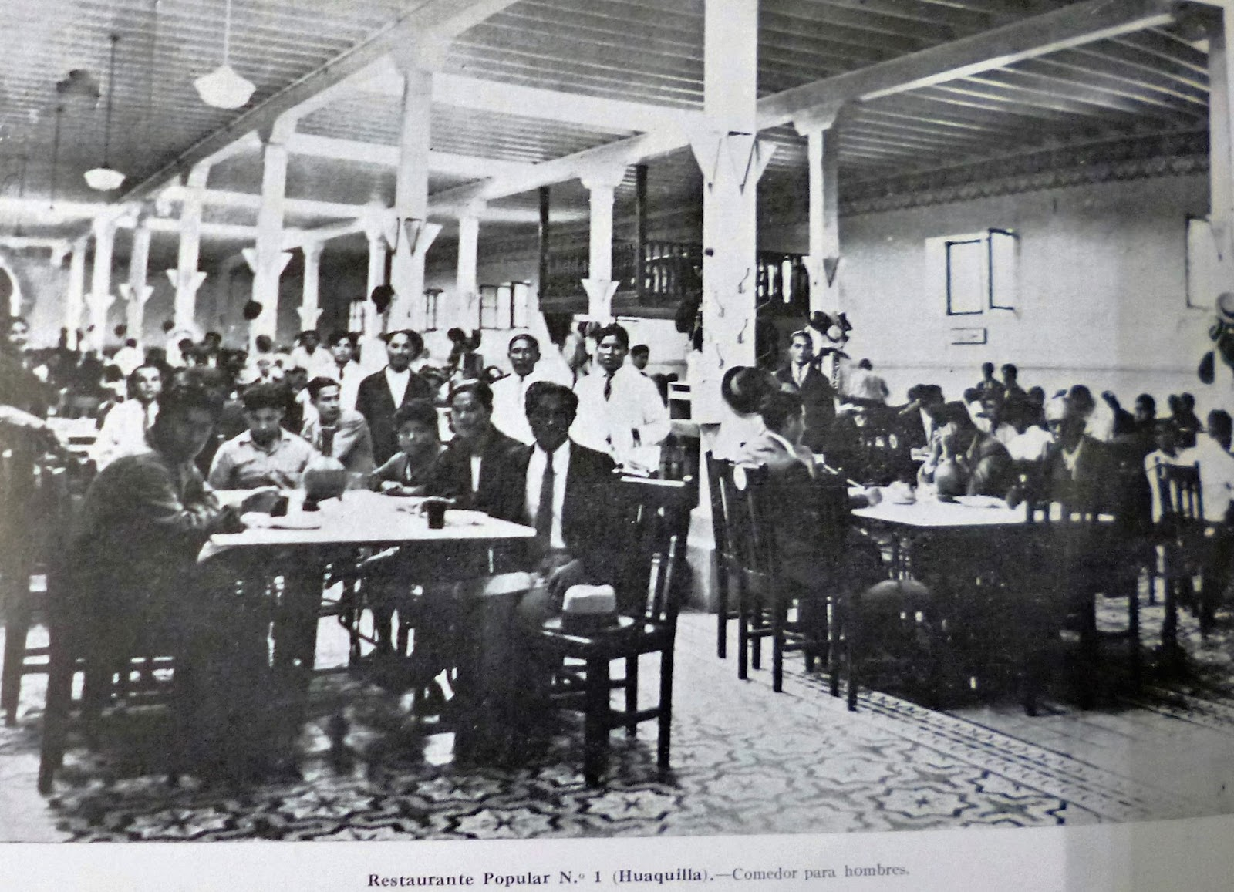
Workers’ canteens: Peru

Slide 21
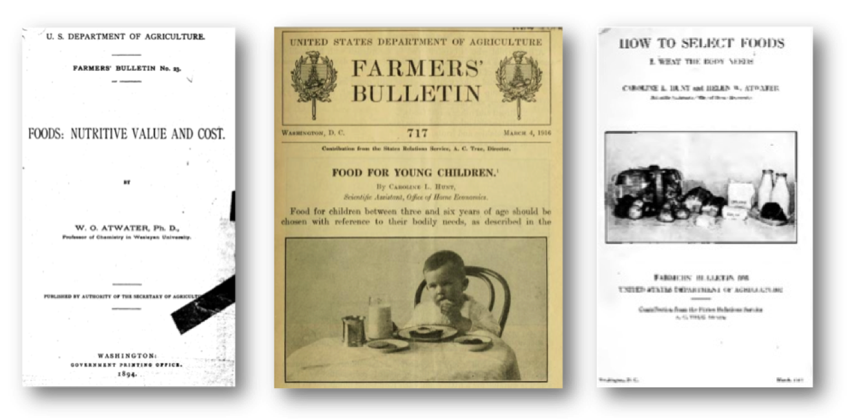

Slide 22
Nutrition, Welfare and National Security
‘War demands better physique and health than peace, and for this reason alone, fundamental changes must be made in the Englishman’s diet. This indeed is becoming increasingly recognised, but everyone is not clear as to what ideal of diet a war-time people in an island position should be aiming. Many, no doubt, feel the whole question of diet is too complicated for lay persons to understand and few even of our rulers are in all probability sufficiently informed to be able to explain to their electors what line they are working on, if any, in Parliament. For this doubt and uncertainty there is no justification, for science has given the answer.’
Public Health 54 (1940-41).

Slide 23
Nutrition, Welfare and National Security
‘The English diet is haphazard and its present composition depends largely upon chance and the tastes that have developed with industrialisation and prosperity. Certain sections of the nation, both rich and poor, are known to be feeding faultily. In some the correct diet is unobtainable; in others it is insufficiently appreciated. . . Protective foods are those which contain appreciable quantities of either essential mineral salts, such as iron, calcium or phosphorus, or the complex organic compounds, which are the vitamins, for example, thiamine, ascorbic acid, calciferol, or those amino-acids which are present only in animal and not vegetable proteins.’
Public Health 54 (1940-41).

Slide 24
Nutrition, Welfare and National Security
‘There are 40 or 50 or 60 percent, perhaps, of rejections [among men who have been drafted] in which at least nutrition or feeding has much to do with the rejection . . . I think it would be a more reasonable thing to say that probably at least 40 percent of them are for reasons in which nutrition can be a definite factor.’
Lewis B. Hershey, Director of the Selective Services, statement to US House Committee on Agriculture (1945).

Slide 25
Nutrition, Class and Race
Critiques of the ‘irrational’ eating habits of the poor (Max Rubner)
Explicit attempts to modify the diets of workers
Educational schemes in approved nutritional practices
Concern that the poor diet of working people would lead to a ‘loss of economic efficiency’ (Robert McCarrison).

Slide 26
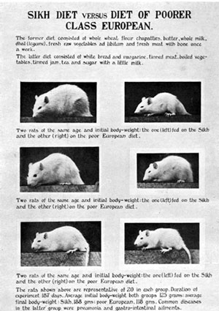
Nutrition, Class and Race:
Robert McCarrison’s rat studies
‘Rats fed on a diet common among large sections of the population of England to-day, namely, low extraction white bread, imitation ham, sugar, a little milk and vegetables boiled in soda, became rapidly ill and fell to eating each other.’

Slide 27
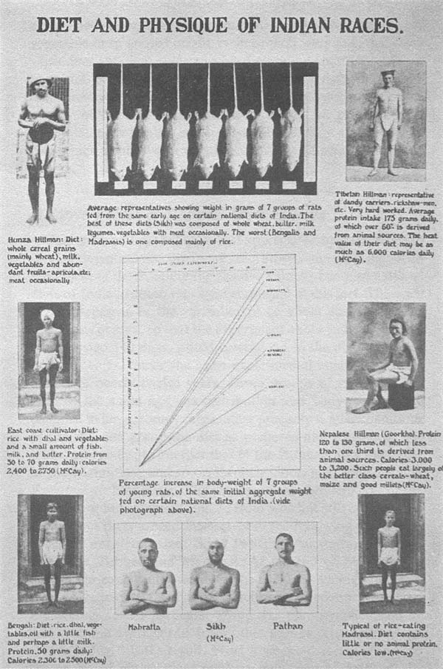
Robert McCarrison’s rat studies
Caption: ‘Note fine physique of races (Mahratta, Sikh, Pathan) whose diets are well constituted and poor physique of those (Bengali, Madrassi) whose diets are ill-constituted.
Note similar effect on rats fed on those diets. From left to right, the rats represent Sikh, Pathan, Mahratta, Goorkha, Kanarese, Bengali, Madrassi.’
From: Robert McCarrison, Nutrition and National Health, being The Cantor Lectures delivered before The Royal Society of Arts 1936 (London, 1953).

Slide 28
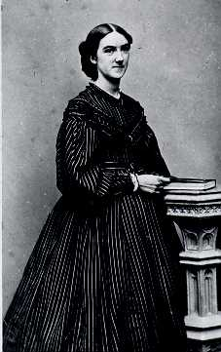
Domestic Science and Nutrition
Laura Shapiro, Perfection Salad: Women and Cooking at the Turn of the Century (1986).
Boston Cooking School (founded 1879)
NY Cooking School (founded 1876)
Ellen Richards: ‘A woman who boils potatoes year after year, with no thought of the how or the why, is a drudge, but the cook who can compute the calories of heat which a potato of given weight will yield, is no drudge.’
Ellen Richards, c. 1864

Slide 29
Domestic Science and Nutrition
‘Starch forms a large proportion of all these plants, and you will remember how useful an article of food that is, because it contains a great deal of carbon. Gluten is the name given to the nitrogenous parts of these plants. . . We need much more carbon than nitrogen to keep up the strength of our bodies. Try to remember that 5000 grains of carbon are required for a man, and 300 grains of nitrogen, to be taken every day.’
E. Rice, A Text-Book of Domestic Economy (1900).

Slide 30
Domestic Science is institutionalised
Reifensteiner Verband (1897, Germany)
Bath College of Domestic Science (1892, UK)
National Society's Training College of Domestic Science (1893, UK)
American Home Economics Association (1909, USA)
Smith-Hughes Act (1917, USA) funds the teaching of domestic science at universities, leading to the establishment of departments of home economics.
Nutrition taught at teacher training colleges from a standardised text (1917, Colombia)
Ligue d’Organisation Ménagère (1924, France)
Instituto Municipal de la Nutrición (1928, Argentina)

Slide 31
Linking the Home to the State: Eating as an Activity requiring Personal Responsibility

Slide 32
personal preference vs. nutritional science
Ellen Richards:
‘In food, not what we like but what is good for the many should be the standard.’
‘A higher rule of life than the mere gratification of taste, regardless of health and pocket, must prevail.’

Slide 33
‘One must ask why more serious efforts have not been made to regulate the diet of our people according to scientific principles. If meat is not essential to health, why do we continue to import it in such quantities and from far distant places at considerable risk of shipping loss? . . . If milk is almost, if not completely, the most valuable form of food for both children and grown-ups, why continue to fatten sheep and plough up grass land, and why not energetically pursue a policy of fertilisation and resowing of grassland? . . . If in any event the potato exceeds grain in its value to man, why not take advantage of such a startling revelation and increase greatly the consumption of potatoes? . . . These any many more questions about the anomalies of our present-day diet need to be answered. Cannot the Minister of Food, himself a man of energy, take steps to bring about the reforms of diet which were overdue in peace-time and for which war is now clamorous?’
Public Health 54 (1940-41).

Slide 34
Report of the United Nations Conference on Food and Agriculture (Hot Springs, 1943).
‘Given the will, we have the power to build in every nation a people more fit, more vigorous, more competent; a people with longer, more productive lives, and with more physical and mental stamina than the world has ever known. Such prospects, remote though they may be, should serve as a stimulus in undertaking immediate tasks and overcoming immediate obstacles.’

Slide 35
Some Points
close connections between the rise of nutritional science in 19C and the conversion of eating into a scientific practice.
The language of nutrition provided powerful tools for governments to conceptualise the eating habits of their populations and then to try to influence them in the name of public health.
Nutritional science also provided a powerful language for criticising the eating habits of the working classes, colonised people, and many other groups.

Slide 36
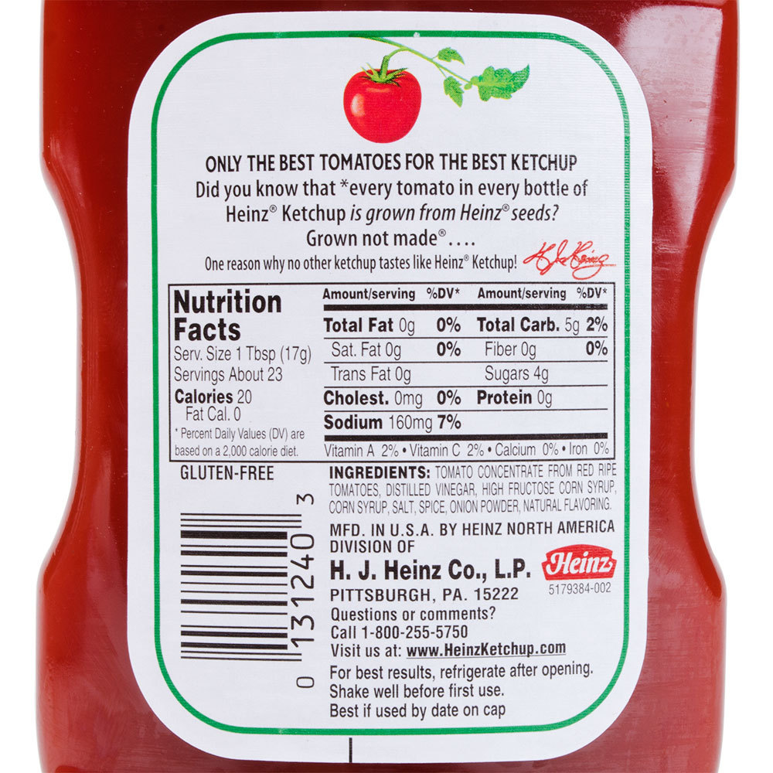
The nutritional label

