Slide 1
Food and Religion
A man asked the messenger of Allah: ‘Which act in Islam is the best?’
Muhammad replied: ‘To give food, and to greet everyone, whether you know them or not’.
Book of Greetings 6, Hadith 845

Slide 2
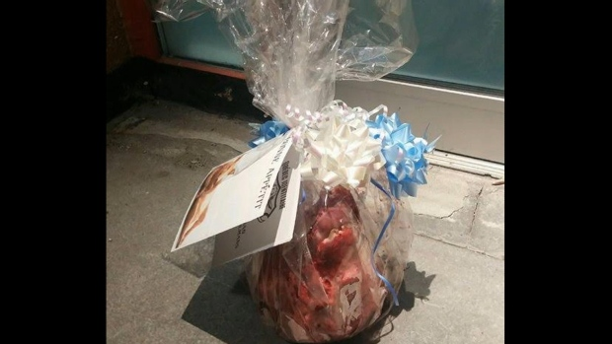
Food and Religious Hate Crimes
In June 2016 a pig’s head was left outside a mosque in Québec City. The card reads ‘Bon appétit’.
The following January 2017 a gunman killed six worshippers at the same mosque.

Slide 3
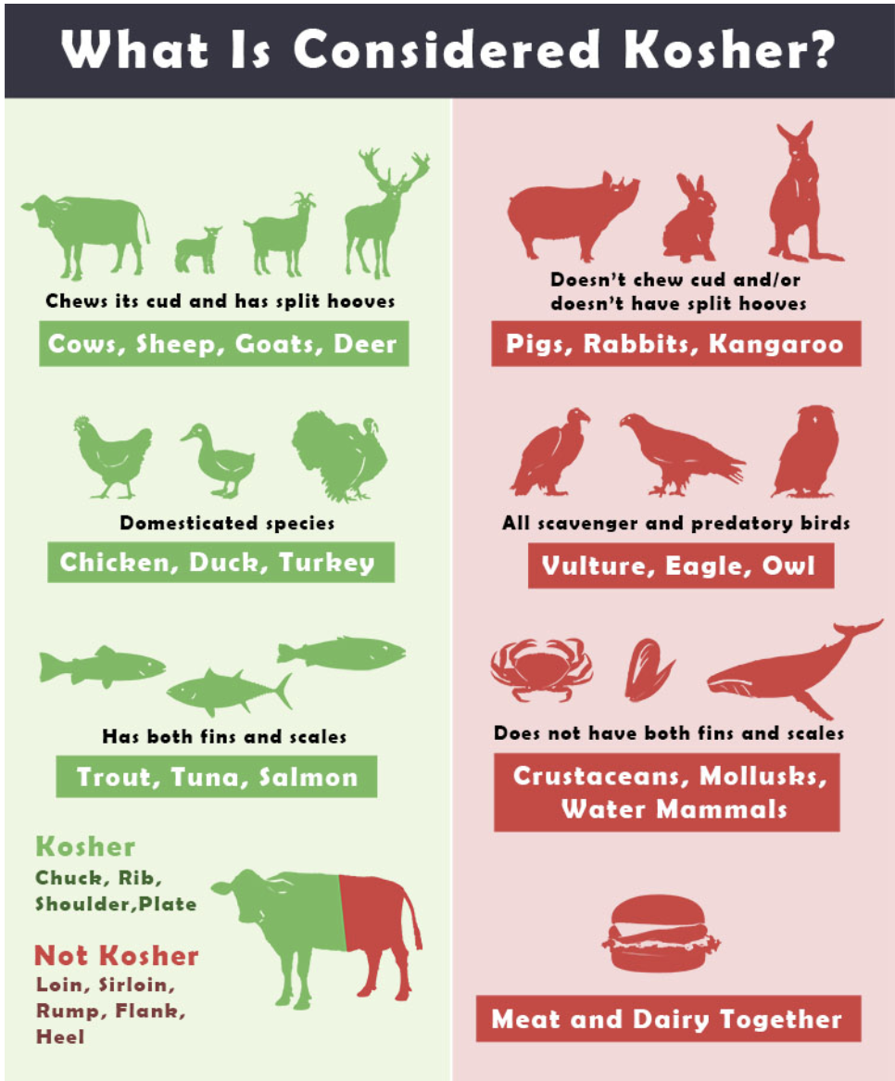
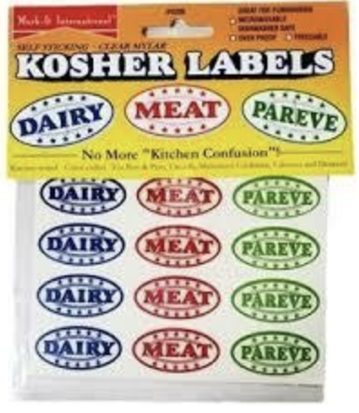
Kashrut

Slide 4
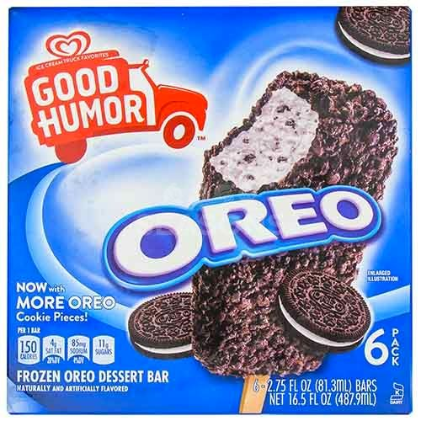

Industrial Kosher: Oreo Ice Cream Bars

Slide 5
Beef in Contemporary India
‘Cow Protection Movement’
Ongoing debates about the status of beef
Maharashtra Animal Preservation Bill (2 March 2018) banned the slaughter and sale of beef.
‘Caste on the Menu Card’

Slide 6
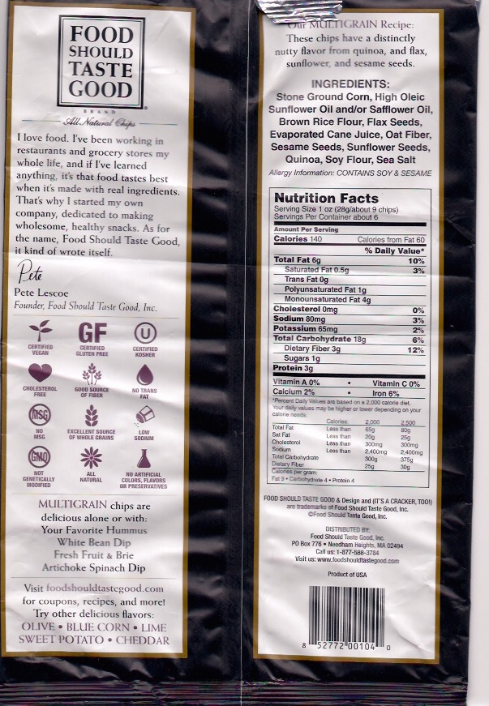
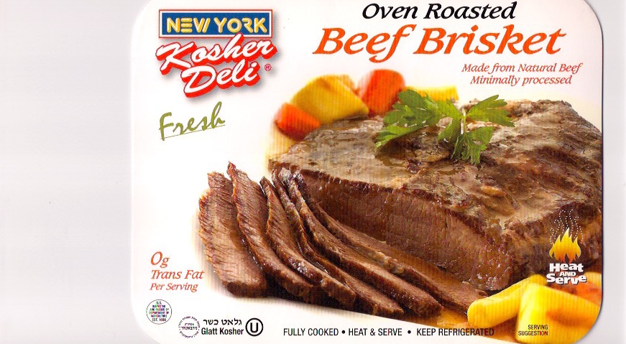
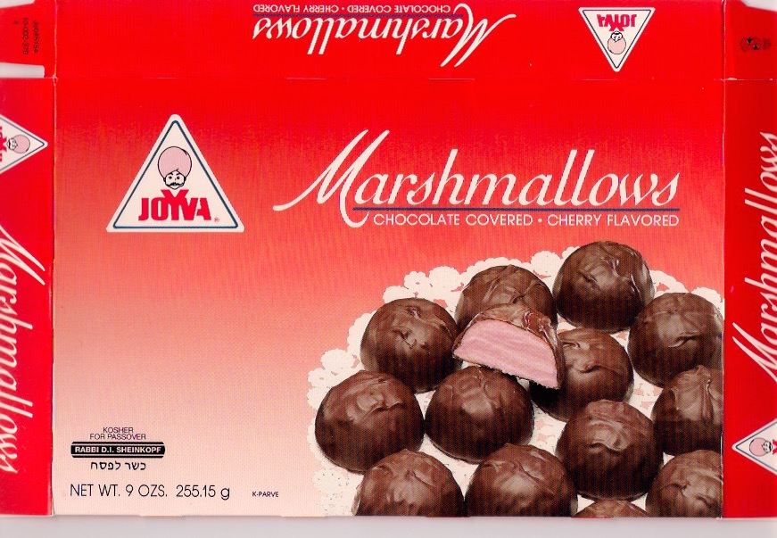
Various kosher certifications

Slide 7
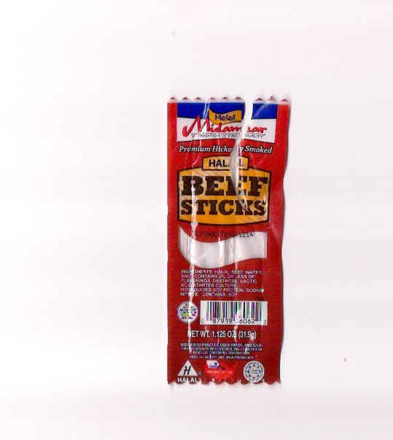
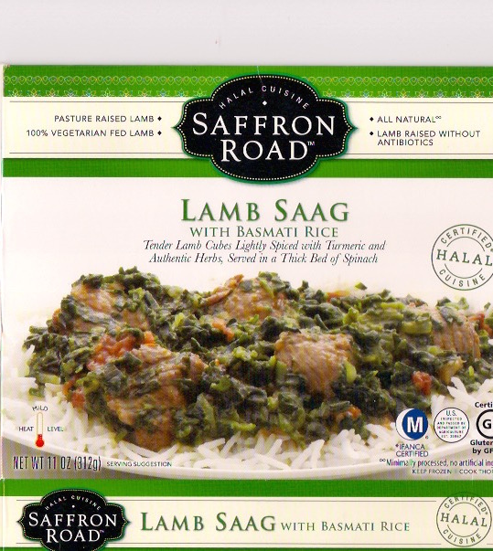
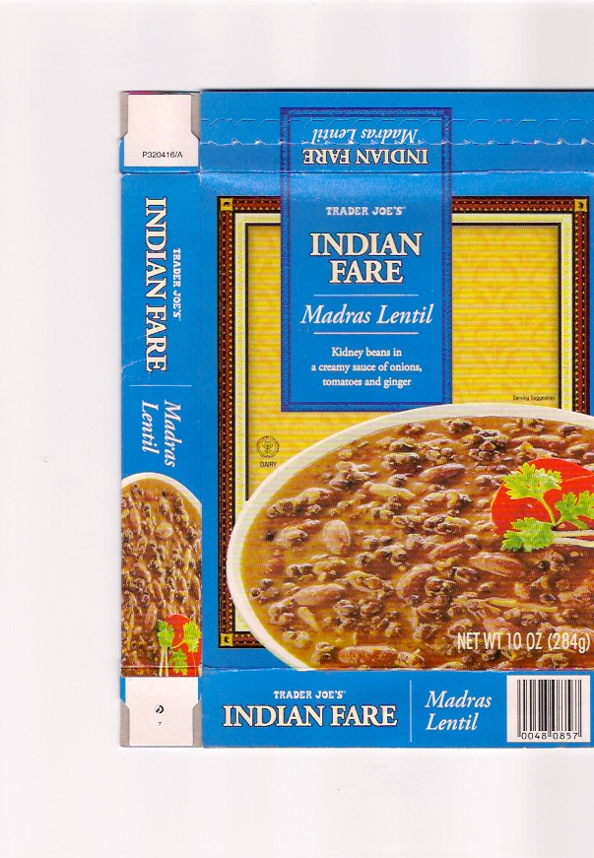
Various halal certifications

Slide 8

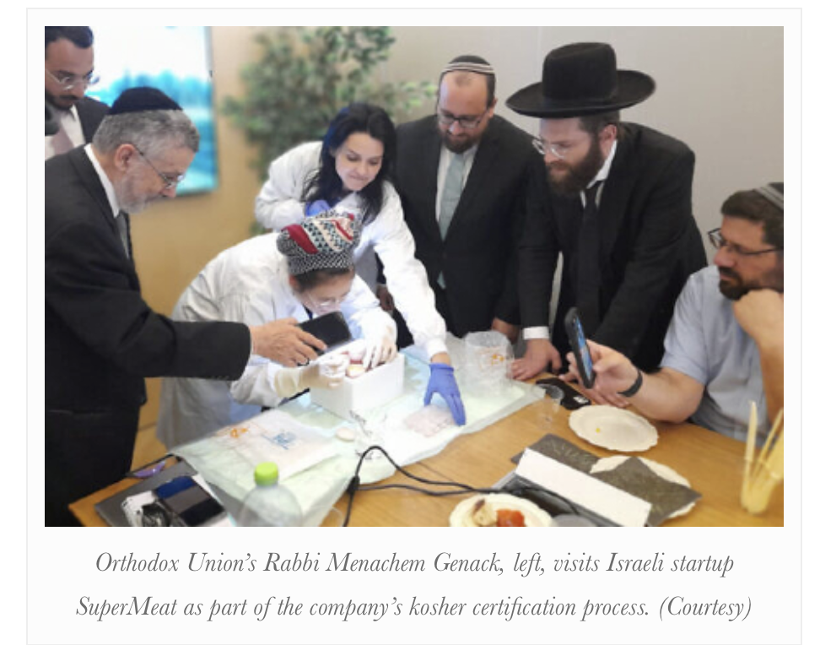
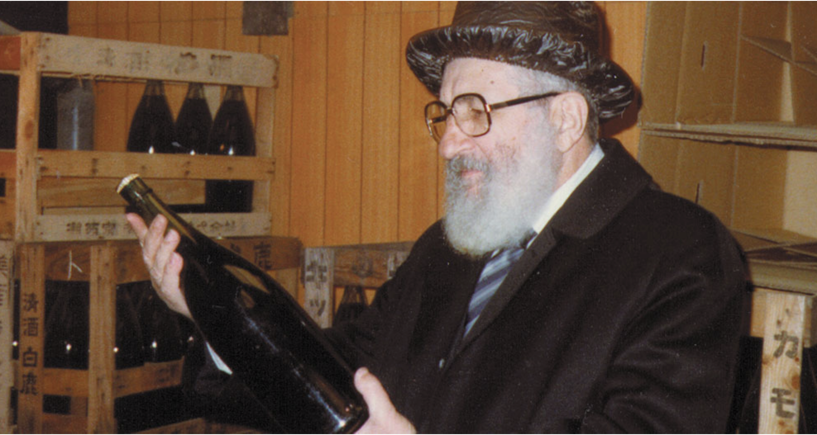

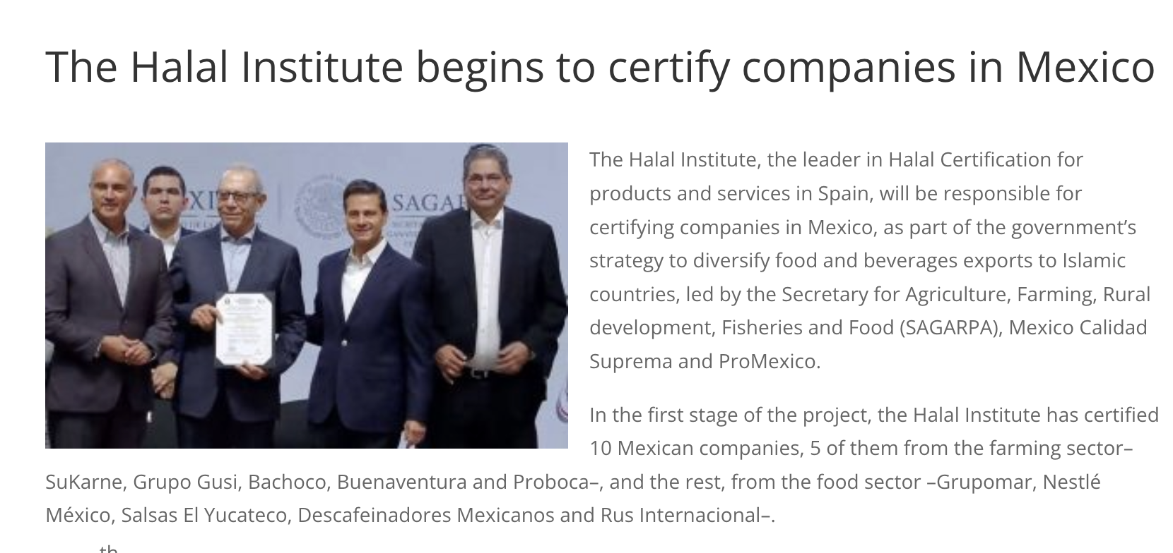

Slide 9
Religious food regulations

Slide 10
Religious food regulations on . . .
prohibited foods
who can prepare your food
whether you can eat your food with non-co-religionists
the utensils used to prepare the food
the manner in which any animals were slaughtered
the combinations of foods on the table at any moment
the consumption of particular foods at particular times. . .

Slide 11
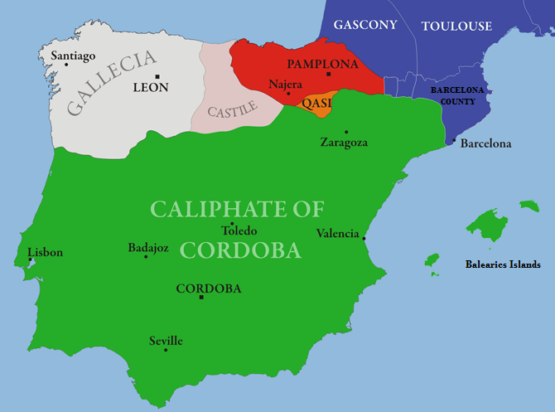
Spain circa 1000 AD: a religious food frontier
pork
No pork

Slide 12
Food identifies religious outsiders a case study from early modern Iberia
In Lope de Vega’s play The First King of Castille (written 1598-1603) a character explains that he has hung a side of bacon outside his door ‘so that the King will know that I am neither a Moor nor a Jew’.
People arrested by the Inquisition on the charge of being Jewish often tried to prove their innocence by insisting that they ate bacon and other meats ‘which Catholics are accustomed to eat and which are forbidden to Jews’.*
*Haim Beinart, ed., Records of the Trials of the Spanish Inquisition in Ciudad Real (1985).

Slide 13
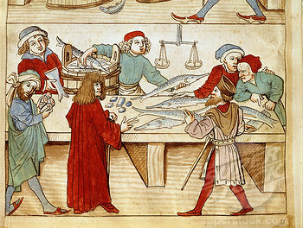
Buying fresh pike in the 15th century to eat on a ‘fasting’ day when meat was prohibited
Fasting and other Christian food-practices helped create ‘imagined religious communities’

Slide 14
Marcie Cohen Ferris, Matzoh Ball Gumbo: Culinary Tales of the Jewish South (2012).
‘Food is a bridge between southern culture and the Jewish experience . . . The degree to which southern Jews either embraced local cuisine or preserved Jewish foodways defined their identity in the South. Food became a barometer, a measuring device that determined how southern Jews acculturated while also retaining their own heritage.’

Slide 15
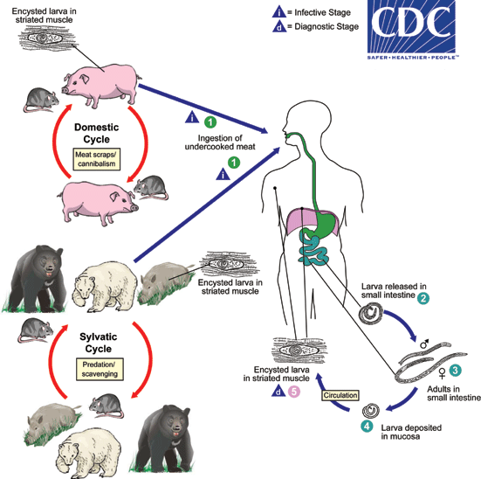
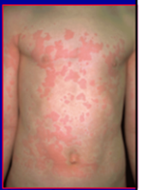
Life cycle of Trichinella spiralis
Typical trichinosis rash

Slide 16
A materialist explanation for not eating pork: trichinosis
The trichinosis theory reflects the
‘Western tendency to seek explanations in terms of disease’.
Frederick Simoons, Eat Not this Flesh: Food Avoidances from Prehistory to the Present (1994).

Slide 17
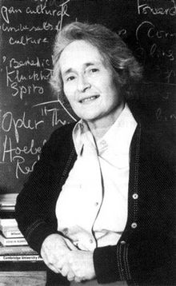
Mary Douglas (1921-2007)
Purity and Danger (1966)
‘Dirt’ is ‘matter out of place’:
Dirt is something that does not
conform to our
normal scheme of classifications

Slide 18
Mary Douglas on Dirt
‘Dirt then, is never a unique, isolated event. Where there is dirt there is system. Dirt is the by-product of a systematic ordering and classification of matter. . . Shoes are not dirty in themselves, but it is dirty to place them on the dining-table; food is not dirty in itself, but it is dirty to leave cooking utensils in the bedroom, or food bespattered on clothing; similarly, bathroom equipment in the drawing room; clothing lying on chairs; out-door things in-doors; upstairs things downstairs; under-clothing appearing where over-clothing should be, and so on. In short, our pollution behaviour is the reaction which condemns any object or idea likely to confuse or contradict cherished classifications.’
Mary Douglas, Purity and Danger: An Analysis of Concepts of Pollution and Taboo (1966).

Slide 19
Conclusions/Main Points
The relationship between food and religion is important today
This relationship is also embedded in history
This lecture has focused on religious food regulations
Food regulations are a powerful way of creating ‘imagined religious communities’ that both unite co-religionists and mark out the boundaries between those inside and outside the religious community.
Scholars have employed different approaches to explain religious food regulations, from Mary Douglas’ cultural approach, to more ‘materialist’ explanations such those offered by Marvin Harris. Yet other scholars stress the political implications of religious food regulations.

Slide 20
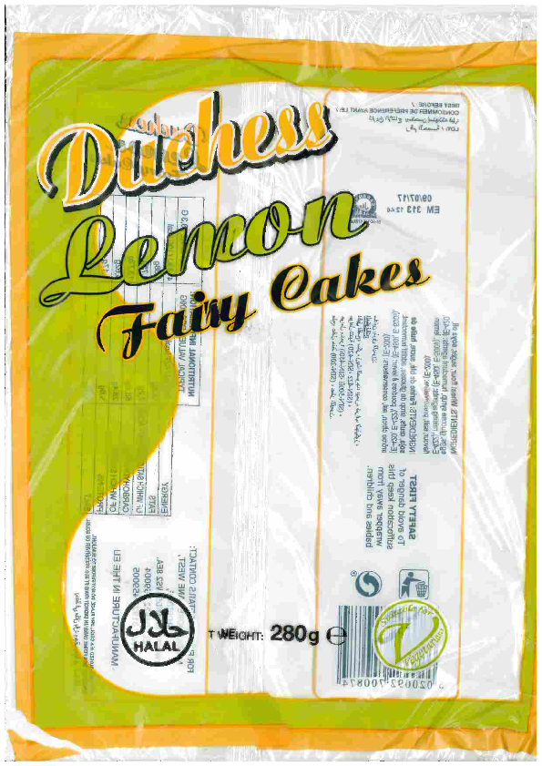
Halal and vegetarian lemon fairy cakes

