Slide 1
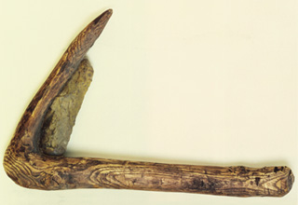
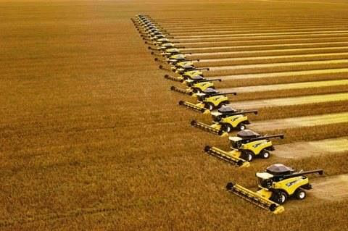
A Brief History of Agriculture
Neolithic wood and flint sickle
Combine harvesters

Slide 2
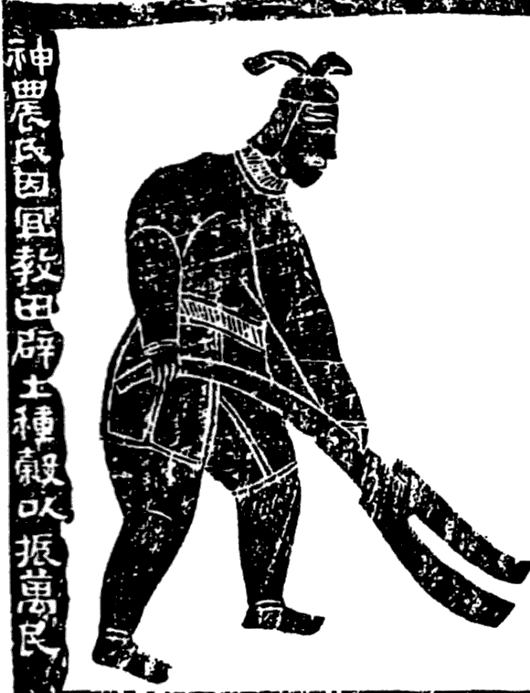
Shennong, Emperor of the Five Grains
Shennong Ploughing, Han Dynasty ((202 BCE–220 AD)
Gan Bozong, Woodcut of Shennong, Tang dynasty (618-907)

Slide 3
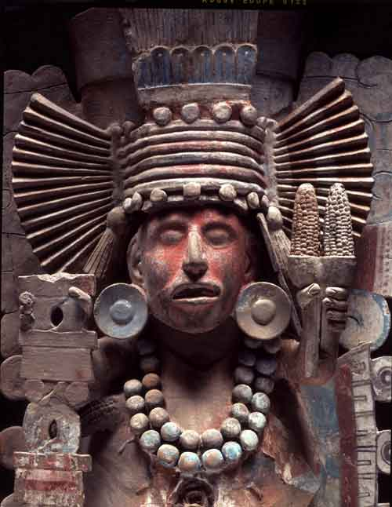
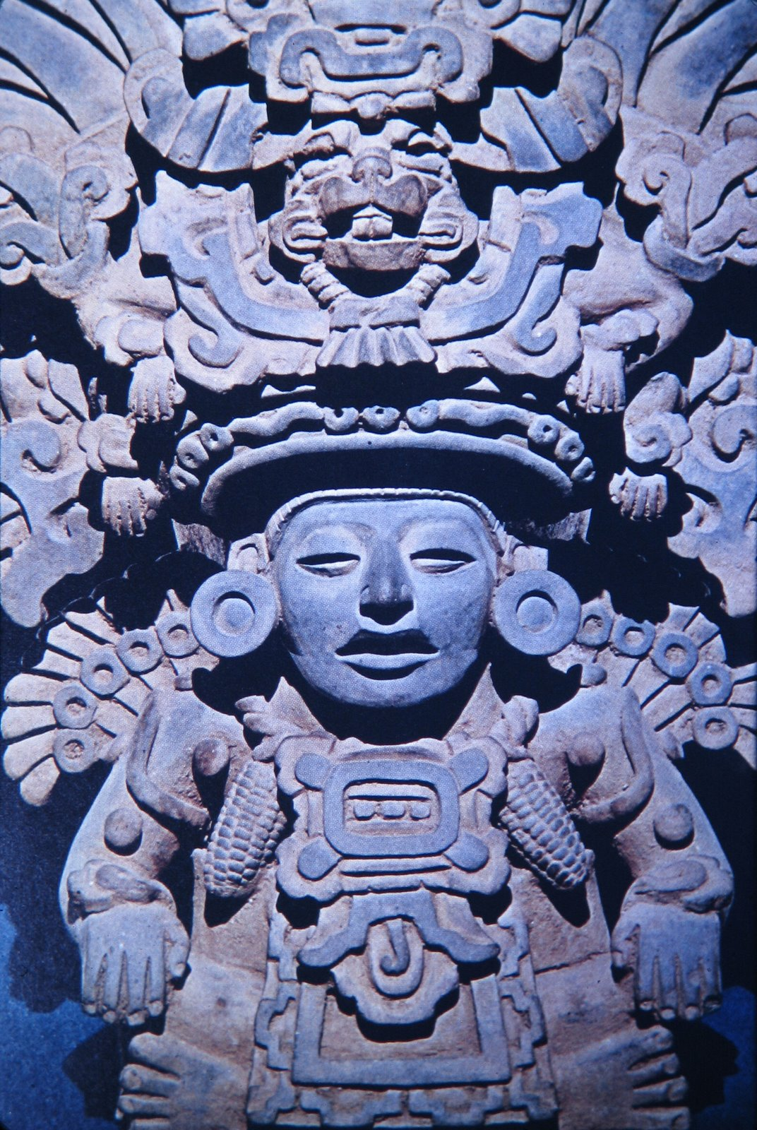
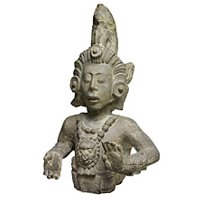
Meso-American Maize Deities
Xilonen
(Aztec maize goddess)
Maya Maize God, Copán, circa 700
Zapotec maize god

Slide 4
Paul McMahon, Feeding Frenzy: the New Politics of Food (2013)
Today:
15 crops supply 90% of the world’s calories
3 crops (wheat, maize, rice) supply 60% of the world’s calories

Slide 5
Combine harvesters

Slide 6
Modern industrial vs. traditional agricultural: yields per worker
2000 tonnes of grain per worker per year
vs.
1 tonne of grain per worker per year

Slide 7
Marcel Mazoyer and Laurence Roudart,
A History of World Agriculture: from the Neolithic Age to the Present (2014).
In 2014:
1.3 billion people economically active in agriculture
28 million tractors—2% of farmers own
250 million draught animals—19% of farmers own

Slide 8
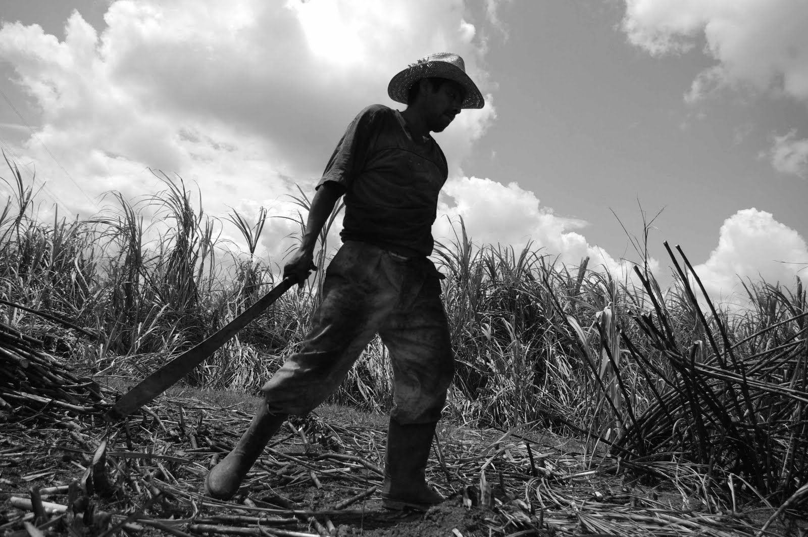

Slide 9
For agriculture you need to. . .
Select seeds
Manage the supply of water
renew the soil’s fertility
Protect the crop from pests
Apply some source of power

Slide 10
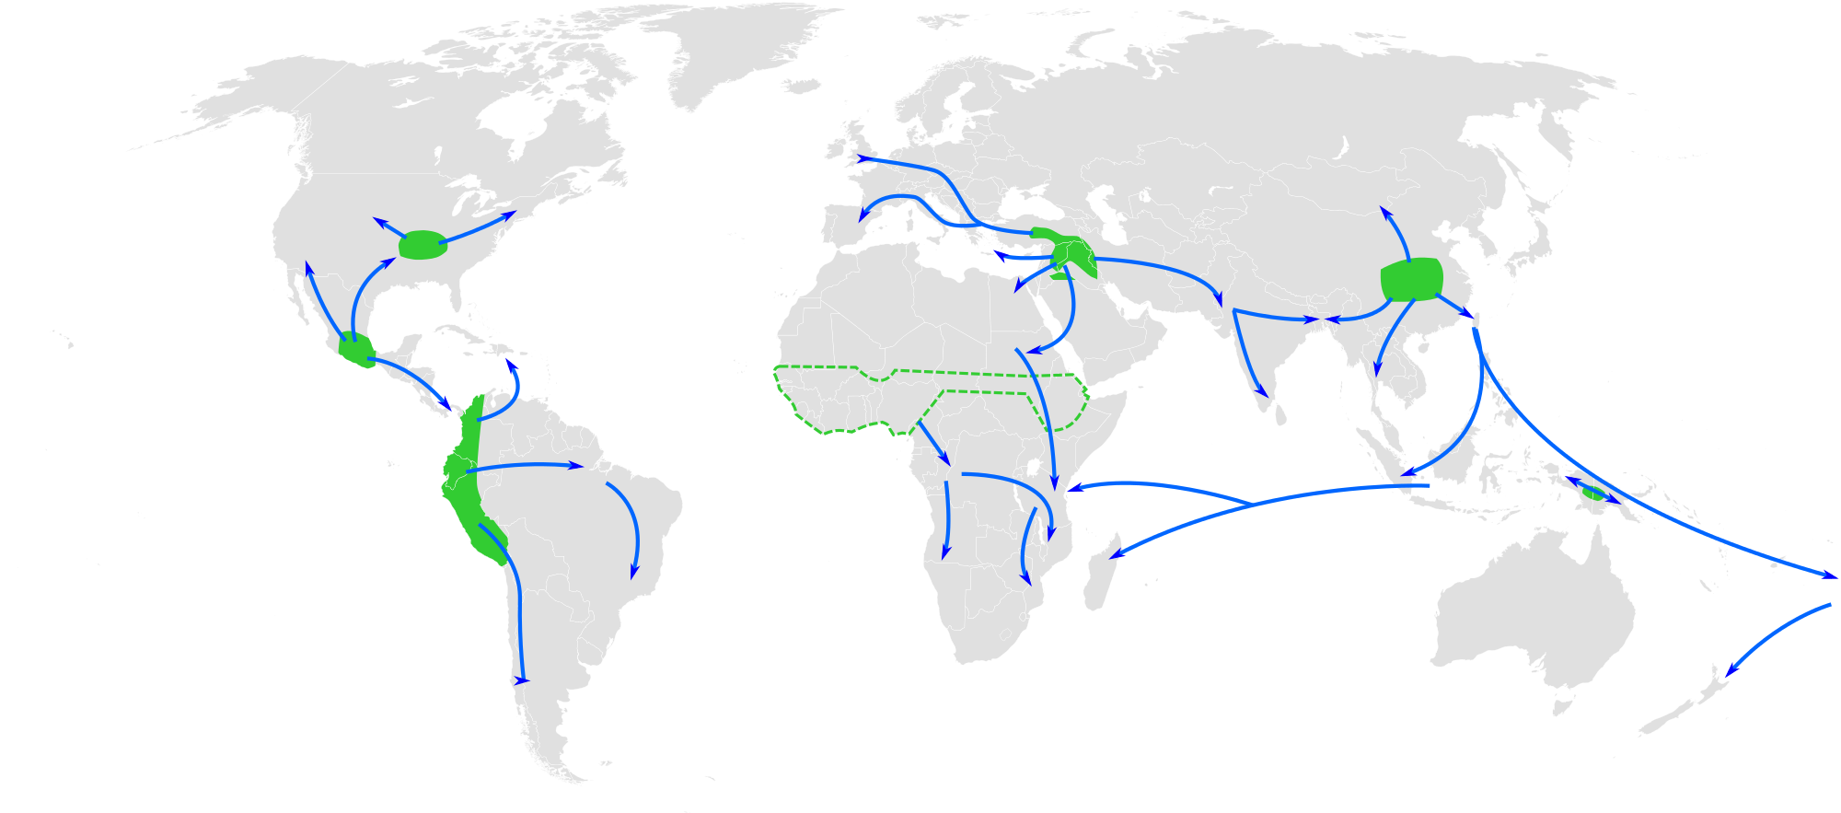
Early agriculture

Slide 11
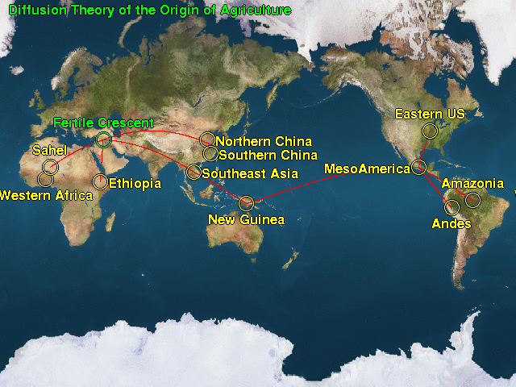
Early agriculture

Slide 12
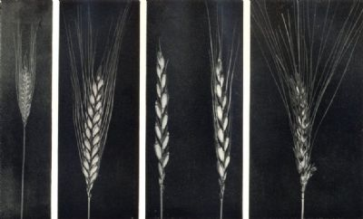
Various varieties of wheat: small spelt, einkorn, emmer, common spelt

Slide 14
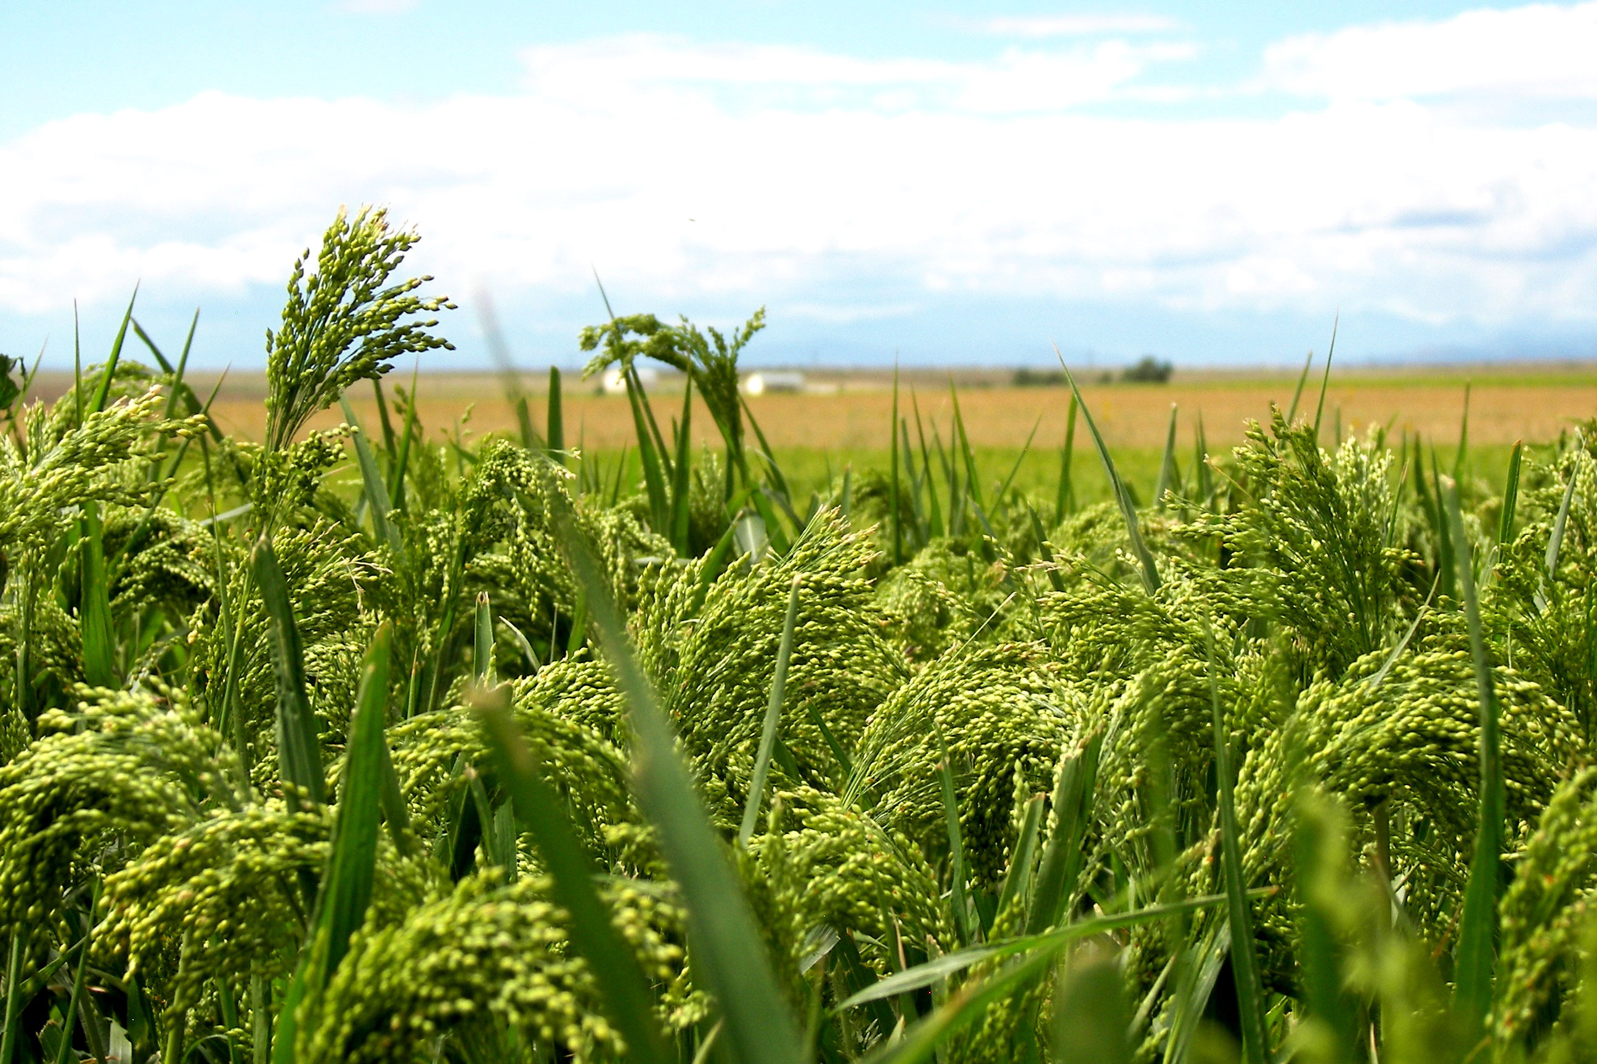
Millet

Slide 16
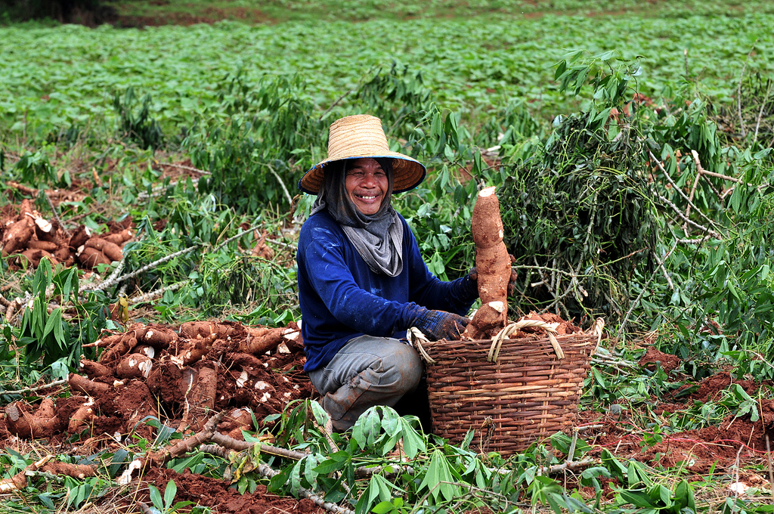
Thai farmer with cassava (aka manioc)

Slide 17
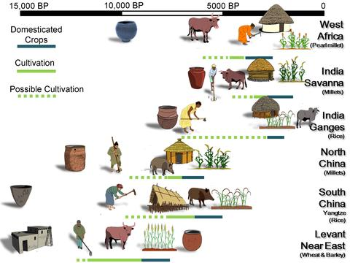

Slide 18
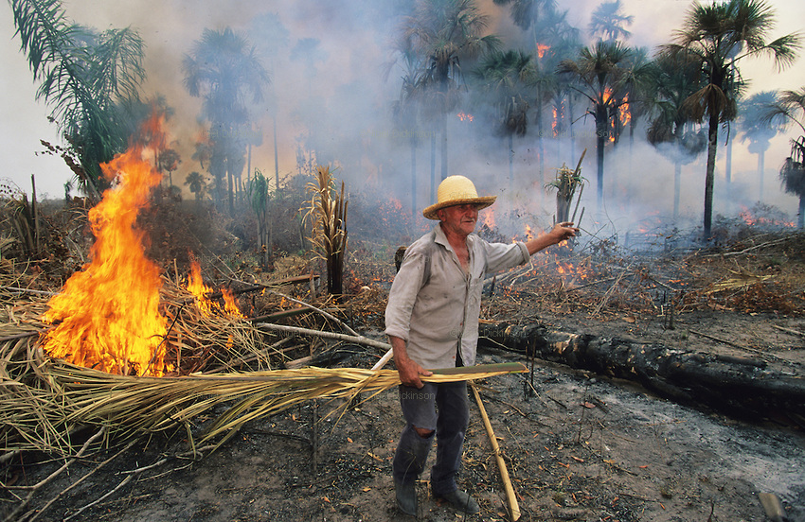
Slash and burn, or swidden agriculture (Indonesia)

Slide 19
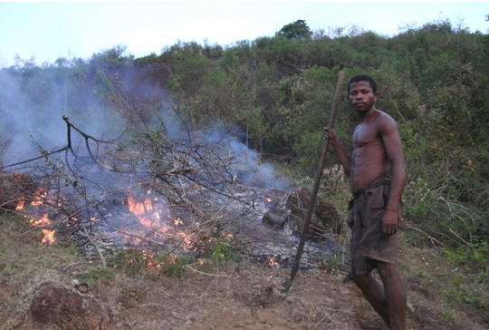

Slide 20
Early agriculture

Slide 21
Key crops:
wheat, barley, rice, millet, maize and potato.

Slide 22
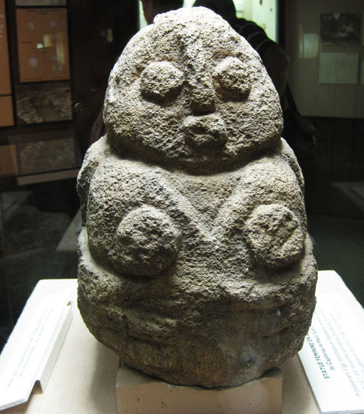
Important Themes
Labour and Social Structures
Role of women
Forced labour
Emergence of states (and also greater inequality?)
Technologies
Consider the plough. . .
Pech-Merle Cave (France)
Neolithic Mother-Goddess

Slide 23
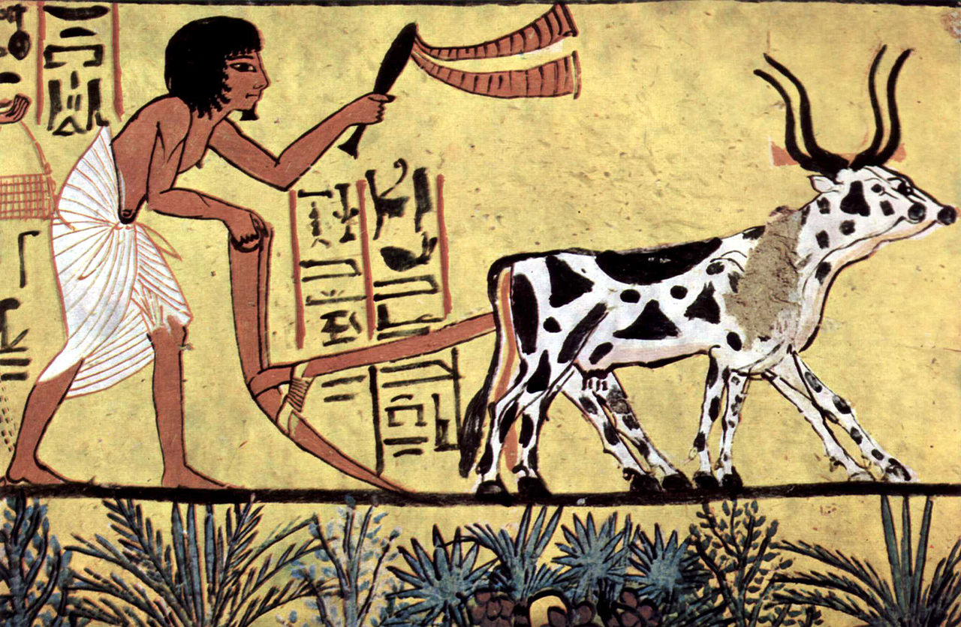
An Ard Plough

Slide 24
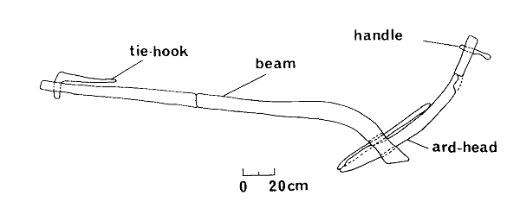
Ard Plough

Slide 25
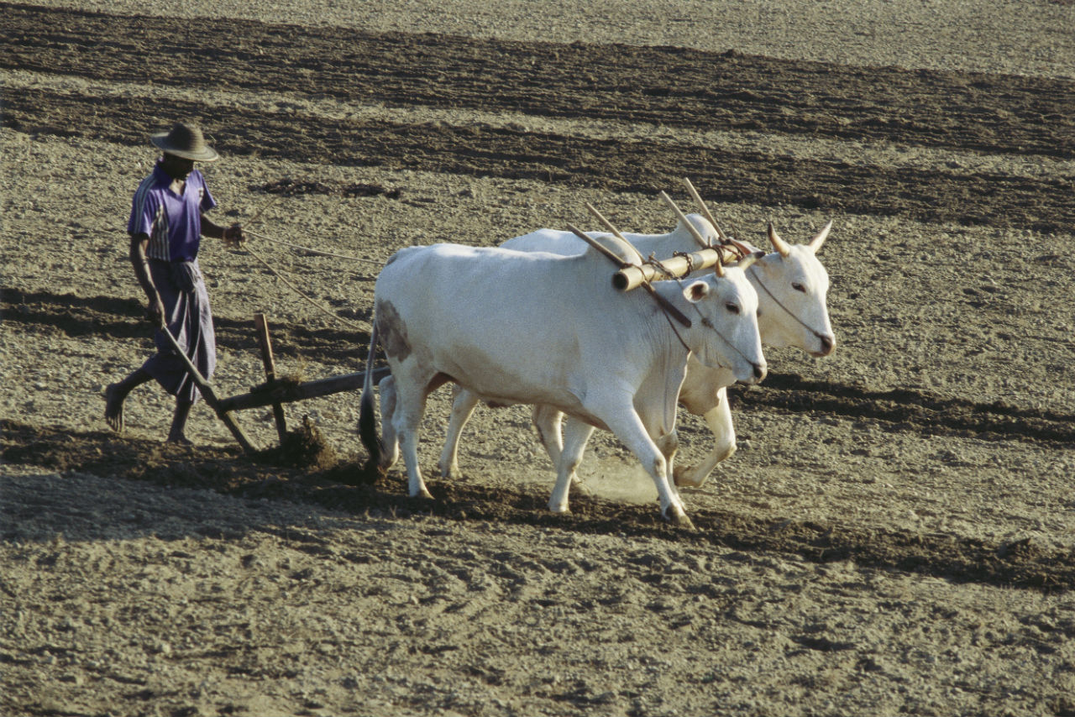
An Ard Plough in Action

Slide 26
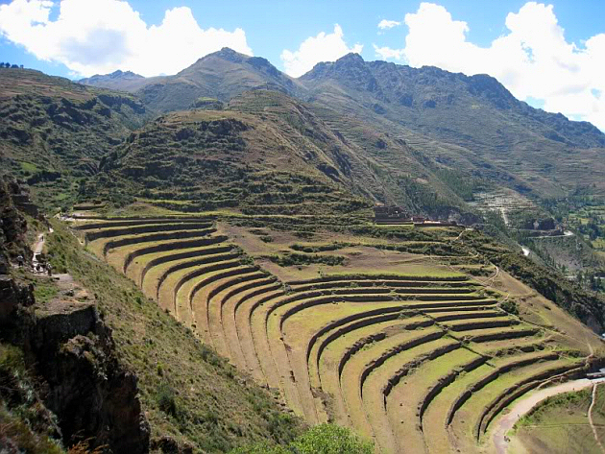
Inca terraces near Písac (Peru), 15th century

Slide 27
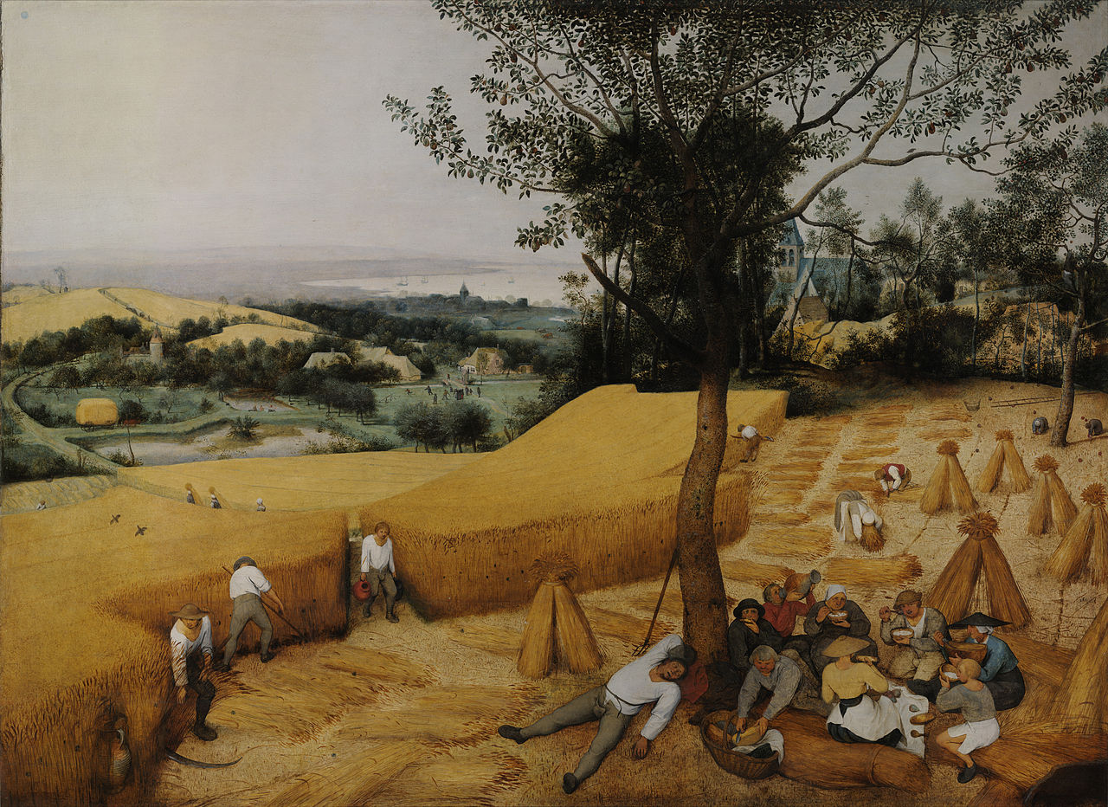
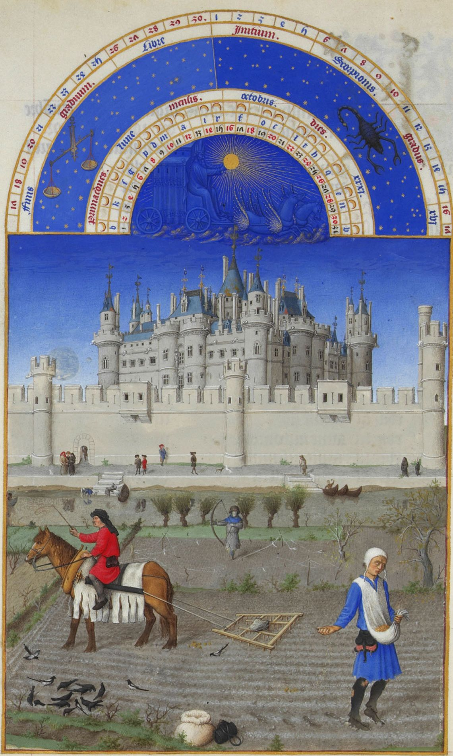
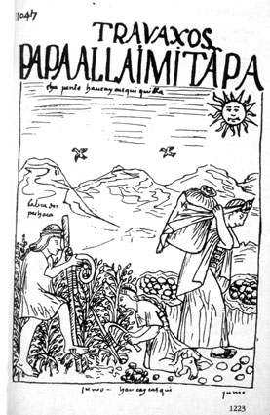
Continuities. . .
Pieter Breugel the Elder, The Harvesters, 1565
‘October’, Les très riches heures du Duc du Berry (c. 1416)
Felipe de Guamon Poma de Ayala, Nueva corónica y buen gobierno (c. 1615)

Slide 28
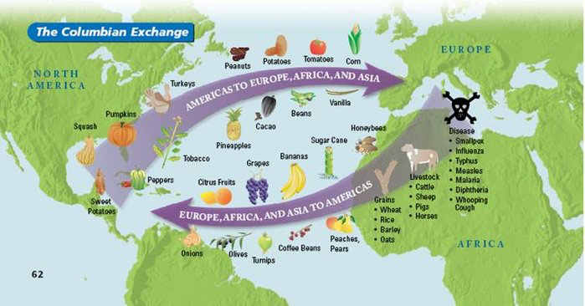
Columbian Exchange

Slide 29
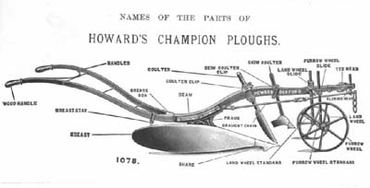
1920s advertisement for a mouldboard plough

Slide 30
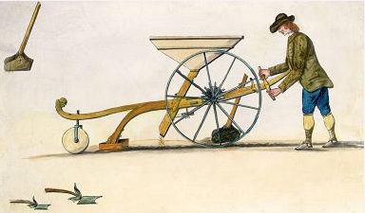
Jethro Tull’s Seed drill

Slide 31
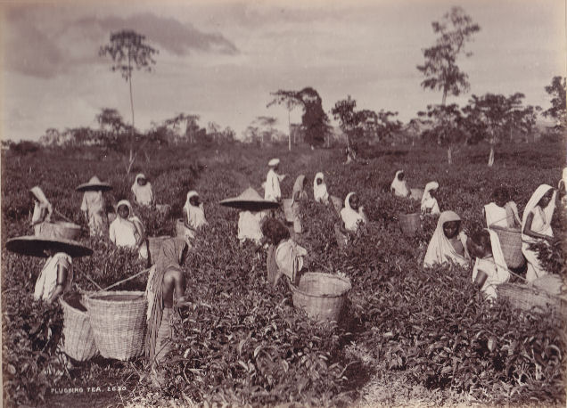
A tea plantation

Slide 32
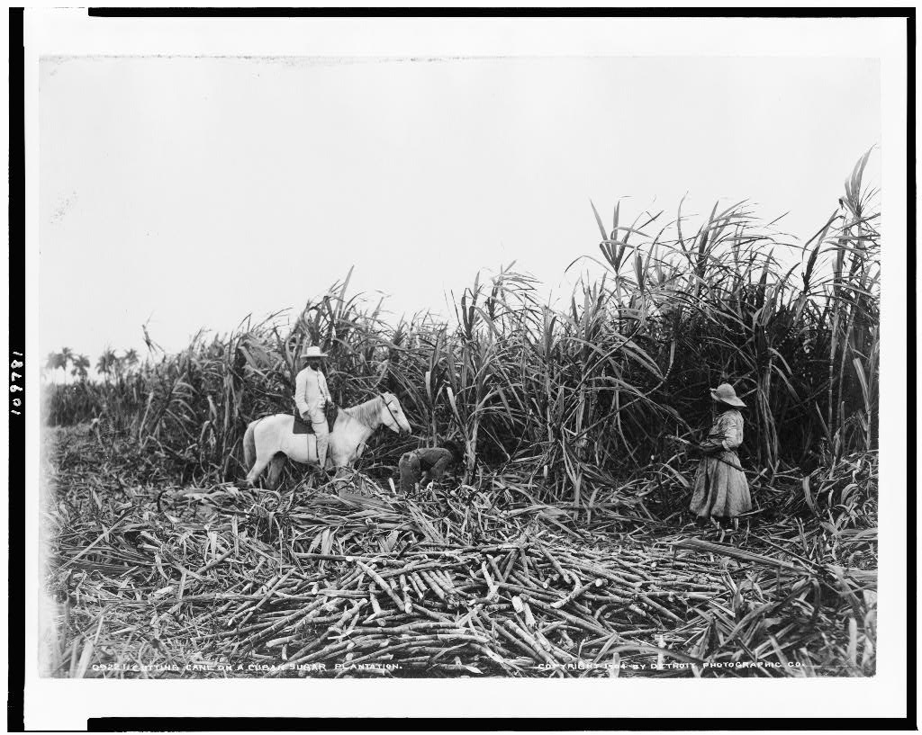
Cuban sugar plantation, 19th century

Slide 33
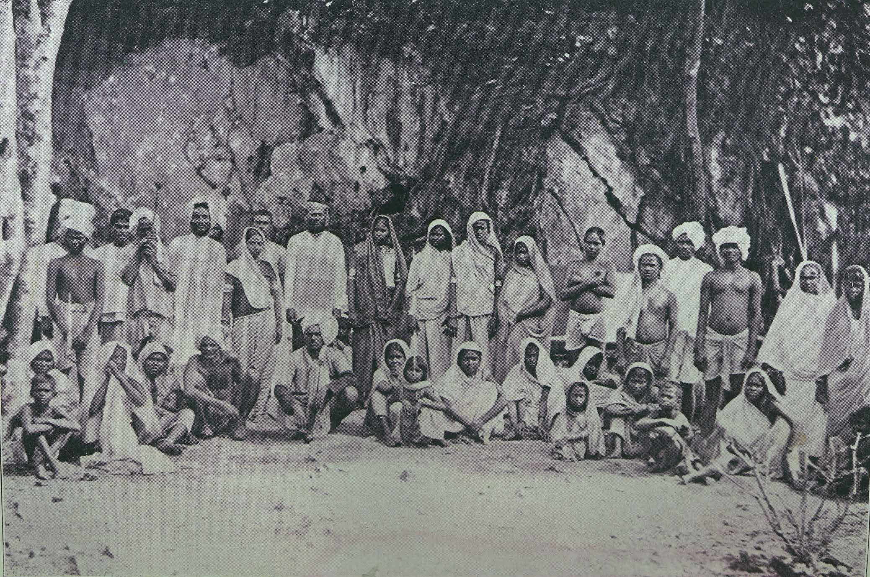
Newly-arrived Indian indentured labourers in Trinidad

Slide 34
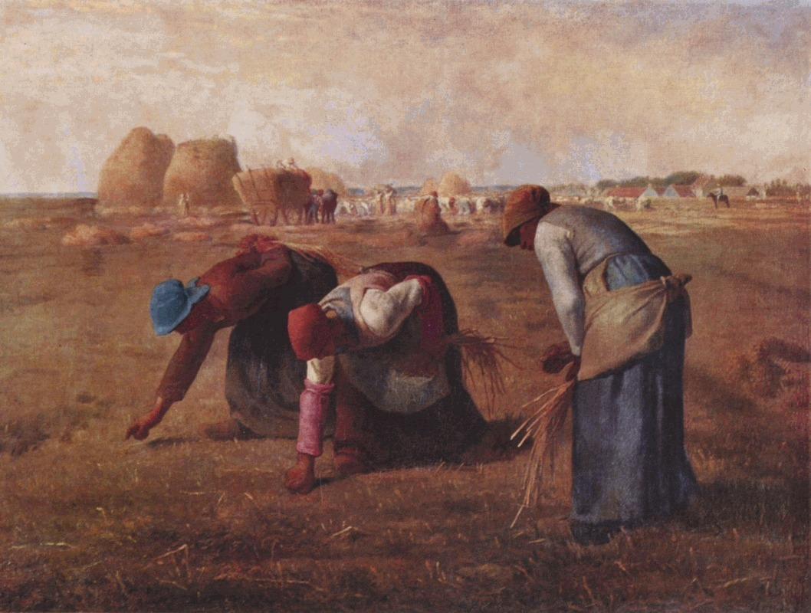
Jean-François Millet, The Gleaners, 1857

Slide 35
19^{th-} and 20th-century Developments
Agricultural Technologies
Tractors, irrigation
Transport Revolutions
Steam, riverboats
Preservation Technologies
Refrigeration

Slide 36
Combine harvesters

Slide 37
19^{th-} and 20th-century Developments
Agricultural Technologies
Tractors, irrigation
Transport Revolutions
Steam, riverboats
Preservation Technologies
Refrigeration, canning

Slide 38
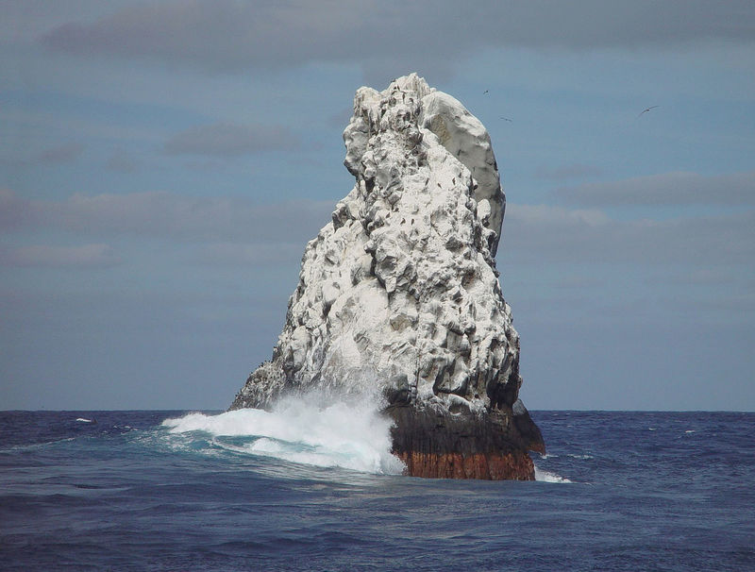
Fertilisers
A guano island

Slide 39
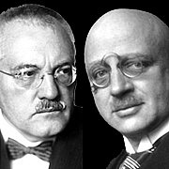
Fritz Haber and Carl Bosch

Slide 40
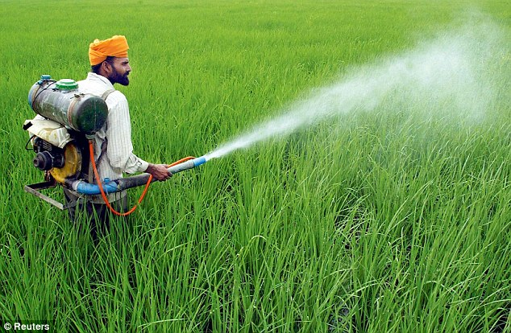
Spraying pesticides

Slide 41
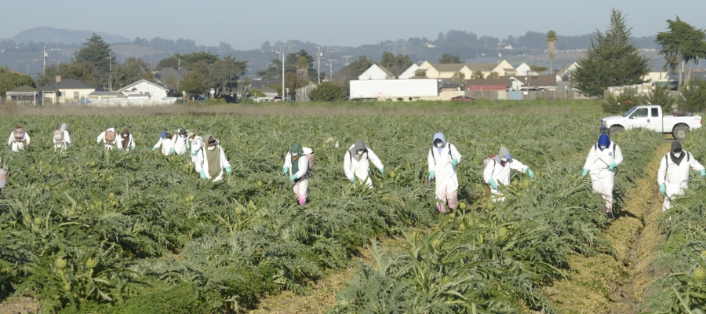
Artichoke growers in California spraying pesticides

Slide 42
Daily Milk production
(per cow)
1900 2,000 litres
2010 10,000 litres

Slide 43
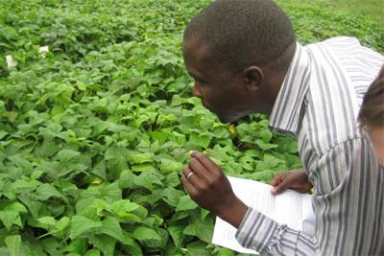
Dr. Charles Wasonga evaluates the performance of green beans grown at lower altitudes at the International Centre of Insect Physiology and Ecology in Mbita Point, Kenya.

Slide 44
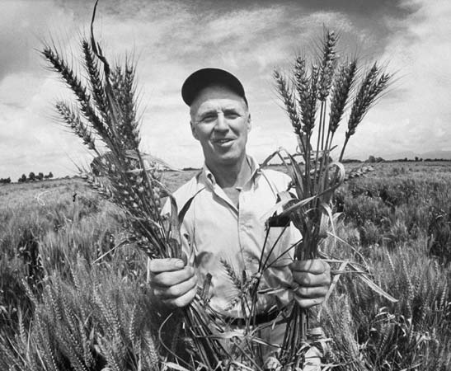
Norman Borlaug and the Green Revolution

Slide 45
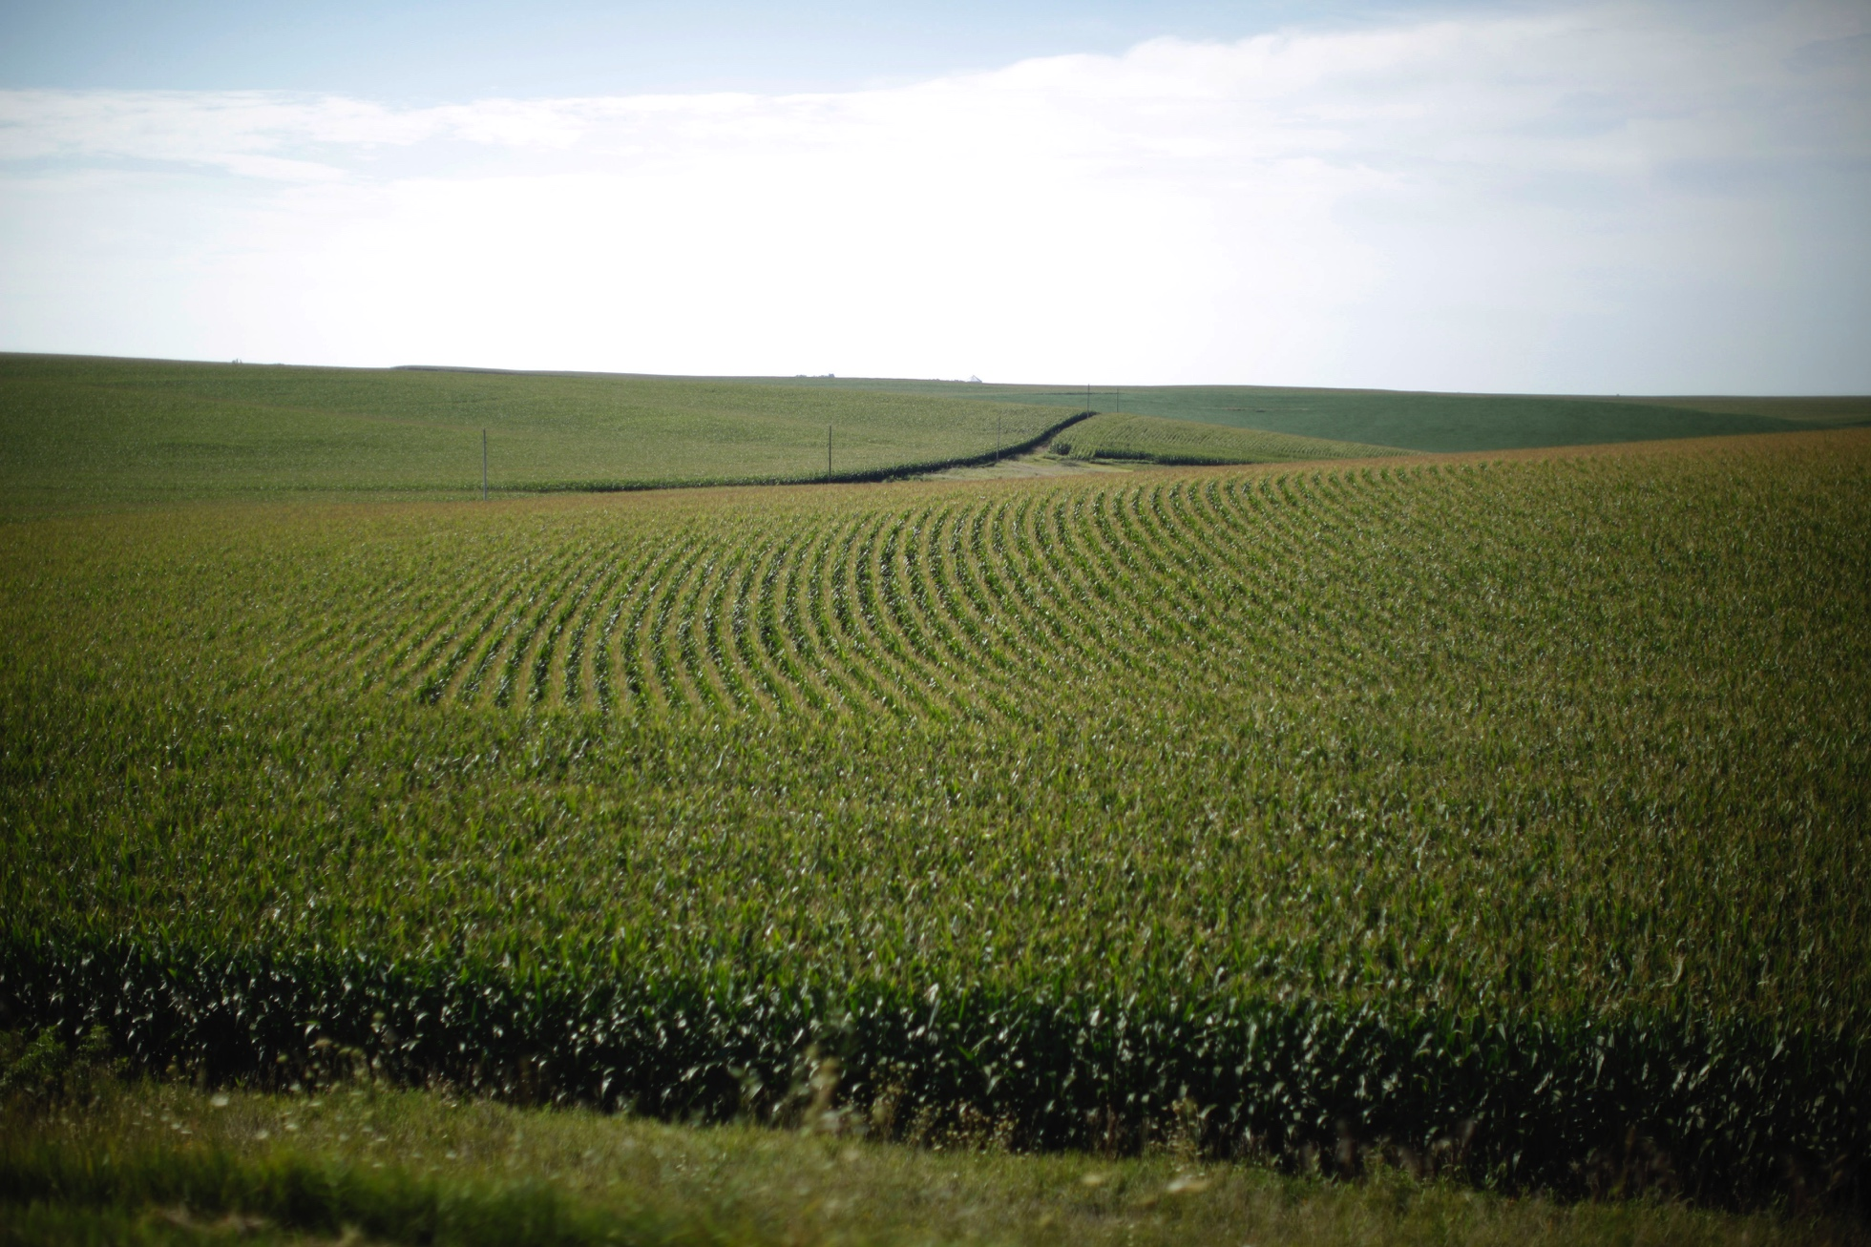
Iowa corn fields

Slide 46
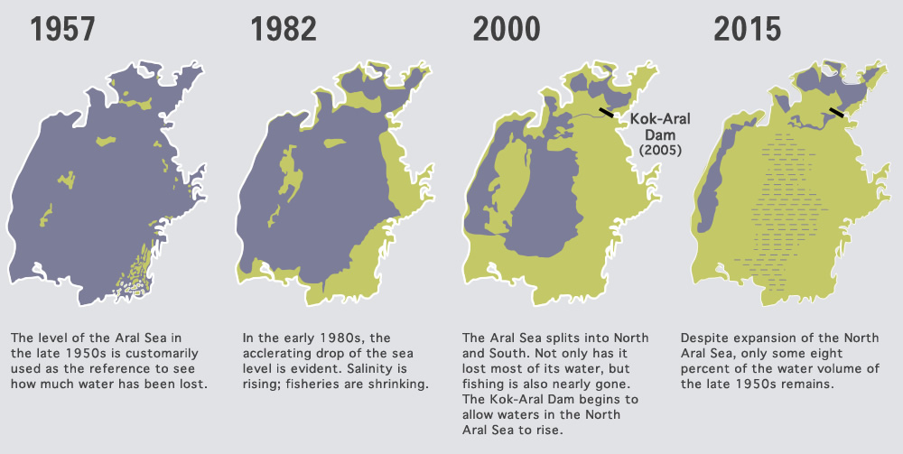
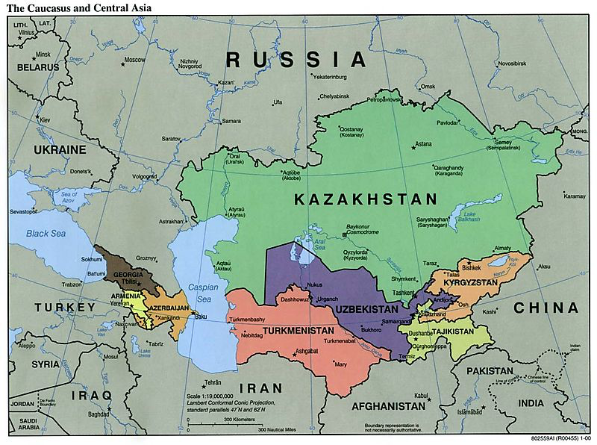
The desertification of the Aral Sea

Slide 47
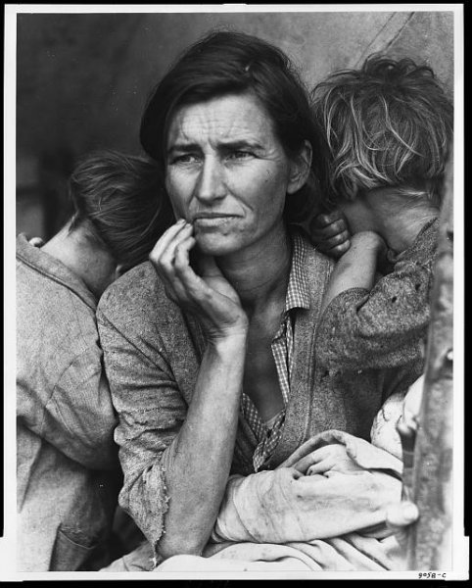
Dorothea Lange, Migrant Mother, Nipomo, California, 1936

