Slide 1
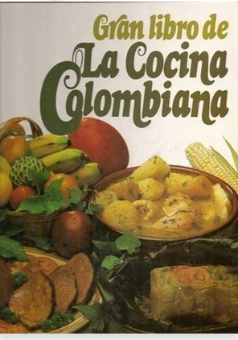
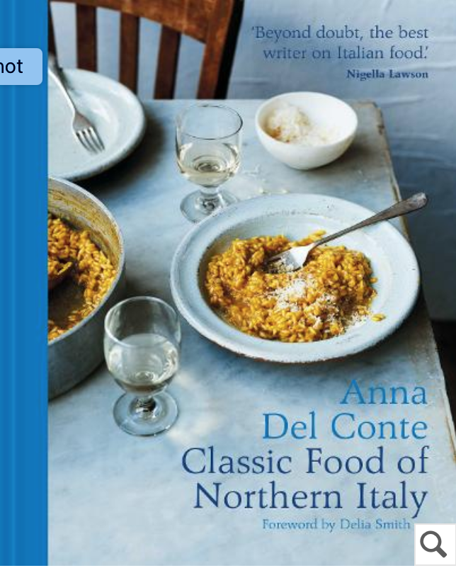
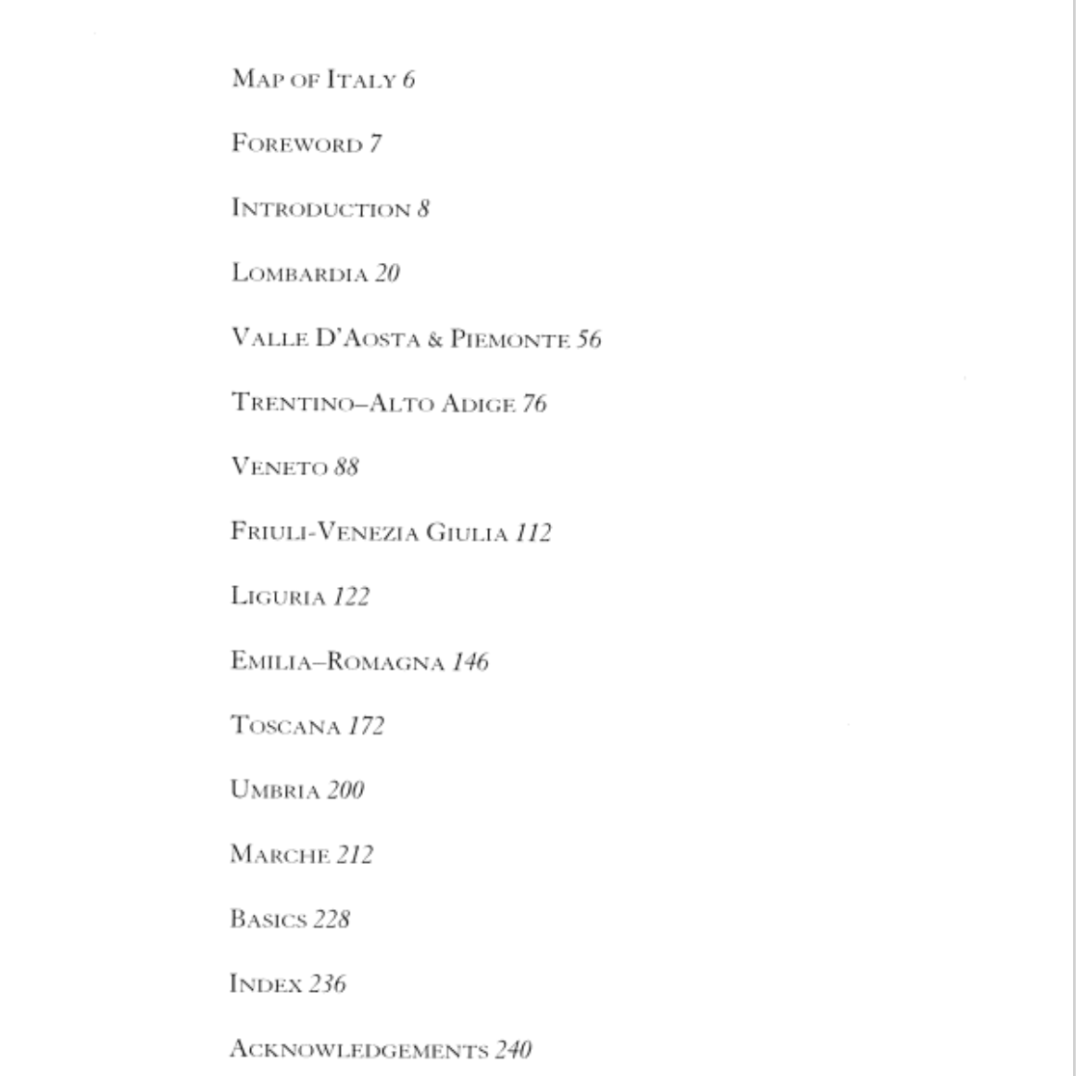
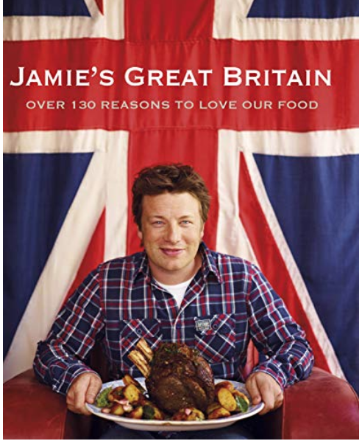
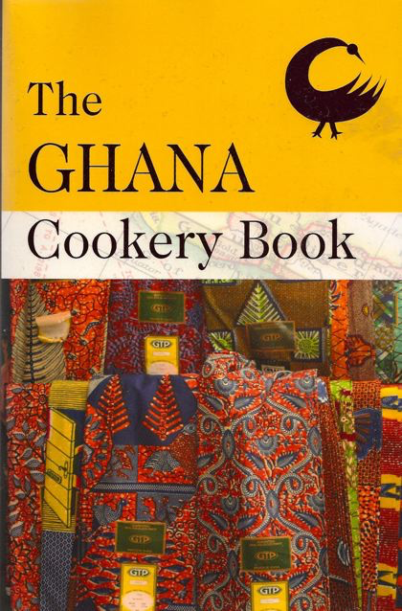
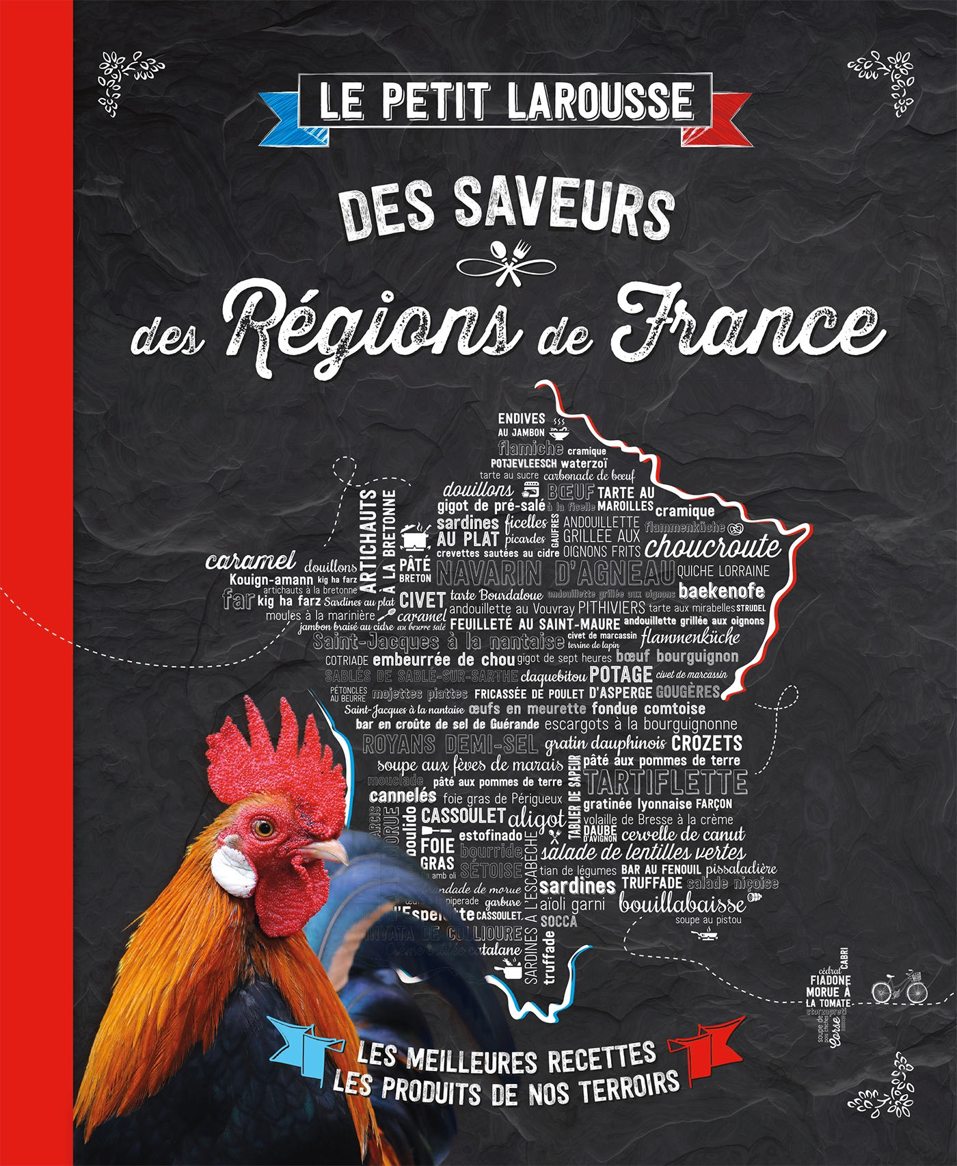
Imagining the nation through food

Slide 2
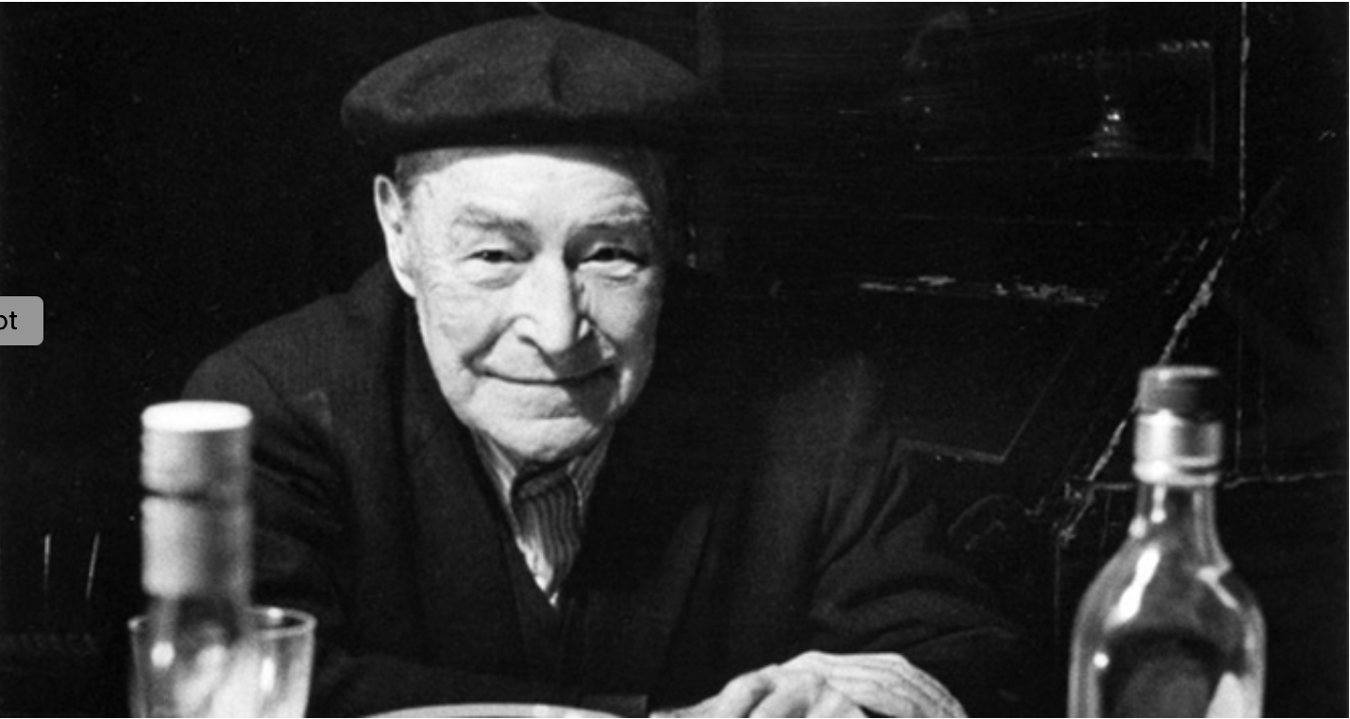
Catalan gastronomist Josep Plà (1897-1981)
‘A country’s cuisine is its landscape in a saucepan.’

Slide 3
Manuel Payno, The Devil’s lapel pin. A novel of Mexican customs, 1859
‘Some had a meal at 10am, lunched at 4pm, took chocolate or a sweet at evensong, and dined at 11pm; others ate in the French style, lunching at noon and dining at 7pm, not sparing the Burgundy or sherry; yet others who described themselves as Mexicans above all else didn’t stint on the pulque, the chicken mole and the refried beans when they dined.’

Slide 4
Aluísio Azevedo, The Slum (1890)
‘And so, little by little, all the sober habits of a Portuguese peasant were transformed, and Jerônimo became a Brazilian. . . The revolution was soon complete: cane liquor replaced wine; manioc flour supplanted bread; stewed codfish gave way to dried beef and black beans; chile peppers invaded his table; bacon soups and meat pies were pushed aside by Bahian delicacies, by dishes cooked with palm oil, coconut milk, and strange herbs. Brazilian kale displaced Portuguese cabbage; cornmeal mush dethroned brown bread, and, once the aroma of hot coffee had begun to fill his house, Jerônimo discovered the pleasures of tobacco, and started smoking with his friends.’

Slide 5
Robin Cook (UK foreign secretary), 19 April 2001
‘Chicken Tikka Massala is now a true British national dish, not only because it is the most popular, but because it is a perfect illustration of the way Britain absorbs and adapts external influences.’

Slide 6
Cuisine
‘The rules of exclusion and inclusion that order menus. . . The cultural knowledge about foods, and the pattern of their preparation and combination.’
Mary Weismantel, Food, Gender and Poverty in the Ecuadorian Andes (1988)
a set of particular foods associated with a particular setting eaten by a group of people who eat it with sufficient frequency to consider themselves experts on it. ‘They all believe, and care that they believe, that they know what it consists of, how it is made, and how it should be made, and how it should taste.’
Sidney Mintz, Tasting Food, Tasting Freedom (1996)

Slide 7
Nationalism and Food

Slide 8
Richard Wilk, ‘Beauty and the Feast: Official and Visceral Nationalism, in Belize’, Ethnos 58 (1993).
‘It is no coincidence that an objectively unified Belizean culture has emerged . . . in the intensely private realm of the kitchen and dining room. On a daily basis, in intimate and personal relationships, Belizeans have built a national cuisine out of diverse regional and ethnic styles. Food has become an area where nationalism is practised daily in a non-rhetorical form.’

Slide 9
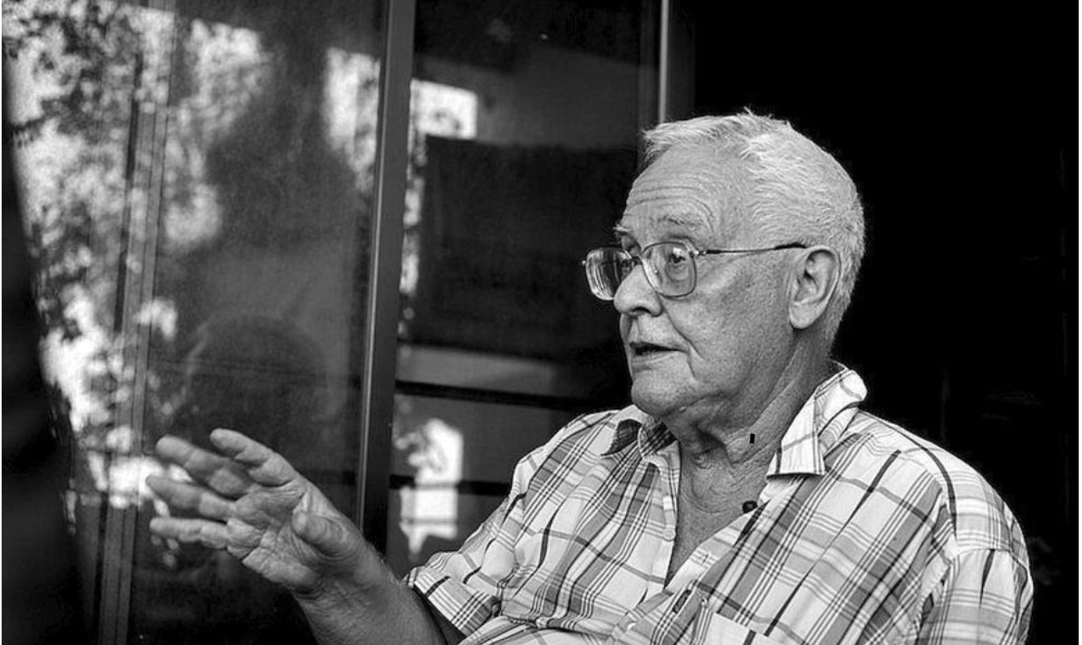
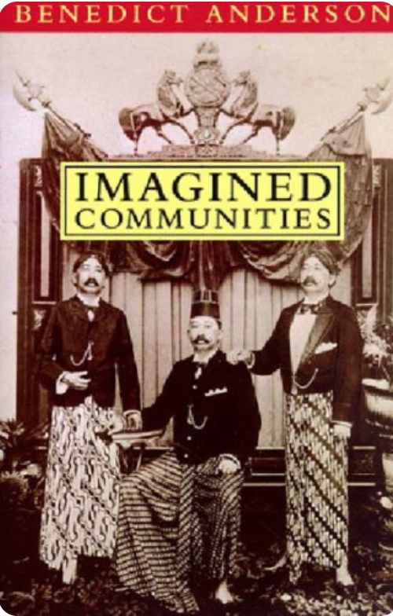
The nation: an imagined political community
Benedict Anderson, Imagined Communities: Reflections on the Origin and Spread of Nationalism (1991).
historian and political scientist Benedict Anderson (1936-2015)

Slide 10
Kaori O’Connor, ‘The King’s Christmas Pudding: Globalization, Recipes, and the Commodities of Empire’, Journal of Global History 4 (2009).
‘It is through food rather than political rhetoric that most people experience the nation in everyday life. . . It is an anthropological commonplace that particular foods, meals, or cuisines are emblematic of nations, ethnicities, regions, and communities.’

Slide 11

‘banal nationalism’ everyday, un-noticed nationalism
‘The concept of banal nationalism can enable theories of national identity to be related to the lives of ordinary people. . . . The body, food and the landscape . . . are as much ‘flags of identity’ as are the more obvious symbols of national belonging: coins, customs, anthems and ceremonies.’
Catherine Palmer, ‘From Theory to Practice: Experiencing the Nation in Everyday Life’, Journal of Material Culture 3:2 (1998).
Political scientist Michael Billig (1947-)

Slide 12
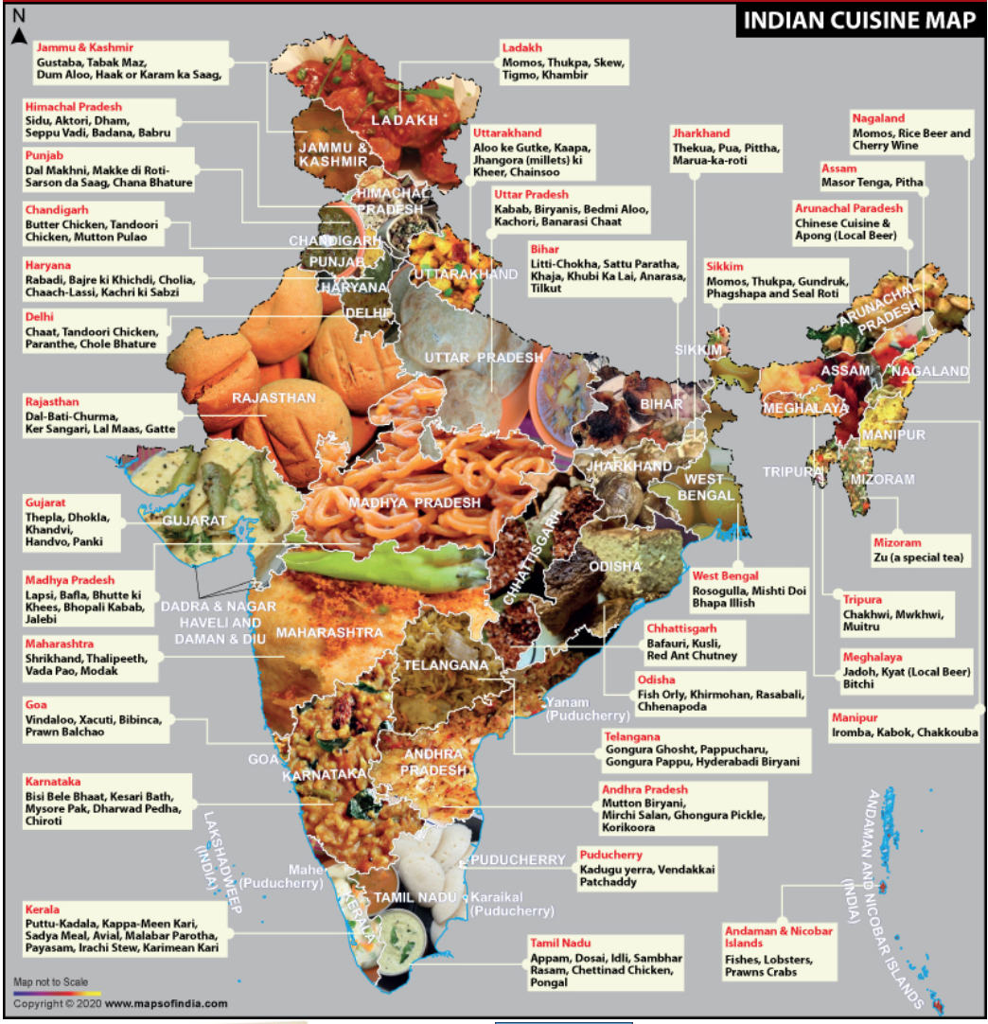
Scale: National, Regional, Local

Slide 13
Scale: National, Regional, Local

Slide 14
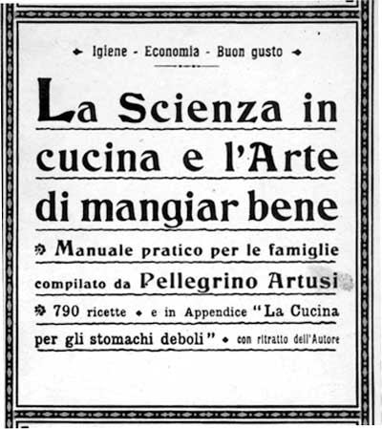
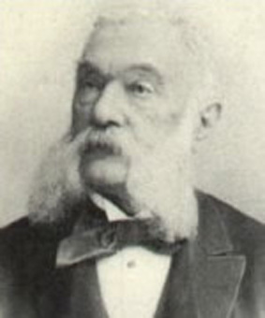
Nation-Building Through Food: Italy
The 1910 edition of Pellegrino Artusi, Science in the Kitchen and the Art of Eating Well.
Pellegrino Artusi (1820-1911)

Slide 15
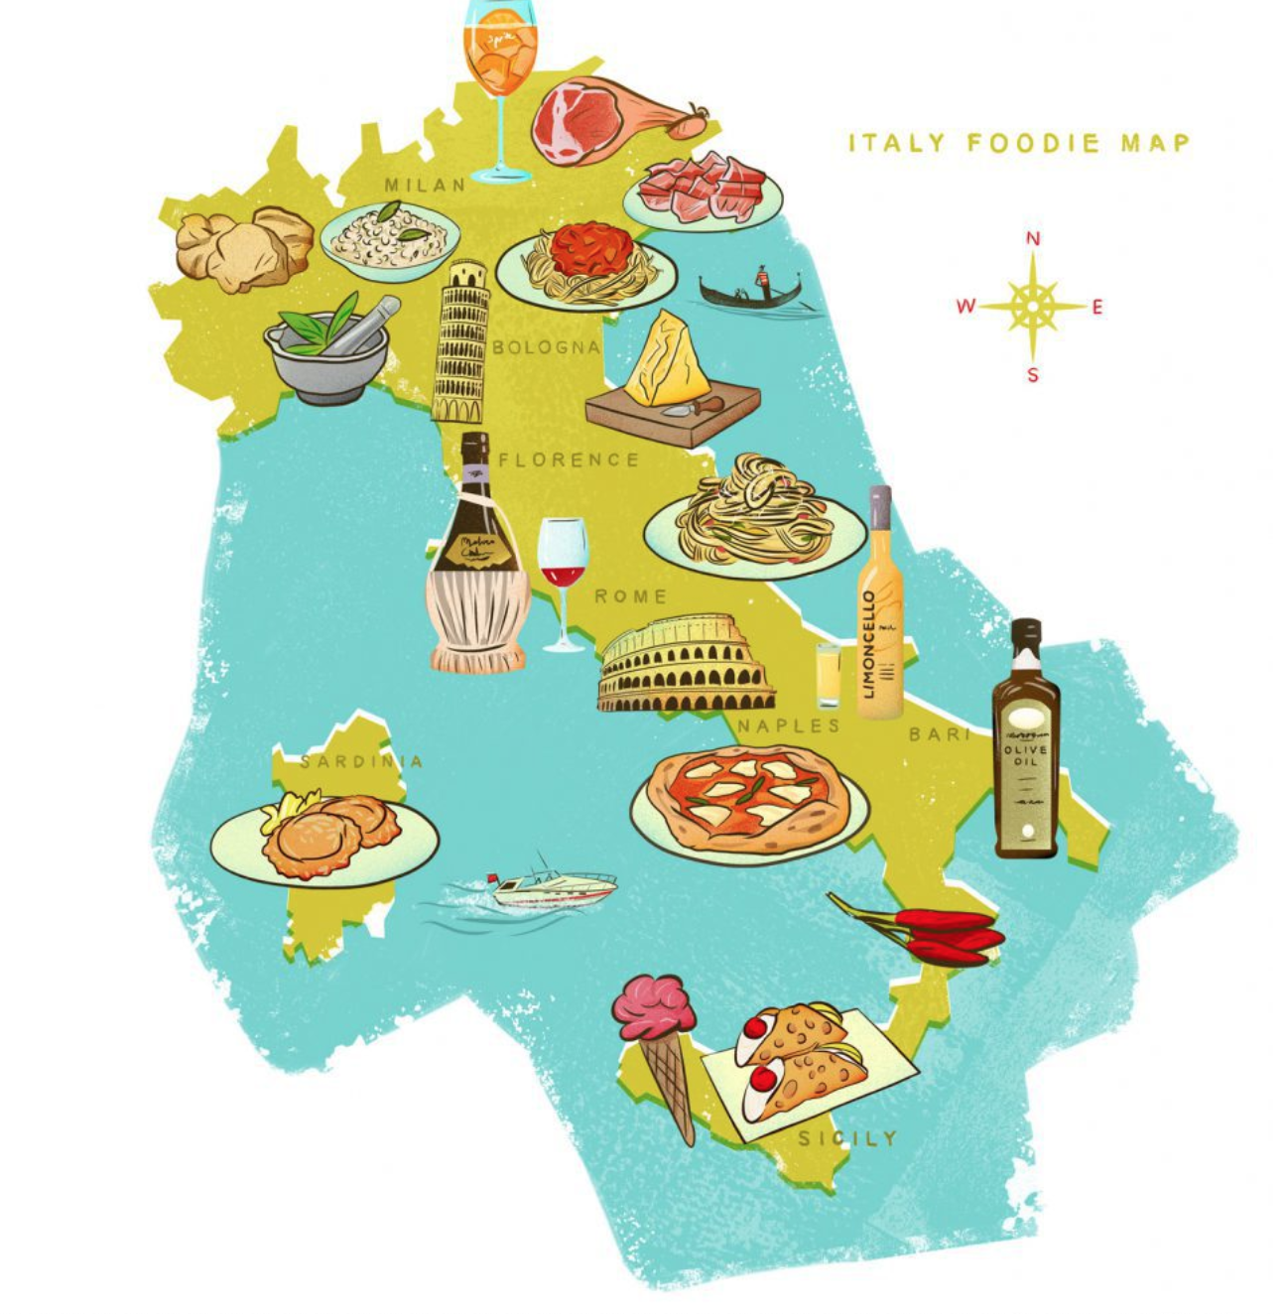
‘By making constant anecdotal references to regional differences in food and preparation, [Pellegrino] Artusi reinforced the idea of Italy as a unique and interesting collection of regions.’
Carol Helstosky, ‘Recipe for the Nation: Reading Italian History through La scienza in cucina and La cucina futurista’, Food and Foodways 11 (2003).

Slide 16
foreign vs. national
‘Food is one of the primary ways in which notions of ‘otherness’ are articulated.’
Allison James, ‘How British is British Food?’, Food, Health and Identity, ed. Pat Caplan (1997)

Slide 17
foreign vs. national
Rabbit recipe in 1890 Buenos Aires cookbook:
‘serve it with yellow chile sauce, for Argentines, and with English mustard for foreigners.’
Juan Manuela Gorriti, Cocina Ecléctica (1890).

Slide 18
Race and Nation
‘By silencing, ignoring, trivializing, and mocking nonwhite Cubans and their culinary traditions, the writers of nearly every cookbook from 1900 to 1959 endeavor to position Cuba as principally European and white.’
Christine Folch, ‘Fine Dining: Race in Prerevolution Cuban Cookbooks’, Latin American Research Review 43:2 (2008).

Slide 19
Betraying the Nation Through Food
‘But the present could not disappear because they were living it, sitting on woven chairs and mechanically eating a meal he had ordered specially: Vichyssoise, lobster, Côtes du Rhone, Baked Alaska.’
Carlos Fuentes, The Death of Artemio Cruz (1962).

Slide 20
Gastronationalism

Slide 21
Gastronationalism
‘Gastronationalism, in particular, signals the use of food production, distribution, and consumption to demarcate and sustain the emotive power of national attachment, as well as the use of nationalist sentiments to produce and market food. . .[ Gastronationalism] presumes that attacks (symbolic or otherwise) against a nation’s food practices are assaults on heritage and culture, not just on the food item itself. . . It strategically weds consideration of national identity to the idea of the nation as a protector of cultural patrimony.’
Michaela DeSoucey, ‘Gastronationalism: Food Traditions and Authenticity Politics in the European Union’, American Sociological Review 75:3 (2010).

Slide 22
Foie gras and French identity
Foie gras ‘is the identity of France. It’s like wine from Bordeaux.’
A French nationalist quoted in DeSoucey, ‘Gastronationalism’.

Slide 23
Gastronationalism
‘In 1989, the French Ministry of Culture created the Conseil National des Arts Culinaires (National Council of Culinary Arts), with the mission of protecting French gastronomy by teaching about the national palate. Its activities include a taste education program for children and an official inventory of the culinary patrimony of each French region. . .’
DeSoucey, ‘Gastronationalism’.

Slide 24
Sites of gastronationalism
Restaurants
Cookbooks
Government websites
Cultural programmes
Schools
Television and other media . . .

Slide 25
Authenticity and Invented Traditions

Slide 26

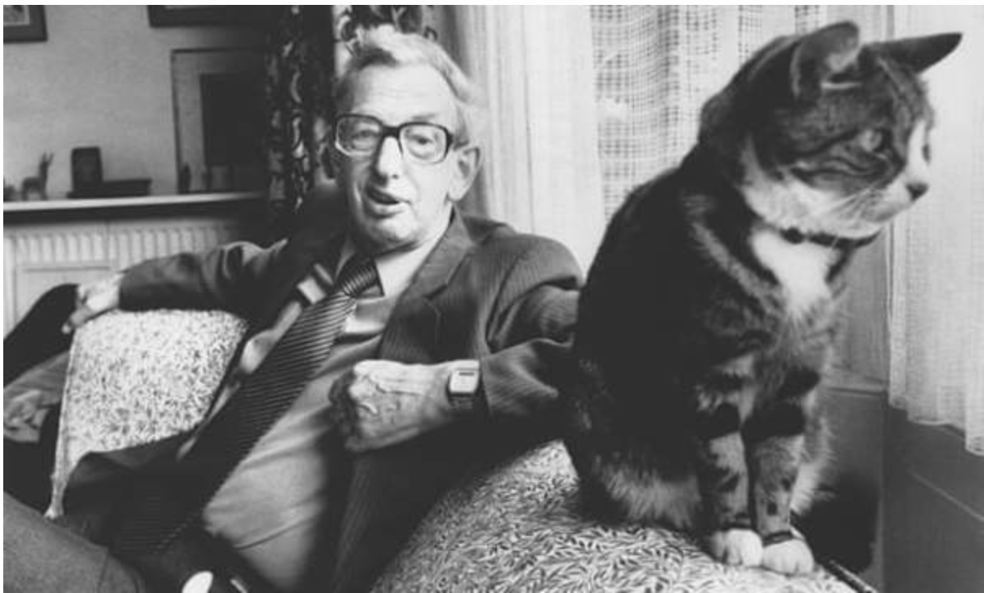
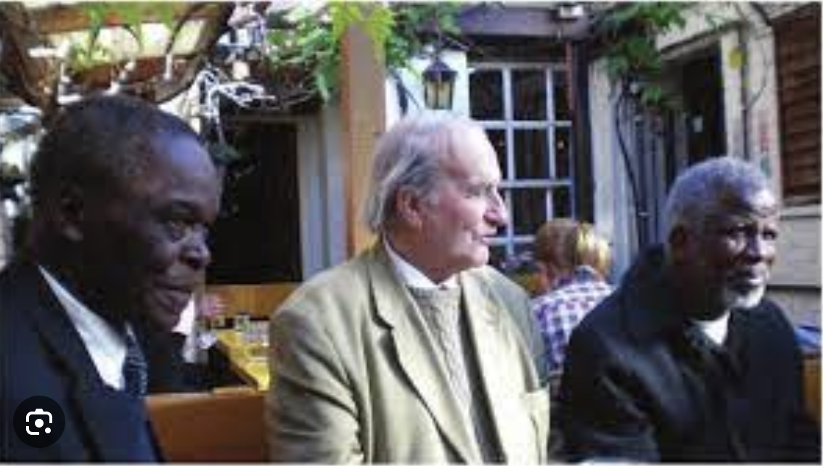
Invented Traditions
Eric Hobsbawm (above) (1917-2012)
Terence Ranger (below, centre) (1929-2015)
The Invention of Tradition (1983)

Slide 27
Invented Traditions
‘The term ‘invented tradition’ is used in a broad, but not imprecise sense. It includes both ‘traditions’ actually invented, constructed and formally instituted and those emerging in a less easily traceable manner within a brief and datable period—a matter of a few years perhaps—and establishing themselves with great rapidity.’
Eric Hobsbawm, ‘Introduction: Inventing Traditions’, The Invention of Tradition (1992).

Slide 28
Invented Traditions
‘Nations lose their origins in the myths of time.’
Homi Bhabha, Nation and Narration (1990).

Slide 29
Food and Invented Traditions
Symbolic foods ‘may be associated with specific events in the nation’s history, but they are not merely commemorative. In some profound way connected with the efficacy of symbols, the consumption of emblematic foods is experienced as an act of communion that puts the eater in direct touch with the values, achievements and heritage of an idealized past.’
Kaori O’Connor, ‘The King’s Christmas Pudding: Globalization, Recipes, and the Commodities of Empire’, Journal of Global History 4 (2009).

Slide 30
O’Connor, ‘The King’s Christmas Pudding
‘It is through food rather than political rhetoric that most people experience the nation in everyday life. . . It is an anthropological commonplace that particular foods, meals, or cuisines are emblematic of nations, ethnicities, regions, and communities.’

Slide 31
To Summarise
We covered various concepts:
nations as imagined political communities
banal nationalism
gastronationalism
invented traditions.
Overall food is an excellent way of thinking about how big concepts like nationalism connect to people’s everyday lived experiences.

