Slide 1
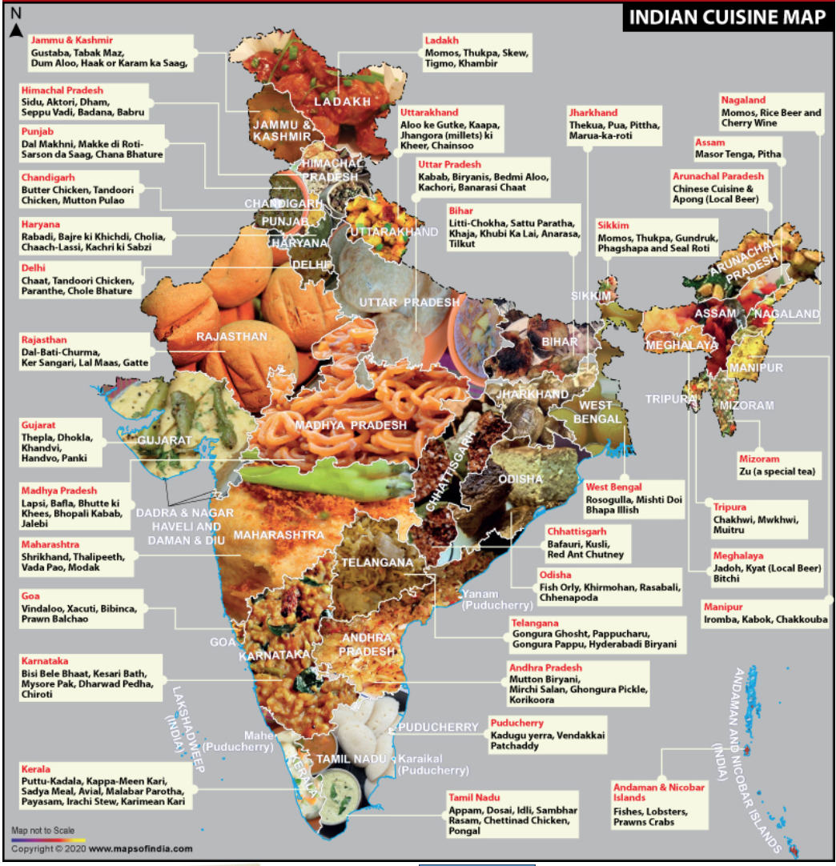

Slide 2
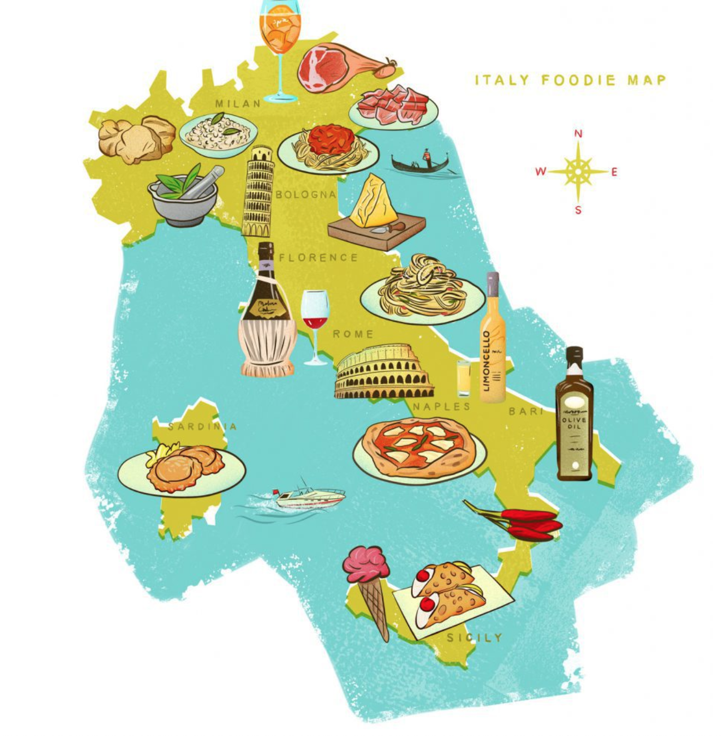
‘By making constant anecdotal references to regional differences in food and preparation, [Pellegrino] Artusi reinforced the idea of Italy as a unique and interesting collection of regions.’
Carol Helstosky, ‘Recipe for the Nation: Reading Italian History through La scienza in cucina and La cucina futurista’, Food and Foodways 11 (2003).

Slide 3

Posters from the German right-wing Alternative für Deutschland Party
‘Burkas? I prefer Burgundy.’
‘New Germans? We make them ourselves.’

Slide 4
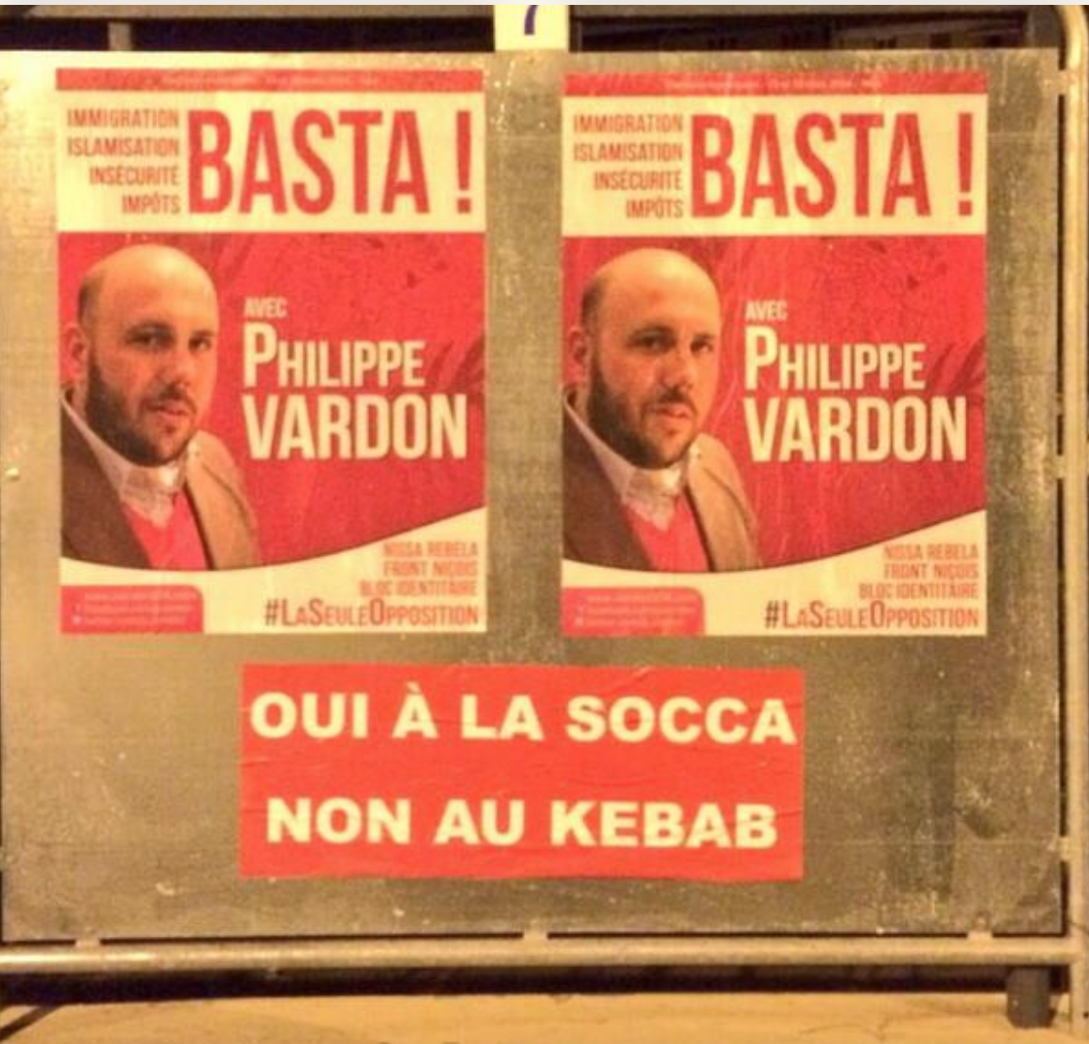
Poster from Nissa Rebela, a right-wing French Identitarian movement.
‘Yes to socca. No to kebabs.’

Slide 5
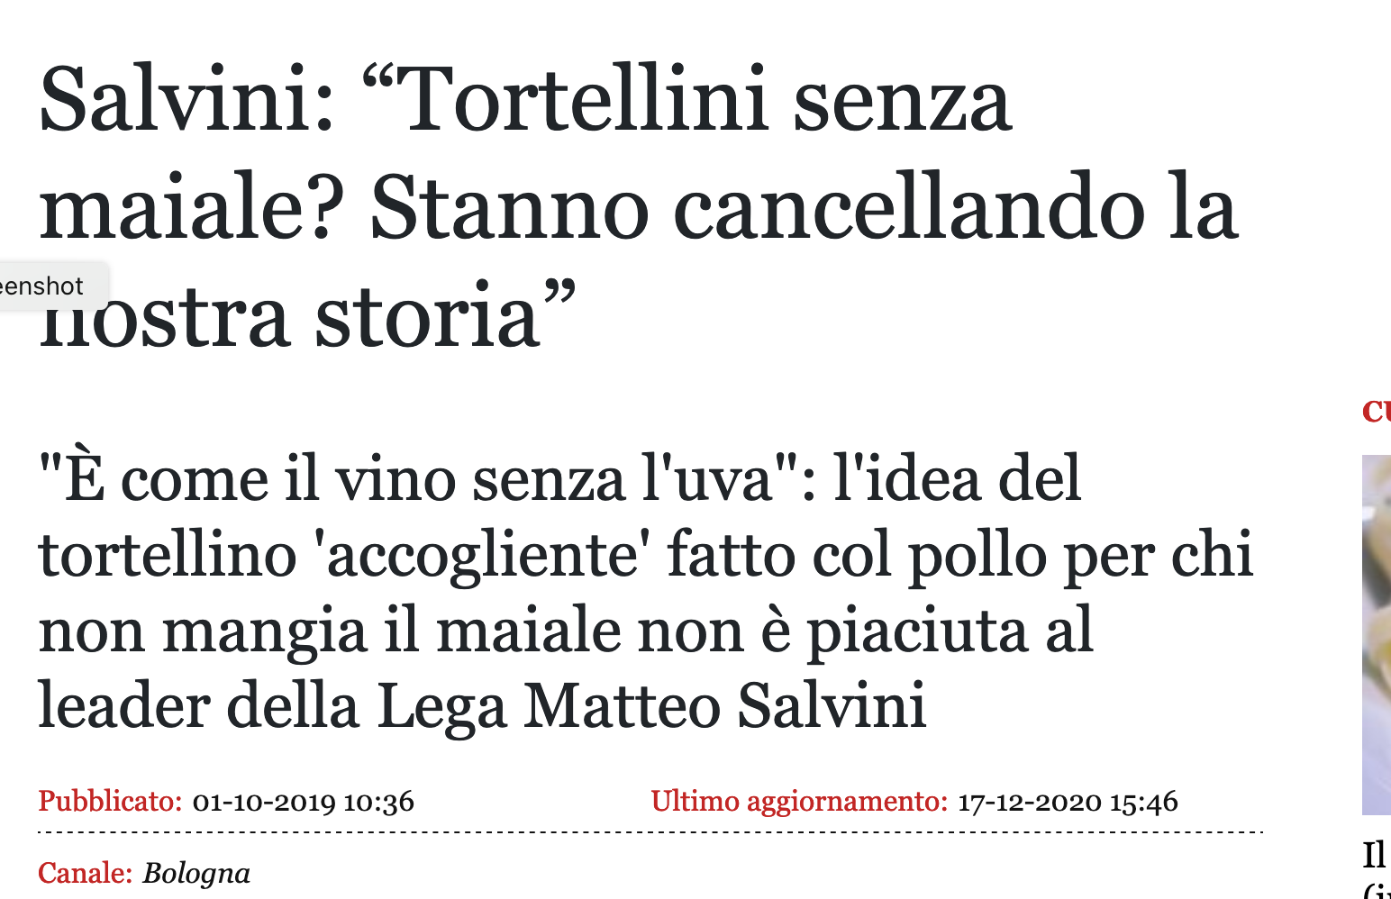
On 12 July 2017 Italian deputy prime minister Matteo Salvini described it as a ‘cancellation of our history’ to make pork-free tortellini.

Slide 6
Questions
What role do 'national cuisines' play in the everyday experience of nationalism?
Does culinary multiculturalism foster other sorts of multiculturalism?
Should nations be allowed to ‘patent’ distinctive foods?
‘It is through food rather than political rhetoric that most people experience the nation in everyday life. . . It is an anthropological commonplace that particular foods, meals, or cuisines are emblematic of nations, ethnicities, regions, and communities.’
Kaori O’Connor, ‘The King’s Christmas Pudding: Globalization, Recipes, and the Commodities of Empire’, Journal of Global History 4 (2009).

