Slide 1
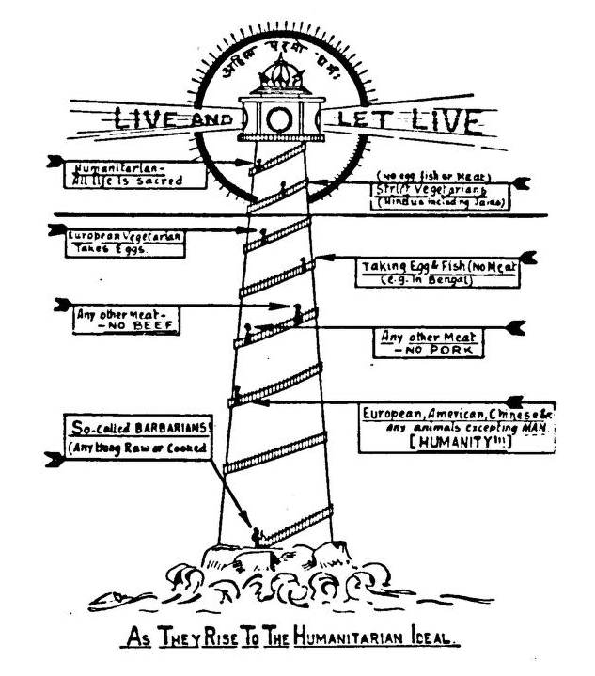
Vegetarianism and Gastropolitics
Scientist and vegetarian advocate Narasinh Narayan Godbole’s ‘As They Rise to the Humanitarian Ideal’ (1938), which presents lacto-vegetarianism as part of a superior moral state.

Slide 2

Veganarchism

Slide 3
Brian Dominick, Animal Liberation and Social Revolution (1995)
‘I am vegan because I have compassion for animals; I see them as beings possessed of value not unlike humans. I am an anarchist because I have that same compassion for humans, and because I refuse to settle for compromised perspectives, half-assed strategies and sold-out objectives. As a radical, my approach to animal and human liberation is without compromise: total freedom for all, or else.’

Slide 4
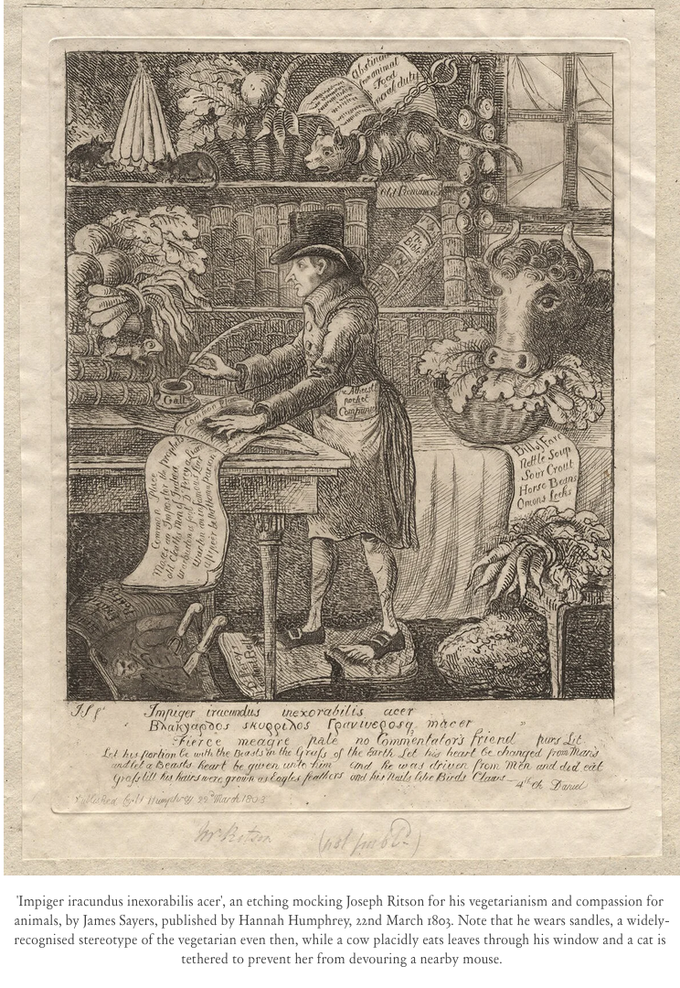
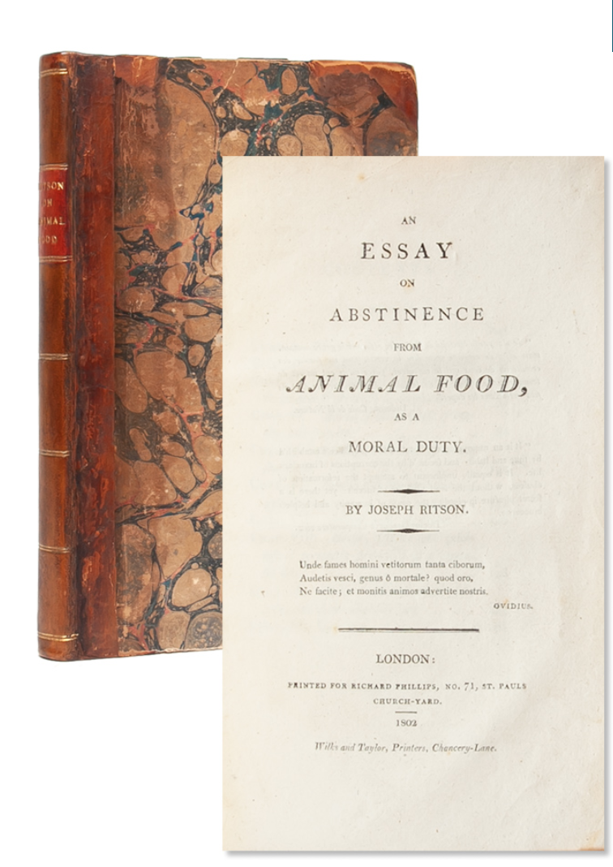
Today’s Topic
The ‘long tradition of vegetarian radicalism.*
*Timothy Morton, ‘The Plantation of Wrath’, Radicalism in British Literary Culture, 1650-1830, eds. Timothy Morton and Nigel Smith (2009).
Joseph Ritson (1752-1803): Jacobin, poet and vegetarian
The caricature is from Rebecca Jones, ‘Soyboys and Sensitivity: Mocking Meat-Avoidance from Punch to Twitter’, 1 Dec. 2020, https://www.epoch-magazine.com/post/soyboys-and-sensitivity-mocking-meat-avoidance-from-punch-to-twitter

Slide 5
17th Century: Puritanism and the ‘Herby-Diet’

Slide 6
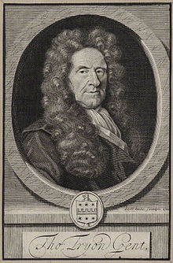
Thomas Tryon (1634-1703)
The Way to Health and Long Life (1683)
Pythagoras His Mystic Philosophy Revived (1691)
Friendly Advice to the Gentlemen-Planters of the East and West Indies (1684)
vegetarianism, anti-slavery, animal rights

Slide 7
Thomas Tryon, The Way to Health, Long Life and Happiness (1683)
‘How shall they but Bestial grow,
That thus to feed on Beasts are willing?
Or why should they a long life know,
Who daily practice KILLING?’

Slide 8
Enlightenment: Animal Rights and Jacobinism

Slide 9
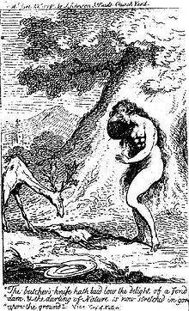
John Oswald, The Cry of Nature, Or, an Appeal to the Mercy and to Justice, on Behalf of the Persecuted Animals (1791)
John Oswald (c.1760-1793)
Scottish army officer, Jacobin, vegetarian and animal rights activist
Caption reads: "The butcher's knife hath laid low the delight of a fond dam, & the darling of Nature is now stretched in gore upon the ground."

Slide 10
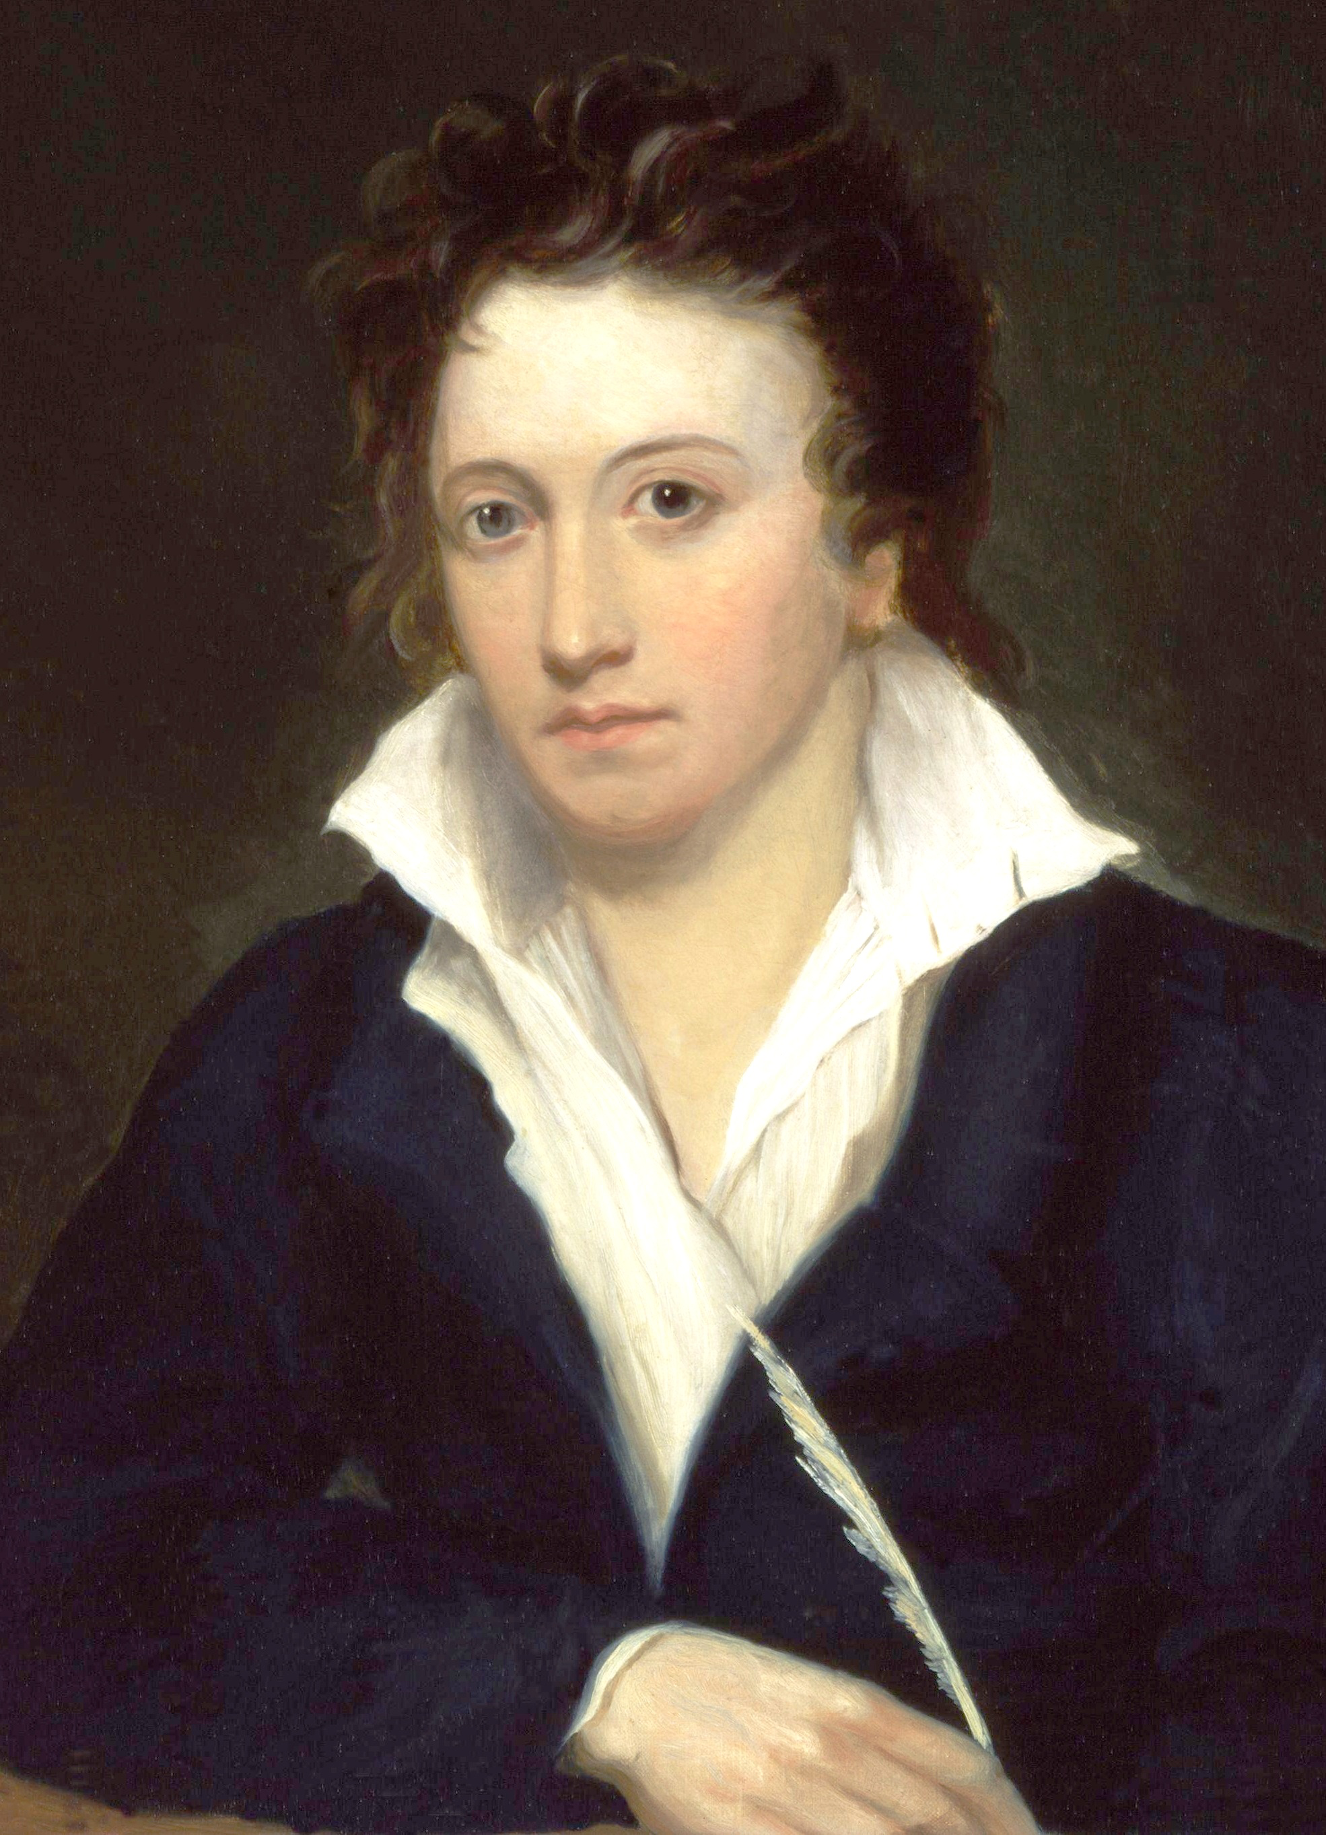
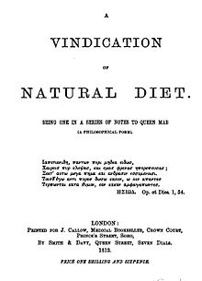
Percy Bysshe Shelley
(1792-1822)
poet, political radical and vegetarian
A Vindication of Natural Diet (1813)
Alfred Clint, Portrait of Percy Bysshe Shelley, 1819, National Portrait Gallery

Slide 11
19th Century: Vegetarianism and the Radical Counterculture

Slide 12
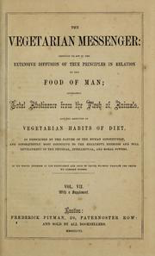
Vegetarianism is institutionalised
Vegetarian Society (1847)
Vegetarian Messenger (1849)
International Vegetarian Congress (1890)
International Vegetarian Union (1909)

Slide 13
Menu from a Vegetarian Restaurant in London (1889)
From the British Library’s extensive food history collection of menus, cookbooks and other sources.
The British Vegetarian Society also has extensive archives.

Slide 14
1888 menu at The Central
(16 Saint Bride Street, London)
3 kinds of soup (green pea, Scotch broth, Florador and milk)
4 kinds of sweet porridge (oatmeal, wheat, maize and ‘Anglo Scotch’)
lentil cutlets with sprouts, turnips or tomatoes
4 kinds of vegetarian mains (tomato and macaroni, Yorkshire pudding with haricot beans, curried egg and rice, sprouts and baked potatoes)
5 kinds of pudding (college, tapioca and custard, blancmange and jam, maize and peaches, wheat and jelly)
stewed fruits, cakes and cheese

Slide 15
Leela Gandhi, Affective Communities: Anticolonial Thought, Fin-de-Siècle Radicalism, and the Politics of Friendship (2005).
There are close links between the ‘fierce anti-imperialism of Sheffield workers in the 1880s; the pro-suffrage activism of late-nineteenth-century homosexuals; [and] the anarcho-socialism of fin-de-siècle vegetarians. . . Despite their differences, Christian Socialists, anarchists, New Lifers, suffragists, vegetarians, prison and land reformers attended each others’ meetings, contributed to each other’s journals, and organized joint demonstrations’.

Slide 16
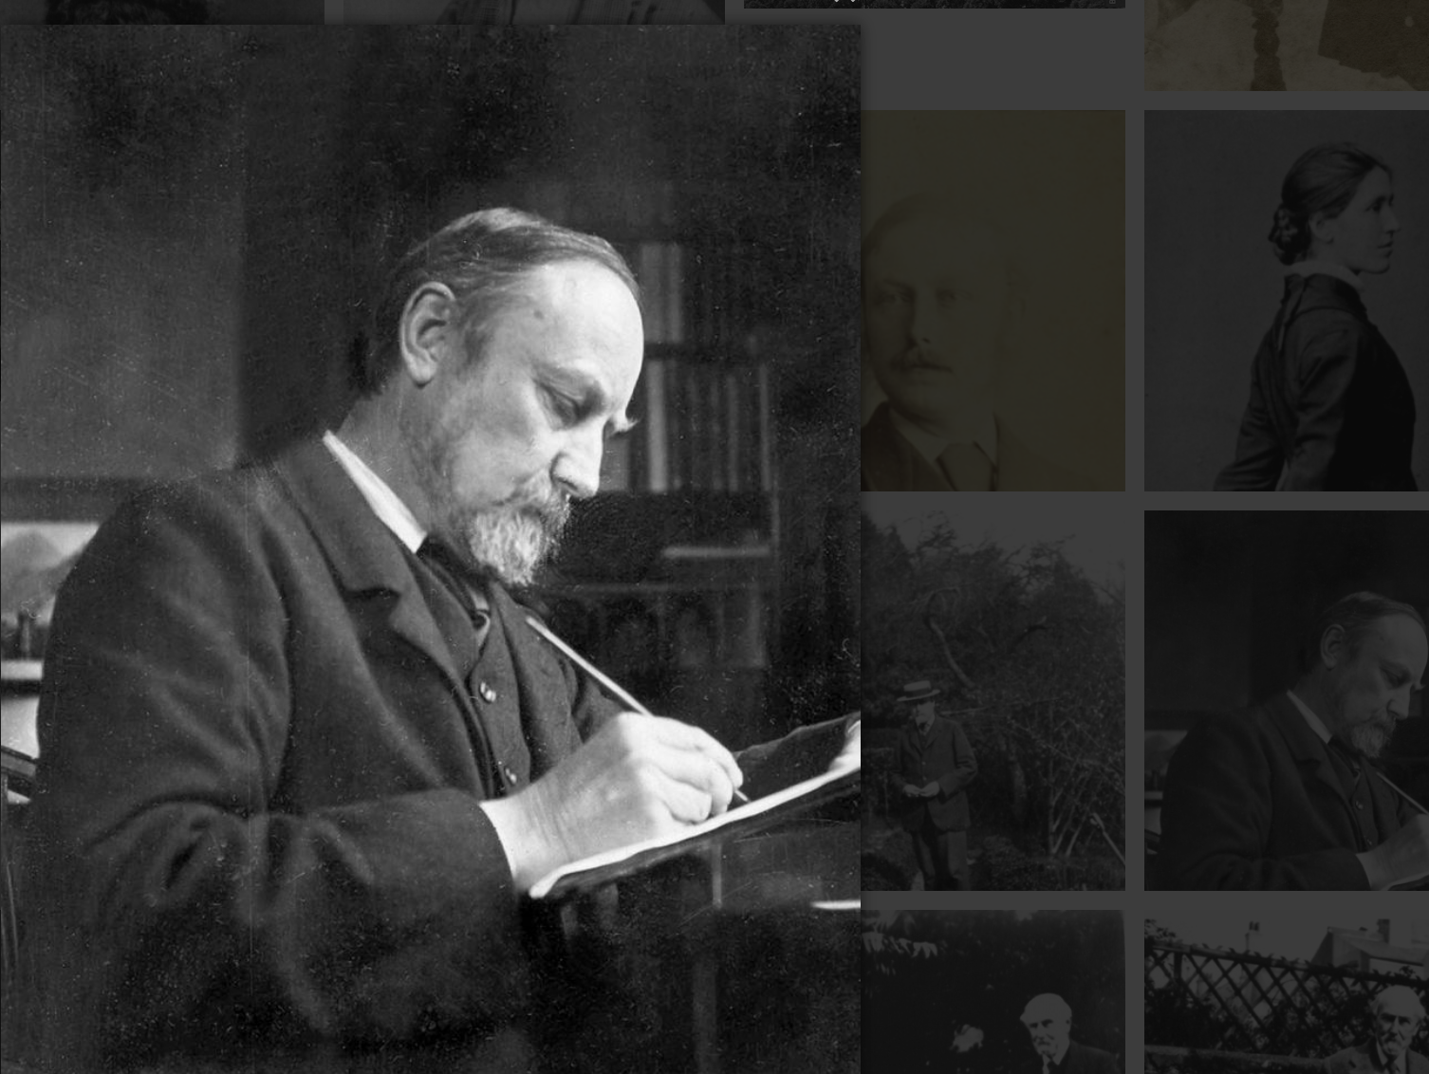
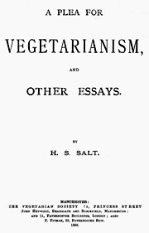
Henry Stephens Salt (1851-1939)
biographer of Shelley and Henry Thoreau; campaigned for animal rights, vegetarianism, environmentalism, socialism and against blood sports
Henry Salt, A Plea for Vegetarianism (1886)

Slide 17
Leela Gandhi, Affective Communities
‘For many late Victorian vegetarian and animal rights campaigners, such as Henry Salt, prevailing attitudes towards nonhuman life were tragically symptomatic of imperial reason, its tireless binarism, and its insistence upon rigid dichotomies between races, cultures, species, genders, sexualities. In this context, dietary reform and the language of animal rights were very often postulated as variations on the theme of anti-imperial politics.’

Slide 18
Oscar Wilde to Violet Fane (1888)
‘Vegetarianism . . . would make a capital article—its connection with philosophy is very curious, —dating from the earliest Greek days, and taken by the Greeks from the East—and so is its connection with modern socialism, atheism, nihilism, anarchy and other political creeds.’

Slide 19
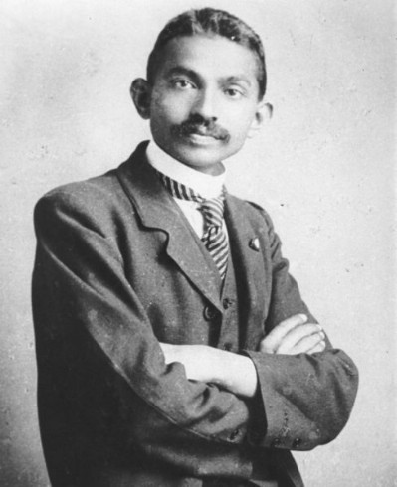
Mohandas Gandhi in London

Slide 20
Gandhi on eating meat (Autobiography)
‘It was not a question of pleasing my palate . . . I wished to be strong and daring and wanted my countrymen also to be such so that we might defeat the English and make India free.’

Slide 21
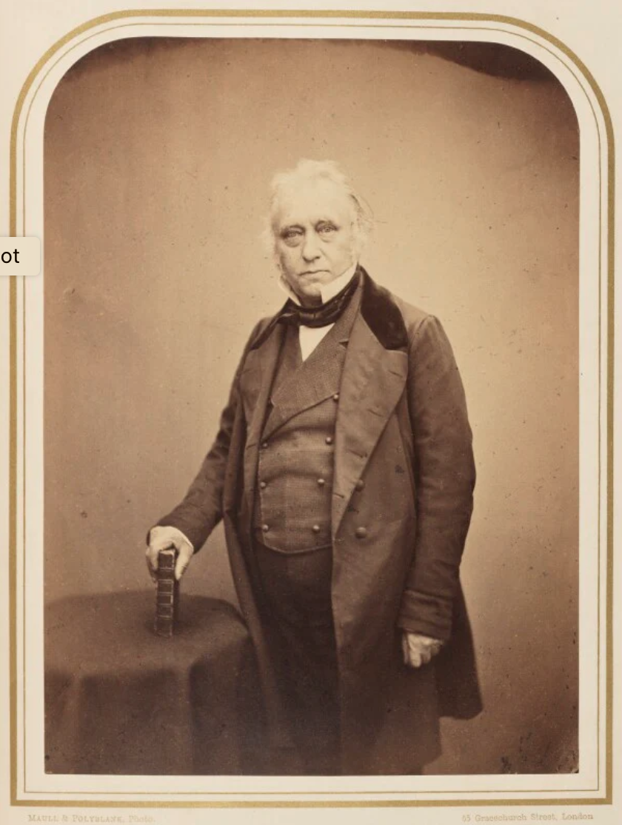
British historian Thomas Babington Macaulay
(writing in 1841)
The Bengali man is ‘feeble even to effeminacy. He lives in a constant vapour bath. His pursuits are sedentary, his limbs are delicate, his movements languid. During many ages he has been trampled upon by men of bolder and more hardy breeds. Courage, independence, veracity, are qualities to which his constitution and his situation are equally unfavourable’.

Slide 22
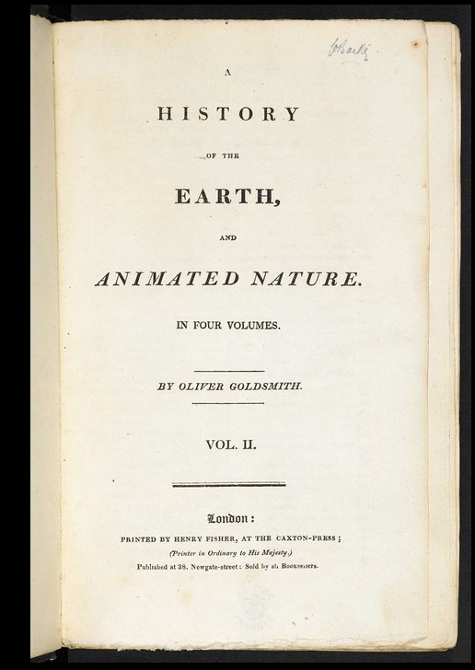
Anglo-Irish writer Oliver Goldsmith’s History of the Earth and Animated Nature (1774)
‘Fed on rice, and clothed in silk vestments, [Bengali] soldiers are unable to oppose the onset of an European army.’

Slide 23
Meat and Manliness
‘The most powerful nations and the greatest and best men everywhere are flesh eaters.’
US historian George M. Beard, Eating and Drinking (1871)
‘Manliness in a race is a function of its diet.’
David McCay, professor of physiology at the Medical College in Calcutta (1911)

Slide 24
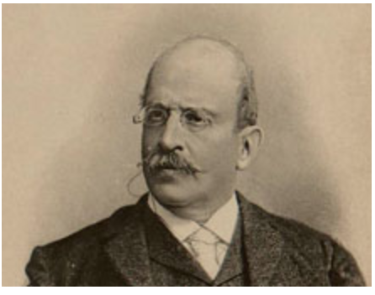
Mexican Liberal Politician Francisco Bulnes (1847-1924)
El porvenir de las naciones latinoamericanas [The Future of the Latin American Nations] (1899)
‘All powerful peoples’ have been carnivores.

Slide 25
Clorinda Matto de Turner, Birds without A Nest: A Story of Indian Life and Priestly Oppression in Peru (1889)
‘It is proven that the Indians’ diet has caused their cerebral functions to degenerate. As you have no doubt noticed, these disinherited beings scarcely ever eat meat, and the advances of modern science have proven to us that cerebral activity is in direct relation to its nutritional sources. With the Indian condemned to eat an extremely limited vegetable diet, living on turnip greens, boiled beans, and quinoa leaves, with no albuminoids or organic salts, his brain has no source from which to draw phosphates and lecithin for psychic effort; it serves only to fatten the brain, which plunges him into the depths of cognitive darkness, making him live at the same level as his work animals.’

Slide 26
A jingle Gandhi recalled from his youth
‘Behold the mighty Englishman
He rules the Indian small.
Because being a meat-eater
He is five cubits tall.’
(5 cubits is about 2.2 meters, or over 7 feet.)

Slide 27
Parama Roy, ‘A Dietetics of Virile Emergency’, Women's Studies International Forum (2014)
‘It is well known that British colonialism in India induced a crisis among the colonised regarding their deficits . . . What to eat, how to eat, and how to make eating a passport into a modern and virile comity of nations—these came to engage Indian thinkers smarting under the accusations of effeminacy, physical degeneracy, historical backwardness, and political enslavement. One common response to this among 19C Bengali males was a cult of physical culture, combined with . . . carefully nurtured [meat eating]; together these were held to constitute a this-worldly programme of man-making that could re-vitalise a physically debilitated and gutless Bengali Hindu male.’

Slide 28
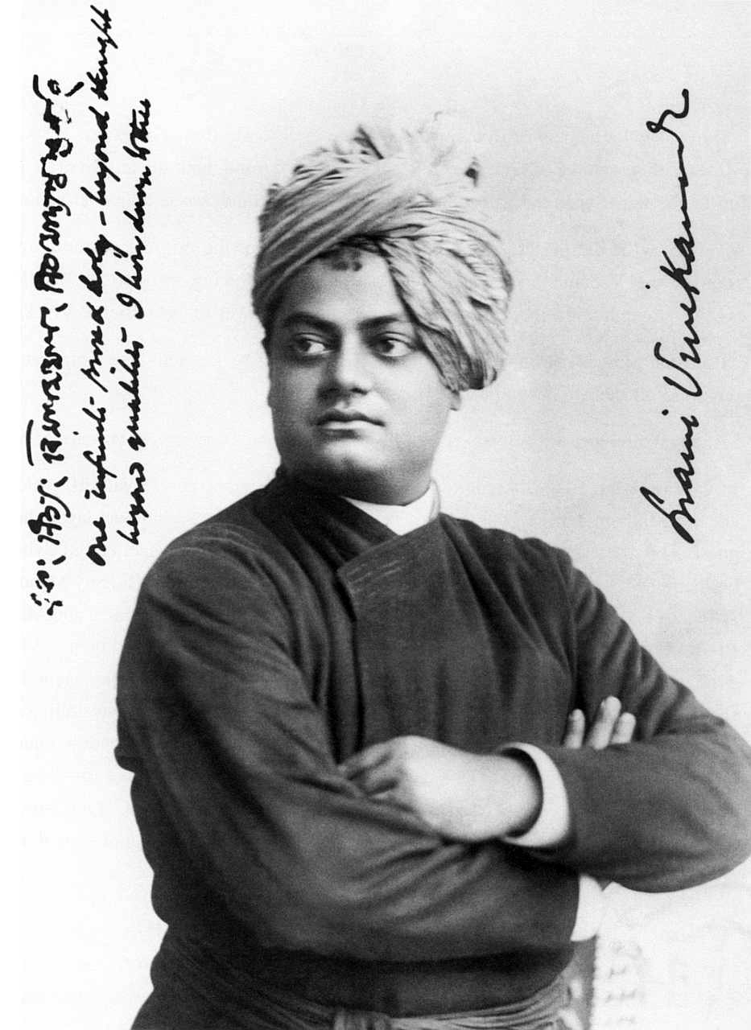
Swami Vivekananda (1863-1902)
Hindu religious teacher, writer and nationalist.
‘beef, biceps and Bhagavad Gita’

Slide 29
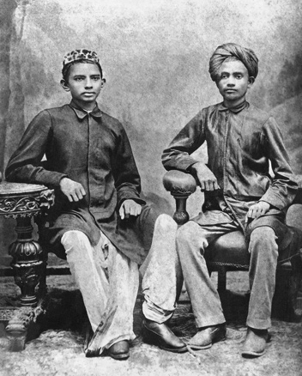
Sheikh Mehtab
A young Gandhi with his classmate Sheikh Mehtab (right) at Rajkot, 1883
‘We are a weak people because we do not eat meat. The English are able to rule over us, because they are meat-eaters. You know how hardy I am, and how great a runner too. It is because I am a meat-eater. . . You should do likewise.’

Slide 30
Vegetarianisms Today
Religious (Buddhism, Jainism, strict Hinduism, Seventh-Day Adventists . . .)
Health (or a ‘neoliberal’ focus on individual wellbeing?)
Moral/ethical (animal rights, environmental)
Political (counter-cultural critiques of industrial food . . .)

