Slide 1
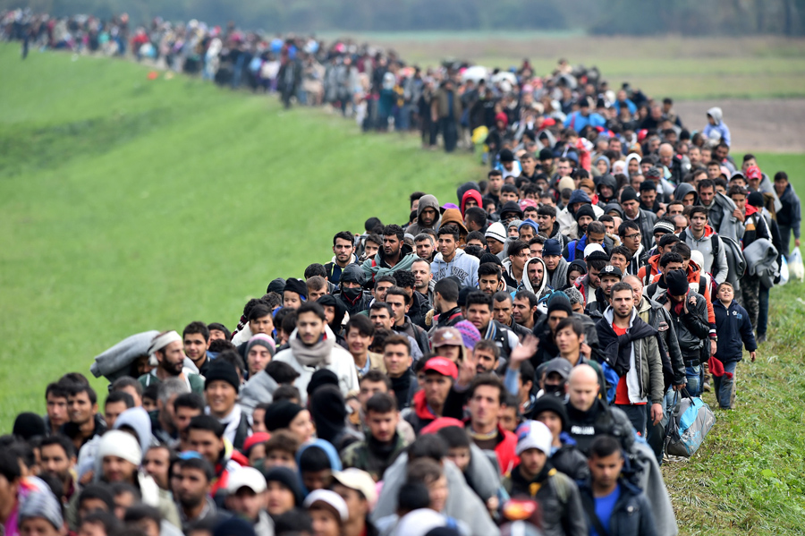
“The world we live in is one in which human motion is more often definitive of social life than it is exceptional”
Arjun Appadurai, in Geographies of Identity (1996)
“The story of human coexistence is always also the story of migrations”
Ludgar Pries, in Migration and Transnational Social Spaces (1999)
“Migration is a unique phenomenon in which movements, crossings, and therefore connections and comparisons are at the very core of this process”
Amit Kumar Mishra, in Global History, Globally (2018)

Slide 2
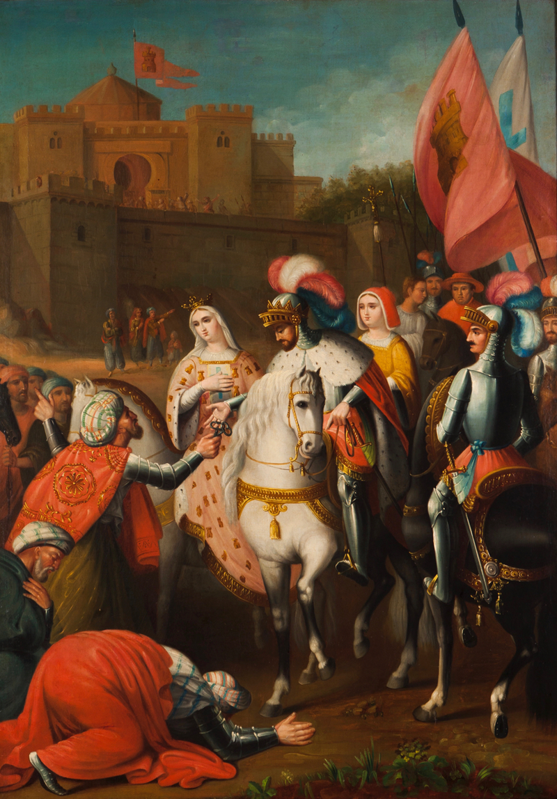
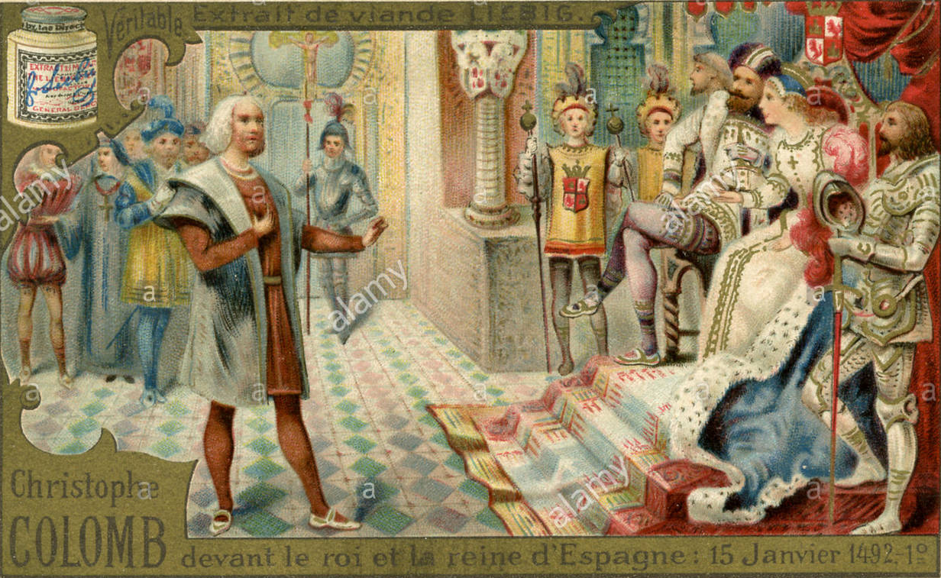
1492

Slide 3

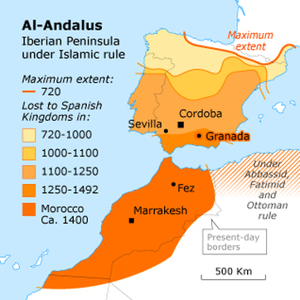

Slide 4
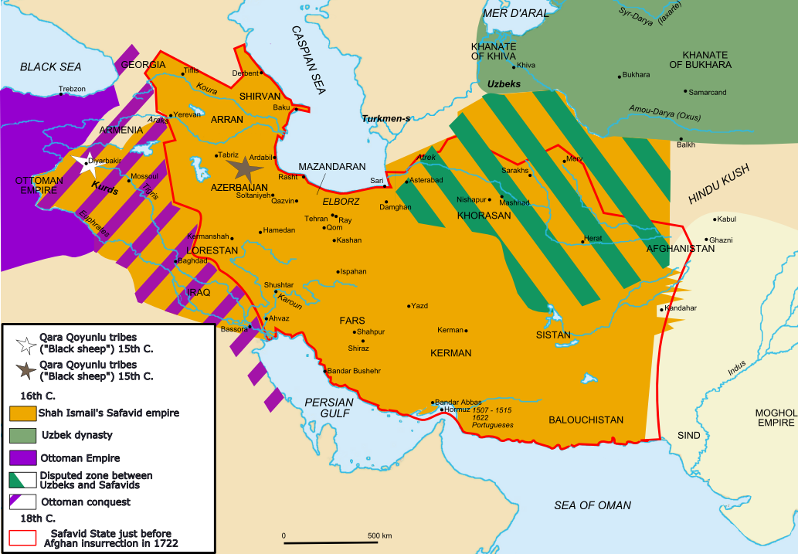

Slide 5
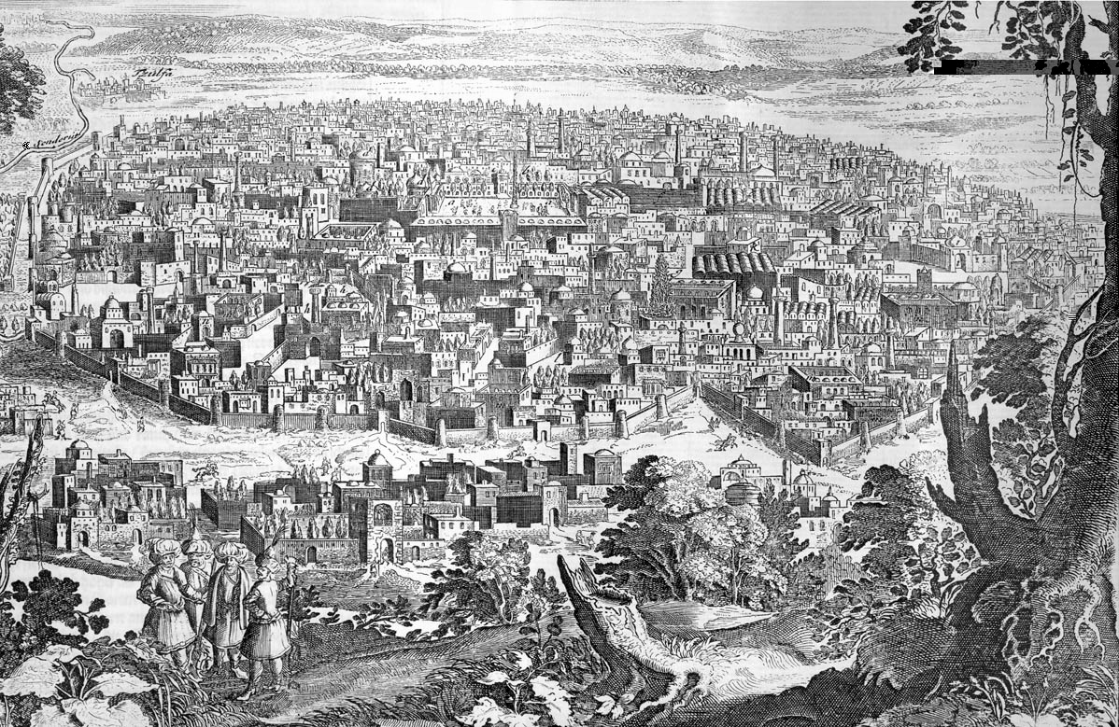
1605
- How did communities act as go-betweens?
- Did individuals and communities have different ways of performing intermediary roles?

Slide 6
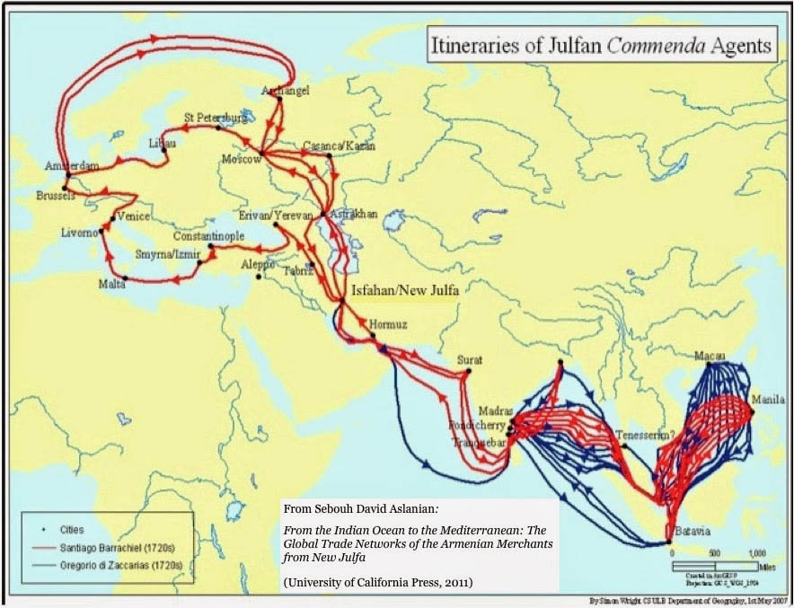
‘The archival material is derived from thirty-one collections in a dozen countries and seven languages, including the Julfa dialect, making this study part of a new wave of scholarship, one based on “indigenous” primary sources rather than European “proxy” documents.’
Sebouh Davis Aslanian, From the Indian Ocean to the Mediterranean (2011)

Slide 7
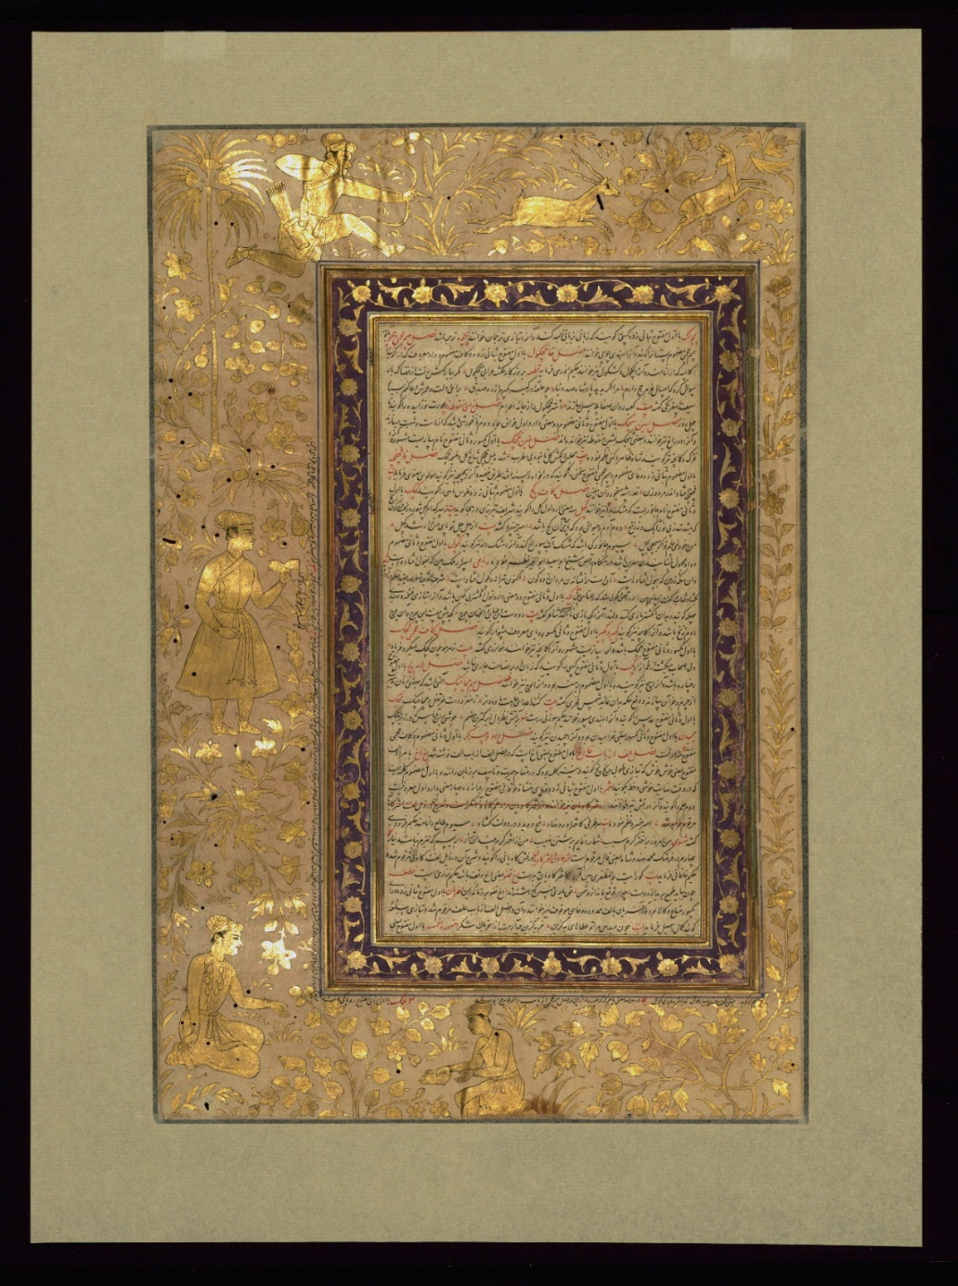
Name three reasons why non-Western sources are essential for studying global history
List three challenges in using non-Western sources
Think of three possible solutions to the challenges above
Page from the Akbarnāmah, by Abū al-Faẓl ibn Mubārak (d. 1011 AH / 1602 CE).

Slide 8
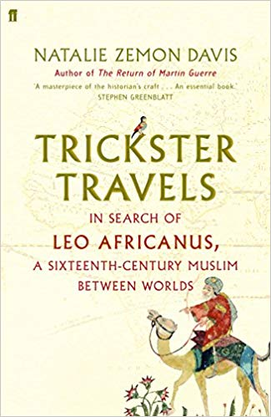
Leo Africanus “consciously moves back and forth between Africa and Europe, between the different cultures and polities of Africa, and between Islam and Christianity”
Natalie Zemon Davis, Trickster Travels (2006)
- In what ways has the figure of al-Hasan al-Wazzan/Leo Africanus been read by modern audiences?
- How does al-Hasan al-Wazzan/Leo Africanus position himself ‘in regard to the world he was writing about and the world he was writing for’ (Davis, 6)?

Slide 9
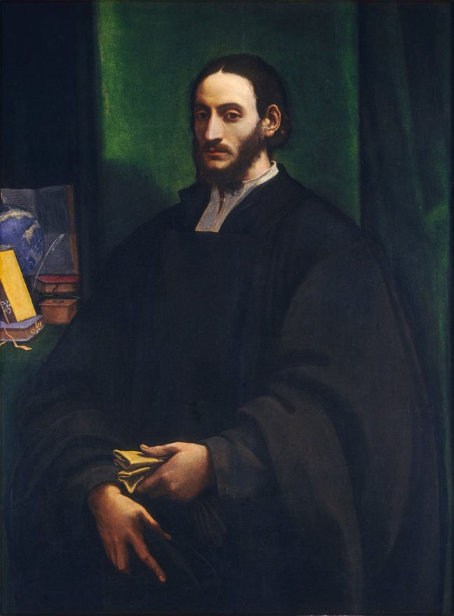
Who albeit by birth a More, and by religion for many yeeres a Mahumetan: yet if you consider his Parentage, Witte, Education, Learning, Emploiments, Trauels, and his conuersion to Christianitie; you shall finde him not altogether unfit to undertake such an enterprize; nor unworthy to be regarded.’ - John Pory ‘To the Reader’ -> How does the Description of Africa construct Leo Africanus’ position as a go-between?

Slide 10
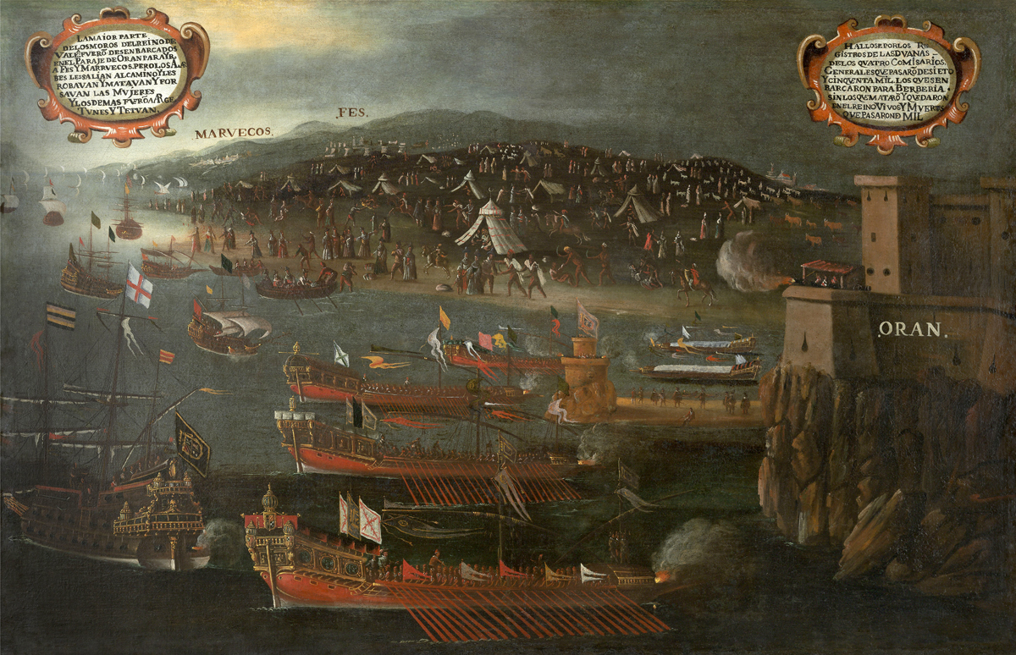
1609

Slide 11
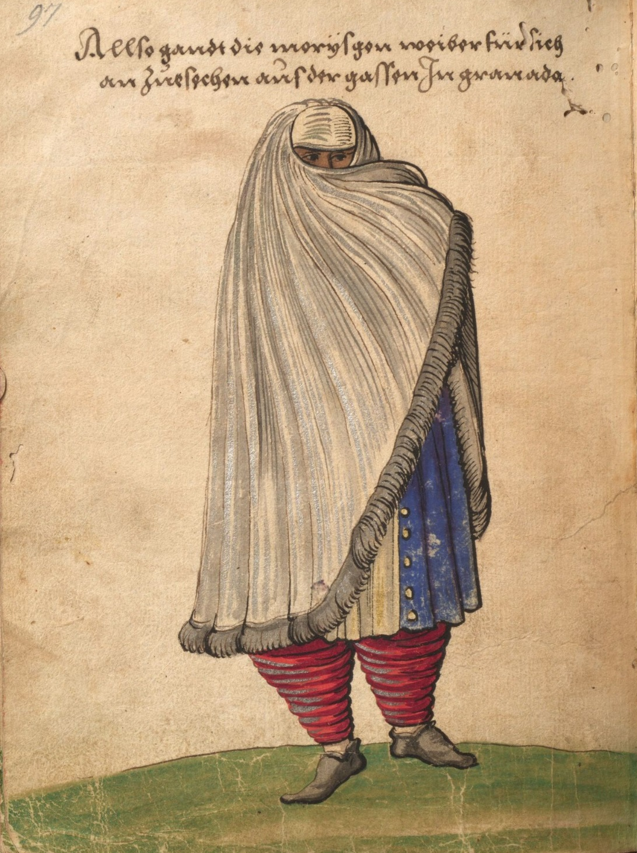
- In what ways does Ahmad bin Qasim mediate between worlds?
- Compare the cultural positioning of Ahmad bin Qasim to that of Leo Africanus: what are the differences and similarities?

Slide 12
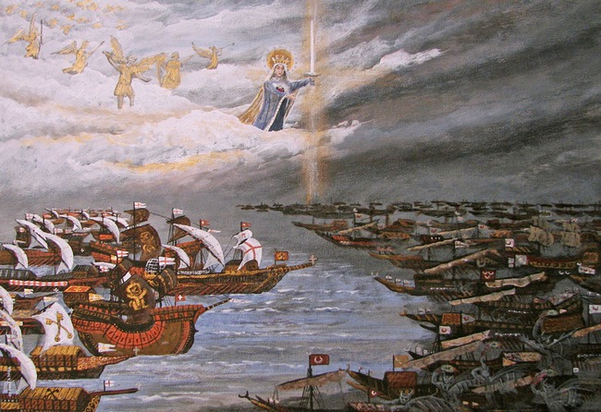
Which larger themes do the stories of Leo Africanus, Ahmad Qasim, and the Julfan Armenians illuminate?

