Slide 1
Group Work Project: (Video) Blog (Week 8, Wednesday 12:00) + Presentation (Week 8, Thursday) (20% of final mark)
Groups of 3 or 4 students -> case study pertaining to theme of module, structured around a relevant historical question, using a variety of media [Groups formed by Monday Week 4]
1) Textual and/or visual presentation of your findings in a blog (e.g. Wordpress) or video (e.g. vlog or animated info-graphics)
-> include only that information necessary to explain and document your findings. Indication: ca. 10-12 minutes of video content or 3,000 words of blog text.
2) 12-15-minute oral presentation using audiovisual media (e.g. Powerpoint, Prezi)
-> Spoken version of your digital project. Cover some or all of the following:
- Justification of your chosen topic and question
- Documentation of your research process, incl. unexpected finds and challenges
- Explanation of your findings and why they matter
- Potential for further research More info: Presentation Marking Scale and Workshop

Slide 2
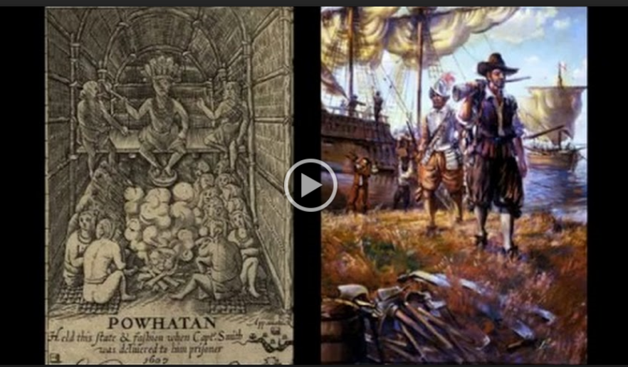
Group Project
Example 2017: Pocahontas and Anglo-Powhatan Relations

Slide 3
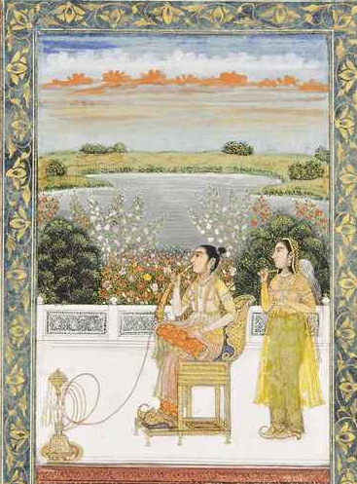
Week 3: Middlemen and Middlewomen 1) The way gender impacted the roles performed by go-betweens 2) The nature of boundaries in the Early Modern World 3) Intersections between gender and Orientalism

Slide 4
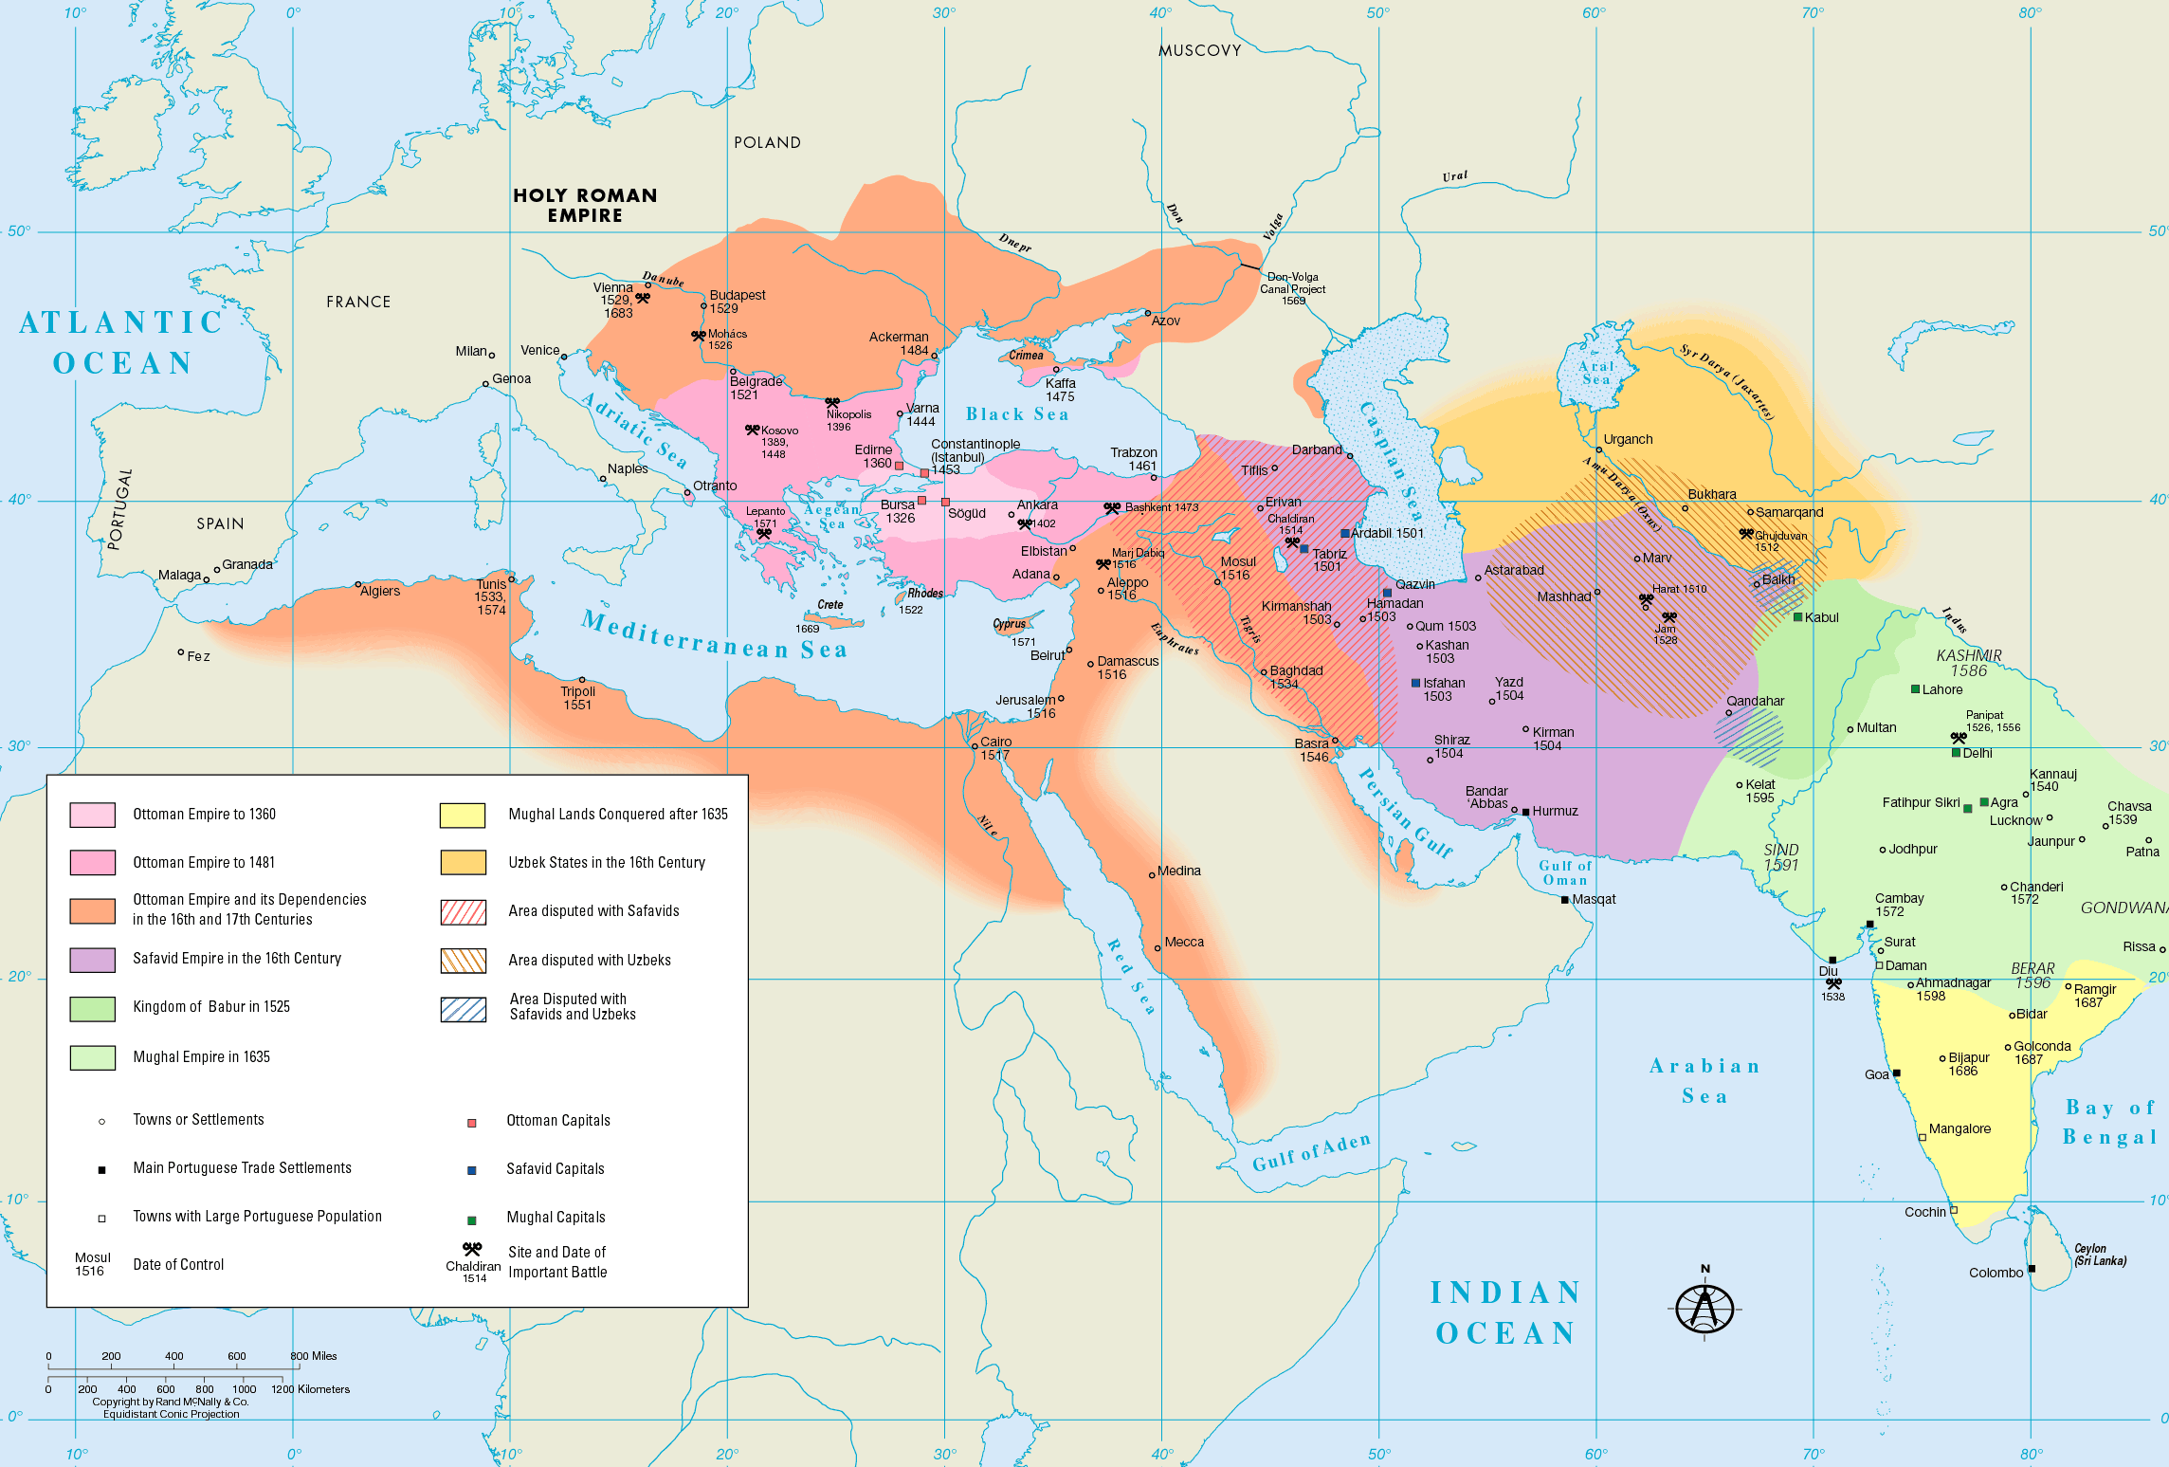
Islamic Empires
16th-17th Centuries

Slide 6
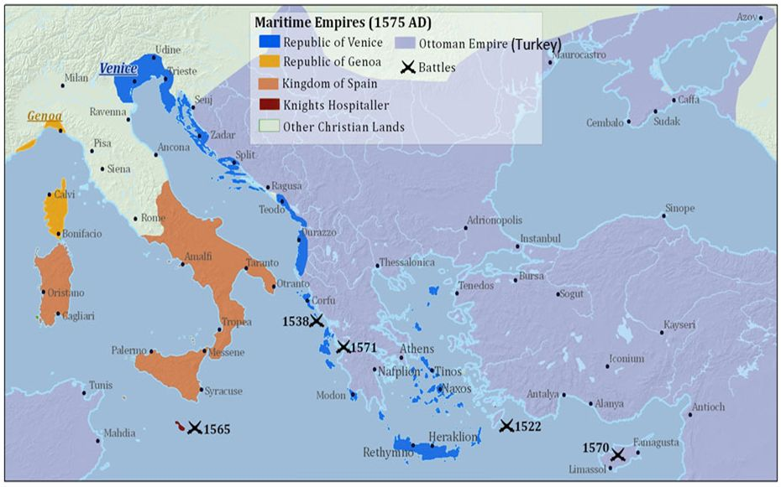

Slide 8
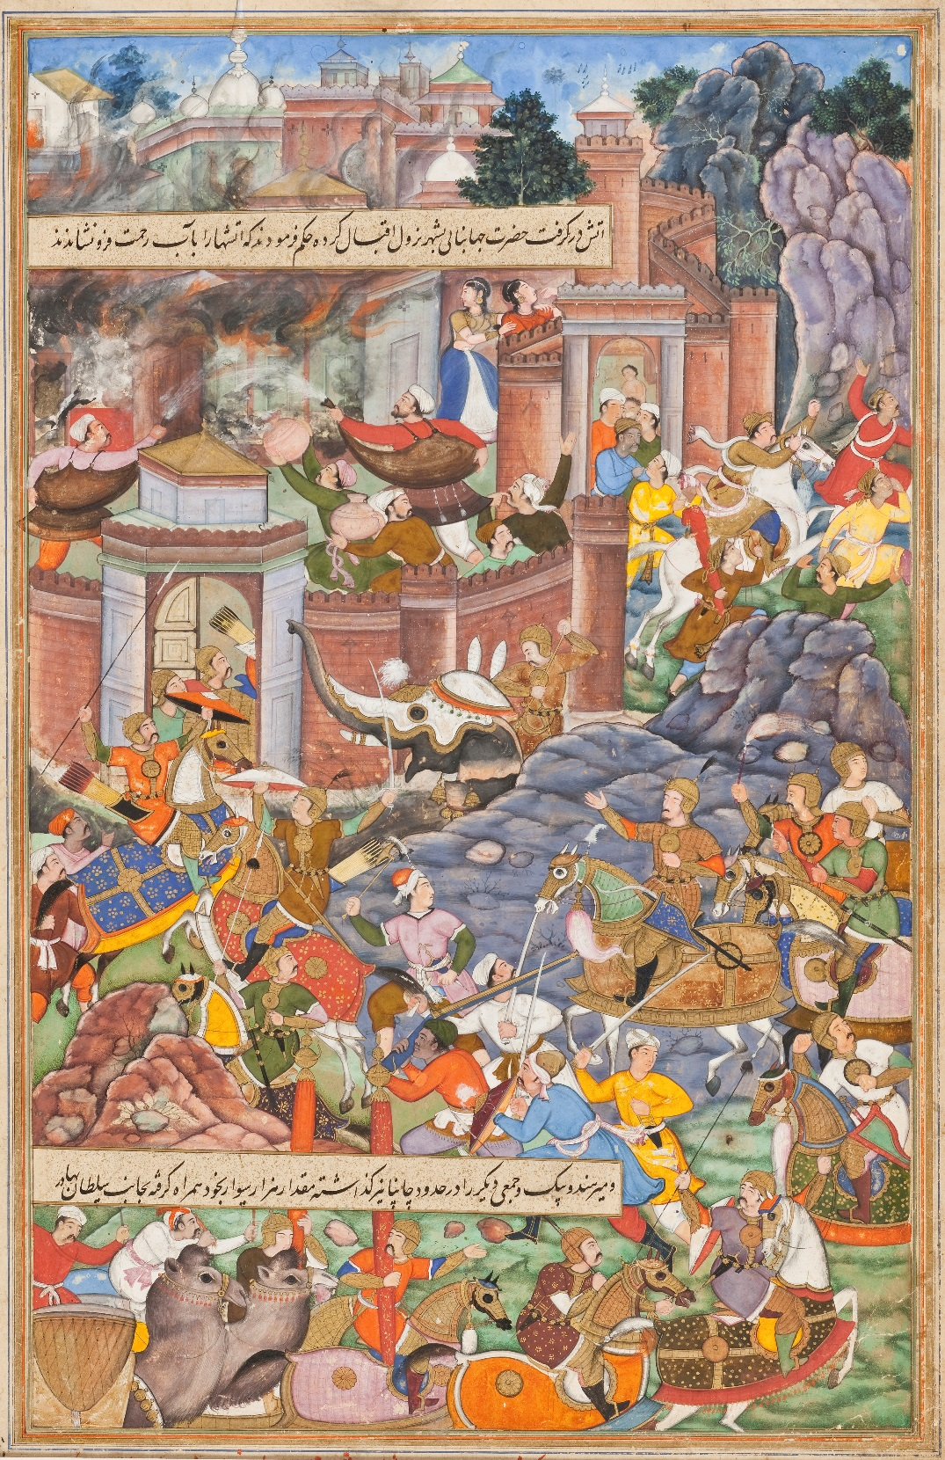
- Which boundary crossings did Gulbadan Begam practice and how did she act as a go-between?
- How does the Humayun-Nama bear testimony to wider border crossings? (identify passages)

Slide 9
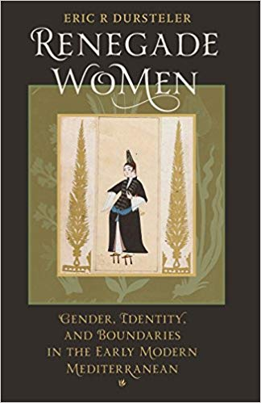
What roles did gender play in shaping Beatrice/Fatima and Gazanfer's ability to mediate?
In what ways do Fatima Hatun’s and Gazanfer’s stories shed light on the nature of Mediterranean boundaries?

Slide 10
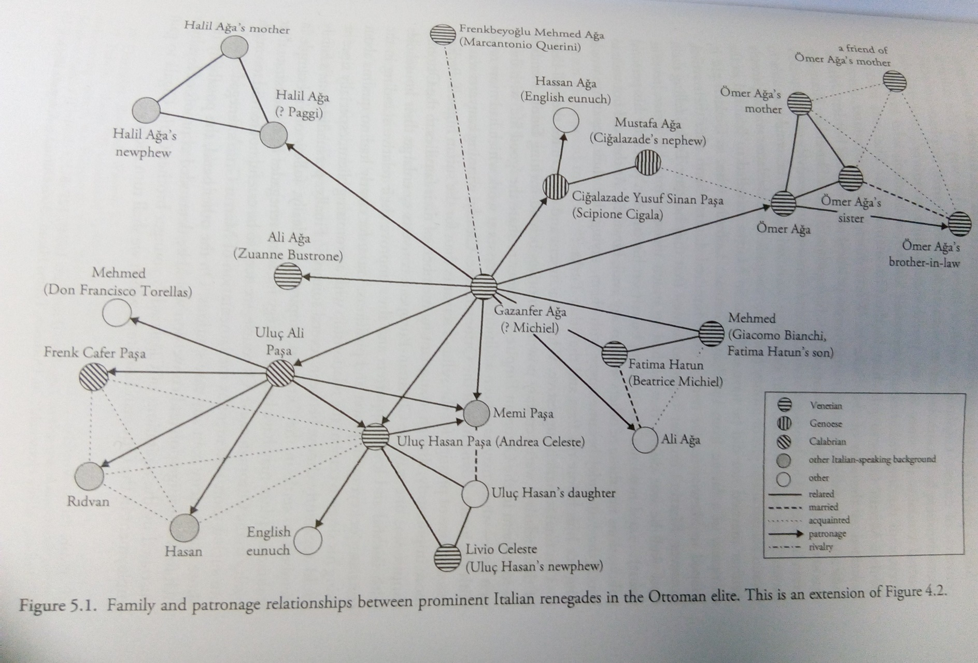

Gazanfer Aga’s network of renegades
‘While the decision to convert granted Fatima freedom from her difficult husband and his involvement in her financial affairs, she remained under the authority of men, first her brother and then her new husband Ali.’
Tobias Graf, The Sultan’s Renegades (2017), p. 169.

Slide 11
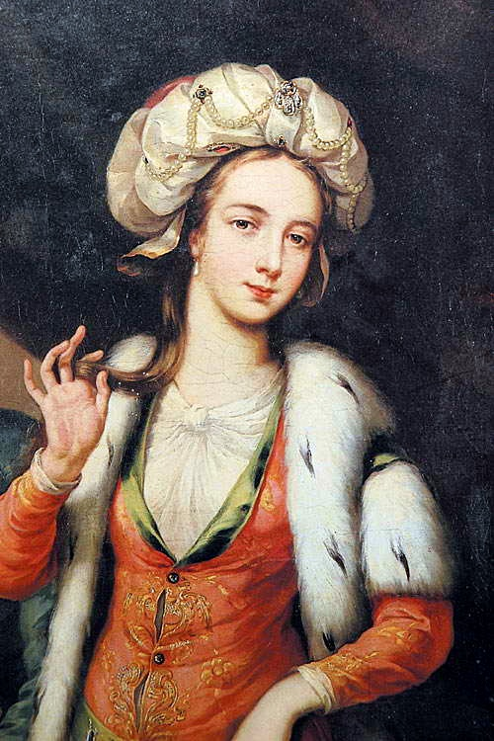
“I look upon the Turkish women as the only free people in the Empire”
Lady Mary Wortley Montagu, Letter 30, 1 April 1717
‘Thus you see, dear Sister, the manners of mankind do not differ so widely as our voyage writers would make us believe.’
Lady Mary Wortley Montagu, Letter 30, 1 April 1717

Slide 12
- What effect did Mary’s gender have on the various ways she acted as a go-between?
- In what ways do the cases of Gulbadan Begam, Fatima Hatun, and Lady Mary Montagu help recover underrepresented experiences?

Slide 13
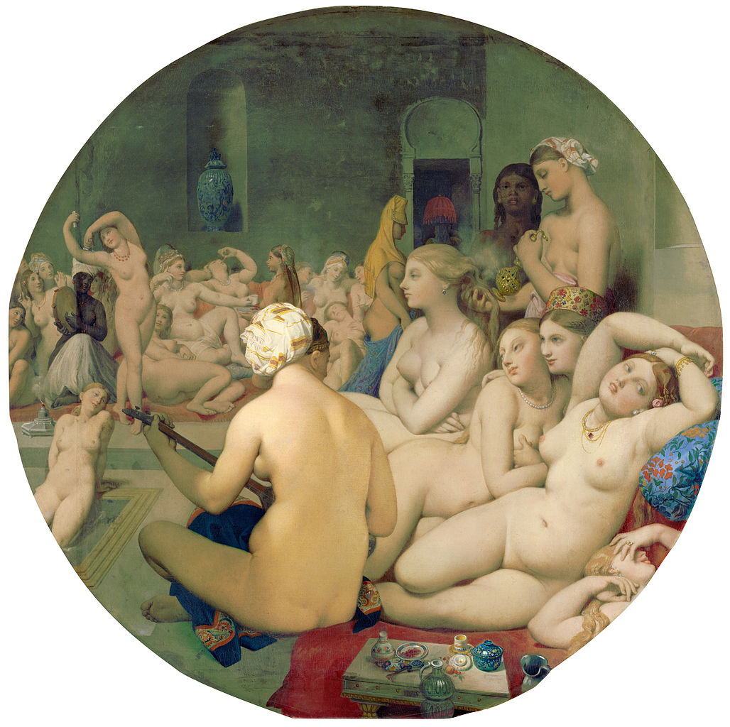
Orientalism
What is “Orientalism”?
How is it manifested in European travel accounts about the Ottoman Empire?
What is specifically gendered about Orientalism?
How does Lady Mary’s perspective challenge or invert such perspectives and where does she contribute to them?
Jean Auguste Dominique Ingres, Le Bain Turc (1862)

Slide 14
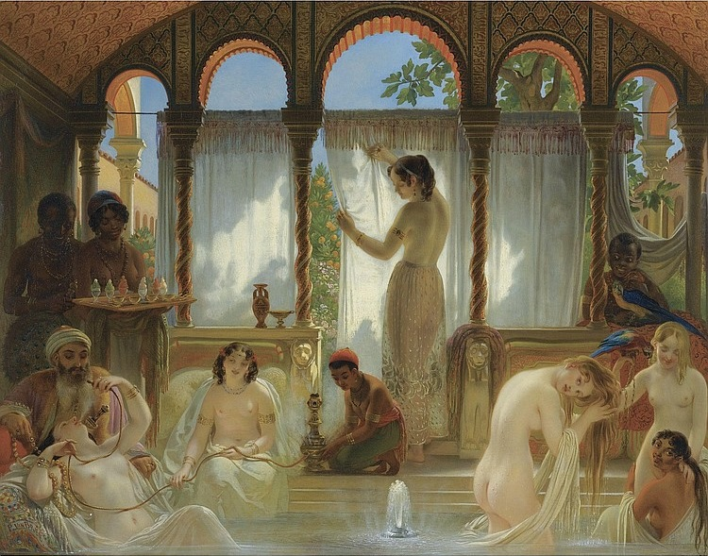
Philippe Jacques van Bree, The Harem Bath (c. 1830)

Slide 15
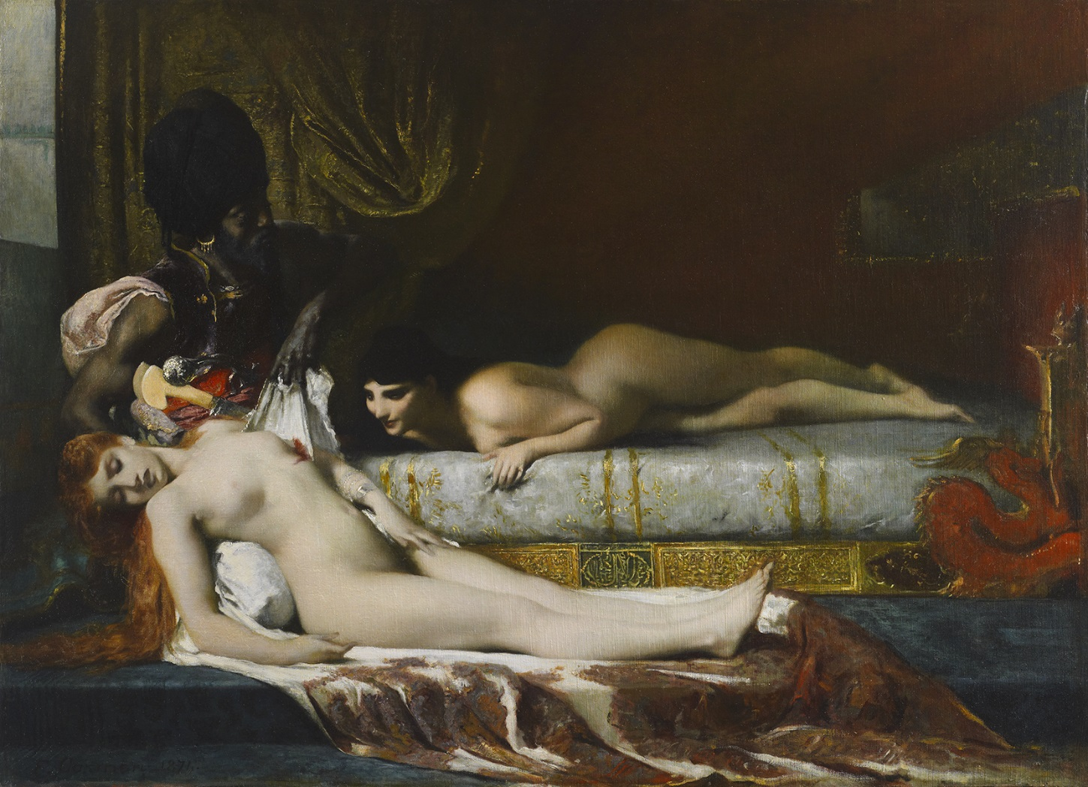
Ferdinand Cormon,
Murder in the Seraglio (1874)

Slide 16
Orientalism
What is “Orientalism”?
How is it manifested in European travel accounts about the Ottoman Empire?
What is specifically gendered about Orientalism?
How does Lady Mary’s perspective challenge or invert such perspectives and where does she contribute to them?
Jean Auguste Dominique Ingres, Le Bain Turc (1862)

Slide 17
Orientalism
‘Orientalism as a Western style for dominating, restructuring, and having authority over the Orient.’
‘European culture gained in strength and identity by setting itself off against the Orient as a sort of surrogate and even underground self.’
‘As much as the West itself, the Orient is an idea that has a history and a tradition of thought, imagery, and vocabulary that have given it reality and presence in and for the West.
Edward Said, Orientalism (1978)
Jean Auguste Dominique Ingres, Le Bain Turc (1862)

