Slide 1
Sex and the uS military
From cold war to the ‘War on Terror’
HI2C6
susan carruthers (h3.07)

Slide 2
Today’s lecture
Some historical background and context
Introducing the core issues and concepts
Explaining the structure of the module
Seminar preparation

Slide 3
Us war-making since 1945
Sept. 1945: WWII officially concludes with japan’s surrender
Us forces continue to occupy part of Germany; japan; korea; and Italy for varying lengths of time into the 1950s; US bases remain thereafter
By 1948: ‘Cold war’ under way with ussr (and prc after 1949)
1950-53: Korean war
1955(?)-75: Vietnam War
1990-91: gulf war vs. Iraq
Oct. 2001 - : Operation enduring freedom
March 2003 - : Operation Iraqi freedom
This list doesn’t include numerous overseas actions; ‘humanitarian interventions’ and involvement in national and regional conflicts

Slide 4
About the us military

Slide 5
https://www.politico.com/magazine/story/2015/06/us-military-bases-around-the-world-119321

Slide 6
Key changes in the structure of the us military since 1945
NB: “the Military” serves as an umbrella term for the us Army, the us marine corps, the us air force (founded 1947), the us navy, the us coast guard, and the reserve services
1948: Desegregation
1973: all-volunteer forces introduced– a signal shift away from reliance on the draft to career services
But American men aged 18+ are still required to register for “Selective service”

Slide 7
Women in uniform
WWii: approx. 400,000 women served in uniform in the women’s army corps [wac], the marine corps women’s reserve and the army nurse corps (a women only branch, 1901-55)
1948: Women’s Armed Services Integration Act, letting women serve as full, permanent members of all of the branches of the military.
But It limited the number of women who could serve to 2% of any military branch, allowed the military to involuntarily discharge pregnant women, and it capped the number of women who could become officers.
the act also prevented women from commanding men or ever serving in combat.
Read more: https://www.army.mil/women/history/
https://www.history.com/news/women-fought-armed-forces-war-service

Slide 8
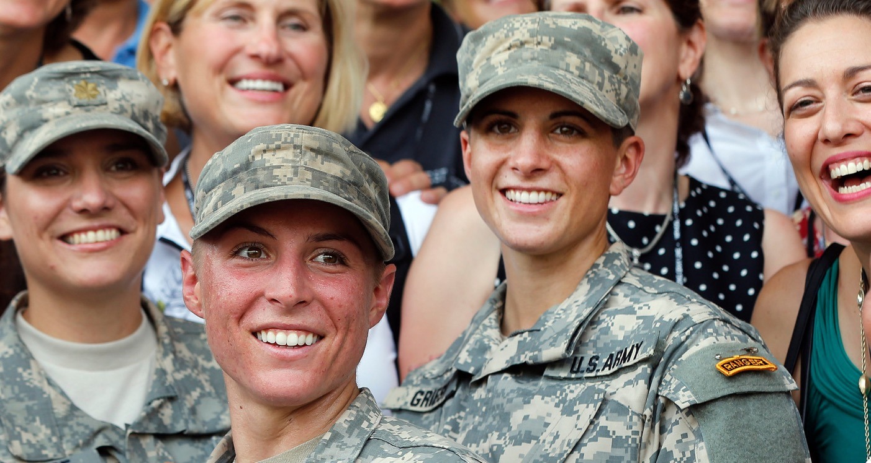
Women in combat
“All Combat Roles Now Open to Women, Defense Secretary Says”
New York Times
Dec. 3, 2015
https://www.nytimes.com/2015/12/04/us/politics/combat-military-women-ash-carter.html
United States Army First Lt. Shaye Haver, center, and Capt. Kristen Griest, right, in August after becoming the first female graduates of the Army's demanding Ranger School.Credit...John Bazemore/Associated Press

Slide 9
Lgbtq military service
For much of the twentieth century, the us military formally debarred openly gay men and lesbian women from serving, with shifting justifications for discrimination (from “perversion” to combat unit cohesion)
"Homosexual personnel, irrespective of sex, should not be permitted to serve in any branch of the Armed Forces in any capacity, and prompt separation of known homosexuals from the Armed Forces is mandatory.” department of defense (dod), 1949
“Homosexuality is incompatible with military service. The presence in the military environment of persons who engage in homosexual conduct or who, by their statements, demonstrate a propensity to engage in homosexual conduct, seriously impairs the accomplishment of the military mission.” dod, 1981

Slide 10
“Don’t ask, don’t tell” [dadt]
Feb 1994: dadt introduced by the clinton administration
2010: Dadt repealed by Obama
Sept. 2011: dadt no longer in operation
Read more:
https://www.hrc.org/resources/the-repeal-of-dont-ask-dont-tell
Image from DIGNITY & RESPECT (2001), a U.S. Army training guide on the homosexual conduct policy.

Slide 11
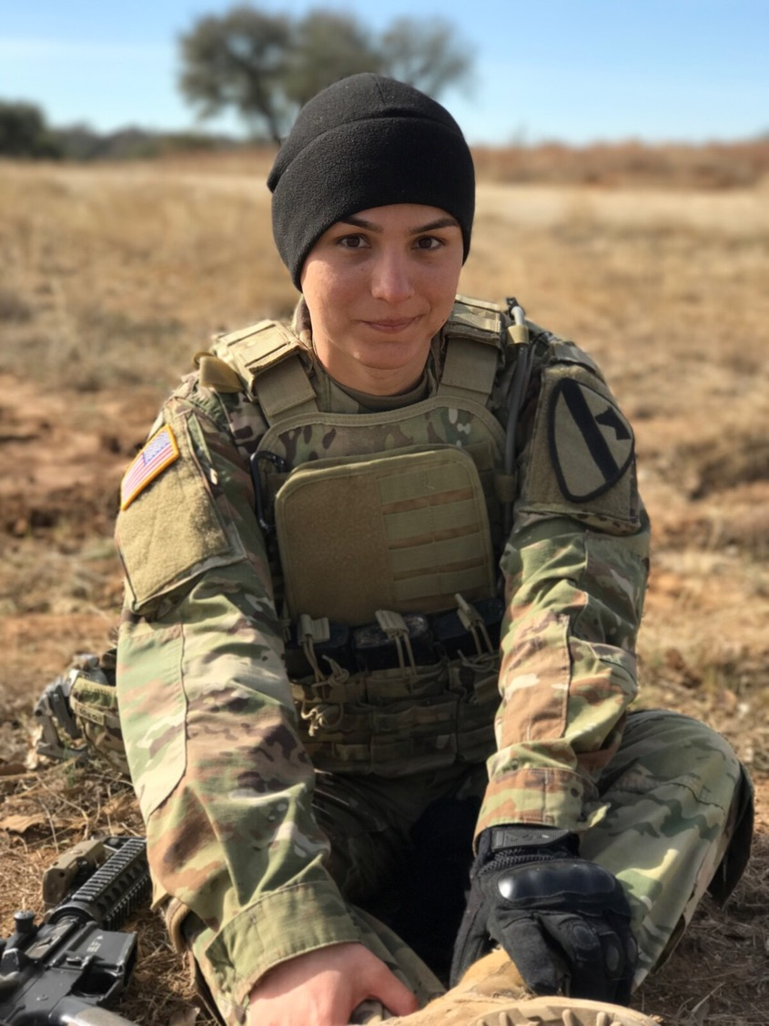
“She’s one of the Army’s first transitioned transgender soldiers — and an infantryman — but now her future is uncertain”
Meghann Myers
https://www.armytimes.com/news/your-army/2017/08/01/shes-one-of-the-armys-first-transitioned-trangender-soldiers-and-an-infantryman-but-now-her-future-is-uncertain/
“After consultation with my Generals and military experts, please be advised that the United States Government will not accept or allow......
Transgender individuals to serve in any capacity in the U.S. Military. Our military must be focused on decisive and overwhelming.....
victory and cannot be burdened with the tremendous medical costs and disruption that transgender in the military would entail. Thank you”
— Donald J. Trump (@realDonaldTrump) July 26, 2017
Spc. Alex Ketchum, an infantryman with 1st Cavalry Division at Fort Hood, Texas, officially changed her gender marker in April, following a year and a half of hormone therapy and less than a year after the Defense Department lifted its ban on service for transgender troops. (Photo courtesy Spc. Alex Ketchum)

Slide 12
About this module

Slide 13
Some foundational propositions
The military has been/is a key domestic institution
Also a major international presence/actor
The military reflects US civil society in some regards
but is distinctive in several ways: as an especially “greedy institution”; as a workplace; as a culture
Different rules apply– literally. The uniform code of military justice [ucmj] introduced 1950
Gender roles, sexual orientation and sexual behaviour all particularly fraught in the armed forces

Slide 14
What is gender?
A social construct– not a biological given
Normative gender roles assume heightened form in the military
Hyper-Masculinity and soldiering synonymous?

Slide 15
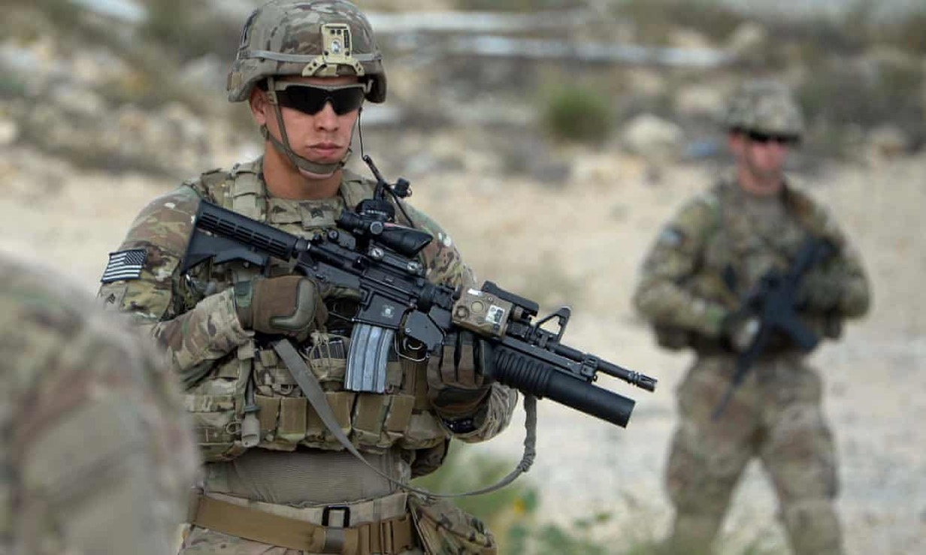
envisioning ‘the soldier’: Military masculinity
Core attributes?
Physical strength
Toughness
Aggression
“Killer instinct”
Courage
Level-headedness
Technical prowess
Resilience
Photograph: Noorullah Shirzada/AFP/Getty Image (2016)

Slide 16
“Wounded when a mine blew up his Jeep, an ambulance driver sobs by the side of the road after learning that a friend was killed in the blast, Korea 1950.”
Photo credit:
David Douglas Duncan
View more of Ducan’s Korean war photography: https://time.com/3667583/korean-war-photos-david-douglas-duncan/

Slide 17
U.S. Army Nurse Corps

Slide 18
What is sex?
why/how has sexual behaviour been problematic in & for the US military?

Slide 19
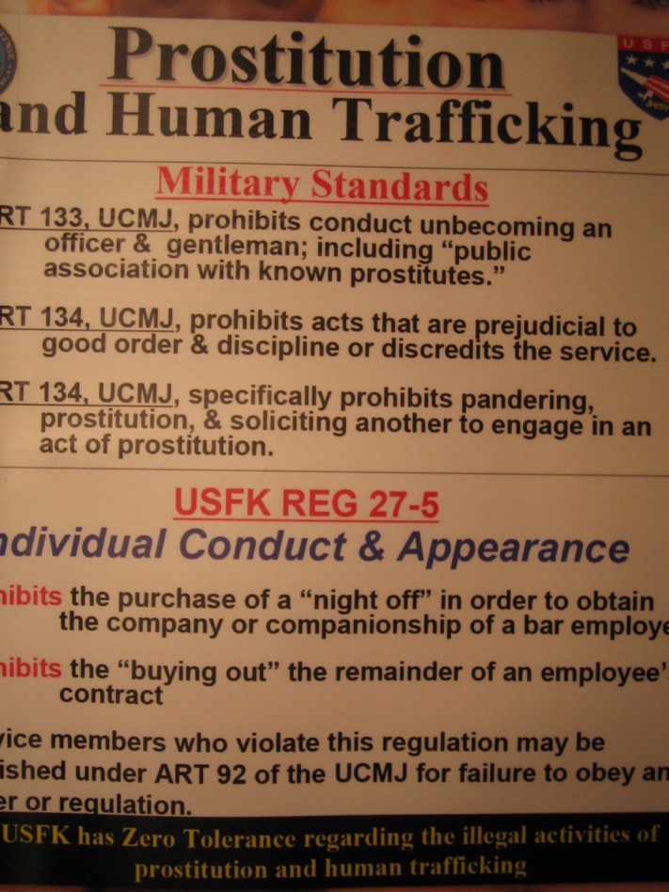
contradictions and conundrums
Heterosexual intercourse as a male
prerogative– a reward or entitlement?
But sex with whom?
Spouses?
Partners of the same sex?
Commercial sex-workers?
Sex as a public health problem
Sex as a public relations problem
Sex as a command problem

Slide 20
Outlawed Sexual behaviours according to ucmj
Same-sex intercourse (until the repeal of dadt)
“sodomy”
Adultery (shifting definitions)
bigamy
“Pandering”
“Consorting with notorious prostitutes”
voyeurism
Sexual assault/rape
Gen. David Petraeus with Paula Broadwell in July 2011

Slide 21
Points to note About the module
Thematic structure
Inter-disciplinary readings
Website as the sole source of information– and me!
Please always ask me if you have any questions about the module content, seminars or assessment
Office hours: thurs 12-1; fri 12-1
or by appointment at other times

Slide 22
Part i: Heteronormativity and the US military
Seminars
1) Defining the terms of engagement
2) Prostitution, rape and resistance to US militarism in Asia
3) Married in and to the military: 'war brides' and 'army wives'
lectures
1) Why and how gender, sex and sexuality matter in the US military
2) The US military and commercial sex
3) Domestication: a 'family friendly' army?

Slide 23
Part ii: Gender, sex and soldiering
Lectures
4) gender at war in Vietnam
5) Recruitment in the All-Volunteer era
6) Reading Week [no lecture]
7) Women in combat
Seminars
4) Women's work in Vietnam
5) Assignment writing workshop
6) Reading Week [no seminar]
7) The fight over fighting women in Iraq and Afghanistan

Slide 24
Part iii: Managing sexuality in the US military
Seminars
8) DADT and its repeal
9) Rape and sexual violence within the US military
10) Conclusions?
Lectures
8) The queerness of the military
9) Sexual violence:
an invisible war?
10) Transgender service: the final frontier?

Slide 25
Seminar preparation
Required readings each week; supplementary reading is suggested for further background and/or more detail; for assignment preparation
Usually one primary source and two scholarly articles
Take notes– but don’t go overboard. Think, don’t just transcribe.
Look at the seminar questions before you start reading
Use these as prompts to guide you through the material, keeping you attuned to what you should be reading for
But also remain alert to what you find most surprising and notable– and hence most in need of discussion
Think about the questions again, having taken a step back from the reading
Come to class with your talking points ready! I want to hear what you think.

