Slide 1
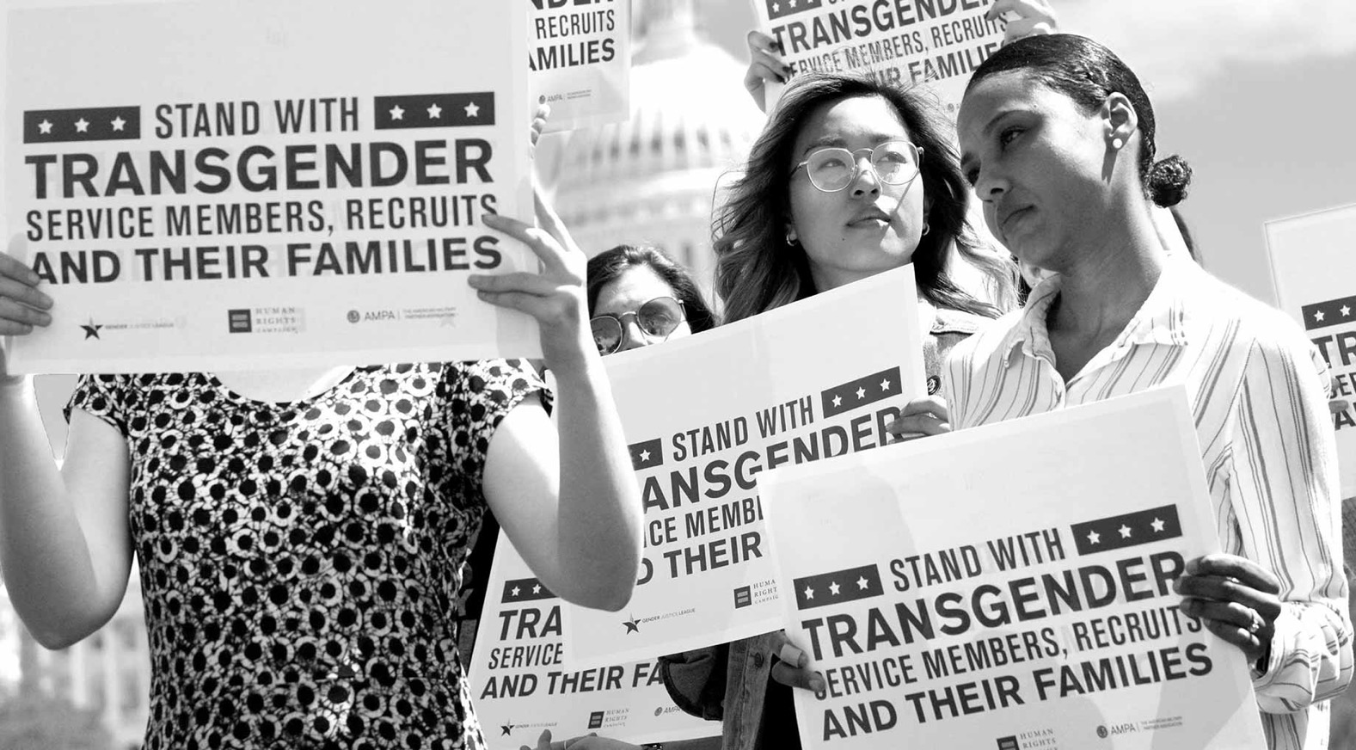
Transgender service

Slide 2
Trump’s transgender ban
July 26, 2017
https://valleycentral.com/news/local/rgv-residents-react-to-trumps-ban-on-transgender-individuals-in-the-military

Slide 3
Meaning what?
“transgender persons with a history or diagnosis of gender dysphoria — individuals who the policies state may require substantial medical treatment, including medications and surgery — are disqualified from military service except under certain limited circumstances.”
Presidential Memorandum
March 23, 2018
https://www.whitehouse.gov/presidential-actions/presidential-memorandum-secretary-defense-secretary-homeland-security-regarding-military-service-transgender-individuals/
DOD chart, March 2019
https://www.defense.gov/Explore/News/Article/Article/1783822/5-things-to-know-about-dods-new-policy-on-military-service-by-transgender-perso/

Slide 4
DOD policy with effect from April 2019
March 2019: The Department of Defense edited version of Trump's ban bars transgender troops and military recruits from transitioning, requires most individuals to serve in their birth gender, and says "a service member can be discharged based on a diagnosis of gender dysphoria.”
“Not a ban”– the DOD claims
The Palm Center argues otherwise https://www.palmcenter.org/military-policy-researchers-raise-alarms-as-transgender-troops-face-expulsion/

Slide 5
Some historical context
Approx. 134,000 US veterans are transgender, and over 15,000 trans people are serving in military today https://transequality.org/issues/military-veterans
Trans Americans twice as likely to serve
An attempt by men troubled about their gender identity to repress gender dysphoria by a “flight into hypermasculinity”?
And/or a search for more “gender neutral” terrain where FTM trans Americans find greater acceptance?
Trans people in the military since the Civil War
US veteran Christine Jorgensen the first person to undergo gender reassignment surgeries in Denmark (1950-52)
Christine Jorgensen 1943, 1952 and 1975
https://www.digitaltransgenderarchive.net/files/kd17cs888
https://www.nbcnews.com/feature/nbc-out/pride50-christine-jorgensen-world-s-first-trans-celebrity-n1006131

Slide 6
Pre-2016: towards a ban
Before 1960 there was no explicit ban on trans people serving
In 1960, Executive Order 10450 was applied to ban trans individuals from serving. Army Regulation 40-501 (1963) reaffirmed this policy
Under DOD Instruction 6130.03, “Medical Standards for Appointment, Enlistment, or Induction in the Military Services” (July 2, 2012) candidates for military service, shall not have “current or history of psychosexual conditions, including but not limited to transsexualism, exhibitionism, transvestism, voyeurism, and other paraphilias.”
The same standard also lists disqualifying physical conditions, including “abnormalities or defects of the genitalia including but not limited to change of sex, hermaphrodism, pseudohermaphrodism, or pure gonadal dysgenesis”
The prohibition against trans service included a physical component, barring “change of sex,” and a psychological one, barring “psychosexual conditions”

Slide 7
The DOD’s logic
1) transgender personnel were too prone to mental illness to serve
2) cross-sex hormone therapy was too risky for medical personnel to administer and monitor
3) gender confirming surgery was too complex and prone to postoperative complications
4) transgender personnel weren’t capable of deploying safely
NB: The American Psychiatric Association’s Diagnostic Manual DSM-IV (1994) listed “Gender Identity Disorder” (GID) as a mental illness
DSM-V (2013) has replaced GID with with “gender dysphoria”– a diagnostic term that refers to an incongruence between a person’s gender identity and their physical gender assigned at birth
While dysphoria may cause psychological distress, DSM-V considers it treatable and also acknowledges that not all transgender individuals suffer from dysphoria

Slide 8
Trans life “in camouflage”
NYT documentary (2015)
https://www.youtube.com/watch?v=zN7VSeja1dw
https://time.com/4874380/donald-trump-military-transgender-how-many/
Time magazine documentary (2017)
Further reading:
Adam Yerke and Valorie Mitchell, “Transgender People in the Military: Don’t Ask, Don’t Tell, Don’t Enlist!,” Journal of Homosexuality 60, 2-3 (2013): 436-57
James E. Parco et al, “Transgender Military Personnel in the Post-DADT Repeal Era: A Phenomenological Study,” Armed Forces & Society 41, 2 (2015): 221-42
M. Jocelyn Elders et al, “Medical Aspects of Transgender Military Service,” Armed Forces and Society 41, 2 (2015): 199-220

Slide 9
Issues
Medical issues: how to access appropriate medical care?
Pronouns: he/she/they
Salutations: (Sir; Ma’am)
Uniforms: M/F
Appearance/“grooming”: haircuts; facial hair; leg hair
Gender standards: fitness; training; BMI
Bathrooms/showers

Slide 10
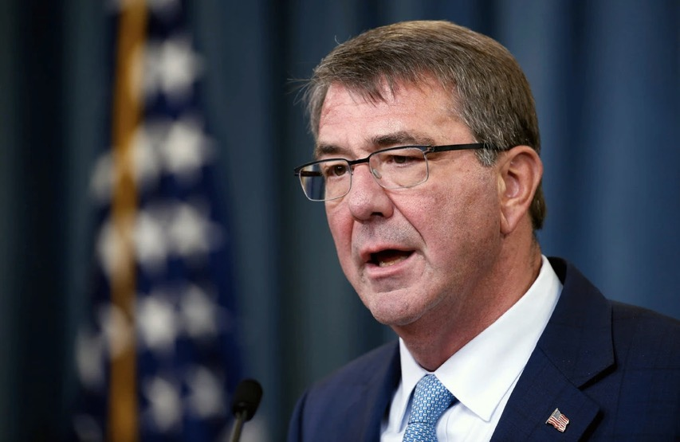
2016: An inclusive turn
2015: Defense Secretary Dr Ash Carter first publicly mooted that the Obama administration was looking to rescind the ban
June 2016: The DoD removed restrictions on trans recruits joining the military and authorized trans personnel to transition while in service
Trans individuals could henceforth serve openly
The military, it was argued, “must have access to 100 percent of America’s population for its all-volunteer force to be able to recruit from among the most highly qualified, and to retain them.”
Defense Secretary Ashton B. Carter announced new rules allowing transgender individuals to serve openly in the military.
Credit. Alex Brandon/Associated Press
https://www.nytimes.com/2016/07/01/us/transgender-military.html?module=inline

Slide 11
The 2016 RAND study
The RAND study estimated that only between 29-129 trans individuals serving in active duty would seek out medical treatment for gender transitions
“Using private health insurance claims data to estimate the cost of extending gender transition–related health care coverage to transgender personnel indicated that active-component health care costs would increase by between $2.4 million and $8.4 million annually, representing a 0.04- to 0.13-percent increase in active-component health care expenditures.”
The RAND study also examined experiences in other countries– including the UK-- in which trans people are allowed to serve openly in accordance with their preferred gender, concluding that inclusion had nowhere diminished unit cohesion or operational efficiency
Read the full report: https://www.rand.org/content/dam/rand/pubs/research_reports/RR1500/RR1530/RAND_RR1530.pdf

Slide 12
Shifting attitudes: civilian & military
Pre-2010: LGB activists campaigning for an end to DADT strategically omitted from their platform advocacy for trans personnel– fearful that this would alienate Americans
“In U.S., 71% Support Transgender People Serving in Military,” Gallup Poll, June 20, 2019
https://news.gallup.com/poll/258521/support-transgender-people-serving-military.aspx
Feb. 2020: a Pentagon study finds that two thirds of troops support allowing trans people to serve
https://www.militarytimes.com/news/your-military/2020/02/27/two-thirds-of-troops-support-allowing-transgender-service-members-in-the-military-pentagon-study-finds/
Further reading:
Morten G. Ender et al, “Cadet and Civilian Undergraduate Attitudes toward Transgender People: A Research Note,” Armed Forces & Society 42, 2 (2016): 427-35

Slide 13
Explaining Trump’s policy reversal
Caitlyn Jenner, lifelong Republican and trans advocate, admits she was wrong about Trump, whose candidacy she supported in 2016. Read her WaPo op-ed from Oct. 25, 2018:
https://www.washingtonpost.com/opinions/caitlyn-jenner-i-thought-trump-would-help-the-lgbtq-community-i-was-wrong/2018/10/25/3c4cd61e-d86a-11e8-83a2-d1c3da28d6b6_story.html
Trump on the presidential campaign trail (2016)

Slide 14
The politics of the ban
Trump justified his new exclusionary policy– which caught the DOD off-guard-- primarily with reference to the budgetary burden that trans personnel’s healthcare costs imposed on the DOD
Trump linked projected “savings” from a trans ban to his Wall building plans
He hoped to placate GOP defense hawks and conservatives trying to block trans service personnel from access to gender confirmation surgery paid for by the DOD
https://www.politico.com/story/2017/07/26/trump-transgender-military-ban-behind-the-scenes-240990
Physicians and psychiatrists working with trans personnel and veterans have uniformly disputed Republican claims about exorbitant healthcare costs
The RAND report’s estimate of approx $5m p/a represents less than a quarter of the $23m the military spends annually on acne medications, or 0.0001% of the military’s $49.3 billion annual healthcare budget

Slide 15
Resistance & legal challenges
Nov. 2017: the ACLU challenged Trump’s ban
Judge Colleen Kollar-Kotelly of the federal district
court of Washington, D.C. determined that “all of the reasons proffered by the President for excluding transgender individuals from the military in this case were not merely unsupported, but were actually contradicted by the studies, conclusions and judgment of the military itself.”
But in 2018 the Supreme Court upheld the ban.
For a timeline of legal challenges:
https://www.axios.com/everything-you-need-to-know-transgender-military-ban-473b2b94-7dcd-431a-b5cb-3bbc095877da.html
The American
Civil Liberties Union’s
camo trans pride
socks ($15)
https://www.aclu.org/blog/lgbt-rights/transgender-rights/our-fight-defeat-transgender-military-ban-enters-new-phase

Slide 16
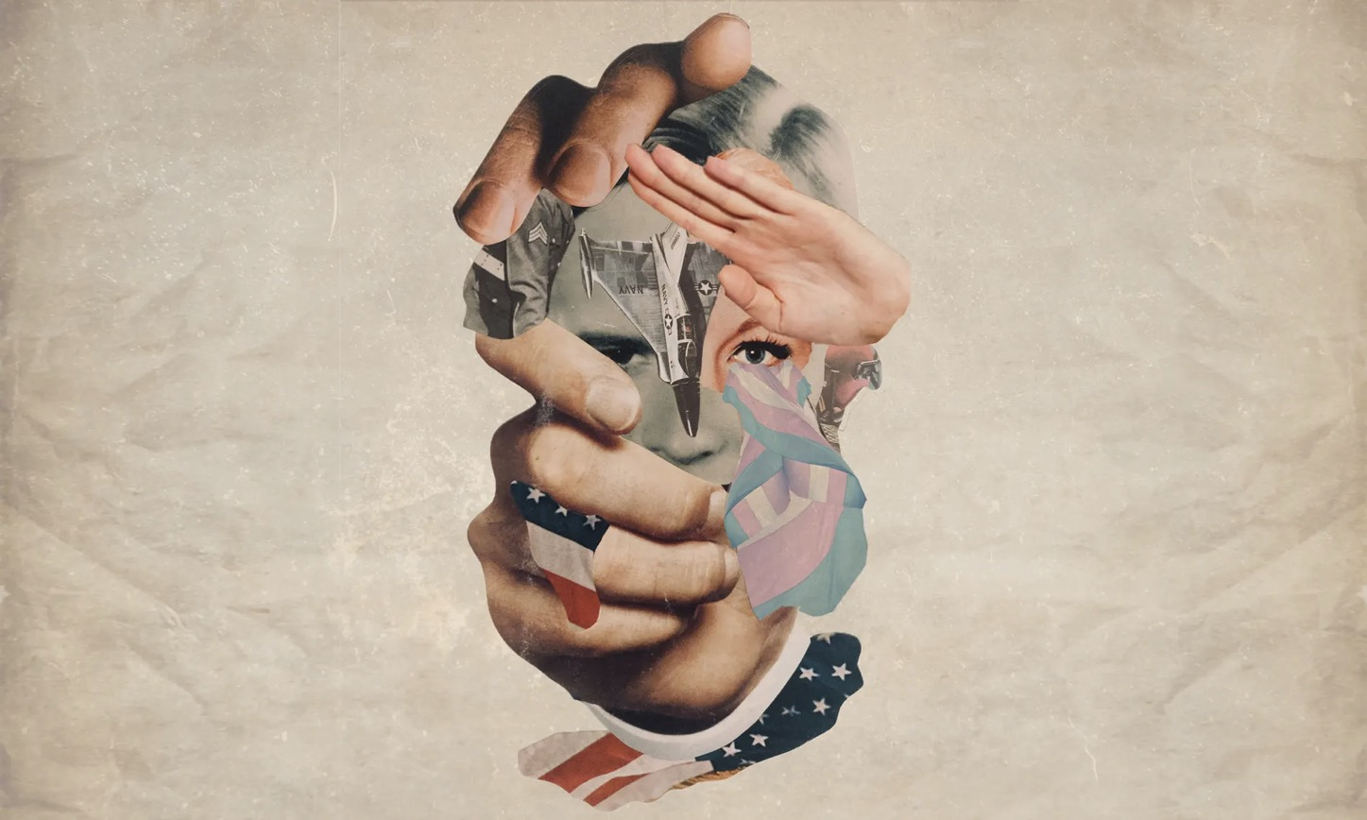
Finally…
If you’re keen to pursue these issues further and would like to devise a scenario addressing trans service as the basis of your policy paper assignment, please let me know
Thank you for taking the module!
Please come along on Friday for a final round-up discussion
https://www.theguardian.com/society/2019/jun/12/revealed-how-trumps-transgender-ban-has-forced-military-members-back-into-hiding

