Slide 1
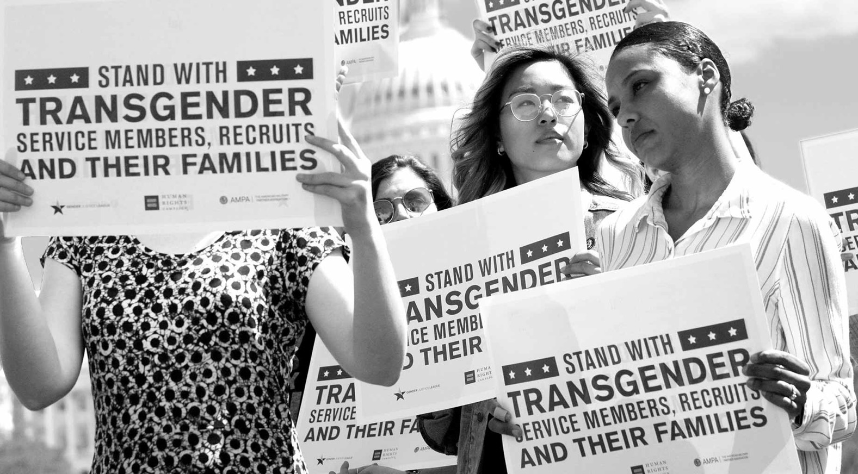
Transgender service: the last civil rights battle?
HI2C6 WEEK 10

Slide 2





A head-spinning series of reversals
Ban
1960 to 2016: ban
Open
2016-2017: open service [Obama]
Ban
Jan. 2017-2021: Trump’s first ban
Open
Ban
Jan. 2021-Jan. 2025: open service [Biden]
Jan. 2025 - present: Trump's second ban

Slide 3
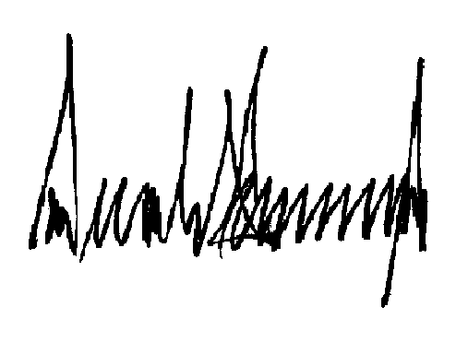
Trump’s second presidency
On 20 Jan. 2025, Trump signed an Executive Order, insisting on two biological sexes:
DEFENDING WOMEN FROM GENDER IDEOLOGY EXTREMISM AND RESTORING BIOLOGICAL
TRUTH TO THE FEDERAL GOVERNMENT
On 27 Jan. 2025, Trump signed EO 14183,
“Prioritizing Military Excellence and Readiness”
Section 1. Purpose. The United States military has a clear mission: to protect the American people and our homeland as the world’s most lethal and effective fighting force. Success in this existential mission requires a singular focus on developing the requisite warrior ethos, and the pursuit of military excellence cannot be diluted to accommodate political agendas or other ideologies harmful to unit cohesion.
Consistent with the military mission and longstanding DoD policy, expressing a false “gender identity” divergent from an individual’s sex cannot satisfy the rigorous standards necessary for military service. Beyond the hormonal and surgical medical interventions involved, adoption of a gender identity inconsistent with an individual’s sex conflicts with a soldier’s commitment to an honorable, truthful, and disciplined lifestyle, even in one’s personal life. A man’s assertion that he is a woman, and his requirement that others honor this falsehood, is not consistent with the humility and selflessness required of
Recently, however, the Armed Forces have been afflicted with radical gender ideology to appease activists unconcerned with the requirements of military service like physical and mental health, selflessness, and unit cohesion.

Slide 4
‘Consistent with the military mission and longstanding DoD policy, expressing a false “gender identity” divergent from an individual’s sex cannot satisfy the rigorous standards necessary for military service. Beyond the hormonal and surgical medical interventions involved, adoption of a gender identity inconsistent with an individual’s sex conflicts with a soldier’s commitment to an honorable, truthful, and disciplined lifestyle, even in one’s personal life. A man’s assertion that he is a woman, and his requirement that others honor this falsehood, is not consistent with the humility and selflessness required of a service member.
For the sake of our Nation and the patriotic Americans who volunteer to serve it, military service must be reserved for those mentally and physically fit for duty. The Armed Forces must adhere to high mental and physical health standards to ensure our military can deploy, fight, and win, including in austere conditions and without the benefit of routine medical treatment or special provisions.
Sec. 2. Policy. It is the policy of the United States Government to establish high standards for troop readiness, lethality, cohesion, honesty, humility, uniformity, and integrity. This policy is inconsistent with the medical, surgical, and mental health constraints on individuals with gender dysphoria. This policy is also inconsistent with shifting pronoun usage or use of pronouns that inaccurately reflect an individual’s sex.’
SERVICE PERSONNEL WITH GENDER DYSPHORIA DIAGNOSES COULD EITHER LEAVE VOLUNTARILY OR FACE DISCHARGE WITHOUT SEPARARATION BENEFITS. https://edition.cnn.com/2025/06/06/us/transgender-military-ban-separation-deadline

Slide 5
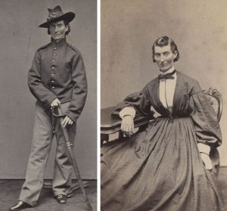
Some counter context
Approx. 134,000 US veterans are transgender, and in the Biden era an est. 10,000-15,000 trans men and women served in the military
Trans Americans are twice as likely to serve as cisgender citizens. 1 in 5 transgender Americans is an active-duty service member or a veteran
https://transequality.org/issues/military-veterans
Frances
Clalin
Clayton
aka
Jack
Williams
fought in
the US
Civil War
US veteran Christine Jorgensen was the first American to undergo gender confirmation surgeries in Denmark (1950-52)
Christine Jorgensen 1943, 1952 and 1975
https://www.digitaltransgenderarchive.net/files/kd17cs888

Slide 6
1960-2016
Before 1960 there was no explicit ban on trans people serving
In 1960, Executive Order 10450 was applied to ban trans individuals from serving. Army Regulation 40-501 (1963) reaffirmed this policy
Under DOD Instruction 6130.03, “Medical Standards for Appointment, Enlistment, or Induction in the Military Services” (July 2, 2012) candidates for military service, shall not have:
“current or history of psychosexual conditions, including but not limited to transsexualism, exhibitionism, transvestism, voyeurism, and other paraphilias.”
The same standard also listed disqualifying physical conditions, including “abnormalities or defects of the genitalia including but not limited to change of sex, hermaphrodism, pseudohermaphrodism, or pure gonadal dysgenesis”
The prohibition against trans service included a physical component, barring “change of sex,” and a psychological one, barring “psychosexual conditions”

Slide 7
DOD policy and APA diagnoses
1) transgender personnel were too prone to mental illness to serve
2) cross-sex hormone therapy was too risky for medical personnel to administer and monitor
3) gender confirming surgery was too complex and prone to postoperative complications
4) transgender personnel couldn’t deploy safely
NB: The American Psychiatric Association’s Diagnostic Manual DSM-IV (1994) listed “Gender Identity Disorder” (GID) as a mental illness
DSM-V (2013) replaced GID with with “gender dysphoria”– a diagnostic term that refers to an incongruence between a person’s gender identity and their physical sex assigned at birth
While dysphoria may cause psychological distress, DSM-V considers it treatable and also acknowledges that not all transgender individuals suffer from dysphoria

Slide 8
Trans life “in camouflage”
NYT documentary (2015)
https://www.youtube.com/watch?v=zN7VSeja1dw
https://time.com/4874380/donald-trump-military-transgender-how-many/
Time magazine documentary (2017)

Slide 9
Bills and binaries
Medical/healthcare issues: how to access?
Who pays?
An institution committed to gender binaries
Pronouns: he/she
Salutations: (Sir; Ma’am)
Uniforms: M/F
Appearance/“grooming”: haircuts; facial hair; leg hair
Gender standards: fitness; training; BMI
Bathrooms/showers

Slide 10
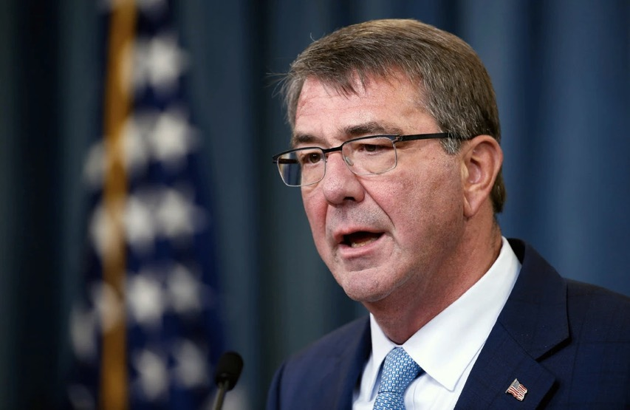
2016: An inclusive turn under Obama
2015: Defense Secretary Dr Ash Carter first publicly mooted that the Obama administration was looking to rescind the ban
June 2016: The DoD removed restrictions on trans recruits joining the military and authorized trans personnel to transition while in service
Trans men & women could henceforth serve openly
The military “must have access to 100 percent of America’s population for its all-volunteer force to be able to recruit from among the most highly qualified, and to retain them.”
Defense Secretary Ashton B. Carter announced new rules allowing transgender men and women to serve openly in the military.
Credit. Alex Brandon/Associated Press
https://www.nytimes.com/2016/07/01/us/transgender-military.html?module=inline

Slide 11
The 2016 RAND study
The RAND study estimated that only between 29-129 trans individuals serving in active duty would seek medical treatment for gender transitions
“Using private health insurance claims data to estimate the cost of extending gender transition–related health care coverage to transgender personnel indicated that active-component health care costs would increase by between $2.4 million and $8.4 million annually, representing a 0.04- to 0.13-percent increase in active-component health care expenditures.”
The RAND study also examined experiences in other countries– including the UK-- in which trans people are allowed to serve openly in accordance with their preferred gender, concluding that inclusion had nowhere diminished unit cohesion or operational efficiency
Read the full report: https://www.rand.org/content/dam/rand/pubs/research_reports/RR1500/RR1530/RAND_RR1530.pdf

Slide 12
LGBT for Trump!
Trump on the presidential campaign trail (2016)
Caitlyn Jenner, lifelong Republican and trans advocate, admits she was wrong about Trump, whose candidacy she supported in 2016.
Read her Washington Post op-ed from Oct. 25, 2018:
https://www.washingtonpost.com/opinions/caitlyn-jenner-i-thought-trump-would-help-the-lgbtq-community-i-was-wrong/2018/10/25/3c4cd61e-d86a-11e8-83a2-d1c3da28d6b6_story.html

Slide 13
Trump’s transgender ban
July 26,
2017
https://valleycentral.com/news/local/rgv-residents-react-to-trumps-ban-on-transgender-individuals-in-the-military
“… victory and cannot be burdened with the tremendous medical costs
and disruption that transgender in the military would entail. Thank you.”

Slide 14
Trump’s ban
“transgender persons with a history or diagnosis of gender dysphoria — individuals who the policies state may require substantial medical treatment, including medications and surgery — are disqualified from military service except under certain limited circumstances.”
Presidential Memorandum
March 23, 2018
https://www.whitehouse.gov/presidential-actions/presidential-memorandum-secretary-defense-secretary-homeland-security-regarding-military-service-transgender-individuals/
DOD chart, March 2019
https://www.defense.gov/Explore/News/Article/Article/1783822/5-things-to-know-about-dods-new-policy-on-military-service-by-transgender-perso/

Slide 15
DOD policy from April 2019 to 2021
March 2019: The Department of Defense edited version of Trump's ban bars transgender troops and military recruits from transitioning, requires most individuals to serve in their birth gender, and says "a service member can be discharged based on a diagnosis of gender dysphoria.”
“Not a ban”– the DOD claims
The Palm Center argues otherwise https://www.palmcenter.org/military-policy-researchers-raise-alarms-as-transgender-troops-face-expulsion/

Slide 16
The politics of the ban
Trump justified his new exclusionary policy– which caught the DOD off-guard-- primarily with reference to the budgetary burden that trans personnel’s healthcare costs imposed on the DOD
Trump linked projected “savings” from a trans ban to his border “Wall”-building plans
He aimed to placate GOP defense hawks and conservatives trying to block trans service personnel from access to gender confirmation surgery paid for by the DOD
https://www.politico.com/story/2017/07/26/trump-transgender-military-ban-behind-the-scenes-240990
Physicians and psychiatrists working with trans personnel and veterans have uniformly disputed Republican claims about exorbitant healthcare costs
The RAND report’s estimate of approx. $5m p/a represents less than a quarter of the $23m the military spends annually on acne medications, or 0.0001% of the military’s $49.3 billion annual healthcare budget
https://www.theguardian.com/society/2019/jun/12/revealed-how-trumps-transgender-ban-has-forced-military-members-back-into-hiding

Slide 17
Resistance & legal challenges
Nov. 2017: the ACLU challenged Trump’s ban
Judge Colleen Kollar-Kotelly of the federal district
court of Washington, D.C. determined that:
“all of the reasons proffered by the President for excluding transgender individuals from the military in this case were not merely unsupported, but were actually contradicted by the studies, conclusions and judgment of the military itself.”
But in 2018 the Supreme Court upheld the ban.
For a timeline of legal challenges:
https://www.axios.com/everything-you-need-to-know-transgender-military-ban-473b2b94-7dcd-431a-b5cb-3bbc095877da.html
For more on SPARTA, a military trans advocacy group: https://spartapride.org
The American
Civil Liberties Union’s
camo trans pride
socks ($15)
https://www.aclu.org/blog/lgbt-rights/transgender-rights/our-fight-defeat-transgender-military-ban-enters-new-phase

Slide 18
Shifting attitudes: civilian & military
Pre-2010: LGB activists campaigning for an end to DADT strategically omitted from their platform advocacy for trans personnel– fearful this would alienate Americans
“In U.S., 71% Support Transgender People Serving in Military,” Gallup Poll, June 20, 2019
https://news.gallup.com/poll/258521/support-transgender-people-serving-military.aspx
Feb. 2020: a Pentagon study finds that two thirds of troops support allowing trans people to serve
https://www.militarytimes.com/news/your-military/2020/02/27/two-thirds-of-troops-support-allowing-transgender-service-members-in-the-military-pentagon-study-finds/

Slide 19
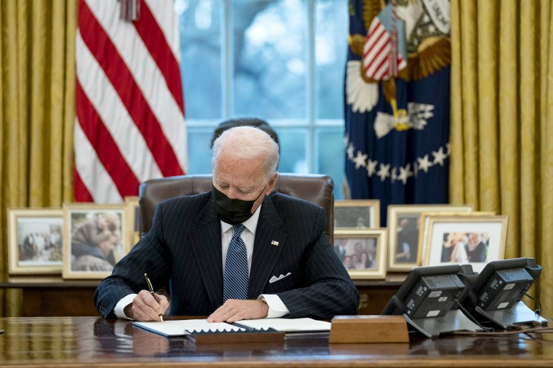
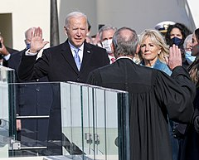
Joe Biden inaugurated as
46th US President, Jan. 20, 2021
President Joe Biden signs an executive order in the Oval Office of the White House on Jan. 25, 2021 reversing the Trump-era ban on transgender people serving in military.
Photo credit: Evan Vucci / AP

Slide 20
Biden reverses course
“By the authority vested in me as President by the Constitution and the laws of the United States of America, it is hereby ordered as follows:
Section 1. Policy. All Americans who are qualified to serve in the Armed Forces of the United States (“Armed Forces”) should be able to serve. The All-Volunteer Force thrives when it is composed of diverse Americans who can meet the rigorous standards for military service, and an inclusive military strengthens our national security.
It is my conviction as Commander in Chief of the Armed Forces that gender identity should not be a bar to military service. Moreover, there is substantial evidence that allowing transgender individuals to serve in the military does not have any meaningful negative impact on the Armed Forces. To that end, in 2016, a meticulous, comprehensive study requested by the Department of Defense found that enabling transgender individuals to serve openly in the United States military would have only a minimal impact on military readiness and healthcare costs. The study also concluded that open transgender service has had no significant impact on operational effectiveness or unit cohesion in foreign militaries.”
The White House, Jan. 25, 2021. Read the statement in full:
https://www.whitehouse.gov/briefing-room/presidential-actions/2021/01/25/executive-order-on-enabling-all-qualified-americans-to-serve-their-country-in-uniform/

Slide 21
As of March 2021
The Defense Department’s new policy permitted troops to serve openly under their self-identified gender and offered access to medical treatments for gender transition
The move restored Pentagon policy on transgender troops to where it stood before Donald Trump entered office in 2017
The announcement followed a two-month review by the Pentagon to develop detailed guidelines for the military after Biden issued an executive overturning Trump’s policy.
Defense Secretary Lloyd Austin also ordered the department to review the records of troops who were discharged or denied the chance to re-enlist because of gender identity issues under the previous policy. It’s unclear how many service members were forced out due to the Trump-era ban.
https://www.nbcnews.com/news/military/biden-admin-scraps-trump-s-restrictions-transgender-troops-n1262646

Slide 22

A changing political landscape:
Transgender issues as “ground zero” of the culture wars
https://penntoday.upenn.edu/news/game-pieces-culture-wars
https://theconversation.com/trans-rights-and-political-backlash-five-key-moments-in-history-187476
While the American Academy of Pediatrics supports a gender-affirmative care model, proposed bills like Texas Senate Bill 1646 sought to criminalize caregivers for providing minors with medical access. (Image: Ted Eytan)

Slide 23
Further resources
Advocates for Trans Equality (A4TE), Understanding Trump’s Trans Military Ban
https://transequality.org/resources/understanding-trumps-trans-military-ban
Transgender American Veterans Association
https://www.transveteran.org
Sparta Pride
https://spartapride.org
PBS Newshour on trans service members fighting the ban in the US Supreme Court [they lost]:
https://www.youtube.com/watch?v=jSnq-MSV7fY

