Slide 1
The US military and the commercial sex industry
HI2C6 Term 1, week 2
NB: This lecture deals with disturbing content, including sexual violence

Slide 2
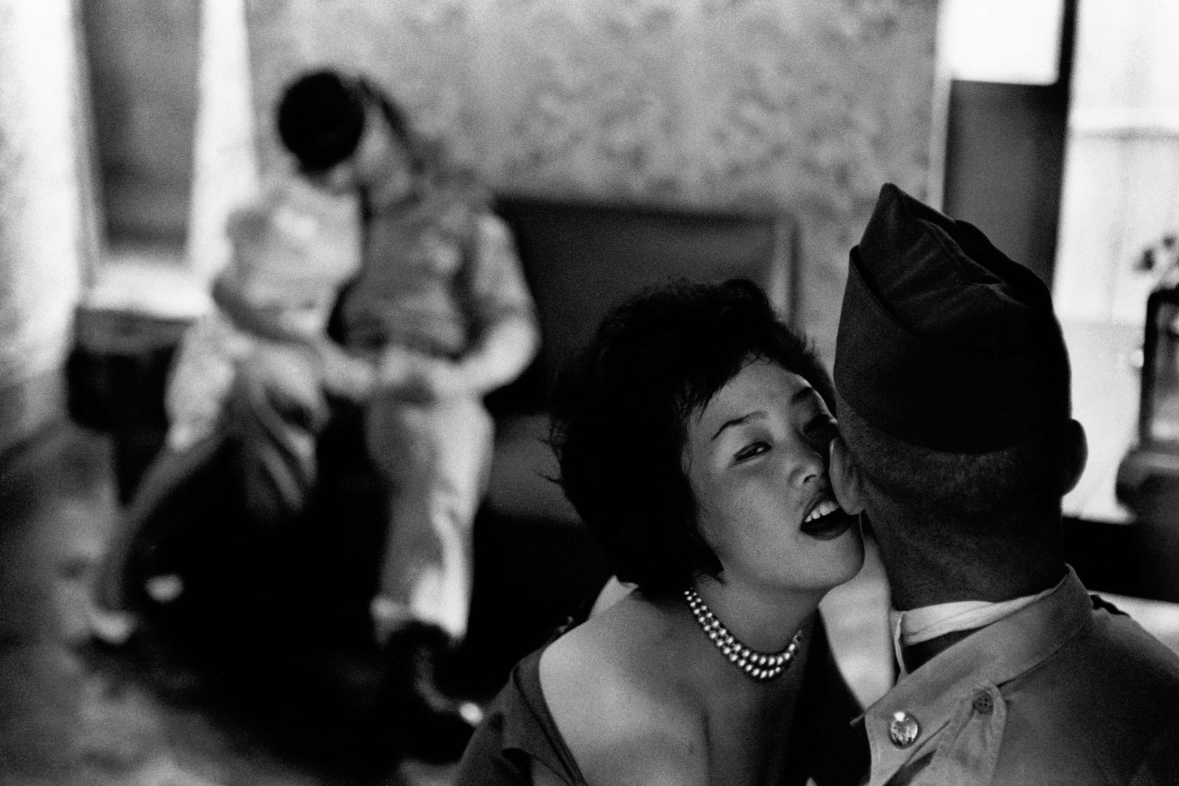
An entangled history
PARADOX: The US military prohibits personnel from engaging in commercial sex
the UCMJ (1951) prohibits ”pandering” and “consorting with notorious prostitutes”
From 2004, the military attempted to crack down on “human trafficking” and “sex trafficking” https://www.defense.gov/News/News-Stories/Article/Article/2909695/dod-is-making-significant-strides-in-combating-human-trafficking-official-says/#:~:text=Since%20that%20time%2C%20DOD%20has,ago%20in%20Korea%2C%20Dixon%20noted.
and yet…
https://newrepublic.com/article/155707/united-states-military-prostitution-south-korea-monkey-house

Slide 3
Lecture overview
The pre-history of postwar military sex work
Why has the US military tacitly (or more actively) sanctioned commercial sex work?
What complicates the business of ‘managing sex’?
Introducing Okinawa

Slide 4
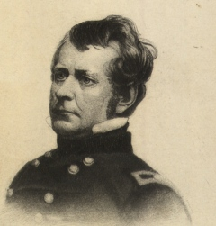
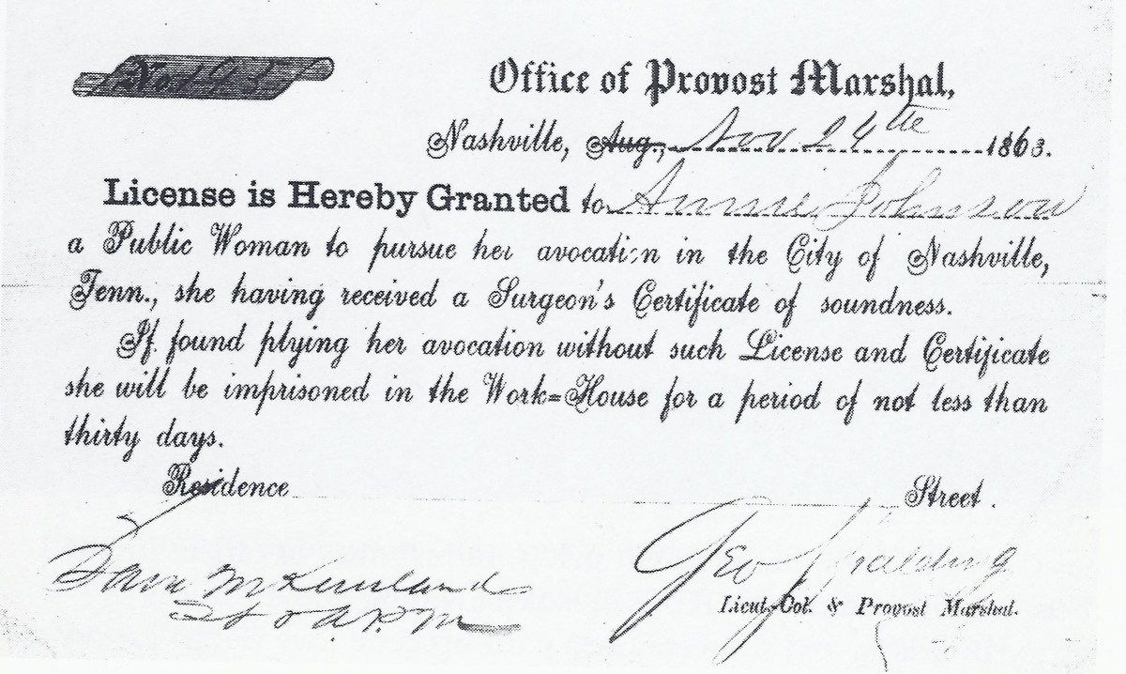
The US Civil War (1861-65)
Maj. Gen. Joseph "Fighting Joe" Hooker made a term for prostitutes more popular.
COURTESY OF THE ARMY HERITAGE AND EDUCATION CENTER
https://www.stripes.com/blogs-archive/the-rumor-doctor/the-rumor-doctor-1.104348/do-hookers-owe-their-moniker-to-a-civil-war-general-1.142179#.Xhrp_-tb9E4
A license to protect sex workers, signed by George Spalding circa 1863. Courtesy of the National Archives.
https://www.history.com/news/civil-war-prostitution-nashville
Watch a short PBS video about prostitution during the US Civil War:
https://www.pbs.org/video/the-dig-civil-war-prostitution-9y8b5c/

Slide 5
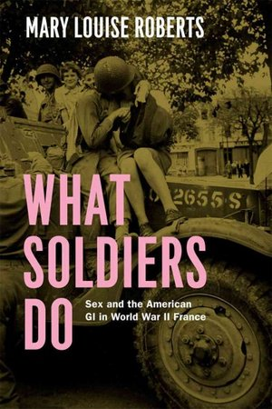
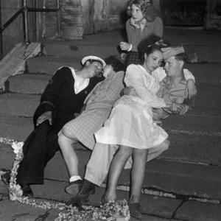
World War II and its aftermath
“Newly released documents show that French complained in droves about American servicemen having sex in the streets.”
Charbonnier/Gamma-Rapho/Getty Images
“one Army report… estimated 80 percent of single men and 50 percent of married [American] men would have sex during their stay in Europe.”
Mary Louise Roberts
https://www.npr.org/2013/05/31/187350487/sex-overseas-what-soldiers-do-complicates-wwii-history
https://nypost.com/2013/06/16/the-dark-side-of-d-day/

Slide 6
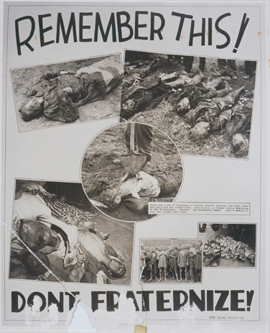
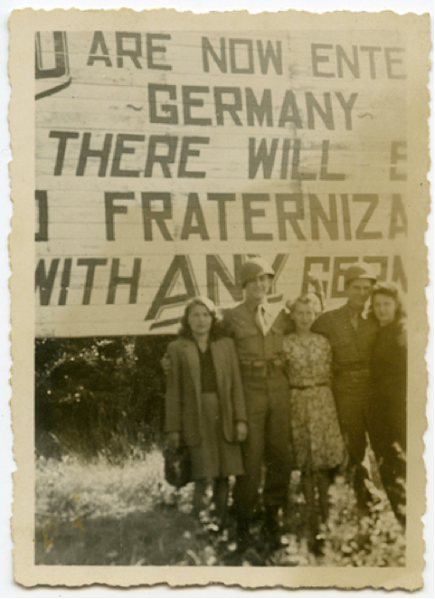
“Non-fraternization”
Left: A 1945 US army
poster warns GIs not
to “fraternize,” using
images from newly
liberated Nazi camps
to underscore the point.
Credit: US Holocaust
Memorial Museum
Right: photo from an
GI’s scrapbook.
caption reads:
“Two buddies. Three girls.
Not bad.”
Credit: unknown

Slide 7
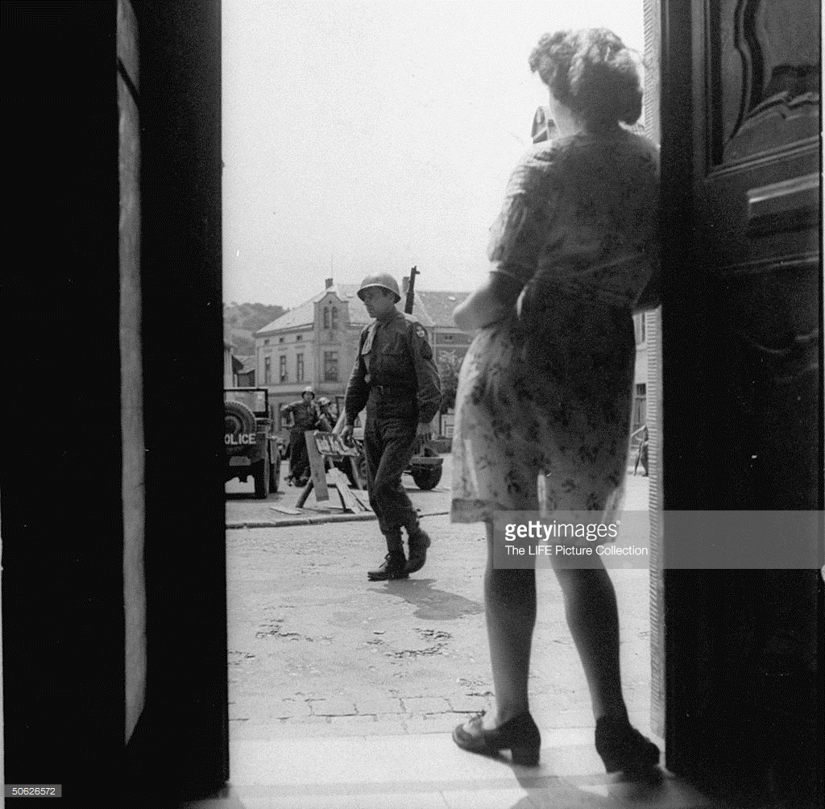
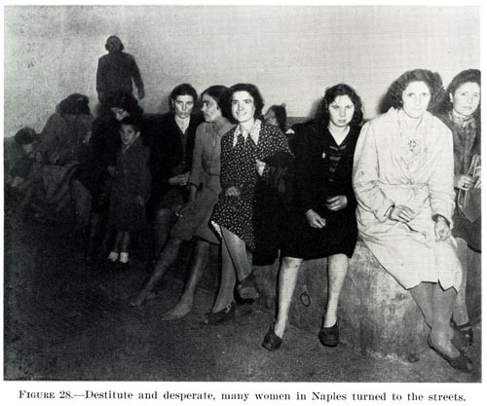
Italy and Germany
“Fraternization”– any social interaction with
German civilians-- which the military attempted
to ban in Germany in the spring/summer of
1945 became a major story in the US press.
The “F-” word became a euphemism.
Italy 1944 – Office of Medical History, U.S. Army Medical Department
https://bethelatwar.org/2014/08/14/letters-to-and-from-bethel-the-crash-of-ruin/

Slide 8
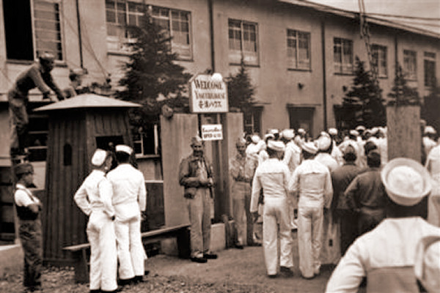
Postwar Japan
With Japanese government
backing, “Recreation and
Amusement Associations” (RAA)
provided brothels for US
occupation troops in the early
months of Japan’s postwar
occupation.
The US Eighth Army initially
gave tacit consent to this
arrangement.
“In this undated image released by the Yokosuka City Council in Japan, U.S. sailors gather in front of a
Yasu-ura House "comfort station" in Yokosuka, south
of Tokyo.”(AP Photo/Yokosuka City Council, HO)
http://navy.memorieshop.com/World-Ports/Japan/Comfort-Women.html

Slide 9
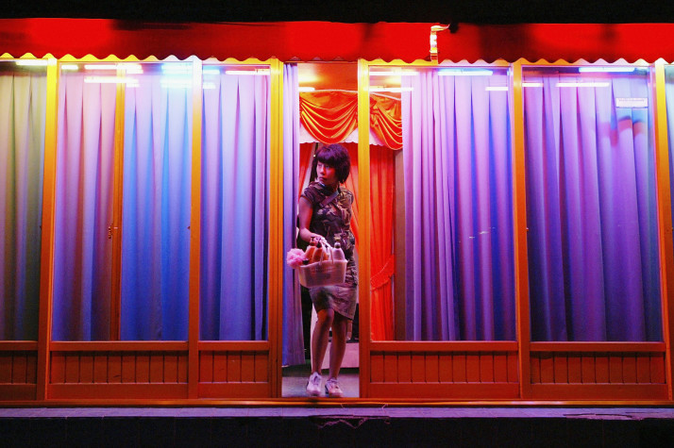
South Korea: 1945 -
A South Korean sex worker leaves her shop in Seoul. [Getty]
https://www.politico.eu/article/my-body-was-not-mine-but-the-u-s-militarys/
Right: Soldier posing with two women at a Korean brothel (1952)
https://cdm15730.contentdm.oclc.org/digital/collection/p15730coll5/id/1550

Slide 10
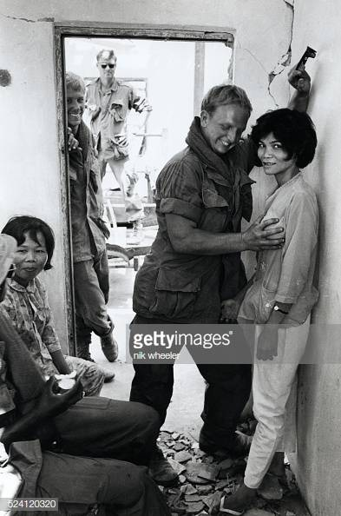
The Vietnam War: R&R
“Troops in Vietnam got to take a few days off from the war during their one-year tour of duty. They were allowed a week of R&R, rest and recuperation, outside of Vietnam. They could choose from a list of approved destinations that included Hawaii, Australia, Japan, Taiwan, the Philippines, Malaysia, Hong Kong, Singapore and Thailand. They were also eligible for shorter breaks, usually three days, inside Vietnam.”
https://www.historynet.com/rr-on-the-beaches-of-south-vietnam-2.htm
“American soldiers play with Vietnamese prostitutes in ruins of bombed village during an operation outside Saigon during the Vietnam War in South Vietnam in the late 1960s.”

Slide 11
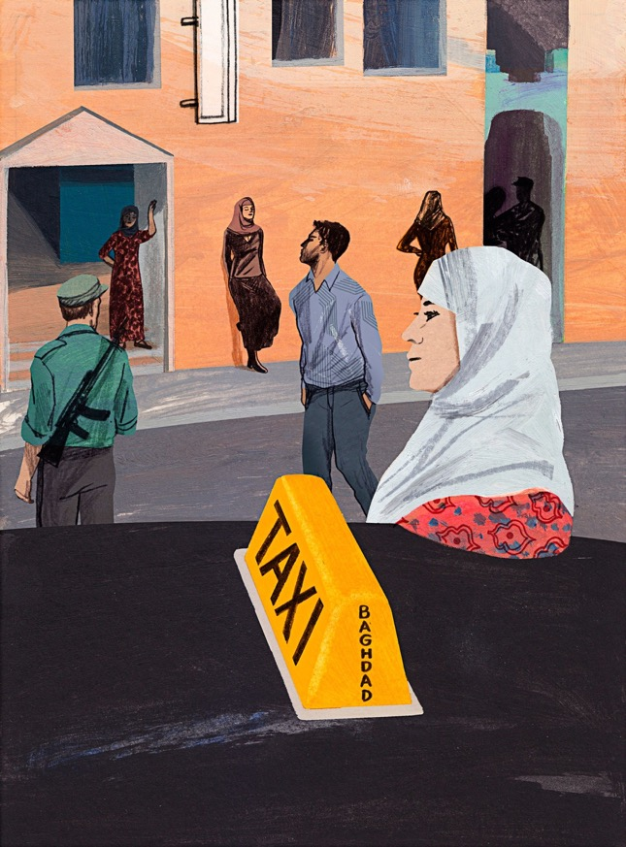
An ongoing issue
“Military Fraud: Alcohol, Hookers Sent
to Iraq War Base Via U.S. Contractor,
Report Claims”
By Greg Price On 5/3/17 at 1:53 PM EDT Newsweek
“U.S.-based security firm Sallyport Global has been accused by two former internal investigators of smuggling alcohol, stealing, keeping two different account ledgers and even human trafficking of prostitutes while executing an almost $700 million contract to protect Balad Air Base in Iraq, the Associated Press reported Wednesday.”
For an investigation of the sex trade and sex trafficking in Iraq in the New Yorker, https://www.newyorker.com/magazine/2015/10/05/out-of-sight-letter-from-baghdad-rania-abouzeid?verso=true

Slide 12




Why has the military tacitly (or more actively) condoned servicemen’s purchase of sex?

Slide 13
The alternative: abstinence campaigns
The US military has made periodic attempts to promote sexual abstinence/chastity
Sometimes the impetus came from civilian society to “clean up” military bases and the areas around them in the domestic US; e.g. the “May Act” of 1941
“Character Guidance” programs in the armed forces have also promoted messages stressing the importance of abstinence; e.g. the Duty, Honor, Country pamphlets first issued in 1952 by the Army and Air Force
Preserving the military’s ”moral character”
Shifting social attitudes towards sex
Role of religious precepts– particularly Christianity

Slide 14
“Masturbation is
unhealthy because it
can train a person to‘fly solo’…”
New York Times
Oct. 30, 2005

Slide 15
Male heterosexual prerogative— or imperative?
"A soldier who won't f**k won't fight.”
Statement attributed to Gen. George S Patton(World War II)
The perceived nexus between esprit and libido
Red-blooded “virility” and combat motivation
Sexual gratification a necessary boon to morale
Sex as a reward for soldiering

Slide 16

Military sex ed as infection-prevention
Brothels as more easily regulated sites of sexual encounter
In WWII, the US military pioneered the use of penicillin in treating STIs, as well as establishing “Pro-Stations” [Pro for Prophylaxis].
The emphasis was primarily on preserving men’s health and hence their operational efficiency.
The military was not so concerned with the wellbeing of the women GIs slept with; nor with preventing unplanned pregnancies.
https://www.theatlantic.com/magazine/archive/2015/04/very-short-book-excerpt-prophylaxis-vs-the-axis/386258/

Slide 17
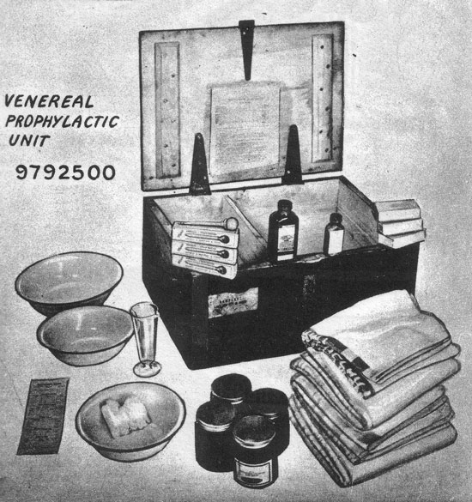
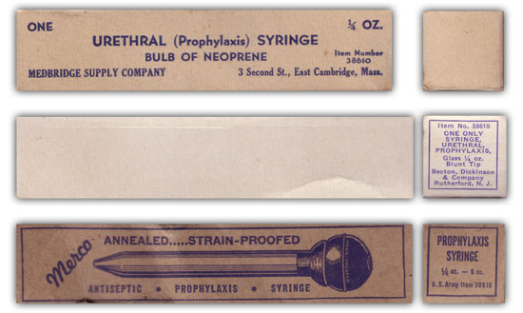
Illustration showing three variations of Prophylaxis (or Urethral) Syringes in use by the US Army during WW2.
Read more on WWII military sex education:
https://www.med-dept.com/articles/venereal-disease-and-treatment-during-ww2/

Slide 18
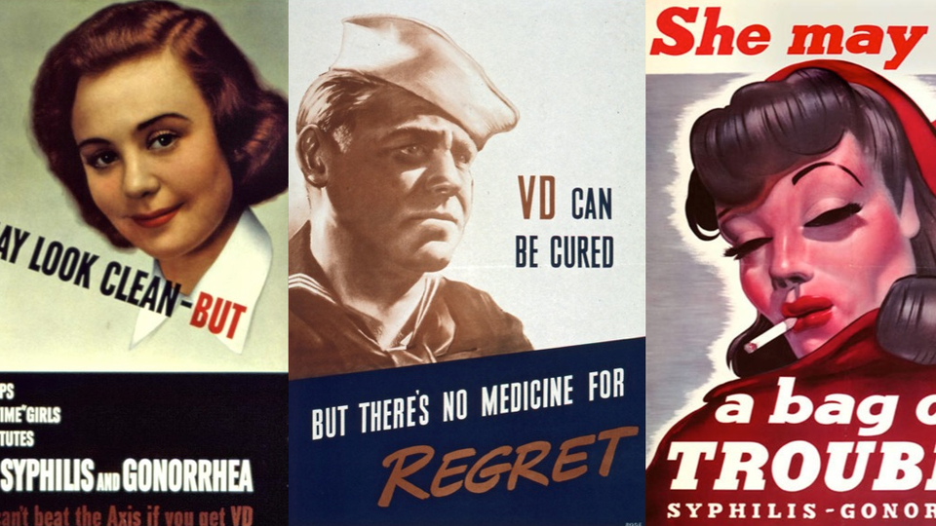

Slide 19
“Containment”
Prostitution perceived by the military as an outlet for male sexual desire likely to reduce (if not eliminate altogether) rape and sexual violence perpetrated by US personnel– the “floodwall” or “buffer” thesis
Regulated commercial sex work would (military authorities imagined) clarify the distinction between “good girls” and “bad,” turning the latter into an expendable underclass
Restricting sex to licensed and controlled “entertainment districts” would supposedly help insulate “respectable” local communities from the problems associated with GI “misbehaviour”– including male retaliatory violence directed by local men towards US soldiers
The US military could police individual establishments and neighbourhoods, and in so doing MPs [Military Police] could also reinforce racialized boundaries between where black and white soldiers “socialized” off-duty
The significance of race more generally to arrangements for overseas troops’ “entertainment”.

Slide 20
Complications

Slide 21
The fallacy of the “buffer” thesis
Rape has been a persistent occurrence in areas with high concentrations of military personnel
The availability of easily purchased sexual services has not eliminated rape
Arguably, the pervasive eroticization of women, particularly in Asia, has encouraged sexual violence (the “anti-prostitution” feminist argument)
Rape better understood as a crime of violence than of frustrated erotic desire
The “buffer theory” also posits some women (sex workers) as essentially “unrapeable”
Military willingness to take violent crime seriously has wavered

Slide 22
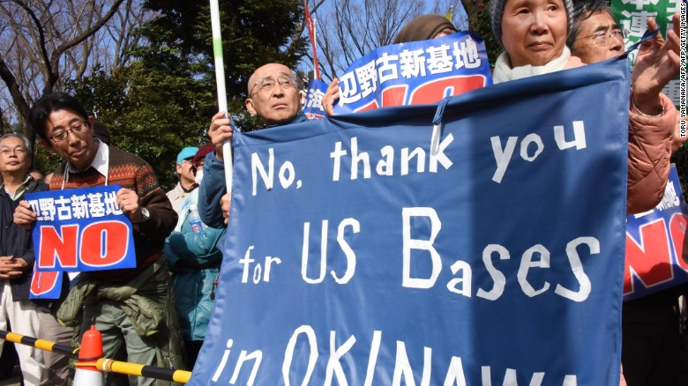
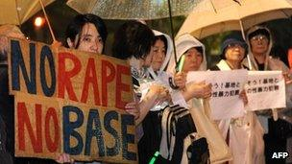
US-host nation tensions
Note also anger often directed by local
populations towards their own governments
for authorizing the US military presence
Demonstrators protest the construction of a U.S. Marine air base in the remote Henoko part of Okinawa island, to replace the existing Futenma facility, in front of the National Diet in Tokyo on February 21, 2016. https://edition.cnn.com/2016/03/17/asia/okinawa-us-serviceman-rape-restrictions/index.html
Protestors register their anger in Okinawa
after a rape perpetrated by 2 US servicemen
in 2012. An earlier gang-rape in 1995 (the
subject of one of this week’s readings)
galvanized protests across Japan.
https://www.bbc.co.uk/news/world-asia-21583785

Slide 23

Bi-national children: abandonment/adoption
“Cooke-Sampson, a radiologist at Howard University Hospital, 63, is working with a California-based organization called Me & Korea that has launched a new effort looking to help reunite Korean War babies with their American G.I. fathers. Tens of thousands of mixed-race Korean babies were sent to the U.S. for adoption after the war, though it is not clear how many of them had American fathers. Mixed-race babies were ostracized in Korea and faced a range of hardships in their homeland.”
https://eu.usatoday.com/story/news/nation/2015/07/26/korean-war-orphans/30630161/
Estelle Cooke-Sampson, a radiologist at Howard University Hospital, was a Korean War orphan and is now seeking her birth parents.
Erin Raftery, USA TODAY

Slide 24


Introducing Okinawa
HOLIDAY PARADISE OR “Base Island”?

Slide 25
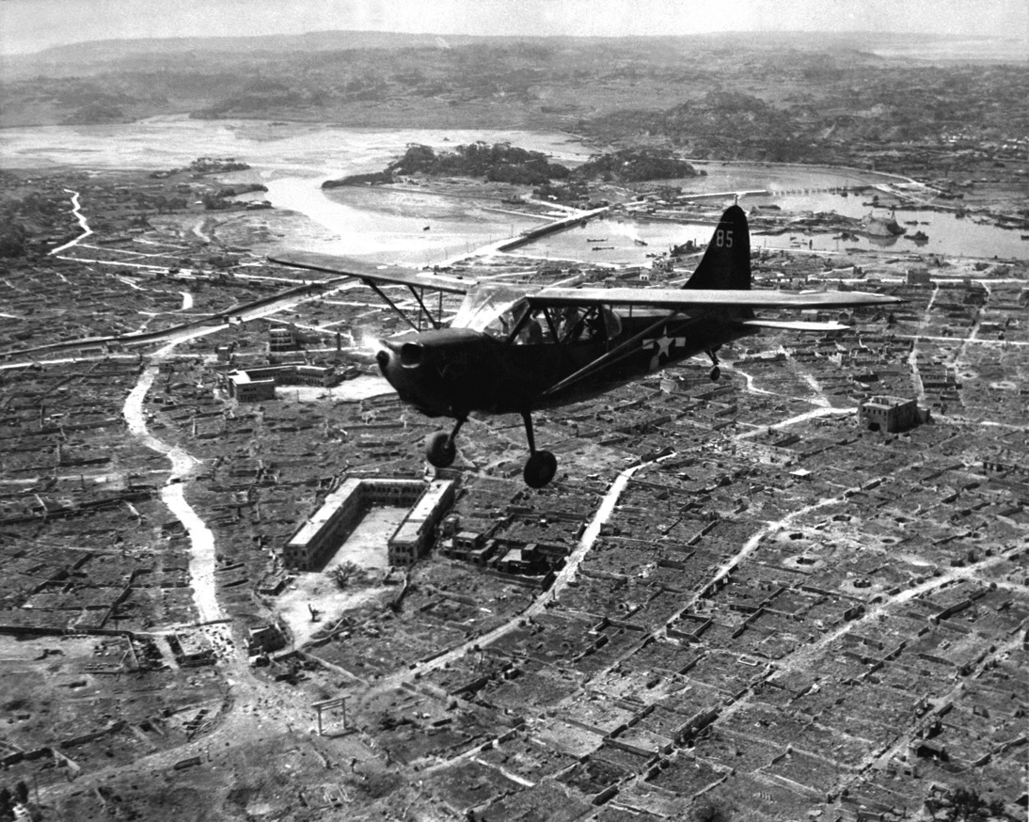
The battle of Okinawa (April-June 1945)
The battle was one of the bloodiest in the Pacific, with approximately 160,000 casualties on both sides: at least 75,000 Allied and 84,166–117,000 Japanese,
including Okinawans impressed into
uniform, died.
149,425 Okinawans were killed, committed suicide or went missing--
a significant proportion of the pre-war local population, estimated at
300,000.
A U.S. Marine Corps Stinson OY-1 Sentinel observation plane flies low over Naha, capital of Okinawa, ca. May 1945. ARC Identifier: 532379; NARA file no. 127-GR-106-121116; U.S. www.defenseimagery.mil photo no. HD-SN-99-02994.

Slide 26
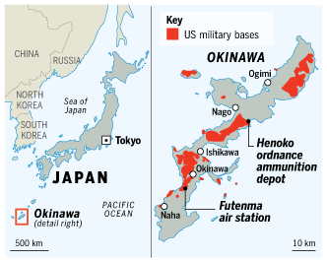
An intensely militarized island
Okinawa Prefecture as a whole accounts for just 0.6% of Japan’s total land area, but is home to 75% of the territory occupied by US military bases in Japan.
Nearly 230 sq km – 10% of Okinawan land – is under US control.
Almost one fifth of the main island is off-limits to ordinary residents.
https://www.ft.com/content/a0b360b8-ce1b-11de-a1ea-00144feabdc0

Slide 27
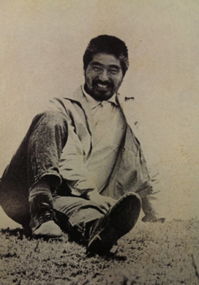
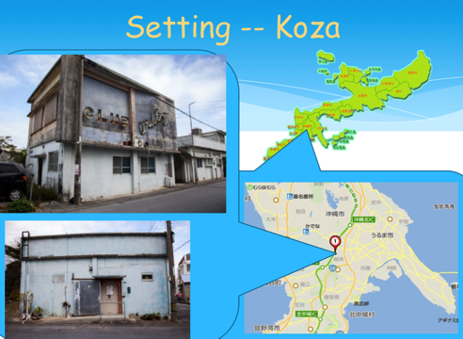
Higashi Mineo, Child of Okinawa (1971)
(b. 1938)
http://takumasminkey.com/readingokinawa/styled-14/

