Slide 1
Domestication
A “family friendly” military?

Slide 2
The martial/marital muddle
“If the army wanted you to have a wife, it would have issued you with one.” [popular adage, n/d]
“We recruit individuals but retain families.” [Army Chief of Staff John A. Wickham, 1983]
“War is bad for marriage.” [recurrent finding of scholars in the aftermath of every war from WWI onwards]

Slide 3
Why the disinclination toward married soldiers?
An ideological contradiction—
if “family” and “home” are presented as the institutions being fought for?
US propaganda poster (1918)

Slide 4
Marriage as a financial burden
Providing financial support to soldiers’ wives
a costly obligation for the US military
Likewise provision of life insurance/
Payments to soldiers’ widows
“Allotments” (payments to soldiers’ dependents) risk making vulnerable young men prey to “bounty-hunters”/”gold diggers”
“Allotment Annie”

Slide 5
Wives as a source of anxiety to soldiers: the spectre of infidelity
Army Air Force engineers in New Guinea tracked
romantic defections on this "operations board."
Source: Stars and Stripes. © 1944
Screenshot from Jarhead (dir. Sam Mendes, 2005) based on USMC veteran Anthony Swofford’s memoir of the 1990-91 Gulf War

Slide 6
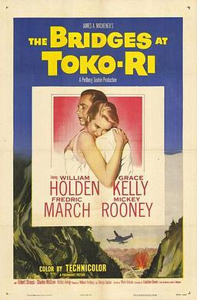
The uxorious husband
as unfocused serviceman
Marriage and home as
distractions from the mission
Dir. Mark Robson, 1954

Slide 7
The postwar turn to domestication
Military families overseas

Slide 8
“Dependents” as unofficial disciplinarians of male sexuality?
Five Army wives meet for tea in Heidelberg,
1946
https://www.uglyhedgehog.com/t-318512-1.html
Unidentified African American GI and his wife in Japan (1945-49) Schomburg Center for Research in Black Culture, Photographs and Prints Division

Slide 9
Dependents as “unofficial ambassadors”
Advertising the “American way of life”
Showing “democracy” in action
Winning over locals’ allegiance
Spearheading civic initiatives– especially
for women and children
Naturalizing the US military presence
Q: But does US military family diplomacy
actually work??
NYU Press, 2007

Slide 10
The rise of overseas “America Towns”
https://www.housing.af.mil/Home/Units/Okinawa/
University of Minnesota Press, 2007

Slide 11
CONSTRAINING MARITAL CHOICES
THE PROBLEMATIC “FOREIGN BRIDE”

Slide 12
From banning foreign marriages to (grudging) tolerance
1942: the War Dept. issued directives requiring all overseas servicemen to obtain permission of commanding officers prior to marrying
During and for some months immediately after WWII, US servicemen overseas were not permitted to marry women from former Axis enemy countries (see Zeiger on this)
When marriages to foreign women were permitted, soldiers who intended to marry had to submit complex and lengthy applications, including birth certificates, medical certificates (showing the woman was free from STDs and TB), a criminal background check, copies of previous marriage/divorce papers; notarized parental consent; character references, etc.
Mandatory pre-marital counseling by military chaplains
WWII-era regulations requiring commanders’ permission to marry remained in place for decades
In justification, the military routinely cited “morale” and “welfare” considerations
But issues of race/racism clearly influenced military marriage policy, as have prejudicial ideas about predatory foreign women and immature US men

Slide 13
Foreign brides
Left and center: Okinawan wives
and US servicemen spouses
https://apjjf.org/2019/21/Crissey.html

Slide 14
The USMC’s proposed ban on married recruits
In August 1993, the US Marine
Corps announced an intention
to bar married people from
enlisting.
Within hours, the USMC back-tracked.
The Corps had neglected to okay
this proposed policy change with
the White House.
“The new policy would have limited the number of married recruits to 4% by Oct. 1 of this year and 2% by Oct. 1, 1994, and would have prohibited married people from enlisting at all after Oct. 1, 1995.”
“The problems associated with a failing marriage, a marriage whose fabric is being torn apart by our operational deployment tempo--or the difficulty of making ends meet on a junior military salary, in locations where the cost of living is especially high--can be overwhelming to a young Marine and his family.”
https://www.latimes.com/archives/la-xpm-1993-08-12-mn-23077-story.html

Slide 15
The All-Volunteer Era
The turn to “family
Friendliness”

Slide 16
Incentivizing marriage and family after the Vietnam debacle
The ”Army Family” as metaphor and reality
Within a year of the military’s turn to an All Volunteer force, 50% of service members were married
NB: while, by the 1970s, more than half of civilian women (aged 18-64) engaged in paid work, this figure was lower for army wives (approx. 30.5%)
WHY? Mobility– frequent postings– expectation that wives perform unpaid welfare work on behalf of the military
Better pay
Better housing
Child-care: by the late ‘70s, nearly 60% men in uniform were fathers
Health care
Harvard, 2015

Slide 17
What about married women soldiers?
During WWII, married women, including women with children 14+, could enlist in the Women’s Army Corps.
But if women became pregnant while in the WAC, they were discharged on the grounds that they were “no longer physically fit for duty.” The other armed services did likewise.
Servicewomen who had abortions were often discharged on the grounds that they had committed “conduct unbecoming,” thus damaging the reputation of the service
after WWII, many women left military service, married women often requesting discharges
1950s/60s: the military continued to discharge women who gave birth or became adoptive parents
Many women terminated pregnancies in order to continue their military careers. Abortion in military medical facilities was legalized in July 1970, if the woman’s mental health was at stake
1971: the DOD announced that it would extend the same spousal benefits to the husbands of married servicewomen as it did to the wives of servicemen
A court case in 1976 deemed the military’s practice of discharging pregnant women unlawful
The military’s ”family friendly” turn owed a good deal to women’s activism, in tandem with second wave feminist activism in civilian society

Slide 18
Uniformed maternity
6701. GENERAL (MATERNITY UNIFORMS)
1. WEAR. Certified maternity uniforms are mandatory for all pregnant women in the Navy when a uniform is prescribed, and regular uniforms no longer fit. Personnel are expected to wear regular uniforms upon return from convalescent leave, however, commanding officers may approve the wear of maternity uniforms up to six months from the date of delivery based on medical officer diagnosis/recommendation.
2. OUTERGARMENTS
a. Pregnant Sailors may wear authorized uniform outergarments unbuttoned or unzipped when a proper fastened fit is no longer possible or becomes uncomfortable.
https://www.public.navy.mil/bupers-npc/support/uniforms/uniformregulations/chapter6/Pages/6701.aspx
US Navy maternity service dress, summer whites and winter blues. https://americanhistory.si.edu/blog/2011/09/pregnant-in-uniform.html

Slide 19
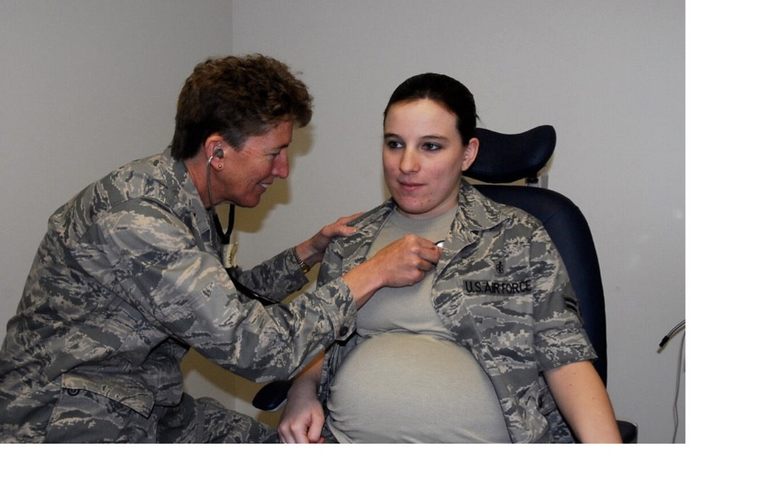
Can mothers be soldiers?
Today nearly half of active-
duty women are married.
Nearly 40% are mothers.
“Airman First Class Brandy Fraher, who is in the final stages of her pregnancy, receives an examination from Major Noreen Burke during a unit training assembly.” Since 2017, Air Force personnel have a 12 month window after giving birth to decide whether to stay on or leave the USAF.
https://www.airforcetimes.com/news/your-air-force/2017/04/29/new-air-force-policy-gives-new-mothers-12-months-to-decide-if-they-want-to-stay-in-uniform/
https://coyotelegal.com/2013/11/27/good-news-for-military-families/

Slide 20
ONGOING TENSIONS
THE AGE OF “FOREVER WAR”
https://www.militaryfamily.org/about-us/

Slide 21
Technology and virtual proximity
“It was through video calling that Sgt. Emmett Mailman was able to witness the birth of his son in Lincoln all the way from Kabul.”
https://www.supertintin.com/blog/skype-recorder/the-soldiers-story-a-skype-video-call-testimony

Slide 22
Suicide and the “signature injury”
26 Sep 2019
Military.com | By Patricia Kime
The suicide rate for active-duty U.S. military members in 2018 was the highest on record since the Defense Department began tracking self-inflicted deaths in 2001.
Officials said Thursday that 2018's rate of 24.8 deaths per 100,000 service members is comparable to age and gender-adjusted civilian rates, but added that fact is "hardly comforting," given that "the numbers aren't moving in the right direction.”
A new DoD publication, the 2018 Annual Suicide Report, released Thursday confirms that 325 active-duty personnel took their own lives last year, up from 285 in 2017 and 280 the previous year.
The Pentagon has long struggled to address the problem of suicides in the ranks, attacking the issue with renewed fervor in 2012, when the number of deaths, 319, and the rate, 22.7 per 100,000, were the highest since the DoD began tracking the data following the 9/11 attacks.
https://www.military.com/daily-news/2019/09/26/military-suicide-rates-hit-record-high-2018.html

Slide 23
Shoring up military marriage: “Resilience” training
Left: Original U.S. Army "Comprehensive Soldier Fitness" logo (2009-2012)
Middle: New U.S. Army "Comprehensive Soldier and Family Fitness" logo (August 2012-present)
Right: U.S. Air Force Comprehensive Airman Fitness logo (2011-present)
https://thewinnower.com/papers/49-a-critical-examination-of-the-u-s-army-s-comprehensive-soldier-fitness-program
https://www.army.mil/article/113208/comprehensive_soldier_and_family_fitness_expands_resilience_training_to_army_leaders

Slide 24
https://www.strongbonds.org/

Slide 25
Seminar preparation
Read Cynthia Enloe, Maneuvers, chapter 5
Read either chapter 4 or 6 from Susan Zeiger, Entangling Alliances
Undertake some original primary research into war brides using the
ProQuest Historical Newspapers database, via Warwick library
Refine your search to the historical period covered by the chapter of Zeiger you read (i.e. either the 1940s, or the 1960s-70s)
Come to class with at least one historical newspaper story to share.

