Slide 1
Domestication
A “family friendly” military?
HI2C6 Week 3

Slide 2

The martial and the marital
“If the army wanted you to have a wife, it would have issued you with one.” [popular adage, n/d]
“We recruit individuals but retain families.” [Army Chief of Staff John A. Wickham, 1983]
“War is bad for marriage.” [recurrent finding of scholars in the aftermath of every war from WWI onwards]

Slide 3
Why the disinclination toward married soldiers?
An ideological contradiction—
if “family” and “home” are presented as the institutions being fought for
US propaganda poster (1918)

Slide 4
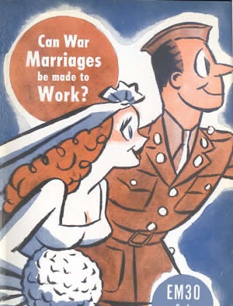
Marriage for the “wrong reasons”?
By Clifford Kirkpatrick
Professor of Sociology, University of Minnesota
(Published November 1944)
https://www.historians.org/about-aha-and-membership/aha-history-and-archives/gi-roundtable-series/pamphlets/em-30-can-war-marriages-be-made-to-work-(1944)

Slide 5
Marriage as a financial burden
Providing financial support to soldiers’ wives a costly obligation for the US state
Likewise provision of life insurance and payments to soldiers’ widows
“Allotments” (payments to soldiers’ dependents) risk making vulnerable young men prey to “bounty-hunters”/”gold diggers”
“Allotment Annie”

Slide 6
Wives as a source of anxiety to soldiers: the spectre of infidelity
Army Air Force engineers in New Guinea tracked
romantic defections on this "operations board."
Source: Stars and Stripes. © 1944
Screenshot from Jarhead (dir. Sam Mendes, 2005) based on USMC veteran Anthony Swofford’s memoir of the 1990-91 Gulf War

Slide 7
The marital turn
Military manpower
And spousal support

Slide 8
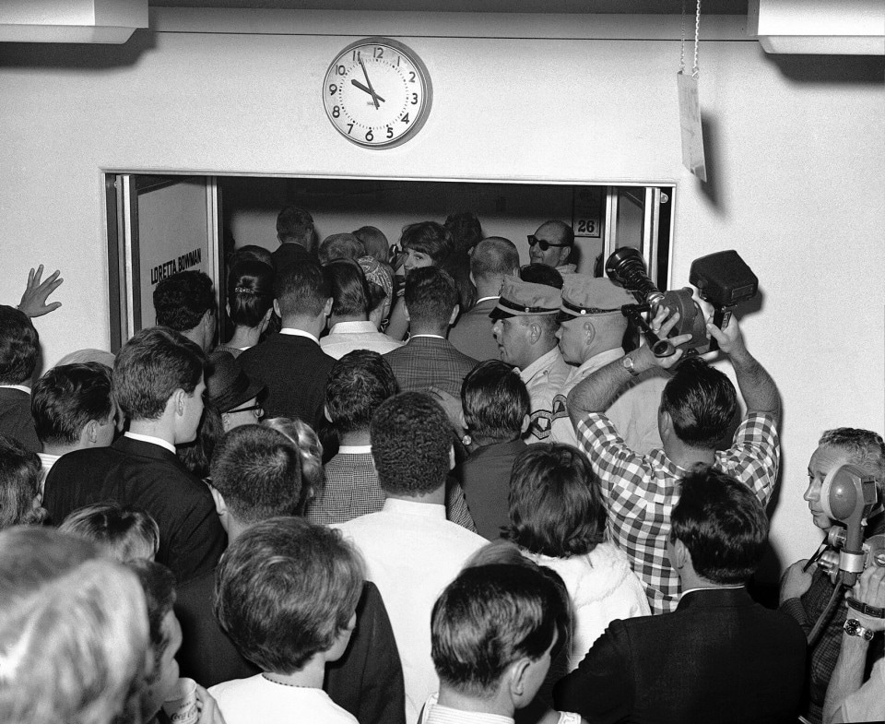
How to prevent “draft dodger” marriages?
“President Lyndon B. Johnson signed an executive order on Aug. 26, 1965, changing the military conscription rules for the expanding war in Vietnam.
One second after midnight, married men would no longer be exempt from the draft. Those married before midnight would be.”
Couples rush to secure a marriage license and get married ahead of a military draft deadline Aug. 25, 1965. (Milt Palmer/Las Vegas News Bureau)
Read the Washington Post story: https://www.washingtonpost.com/news/retropolis/wp/2017/09/23/a-rush-to-the-altar-to-avoid-the-vietnam-draft-the-day-lbj-eliminated-the-marriage-exemption/

Slide 9
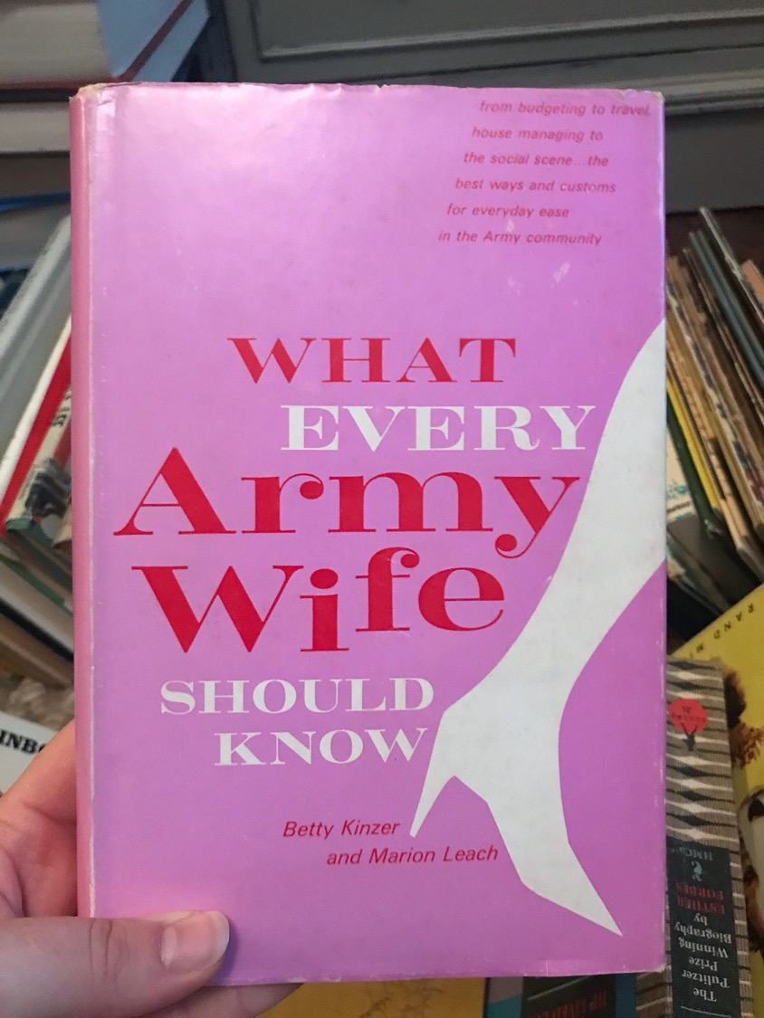
The “army wife” as individual and institutional asset
1966

Slide 10
“Dependents” as unofficial disciplinarians of male sexuality?
Five Army wives meet for tea in Heidelberg,
1946
https://www.uglyhedgehog.com/t-318512-1.html
Unidentified African American GI and his wife in Japan (1945-49) Schomburg Center for Research in Black Culture, Photographs and Prints Division

Slide 11
Dependents as
“unofficial ambassadors”
Advertising the “American way of life”
Showing “democracy” in action
Winning over locals’ allegiance
Spearheading civic initiatives– especially
for women and children
Naturalizing the US military presence
Q: But does US military family diplomacy
actually work??
NYU Press, 2007

Slide 12
CONSTRAINING
MARITAL CHOICES
THE PROBLEMATIC “FOREIGN BRIDE”

Slide 13
From banning foreign marriages to
(grudging) tolerance
1942: War Dept. directives required all overseas servicemen to obtain permission of commanding officers in order to marry
During and for some months after WWII, US servicemen overseas were not permitted to marry women from former Axis enemy countries (see Zeiger)– a ban later lifted
Soldiers who intended to marry had to submit lengthy applications, including birth certificates, medical certificates (showing the woman was free from STDs and TB), a criminal background check, copies of previous marriage/divorce papers; notarized parental consent; character references, etc.
Mandatory pre-marital counseling by military chaplains
WWII-era regulations requiring commanders’ permission to marry remained in place for decades– applying to GIs who hoped to marry Vietnamese women in the ‘60s and ‘70s
Why so much hostility to bi-national marriages?
Issues of race/racism clearly influenced military marriage policy, as have prejudicial ideas about predatory foreign women and immature US men
1967: Loving v State of Virginia– ended ‘anti-miscegenation’ statutes

Slide 14
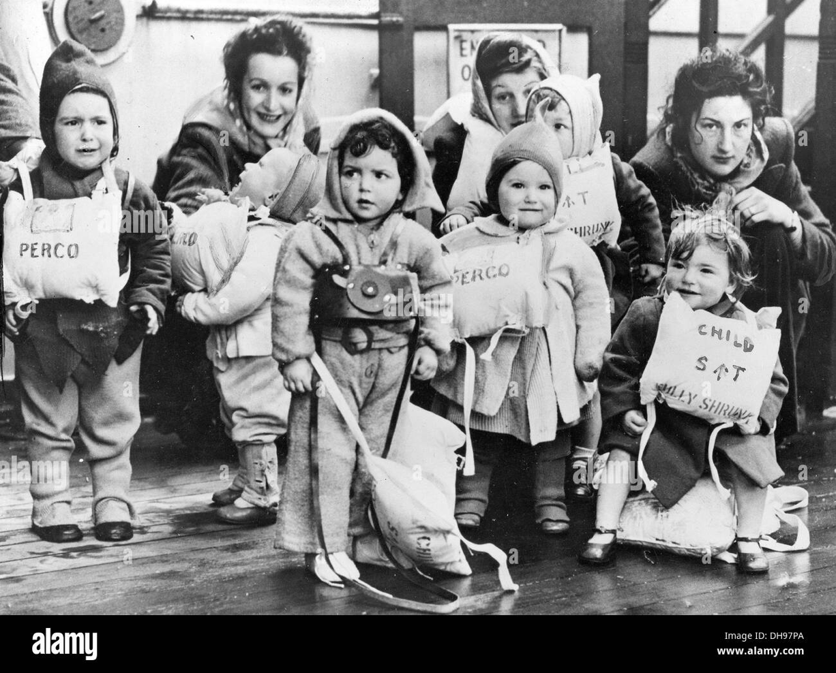
“War brides”
Left: British GI War brides and their GI children during lifeboat drill head for America on the Queen Mary at the end of WWII

Slide 15
The All-Volunteer
Era (1973 - )
The turn to “family
Friendliness”

Slide 16
Incentivizing marriage and family after Vietnam
The ”Army Family” as metaphor and reality
Within a year of the military’s turn to an All Volunteer force, 50% of service members were married
NB: while, by the 1970s, more than half of civilian women (aged 18-64) engaged in paid work, this figure was lower for army wives (approx. 30.5%)
WHY? Mobility– frequent postings– expectation that wives perform unpaid welfare work on behalf of the military
Army spouses fought for: better pay & housing
Child-care: by the late ‘70s, nearly 60% men in uniform were fathers
Health care
Harvard, 2015

Slide 17
What about married women soldiers?
During WWII, married women, including those with children 14+, could enlist in the WAC
But if women became pregnant, they were discharged on the grounds that they were “no longer physically fit for duty.”
Servicewomen who had abortions were often discharged on the grounds that they had committed “conduct unbecoming,” damaging the reputation of the service
after WWII, many women left military service
1950s/60s: the military continued to discharge servicewomen who gave birth or became adoptive parents
Many women terminated pregnancies in order to continue their military careers.
Abortion in military medical facilities was legalized in July 1970, if the woman’s mental health was at stake
1971: the DOD announced that it would extend the same spousal benefits to the husbands of married servicewomen as it did to the wives of servicemen
A court case in 1976 deemed the military’s practice of discharging pregnant women unlawful

Slide 18
Uniformed maternity
6701. GENERAL (MATERNITY UNIFORMS)
1. WEAR. Certified maternity uniforms are mandatory for all pregnant women in the Navy when a uniform is prescribed, and regular uniforms no longer fit. Personnel are expected to wear regular uniforms upon return from convalescent leave, however, commanding officers may approve the wear of maternity uniforms up to six months from the date of delivery based on medical officer diagnosis/recommendation.
2. OUTERGARMENTS
a. Pregnant Sailors may wear authorized uniform outergarments unbuttoned or unzipped when a proper fastened fit is no longer possible or becomes uncomfortable.
https://www.public.navy.mil/bupers-npc/support/uniforms/uniformregulations/chapter6/Pages/6701.aspx
US Navy maternity service dress, summer whites and winter blues. https://americanhistory.si.edu/blog/2011/09/pregnant-in-uniform.html

Slide 19
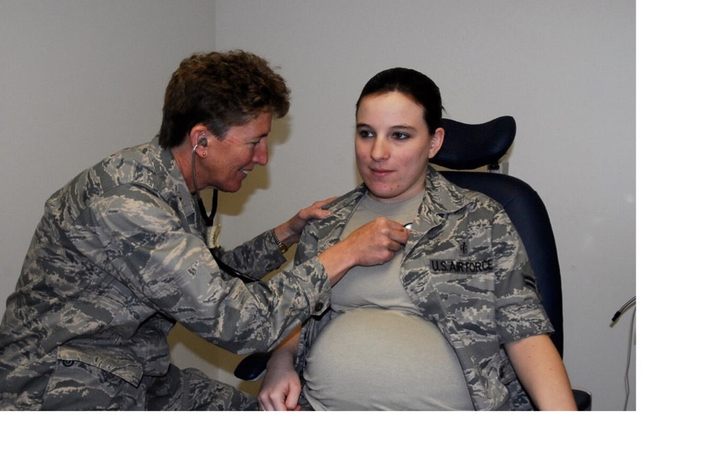
Can mothers be soldiers?
Today nearly half of active-
duty women are married.
Nearly 40% are mothers.
“Airman First Class Brandy Fraher, who is in the final stages of her pregnancy, receives an examination from Major Noreen Burke during a unit training assembly.” Since 2017, Air Force personnel have a 12 month window after giving birth to decide whether to stay on or leave the USAF.
https://www.airforcetimes.com/news/your-air-force/2017/04/29/new-air-force-policy-gives-new-mothers-12-months-to-decide-if-they-want-to-stay-in-uniform/
https://coyotelegal.com/2013/11/27/good-news-for-military-families/

Slide 20
ONGOING TENSIONS
THE AGE OF “FOREVER WAR”
https://www.militaryfamily.org/about-us/

Slide 21
The USMC’s proposed ban on married recruits
In August 1993, the US Marine
Corps announced an intention
to bar married people from
enlisting.
Within hours, the USMC back-tracked.
The Corps had neglected to okay
this proposed policy change with
the White House.
“The new policy would have limited the number of married recruits to 4% by Oct. 1 of this year and 2% by Oct. 1, 1994, and would have prohibited married people from enlisting at all after Oct. 1, 1995.”
“The problems associated with a failing marriage, a marriage whose fabric is being torn apart by our operational deployment tempo--or the difficulty of making ends meet on a junior military salary, in locations where the cost of living is especially high--can be overwhelming to a young Marine and his family.”
https://www.latimes.com/archives/la-xpm-1993-08-12-mn-23077-story.html

Slide 22
Technology and virtual proximity
“It was through video calling that Sgt. Emmett Mailman was able to witness the birth of his son in Lincoln all the way from Kabul.”
https://www.supertintin.com/blog/skype-recorder/the-soldiers-story-a-skype-video-call-testimony

Slide 23
Suicide and relationship breakdown: correlation or cause?
26 Sep 2019
Military.com | By Patricia Kime
“The suicide rate for active-duty U.S. military members in 2018 was the highest on record since the Defense Department began tracking self-inflicted deaths in 2001.
Officials said Thursday that 2018's rate of 24.8 deaths per 100,000 service members is comparable to age and gender-adjusted civilian rates, but added that fact is "hardly comforting," given that "the numbers aren't moving in the right direction.”
A new DoD publication, the 2018 Annual Suicide Report, released Thursday confirms that 325 active-duty personnel took their own lives last year, up from 285 in 2017 and 280 the previous year.
The Pentagon has long struggled to address the problem of suicides in the ranks, attacking the issue with renewed fervor in 2012, when the number of deaths, 319, and the rate, 22.7 per 100,000, were the highest since the DoD began tracking the data following the 9/11 attacks.”
https://www.military.com/daily-news/2019/09/26/military-suicide-rates-hit-record-high-2018.html

Slide 24
Shoring up military marriage:
“Resilience” training
Left: Original U.S. Army "Comprehensive Soldier Fitness" logo (2009-2012)
Middle: New U.S. Army "Comprehensive Soldier and Family Fitness" logo (August 2012-present)
Right: U.S. Air Force Comprehensive Airman Fitness logo (2011-present)
https://thewinnower.com/papers/49-a-critical-examination-of-the-u-s-army-s-comprehensive-soldier-fitness-program
https://www.army.mil/article/113208/comprehensive_soldier_and_family_fitness_expands_resilience_training_to_army_leaders

Slide 25
https://www.strongbonds.org/

Slide 26
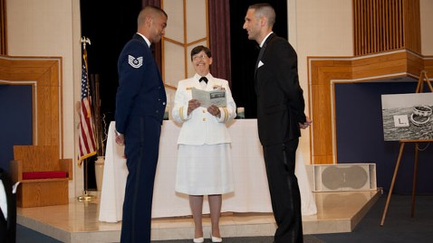
Same-sex marriage (2013 - )
On 14 August 2013, the Department of Defense (DoD) announced that it would provide spousal and family benefits to servicemembers in same-sex marriages on the same terms as it does to those in different-sex marriages.
Two men became the first same-sex couple to marry on a military base when they held their wedding ceremony in [June 2012] at Joint Base McGuire-Dix-Lakehurst in New Jersey.
https://abcnews.go.com/blogs/headlines/2012/07/first-military-base-same-sex-wedding-held

