Slide 1
Can women fight?
“Combat Exclusion”: Supporters, Critics and the Erosion of a Ban
HI2C6 Week 7
NB: some slides (particularly the final one) contain disturbing content

Slide 2
Why were women officially excluded from combat for so long?
Arguments against women in combat: what drove them?
Who made them?
Critics and critiques of “Combat Exclusion”
How the ban on women in combat was established, evolved, and ended (2015)
The instrumentalization of gender in counterinsurgency warfare in Afghanistan and Iraq

Slide 3
No female fighters
Making the case
2007

Slide 4
US society’s gendered division of labour
Men protect women
Women protect children
Men fight
Women nurture
If called upon by the state, men take life
Women reproduce it
Putting women’s lives at risk of death or
capture in war is less tolerable
Sept. 1990

Slide 5
Biological Sex: anatomy as incapacity
“Women aren’t built to fight”
Women are physically smaller/weaker
Women have periods
And before they have periods
they get PMS
They can get pregnant
And have babies….
How to manage bodily differences/
bodily functions on the battlefield?

Slide 6
Gender: female = feminine = weakness
Feminine ”nature” isn’t compatible with front line combat
Too emotional; too irrational
Lacking in courage, stamina, resilience and “killer instinct”
Women in combat roles would require male soldiers’ protection
"The majority of females I know are not soldiers. They are employed. Anything strenuous is avoided with a passion. I would hate to serve with them during combat! I would end up doing my job and 2/3 of theirs just to stay alive.”
Anon. enlisted male soldier quoted by David Frum,
“The Truth About Women in Combat,” April 2017
https://www.thedailybeast.com/the-truth-about-women-in-combat

Slide 7
Sex: women as distraction/temptation
“The U.S. military is already awash in discipline and morale problems coming out of female–male interactions. Captain Serrano notes that ‘platoon commanders in co-ed units already deal with a tremendous amount of drama, pregnancies, and sex in the co-ed unit barracks.’ The unavoidable disruption means units that are less lethal and less survivable.”
Putting Women in Combat Is an Even Worse Idea Than You’d Think
By MIKE FREDENBURg, July 15, 2015
https://www.nationalreview.com/2015/07/women-in-combat-military-effectiveness-deadly-pentagon/

Slide 8
Unit “cohesion”
Why men fight
Cause or comrades?
Men fight for the “guy standing next to him”
Women’s presence in hitherto all-male units would corrode fraternal bonds
“primary group” cohesion requires women’s exclusion
morale and fighting elan depend on male bonding

Slide 9
Who makes these arguments?
Some senior male military commanders
Some male enlisted men
Conservative pundits/commentators
Public intellectuals (cf. Martin van Creveld)
Some conservative women’s organizations (e.g. the Independent Women’s Forum, https://www.iwf.org/)
Some military wives

Slide 10
A victory– for women’s rights?
For “political correctness”?
https://www.theatlantic.com/politics/archive/2013/01/all-these-objections-women-combat-are-dumb/319101/

Slide 11
Critiques of Combat Exclusion

Slide 12
Strength & stamina not size
1st Lt. Shaye Haver graduated from the Army's grueling Ranger School in August 2016.
Robin Trimarchi/AP
https://www.motherjones.com/politics/2016/01/female-officers-break-down-myths-about-women-at-war/
High-tech research developing exoskeletons that would help reduce injury and fatigue. DARPA
http://theconversation.com/eight-myths-about-women-on-the-military-frontline-and-why-we-shouldnt-believe-them-55594

Slide 13
The sexless brain
“It’s impossible to tell the sex of
an individual based solely on
MRI images of the brain.”
Dr Leah T Johnstone

Slide 14
The “myth” of the “band of brothers”
Combat exclusion has “always been about men, not women”
Policies intended to keep women from combat were not designed in response to research and evidence
These measures were created and sustained through “stories, myths, and emotional arguments” (p. 3)
https://www.c-span.org/video/?325610-3/discussion-women-combat
2015

Slide 15
“Exclusion” and its erosion

Slide 16
How “Combat Exclusion” came into being
WWII: Women’s Army [Auxiliary] Corps organized– and publicly sold– on the basis that it “released men for combat”
1948: Women’s Armed Services Integration Act– set cap on women in the military at 2%; formally excluded women from combat. The WAC remained in existence until 1978
From the 1980s onwards, more women entered the military. “Combat Exclusion” firmed up
Women were debarred from certain Military Occupation Specialties (MOS) focused on ground combat and from training academies/programmes, incl. special forces
But a/c Mackenize ”combat exclusion” should be regarded primarily as a “trope” not a concrete policy

Slide 17
How rules evolved
1988: The DOD’s “Risk Rule” permitted exclusion of women from any role, combat or non-combat, “if the risks of exposure to direct combat, hostile fire or capture were equal to, or greater than, the risks in the units they supported”
1992-93: National Defense Authorization Act lifted limits on assignment of women to combat aircraft in the USAF, Navy and USMC
1994: Defense Sec memo, “Direct Ground Combat Definition and Assignment Rule”
All service members should be eligible for positions for which they qualify; but women should be excluded from roles whose primary mission was direct combat.
Women were still prohibited from serving in Armor, Infantry, Combat Engineer, Field Artillery, forward-area Air Defense Artillery and Special Operations units.
Individual services could further restrict women if the cost of separate “berthing and privacy” arrangements was prohibitive; where combat and support units were “co-located”; where units engaged in reconnaissance ops and Special Operations Forces missions

Slide 18
How/why Combat Exclusion ended
2013: Defense Sec. Leon Panetta announced the revocation of the 1994 Combat Exclusion memo, but some fields and training programs still remained barred to women
2015: Ash Carter announced that all military programs and jobs would be open to women without exception
2 women graduated from the Army Ranger School in 2015
2019: the first woman graduated from the Navy SEAL officer program
https://www.military.com/daily-news/2019/12/11/first-woman-has-made-it-through-seal-officer-screening.html
These moves resulted from pressure from legal cases initiated by military women– often working with the American Civil Liberties Union (ACLU)– to challenge the constitutionality of DOD policy blocking them from some MOS and from combat roles. https://www.aclu.org/issues/womens-rights/womens-rights-workplace/combat-exclusion-policy-women
Combat Exclusion had been undermined in Iraq and Afghanistan by commanders’ exploitation of its loop-holes and subjective evaluation of ‘risk’– hypocrisy/cynicism became publicly visible
Women were in combat, but were not always compensated accordingly; nor were they able to earn promotions based on combat performance

Slide 19
Instrumentalizing gender in counterinsurgency warfare
Women soldiers in Iraq and Afghanistan

Slide 20
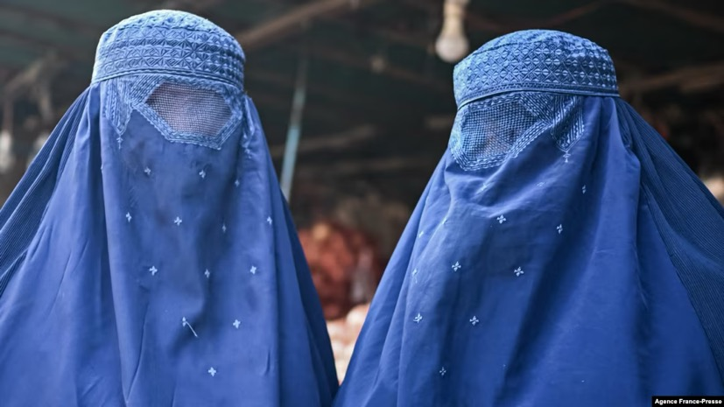
“Operation Enduring Freedom”: a war to liberate women in Afghanistan?
.
“Good morning. I'm Laura Bush, and I’m
delivering this address to kick off a world-wide
effort to focus on the brutality against women
and children by the al-Qaida terrorist network
and the regime it supports in Afghanistan, the
Taliban. That regime is now in retreat across much
of the country, and the people of Afghanistan –
especially women – are rejoicing. Afghan women
know, through hard experience, what the rest of
the world is discovering: The brutal oppression
of women is a central goal of the terrorists.”
https://georgewbush-whitehouse.archives.gov/news/releases/2001/11/20011117.html

Slide 21
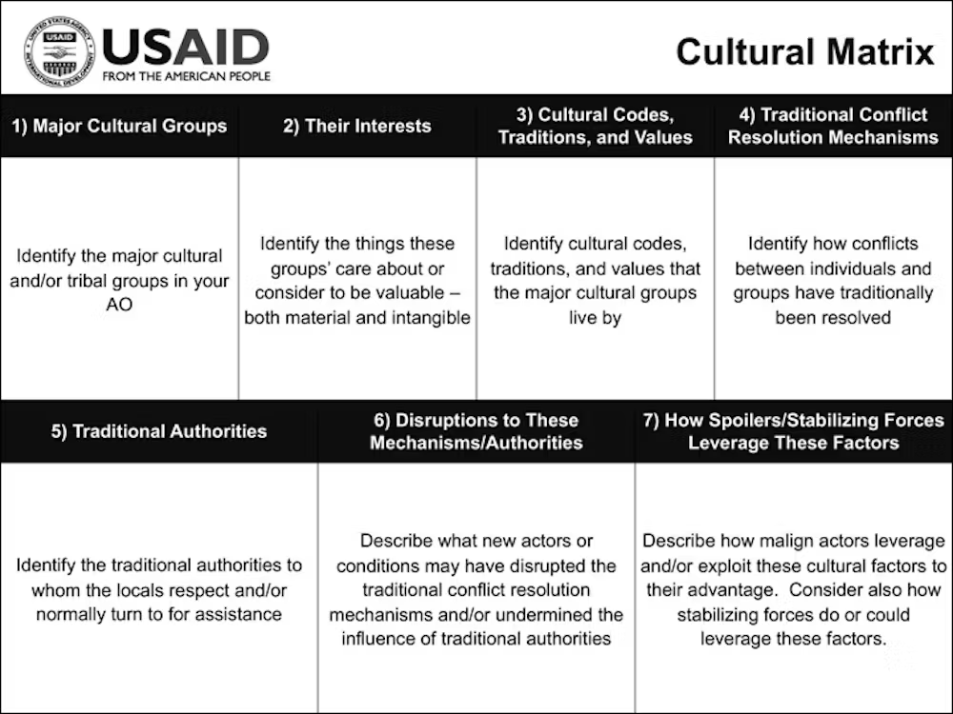
“Cultural support teams”
“Winning hearts & minds”
Amelia, a female soldier attached to a special forces mission, spoke of how
she was an asset because:
“We were not threatening, we were just there. For Afghan men, we were fascinating because
we were these independent women in a different role than they see for most women there. And we were non-threatening to them, so they could talk to us openly.”
https://theconversation.com/womens-secret-war-the-inside-story-of-how-the-us-military-sent-female-soldiers-on-covert-combat-missions-to-afghanistan-205669

Slide 22
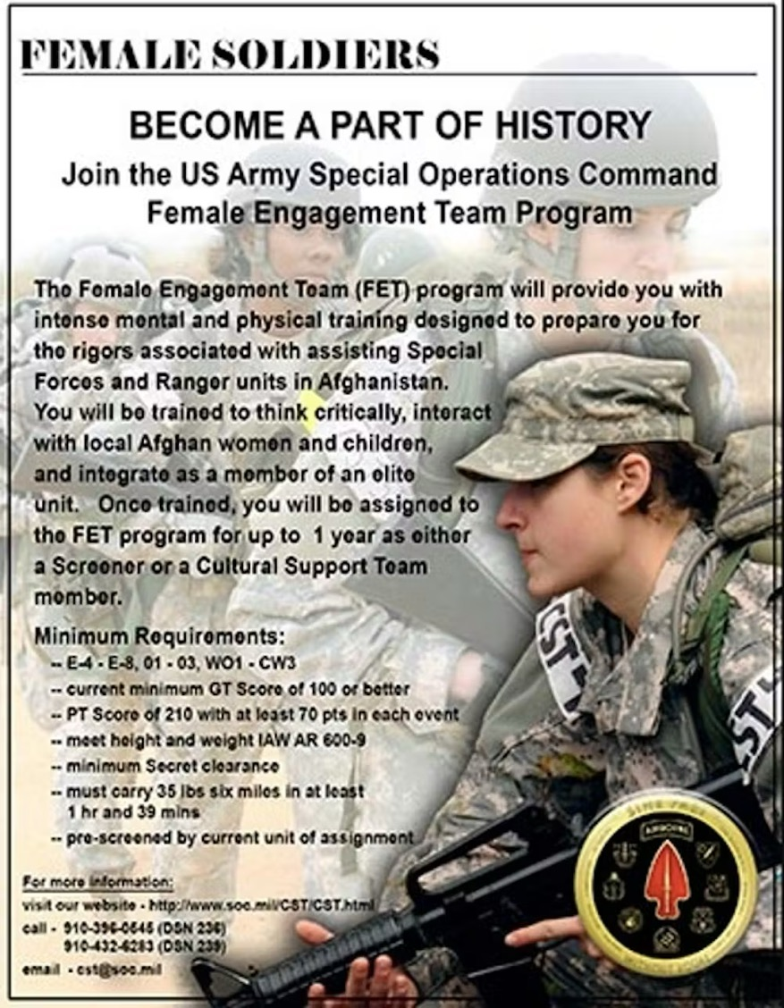
‘While male soldiers could not easily enter an Afghan home without being seen as disrespecting women who lived there, the [Marine Corps] handbook for female engagement teams advised that:
Afghan men often see western women as a “third gender” and will approach coalition forces’ women with different issues than are discussed with men.
And a 2011 Marine Corps Gazette article underlined that:
Female service members are perceived as a “third gender” and as being “there to help versus there to fight”. This perception allows us access to the entire population, which is crucial in population-centric operations.’
https://theconversation.com/womens-secret-war-the-inside-story-of-how-the-us-military-sent-female-soldiers-on-covert-combat-missions-to-afghanistan-205669

Slide 23
“Female Engagement Teams” in Afghanistan
“Spc. Heather Ray and Pfc. Jacqueline Buschman, Battle Company, 5th Battalion 20th Infantry Regiment, Task Force 1-14 Cavalry Regiment, and their female interpreter, return from a meeting with some Afghan women in the village of Akhvond Qalay, Afghanistan, May 8, 2012. Women account for nearly half the population of Afghanistan and have considerable influence on Afghan society so it is important for female engagement teams, such as the one Ray and Buschman make up, to develop trust-based and enduring relationships with the Afghan women they encounter on patrols.”
(Photo Credit: Sgt. Christopher McCullough)
https://www.army.mil/article/88366/female_engagement_teams_who_they_are_and_why_they_do_it

Slide 24
Whose hearts
and minds—
Afghan women’s
or American
civilians?
“Marines and sailors from the female engagement team with Bravo Battery, 3rd Low Altitude Air Defense Battalion, conduct a medical outreach for residents in the village of Habib Abad, Afghanistan”
July 3, 2015
https://www.marinecorpstimes.com/news/your-marine-corps/2015/08/05/marine-corps-revives-female-engagement-team-mission/

Slide 25
“Lioness” teams in Iraq
“Cpl. Jennifer San Martin, 24, a lioness attached to 3rd Battalion, 23rd Marine Regiment, Regimental Combat Team 5, who is from Katy, Texas, searches an Iraqi woman as she travels through the checkpoint in Haditha City, Iraq.” (2008)
USMC-02730.jpg

Slide 26
“Softening” the image of “forever war”
A war of house-to-house
searches for “insurgents”;
mortar attacks on bases;
convoys and road checks;
ambushes and IEDs
U.S. Army soldiers fight a blaze, which
started after a mortar round fired by
insurgents ignited a fuel truck at their
operating base, in Baiji on
December 26, 2007.
Bob Strong / Reuters
https://www.theatlantic.com/photo/2018/03/photos-looking-back-at-the-war-in-iraq-15-years-after-the-us-invaded/556028/

Slide 27
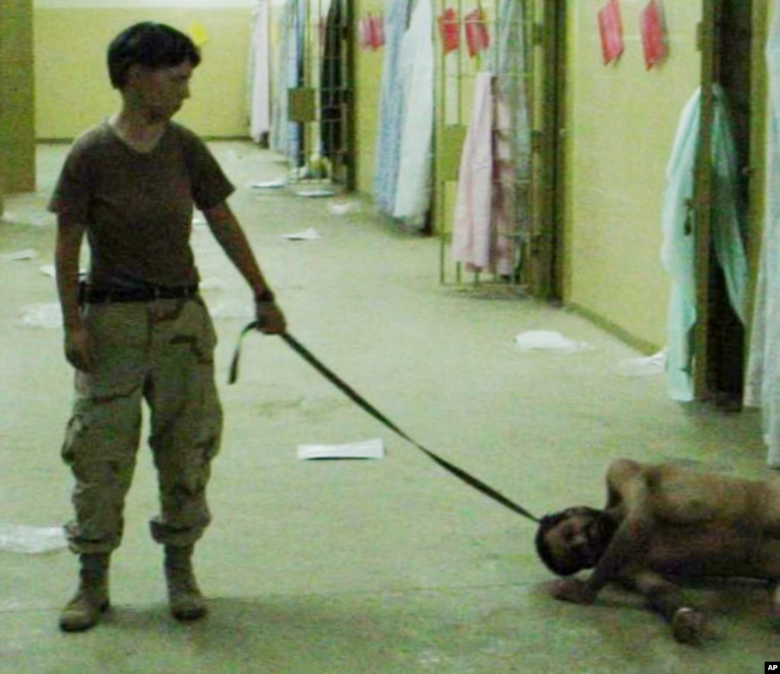
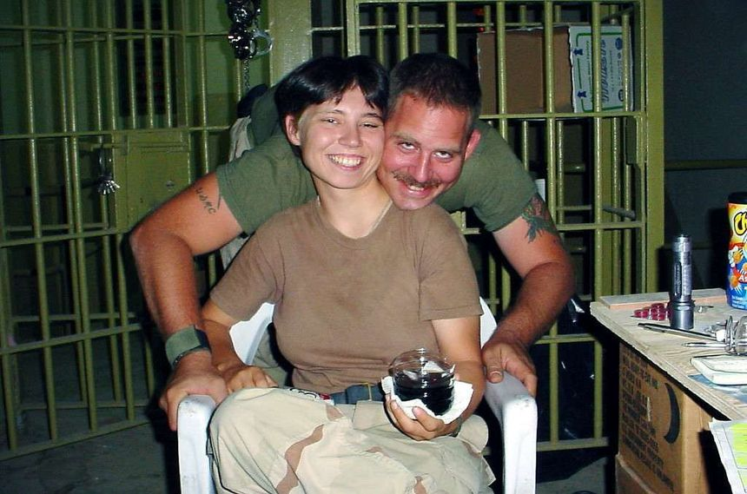
The Abu Ghraib Scandal
(2003-4)
This is image obtained by The Associated Press shows Pfc. Lynndie England holding a leash attached to a detainee in late 2003 at the Abu Ghraib prison in Baghdad, Iraq. https://www.voanews.com/a/images-from-abu-ghraib-prison-in-iraq/1580454.html

