Slide 1
Queering the US Military
Daniel Hall and Vincent Franchino became the first active-duty same-sex couple to marry at West Point.
January, 2018

Slide 2
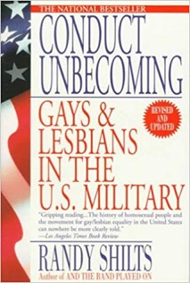
An opening salvo
“The history of homosexuality in the United States armed forces has been a struggle between two intransigent facts– the persistent presence of gays within the military and the equally persistent hostility toward them.”
Randy Shilts, Conduct Unbecoming: Gays and Lesbians in the U.S. Military (1993), p.3

Slide 3
Lecture overview
Part I: Exclusion-– from WWII to the 1990s
Part II: DADT: from introduction to revocation (1993-2010)
Part III: Queerness in/and the military
Issues:
Shifting understandings and definitions of sexuality– is it specific sex acts or sexual orientations that are deemed problematic? HOW, TO WHOM, WHY??
Rationales for excluding gays, lesbians and bisexuals– and their evolution
Resistance, challenges, and change
Homophobia/homosociality/homosexuality/”homonormativity”

Slide 4
EXCLUSION
Inventing and stigmatizing “the Homosexual”
1940-1990

Slide 5
Criminalizing sex: in American society
& the military
Sex, morality & legality: From the earliest colonization of N America, colonies (then states) criminalized certain categories of sex acts (eg ‘sodomy’, ‘adultery’, ‘bestiality’, ‘incest’)
c18-19: Men might (or might not) be discharged from the armed forces for ‘sodomy’, but there wasn’t a concerted effort to bar ‘homosexuals’ before the c20th. ‘Situational’ sex.
The straight/gay binary crystallized over time as ideas about sexuality & sexual behaviour evolved, influenced by new fields of knowledge (psychiatry; psychology; ‘sexology’)
The military tried to keep out so-called ‘sex perverts’ during WWI
1940: Selective Service began drafting men into the military
1942: screeners sought to exclude ‘unfit’ men, defining unfitness according to various criteria (intelligence, physical fitness, physique, as well as presumed sexual ‘tendencies’)
The medical/psy-professions construed “homosexualists” as suffering from a pathological psycho-sexual condition–variously associated with criminality, deviance, effeminacy, and alcoholism-- that rendered them more likely to break down under duress, destroying unit cohesion

Slide 6
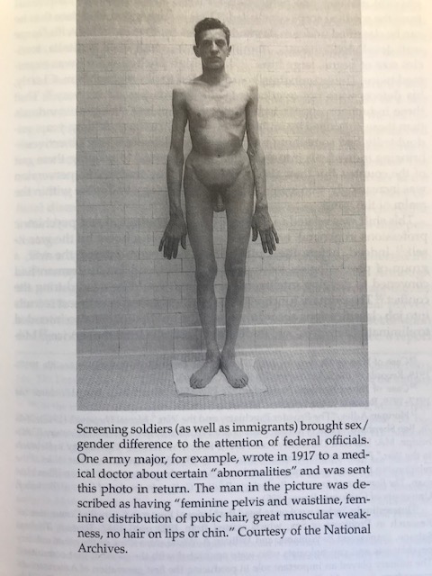
In search of “stigmata”
But how to tell who should be excluded?
Appraisal of “deviant”/“degenerate” bodies? Mannerisms? Affect? Speech? (Techniques borrowed from Immigration screening.)
Servicemen who were outed during WWII were often ejected with “blue discharges” or dishonorable discharges.
Not always court-martialed-- too costly and liable to draw attention to an embarrassing situation that supposedly didn’t exist. The military’s concern with PR/”reputation”
Negative consequences for discharged men’s civilian employment prospects and for access to healthcare and military benefits and pensions.
Illustration from Margot Canaday, The Straight State: Sexuality and Citizenship in Twentieth-Century America (Princeton University Press, 2009), p.63

Slide 7
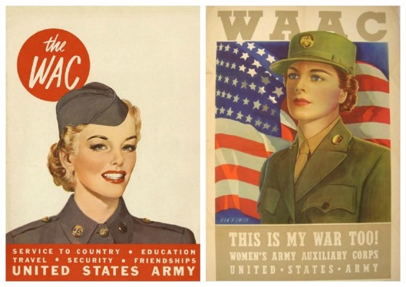
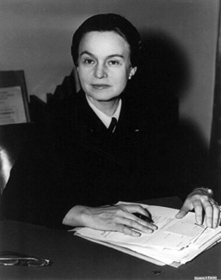
Lesbians and the WAC
The creation of the Women’s Army Auxiliary Corps in 1942 triggered a major backlash– a ”slander campaign”—led by disgruntled GIs-- with WAACs slurred as either/both prostitutes and/or lesbians
Recruitment propaganda stressed the conventionally feminine appearance of women in uniform, with the suggestion that they were thoroughly respectable straight women, wishing only to do their patriotic duty & whose femininity wouldn’t be corroded by serving in uniform
WAC leader Colonel Oveta Culp Hobby (right) demanded more strict screening to determine the motivations of women wanting to enlist
Answers like “loves a uniform and what it stands for,” “always wanted to be a boy and join the army,” seeks “companionship of girls with similar patriotic desire,” and wants the “opportunity to mix with other girls” etc. sounded alarm bells
Berube, Coming Out Under Fire: The History of Gay Men and Women In World War II, p. 30.
Arguably,
lesbians have faced
more persistent
and pernicious
discrimination/
persecution than
men—the mere fact
of their enlistment
taken to indicate
non-normative
gender identity/
sexual orientation.

Slide 8
The Uniform Code of Military Justice (UCMJ) (enacted 1950; in effect from 1951)
In October 1949, the newly consolidated Department of Defense standardized discriminatory regulations taking aim at queer personnel across all branches of the military:
"Homosexual personnel, irrespective of sex, should not be permitted to serve in any branch of the Armed Forces in any capacity, and prompt separation of known homosexuals from the Armed Forces is mandatory.”
Article 125 forbids sodomy among all military personnel, defining an offender as:
"any person subject to this chapter who engages in unnatural carnal copulation with another person of the same or opposite sex or with an animal is guilty of sodomy. Penetration, however slight, is sufficient to complete the offence.”
NB: This expansive definition encompassed both oral and anal sex as “unnatural” acts.
Most court-martial cases tried personnel accused of same-sex sodomy
The “Queen for a Day” rule offered a loophole for service personnel caught engaging in “unnatural acts” if this behaviour was deemed to constitute an isolated aberration– reflecting a long-standing tendency in the military (and beyond) to distinguish between ”confirmed” homosexuals and those who were immature, curious, coerced or inebriated

Slide 9
The early cold war “lavender scare”
In 1950, the Hoey Committee
inquired into the employment of
homosexuals in Federal Gov’t.
The Report deemed homosexuals
a “security risk”-- because
susceptible to communist
blackmail attempts.
In 1952, the American
Psychiatric Association’s first
Diagnostic and Statistical Manual
of Mental Disorders classified
homosexuality as a "sociopathic
personality disturbance."
When Capt. George Raines testified before the committee, he submitted this diagram, which he had used to teach his psychiatry students at Georgetown University. Raines believed that homosexuality was contained to some degree in all personalities.
(Records of the U.S. Senate, RG 46)
https://www.archives.gov/publications/prologue/2016/summer/lavender.html

Slide 10
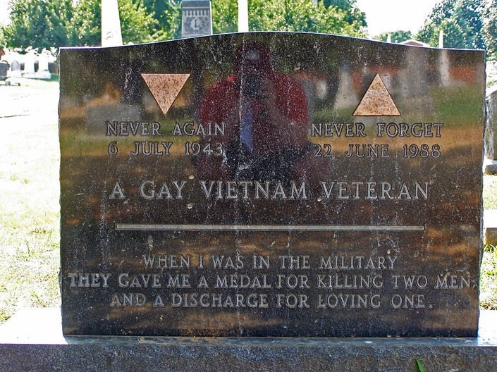
Legal challenges
T/Sgt Matlovich outed himself in order to challenge the military’s exclusionary policies.
During his September 1975 administrative discharge hearing, an Air Force attorney asked him if he would sign a document pledging to "never practice homosexuality again" in exchange for being allowed to remain in the Air Force.
Matlovich refused. He was recommended for a General (Under Honorable Conditions) discharge.
Matlovich died of
HIV/AIDS in 1988,
aged 44.
Leonard Matlovich on the cover of Time
September 8, 1975

Slide 11
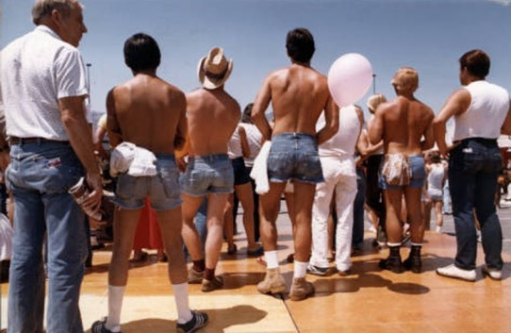
The rise of gay activism
The birth of “Pride” (first march in 1970)
Queer culture gains more visibility
Queer male physicality in public space
AIDS activism
In 1983 (after 1,450 cases, 558 of which ended in death) the New York Times put AIDS on the front page when the US government’s top health official declared an investigation of the disease was now “the number 1 priority”
Homophobia/exclusion framed as a “civil rights” issue-- analogous to racial desegregation (1948)
Scenes from the 1981 Christopher Street West Pride parade, Los Angeles.
Photo: ONE Archives Foundation
https://www.lgbtqnation.com/2018/05/pride-pictures-1980-81-boys-back-town/

Slide 12
DOD Directive 1332.14 (Enlisted Administrative Separations), January 1981:
“Homosexuality is incompatible with military service. The presence in the military environment of persons who engage in homosexual conduct or who, by their statements, demonstrate a propensity to engage in homosexual conduct, seriously impairs the accomplishment of the military mission. The presence of such members adversely affects the ability of the armed forces to maintain discipline, good order, and morale; to foster mutual trust and confidence among service members; to ensure the integrity of the system of rank and command; to facilitate assignment and worldwide deployment of service members who frequently must live and work in close conditions affording minimal privacy; to recruit and retain members of the armed forces; to maintain the public acceptability of military service; and to prevent breaches of security.”

Slide 13
Debating exclusion
DADT
And beyond

Slide 14
The Reagan-era rise of the religious right
Social conservatism invigorated by evangelicalism
Growing prominence of evangelicals in the military
Homophobia give a scriptural spin
The “culture wars” animated by issues of sexuality and reproductive rights (pro-life; pro-family; anti-gay rights)
Increasing salience of sex in US politics
Opposition to Bill Clinton— finds ammunition in his sex life
Conservatives determined to oppose Clinton’s campaign pledge to end the exclusion of gays and lesbians from the military
Gen. Colin Powell– an opponent
of open gay service and leading commander in the 1990-91 Gulf War

Slide 15
Don’t Ask, Don’t Tell,
Don’t Pursue (1993-2011)
“The presence in the armed forces of persons who
demonstrate a propensity or intent to engage in homosexual acts would create an unacceptable risk to the high standards of morale, good order and discipline, and unit cohesion that are the essence of military capability.” USC Act 654 1993
A compromise?
A step towards a more inclusive military?
Or homophobia by any other name?
Ongoing witch-hunts and dishonorable discharges (approx. 13,000)
For more online resources on DADT and its repeal
https://guides.lib.uw.edu/research/govpubs-quick-links/LGB-mil
DIGNITY & RESPECT (2001) a U.S. Army training guide
on the homosexual conduct policy

Slide 16
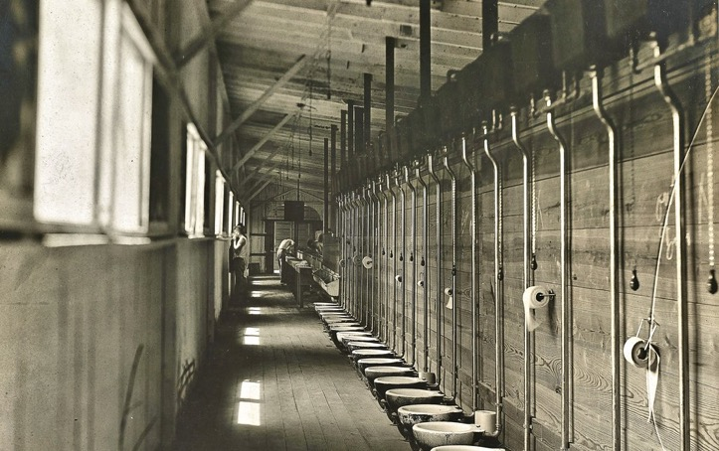
Opposition to ending DADT in the 1990s: the “privacy” argument
Privvies without privacy
The claim that straight service
personnel ought to be afforded
a right to personal privacy in military
bathrooms and barracks became a
core argument in favour of continued
exclusion of openly gay men and lesbians from the military during the DADT era.
Latrine, Camp Dick, TX 1918 NARA165-WW-268A-043
Source of Photograph: National Archives, RG:165; Medical Department - Sanitation.

Slide 17
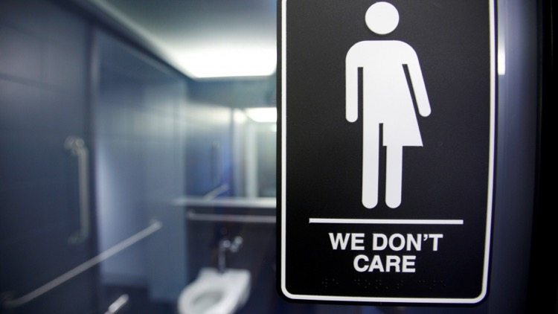
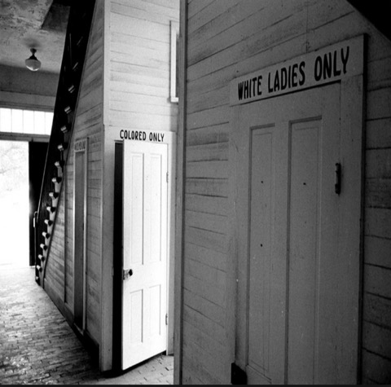
The body politics
of who “goes” where
“A sign protesting a recent North Carolina law restricting transgender bathroom access adorns the bathroom stalls at the 21C Museum Hotel in Durham, North Carolina, May 3, 2016. The hotel installed the restroom signage designed by artist Peregrine Honig last month after North Carolina's "bathroom law" gained national attention, positioning the state at the center of a debate over equality, privacy and religious freedom.”
Credit: Jonathan Drake/Reuters
https://www.pri.org/stories/2016-05-12/why-1920s-legal-move-responsible-gender-segregated-bathrooms-we-have-today
In the Jim Crow South, bathrooms
were segregated by both sex and race

Slide 18
Changing attitudes and laws: the 2000s
Click on the link below to see the rapidly changing
legal landscape with regard to same-sex marriage.
Between 2004 and 2015, gay marriage was legalized
in all states (ultimately by Supreme Court fiat).
https://www.theatlantic.com/politics/archive/2013/04/gay-rights-marriage-map-gif/315435/

Slide 19
The end of DADT
In December 2010, President Obama signed DADT out of existence. Repeal took effect in Sept. 2011.
“First-Ever Gay ‘Dear John’ Letters Begin
Reaching U.S. Troops Overseas”
"For too long, gays and lesbians in the armed forces were barred from receiving such letters, leaving them woefully unaware that the person they once called their soul mate had been cheating on them throughout their deployment," said Clarence Navarro of the Human Rights Campaign, an LGBT advocacy group. "But now all troops, regardless of their sexual orientation, are free to have their entire lives ripped out from underneath them in a single short note."
"This is a great day for homosexuals," Navarro added. "Even those who now have nothing to return home to.”
The satirical newspaper, The Onion, greets the end of DADT.
https://www.theonion.com/first-ever-gay-dear-john-letters-begin-reaching-u-s-tr-1819572970
“One of the many historic letters U.S. service members across the world are beginning to receive.”

Slide 20
The queer military?

Slide 21
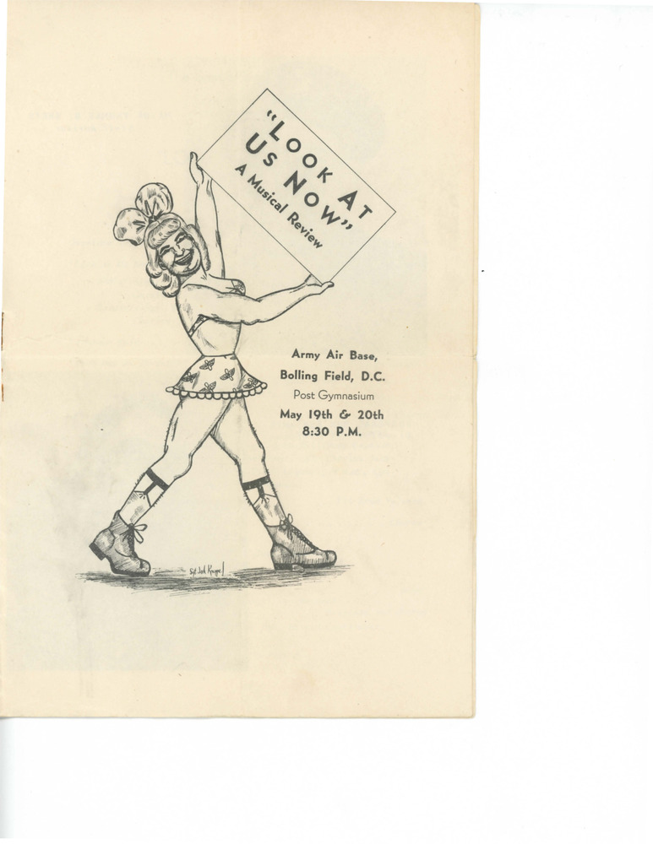
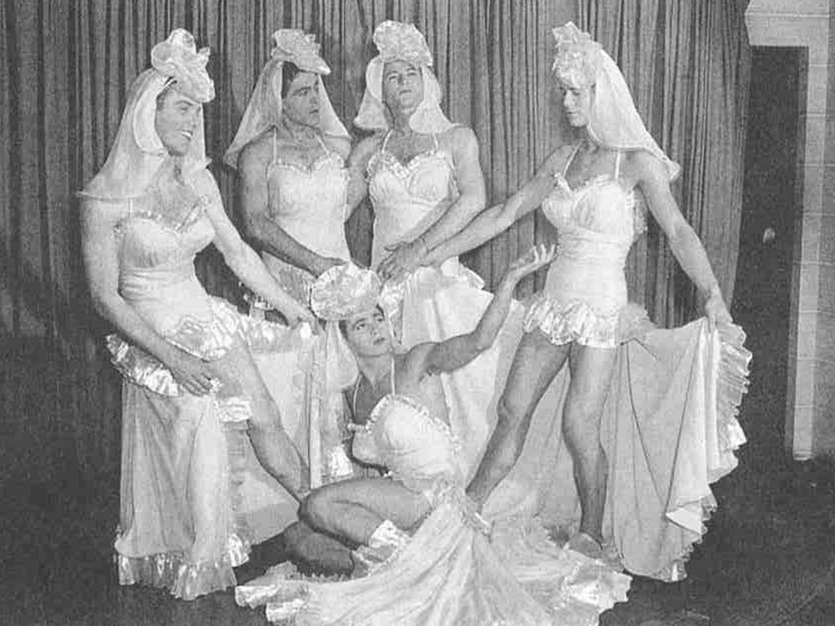
https://ssl.digitaltransgenderarchive.net/files/474299274
This Is the Army (Irving Berlin, 1942)
Army Signal Corps photographs, courtesy of the National Archives.
https://www.nationalww2museum.org/war/articles/drag-entertainment-world-war-ii

Slide 22
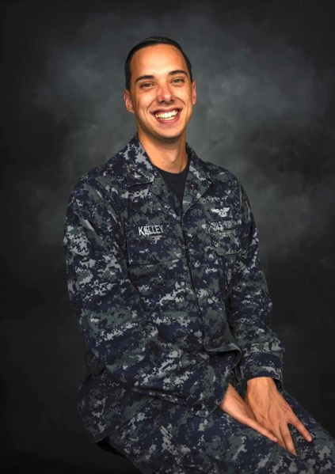
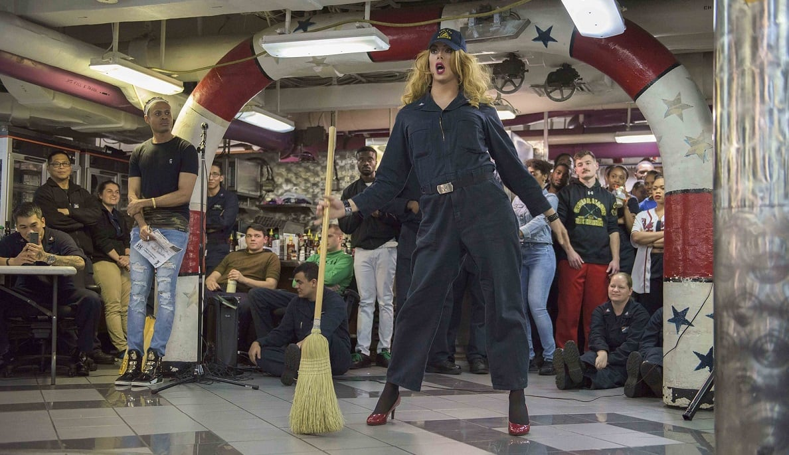
“Sailor by day, performer by night —
meet the Navy’s drag queen, ‘Harpy Daniels’”
Yeoman 3rd Class Joshua Kelley is a sailor onboard the carrier Ronald Reagan. (MC3 Tyler D. John/Navy)
https://www.militarytimes.com/off-duty/military-culture/2018/08/30/sailor-by-day-performer-by-night-meet-the-navys-drag-queen-harpy-daniels/

Slide 23
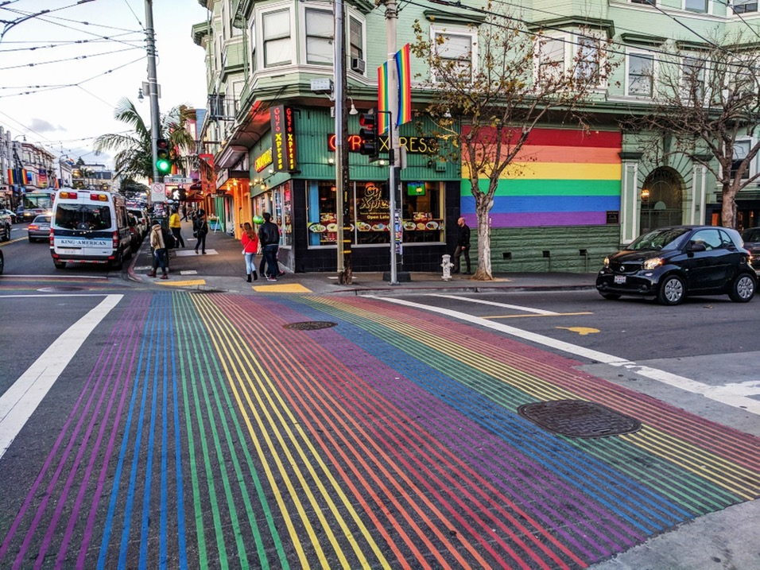
Perverse consequences of prejudice
The military loses many expensively trained and highly skilled personnel (est. 114,000 since WWII)
An institution whose ethos announces its commitment to high ethical standards– honour, fidelity, truth-- becomes a place in which secrets, lies and subterfuge are the order of the day
Straight men pose as gay to try to evade military service, esp. during Vietnam (the “hoaxosexual”)
Gay and lesbian personnel masquerade as straight to avoid being outed/discharged:
https://www.motherjones.com/politics/2010/08/lesbian-cadet-miller-west-point-velvet-park-katie-dadt-army/
But military exclusionary policies and prejudicial practices also help consolidate LGB identities
Gay and lesbian subcultures within the military
Several of the oldest gay neighbourhoods and gay-friendly cities in the US owe their origins to discharged service personnel: San Francisco, Providence, New York, Seattle
San Francisco’s Castro district

Slide 24
Gay veteran activist networks
At a 1993 demonstration in New York, gay rights advocates voiced their opposition to the military policy that became "don't ask, don't tell."
Porter Gifford/Getty Images
BOSTON -- Organizers of the St. Patrick’s Day parade in South Boston have decided to allow a gay veterans group to march in this year’s parade, reports CBS Boston. March 11, 2017.
The Palm Center: https://www.palmcenter.org/
Human Rights Campaign:
https://www.hrc.org/

Slide 25
From homophobia to “homonormativity”?
WASHINGTON — Pentagon officials announced Wednesday that the DOD will provide marriage benefits to same-sex couples for the first time, giving gay spouses access to health care, housing allowances and family separation pay.
Aug. 14, 2013
”Sodomy” decriminalized under UCMJ late 2013/ w effect 2014.
Army Sgt. Michael Potoczniak and his partner, Todd Saunders, left, and Cynthia Wides, left, and Elizabeth Carey go through the process of getting married at City Hall in San Francisco, California, June 29, 2013.
WALLY SKALIJ/LOS ANGELES TIMES
https://www.stripes.com/news/us/dod-announces-full-benefits-to-married-same-sex-couples-1.235284

