Slide 1
An “invisible war”
Sexual violence in the US military

Slide 2
Dir. Kirby Dick
2012
https://www.youtube.com/watch?v=3fBaFQk6aE0
Read more about the film: http://www.pbs.org/independentlens/films/invisible-war/

Slide 3
Lecture overview
An “invisible war” amid a series of highly visible military scandals over several decades
The nature of this war: a misogynistic campaign against women in uniform? Victims’ struggle to overcome PTSD? A campaign to expose a problem whose dimensions are persistently minimized? For justice?
Part I: What the UCMJ says about prohibited forms of sexual behaviour
Part II: Rape culture in the military
Part III: Military (in)justice– how the military criminal justice system works
Part IV: Is change possible? What and how much would need to change to end the “epidemic” of intramilitary sexual violence?

Slide 4
Part 1: Theory
What the military says about illicit sexual behaviour

Slide 5
The military’s written codes…
The UCMJ promises to punish conduct “unbecoming an officer and a gentleman” (Article 133)
Article 134 prohibits conduct prejudicial to “good order and discipline in the armed forces, [and] all conduct of a nature to bring discredit upon the armed forces”
UCMJ outlaws an array of behaviours relating to sex and intimate relationships:
Sodomy (Article 125): “unnatural carnal copulation” with “another person of the same or opposite sex or with an animal.” Why?? http://www.msnbc.com/msnbc/why-the-military-still-bans-sodomy
Adultery (until Jan. 2019 defined as sexual intercourse between a man and a woman– “specifically the variety that can produce offspring”). Unmarried soldiers (M or F) could be court-martialed for adultery if they slept with a married person.
Bigamy
Alienation of affections
Wrongful cohabitation
Pandering
Indecent exposure
”Peeping Tom” offenses
The military also outlaws “fraternization”– officers having sexual relationships with enlisted personnel; and (more recently) has prohibited touching by drill sergeants

Slide 6
Part II: Practice
Rape culture in the us military

Slide 7
The Tailhook Scandal (1991)
At an annual officers’ convention held at the Hilton in Las Vegas, more than 100 US Navy and Marine Corps aviation officers sexually assaulted 83 women and seven men, or otherwise engaged in "improper and indecent" conduct.
Watch a New York Times retrospective video report from 2013: https://www.youtube.com/watch?v=93vW5QZilAw
Demonstrators beat the effigy of a Navy flier while protesting sexism in the military in front of then-Naval Air Station Miramar in 1992, a year after the Tailhook scandal. U-T file photo
https://www.sandiegouniontribune.com/opinion/commentary/sdut-utbg-tailhook-navy-women-2016sep01-story.html
Read a contemporary press account: https://www.latimes.com/archives/la-xpm-1993-04-24-mn-26672-story.html

Slide 8
The Aberdeen Proving Ground Scandal (1996)
On Nov. 7, 1996, the Army announced that three male trainers at Aberdeen Proving Ground– a northern Maryland training base—had been charged with rape, abuse and harassment of female soldiers under their supervision. Accusations against other soldiers followed, and the Army soon found itself in the middle of a scandal exposing rampant sex and abuse of authority among male drill sergeants and the female soldiers whose lives they virtually controlled.
Read a contemporary press account:
https://www.washingtonpost.com/wp-srv/local/longterm/library/aberdeen/caution.htm
What a retired major general says the army learned from this episode, 20 years on:
https://www.armytimes.com/opinion/2016/11/08/20-years-on-what-the-army-s-learned-from-the-aberdeen-sex-scandal/

Slide 9
US Air Force Academy (USAFA) scandal 2003 +
12% of the women who graduated from the Air Force Academy in 2003 reported that they were victims of rape or attempted rape while at the Academy
70% of the 579 women at the Academy alleged they had been the victims of sexual harassment
22% said they experienced "pressure for sexual favors”
The allegations made by four women “whistle-blowers” in 2003 triggered a major investigation and prompted the DoD to do (or be seen to be doing) more to address endemic sexual violence in the armed forces
More recent sexual assaults have also been reported at the USAFA:
CBS News report 2017
https://www.cbsnews.com/news/air-force-academy-sexual-harassment-retaliation-allegations/
Read more on the 2003 USAFA scandal:
https://www.vanityfair.com/news/2003/12/airforce200312

Slide 10
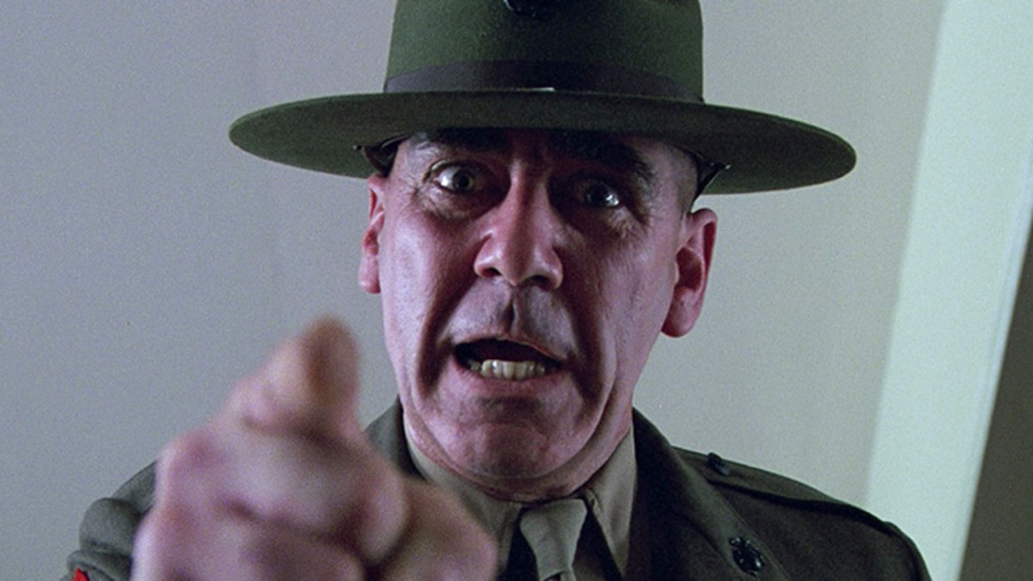
Elements of rape culture: adversative training
Watch a clip from Full Metal Jacket– a Stanley Kubrick film released in 1987 about the Vietnam war–
for a purportedly quite realistic representation of a US Marine Corps drill sergeant in action:
https://www.youtube.com/watch?v=j8OyjTkWhcA

Slide 11
Pervasive misogyny: Jody chants
“Jody this and Jody that
Jody is a real cool cat
Ain’t no use in calling home
Jody’s on your telephone
Ain’t no use in going home
Jody’s got your girl and gone
Ain’t no use in feeling blue
Jody’s got your sister too”
U.S. Army marching cadence, 1944
Watch a Jody cadence being performed in 2010
https://www.youtube.com/watch?v=dBIEUbqEhvE
https://slate.com/human-interest/2016/03/the-secret-history-of-the-name-jody.html

Slide 12
Hazing rituals/gendered degradation
Read a 2015 report by RAND on hazing in the military, with recommendations for its suppression:
https://www.rand.org/content/dam/rand/pubs/research_reports/RR900/RR941/RAND_RR941.pdf
The DoD Definition of Hazing Can Be Improved
The definition should include qualities that distinguish hazing from other types of abuse and mistreatment.
It should clarify the role of authority figures and the individual's responsibility.
It should consider the addition of more objective terms in describing harm, such as "psychological injury" or "extreme mental stress" and provide current examples.
The Effects of & Motivations for Hazing Need to be Addressed
Among other things, proponents of hazing argue that acts of hazing or harsh initiation rituals contribute to increased liking of, commitment to, and cohesion within the group.
However, evidence for these different effects is mixed, and research and reports demonstrate that hazing can lead to physical and psychological injuries among hazees.

Slide 13
Pornography
Pornography use is pervasive, and becoming ever more prevalent,
in the US military. Does this phenomenon help explain why sexual
assault is so rife in the armed forces?
Feminists and social conservatives converge– sort of...
“…. in an interview with the Army Times, Navy Lt. Michael Howard, a licensed therapist and military chaplain, believes that at least 20 percent of the military is addicted to online pornography. The common theme among many military chaplains is that addiction to internet pornography is one of the biggest, if not the biggest, personal problem facing our military members today.
It is not uncommon for military members to come home from a deployment addicted to pornography. Military spouses often complain about these devastating addictions post-deployment.”
The Public Discourse, June 2013
https://www.thepublicdiscourse.com/2013/06/10360/
For a left/feminist critique of porn use in the military:
https://www.counterpunch.org/2010/06/18/pornography-and-the-military/
Does pornography encourage
sexual violence against women?
Radical feminist Dworkin made
the case in this 1981 classic.

Slide 14
Part III: Military (In)justice
The military judicial system

Slide 15
Obstacles to reporting
In 2009, a report estimated that 80% of military sexual assault survivors do not report crimes perpetrated against them. Why not?
Fear of betraying colleagues in tight-knit units living in close quarters
Threats of retaliatory violence made by perpetrators
Pvt. Jessica Bleckley (17), one of the Aberdeen Proving Ground victims, said that the drill sergeant who demanded she have sex with him warned her “if I told anybody… he would cut my throat, that he knew ways of killing people where no one would find out who did it” (quoted in Newsweek, 25 Nov. 1996)
The risk of being accused of homosexuality– especially during the era of DADT-- a potentially career ending claim, feared by women and men alike
Married victims of sexual violence fear being court-martialed for adultery
Victims may be discharged on mental health grounds
How to report up the chain of command if your commanding officer is the perpetrator?

Slide 16
Courts-martial
The US military tries service personnel in three different
types of courts-martial, depending on the severity of the
charges: summary, special, and general.
A general court-martial– for serious offenses, including
sexual assault—consists of not less than five
members and a military judge. An accused
may be tried by military judge alone upon request.
Since 2013, sexual assault victims may be represented by
a “Special Victim’s Counsel.”
Military Rule of Evidence 412 prohibits either side from
presenting evidence of a victim's past sexual behaviour
and “sexual predisposition.”
A general court-martial may adjudge any punishment not prohibited by the UCMJ, including death.
https://www.military.com/benefits/military-legal-matters/courts-martial-explained.html
Read about how the USAF handles sexual assault cases by court martial:
https://www.af.mil/News/Commentaries/Display/Article/586763/general-courts-martial-for-sexual-assault-how-do-they-work/

Slide 17
The civil justice system: The Feres Doctrine
Q: Why don’t victims of sexual assault who are military personnel
or veterans use the regular US judicial system to seek redress?
The Feres doctrine, established in 1950, prevents servicemembers for suing based on any injuries that “arise out of or are in the course of activity incident to service.”
The Feres doctrine’s domain has stretched to prevent just about anyone from suing the military, including victims of rape.
Servicemembers have been effectively blocked from civil courts.
The doctrine comes from the U.S. Supreme Court case Feres v. United States, in which servicemen who picked up highly radioactive weapons fragments from a crashed airplane were not permitted to recover damages from
the government.

Slide 18
Institutional Reform?
Can military culture be changed?

Slide 19
What has the military done to address sexual violence?
2005: Defense Task Force established
DoD Sexual Assault Prevention and Response Office https://www.sapr.mil
Clearer and more robust definitions of sexual assault
Improved reporting procedures; mandatory training
Preventive measures, including outlawing hazing rituals, “Jodies”
Appointment of SAPR officers
Better support for survivors, including allowing the latter a right NOT to initiate a formal complaint; recognition of the relationship between sexual assault and PTSD; provision of appropriate professional treatment
2016: DOD announces more support to male victims of sexual assault
https://www.defense.gov/Explore/News/Article/Article/1030795/dod-unveils-plan-to-broaden-sexual-assault-support-to-men/
USAFA: https://www.usafa.edu/cadet-life/cadet-support-services/sexual-assault-response/

Slide 20
Recent revisions of the UCMJ
2019: Changes to the UCMJ, including articles relating to adultery, sexual violence and intimate partner violence (expanded to include violence against former partners and non-spouses)
Adultery now encompasses a wider array of sexual encounters, but excludes legally separated people from its definition
Cyberstalking has been added as a crime
Article 132, Retaliation. It is now illegal to misuse authority in an attempt to retaliate against a person for making a complaint or reporting a crime. This might include corrective training or withholding awards for no other reason than to punish whistle-blowing, for example. It is also illegal to discourage someone from making a complaint or reporting a crime.
https://www.militarytimes.com/news/your-army/2019/01/15/heres-what-you-need-to-know-about-the-biggest-update-to-ucmj-in-decades/

Slide 21
Activism for justice and change
“The Service Women’s Action Network (SWAN) is the voice of women who have served or are currently serving in the military. We are a member-driven network dedicated to supporting, connecting and advocating for the individual and collective needs of service women”
Protect our Defenders provides free legal and other assistance for military sexual assault survivors, including active-duty service members, veterans, and civilians.
https://www.protectourdefenders.com/
For a critique of how little change the DOD has effected:
https://www.protectourdefenders.com/wp-content/uploads/2019/12/MST-Debunking-Claims-of-Progress.pdf
National Center on Domestic and Sexual Violence
http://www.ncdsv.org/ncd_military_svissues.html
Human Rights Watch
Supporting wrongfully discharged military rape survivors
https://www.hrw.org/sites/default/files/report_pdf/us0516_militaryweb_1.pdf
https://www.servicewomen.org
Video testimony from
Protect Our Defenders
https://youtu.be/gp9oJaheJGY

