Slide 1
An ‘invisible war’?
Sexual violence in the US military
HI2C6 week 9
Warning: This lecture deals with difficult & distressing material.

Slide 2
‘Female service members are more likely to be sexually assaulted by a fellow member of the military than shot by an enemy combatant at war. ’
https://www.youtube.com/watch?v=3fBaFQk6aE0
Dir. Kirby Dick (2012)
Read more about the film: http://www.pbs.org/independentlens/films/invisible-war/

Slide 3
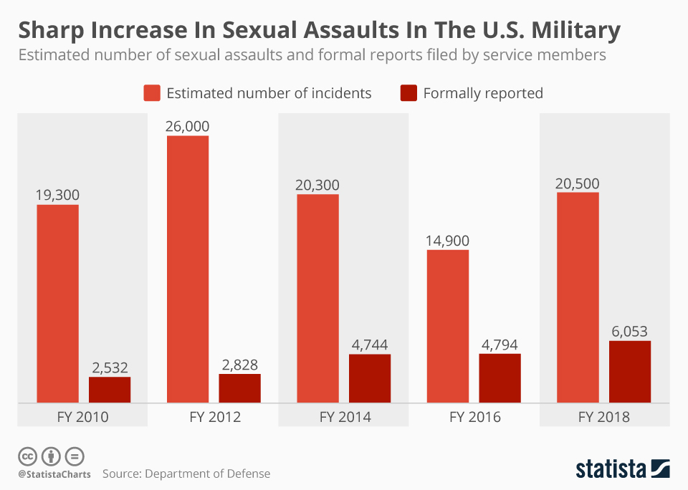
https://www.statista.com/chart/17887/the-estimated-number-of-sexual-assaults-in-the-us-military/?srsltid=AfmBOoqFQVhZRtbiYGuTFy_pL5WAWSl8lU5LIV0Pgc7LiqU-eJBEyV8e

Slide 4
What kind of ‘war’ is this? Who– and what—has been ‘invisible’ to whom?
The nature of this war:
A misogynistic campaign against women in uniform? Survivors’ struggle to overcome PTSD? A campaign to expose a problem whose dimensions are persistently minimized? A battle for recognition/compensation/justice?
(In)visibility:
A highly publicized series of military ‘scandals’ involving harassment/assault
The lesser visibility of uniformed women of colour
The marginalization of male survivors in efforts to make this ‘war’ visible

Slide 5
Lecture overview
I: What the UCMJ says about prohibited sexual behaviour
II: A series of ‘scandals’ rendering sexual violence more visible– within and beyond the military
III: Why is sexual harassment/violence so pervasive? What’s productive of ‘rape culture’ in the US military? (NB: not JUST the US military)
IV Military justice– how the US military criminal justice system works
Q for seminar discussion: Is change possible? What and how much would need to change to end the ‘epidemic’ of intra-military sexual violence?

Slide 6
On paper…
The UCMJ promises to punish conduct “unbecoming an officer and a gentleman” (Article 133)
Article 134 prohibits conduct prejudicial to “good order and discipline in the armed forces, [and] all conduct of a nature to bring discredit upon the armed forces”
UCMJ outlaws an array of behaviours relating to sex and intimate relationships:
Rape (Article 120): “an act of sexual intercourse with a female not his wife, by force and without her consent” (revised 1992)
Sodomy (Article 125): “unnatural carnal copulation” with “another person of the same or opposite sex or with an animal.”
http://www.msnbc.com/msnbc/why-the-military-still-bans-sodomy
Adultery (until Jan. 2019) defined as sexual intercourse between a man and a woman– “specifically the variety that can produce offspring”). Unmarried soldiers (M or F) could be court-martialed for adultery if they slept with a married person.

Slide 7
The Tailhook Scandal (1991)
At an annual officers’ convention held at the Hilton in Las Vegas, more than 100 US Navy and Marine Corps aviation officers sexually assaulted 83 women and seven men, or otherwise engaged in "improper and indecent" conduct.
Demonstrators beat the effigy of a Navy flier while protesting sexism in the military in front of then-Naval Air Station Miramar in 1992, a year after the Tailhook scandal. U-T file photo
https://www.sandiegouniontribune.com/opinion/commentary/sdut-utbg-tailhook-navy-women-2016sep01-story.html
Read a contemporary press account: https://www.latimes.com/archives/la-xpm-1993-04-24-mn-26672-story.html

Slide 8
The Aberdeen Proving Ground Scandal (1996)
On Nov. 7, 1996, the Army announced that three male trainers at Aberdeen Proving Ground– a northern Maryland training base—had been charged with rape, abuse and harassment of female soldiers under their supervision.
Accusations against other soldiers followed, and the Army soon found itself mired in a scandal exposing rampant sexual assault and abuse of authority among male drill sergeants and the female soldiers whose lives they virtually controlled.
Read a contemporary press account:
https://www.washingtonpost.com/wp-srv/local/longterm/library/aberdeen/caution.htm
What a retired major general says the army learned from this episode, 20 years on:
https://www.armytimes.com/opinion/2016/11/08/20-years-on-what-the-army-s-learned-from-the-aberdeen-sex-scandal/

Slide 9
US Air Force Academy (USAFA) scandal 2003 +
12% of the women who graduated from the Air Force Academy in 2003 reported that they were victims of rape or attempted rape while at the Academy
70% of the 579 women at the Academy alleged they had been the victims of sexual harassment
22% said they experienced "pressure for sexual favors”
The allegations made by four women “whistle-blowers” in 2003 triggered a major investigation and prompted the DoD to do (or be seen to be doing) more to address endemic sexual violence in the armed forces
More recent sexual assaults have also been reported at the USAFA:
CBS News report 2017
https://www.cbsnews.com/news/air-force-academy-sexual-harassment-retaliation-allegations/
Read more on the 2003 USAFA scandal:
https://www.vanityfair.com/news/2003/12/airforce200312

Slide 10
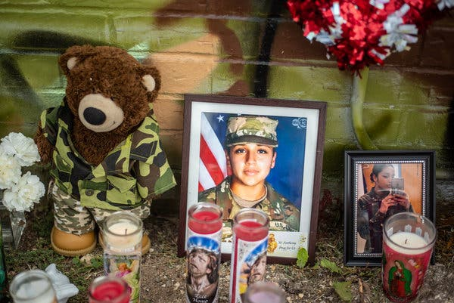
The Vanessa Guillén case (2020)
In April 2020, 19 year-old Army Specialist Vanessa Guillén was bludgeoned to death in an armory by another Specialist at Fort Hood, TX– a 20 year-old male soldier, who later killed himself. He was having an affair with a married female soldier and purportedly thought Guillén might expose his violation of the UCMJ.
Investigators found Guillén had endured harassment by her supervisor, which unit leaders had failed to address despite the problem being repeatedly reported.
The base in general was found to have a command climate “permissive of sexual harassment and sexual assault.”
https://www.nytimes.com/article/vanessa-guillen-fort-hood.html

Slide 11
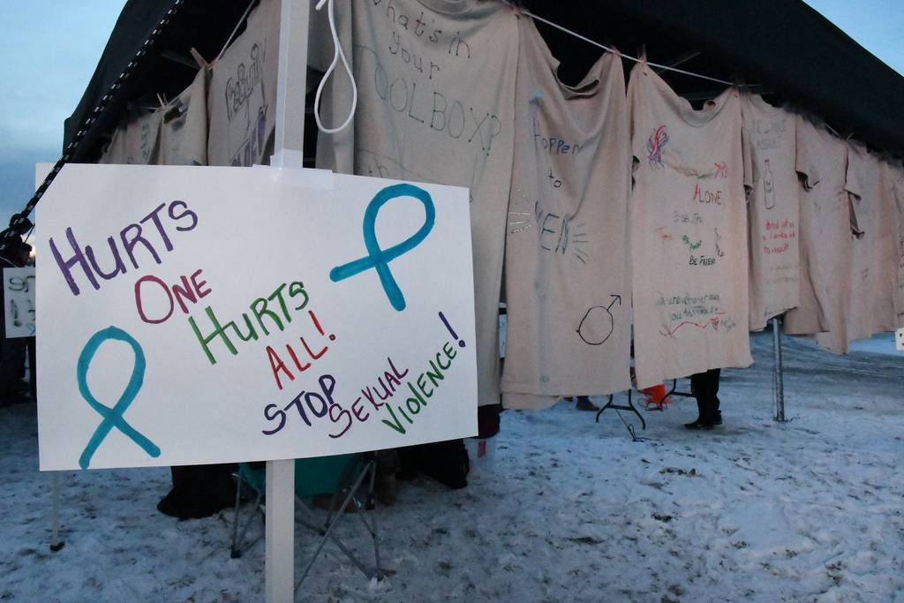
WHY?

Slide 12
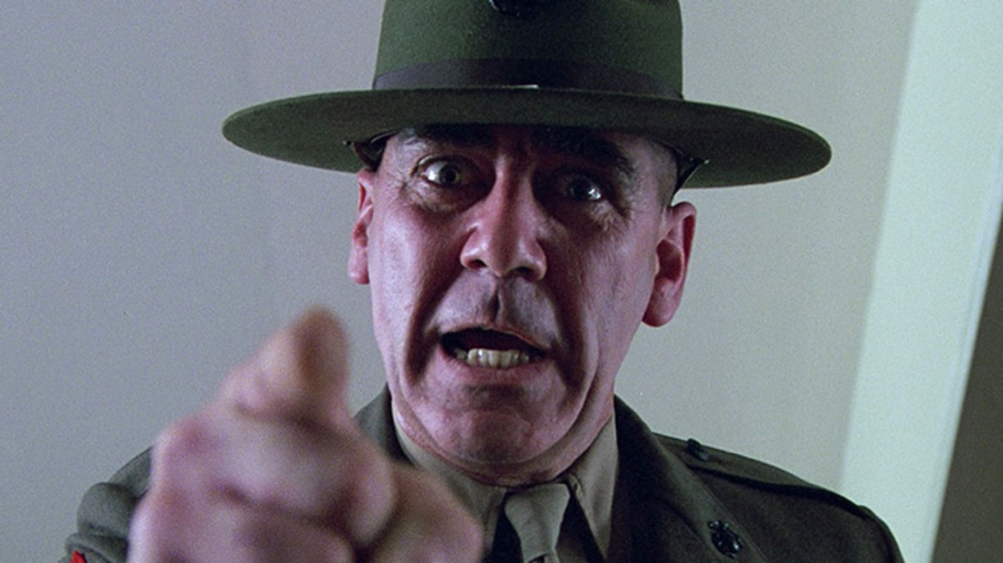
Elements of rape culture: Adversative training
Watch a clip from Full Metal Jacket– a Stanley Kubrick film released in 1987 about the Vietnam war–
for a purportedly quite realistic representation of a US Marine Corps drill sergeant in action:
https://www.youtube.com/watch?v=j8OyjTkWhcA

Slide 13
Pervasive misogyny: Jody chants
“Jody this and Jody that Jody is a real cool cat Ain’t no use in calling home Jody’s on your telephone Ain’t no use in going home Jody’s got your girl and gone Ain’t no use in feeling blue Jody’s got your sister too”
U.S. Army marching cadence, 1944
Watch a Jody cadence being performed in 2010
https://www.youtube.com/watch?v=dBIEUbqEhvE
https://slate.com/human-interest/2016/03/the-secret-history-of-the-name-jody.html

Slide 14
Hazing rituals/gendered degradation
Read a 2015 report by RAND on hazing in the military, with recommendations for its suppression:
https://www.rand.org/content/dam/rand/pubs/research_reports/RR900/RR941/RAND_RR941.pdf
The DoD Definition of Hazing Can Be Improved
The definition should include qualities that distinguish hazing from other types of abuse and mistreatment
It should clarify the role of authority figures and the individual's responsibility
It should consider the addition of more objective terms in describing harm, such as "psychological injury" or "extreme mental stress" and provide current examples

Slide 15
Pornography
Pornography use is pervasive, and becoming ever more prevalent,
in the US military. Does this phenomenon help explain why sexual
assault is so rife in the armed forces?
“…. in an interview with the Army Times, Navy Lt. Michael Howard, a licensed therapist and military chaplain, believes that at least 20 percent of the military is addicted to online pornography. The common theme among many military chaplains is that addiction to internet pornography is one of the biggest, if not the biggest, personal problem facing our military members today.
It is not uncommon for military members to come home from a deployment addicted to pornography. Military spouses often complain about these devastating addictions post-deployment.”
The Public Discourse, June 2013
https://www.thepublicdiscourse.com/2013/06/10360/
For a left/feminist critique of porn use in the military:
https://www.counterpunch.org/2010/06/18/pornography-and-the-military/
Does pornography encourage
sexual violence against women?
Radical feminist Dworkin made
the case in this 1981 classic.

Slide 16
The Military Criminal Justice System

Slide 17
Obstacles to reporting
In 2009, a report estimated that 80% of military sexual assault survivors do not report crimes perpetrated against them. Why not?
Fear of betraying colleagues in tight-knit units living in close quarters; ostracism
Threats of retaliatory violence made by perpetrators
Pvt. Jessica Bleckley (17), one of the Aberdeen Proving Ground victims, said that the drill sergeant who demanded she have sex with him warned her: “if I told anybody… he would cut my throat, that he knew ways of killing people where no one would find out who did it” (quoted in Newsweek, 25 Nov. 1996)
Fear of being accused of homosexuality– especially before repeal of DADT
Married victims of sexual violence fear being court-martialed for adultery
Victims may be discharged on mental health grounds
LOW EXPECTATIONS THAT A PERPETRATOR WILL BE CONVICTED & PUNISHED

Slide 18
The chain of command
Q: How to report up the chain of command if your commanding officer is the perpetrator or a friend of the perpetrator?
Commanding officers decide:
whether or not to investigate a charge
whether it’s subsequently brought to trial
and they can intervene to overturn the outcome
To better understand the concept of the chain of command and why it looms
so large in debates over how to address sexual violence in the military, watch this
7 minute video from the New York Times (June 19, 2021):
https://nyti.ms/3iaVn5X
https://www.nytimes.com/2021/06/19/opinion/sunday/inhofe-reed-military-sexual-assault-gillibrand.html

Slide 19
Courts-martial
The US military tries service personnel in three different
types of courts-martial, depending on the severity of the
charges: summary, special, and general.
A general court-martial– for serious offenses, including
sexual assault—consists of not less than five
members and a military judge. (JAGs are military personnel)
Since 2013, sexual assault victims may be represented by
a Special Victim’s Counsel.
Military Rule of Evidence 412 prohibits either side from
presenting evidence of a victim's past sexual behaviour
and “sexual predisposition.”
A general court-martial may adjudge any punishment not prohibited by the UCMJ, including death.
https://www.military.com/benefits/military-legal-matters/courts-martial-explained.html
Read about how the USAF handles sexual assault cases by court martial:
https://www.af.mil/News/Commentaries/Display/Article/586763/general-courts-martial-for-sexual-assault-how-do-they-work/

Slide 20
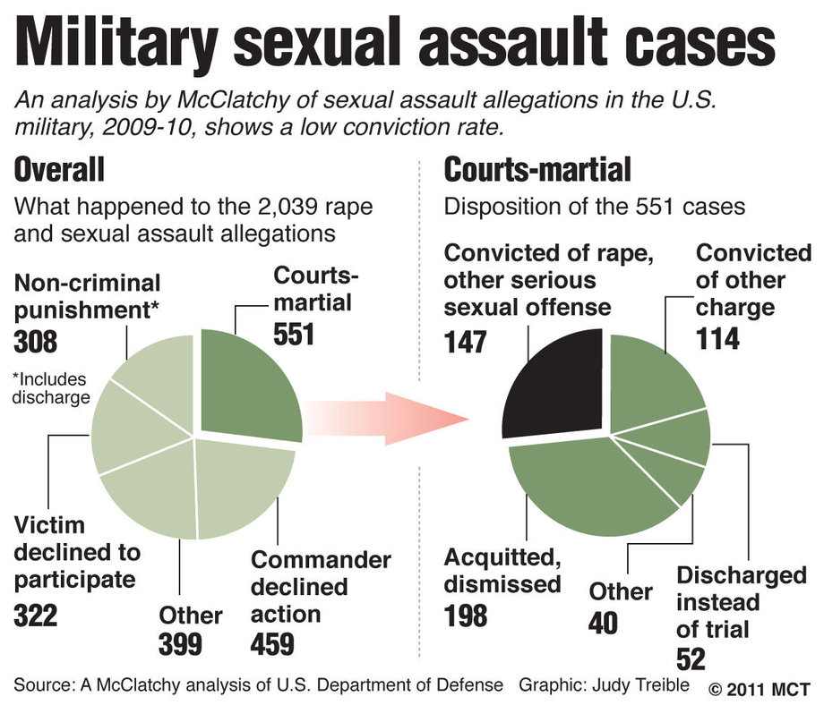
https://www.stopvaw.org/uploads/mcclatchy_graphic.jpg

Slide 21
The US civil justice system: The Feres Doctrine
Q: Why don’t victims of sexual assault who are military personnel
or veterans use the civilian judicial system to seek redress?
The Feres doctrine, established in 1950, prevents servicemembers from suing based on any injuries that “arise out of or are in the course of activity incident to service.”
The Feres doctrine’s domain has stretched to prevent just about anyone from suing the military, including victims of rape.
Servicemembers have been effectively blocked from civil courts.
The doctrine comes from the U.S. Supreme Court case Feres v. United States, in which servicemen who picked up highly radioactive weapons fragments from a crashed airplane were not permitted to recover damages from
the government.

Slide 22
Institutional Reform
Can military culture be changed?

Slide 23
What has the military done?
2005: Defense Task Force established
DoD Sexual Assault Prevention and Response Office (SAPRO) https://www.sapr.mil
Clearer and more robust definitions of sexual assault and rape, as well as what constitutes ‘consent’ or the lack thereof
Mandatory training; by-stander intervention programs
Preventive measures, including outlawing hazing rituals, ‘Jodies’
Appointment of SAPR officers
Better support for survivors, including allowing the latter a right NOT to initiate a formal complaint; recognition of the relationship between sexual assault and PTSD; provision of appropriate professional treatment
Open or closed (unrestricted or restricted) reports. Watch a video explaining the difference.
2016: DOD announces more support to male victims of sexual assault
https://www.defense.gov/Explore/News/Article/Article/1030795/dod-unveils-plan-to-broaden-sexual-assault-support-to-men/
USAFA: https://www.usafa.edu/cadet-life/cadet-support-services/sexual-assault-response/

Slide 24
Recent revisions of the UCMJ
2019: Changes to the UCMJ, including articles relating to adultery, sexual violence and intimate partner violence (expanded to include violence against former partners and non-spouses)
Adultery now encompasses same-sex relationships, but excludes legally separated people from its definition
Cyberstalking has been added as a crime
Article 132, Retaliation. It is now illegal to misuse authority in an attempt to retaliate against a person for making a complaint or reporting a crime.
It is also illegal to discourage someone from making a complaint or reporting a crime.
https://www.militarytimes.com/news/your-army/2019/01/15/heres-what-you-need-to-know-about-the-biggest-update-to-ucmj-in-decades/

Slide 25
DOD reform initiatives
The Pentagon’s Sept. 2021 report– aimed to remove sexual assault investigations and courts-martial from the chain of command
“First on the agenda is establishing offices for special victims prosecutors, who will assume responsibility for filing charges and sending cases to courts martial. Next will be creating a workforce of independent investigators for sexual harassment, a policy that will include initiating involuntary separation for any service member with a substantiated report against them.”
The four-tiered system includes multiple deadlines, starting in 2027 and continuing through 2030 for the more specific of the 82 recommendations the commission handed down.
Read more: https://www.militarytimes.com/news/pentagon-congress/2021/09/22/pentagon-unveils-new-sexual-assault-response-plan-with-a-deadline-of-up-to-8-years/

Slide 26

On Capitol Hill
In April 2021, Kirsten Gillibrand (D- senator for New York) reintroduced the Military Justice Improvement and Increasing Prevention Act
In May, Gen. Mark Milley, chairman of the Joint Chiefs of Staff, indicated that he no longer opposed the bill.
Senator Joni Ernst, a Republican from Iowa, a sexual-assault survivor and a retired lieutenant colonel in the National Guard, co-sponsored the legislation, having previously opposed it.
Ernst has said that she had a change of heart because she spent years working to address the issue of military sexual assault within the existing system, yet “we are not seeing a dent in the numbers.”
https://www.nytimes.com/2021/08/03/magazine/military-sexual-assault.html
Gillibrand (official portrait 2019)

Slide 27
Executive Order Changes How Military Handles Sexual Assaults
Aug. 1, 2023 | By C. Todd Lopez , DOD News |
The president [Biden] on Friday signed an executive order that changes how some crimes — including sexual assault, domestic violence, child abuse and murder — are handled within the military justice system.
The executive order makes changes to the Manual for Courts-Martial. The changes, among other things, move responsibility for the handling of such crimes away from military commanders to independent military prosecutors, who are outside the military chain of command.
The order also:
Establishes that prosecutorial decisions made by the special trial counsel are binding and are fully independent from the military chain of command.
Clearly delineates the relationship and authorized interactions between special trial counsel and commanders to protect the independence of the special trial counsel.
Updates the procedures necessary to protect victims and the accused before, during and after court -martial proceedings.
https://www.defense.gov/News/News-Stories/Article/Article/3479106/executive-order-changes-how-military-handles-sexualassaults/#:~:text=The%20executive%20order%20makes%20changes,the%20military%20chain%20of%20command.
The DOD claims these reforms are having a positive effect:
https://www.war.gov/News/News-Stories/Article/Article/3779672/dod-report-prevalence-of-sexual-assault-declined-across-services-in-2023/

Slide 28
Activism for justice and change
“The Service Women’s Action Network (SWAN) is the voice of women who have served or are currently serving in the military. We are a member-driven network dedicated to supporting, connecting and advocating for the individual and collective needs of service women”
Protect our Defenders provides free legal and other assistance for military sexual assault survivors, including active-duty service members, veterans, and civilians.
https://www.protectourdefenders.com/
For a critique of how little change the DOD has effected:
https://www.protectourdefenders.com/wp-content/uploads/2019/12/MST-Debunking-Claims-of-Progress.pdf
National Center on Domestic and Sexual Violence
http://www.ncdsv.org/ncd_military_svissues.html
Human Rights Watch
Supporting wrongfully discharged military rape survivors
https://www.hrw.org/sites/default/files/report_pdf/us0516_militaryweb_1.pdf
https://www.servicewomen.org
Video testimony from
Protect Our Defenders
https://youtu.be/gp9oJaheJGY

