Slide 1
Sex and the US Military
Seminar week 1

Slide 2
Welcome!
Please introduce yourself to the person(s) sitting next to you
Then chat about the following:
What drew you to this module?
Have you ever spent time in the US? Studied it?
Do you have any personal/familial connection with war & the military?
Do you consider that you grew up in ‘wartime’?
Do you feel that you live in a militarized society? If so, how?
What do you make of Tom Digby’s argument about the connection between gender ideology and militarism? Is he right?

Slide 3
Some important points about the module
Thematic organization
Inter-disciplinary approach
Seminar readings typically include one primary source– produced by someone with first-hand experience of the US military (from within or without)– as well as a couple of scholarly articles/book chapters
Read them in the suggested sequence
If in doubt, ask!
Make use of my office hours– and availability at other times– to ensure you get the most out of the module
Difficult content– please share concerns with me
All of us need to engage in thoughtful/respectful dialogue

Slide 4
Assessment
Participation/engagement (10%): coming to class prepared; contributing to discussion (peer-to-peer and whole-class); asking questions; individual chats
Primary source analysis (40%): due week 5. TBD in week 2
Policy position paper (50%): due week 10. TBD in week 5.
Any questions right now??
NB: detailed descriptions of these tasks are on the module website if you want to look ahead

Slide 5
Today’s readings/themes
Men/women
Heteronormativity/homosociality
Love/hate
Military/family
Soldier (veteran)/civilian
American/‘Other’
Killing/dying
Sex/violence
‘Everydayness’ (mundanity)/exhilaration
War is hell/war is fun
So many antagonistic oppositions! Except for men/men

Slide 6
Thinking critically about primary sources
Before you start reading, investigate the author/creator
As/after you’ve read the source, try to answer the following (if necessary by inference):
Written by whom?
When?
Where?
Published/circulated in what format?
For what audience?

Slide 7
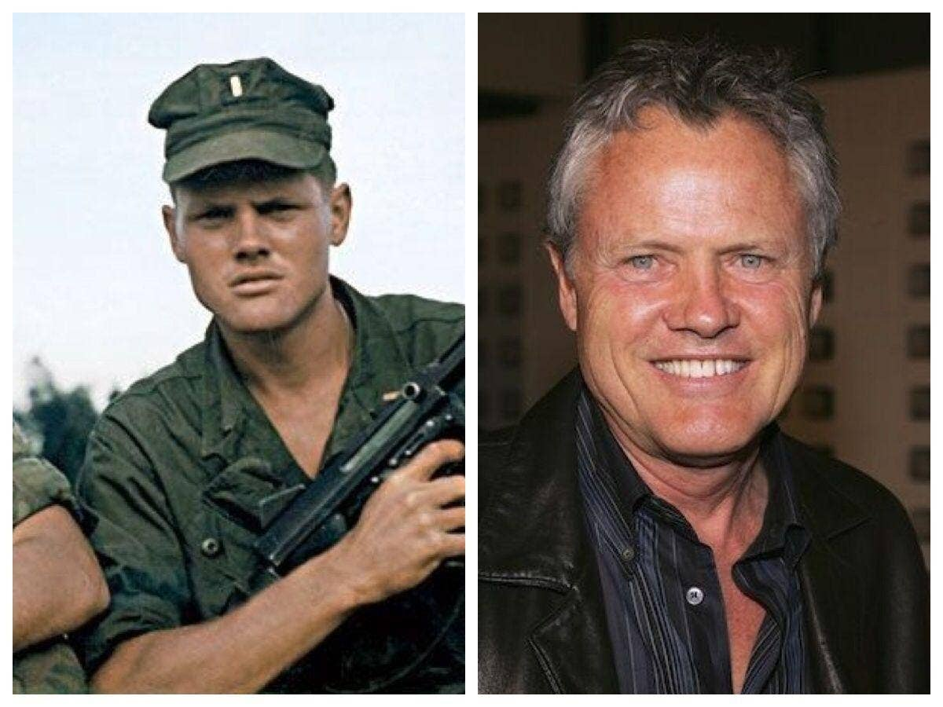
William Broyles Jr. (1944- )
‘Broyles deployed to Vietnam, served as an infantry platoon commander and earned a Bronze Star and a Vietnamese Cross of Gallantry with Silver Star before his illustrious Hollywood career began. Broyles is known for creating the TV show China Beach and for writing such great screenplays as Apollo 13, directed by Ron Howard. Broyles also wrote Castaway and Polar Express, both directed by Robert Zemeckis, Jarhead, directed by Sam Mendes and Flags of Our Fathers, directed by Clint Eastwood.’
https://www.wearethemighty.com/veterans/william-broyles-screenwriter-marine/
Broyles in Vietnam Broyles in Hollywood

