Slide 1
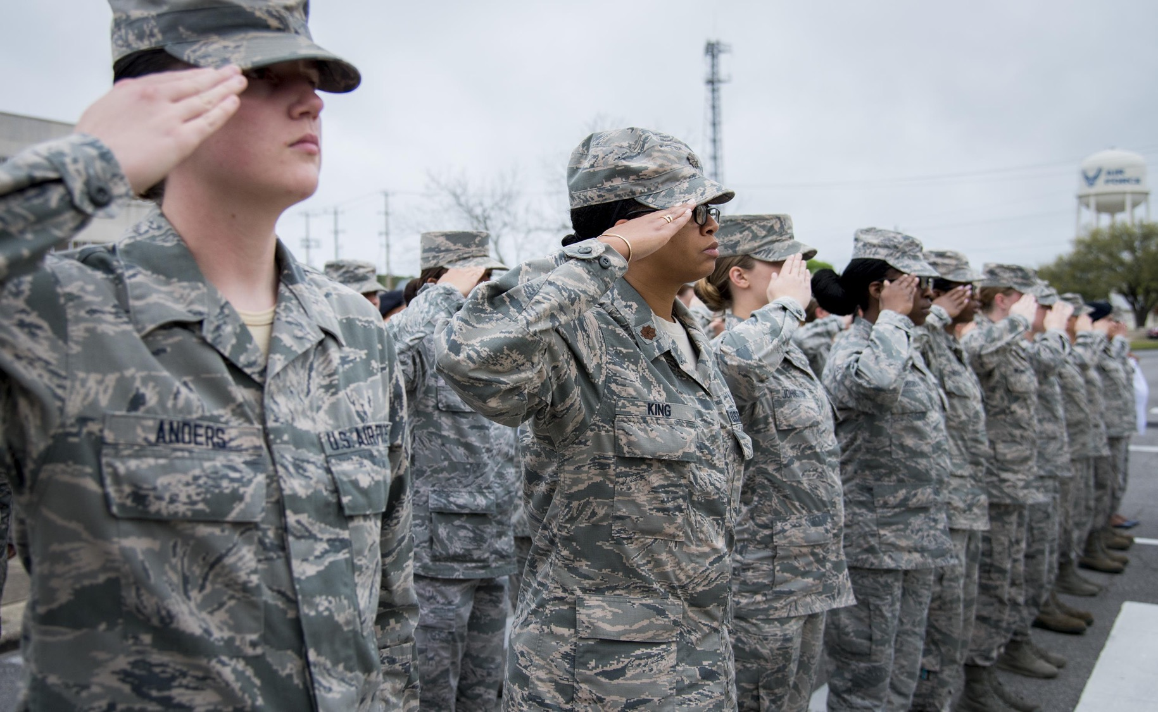
Sex and the US Military
Seminar 1
Week 1, Term 2

Slide 2
Welcome!
Please introduce yourself to the person(s) sitting next to you
Then chat about the following:
What drew you to this module?
Have you ever spent time in the US? Studied it?
Do you have any personal/familial connection with war & the military?
Do you consider that you grew up in ‘wartime’ and/or that your life has been directly impacted by military conflict?
Do you feel that you live in a militarized society? If so, how does militarization manifest itself?

Slide 3
Some important points about the module
Thematic organization
Inter-disciplinary approach
Seminar readings typically include one primary source– produced by someone with first-hand experience of the US military (from within or without)– as well as a couple of scholarly articles/book chapters
Read them in the suggested sequence
If in doubt about anything, ask!
Make use of my office hours– and availability at other times– to ensure you get the most out of the module (Tues 2-3pm; Weds 11-12am)
Difficult content– please share concerns with me
All of us need to engage in thoughtful/respectful dialogue

Slide 4
Assessment
Participation/engagement (20%): coming to class prepared; contributing to discussion (peer-to-peer and whole-class); asking questions; individual chats. NO written component required.
Policy position paper (80%): due week 10. The whole seminar in week 5 will be devoted to explaining this assignment.
NB: detailed descriptions of this task is on the module website if you want to look ahead.

Slide 5
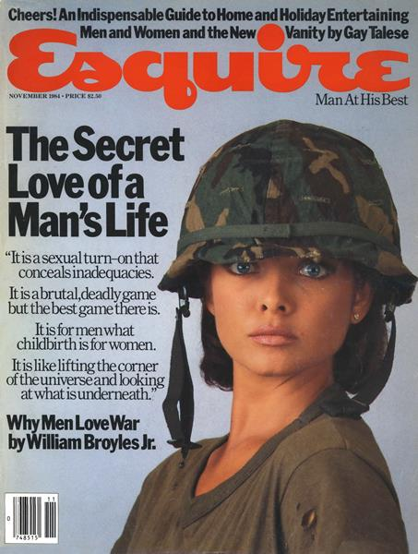
Thinking critically about primary sources
Before you start reading, investigate the author/creator
As/after you’ve read the source, try to answer the following (if necessary by inference):
Written by whom?
When?
Where?
Published/circulated in what format?
For what audience?
1 Nov., 1984

Slide 6
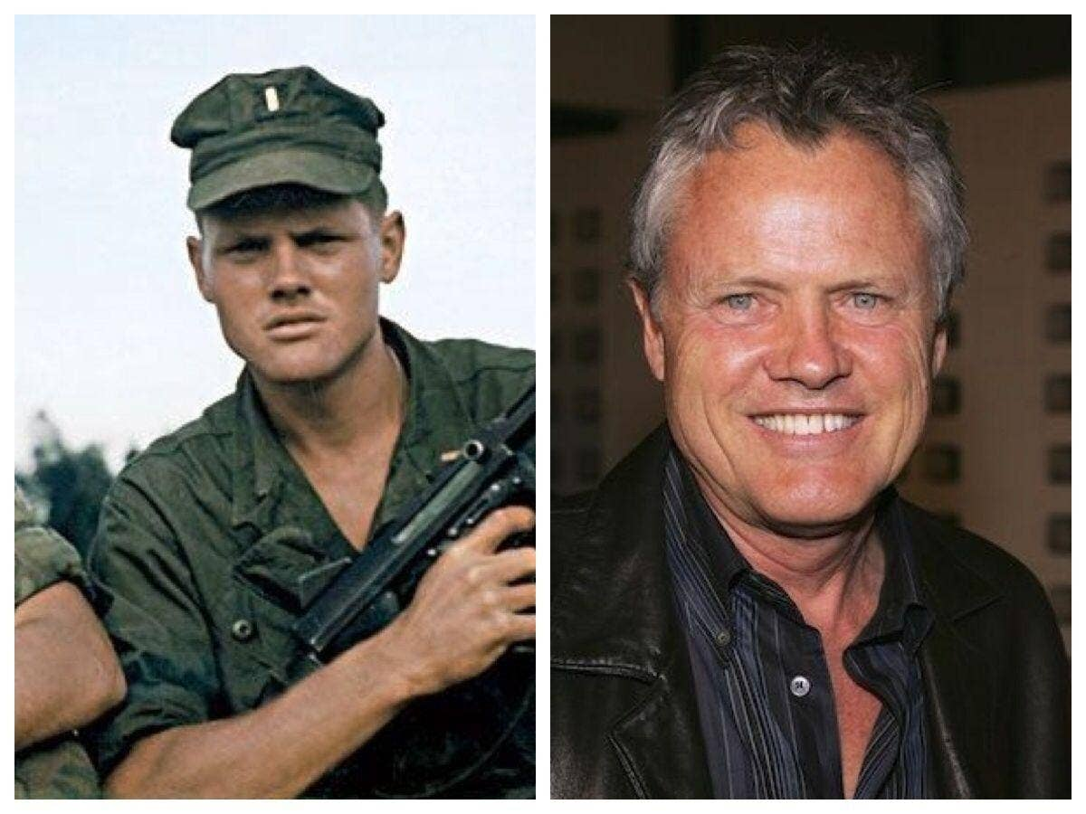
William Broyles Jr. (1944- )
‘Broyles deployed to Vietnam, served as an infantry platoon commander and earned a Bronze Star and a Vietnamese Cross of Gallantry with Silver Star before his illustrious Hollywood career began. Broyles is known for creating the TV show China Beach and for writing such great screenplays as Apollo 13, directed by Ron Howard. Broyles also wrote Castaway and Polar Express, both directed by Robert Zemeckis, Jarhead, directed by Sam Mendes and Flags of Our Fathers, directed by Clint Eastwood.’
https://www.wearethemighty.com/veterans/william-broyles-screenwriter-marine/
Broyles in Vietnam Broyles in Hollywood

Slide 7
Love/sex/war
Are you surprised to find that 'love' looms so large in the lives and language of service personnel and the US military? Why or why not?
According to Broyles, why DO men love war? How do you respond to the claims he makes? Are you persuaded and/or repulsed by what he says about men and women-- love and sex-- in a combat zone?
With reference to Digby’s chapter, do you agree that militarized societies exhibit a particularly rigid gender binary, with a correspondingly adversarial (‘battle of the sexes’) model of heterosexual ‘love’?
Thinking about MacLeish’s account of troops deploying from Fort Hood, what variety of things does love mean in military contexts? And what does love do in/for the US military?

Slide 8
A world of binary oppositions:
Men/women
Heteronormativity/homosociality
Love/hate
Military/family
Soldier (veteran)/civilian
American/‘Other’
Killing/dying
Sex/violence
‘Everydayness’ (mundanity)/exhilaration
War is hell/war is fun

