Slide 1
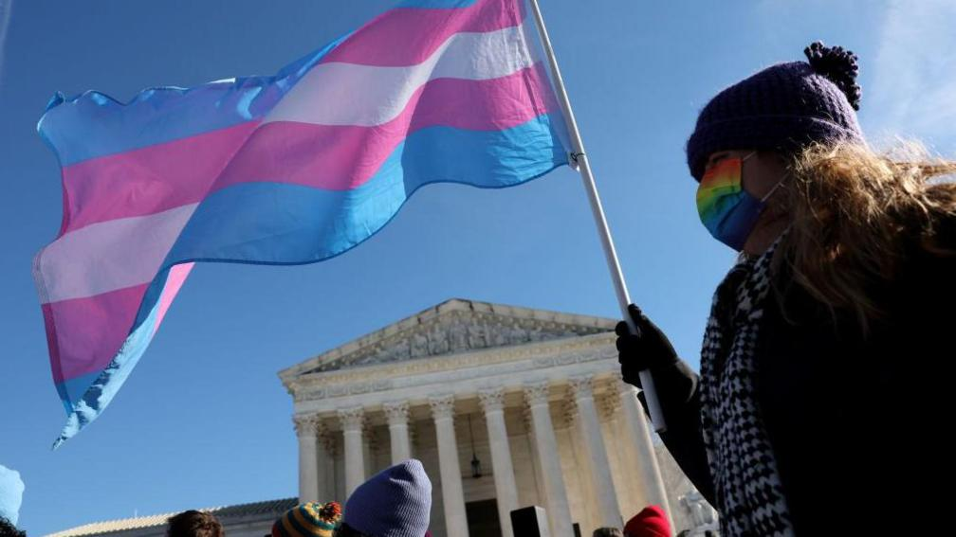
A protester supporting transgender rights outside the US Supreme Court
Sex and the US Military
Seminar week 10
Ongoing battles for inclusion
A protester supporting transgender rights outside the US Supreme Court, 6 May, 2025 (Getty Images)

Slide 2
Trans life “in camouflage”
NYT documentary (2015)
https://www.youtube.com/watch?v=zN7VSeja1dw

Slide 3

‘Pentagon told trans troops to get diagnosed.
It's using the paper trail to kick them out’
NPR [National Public Radio]
UPDATED SEPTEMBER 8, 2025 5:01 AM ET
Eight years ago — under President Trump's first term — Air Force Master Sgt. Logan Ireland needed a doctor's note diagnosing him with gender dysphoria to continue serving his country.
Now, that same doctor's note is the reason why he's being kicked out of service.
Earlier this year, the Pentagon included gender dysphoria as one of the medical conditions that disqualify people from military service.
https://www.npr.org/2025/09/03/nx-s1-5504670/pentagon-trans-troops-gender-dysphoria

Slide 4
Seminar questions
Of all the issues relating to gender and sexuality navigated by the US military, why has transgender service proven the most contentious and unresolved?
Why do conservatives decry what they regard as attempts to use the military as a 'social experiment’? What does this critique reveal?
Should American women be required to register for Selective Service along with male citizens aged 18-25? Why hasn’t this debate attracted much attention?
What are the most striking and/or surprising things that you've learnt by taking this module?

Slide 5

History Module Feedback
Please complete the History Department Module Feedback Form: https://warwick.ac.uk/fac/arts/history/students/currentug/modulefeedbackform
The module code is HI2C6
Your group number is 1 (Mon 4-5);
2 (Weds 9-10) or 3 (Weds 10-11)
Thank you for your feedback!

