Slide 1
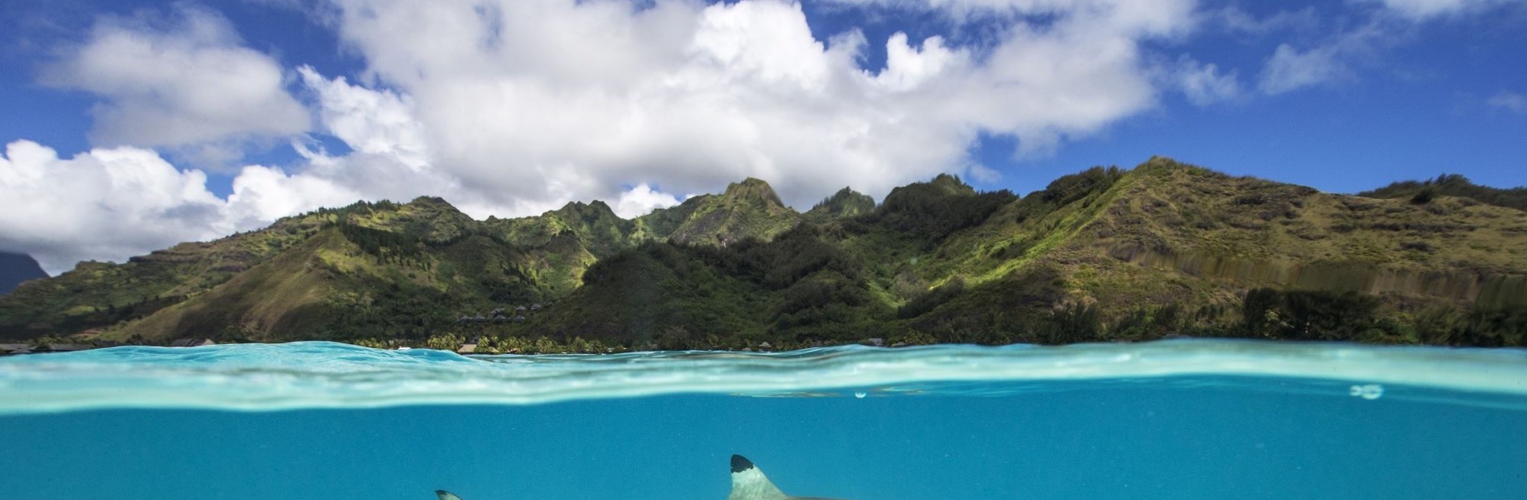

Okinawa: sex work, rape & resistance
HOLIDAY PARADISE OR “Base Island”?

Slide 2
What historical context about Okinawa do we need to help make sense of Child of Okinawa and the 1995 rape case?

Slide 3
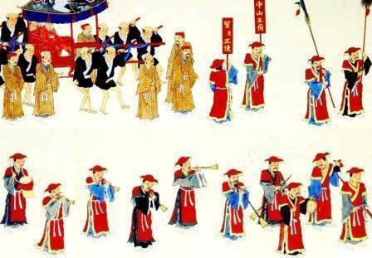
The (China-) Japan-Okinawa relationship
‘Historically the center of the Ryukyu Kingdom, Okinawa long served as a maritime trading hub and cultural gateway; the kingdom participated in the Chinese tributary system—maintaining formal tribute relations with the Ming and Qing—and retained distinct statehood until it was incorporated into Japan as Okinawa Prefecture in 1879 following the Ryukyu Disposition.’
https://en.wikipedia.org/wiki/Okinawa_Prefecture
1710 Ryukyuan mission to Edo
https://en.wikipedia.org/wiki/Okinawa_Prefecture#/media/File:Ryukyuan_mission_in_Edo.jpg

Slide 4
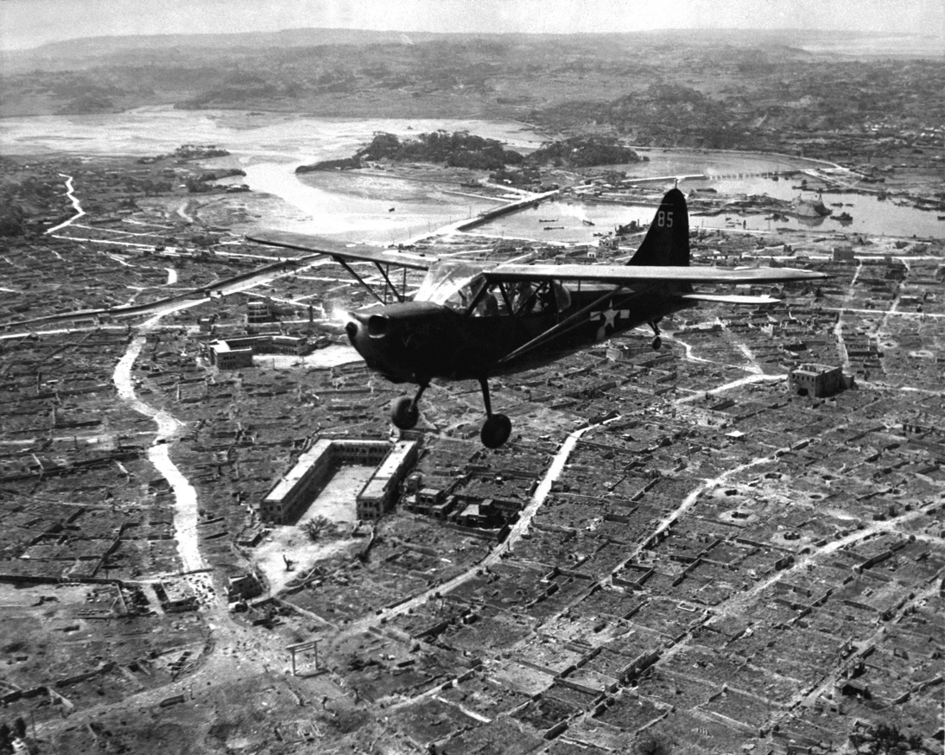
The battle of Okinawa (April-June 1945)
The battle was one of the bloodiest in the Pacific, with approximately 160,000 casualties on both sides: at least 75,000 Allied and 84,166–117,000 Japanese,
including Okinawans impressed into
uniform, died.
149,425 Okinawans were killed, committed suicide or went missing in these months--
an enormous proportion of the pre-war local population, estimated at
300,000.
A U.S. Marine Corps Stinson OY-1 Sentinel observation plane flies low over Naha, capital of Okinawa, ca. May 1945. ARC Identifier: 532379; NARA file no. 127-GR-106-121116; U.S. www.defenseimagery.mil photo no. HD-SN-99-02994.

Slide 5
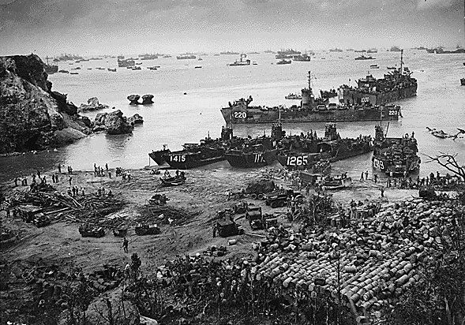
Okinawa - American ships unload supplies on Yellow Beach near the mouth of the Bishi Gawa river on 13 April 1945.
https://en.wikipedia.org/wiki/Okinawa_Prefecture#/media/File:Okinawa_01.jpg

Slide 6
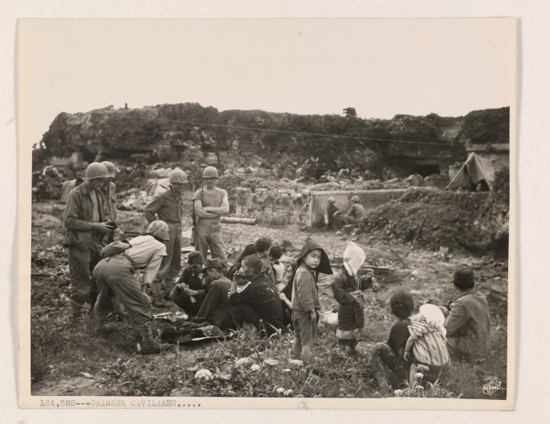
Trauma and
displacement
Local Photo ID: 127-GR-95-124582.
US National Archives
Original Caption:
“OKINAWAN CIVILIANS…
Pictured here are Okinawan men, women, and children who have gathered from caves and make-shift homes by Marines on Oroku Peninsula.”
Photographer: Corporal John J. Curran
https://unwritten-record.blogs.archives.gov/2020/04/02/spotlight-battle-of-okinawa/

Slide 7
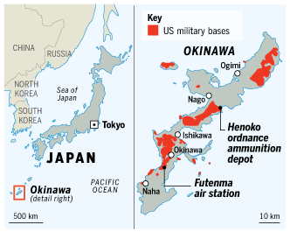
An intensely militarized island
Okinawa Prefecture as a whole accounts for just 0.6% of Japan’s total land area, but is home to 75% of the territory occupied by US military bases in Japan.
Nearly 230 sq km – 10% of Okinawan land – is under US control.
Almost one fifth of the main island is off-limits to local residents.
Okinawa did not ‘revert’ to Japanese sovereignty after WWII until 1972.
https://www.ft.com/content/a0b360b8-ce1b-11de-a1ea-00144feabdc0

Slide 8
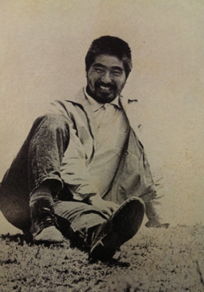
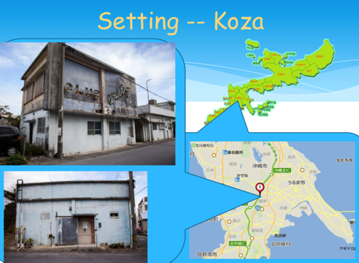
Higashi Mineo, Child of Okinawa (1971)
(b. 1938)
http://takumasminkey.com/readingokinawa/styled-14/

Slide 9
Discussion questions on Child of Okinawa
Why do you think Higashi Mineo chose to tell his story from the perspective of a boy rather than an adult narrator? (How old do you take Tsuneyoshi to be?)
What do we learn from this novella about the sexualization of postwar life in Okinawa?
Which particular scenes, themes or motifs in the novella did you find most striking/revealing?
As historians, do we need to approach fiction in a different way than we would other types of source material? If so, how/why?

Slide 10
‘US marine jailed for seven years for sexual assault in Japan’
Shaimaa Khalil and Flora Drury. BBC News, Reporting from Tokyo and London. Published 24 June 2025
A court in Japan has sentenced a US marine to seven years in prison after finding him guilty of sexually assaulting a woman in Okinawa last year.
Lance Cpl Jamel Clayton, 22, attacked the woman in her 20s, choking her from behind and attempting sexual intercourse, the court ruled.
The case is one of a string involving US servicemen based in the Okinawa archipelago, where more than half of the 54,000 US soldiers serving in Japan are based.
Previous crimes committed by American personnel have sparked anger and protests by locals in Okinawa, the largest of which took place 30 years ago, when tens of thousands took to the street following the rape of a 12-year-old girl.
In the last year alone, there have been four sexual assault cases involving US service members in Okinawa, including air force member Brennon Washington, who was given five years for the rape and kidnapping of an underage girl by a court in December 2024. https://www.bbc.co.uk/news/articles/cwyxjnee9rzo

