Slide 1
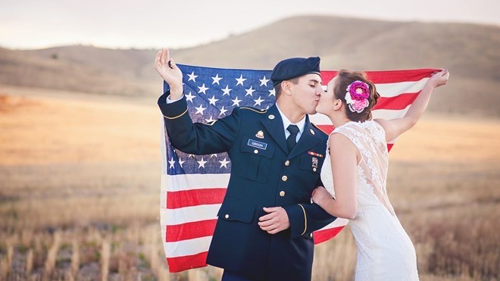
War brides v. army wives
HI2C6 week 3

Slide 2
The Army as a ‘greedy institution’
A social institution that demands total commitment from its members and overrides the established separation of social life into different spheres, such as work, home, leisure, politics, and religion. The best examples of greedy institutions are religious sects, monastic orders, and revolutionary political parties. Companies that seek to develop high levels of organizational commitment and promote a strong culture may also approximate to this form, however, and place heavy demands on their committed employees.
[See work-life balance.]
A Dictionary of Human Resource Management
https://www.oxfordreference.com/display/10.1093/oi/authority.20110803095905791
First coined by sociologist Lewis A Coser in his book Greedy Institutions: Patterns of Undivided Commitment (1974)

Slide 3
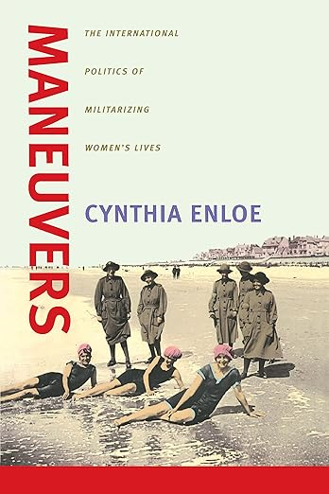

Militarization as a
gendered phenomenon
https://www.clarku.edu/faculty/profiles/cynthia-enloe/

Slide 4
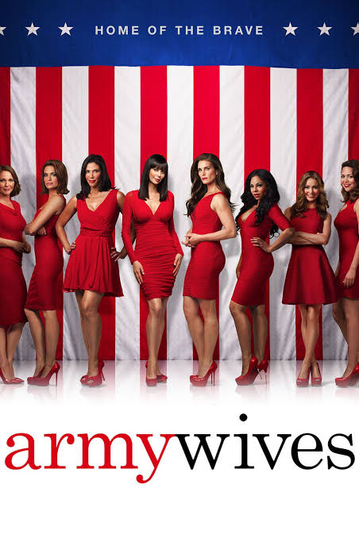
The ‘Army Wife’ as cultural trope
The drama series followed the lives of four army wives, one army husband, and their families. The series premiered on Lifetime on June 3, 2007, and ran for seven seasons, ending on June 9, 2013. During its run, it was nominated for several awards, winning five ASCAP Awards and one Gracie Allen Award.
Based on the non-fiction book originally titled Under the Sabers: The Unwritten Code of Army Wives by Tanya Biank, the series was set at fictional Fort Marshall, in South Carolina. It also featured the fictional 23rd Airborne Division, a component unit of the XVII Airborne Corps.
https://people.com/where-is-the-army-wives-cast-now-11765516

Slide 5

Prescriptive advice for Army wives: a sub-genre of self-help literature
FROM AMAZON.COM
The Military Wife Field Manual was written with you in mind. It's not a guide explaining formal military event dress codes and the finer points of Tricare. No, this book is for you. For your heart and mind. For your silenced dreams and desires. For finding your place as a military wife while still serving your husband well.
In the Military Wife Field Manual, Heather Eberhart is ready to help you shift your mindset and build your strong foundation as a military wife as you
Abandon your resentment toward your husband’s job and cultivate a united family who proudly serves the mission of the military
Discern and engage in your right community, a support system of life-giving individuals
Stop doubting your worth by discovering your identity and breathing life back into your dreams and visions
Step in confidence as a mentor to other military wives needing support
Move from feeling unseen to believing there is hope for a more fruitful military life
(2022)

Slide 6


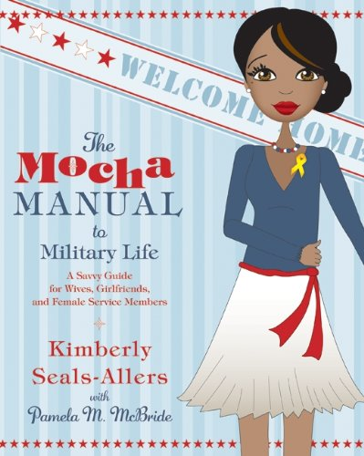

Slide 7
About the authors of What Every Army Wife Should Know
Elizabeth Kinzer Obituary
KINZER ELIZABETH BOUCHER KINZER "Betty”. On Friday, May 16, 2008, died peacefully at her home at The Fairfax Retirement Community. Beloved wife of the late Brig. Gen. John M. Kinzer; dear mother of Jeanne, John and Dan; cherished grandmother and great-grandmother. Graduate of the University of Missouri, Pi Beta Phi, devoted Episcopalian. Daughter of an Army officer, she married an Army officer and beautifully lived the life of an Army wife. She was the author of the etiquette book, "What Every Army Wife Should Know" (Stackpole Books, 1966). Kind and loving to family and friends, she will truly be missed by all who knew her. An interment ceremony will be held at Arlington National Cemetery at 2 p.m., Monday, July 7, followed by a Memorial Service at The Fairfax Retirement Community at 4:30 p.m. Memorial contributions may be made to Food for the Poor or Breast Cancer Research.
https://www.legacy.com/us/obituaries/washingtonpost/name/elizabeth-kinzer-obituary?id=5618116

Slide 8
Marion Floyd Leach
Marion Floyd Leach, graduated in 1943 from Furman College in Greenville, South Carolina
A self-described “army wife” who was married to a Brigadier General
Leach and her husband retired from a long and well-traveled Army career to Beaufort, South Carolina
Leach died early in 2017
https://blogs.furman.edu/library-news/2018/03/20/army-wives-and-womens-military-memoir-collection/

Slide 9
What Every Army Wife Should Know (1966)
What should we note about the authors and the date of publication? Who do we imagine Kinzer & Leach were writing for, and why?
What are the most significant/revealing prescriptions– relating to both behaviour and demeanour– that the authors offer to Army wives? Draw up 5 (or so) bullet points
What’s specific to Army wives that wasn’t required (or not so insistently) of US wives in civilian society?
What does this reading tell us about how institutional ‘greed’ was gendered?

Slide 10
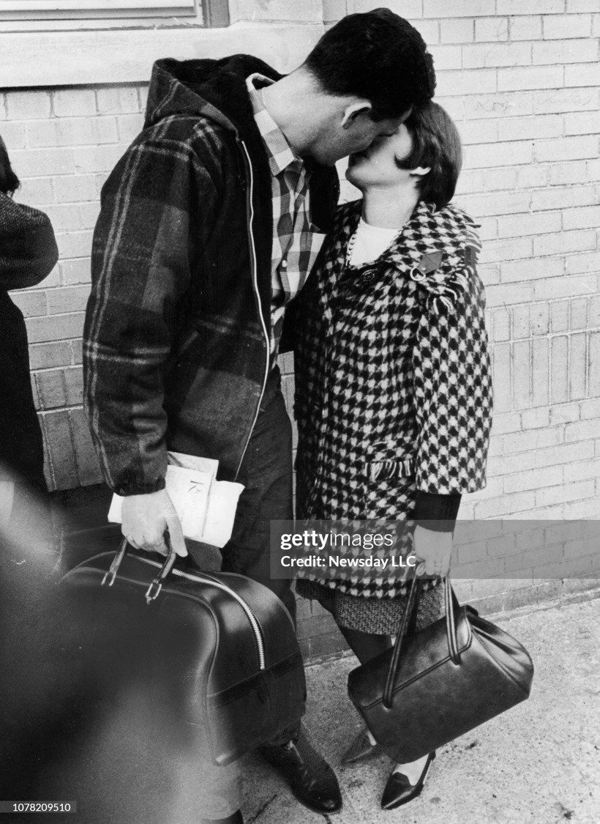
Where’s Vietnam?
By the end of 1966, American forces in Vietnam totalled 385,000, plus an additional 60,000 sailors stationed offshore.
More than 6,000 Americans were killed in this year
30,000 were wounded in 1966
Freeport, N.Y.: Charles Hanigan, 25, of Lindenhurst, New York, kisses his wife Judith goodbye as he is about to board a bus with other Army draftees outside the Draft Board in Legion Hall in Freeport, New York on November 1, 1966. (Photo by Stan Wolfson/Newsday RM via Getty Images)

Slide 11
War Brides
With your neighbours swap notes on what you read for today’s seminar (esp. which chapter of Susan Zeiger’s book). Then share the fruits of your newspaper research.
If you had any problems navigating the ProQuest Historical Newspapers database, please give me a shout and I’ll offer pointers.
Discussion points:
What were the connotations of the term ‘war bride’ in the years immediately after WWII? How would you characterize the treatment of ‘war brides’ in/by the US during the mid-late ‘40s?
If the ‘war bride’ suffered a demise, when and why was that?
In what ways did racism shape attitudes towards war brides and official policy governing bi-national military marriages?
What insights did you gain from looking at historical press stories? Was there anything that particularly surprised you?
Prepare to share a couple of key points with the group as a whole.

