Slide 1
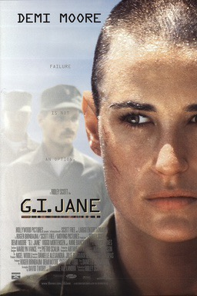

HI2C6
Week 7
Women in combat
1997
https://www.youtube.com/watch?v=5nSlJSfnkWc

Slide 2
https://www.youtube.com/watch?v=aH06LWZs-Ys
First aired September 9, 2001. NB: The phrase ‘band of brothers’ appears in Shakespeare’s Henry V (1599)

Slide 3
Exploring the debate over
‘combat exclusion’
‘Exclusion’
What are van Creveld’s main arguments against women’s inclusion in combat roles?
How convincing (or otherwise) do you find his claims?
What other justifications did opponents of women inclusion in combat roles put forward?
Why did these exclusionary arguments prevail for so long?
‘Inclusion’
Drawing on Lioness, Alvarez & Greenburg, what kinds of gendered labour did women in the US military perform in Iraq and Afghanistan, officially and unofficially?
What particular challenges did women of colour confront?
Do you imagine the ‘performance of femaleness’ succeeded as a counterinsurgency tactic?
How did women’s deployment in these conflicts contribute to the erosion of ‘combat exclusion’?
Q: Why, when all occupational specialties & training
schools were opened to women (2015), wasn’t there
more public reaction to the end of ‘combat exclusion’?

