Slide 1
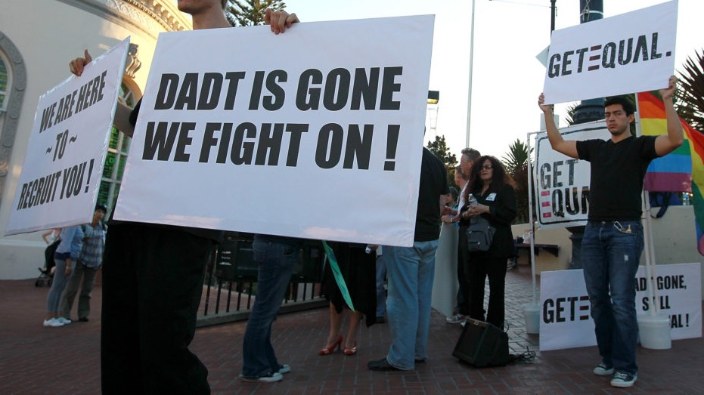
Sex and the US Military
Week 8: DADT and its repeal

Slide 2
Group work exercise: the evolution of LGB military exclusion in the US press
Each team (2-3 people each) works on a different decade: 1960-69; 1970-79; 1980-89; 1990-99; 2000-2009; 2010-20
Log into the ProQuest Historical Newspapers database via Warwick library. Each team member will select a different newspaper (Boston Globe; Chicago Tribune; Nashville Tennessean; NYT; Washington Post or LA Times)
Using the ‘Advanced search’ feature, select the range of years assigned to your team
Then run a keyword search using terms such as ‘homosexual’ AND ‘military’ (or ‘army,’ ‘navy’, ‘marine corps’ etc); ‘lesbian’ AND ‘military’ (or ‘army’, ‘navy’, ‘marine corps’ etc). For more recent decades, try searching with ‘gay’ or ‘queer’ as keywords
Spend 15 mins scanning the results of your search: how many relevant hits did this generate? (If there are 100s of relevant hits for a decade, you might narrow the search down further to a particular year.) What kinds of stories were printed by your newspaper on this topic in the decade in question?
Swap notes with team-mates about your findings, and prepare to report back to the group as a whole about overall trends and particularly revealing stories
Any questions, please give me a shout!

Slide 3
Discussion questions on the readings
  Aaron Belkin has explored the 'queerness' of the US military. How do we square this conception with persistent institutional homophobia in the armed forces?
  If DADT was intended as a 'compromise' between an all-out ban on queer personnel and acceptance of their service, why did many LGB service members regard it as 'worse' than the previous situation?
  Why did DADT seem to have more pernicious consequences for lesbian personnel than their gay male colleagues? (see Damiano)
  Was the repeal of DADT in 2011 a case of 'progress where you might least expect it’? In other words, was the turn to LGB inclusivity a surprising development?

Slide 4
Belkin on the queerness of military masculinity
“The production of masculine warriors has required those who embody masculinity to enter into intimate relationships with femininity, queerness and other unmasculine foils, not just to disavow them. The military has motivated service members to fight by forcing them to embody traits and identifications that have been framed as binary oppositions– masculine/feminine, strong/weak, dominant/subordinate, victor/victim, civilized/barbaric, clean/dirty, straight/queer, legible/illegible, stoic/emotional– and to deny those embodiments at the same time. As such, troops have found themselves entrapped in dense webs of double binds that confuse them and sustain a penchant for obedience and conformity.”
Aaron Belkin, Bring Me Men: Military Masculinity and the Benign Façade of American Empire, 1898-2001 (Columbia University Press, 2012), p.4

