Slide 1
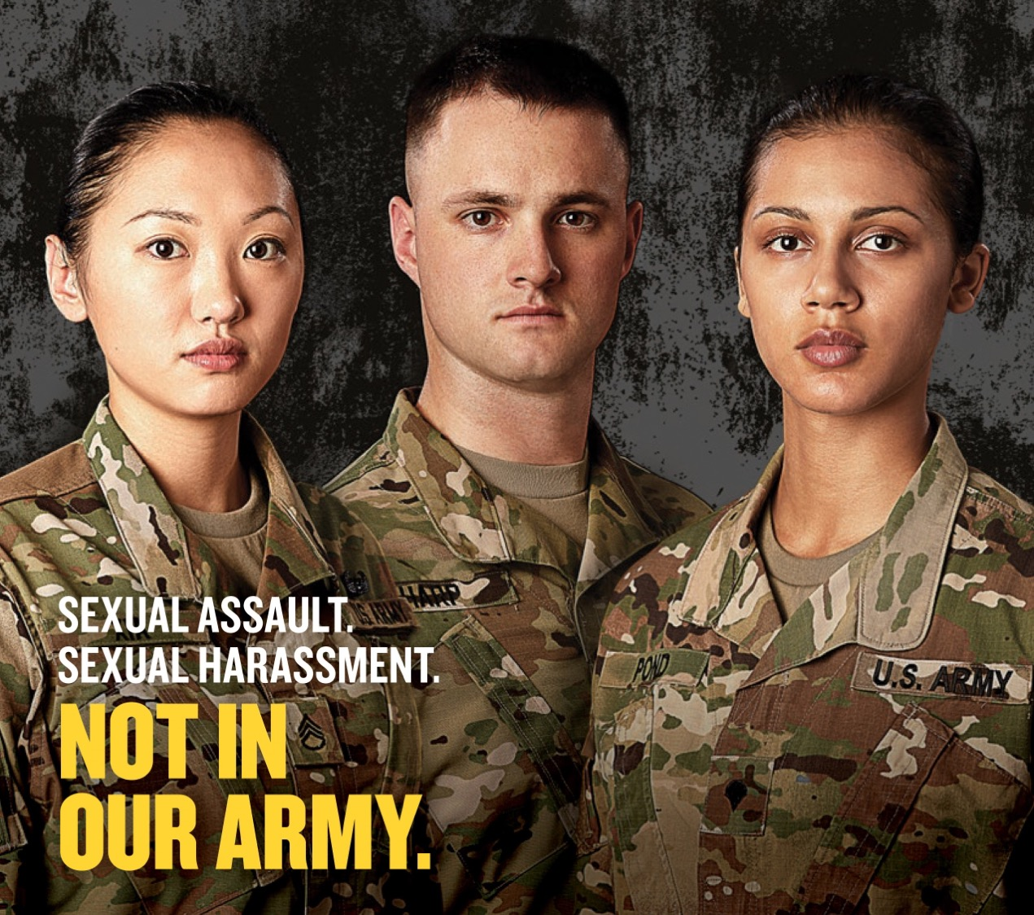
Sex and the US Military
Seminar week 9
Rape and sexual violence in the ranks

Slide 2
The Tailhook Scandal (1991)
New York Times ‘Retro Report’ (2014)
https://www.youtube.com/watch?v=93vW5QZilAw

Slide 3
Discussion questions
What did you find most striking, surprising and/or shocking from the
reading/podcast as you prepared for class and from watching
the NYT Tailhook video?
Why has sexual assault been so pervasive in the US armed forces? What do
you think is least well understood about this issue?
3. Do you anticipate that the 2023 reform of the military judicial system will:
(a) lower rates of sexual violence
(b) increase the number of sexual assaults/rapes reported
(c) increase conviction rates?
Do you think the military is capable of meaningful institutional change?
If so, what would be required to bring that about?

Slide 4
NYT ‘Chain of Command’ video (2021)
https://www.nytimes.com/video/opinion/100000007737321/sexual-assault-military-ernst-gillibrand.html?smid=pl-share

