Slide 1
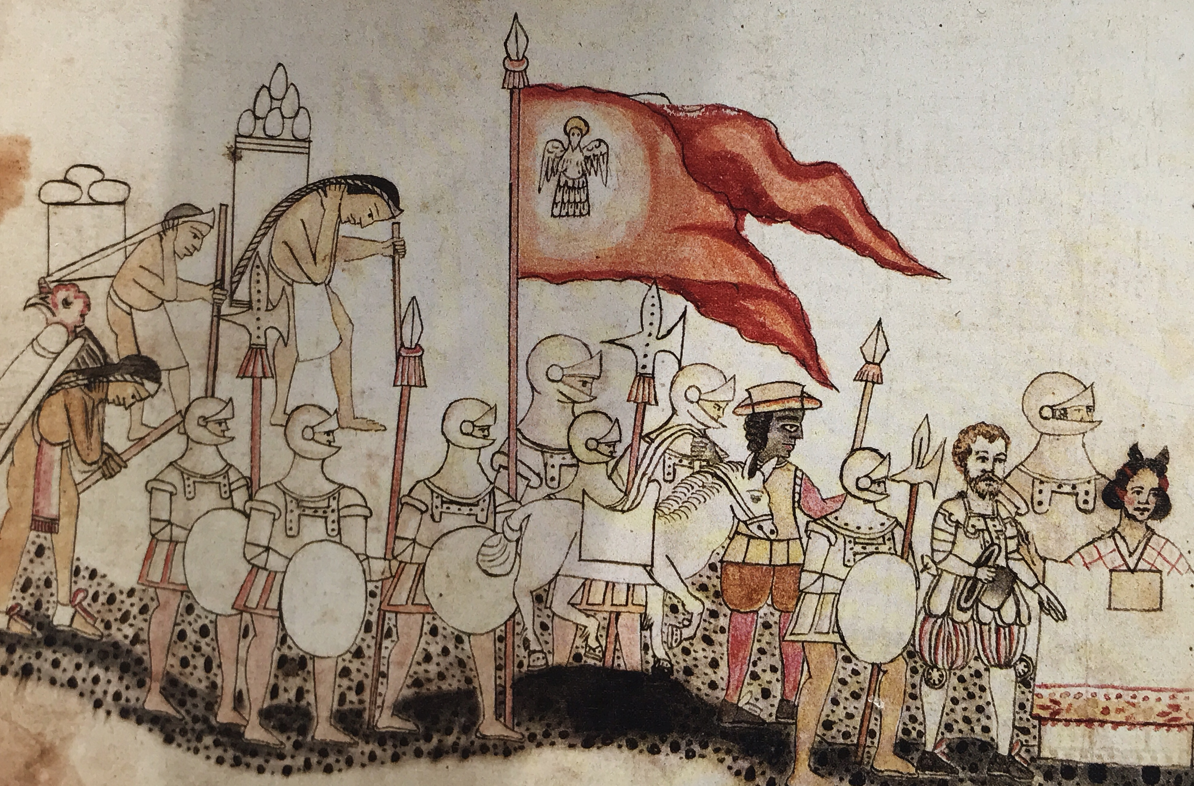
Expansion and Encounter
WEEK 2

Slide 2
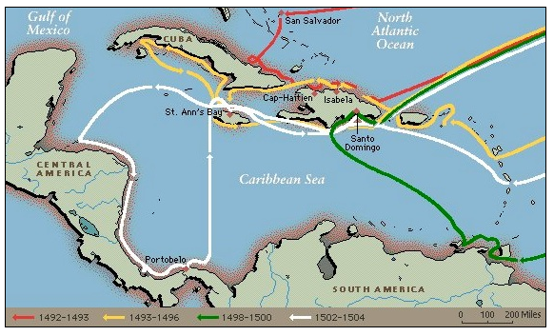

Slide 3
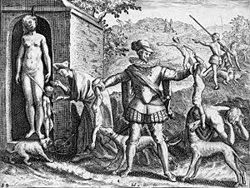
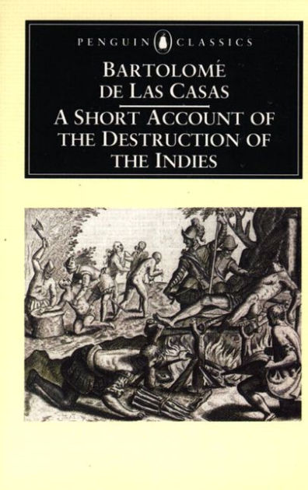
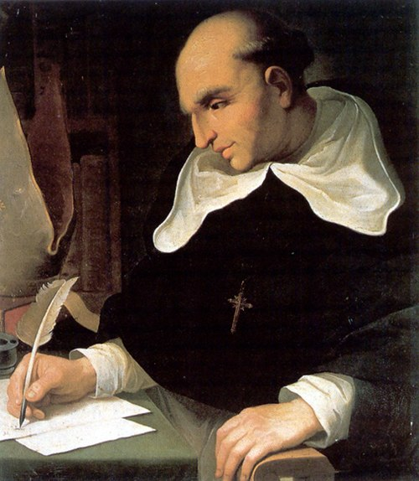

Slide 4
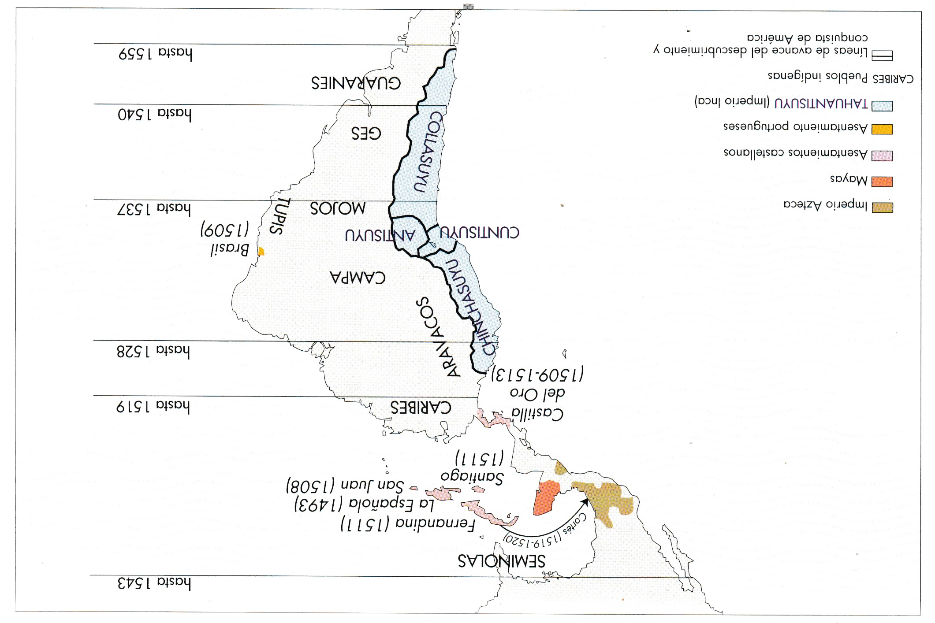

Slide 5
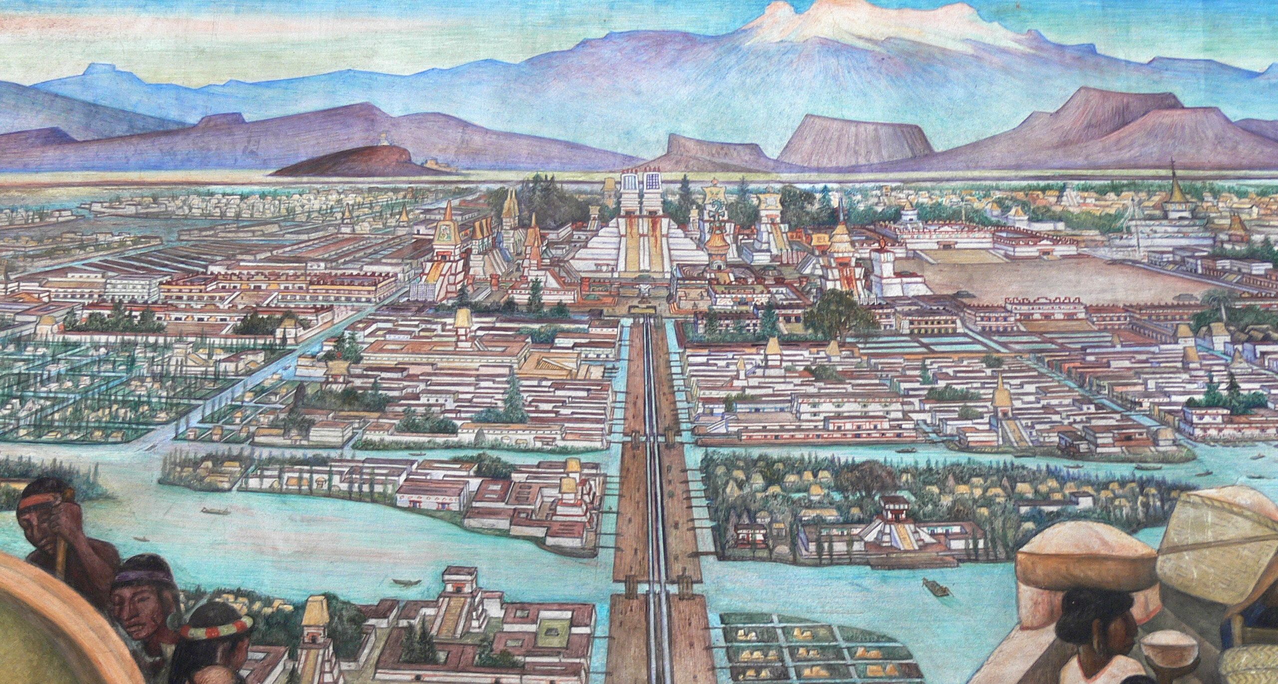
The Aztec Empire

Slide 6
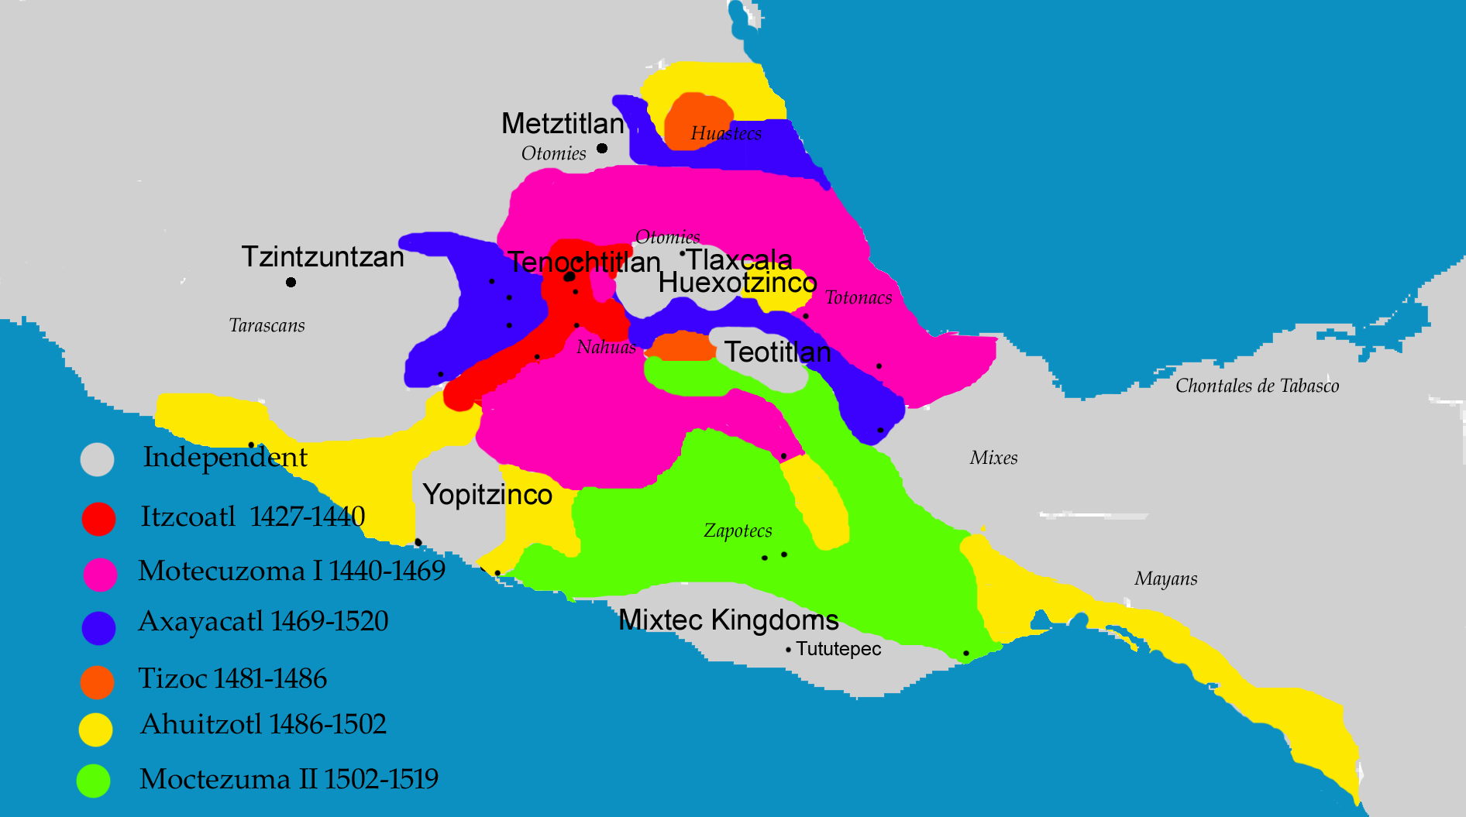
Aztec Empire: 1427-1519

Slide 7
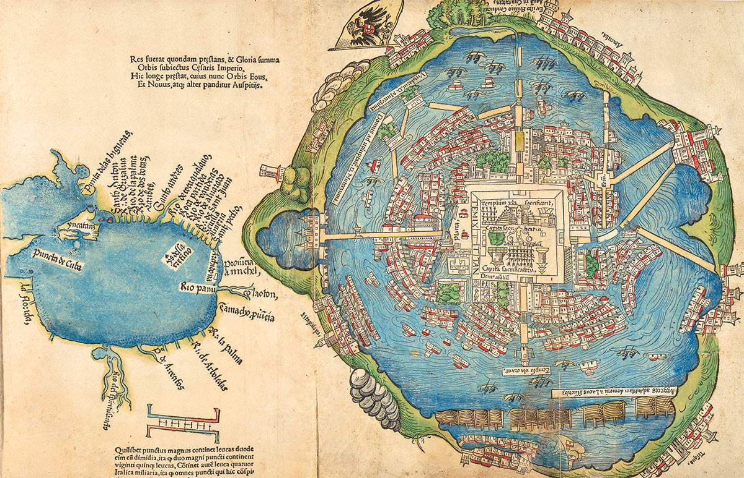
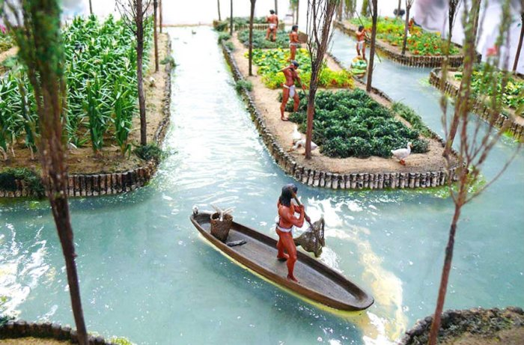
Tenochtitlán and the Gulf of Mexico, unknown artist, 1524. Based on a map presented to Cortés by the Mexica. Library of Congress
Chinampas

Slide 8
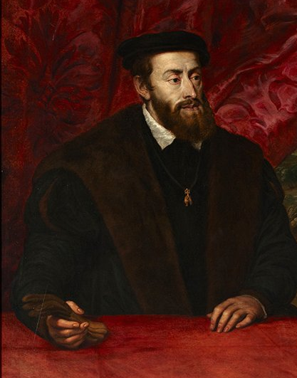
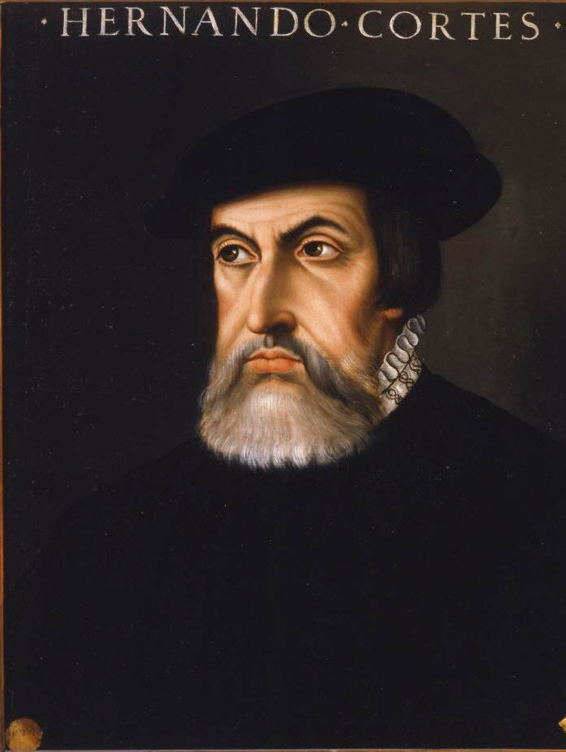
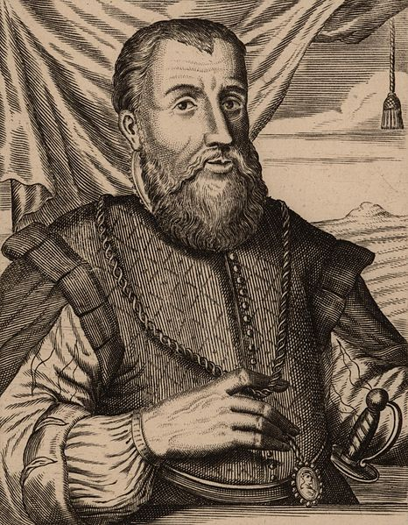
The Conquest of MEXICO
1516-1518: Reconnaissance missions to the mainland. From Cuba: Diego Velázquez reconnoitres Yucatán. rivalry with Cortés
1518: Hernán Cortes departs for the mainland
22 April 1519: Arrives in Pontonchán.
Cortes founds Veracruz
Exploitation of rivalries (alliance with Tlaxcalans, among others)

Slide 9
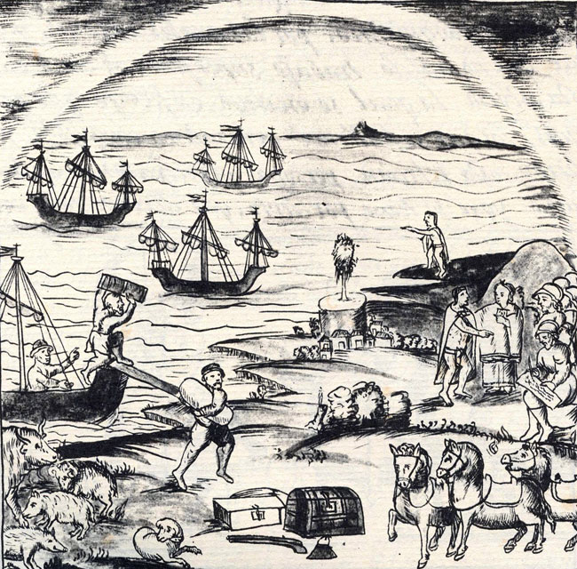

Slide 10
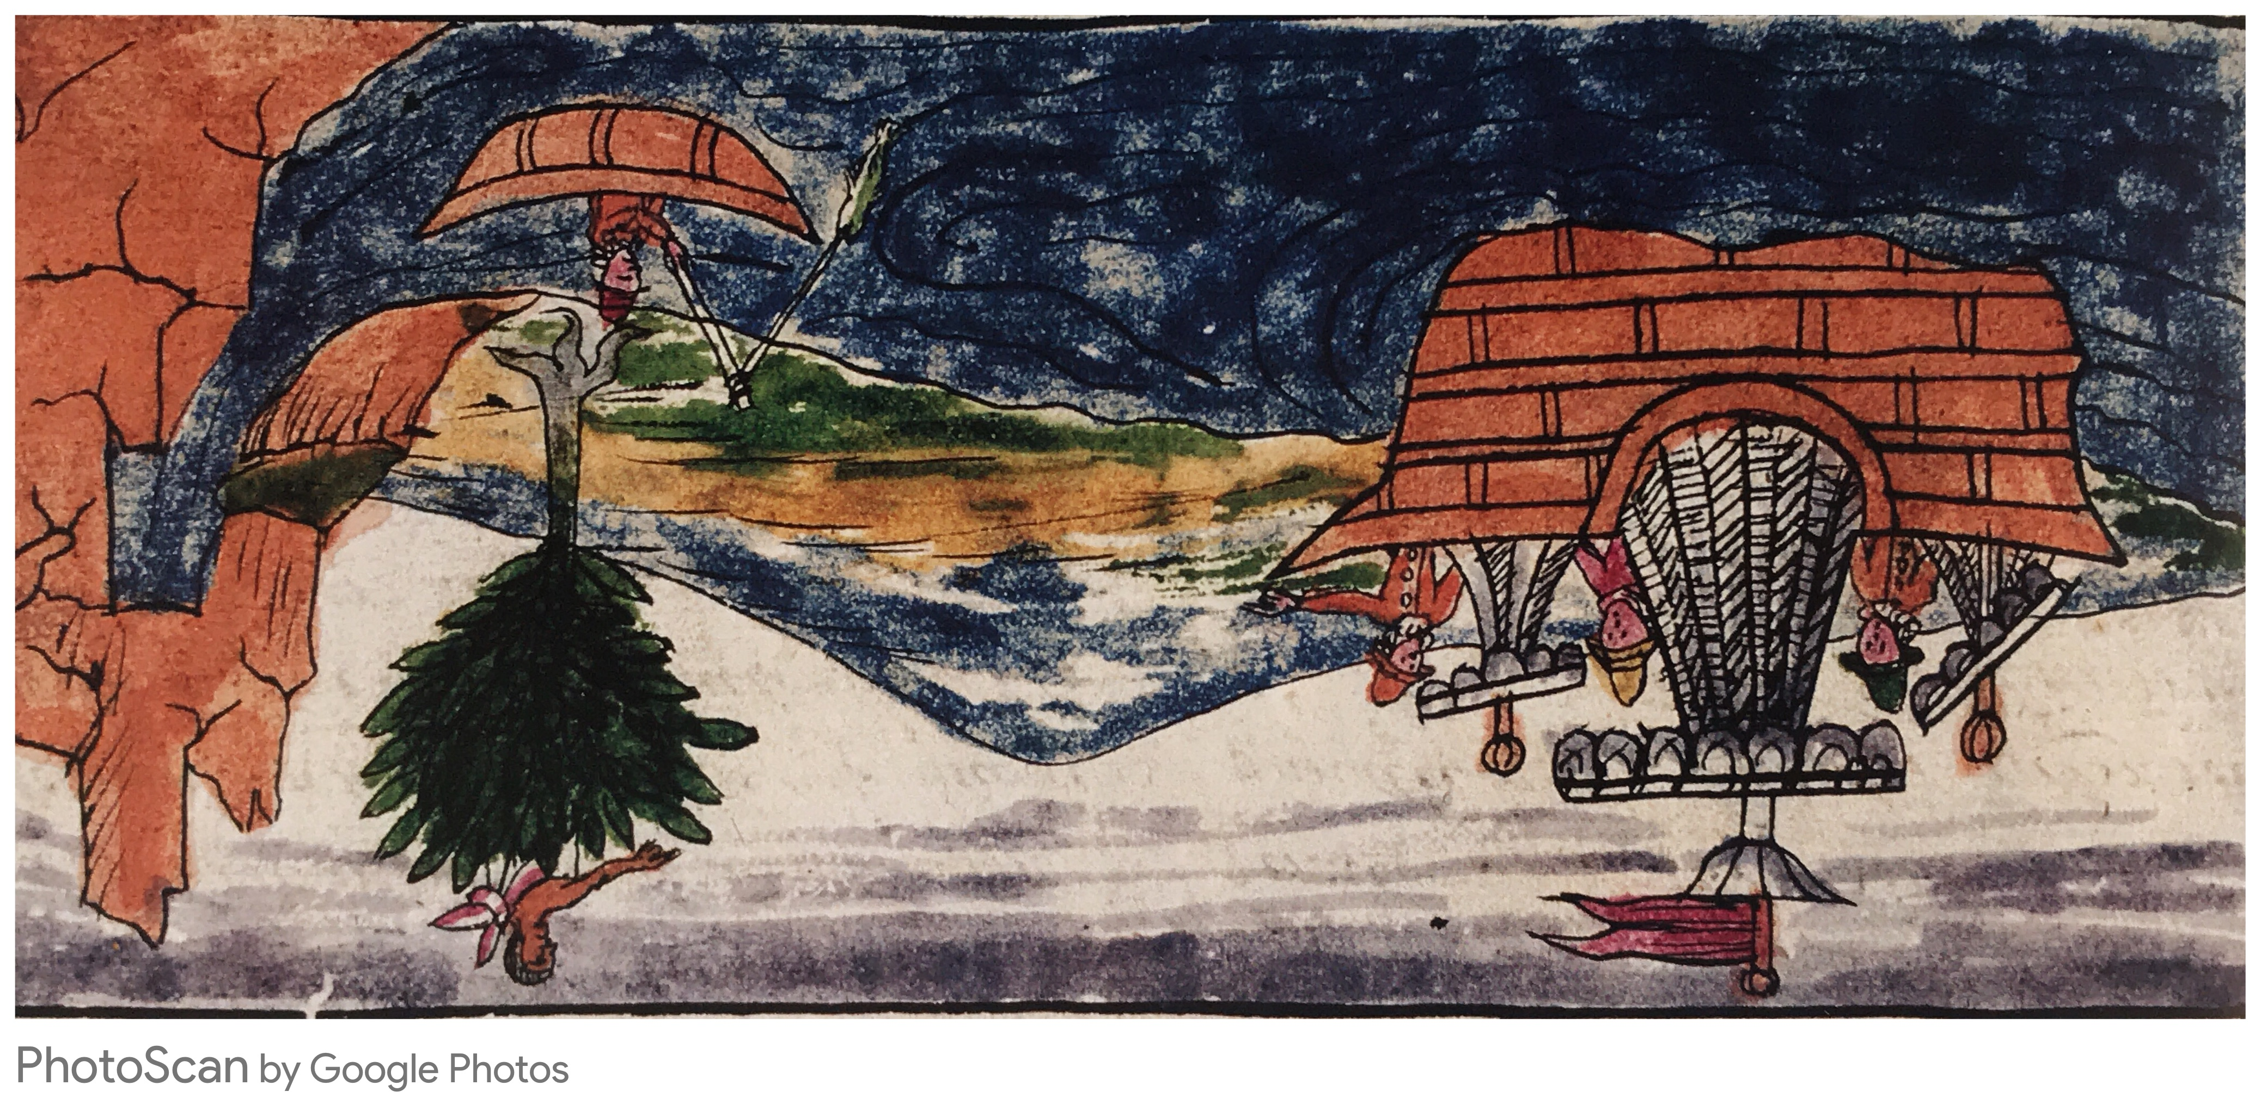

Slide 11
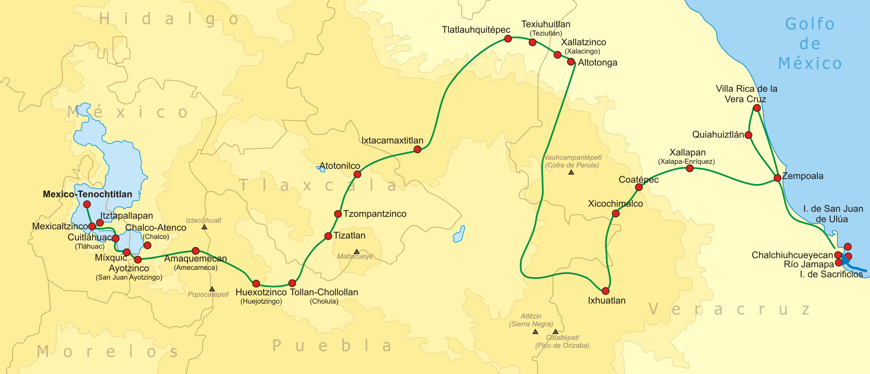
THE MARCH TO TENOCHTITLAN
Follow on twitter: @noticonquista

Slide 12
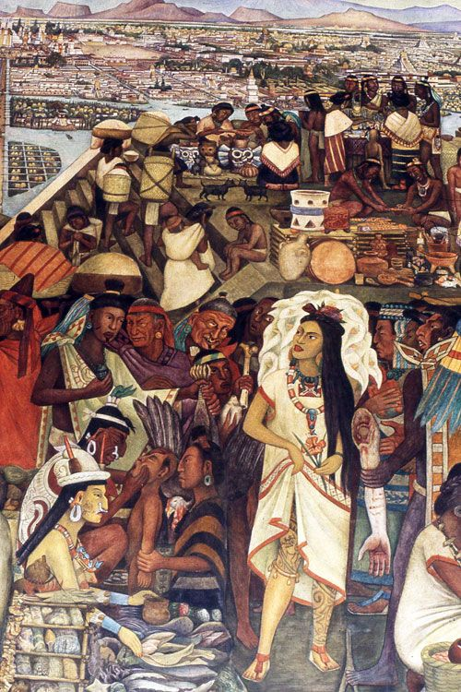
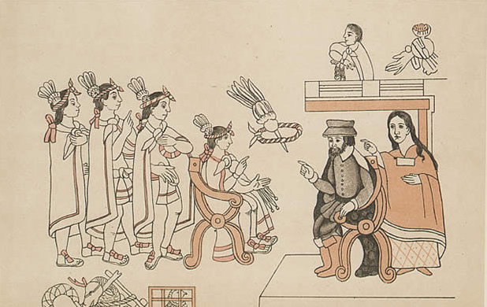
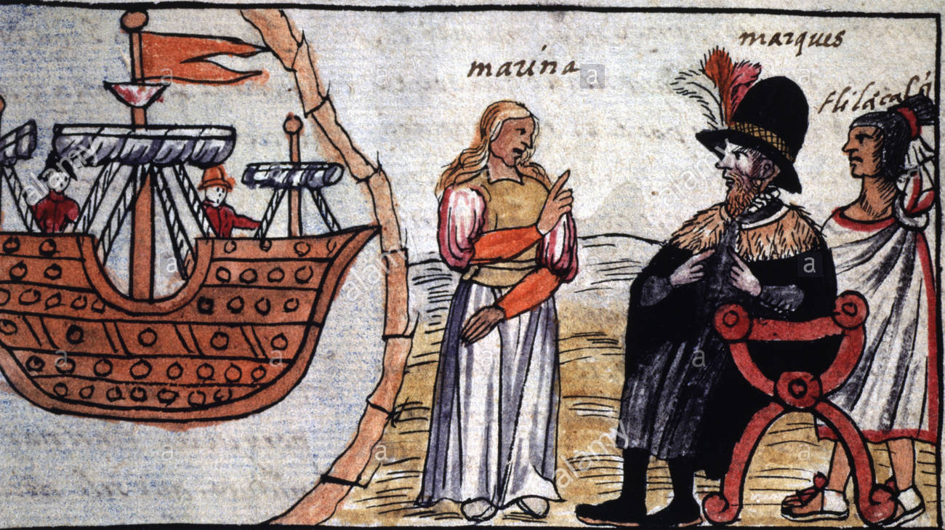
Doña Marina Malintzin

Slide 13
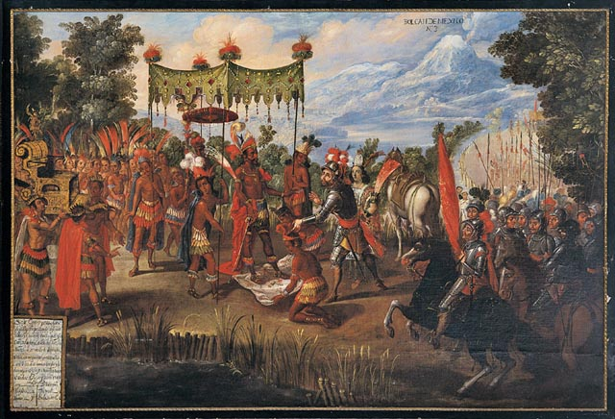

Slide 14
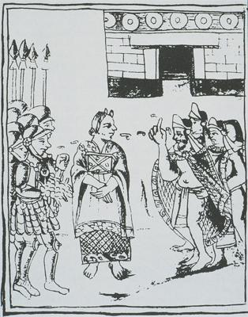

Slide 15
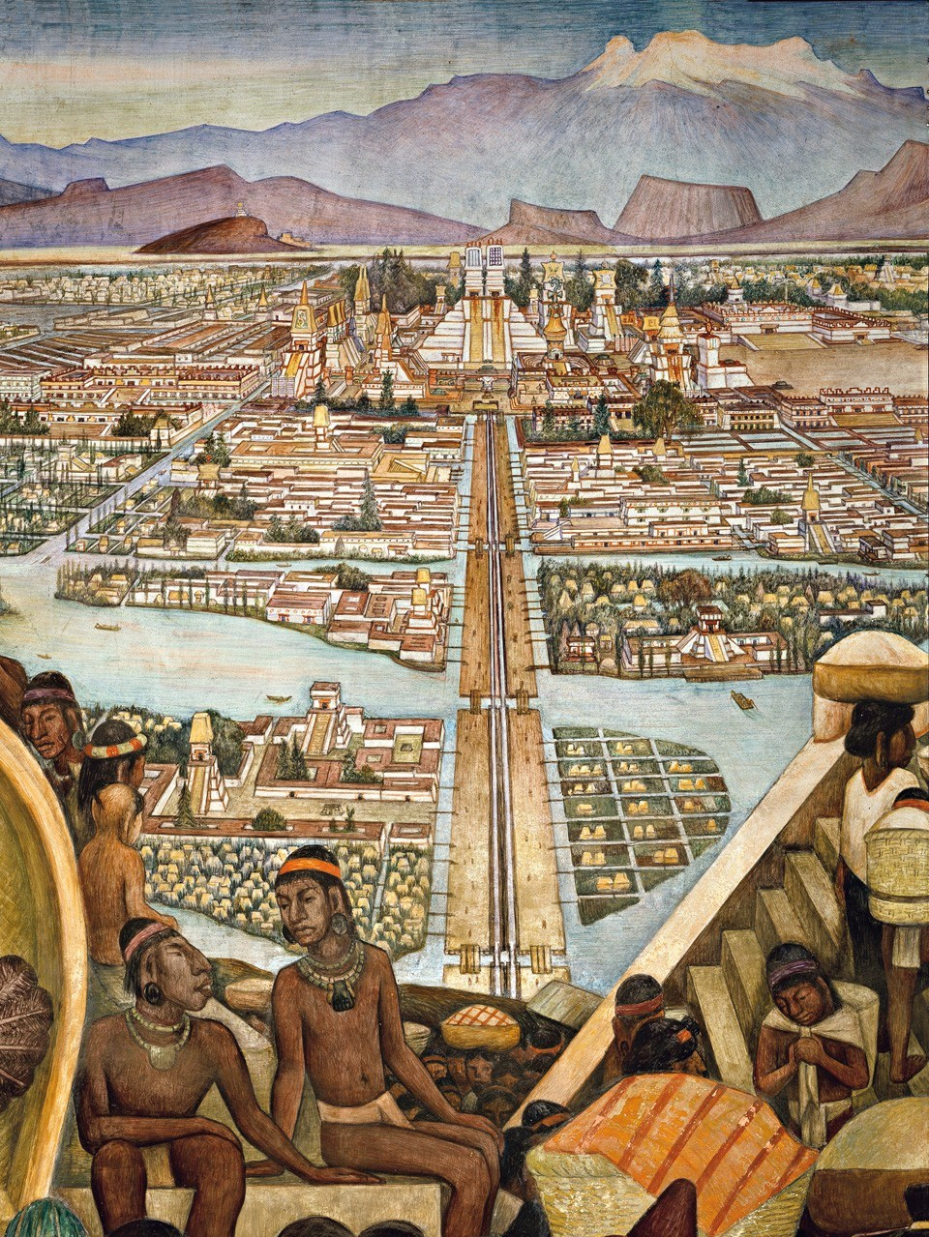
8 November 1519: Cortés enters Tenochtitlán
Departs for the coast to quell attack ordered by Velázquez
Leaves Pedro de Alvarado in command

Slide 16
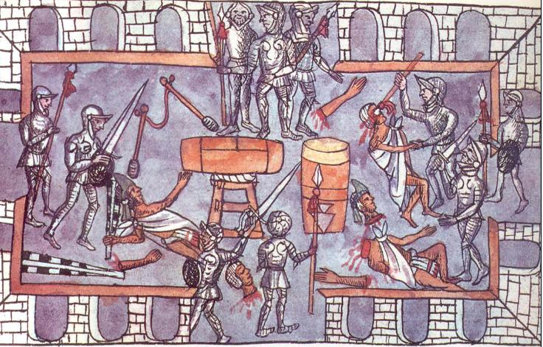
May 1520: Massacre at the Great Temple

Slide 17
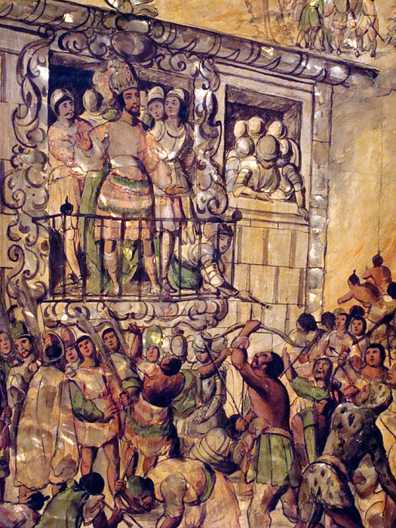
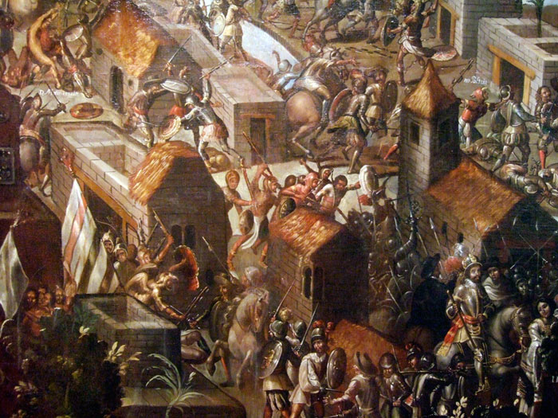

Slide 18
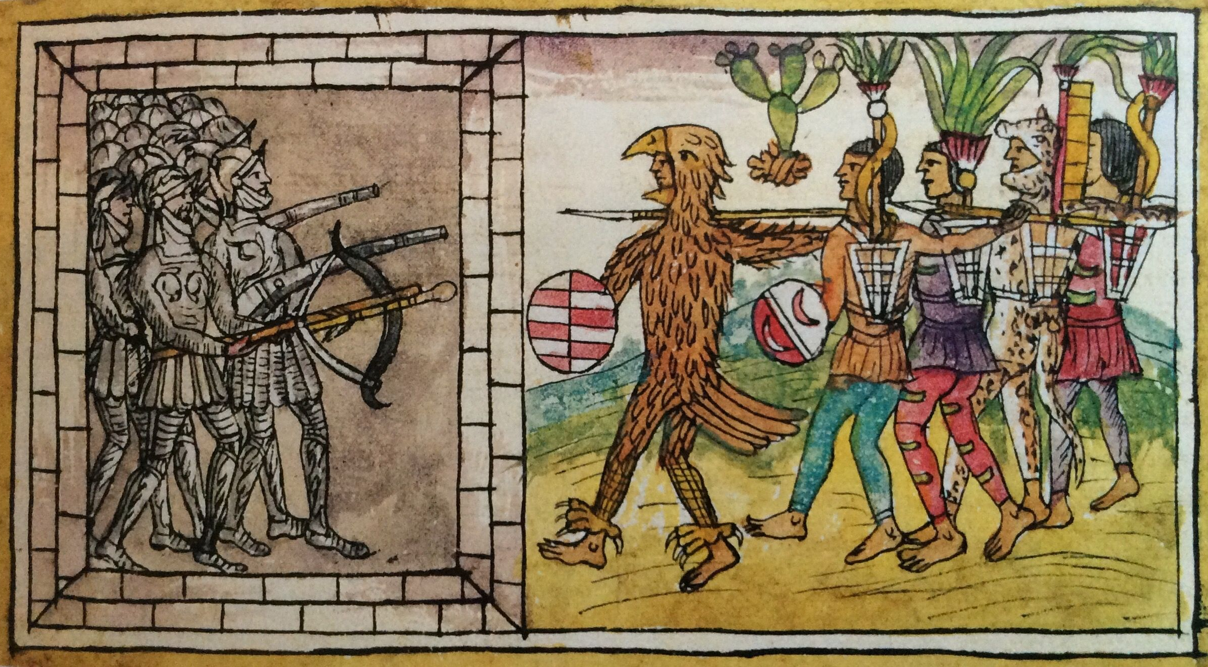
The Mexican Counterattack, Duran Codex, mid-16THC

Slide 19
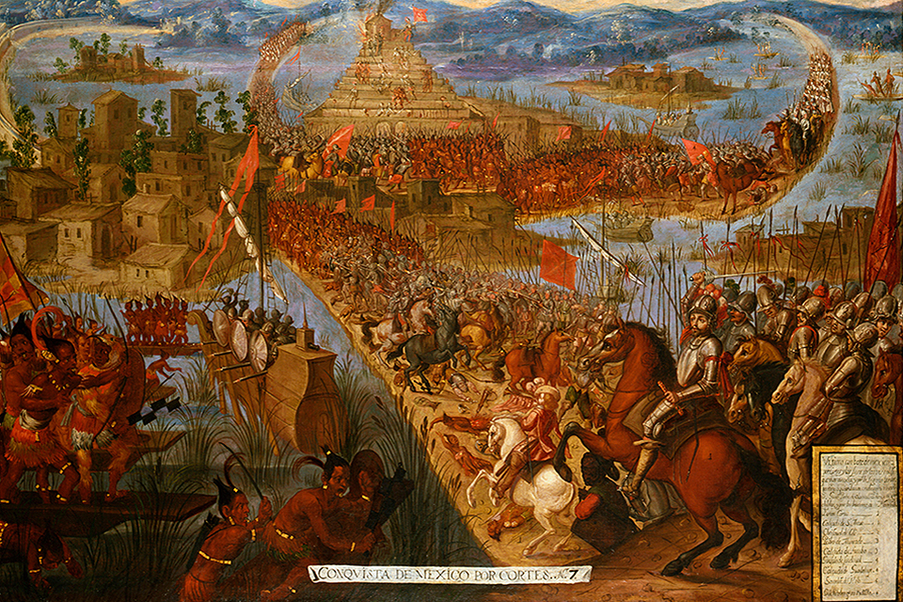
The Capture of Tenochtitlán, 17THC. Oil on canvas. Library of Congress

Slide 20
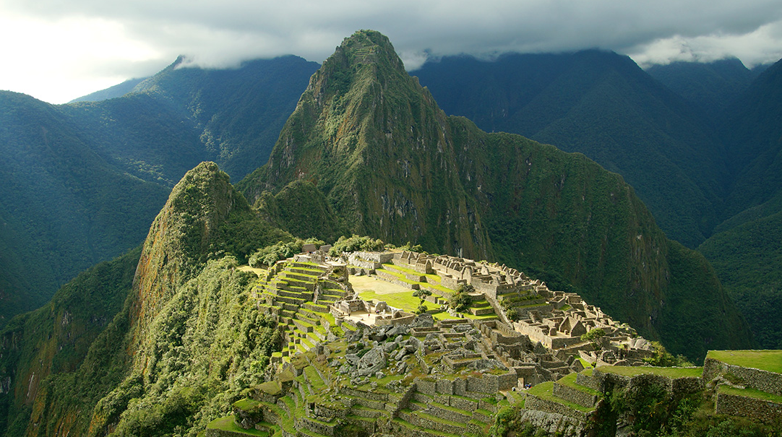
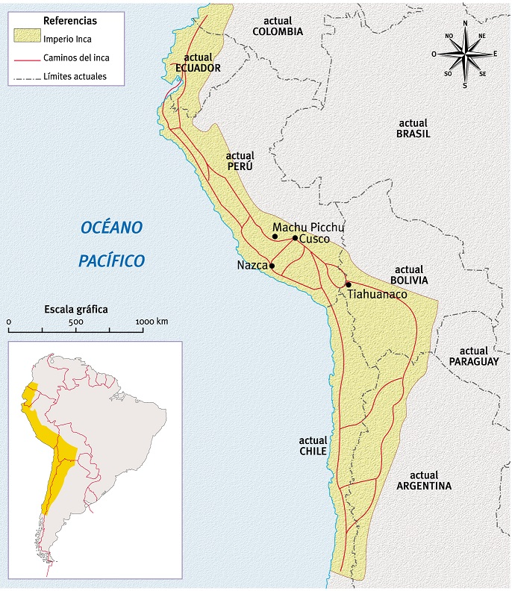
The Inca Empire: Tahuantinsuyu

Slide 21
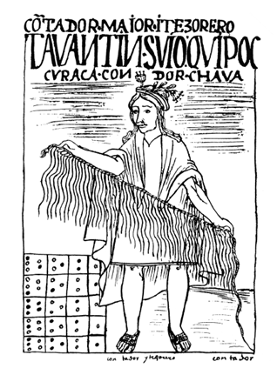
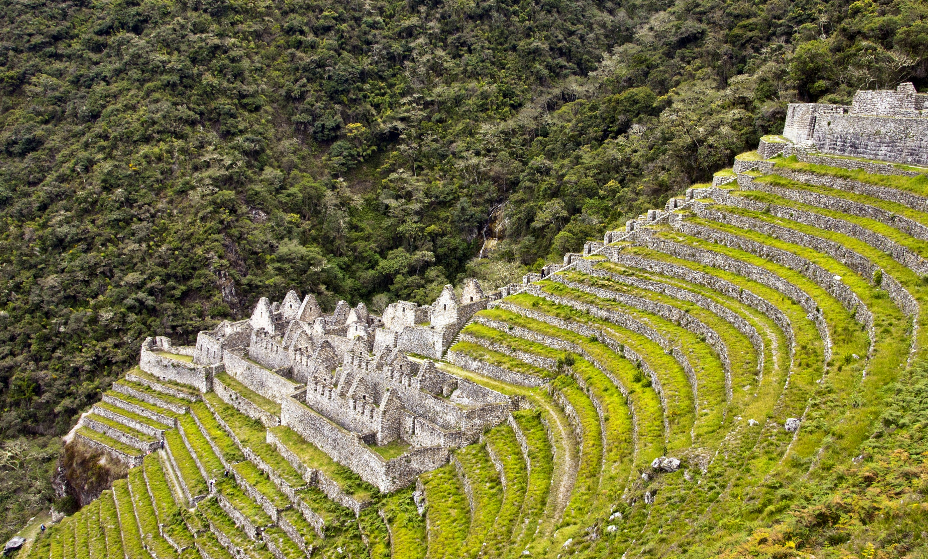
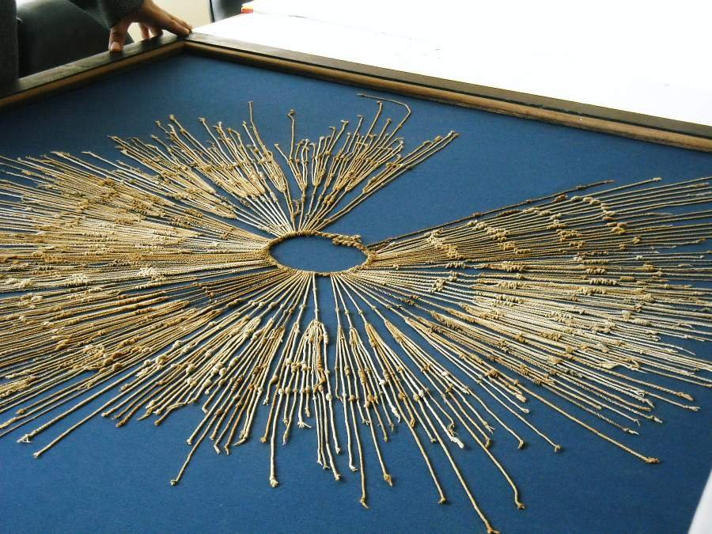
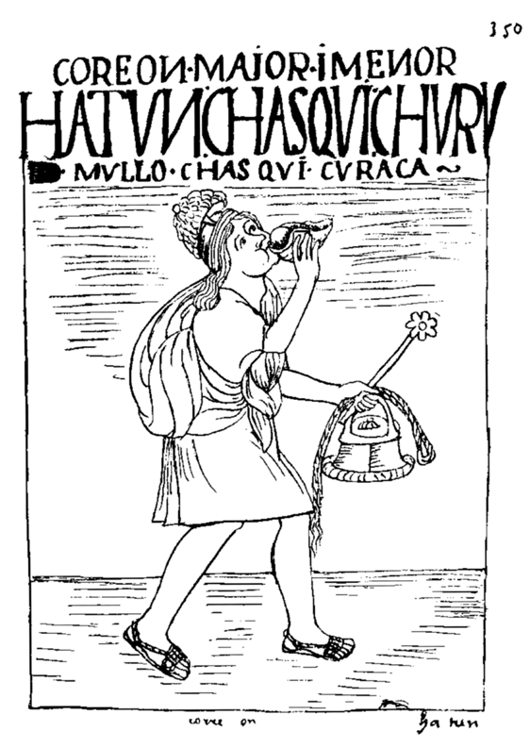

Slide 22
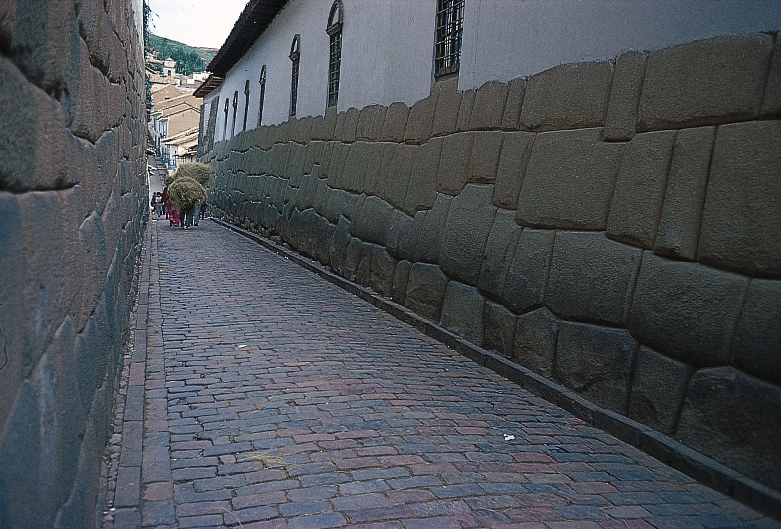
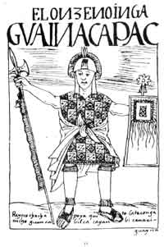
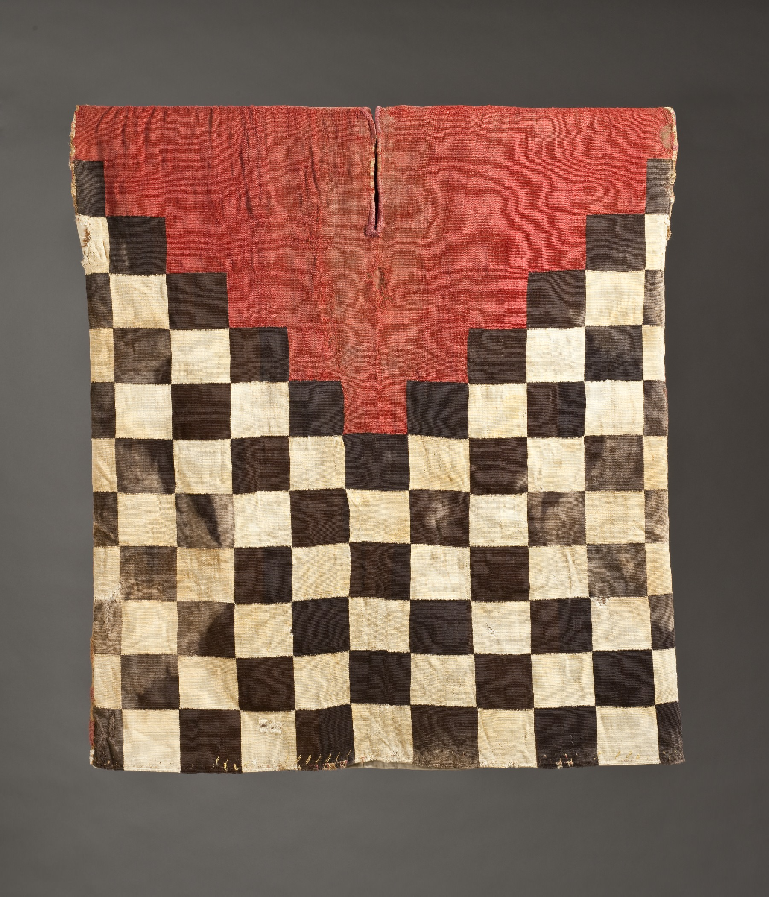

Slide 23
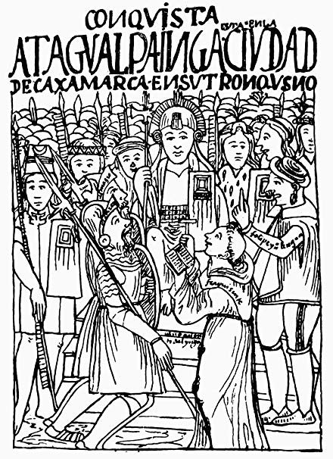
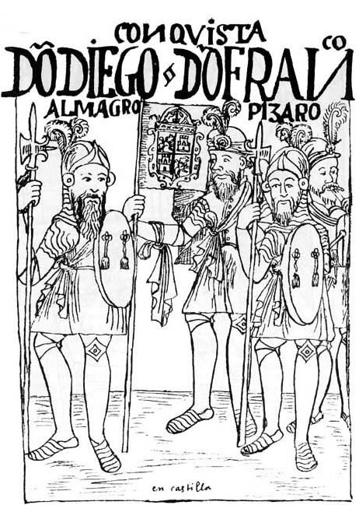
Felipe Guaman Poma de Ayala, Nueva crónica I Buen Gobierno (1615)

Slide 24
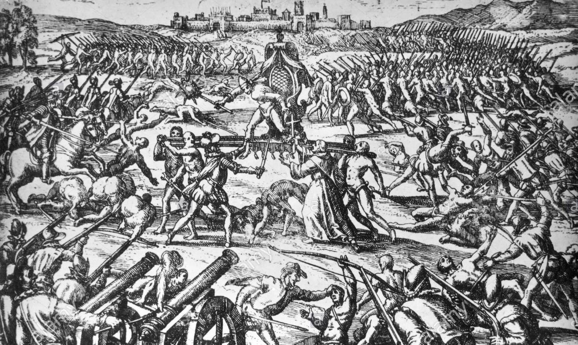

Slide 25
‘How was it that a motley bunch of Spanish adventurers, never numbering much more than four hundred or so, was able to defeat an Amerindian military power on its home ground in the space of two years? What was it about Spaniards, or about Indians, that made so awesomely implausible a victory possible?’
Inga Clenndinnen

Slide 26
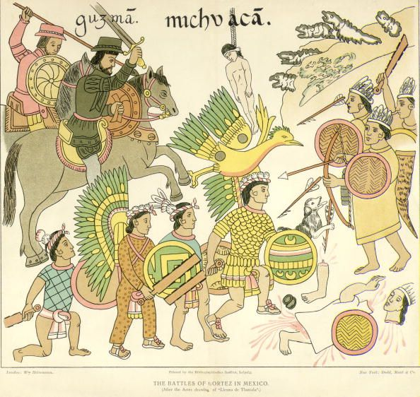
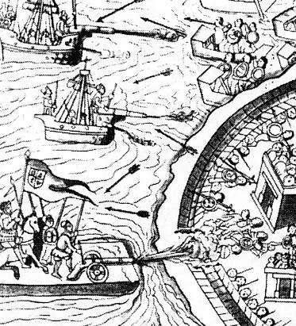
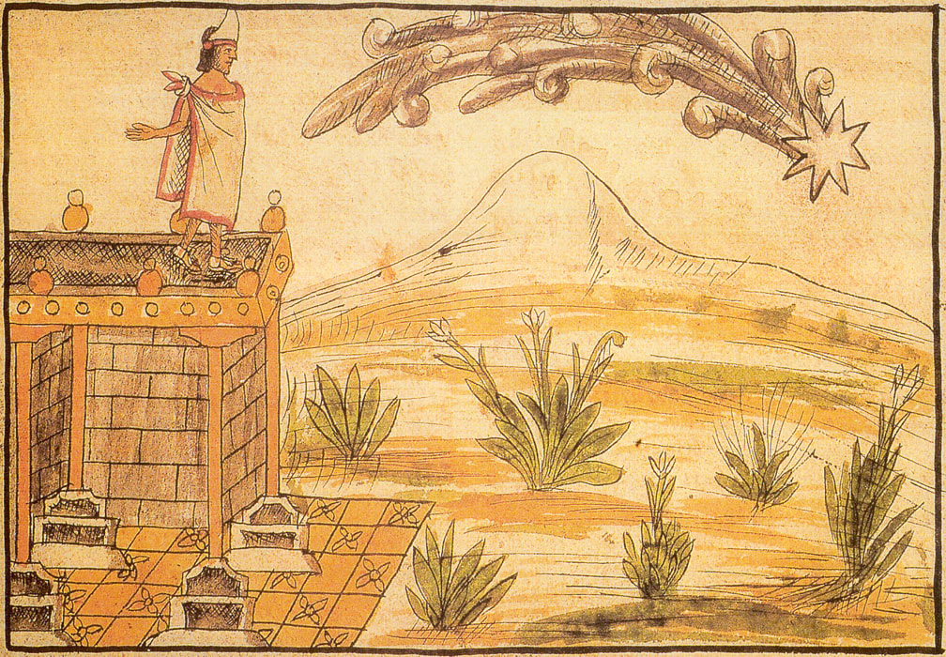
Military Technology
Division and Resistance
Providence

Slide 27
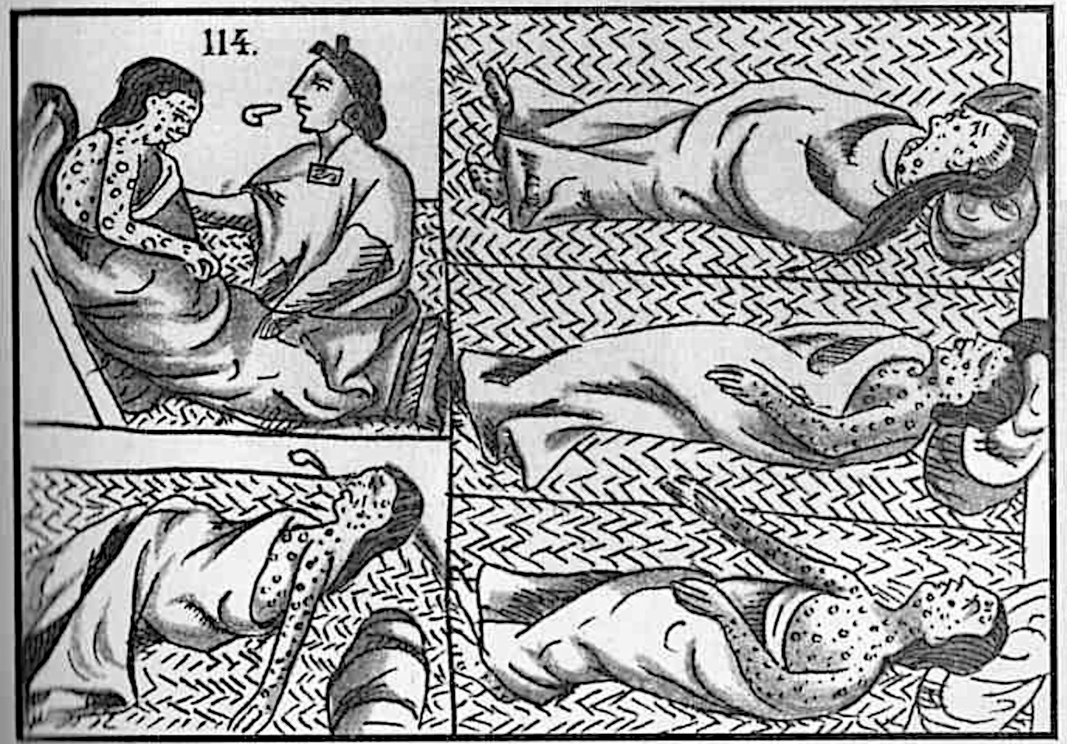
Disease
“This sore affliction entered so deep into the minds of men and women that, in the horror thereof, brother was forsaken by brother, nephew by uncle, brother by sister and, oftentimes, husband by wife; nay, what is more and scarcely to be believed, fathers and mothers were found to abandon their own children, untended, unvisited, to their fate, as if they had been strangers…””
From Boccaccio,
The Decameron, M. Rigg, trans. (London: David Campbell, 1921), Vol. 1, pp. 5-6.

Slide 28
Sources for the Conquest of Mexico
Letters of Hernán Cortés (1522-1525)
Juan Ginés de Supúlveda (1540s)
Fray Bernardino de Sahagún Florentine Codex (1585)
Bernal Díaz del Castillo, The True History of the Conquest of New Spain (1576)
Diego Durán’s account, The History of the Indies and New Spain (1581)

Slide 29
New Conquest History
Since 2000 five core approaches:
Revisiting (re-reading old sources, motivations etc.)
Paleography (learning to read sources left unread)
Protagonists (forgotten Spaniards, women, settlers of African descent, indigenous people)
Indigenous perspectives (indigenous conquistadors, indigenous diaspora)
Boundaries (a- of space away from centres of empire. b-of discipline: History, Anthropology, Ethno-History to Art History, Geography, Literature)
Matthew Restall, “New Conquest History,” History Compass, 2012

Slide 30
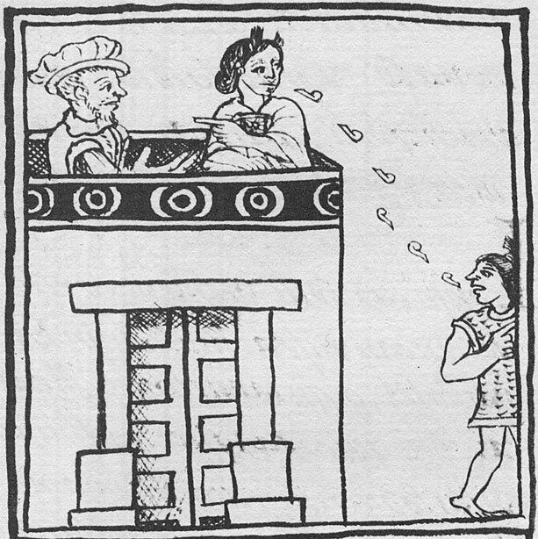
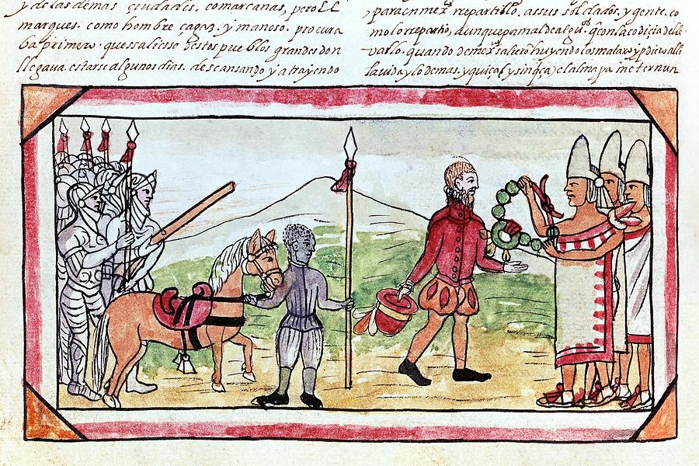
Doña Marina, Malintzin, la Malinche
Juan Garrido (c. 1480-c. 1550)
Source: Malinche Translating
In Book 12, Chap. 18, Florentine Codex.
See Peter Gerhard, “A Black Conquistador in Mexico” The Hispanic American Historical Review, 1978

Slide 31
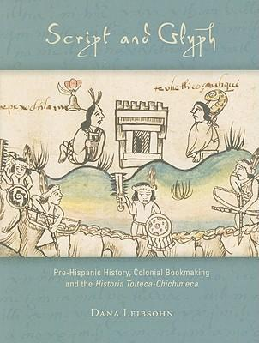
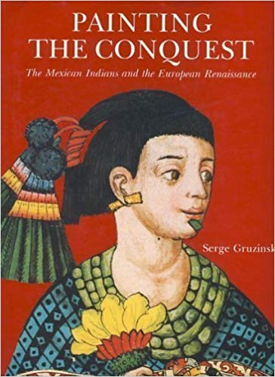

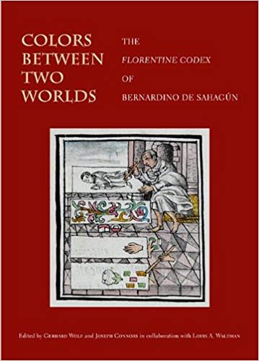
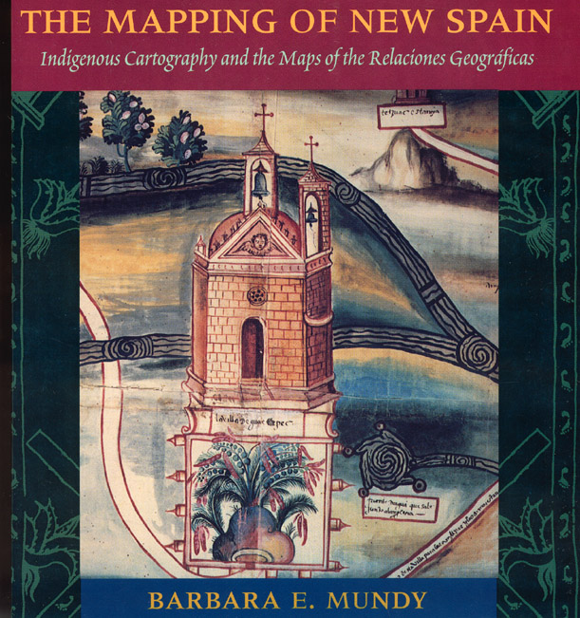

Slide 32
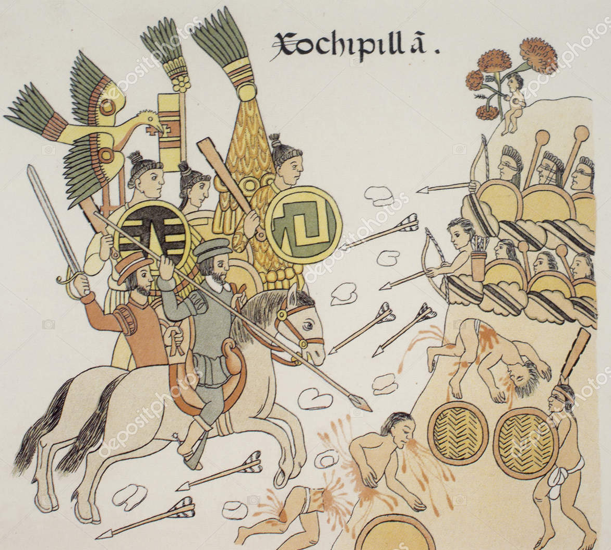



Slide 33




Slide 34



Netzahualcoyotl as a Warrior, Codex Ixtilxóchitl,1582
Bibliothéque Nationale de France, Paris

