Slide 1
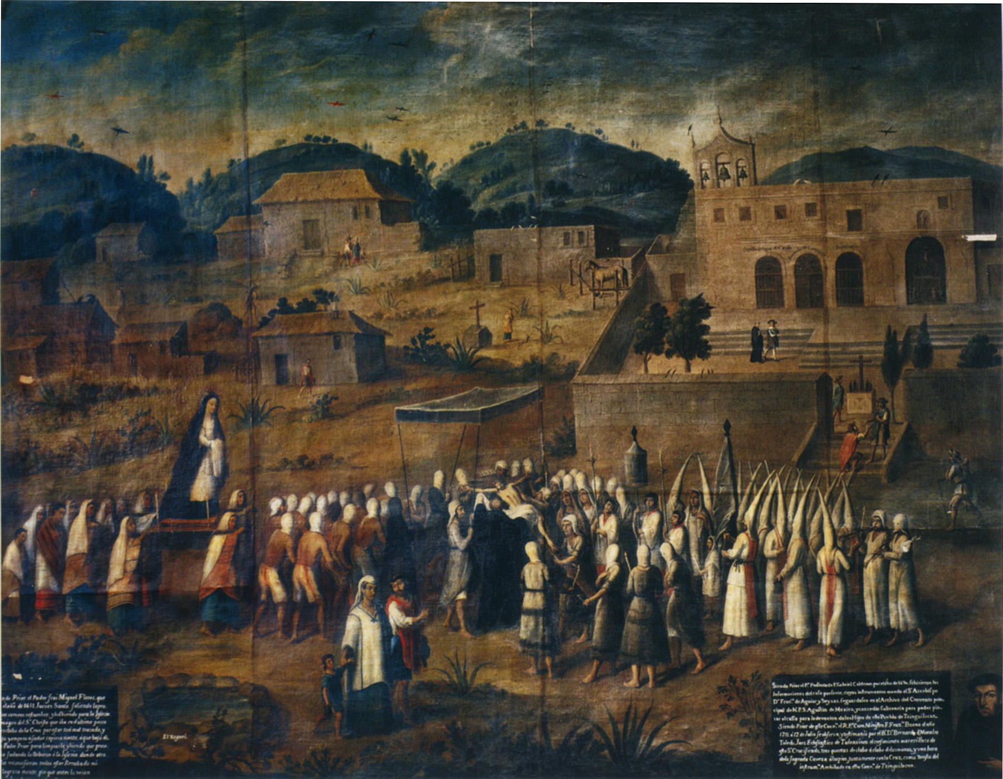
Week 7: Ceremony and Ritual

Slide 2
Processions in Mexico City, Seville, and Cuzco
https://www.youtube.com/watch?v=k47BFePixPM
https://www.youtube.com/watch?v=PVBUY2jEULA
https://www.youtube.com/watch?v=z7WZwYzn1Zw
https://www.youtube.com/watch?v=B1wZPZ2-tNc

Slide 3
“Church and king were the two common elements in the disparate and fragmented Spanish monarchy; and religious uniformity, enforced by king, church, and inquisition, was the guarantee of continuing political order and stability”
John Elliott, “Power and Propaganda in the Spain of Philip IV,” in Spain and its World, 169

Slide 4
The rituals that were acted out in Mexico in the 16th and 17th centuries shaped colonial society as much as they were a reflection of it, allowing for a variety of often unpredictable responses; therefore, the theatre of colonial politics, constitutive as well as representative of power, was by no means inconsequential in elaborating the rapport of forces in the colonial power play.
Alejandro Cañeque, The King’s Living Image, p.120

Slide 5
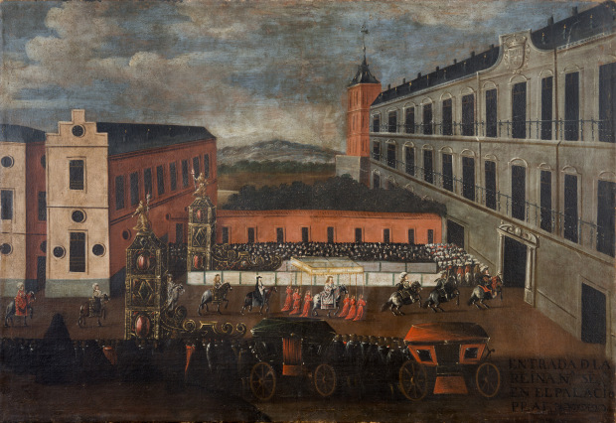

Slide 6
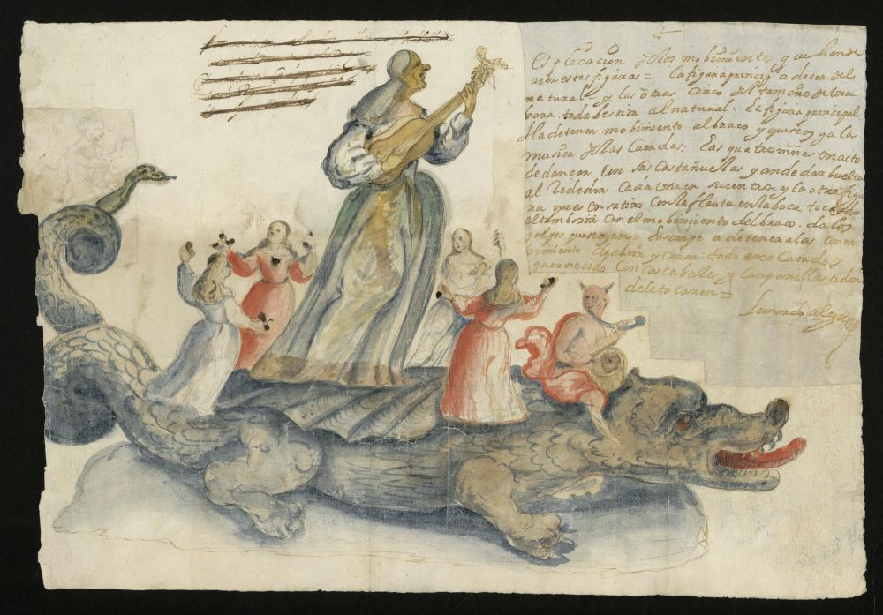

Slide 7
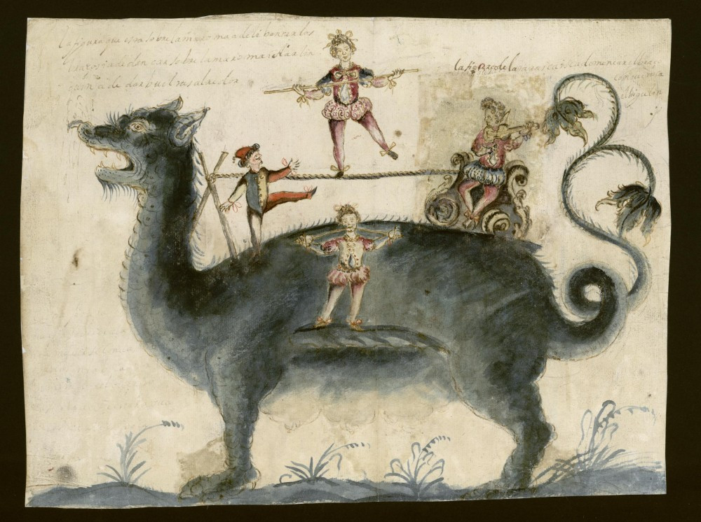

Slide 8
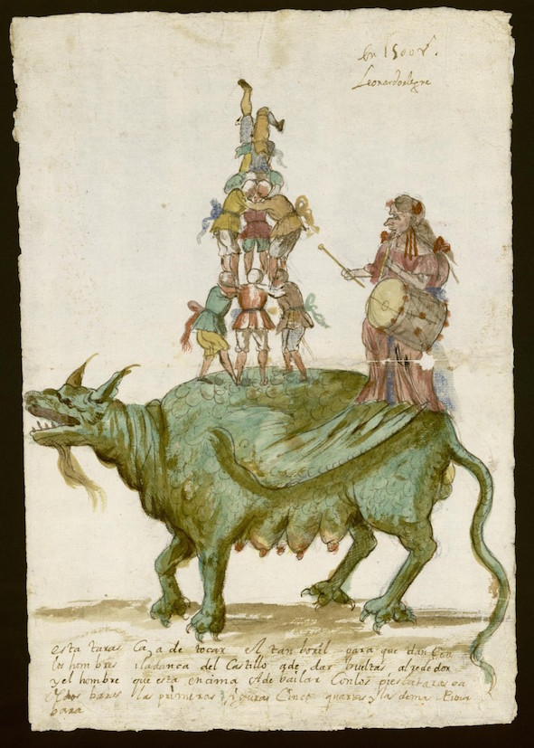
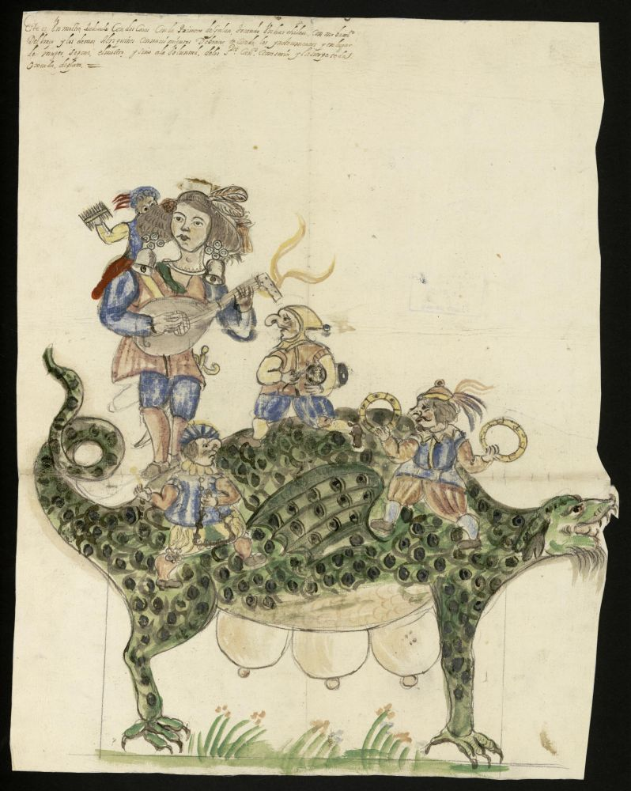

Slide 9
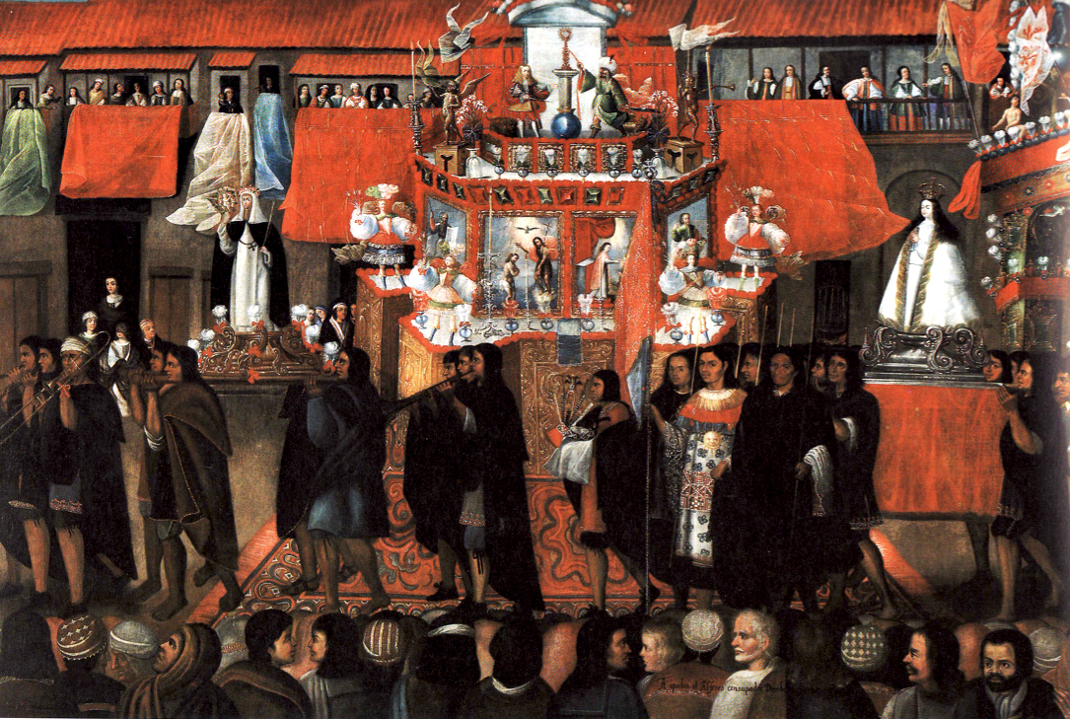

Slide 10
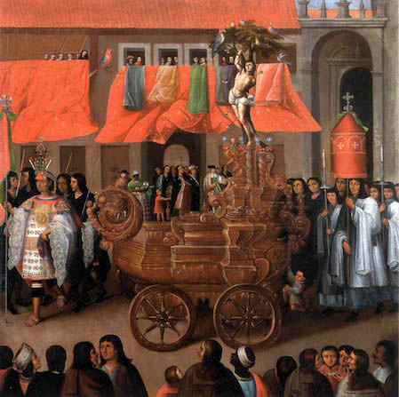

Slide 11
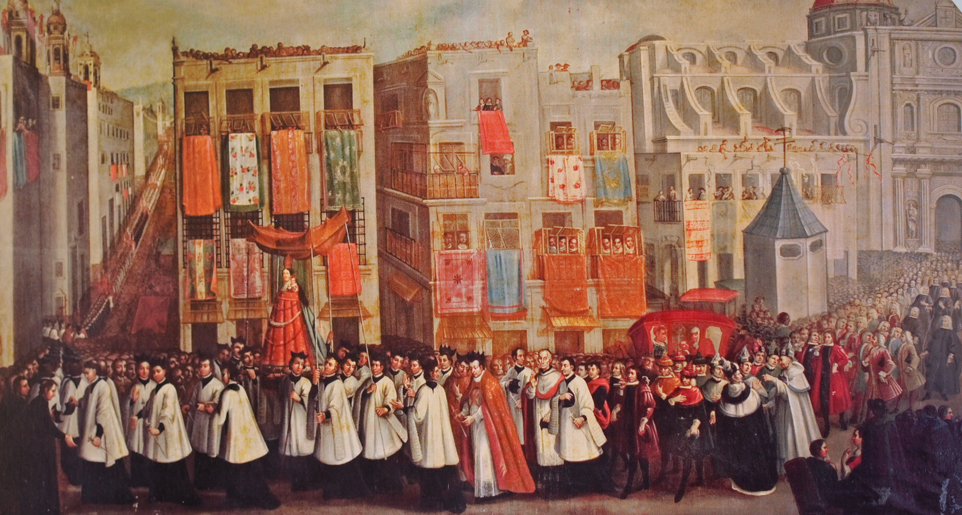

Slide 12
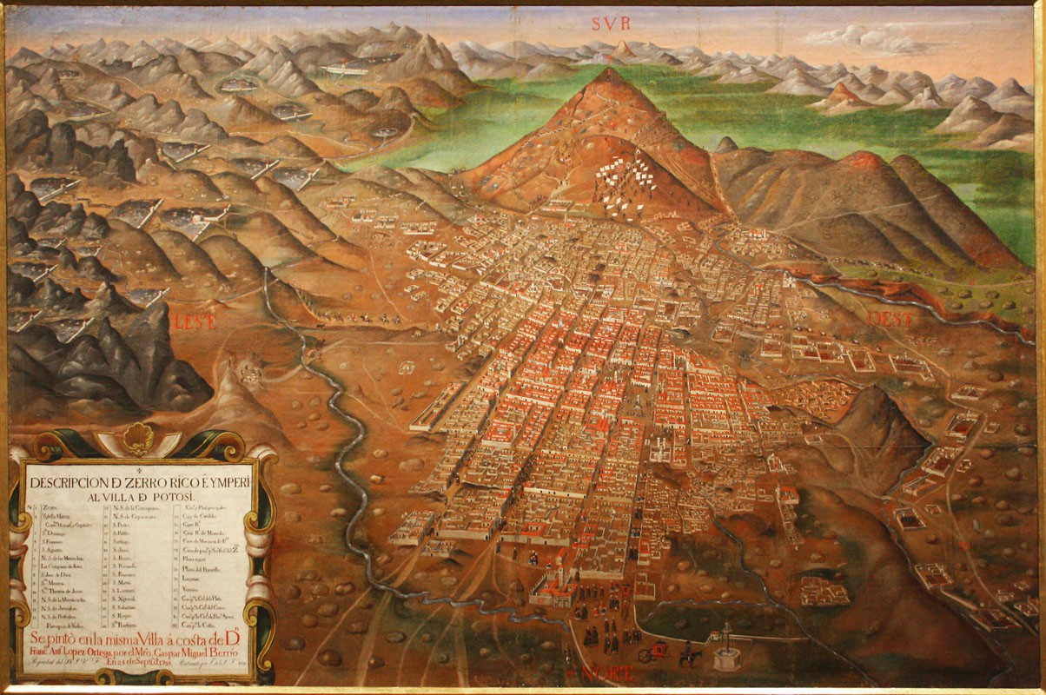

Slide 13
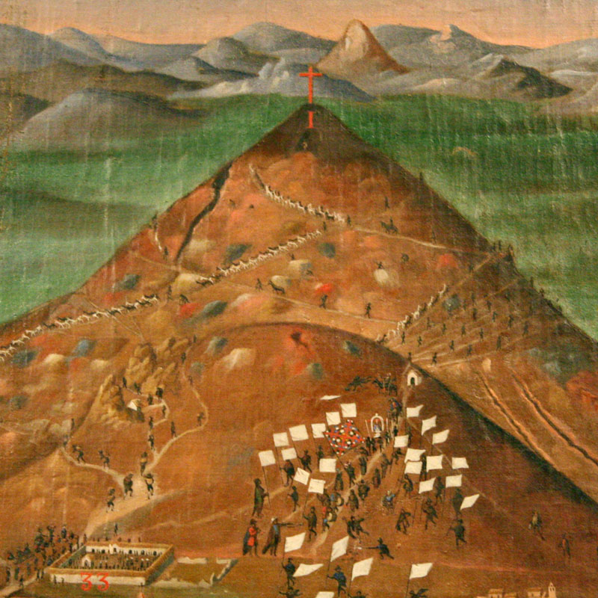

Slide 14
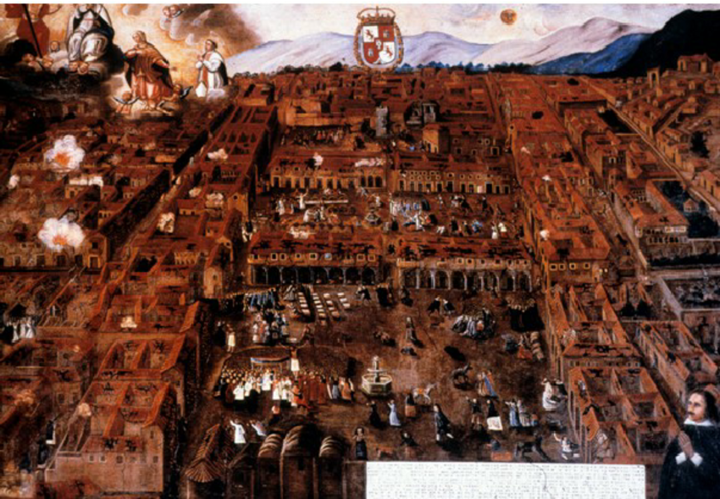

Slide 15
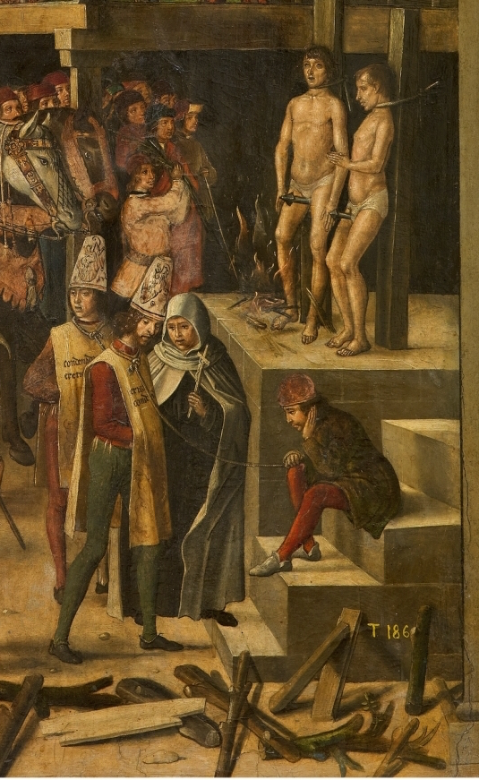
Inquisition

Slide 16
How the Portuguese Made a Superb Auto-De-Fe to Prevent Any Future Earthquakes, and How Candide Underwent Public Flagellation (Voltaire, Candide)
After the earthquake, which had destroyed three-fourths of the city of Lisbon, the sages of that country could think of no means more effectual to preserve the kingdom from utter ruin than to entertain the people with an auto-da-fe, it having been decided by the University of Coimbra, that the burning of a few people alive by a slow fire, and with great ceremony, is an infallible preventive of earthquakes.
In consequence thereof they had seized on a Biscayan for marrying his godmother, and on two Portuguese for taking out the bacon of a larded pullet they were eating; after dinner they came and secured Dr. Pangloss, and his pupil Candide, the one for speaking his mind, and the other for seeming to approve what he had said. They were conducted to separate apartments, extremely cool, where they were never incommoded with the sun.

Slide 17
…Eight days afterwards they were each dressed in a sanbenito, and their heads were adorned with paper mitres. The mitre and sanbenito worn by Candide were painted with flames reversed and with devils that had neither tails nor claws; but Dr. Pangloss's devils had both tails and claws, and his flames were upright. In these habits they marched in procession, and heard a very pathetic sermon, which was followed by an anthem, accompanied by bagpipes. Candide was flogged to some tune, while the anthem was being sung; the Biscayan and the two men who would not eat bacon were burned, and Pangloss was hanged, which is not a common custom at these solemnities. The same day there was another earthquake, which made most dreadful havoc…

Slide 18
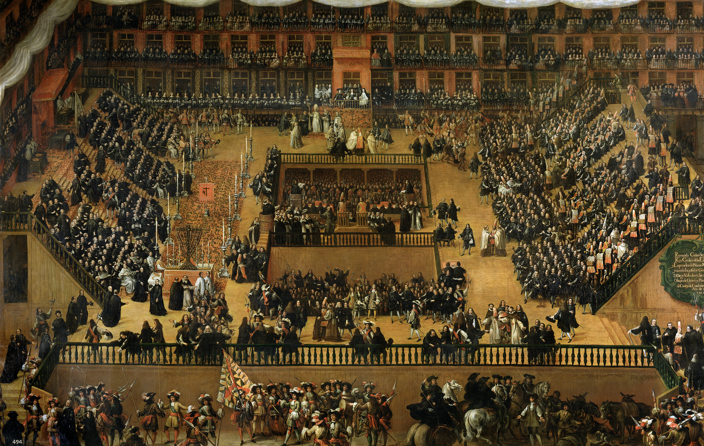

Slide 19
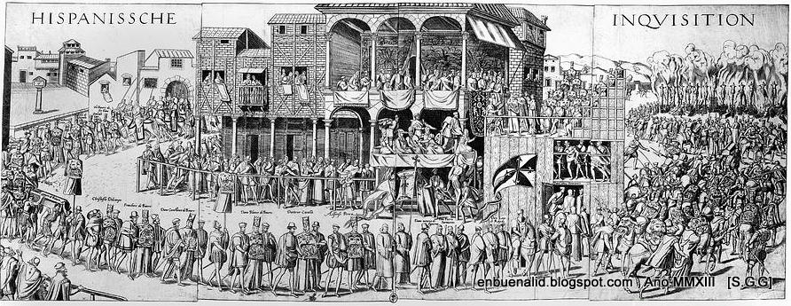

Slide 20
