Slide 1

War, Sex and Gender in the United States
Term 1, week 1
Gender as a CAUSE of war?

Slide 2
Talk to me! (And feel free to call me Susan.)
Module Convenor: Professor Susan Carruthers
Email: s.carruthers@warwick.ac.uk
Office: FAB 3.76
Office hours (2025-26): Mon 12-1pm [Teams]; Tues 2-3pm [in person]
Please email to make an appointment at these or other mutually convenient times.

Slide 3
Seminar outline
1 Getting acquainted: your preferred name; where your home university is; whether you’ve studied any US history before; what attracted you to this module
2 Thinking about what gender is
3 Thinking about what gender ‘does’– with particular reference to the Spanish-American-Cuban war of 1898

Slide 4
Define ‘gender’
Write a brief dictionary definition– without Googling/using AI to generate an answer!

Slide 5
Did gender (i.e. gendered discourse, norms, tropes, imagery) CAUSE the Spanish-American War of 1898?
If gender didn’t cause the US to go to war, what role(s) did it play in the Spanish-American-Cuban conflict?
What context do we need in order to make sense of
McKinley’s decision to go to war with Spain over Cuba
in 1898?
Why has THIS war been so subject to gendered explanation?

Slide 6
Taking cues from contemporary film
'Roosevelt's Rough Riders': https://www.loc.gov/item/98500909/
'Love and war': https://www.loc.gov/item/98501279/
'Blanket-tossing a new recruit': https://www.loc.gov/item/98501030/
An exciting new medium– the ‘romance’ of war
Homosocial appeals of soldiering vs heterosexual rewards of service
War stories as stories of male camaraderie and/or as love stories

Slide 7
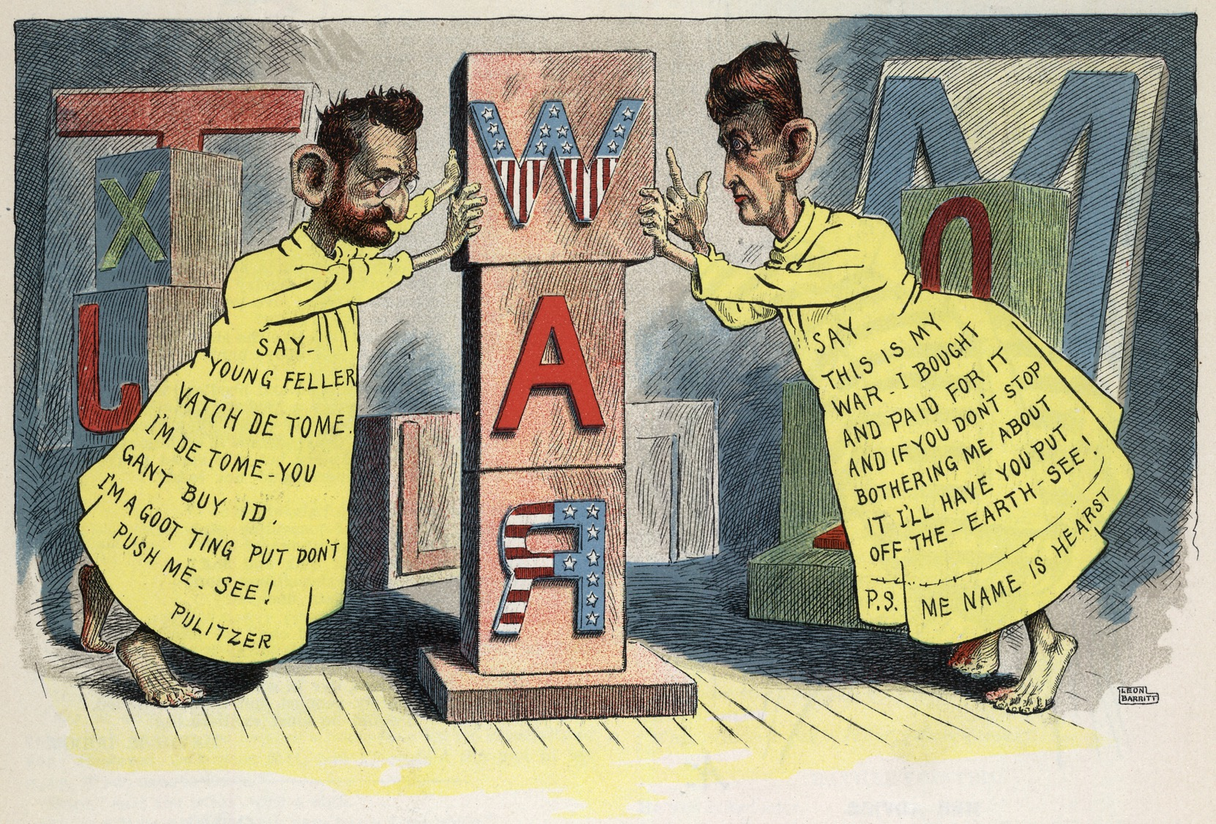
Cartoon by Leon Barritt, first published in "Vim", v. 1, no. 2, 29 June 1898. Via Library of Congress website

Slide 8
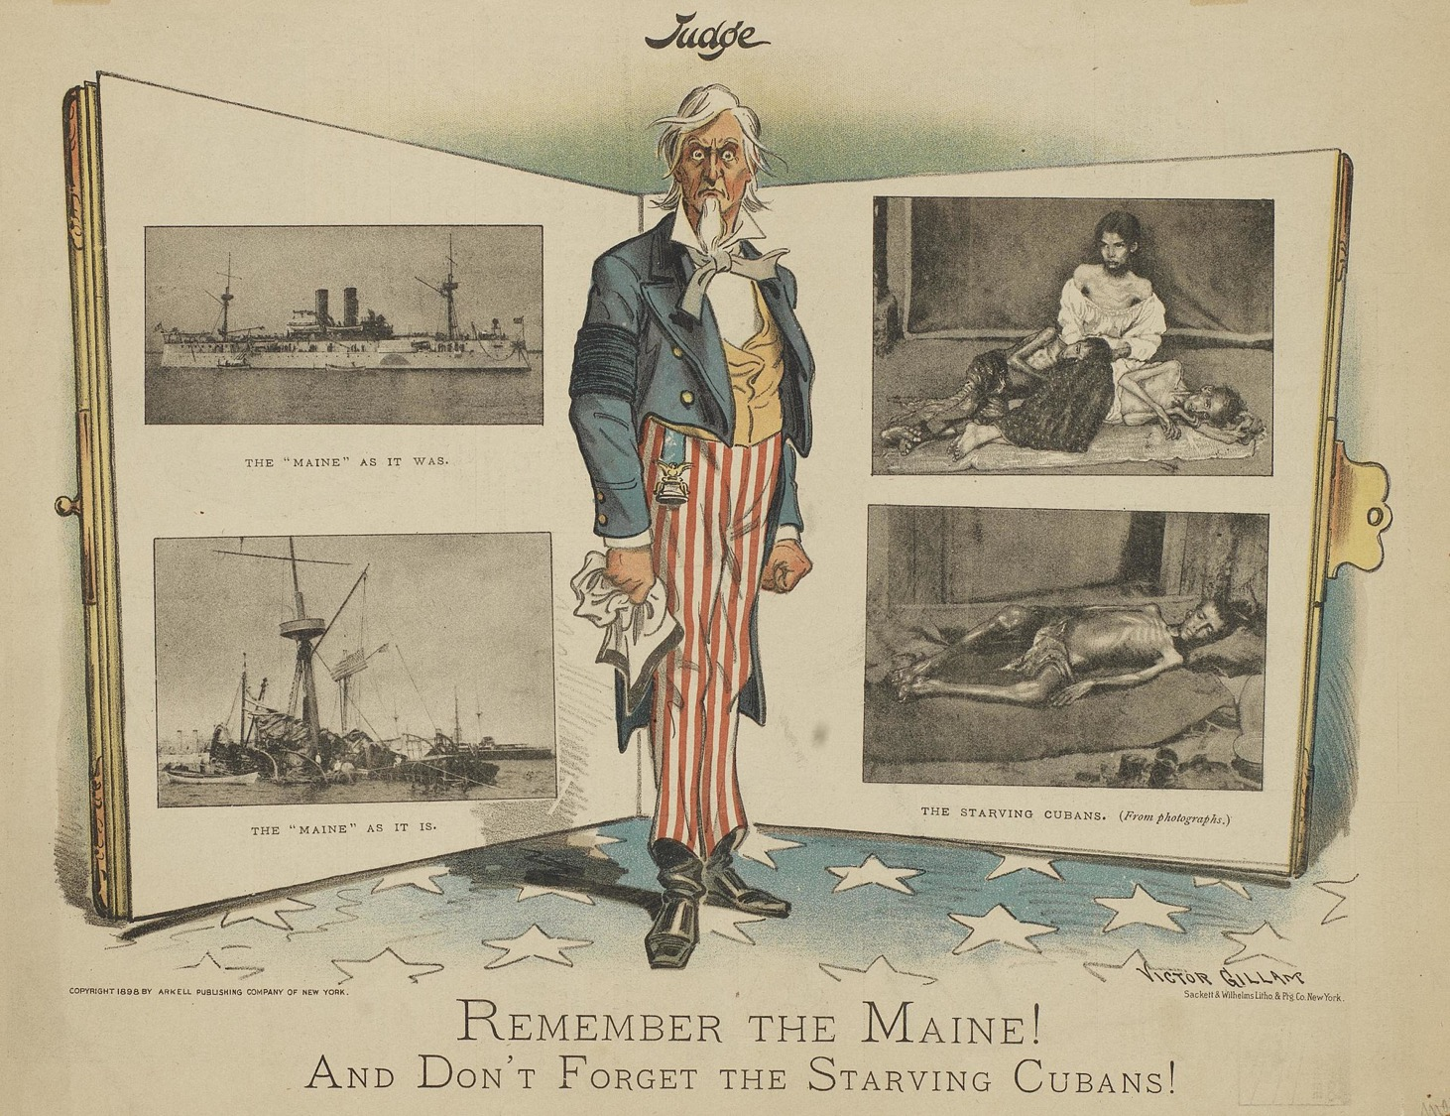
Victor Gillam
Originally published in Judge (New York), May 7, 1898, volume 34, page 312

Slide 9
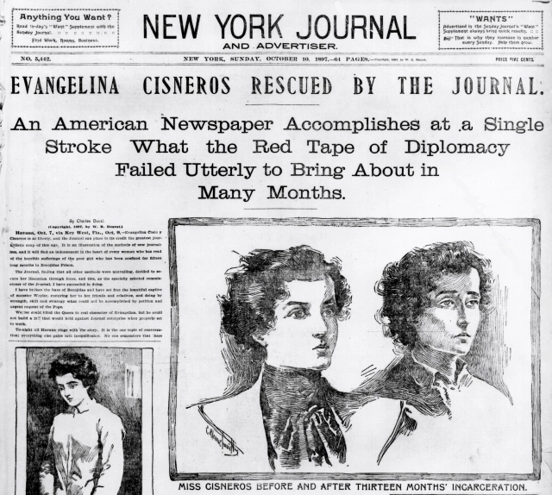

Slide 10
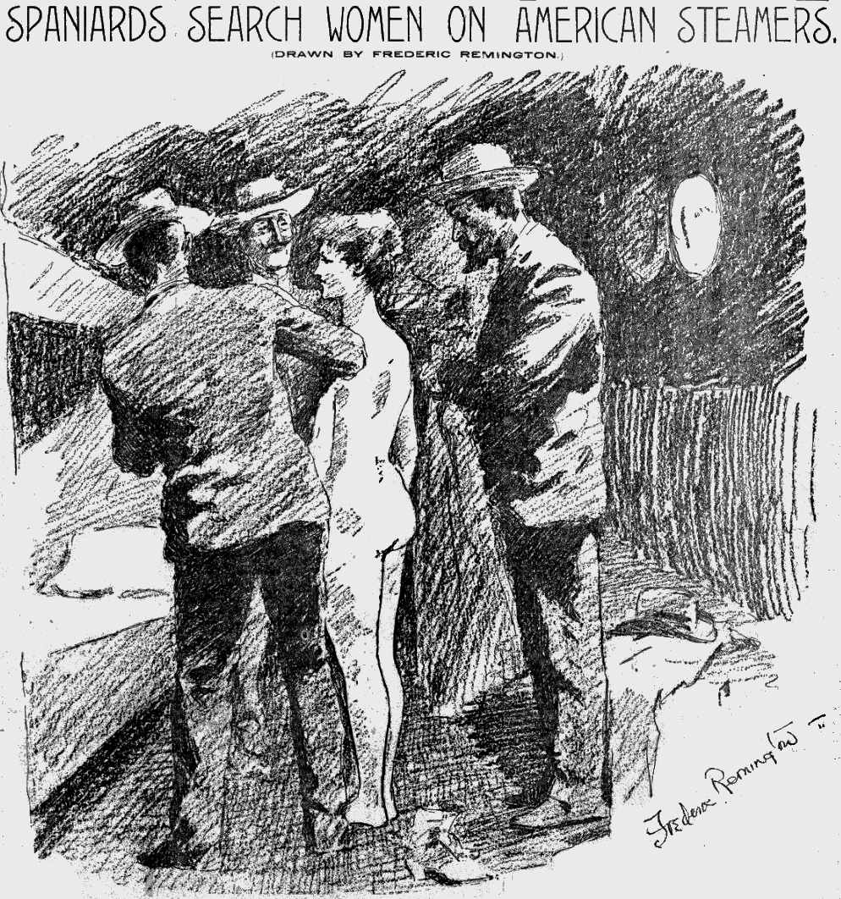
Male Spanish officials strip search an American woman tourist in Cuba looking for messages from rebels; front page "yellow journalism" from Hearst (artist: Remington)

Slide 11
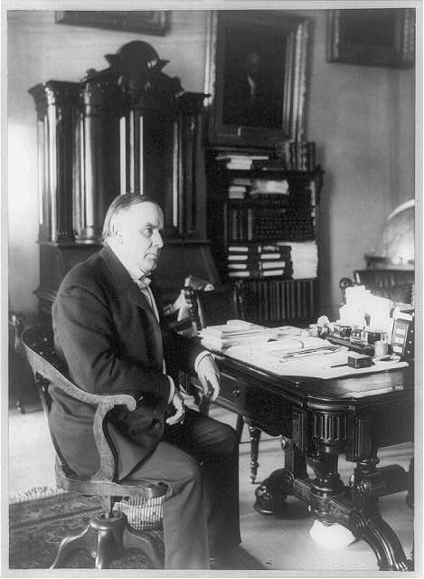
“no more backbone
than a chocolate éclair”—
an often-repeated quote
about McKinley ascribed
to Theodore Roosevelt
William McKinley, full-length portrait,
seated at desk, facing right, June 7, 1898
Library of Congress

Slide 12
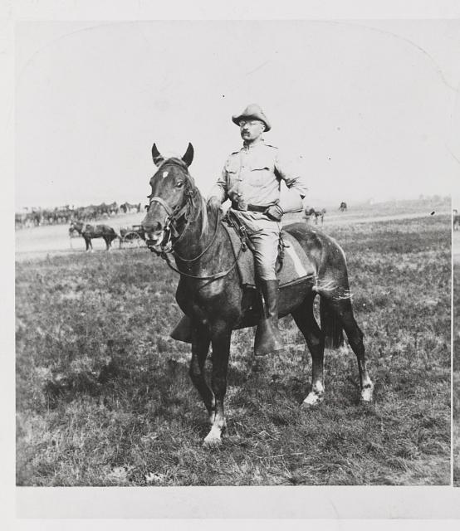
Col. Theodore Roosevelt
of the "Rough Riders" –
after his return from Cuba
Library of Congress

Slide 13
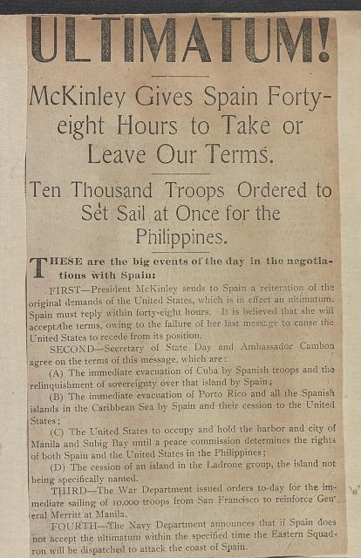

Slide 14
Why do you imagine the war between the US and Spain over Cuba has attracted more attention from historians of gender than some other American wars? And why do they (or some of them) make such strong claims about the causative work of gender in this war?
Scholars don’t, after all, tend to argue that gender caused either of the world wars…

