Slide 1

Conscripting Masculinity
HI2C9 War, Sex & Gender in the US
Term 1, Seminar week 2

Slide 2
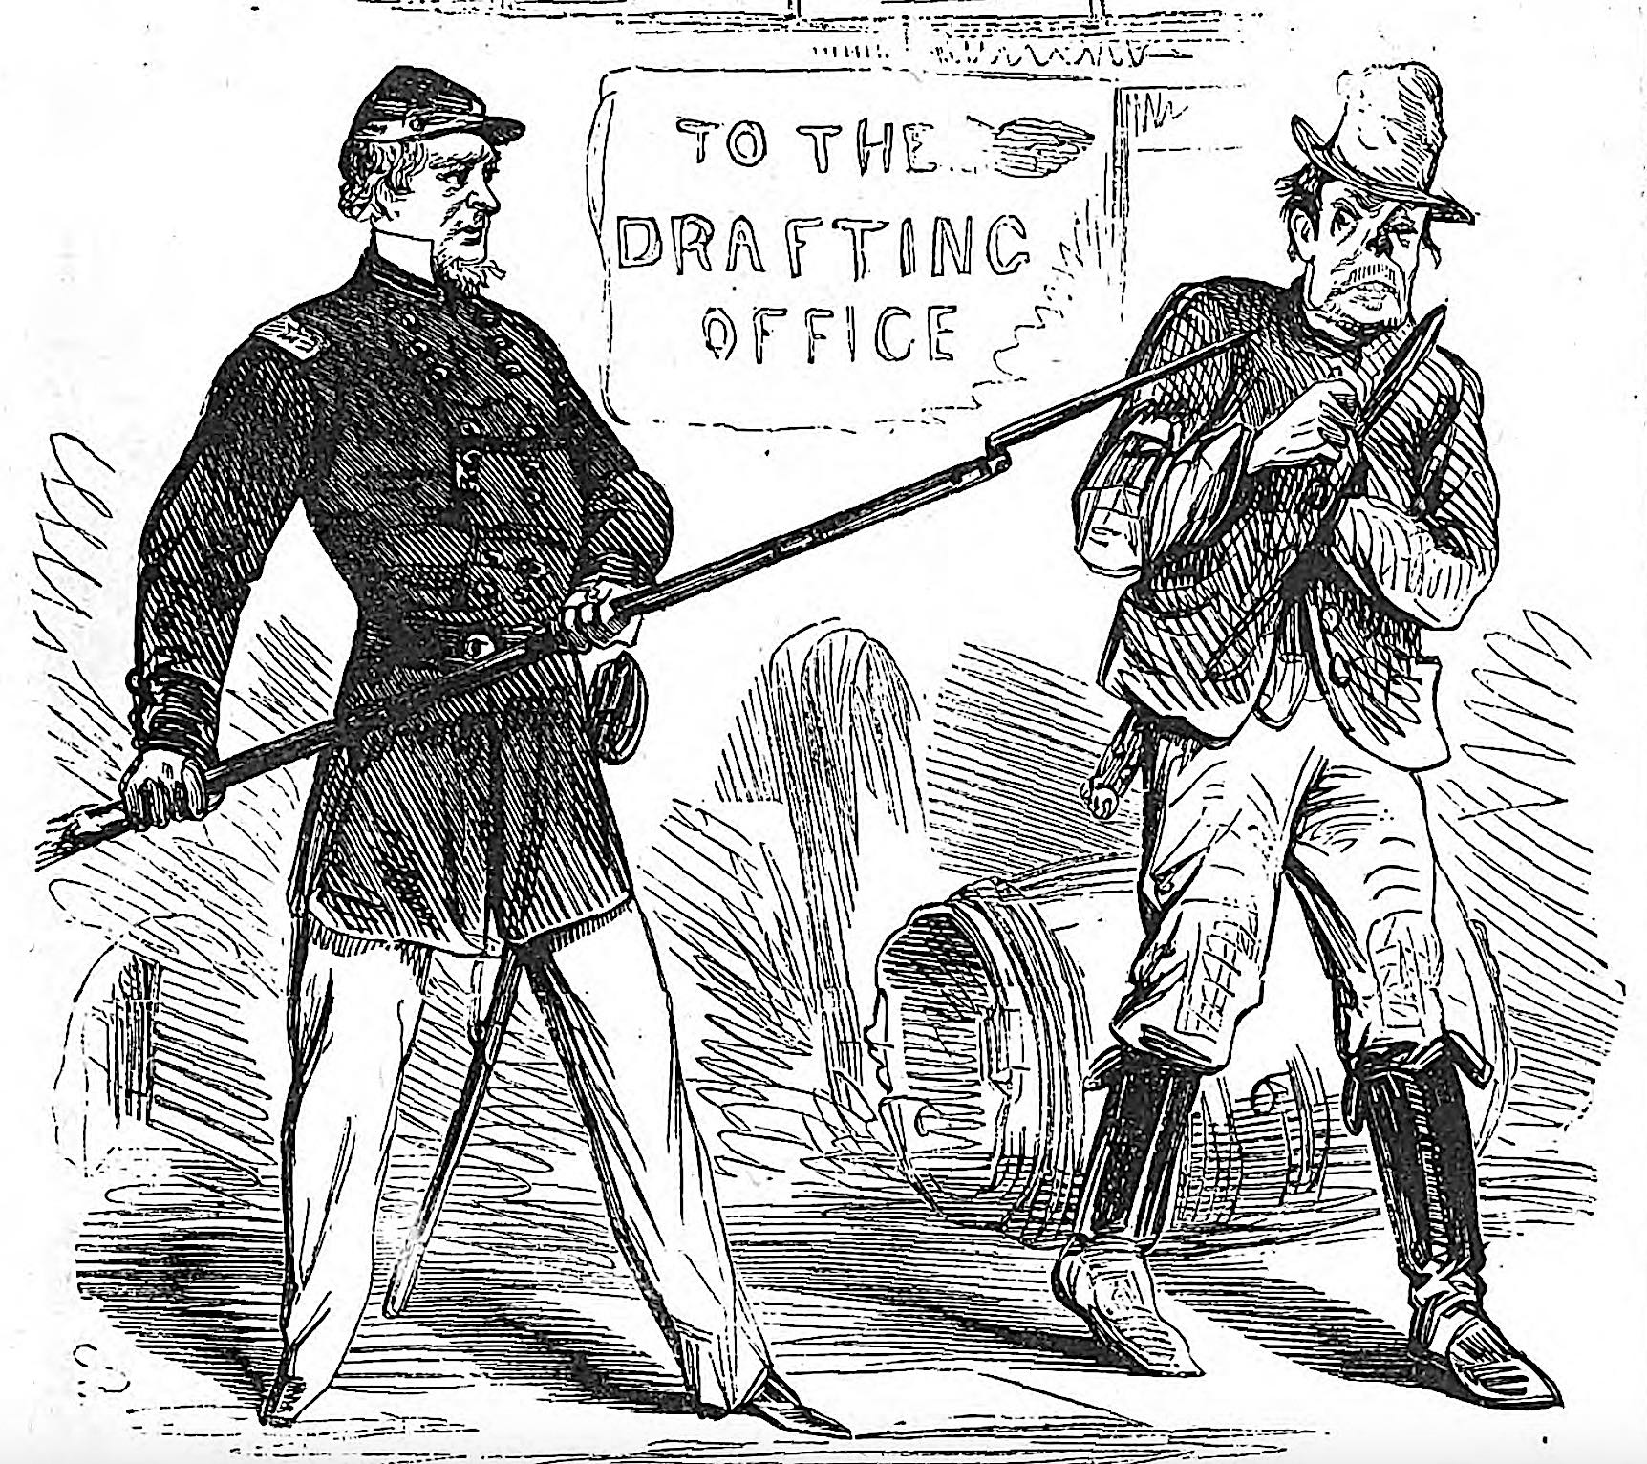
On August 29, Harper’s Weekly published this cartoon titled “Don’t You See the Point?” in which a soldier points his bayoneted rifle at a reluctant draftee before he can resort to violence in an attempt to get out of his obligation to serve.
https://www.civilwarmonitor.com/nyc-draft-riots/

Slide 3
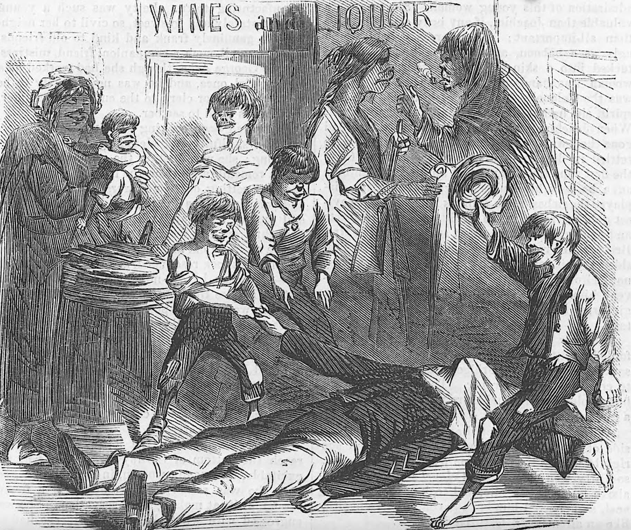
Another Harper’s Weekly illustration shows the body of an army sergeant who, in the words of the man who made this sketch, “was killed by a bullet fired from one of the houses in the vicinity, and then barbarously beaten and mangled by the mob. As he lay there, with a cloth thrown by some decent person over his face, to hide his ghastly wounds, ill-looking women came now and then to look at him, jesting over the unconscious remains, and pointing them out to their infant children with fiendish glee. The little boys amused themselves by lifting up his hands, and then letting them fall to the ground with heavy ‘thud.’ Others performed savage dances around the body, jumping round it, and over it, and even upon it.”

Slide 4
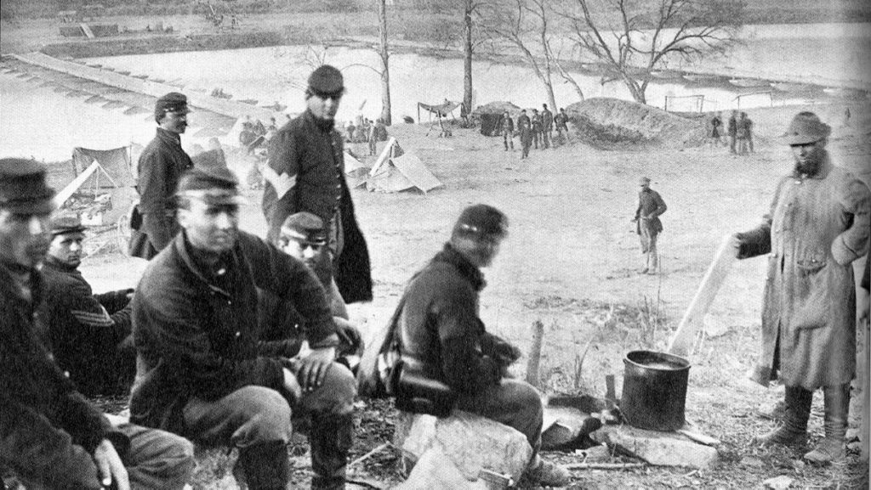
The 15th New York Engineers photographed with their pontoon bridges at Franklin’s Crossing, Virginia in May 1863.
Library of Congress
The 15th New York Engineers photographed with their pontoon bridges at Franklin’s Crossing, Virginia in May 1863.
Library of Congress

Slide 5
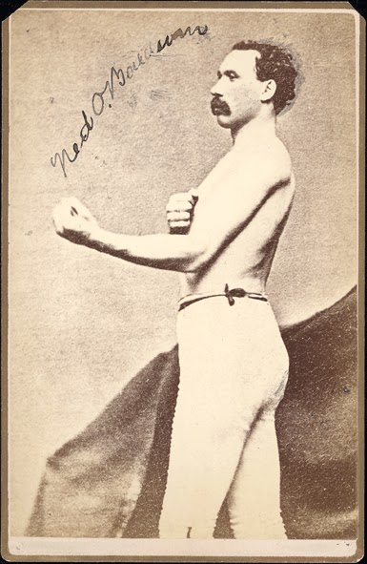
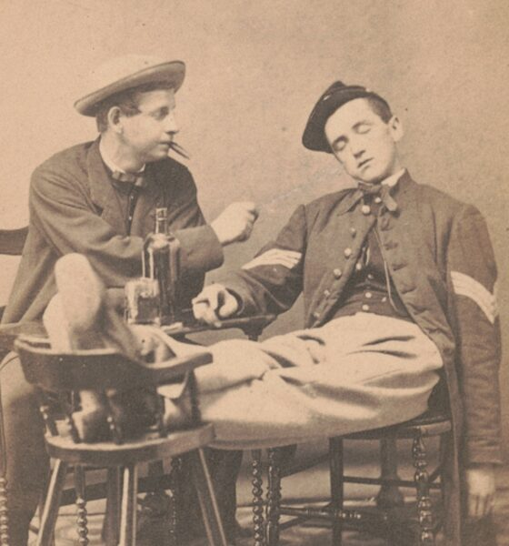
Manly compensations?
A Union sergeant feigns drunkenness in a photo made during the Civil War.
Library of
Congress
https://www.civilwarmonitor.com/podcast/episode-3-alcohol-in-the-armies/
“The Irish Giant” Ned O’Baldwin.
https://irishamericancivilwar.com/2018/01/30/brutal-good-natured-face-new-york-irish-rowdy-war-peace/

Slide 6
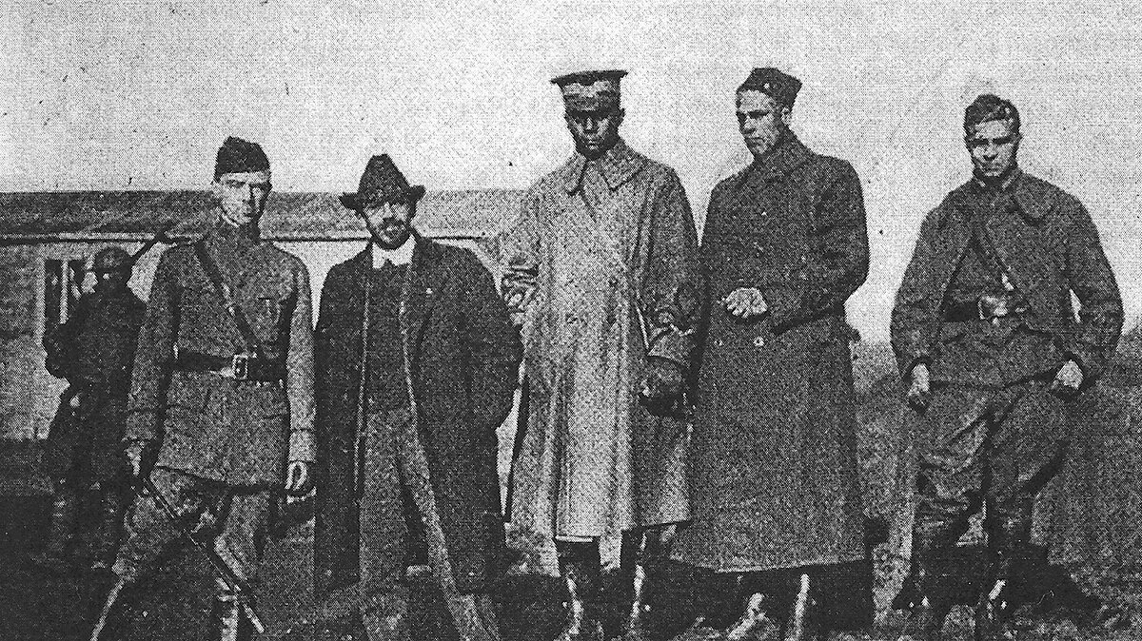
Black American participation in WWI
W.E.B. Du Bois (second from left) talks to Black American officers in
Le Mans, France, 1919 (The Crisis)

Slide 7
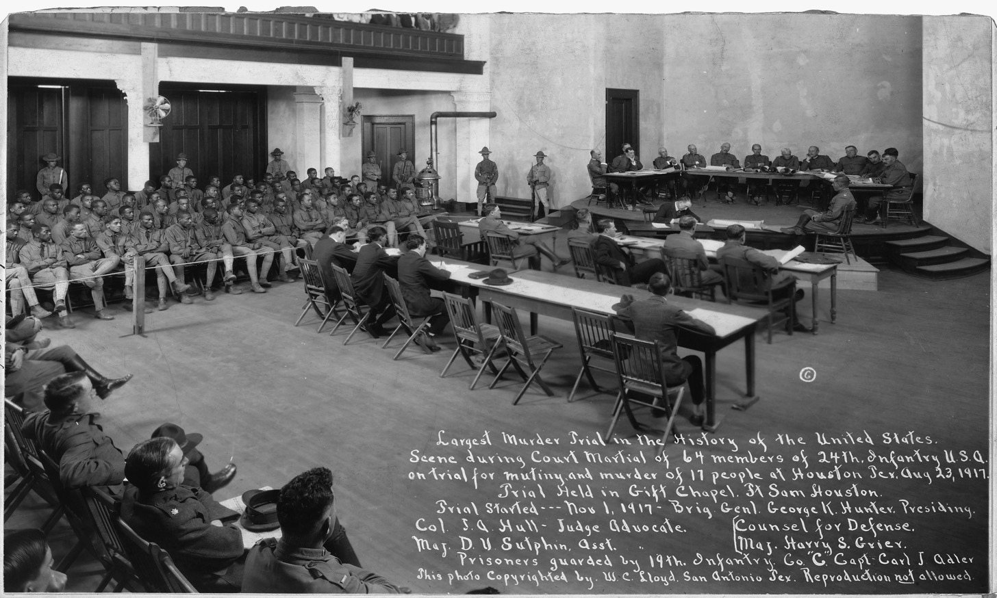
The Houston (or Camp Logan) Mutiny, August 1917
A mutiny and riot by 156 soldiers from the all-Black 24th Infantry Regiment of the United States Army took place on August 23, 1917 in Houston, Texas. The incident occurred within a climate of overt racist hostility from members of the all-white Houston Police Department (HPD) against members of the local black community and black soldiers stationed at Camp Logan. Following an incident where police officers arrested and assaulted black soldiers, many of their comrades mutinied and marched to Houston. There they opened fire and killed eleven civilians (including a minor, Fred E. Winkler) and five policemen. Five soldiers also died, (four to friendly fire and one to suicide).
In accordance with the military laws of the time, 118 soldiers were tried in three courts-martial. This was the largest murder trial in US history. A total of 110 were convicted, of whom 19 were executed and 63 were sentenced to life imprisonment.
https://en.wikipedia.org/wiki/Houston_riot_of_1917
Watch a 5 minute video by the National Cemetery Administration https://www.youtube.com/watch?v=EhXhmlegNvk

Slide 8
In 1914, Du Bois was “Black America’s foremost thinker and leader”. Author of the celebrated 1903 essay collection “The Souls of Black Folk,” he was the first African American to earn a doctorate from Harvard and was a co-founder of the NAACP. He had a powerful platform as editor of the NAACP’s monthly magazine, The Crisis.
Though a pacifist, Du Bois used his considerable influence to urge readers to support the war effort. In a July 1918 editorial, he wrote that “the colored race” ought to “forget our special grievances and close our ranks shoulder to shoulder with our own white fellow citizens and the allied nations that are fighting for democracy.”
https://www.csmonitor.com/Books/Book-Reviews/2023/0622/The-Wounded-World-probes-one-of-W.E.B.-Du-Bois-greatest-regrets

Slide 9
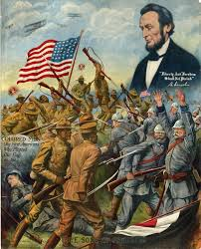
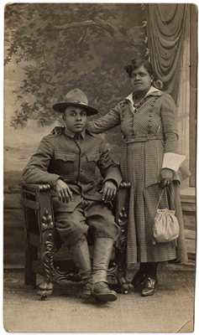
Black and white photograph of an unidentified African American soldier with civilian woman, WWI.
https://collections.theworldwar.org/argus/final/Portal/Default.aspx?component=AAAS&record=95ce756a-501d-4b47-ba1a-56fed2da6259
“Colored Men: The First Americans Who Planted Our Flag on the Firing Line”; True Sons of Freedom, broadside by Charles Gustrine, Chicago, Illinois, 1918.

Slide 10
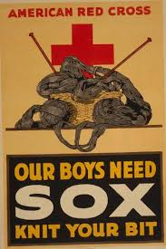
Discussion questions
CIVIL WAR (Lorien Foote)
In the Civil War Union Army, who were the 'roughs’ and how did 'roughness' manifest itself?
Was this form of masculine self-assertion functional to the army or a disciplinary problem?
Where did sexuality fit in the matrix of martial masculinity?
What most surprised/intrigued you from the reading(s)?
WWI (Adriane Lentz-Smith)
1) Why did a significant number of young Black American men envision enlistment in the American Expeditionary Force in WWI as an opportunity to be 'made men’?
2) Were their aspirations warranted?
3) Where did sexuality fit in the matrix of martial masculinity?
4) What most surprised/intrigued you from the reading(s)?

Slide 11
Overarching questions
Between 1860 and 1918, how much did US gender ideologies-- and ideas about martial masculinity in particular-- change?
How might we account for these changes?

