Slide 1
Women’s resistance to– and participation in—World War I
HI2C9
Term 1, week 3

Slide 2
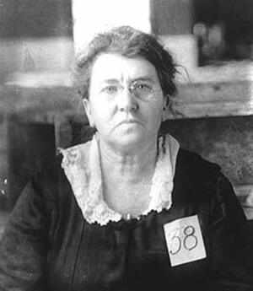
Who was Emma Goldman?
Why was Goldman such a potent ‘hate figure’ for much of the US press?
What did you glean from contemporary press reports about the nature of her opposition to US entry into WWI?
Was she a ‘maternalist’?
Clip from PBS programme on Goldman:
https://www.pbs.org/video/american-experience-emma-goldman-opposition-world-war-i-wwi/
Goldman’s deportation portrait, 1919
https://jwa.org/thisweek/jul/19/1908/emma-goldman

Slide 3
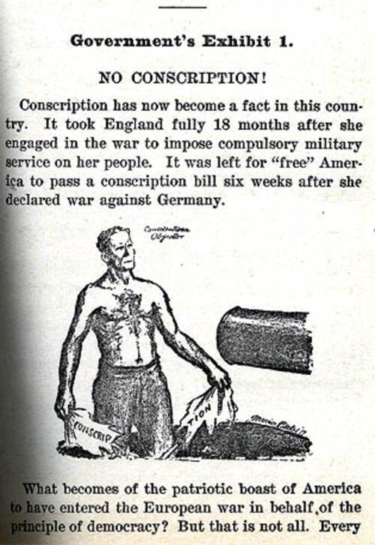
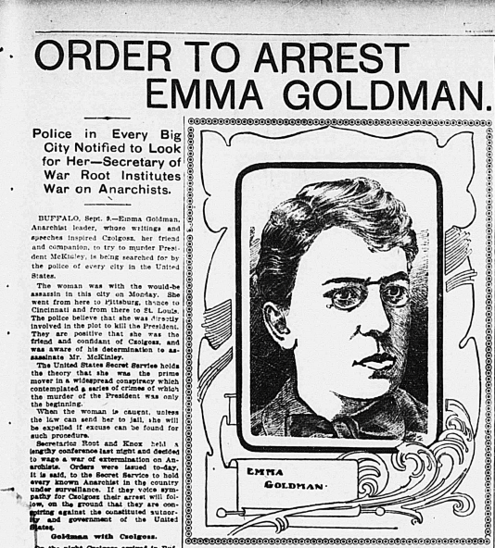
Manifesto of the No-Conscription League
circa 1917, page 1
https://jwa.org/media/manifesto-of-no-conscription-league

Slide 4
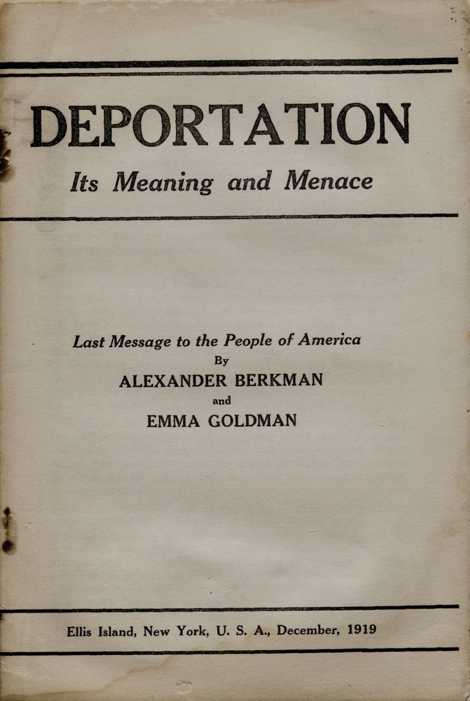
In 1917, Emma Goldman was sentenced to two years in prison. Upon her release in 1919, J. Edgar Hoover, the director of the Justice Department’s General Intelligence Division, persuaded the courts to deny her citizenship claims, making her eligible for deportation. She wrote Deportation—Its Meaning and Menace with Alexander Berkman, her romantic partner and fellow anarchist, on Ellis Island in 1919 before being sent back to Russia.
https://www.gilderlehrman.org/history-resources/spotlight-primary-source/emma-goldman-restriction-civil-liberties-1919

Slide 5
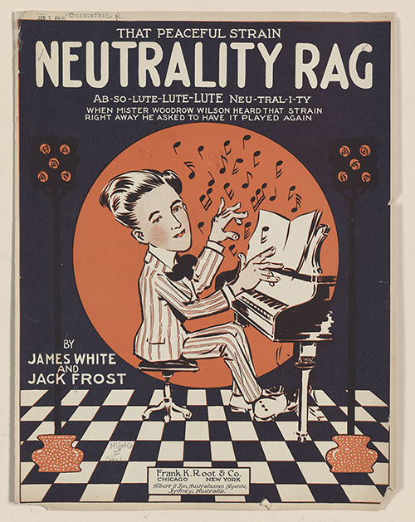
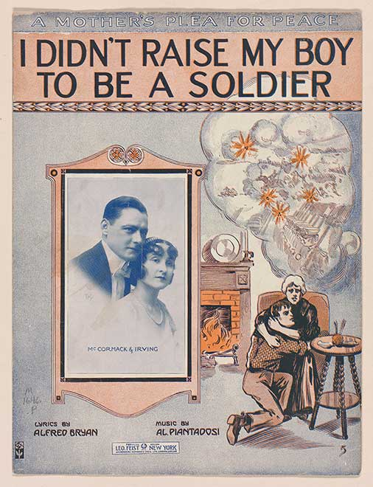
Popular maternalist pacifism
"I Didn't Raise My Boy to Be a Soldier," published in January 1915, a few months after war broke out in Europe became a rallying cry for the nation's pacifists. Reflecting the official U.S. policy of neutrality, the song was one of the most popular of the era.
Link to song:
https://historymatters.gmu.edu/d/4942
https://www.loc.gov/exhibitions/world-war-i-american-experiences/about-this-exhibition/over-here/raising-an-army/answer-songs/

Slide 6
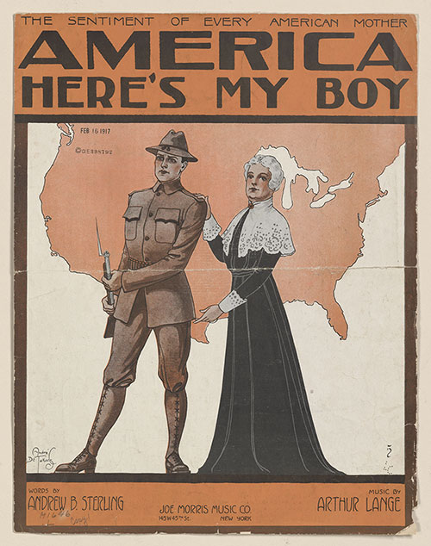
So, what changes?
How do we explain the shift from
popular pacifism to pro-war
‘patriotism’?
Arthur Lange and Andrew Sterling. “America Here's My Boy.”
New York: Joe Morris Music Co., February 1917.
Sheet music cover.
Music Division, Library of Congress (008.02.00)

Slide 7
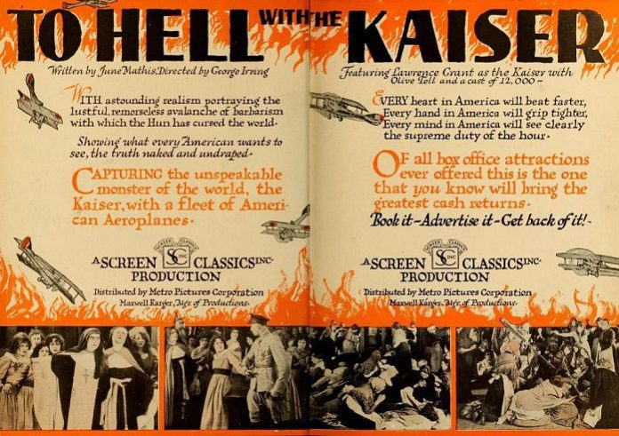
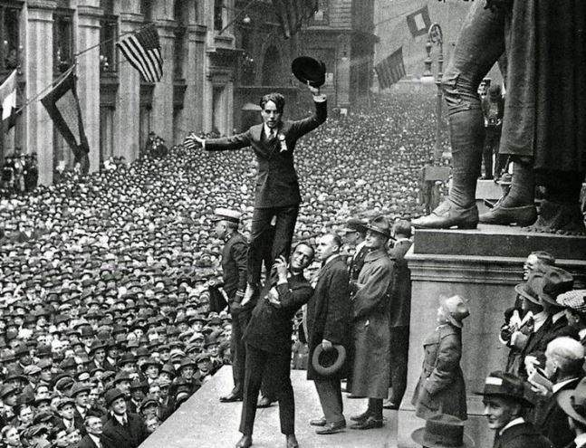
What role(s) did Hollywood play in this process?
In 1918, Charlie Chaplin stood on Wall Street in New York City, drawing a massive crowd of 20,000 people at the base of the United States Sub-Treasury building (now known as Federal Hall). His purpose was to rally support for Liberty bonds, aiding the American war effort during World War 1. https://doughboy.org/charlie-chaplin-other-stars-promote-liberty-bonds-on-wall-street-in-1918/
PROMOTIONAL POSTER FOR the FILM “TO HELL WITH THE KAISER!” (1918). PHOTO COURTESY OF METRO PICTURES.

Slide 8
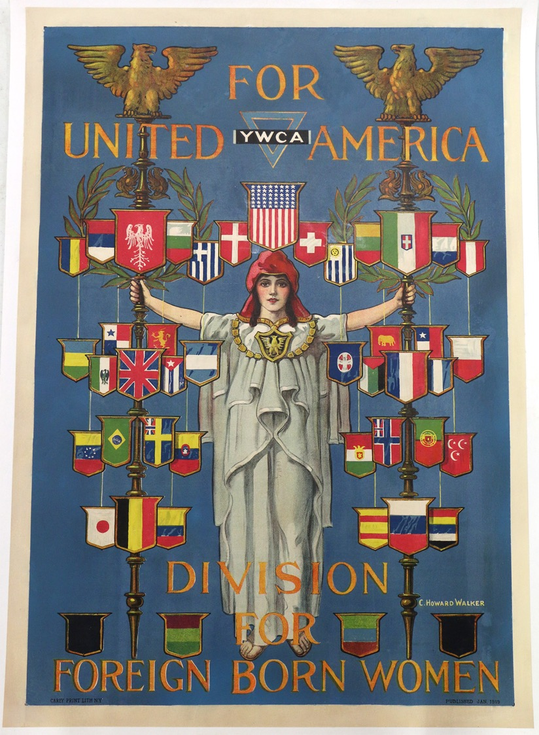
What does Dumenil’s essay on LA Clubwomen reveal about the motivations behind– and practical applications—of women’s civic participation in WWI?
https://www.theworldwar.org/learn/about-wwi/ywca-united-america

Slide 9
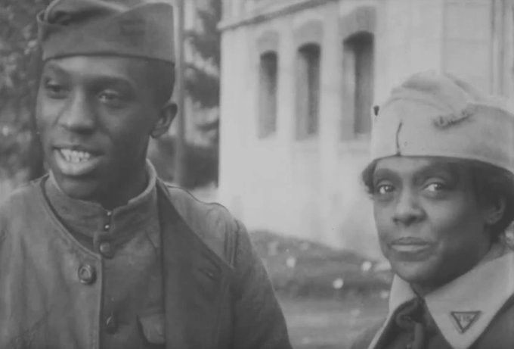
Black American Club Women’s involvement in WWI
After her husband died in 1916, Addie Waites Hunton (b. 1866) became involved in the YMCA’s work abroad during World War I.
She set sail for France in June 1918. Hunton was assigned along with Kathryn M. Johnson and Helen Curtis to work with the 200,000 segregated black troops stationed there. They were the only three Black women assigned to this duty.
NB: Hunton is mentioned in
Adriane Lentz-Smith’s chapter
assigned in week 2.
Addie Waites Hunton became involved in the YMCA’s work abroad during World War I. She set sail for France in June 1918. Hunton was assigned along with Kathryn M. Johnson and Helen Curtis to work with the 200,000 segregated black troops stationed there. They were the only three black women assigned to this duty.
https://rvalibrary.org/shelf-respect/black-suffragists-and-activists-addie-waites-hunton/

