Slide 1
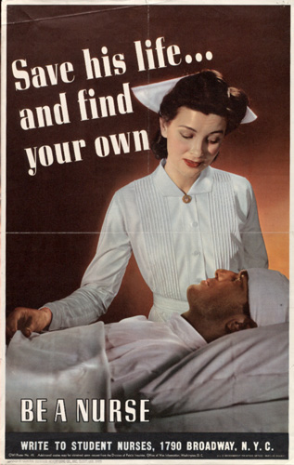
Who cares?
The gendered politics of nursing in
wartime America
HI2C9 Seminar Week 4

Slide 2
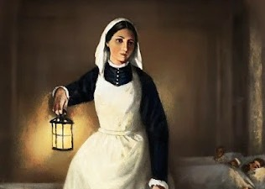
Q: What symbolic associations does the figure of the nurse conjure? Put differently, how do you think Americans imagined the archetypal nurse from the 1860s to the 1940s?
Who and what is a nurse?
Is a military nurse a soldier?
Q: Draw up a list– in 2 columns– of the work nurses were expected to perform in WWI. On the left, list the key formal job requirements; on the right, the (informal/unpaid) expectations of what men in uniform wanted nurses to do/be.

Slide 3
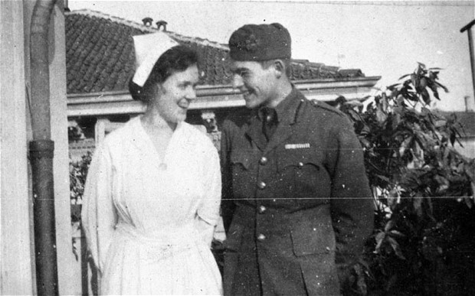
What did nurses do? What non-medical work they also expected to perform?
Ernest Hemingway (18) with Agnes von Kurowsky (26), the nurse who became the inspiration for the heroine of A Farewell to Arms
Photo: JOHN F KENNEDY PRESIDENTIAL LIBRARY AND MUSEUM, BOSTON

Slide 4
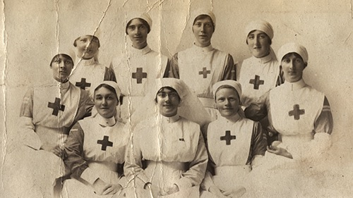
Nurses of Base Hospital #28
Kansas U. Medical Center

Slide 5
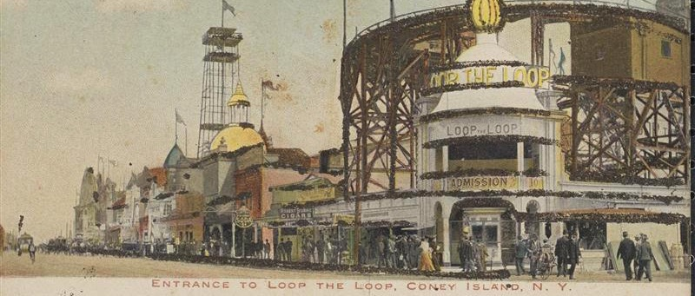
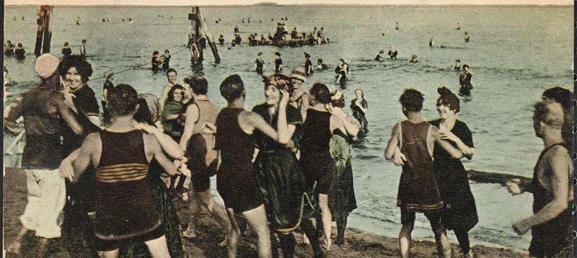
WWI: In what ways did nurses in the ANC face a ‘hostile workplace environment’? Why were nurses so keen to acquire military rank? Was rank likely to make the workplace less hostile? Postcards showing the working-class attractions of Coney Island, New York c.1910

Slide 6
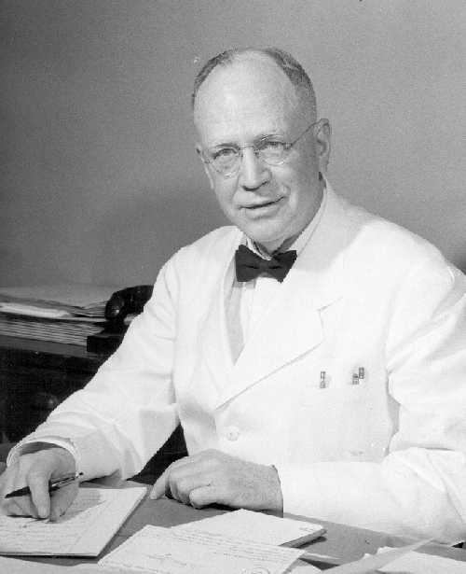
WWII: Male nurses’ pursuit of acceptance
Q: What does LeRoy Craig’s 1940 article reveal about the gendered nature of the nursing profession on the eve of US entry into WWII?
Q: Drawing on Craig’s essay and the chapter of Charissa Threat’s book, what can we glean about the various anxieties that surrounded the figure of the ‘male nurse’?
Q: What does it tell us that Black women nurses gained admission into the ANC late in WWII even as white men were denied?
LeRoy N. Craig, R.N. was the first superintendent of The Pennsylvania Hospital School of Nursing for Men, which was founded in 1914. It was the first training school of its type to be headed by a man.
http://www.uphs.upenn.edu/paharc/collections/gallery/people/craig.html

Slide 7
Revealing quotes
Surgeon General Norman Kirk:
female nurses were “appointed for a single, specific duty for which they are particularly qualified by reason of their sex. . . . Army nurses of either sex must accord patients all the usual care required by duties of their profession, including a variety of intimate offices and quasi-menial services. Women of officer rank can render those duties without incongruity, while men of such rank could not.”
Quoted by Threat, Nursing Civil Rights, p. 75
Rep. Frances Bolton (R-Ohio):
“The Army Nurse Corps was created as a ‘female’ Corps, and there is very strong feelings that it would be exceedingly unfortunate to change that fundamental ruling, not because men can’t nurse well and are not really desperately needed in some of the specialties, but rather because men as a whole do better with women nurses than men.”
Quoted by Threat, Nursing Civil Rights, p. 78

