Slide 1
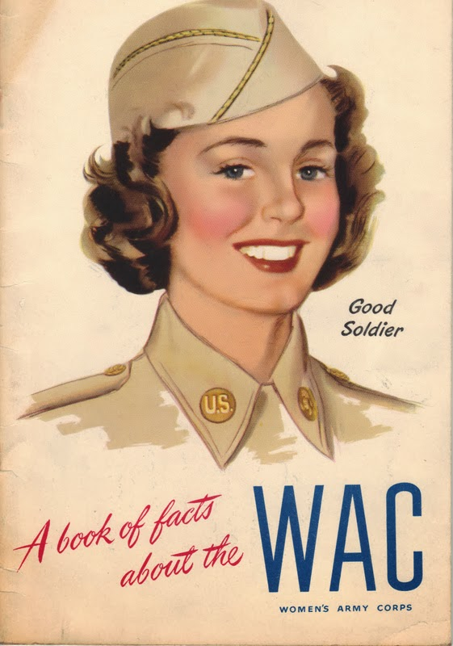
The Women’s Army Corps and the politics of sexuality in World War II
HI2C9 Week 5

Slide 2
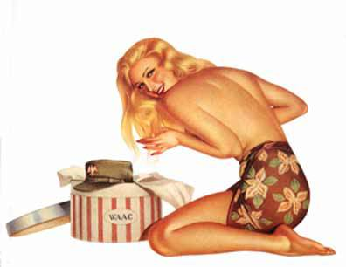
Sexualizing the WAC
Vargas Girl
Description
Esquire’s December 1943 calendar page featuring a Vargas girl donning a WAAC uniform.
Alberto Vargas is best known for is creating World War II era pin-ups for Esquire magazine. Between 1940 and 1946, he produced 180 paintings for the magazine, and inspired the nose art for hundreds of American and Allied WWII aircraft.
https://outhistory.org/exhibits/show/lesbians-20th-century/item/682

Slide 3
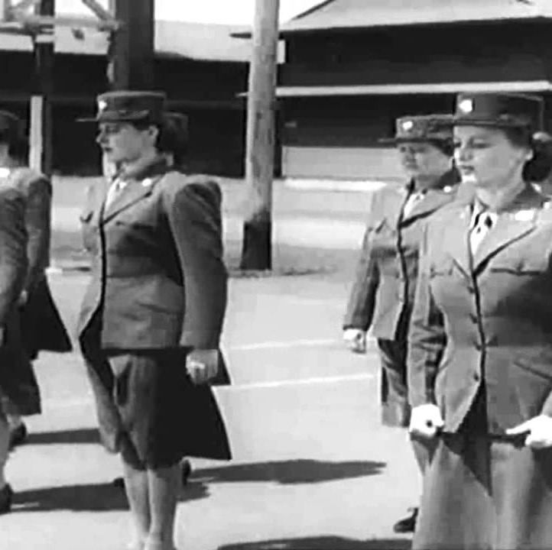
We’re In The Army Now (1943)
https://archive.org/details/WereInTheArmyNow

Slide 4
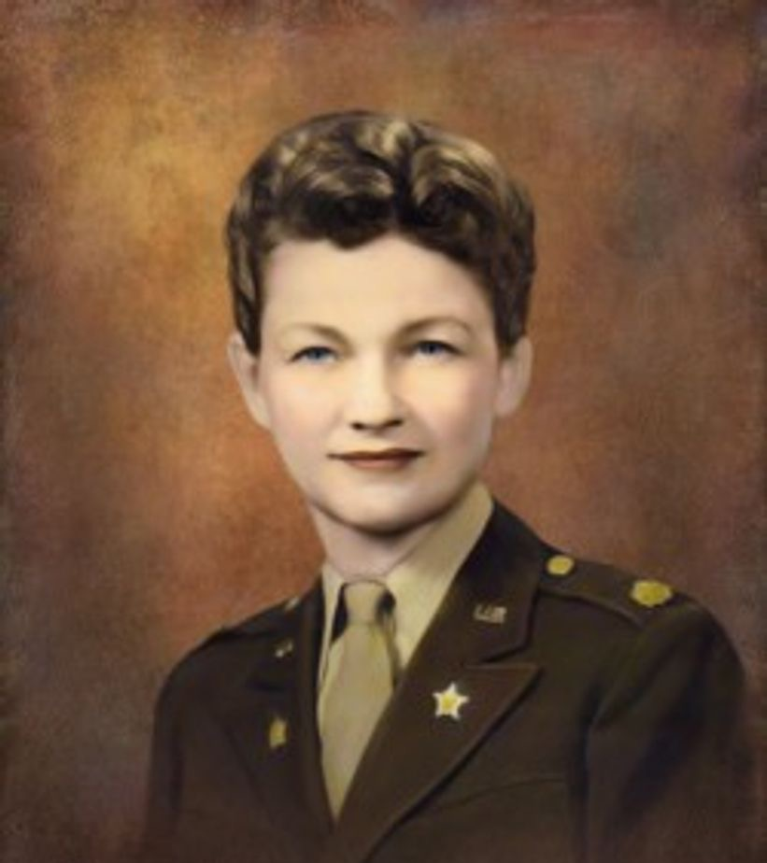
Mattie Treadwell (1913 — 2010)
A native of Texas with a B.A. and M.A. degree from the University of Texas.
Served in the Women's Army Corps (WAC) during World War II attaining the rank of lieutenant colonel.
Author of the official WAC history (1947-1952), published in 1954.

Slide 5
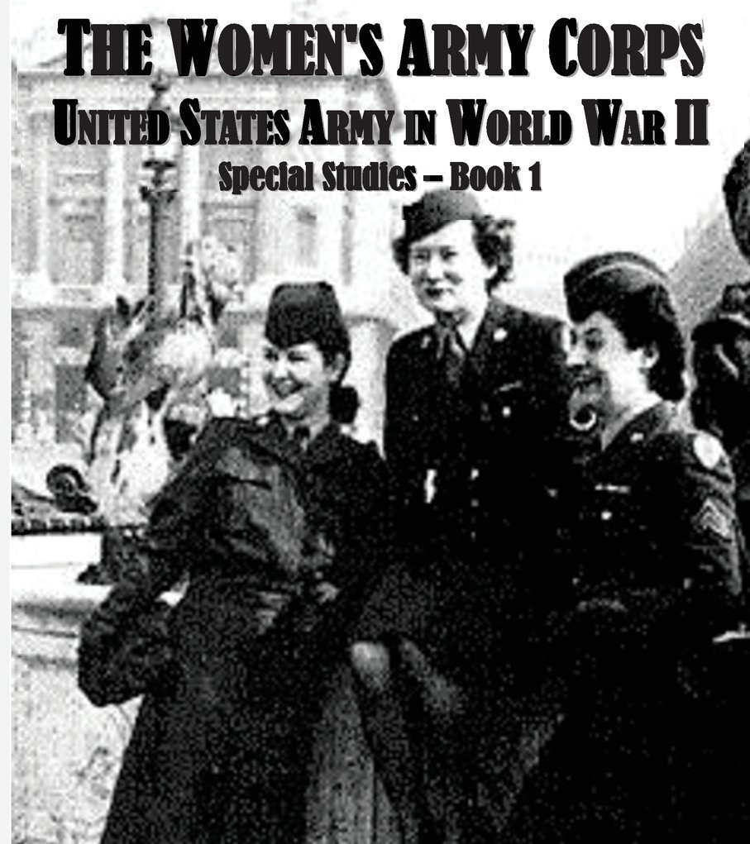
The slander campaign
Mattie E. Treadwell:
‘Male columnists were the worst offenders, in spite of Damon Runyon’s remark, “A lady in the uniform of her country will scarcely be an object of jesting on the part of a gentleman not in the same garb.” Some of the attacks contained savage comparisons to “the naked Amazons… and the queer damozels of the Isle of Lesbos.” Others, as expected, had a field day with the idea that woman’s place is in the maternity ward.’ (p. 49)

Slide 6
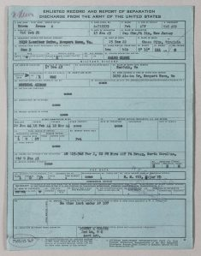
Why—and with what consequences—was the military so concerned about homosexuality in WWII?
“During WWII, to cut costs and save time, the military began issuing ‘blue’ discharge or ‘blue tickets’. Named after the paper they were printed on, these were given to soldiers who had “undesirable habits and traits of character.” A broad definition used against women, African Americans, and gay and lesbian servicemen. 9,000 men and women received ‘blue’ discharge because of their sexuality. In total, about 50,000 people received blue discharges during WWII. The largest subgroup of those recipients were African American men.”
NB: recipients of these discharges were denied veterans’ benefits
https://www.nps.gov/articles/000/blue-and-other-than-honorable-discharges.htm

Slide 7
What does the slander campaign tell us about Americans’ reactions to women in uniform and military life more broadly?
What different accusations were levelled at Wacs and what do these insinuated claims tells us about the prejudices and/or fantasies of wartime America?
Who was responsible for fabricating and/or circulating them?
For what variety of reasons were slurs spread about Wacs?

Slide 8
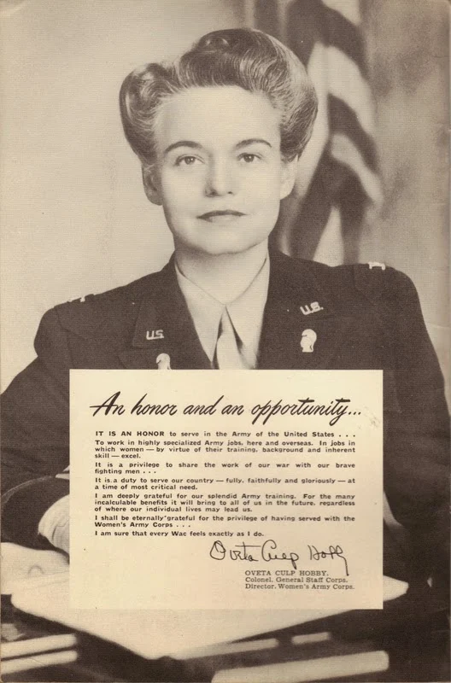
What do the primary sources reveal about the WAC’s attempted ‘reputational rescue’ mission?
Did it succeed? If so, at what cost to whom?

Slide 9
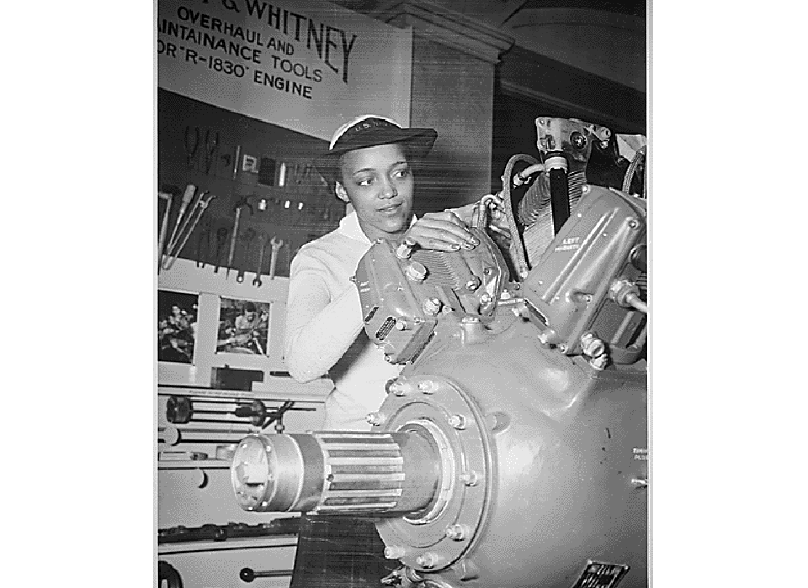
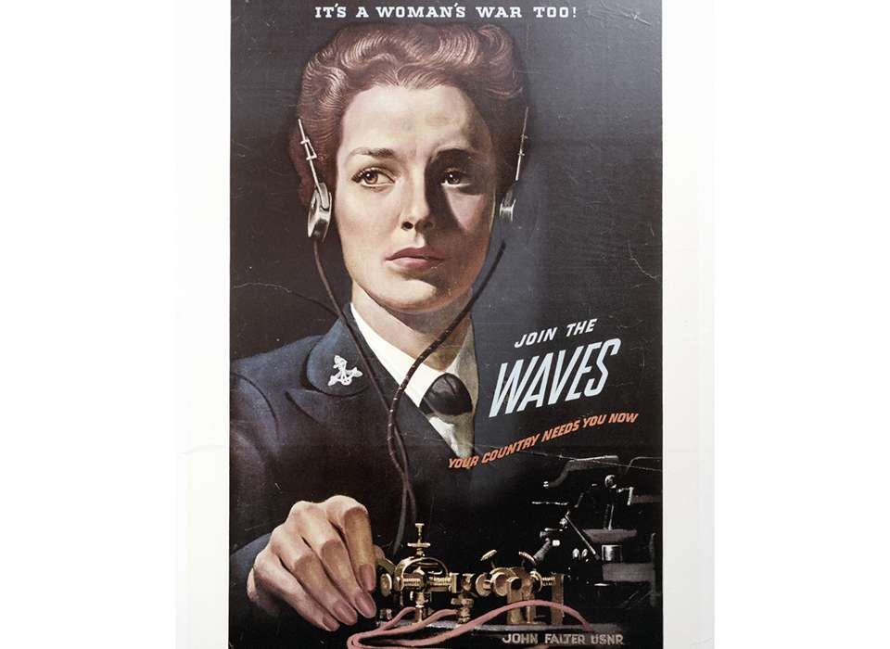
Forgetting military women’s work
WAVE Apprentice Seaman Frances Bates inspects a Grumman Wildcat engine as part of her training at the US Naval Training School (WR) Bronx, New York. The National Archives.

Slide 10
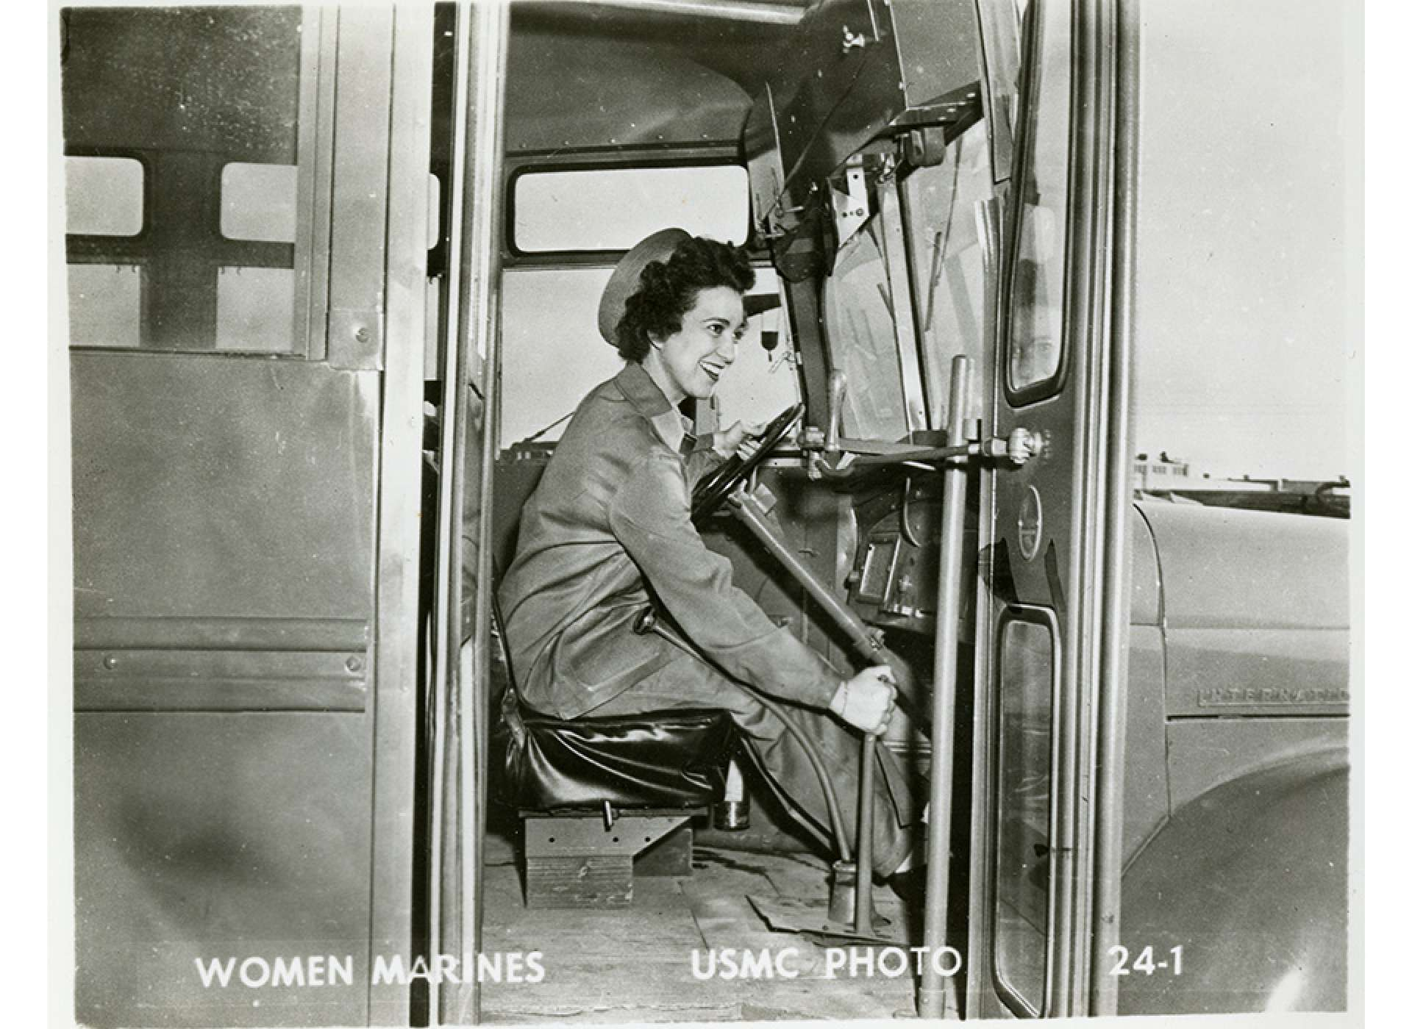
For further resources on
Women in other branches
Of the armed forces, including photos and recruitment films:
https://www.nationalww2museum.org/war/articles/its-your-war-too-women-world-war-ii

