Slide 1
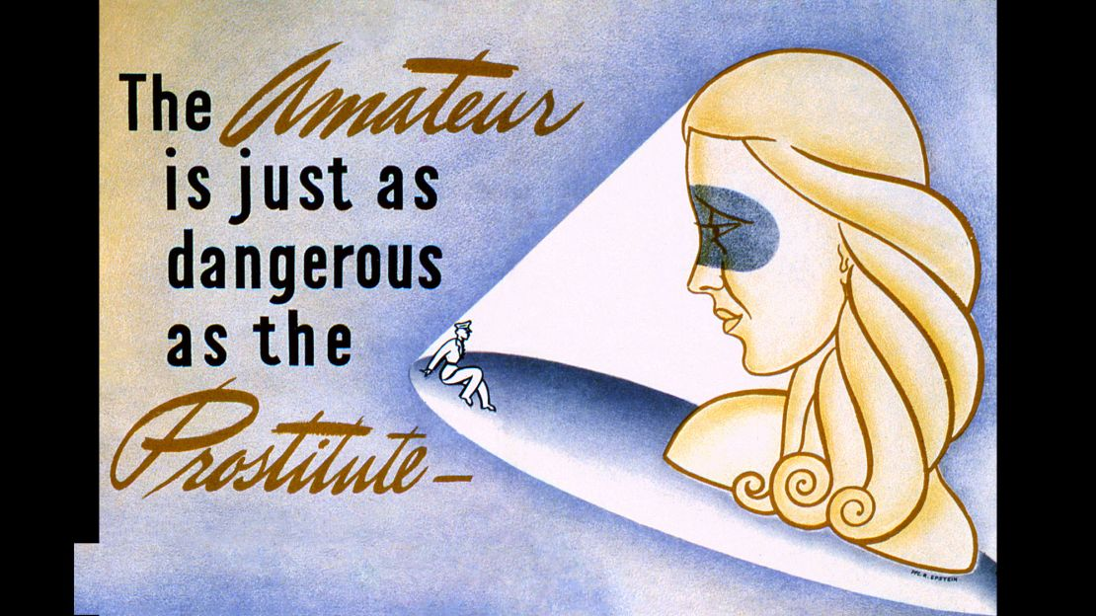
'Good' and 'bad girls' in the 'Good War'
'Good’ and ‘bad’ girls in the ‘Good War’
HI2C9 Term 1, week 7 seminar
HI2C9 Term 1, week 7

Slide 2
The vexing conundrum
‘Prostitution was illegal, promiscuity was immoral, female sexuality was dangerous, but sexual labor was essential to the war effort– a veritable catch-22.’
Marilyn Hegarty, Victory Girls, p. 85

Slide 3
Themes/issues
The contradictions of compulsory heterosexuality under pressure of wartime emergency conditions
The regulation of female behaviour– social, emotional, marital, sexual– not only by the federal government and military but other interested parties (including welfare and charitable organizations, women’s magazines etc)
Women’s ‘morale work’ on behalf of men in uniform
‘Emotional labour’
Female desire/agency

Slide 4
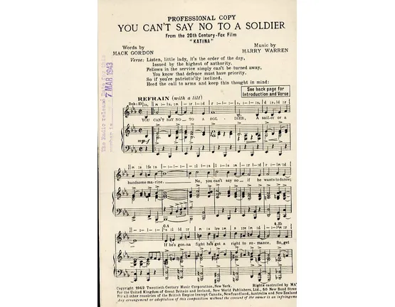
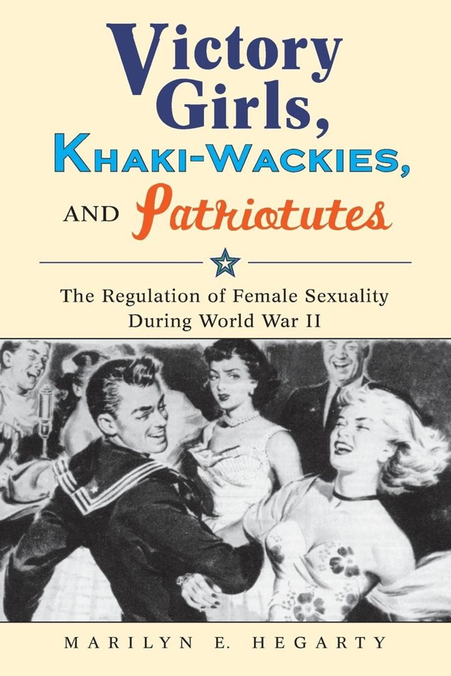
Sexual coercion in the name
of wartime patriotism

Slide 5
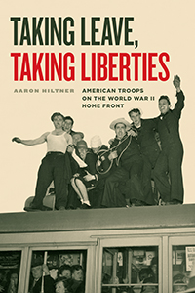
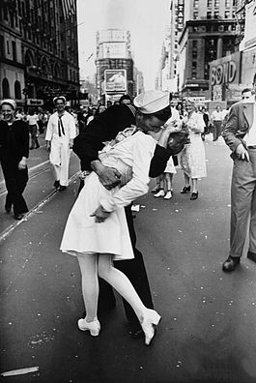
The invisible problem
of heterosexual male
entitlement
V-J Day in Times Square
a photograph by Alfred Eisenstaedt, was published in Life in 1945 with the caption:
"In New York's Times Square a white-clad girl clutches her purse and skirt as an uninhibited sailor plants his lips squarely on hers."
Brooke L. Blower, 'V-J Day, 1945, Times Square,' in Brooke L. Blower and Mark Philip Bradley (eds), The Familiar Made Strange: American Icons and Artifacts after the Transnational Turn (2015), e-book

Slide 6
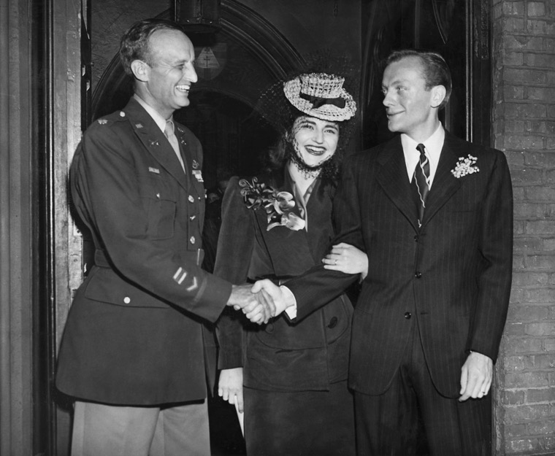
Interrogating the primary sources
Gretta Palmer, 'Marriage and War,' Ladies' Home Journal, 59, 3 (March 1942), pp. 110-11
Louise Paine Benjamin, 'What Is Your Dream Girl Like?', Ladies' Home Journal, 59, 3 (March 1942), p. 114
Based on these articles, what inferences would you draw about the nature of LHJ and its audience?
Do you think these two pieces were aimed at slightly different readers?
What do Benjamin’s and Paine’s pieces reveal about heterosexual coupledom and how American women were encouraged to think about male-female romantic partnerships in wartime?
4. What contradictions or tensions emerge from these pieces?
NB: In 1942 alone, 1.8 million weddings took place, up 83% from 10 years before. Two-thirds of those brides were marrying men newly enlisted in the military. https://www.nytimes.com/interactive/projects/cp/weddings/165-years-of-wedding-announcements/world-war-two-weddings
Theodora Roosevelt marries Thomas C. Keogh (right), an artist, in a modest ceremony at the Little Church Around the Corner, 1945. Her father, Lieut. Col. Archibald B. Roosevelt, is on the left. CREDIT THE NEW YORK TIMES

Slide 7
Key insights from the secondary sources
Marilyn Hegarty, Victory Girls, Khaki-Wackies, and Patriotutes: The Regulation of Female Sexuality During World War II (2008), ch. 4, '"A Buffer of Whores": Military and Social Ambivalence about Sexuality and Gender,' pp. 85-109, e-book
Amanda Littauer, Bad Girls: Young Women, Sex, and Rebellion Before the 'Sixties (2015), ch. 1, 'Victory Girls, Sex, Mobility and Adventure on the Home Front', pp. 18-51, e-book
Meghan K Winchell, '"To Make the Boys Feel at Home": USO Senior Hostesses and Gendered Citizenship,' Frontiers: A Journal of Women's Studies 25, 1 (2004), pp. 190-211
In your small group, you can either discuss these suggested questions from the module website or share reflections on what you found most striking from the readings.
why did WWII pose such acute-- and contested-- questions about romantic love, marriage and heterosexuality, particularly between civilian women and male soldiers?
what prompted the moral panic in wartime America about female sexuality, and how did excoriation of 'khaki-wackies’/’Victory girls’ intersect with anxieties about female infidelity?
how did race and class inflect wartime discussions of, and attempts to regulate, female sexuality?
would you evaluate World War II as a time of sexual experimentation and opportunity for American women and/or a time of repression and 'straightened' desire?

